Slide 1
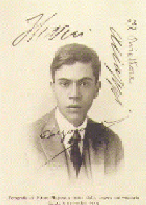

























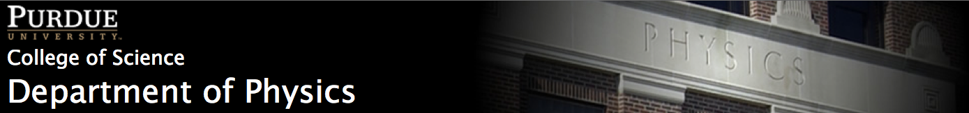
Neutrinoless double-deta decay and
The Majorana Demonstrator
The Majorana Collaboration
LA-UR-13-28954
Wenqin Xu, Los Alamos National Lab
Purdue University, Dec/04/2013

Slide 2
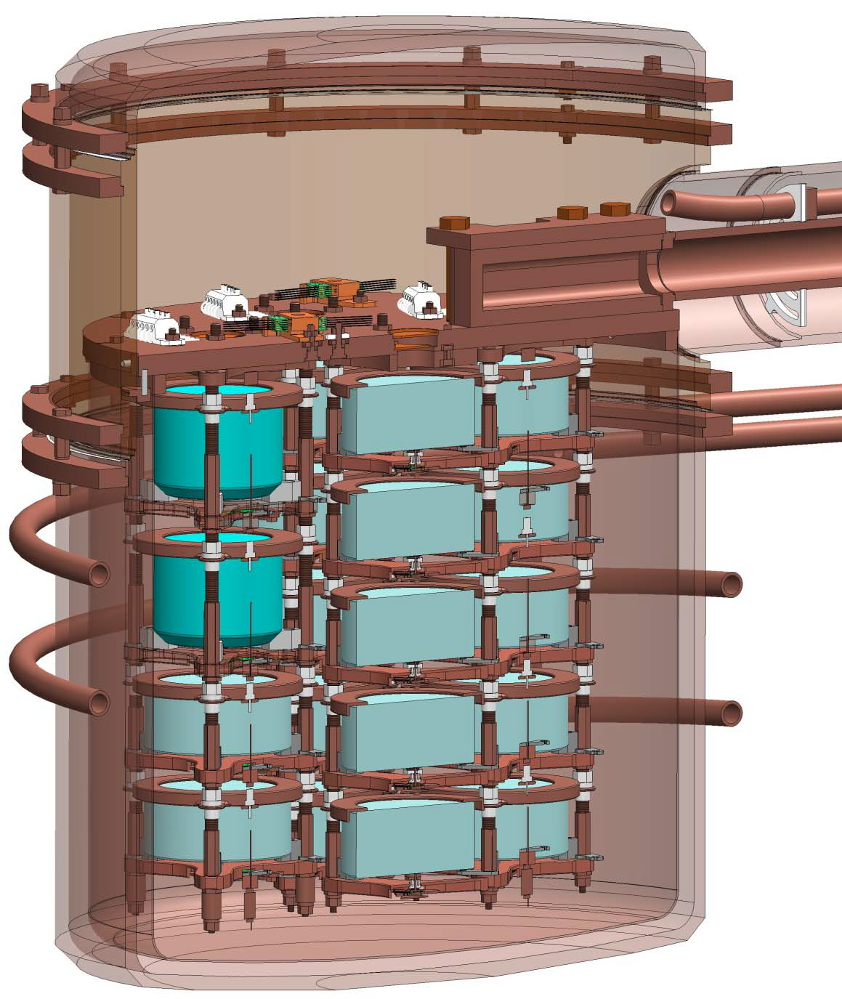
Outline of the talk
Neutrinoless double-beta decay
the physics
the experiments
The Majorana Demonstrator

Slide 3
Outline of the talk
Neutrinoless double-beta decay
the physics
the experiments
The Majorana Demonstrator

Slide 4
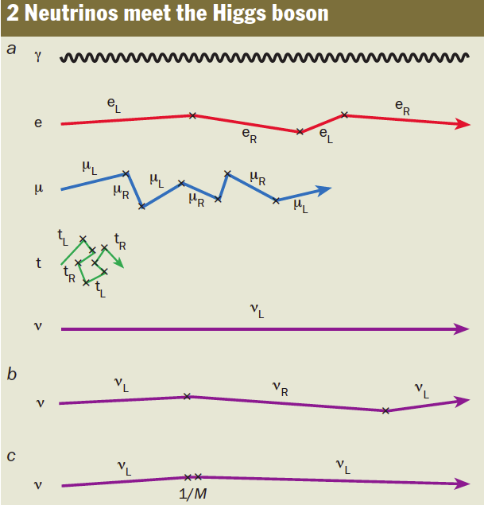
Masses in the Standard Model
H. Murayama, Physics World, May 2002
Photons do not interact with Higgs, zero mass
Other particles collider with Higgs, flipping the
handedness, acquiring masses
No right-handed neutrinos, no coupling to Higgs
Neutrinos should have zero mass.
But they do have non-zero mass.
Right-handed neutrino, Dirac particle, but much smaller coupling to Higgs
Non-zero neutrino masses is the first direct indication of physics
beyond the minimal standard model
Neutrinos having Dirac masses. Never detect ν_{R}
Why the interactions of ν_{R} are so weak? <(10⁻²⁶)
Right-handed neutrino, Majorana particle, very very heavy, only exists shortly due to uncertainty principle
Neutrinos having Majorana masses.
No need for very weak interactions
Notes:
For dirac neutrinos, firstly the right-handed neutrinos were never observed, so its coupling to other particles is 10^26 weaker.
Secondly, their (both left-handed and right-handed neutrinos) must have small coupling to Higgs, 10^12 smaller than that of top quark.
Wiki: The existence of nonzero neutrino masses somewhat complicates the situation. Neutrinos are produced in weak interactions as chirality eigenstates. However, chirality of a massive particle is not a constant of motion; helicity is, but the chirality operator does not share eigenstates with the helicity operator. Free neutrinos propagate as mixtures of left- and right-handed helicity states, with mixing amplitudes on the order of m_{ν}/E. This does not significantly affect the experiments, because neutrinos involved are nearly always ultrarelativistic, and thus mixing amplitudes are vanishingly small. For example, most solar neutrinos have energies on the order of 100 keV–1 MeV, so the fraction of neutrinos with "wrong" helicity among them cannot exceed 10⁻¹⁰

Slide 5
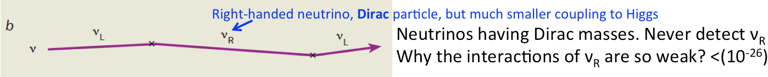
Beyond the Standard Model
H. Murayama, Physics World, May 2002
Photons do not interact with Higgs, no mass
Possible Extensions to the standard model to introduce non-zero neutrino masses:
Other particles collider with Higgs, flipping the
handedness, acquiring masses
No right-handed neutrino, so no coupling to H.
Neutrinos having zero mass. Excluded
Majorana Particle: a fermion that is its own anitparticle.
Right-handed neutrino, Dirac particle, but much smaller coupling to Higgs
Neutrinos having Dirac masses. Never detect ν_{R}
Why the interactions of ν_{R} are so weak? <(10⁻²⁶)
Seesaw model: An average mass m²/M over time
Right-handed neutrino, Majorana particle, very very heavy, only exists shortly due to uncertainty principle
Neutrinos having Majorana masses.
No need for very weak interactions
Notes:
For dirac neutrinos, firstly the right-handed neutrinos were never observed, so its coupling to other particles is 10^26 weaker.
Secondly, their (both left-handed and right-handed neutrinos) must have small coupling to Higgs, 10^12 smaller than that of top quark.
Wiki: The existence of nonzero neutrino masses somewhat complicates the situation. Neutrinos are produced in weak interactions as chirality eigenstates. However, chirality of a massive particle is not a constant of motion; helicity is, but the chirality operator does not share eigenstates with the helicity operator. Free neutrinos propagate as mixtures of left- and right-handed helicity states, with mixing amplitudes on the order of m_{ν}/E. This does not significantly affect the experiments, because neutrinos involved are nearly always ultrarelativistic, and thus mixing amplitudes are vanishingly small. For example, most solar neutrinos have energies on the order of 100 keV–1 MeV, so the fraction of neutrinos with "wrong" helicity among them cannot exceed 10⁻¹⁰

Slide 6
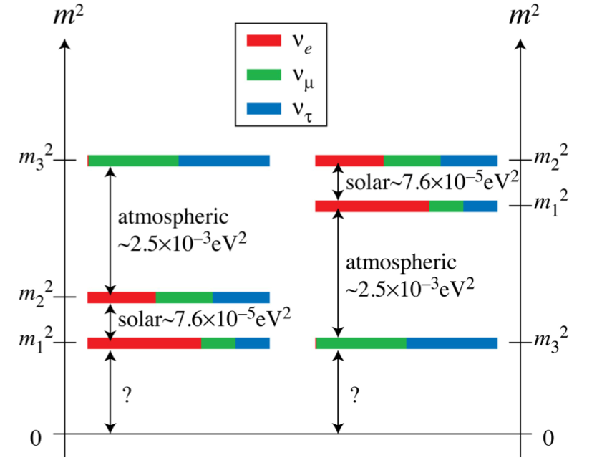
Questions to be answered
Neutrinoless double beta decay:
Is neutrino a Majorana Particle?
0νββ is the only practical way to
test this.
Is the (total) lepton number
conservation violated?
Leptogenesis as a way to produce
the excess of matter?
Neutrino mass hierarchy ?
Absolute neutrino mass scale?
http://hitoshi.berkeley.edu/neutrino/
Normal
Inverted
Minimum
Neutrino Mass
Notes:
Sqrt(2.5e-3)=0.5e-1=0.05eV,
Electronic, muonic, tauonic number is already violated
each conserved quantity has a corresponding symmetry
Class Invariance Conserved quantity
Proper orthochronous
Lorentz symmetry translation in time(homogeneity) energy
translation in space (homogeneity) linear momentum
rotation in space (isotropy) angular momentum

Slide 7
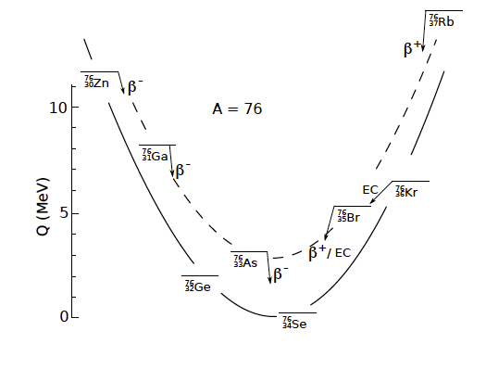
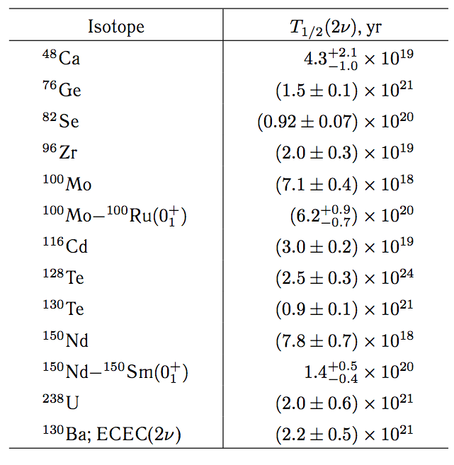
2-neutrino double beta decay
First direct observation by Steve Elliott et al in 1987
Elliott, S. R., A. Hahn, and M. K. Moe, 1987, Phys. Rev. Lett. 59, 2020.
2nd order weak decay, very long half life
Only possible if single beta decay
is energetically forbidden.
Observed for some nuclei
with even numbers of protons and neutrons
A. S. Barabash, ISSN 1063-7788, Physics of Atomic Nuclei, 2010,
Vol. 73, No. 1, pp. 162–178.

Slide 8
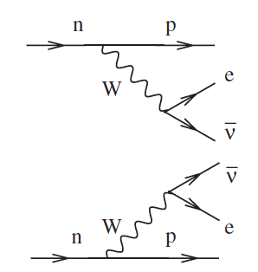
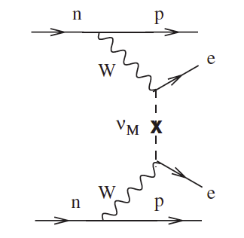
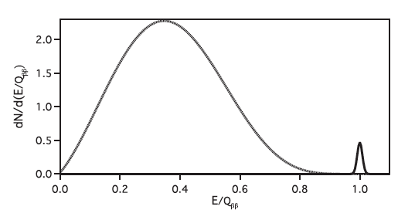
Neutrinoless double beta decay
( 0νββ )
If neutrino is its own antiparticle, annihilation
2νββ
0νββ
Avignone, Elliott, and Engel,
Rev. Mod. Phys., Vol. 80, No. 2, April–June 2008
E is the sum energy of the 2 electrons

Slide 9
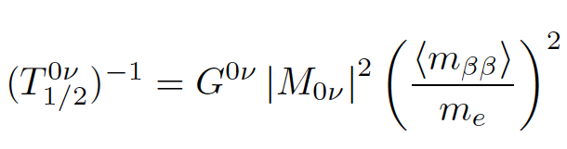
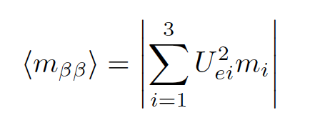
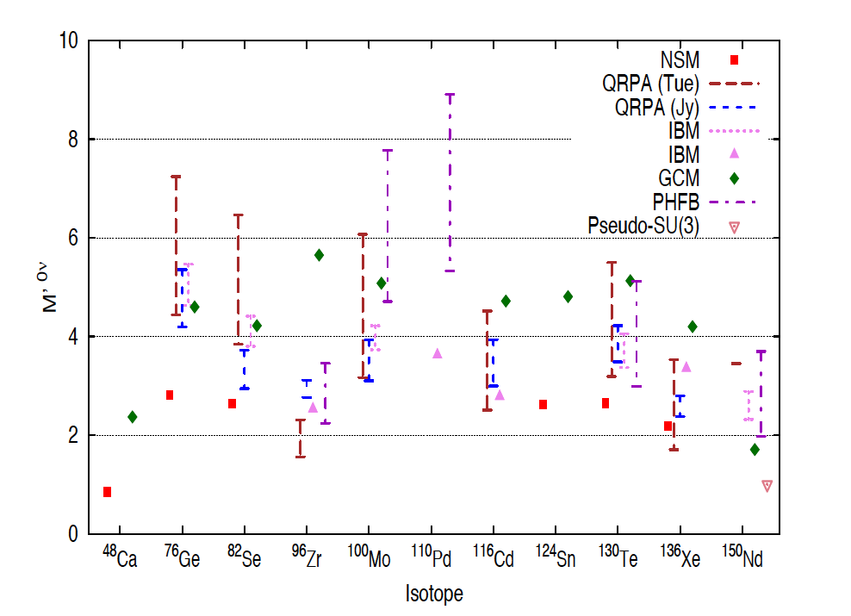


0νββ half life is related to mass
: Effective Majorana neutrino mass
: Phase factor
A. Dueck, W. Rodejohann and K. Zuber,
Phys. Rev. D83 (2011)
: Nuclear Matrix Element
Half life can be directly translated to
effective majorana neutrino mass,
although large uncertainties exist on
NME calculation
Notes:
Mbeta-beta, also know as Mee

Slide 10
Outline of the talk
Neutrinoless double-beta decay
the physics
the experiments
The Majorana Demonstrator

Slide 11
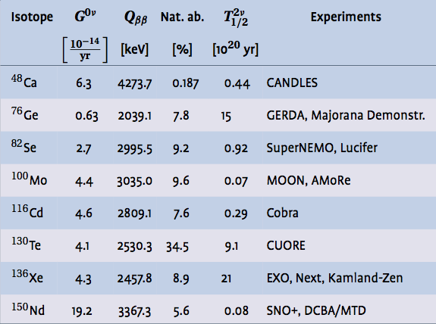
Recent List of 0νββ experiments
GERDA, Majorana Demonstr.
B. Schwingenheuer, Ann. Phys. (Berlin) 525, No. 4 (2013)

Slide 12
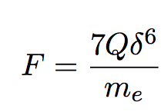
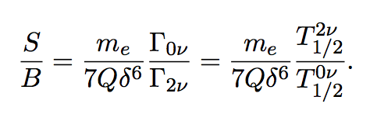
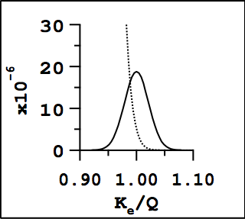
The Choice of Ge
Steven R. Elliott, Petr Vogel, Ann.Rev.Nucl.Part.Sci.52:115-151,2002
Excellent energy resolution: crucial in distinguishing
2νββ (the ultimate background) from 0νββ near the end point
is roughly the fraction of 2νββ decays ends up in the 0νββ peak region, δ=ΔΕ/Q
depends on the half life of 2νββ and 0νββ, element dependent
Assumes 5%
energy resolution,
Γ_{0ν}=1e-6 Γ_{2ν}
Half life ratio and (ΔE)⁶ decides the S/B,
thus the ultimate sensitivity.
ΔE is crucial
Ge detector has ΔE/E~0.2% at Q_{ββ}
i.e. 4 keV Region of Interest (ROI) @2039keV
2νββ is estimated to be negligible of the final
background in ROI for the Demonstrator
Tail of 2νββ could
overwhelm 0νββ
Notes:
The 0!"" half-life is assumed to be 10^26
years, approximately ten times the current lower limit. The two-neutrino double-beta decay
spectrum was calculated using the Primakoff-Rosen approximation [12] for the 2!"" halflife
of 1.5*10^21 years [13]. Spectra are calculated for emitted electrons; detector resolution
is not included. Rates are calculated for germanium enriched to 86% 76Ge; there are 47
counts in the 0!"" peak and 32*10^6 counts in the 2!"" spectrum per tonne-year.

Slide 13
Good reasons for Ge
  Excellent Energy resolution (~0.2% at 2039keV)
  Source is detector
  Can be enriched in ⁷⁶Ge to 86%
  Low level of radio-impurities can be achieved during processing
  Technology is well understood
  Easy to operate (LN temperature, volume is small)
  Large Q-value puts 0νββ peak above most backgrounds

Slide 14
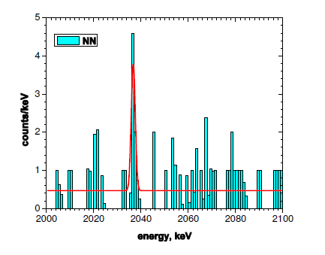
Previous Ge experiments
The upper limits on 0νββ half-life:
Heidelberg-Moscow:
T_{1/2} (⁷⁶Ge)>1.9x10²⁵ years (90% CL)
Eur. Phys. J. A. 12, 147-154 (2001)
IGEX (International Germanium Experiment):
T_{1/2} (⁷⁶Ge)>1.57x10²⁵ years (90% CL)
Phys. Rev. D, 65, 092007 (2002)
They are the most sensitive limits until recently.
The claims:
The (2004) 4.2σ 0νββ claim: T_{1/2} = 1.19^{+0.38}_{-0.22} x10²⁵y
Total exposure 71.8kg*yr
H.V. Klapdor-Kleingrothaus, et al, PLB 586 (2004) 198-212
The (2006) 6.4σ 0νββ claim: T_{1/2} = 2.23^{+0.44}_{-0.31} x10²⁵y
H.V. Klapdor-Kleingrothaus
And I. V. Krivosheina, Mod. Phys. Lett. A 21, 1547 (2006)
Notes:
PSA applied to 2004 result and 2 peaks
KK is a subgroup of HM!!!
Whether or not the claim is true, the experiment is most sensitive.
2004, 0.11cnts/keV kg yr

Slide 15

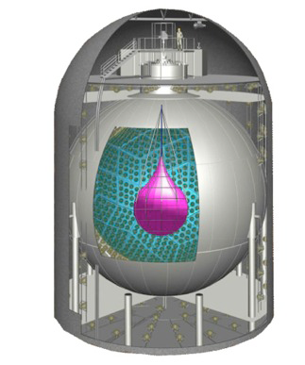
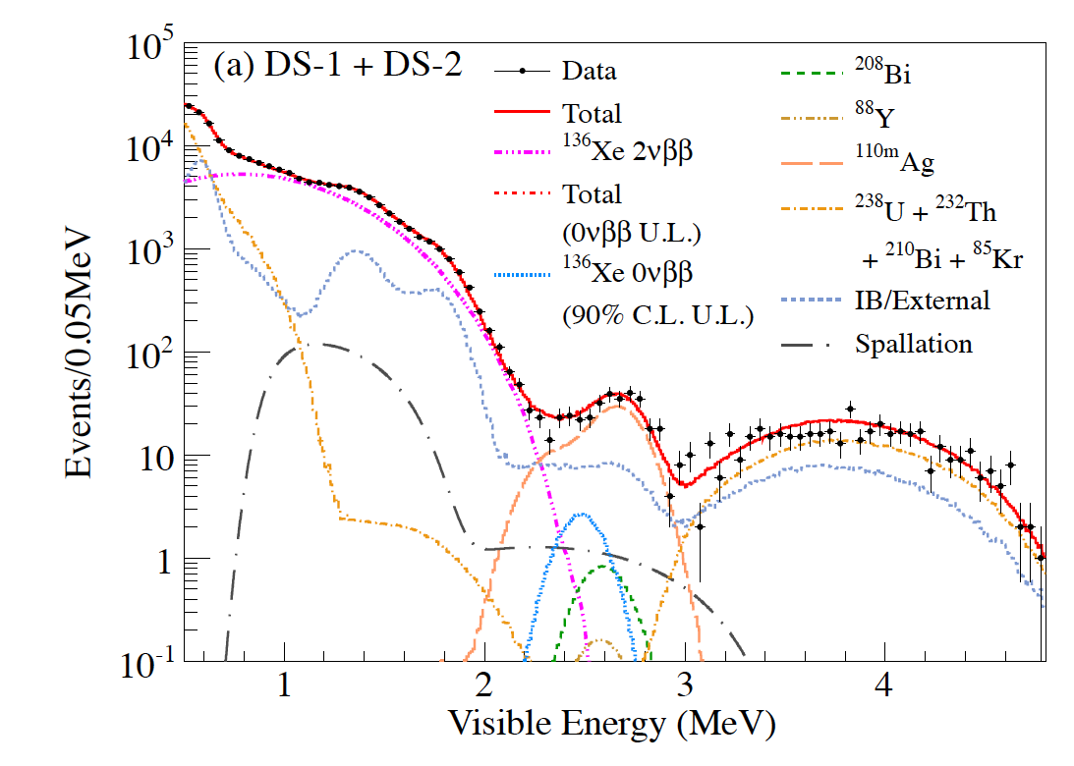
Non-Ge: KamLAND-Zen
KamLAND-Zen: T_{1/2} (¹³⁶Xe)>1.9x10²⁵ years (90% CL)
Phys.Rev.Lett. 110, 062502 (2013)
Figures adapter from:
Patrick Decowski, TAUP2013
Notes:
179 kg of 136Xe, enrichment Xenon, 2.458MeV Q value.
inner ballon (IB), liquid scintillator, PMT+ water-Cherenkov veto
The vertex resolutionis ∼ 15 cm/sqrtE (MeV), and the energy resolution is = (6.6+/-0.3)%/sqrtE(MeV).
The U and Th contaminations in the Xe-LS can be investigated by the delayed coincidence detection of 214Bi-214Po and 212Bi-212Po.
U238, Bismuth 214 (beta) – Polonium 214 (164.3 microsecond, alpha)
Th232, Bismuth 212(beta)-Polonium 212 (0.3 microsecond, alpha)
the Bi-Po measurements are used to constrain only the rates for the 222Rn-210Pb subchain of the 238U series and the 228Th-208Pb subchain of the 232Th series,
Wenqin: the secular equ: the very first parent half time must be much longer than any other daughter in the chain, up to the last.
For U238, Rn(222) t1/2= 3.8day,, Pb(210) t1/2=22.3year. All in between,t1/2 are min, sec. Rn is a gas, so the equilibrium cannot be assumed prior to Rn.
For Th232, Th(228) t1/2= 1.9year, Pb(208) is stable, and the chain includes Rn220. Although, Rn (220) is a gas, it is not stable (55 second), so it cannot break the equilibrium.

Slide 16

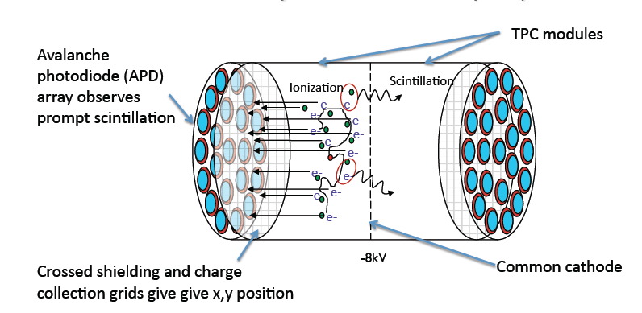
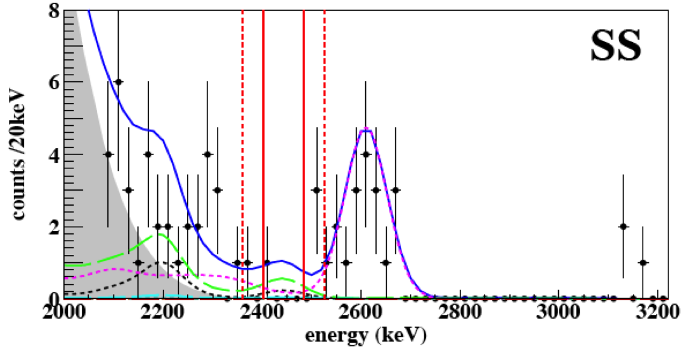
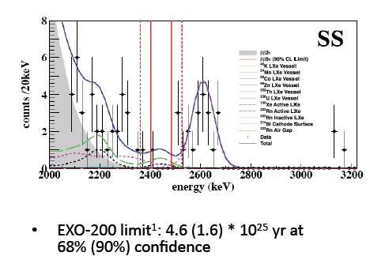
Non-Ge: EXO-200
^{enr}LXe
Common
cathode
Figures adapter from:
Tim Daniels, TAUP2013
PRL 109 (2012) 032505
Notes:
enrLXe enriched to 80.6%136Xe.
Energy depositions in the TPC produce both ionization and scintillation signals
HFE-7000/lead shield, + plastic-scinitillator veto
Primarily due to bremsstrahlung, a fraction of events are MS. The MC simulation predicts that 82.5% of 0 events are SS.

Slide 17
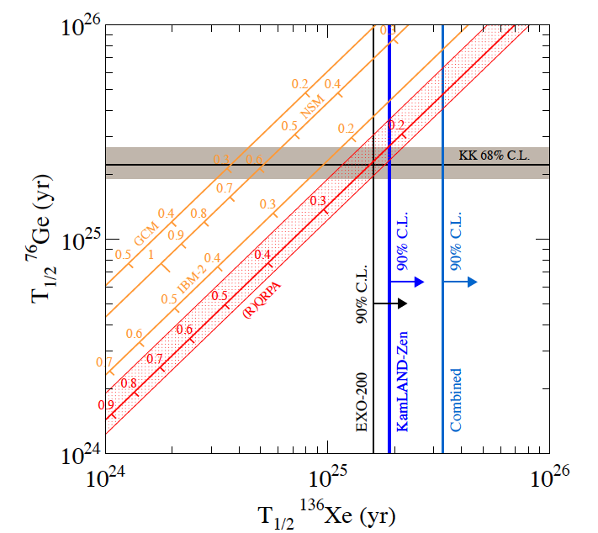
Status prior to the most recent Ge results
Phys.Rev.Lett. 110, 062502 (2013)
(2006)
NME correlates
¹³⁶Xe and ⁷⁶Ge
Notes:
Quasiparticle Random-Phase Approximation (QRPA)

Slide 18
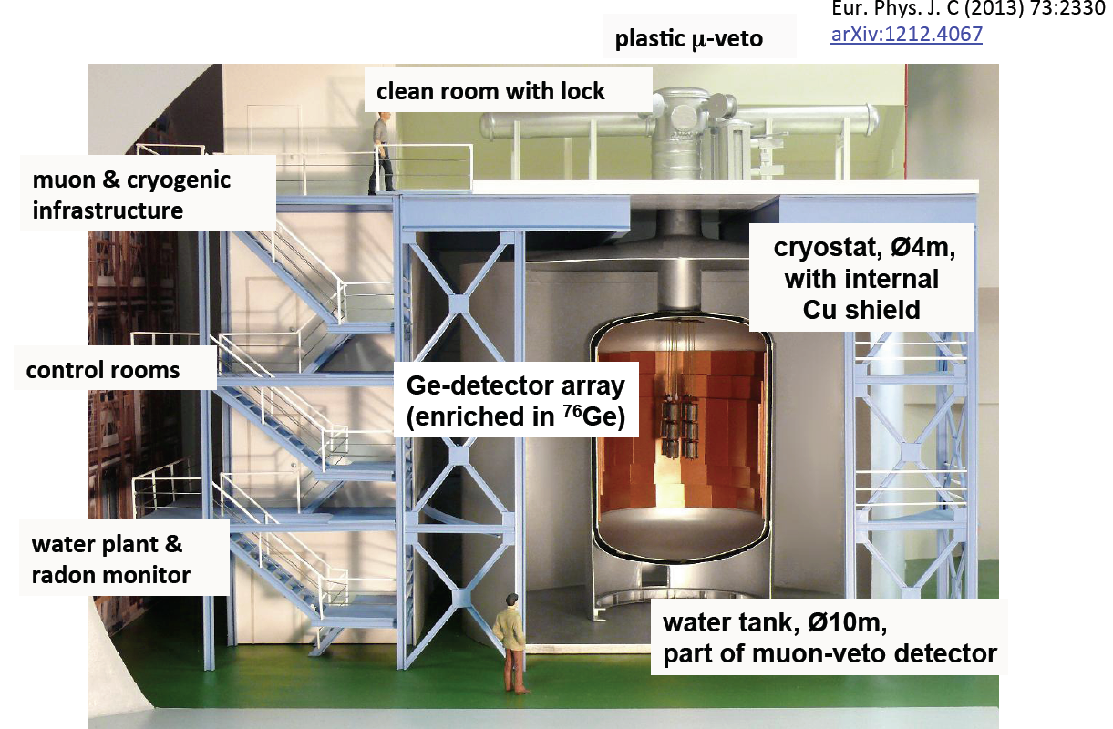
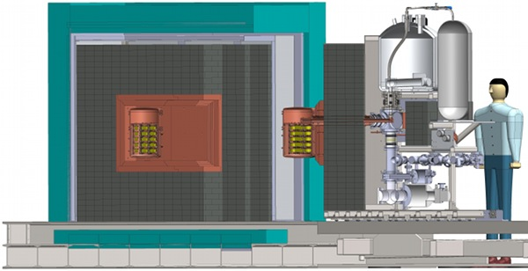
Now: GERDA &
Majorana Demonstrator
Figure adapted from: Stefan Schönert
(for the GERDA collaboration) LNGS Seminar, July 16, 2013
GERDA
(Germanium Detector Array)
Detectors inside a liquid argon shield
high-Z material budget is small,
relaxing depth requirement
Majorana Demonstrator
Detectors are inside lays of compact shield
Effectively shield against natural radioactivity

Slide 19

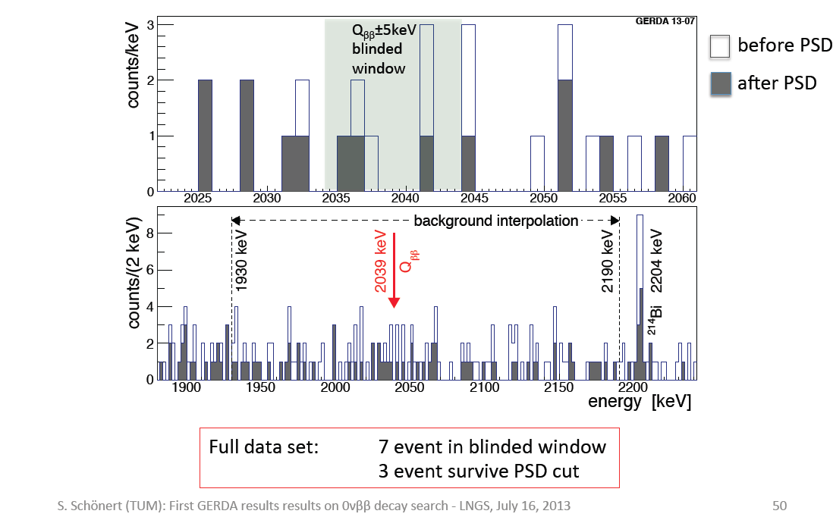
GERDA phase I results
PSD: Pulse Shape
Discrimination
Around Q value
Figure adapted from:
Stefan Schönert
(for the GERDA collaboration)
LNGS Seminar, July 16, 2013
Wider energy range
Expect 5.1 background
Expect 2.5 background
No 0νββ

Slide 20
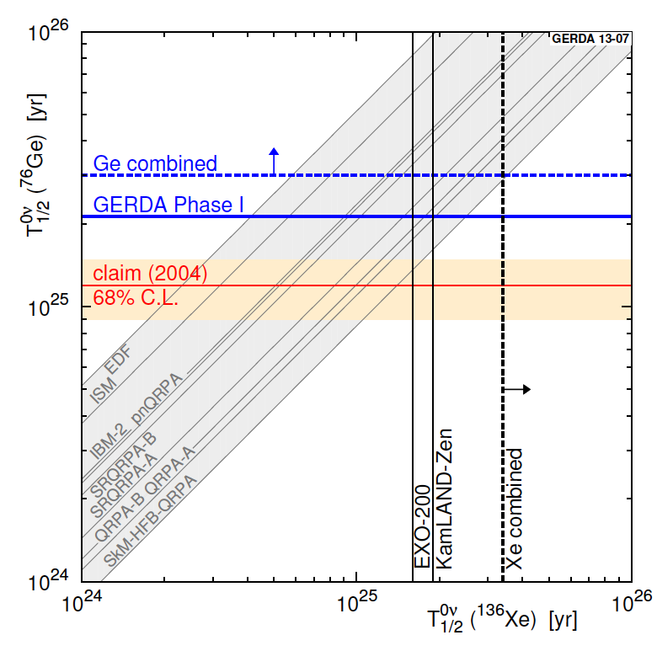
GERDA phase I results
GERDA, T_{1/2} (⁷⁶Ge)>2.1x10²⁵ years (90% CL), PRL 111, 122503 (2013)
(90% CL) 21.6kg.y
NME correlates
¹³⁶Xe and ⁷⁶Ge
Notes:
Skyrme Quasiparticle Random-Phase Approximation (QRPA)

Slide 21
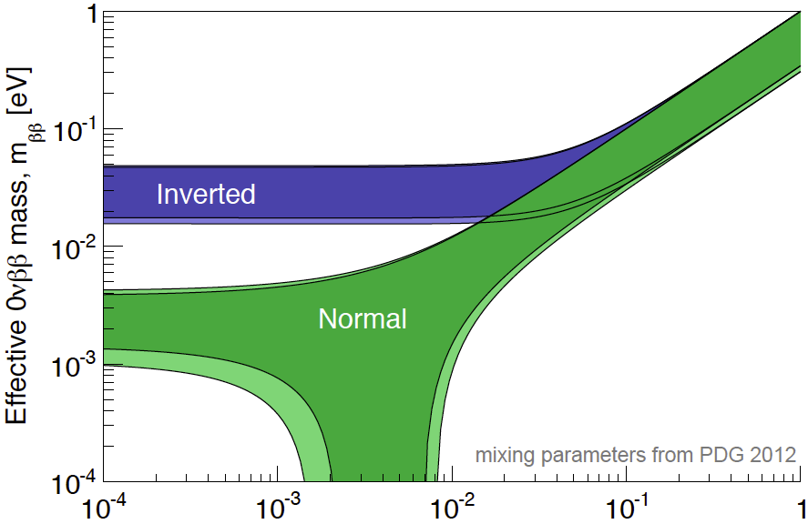
The mass plot
Minimum Neutrino Mass [eV]
Notes:
Cosmology ~ 1eV
degenerated

Slide 22
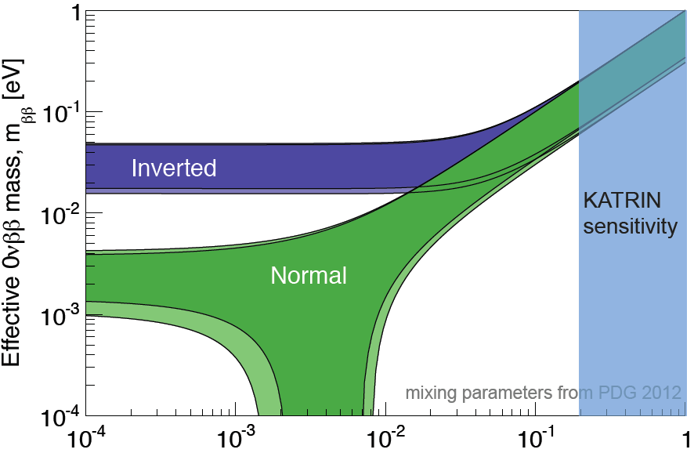
KATRIN sensitivity
Animation adapted from
Alexis Schubert,
University of Washington,
Ph.D. defense talk
Minimum Neutrino Mass [eV]
https://www.katrin.kit.edu/128.php
Notes:
https://www.katrin.kit.edu/128.php
KATRIN is expected to achieve the following sensitivities for the mass of the electron neutrino:
Sensitivity: (90% upper limit if neutrino mass is zero)
0.2 eV with about equal contributions of statistical and systematical errors.
Discovery potential:
A neutrino mass of 0.35 eV would be discovered with 5 sigma significance. A neutrino mass of 0.30 eV would be discovered with 3 sigma significance.
Sensitivity 0.35eV/c
An experiment like KATRIN, which answers the question if at least one neutrino flavor is heavier than 0.2 eV/c², disentangles the hierarchical and degenerated models.
https://www.katrin.kit.edu/77.php

Slide 23
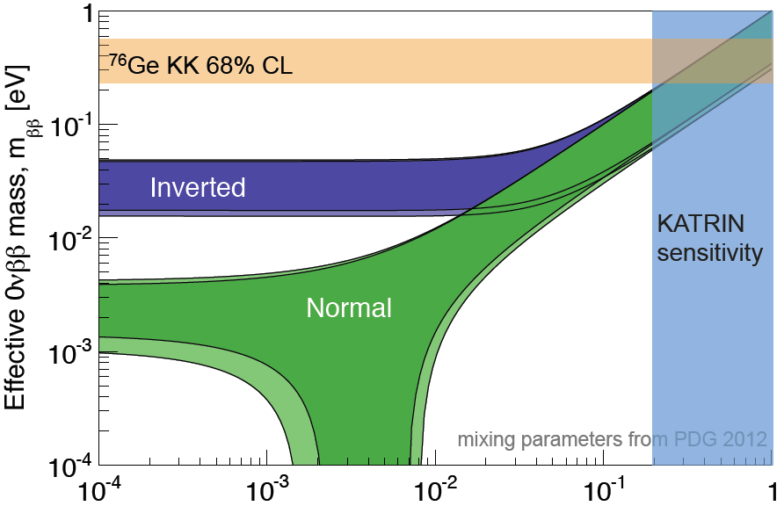
Neutrinoless double beta decay
Animation adapted from
Alexis Schubert,
University of Washington,
Ph.D. defense talk
Minimum Neutrino Mass [eV]

Slide 24
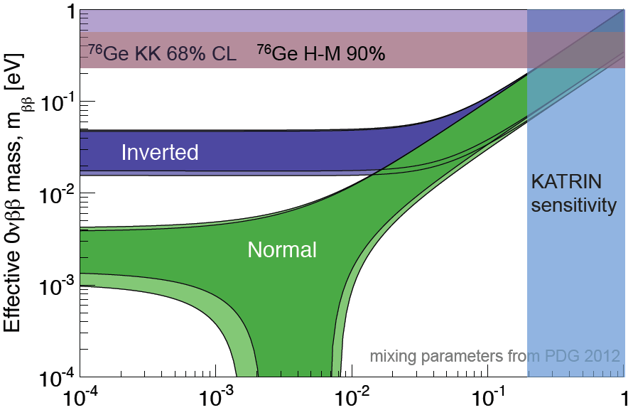
Neutrinoless double beta decay
Upper limit
of <m_{ββ}>, if
Majorana
particle.
The band
uncertainty
mainly comes
from nuclear
matrix
Element.
Animation adapted from
Alexis Schubert,
University of Washington,
Ph.D. defense talk
Minimum Neutrino Mass [eV]
Eur. Phys. J. A 12. 147-154
Notes:
0.35eV 90%CL Eur. Phys. J. A 12. 147-154

Slide 25
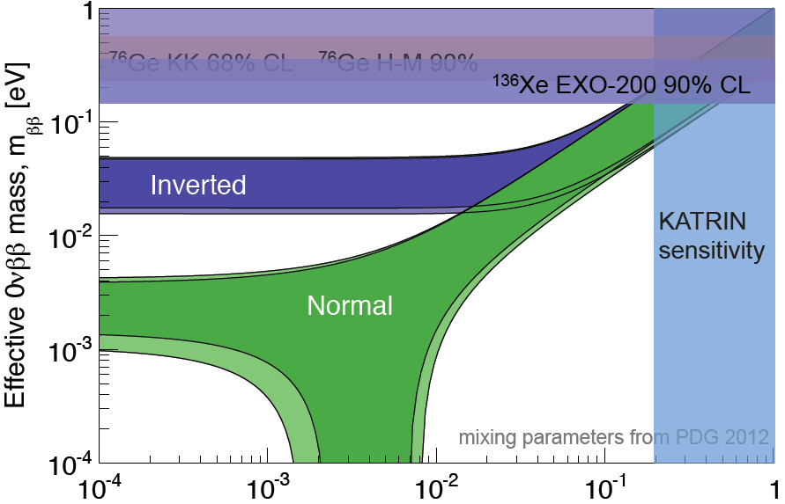
Neutrinoless double beta decay
Upper limit
of <m_{ββ}>, if
Majorana
particle.
The band
uncertainty
mainly comes
from nuclear
matrix
Element.
Animation adapted from
Alexis Schubert,
University of Washington,
Ph.D. defense talk
Minimum Neutrino Mass [eV]
Phys. Rev. Lett. 109, 032505 (2012)

Slide 26
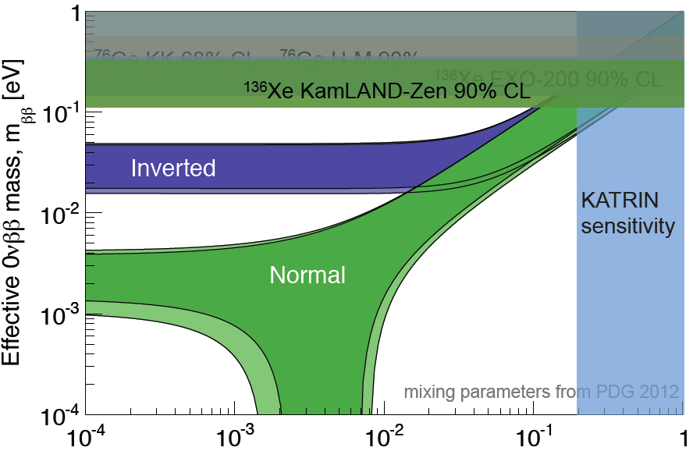
Neutrinoless double beta decay
EXO combined
Upper limit
of <m_{ββ}>, if
Majorana
particle.
The band
uncertainty
mainly comes
from nuclear
matrix
Element.
Animation adapted from
Alexis Schubert,
University of Washington,
Ph.D. defense talk
Minimum Neutrino Mass [eV]
Phys.Rev.Lett. 110, 062502 (2013)

Slide 27
Neutrinoless double beta decay
combined Ge (GERDA and others) 0.2-0.4 eV
Upper limit
of <m_{ββ}>, if
Majorana
particle.
The band
uncertainty
mainly comes
from nuclear
matrix
Element.
Minimum Neutrino Mass [eV]
arXiv:1307.4720

Slide 28
Outline of the talk
Neutrinoless double-beta decay
the physics
the experiments
The Majorana Demonstrator

Slide 29
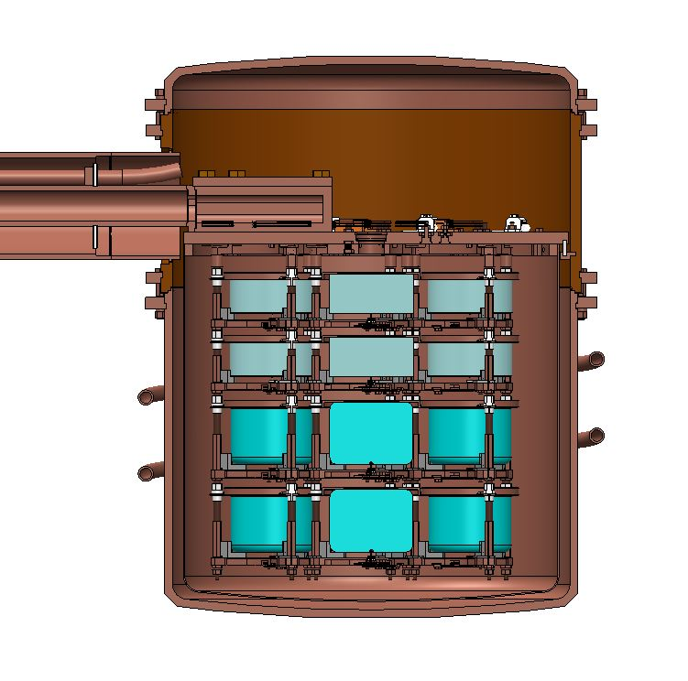
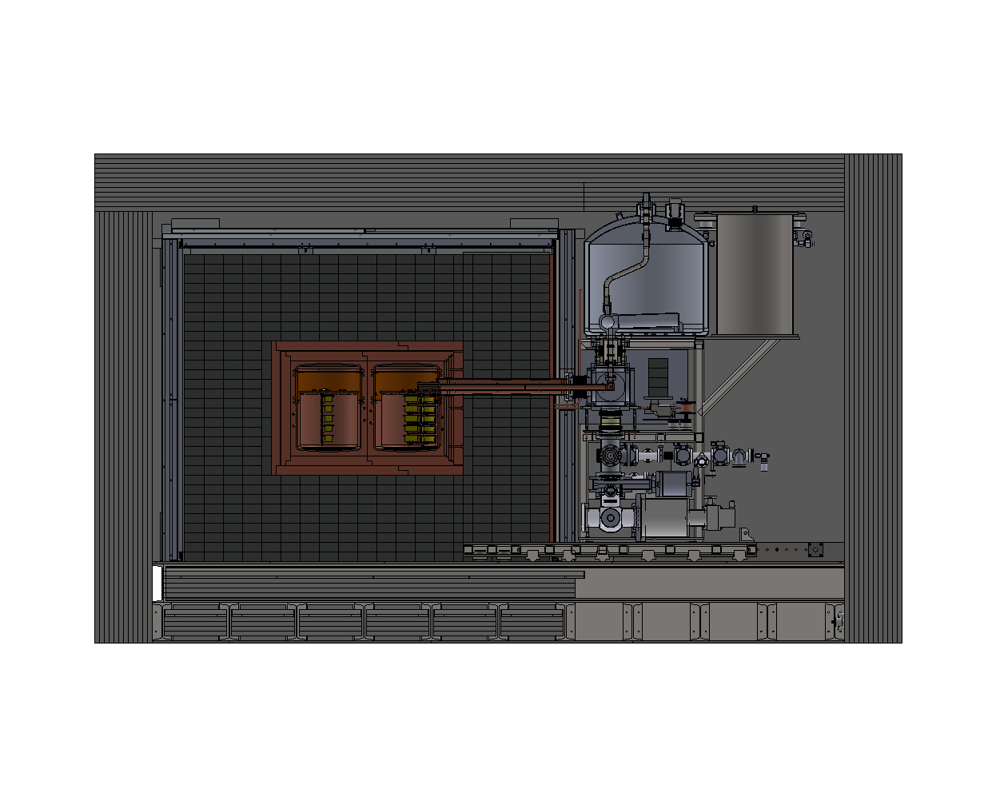
The Majorana Demonstrator
Funded by DOE Office of Nuclear Physics and NSF Particle Astrophysics,
with additional contributions from international collaborators.
Goals: - Demonstrate backgrounds low enough to justify building a tonne scale experiment.
- Establish feasibility to construct & field modular arrays of Ge detectors.
- Test Klapdor-Kleingrothaus claim.
- Low-energy dark matter (light WIMPs, axions, ...) searches.
Located underground at 4850’ Sanford Underground Research Facility
Background Goal in the 0νββ peak region of interest (4 keV at 2039 keV)
3 counts/ROI/t/y (after analysis cuts)
scales to 1 count/ROI/t/y for a tonne experiment
40-kg of Ge detectors
  30 kg of 86% enriched ⁷⁶Ge crystals &
  10 kg of ^{nat}Ge
  Detector Technology: P-type, point-contact.
2 independent cryostats
  ultra-clean, electroformed Cu
  20 kg of detectors per cryostat
  naturally scalable
Compact Shield
  low-background passive Cu and Pb
  shield with active muon veto

Slide 30
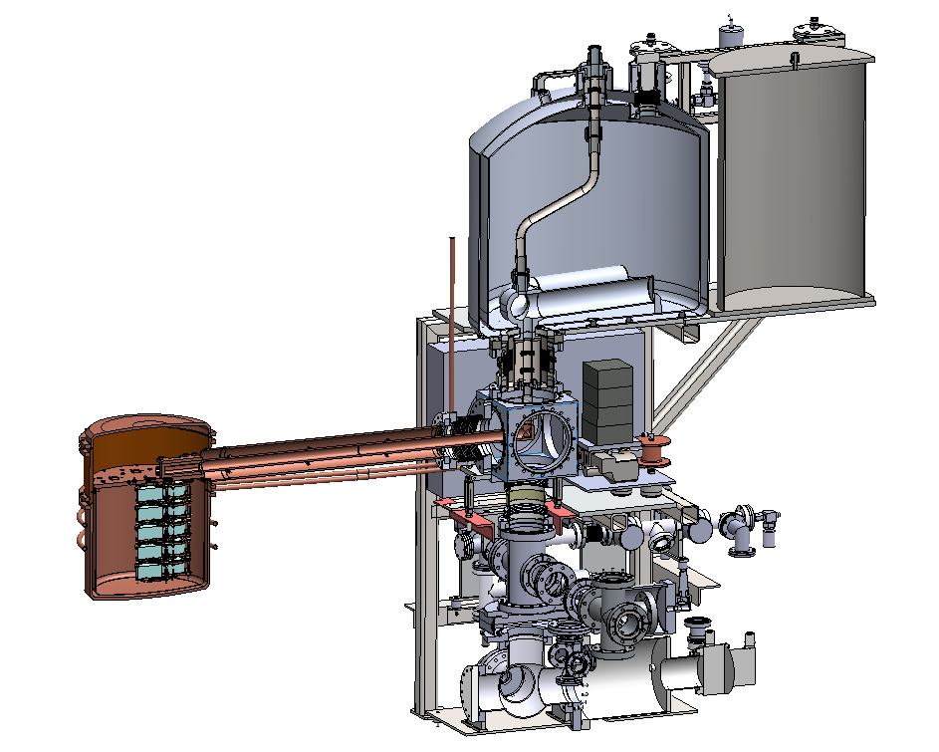
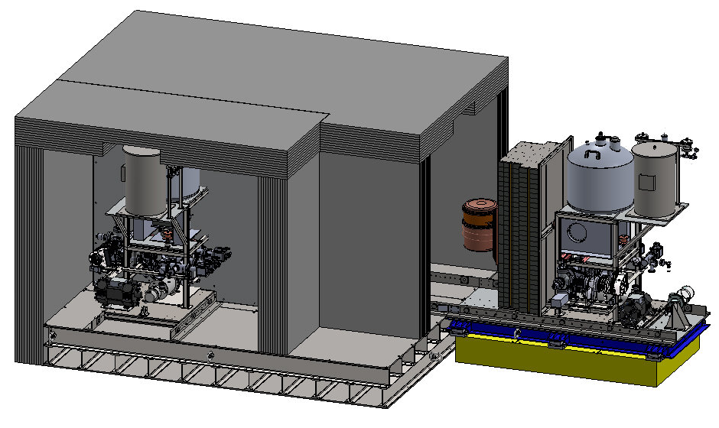
MJD Implementation
Three Steps
  Prototype Cryostat* (2 strings, ^{nat}Ge)
  Cryostat 1 (3 strings ^{enr}Ge & 4 strings ^{nat}Ge)
  Cryostat 2 (7 strings ^{enr}Ge)
Same design as Cryos 1 & 2, but fabricated using OFHC Cu (non-electroformed) components.

Slide 31
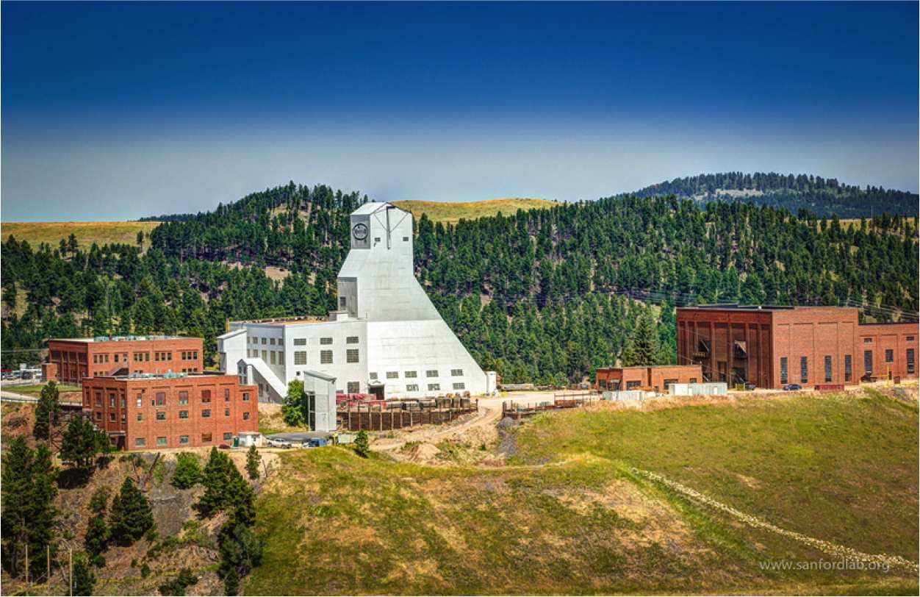
Sanford Underground Research Facility (SURF), Lead, SD
http://sanfordlab.org
Head frame,
the cage goes down here
Hoist building,
Hoist the cables here
Cables that hoist
the cage

Slide 32
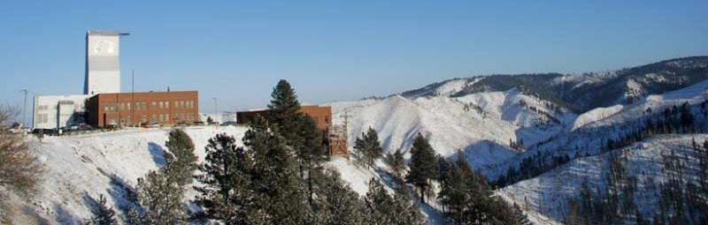
Sanford Underground Research Facility (SURF), Lead, SD
Photo Courtesy of R. Martin

Slide 33
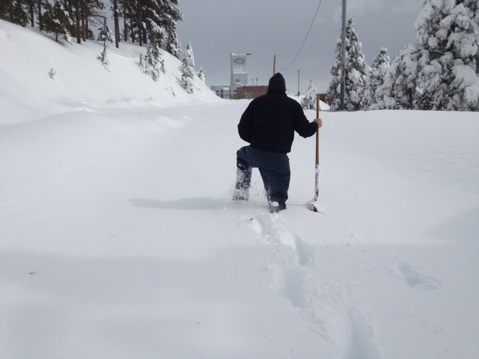
Sanford Underground Research Facility (SURF), Lead, SD
SURF, head frame
The deputy
Project manager

Slide 34
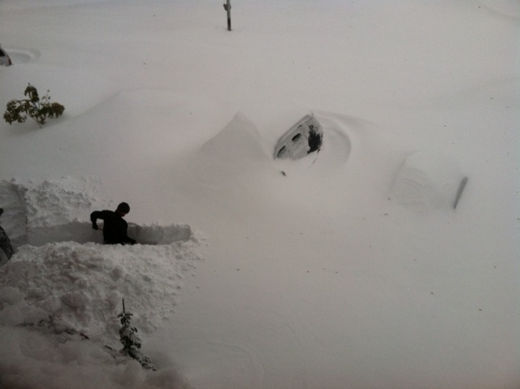
Sanford Underground Research Facility (SURF), Lead, SD
Cars
The Spokesperson

Slide 35
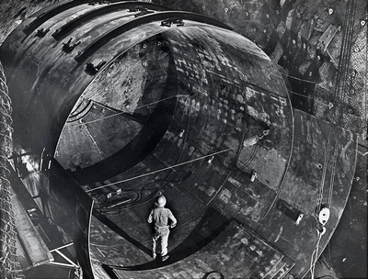
Sanford Underground Research Facility (SURF), Lead, SD
Ray Davis'
Solar Neutrino
Experiment (1967-1985)
2002 Nobel price for
“detecting solar neutrinos”
Photo Credit :
Sanford Underground
Research Facility

Slide 36
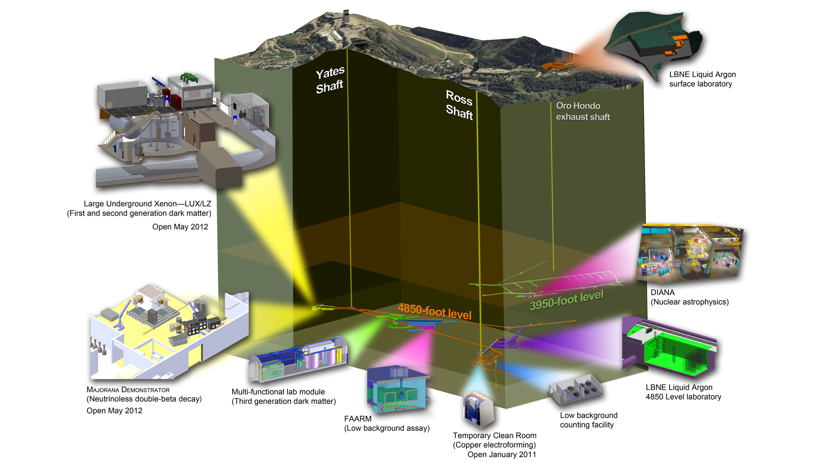
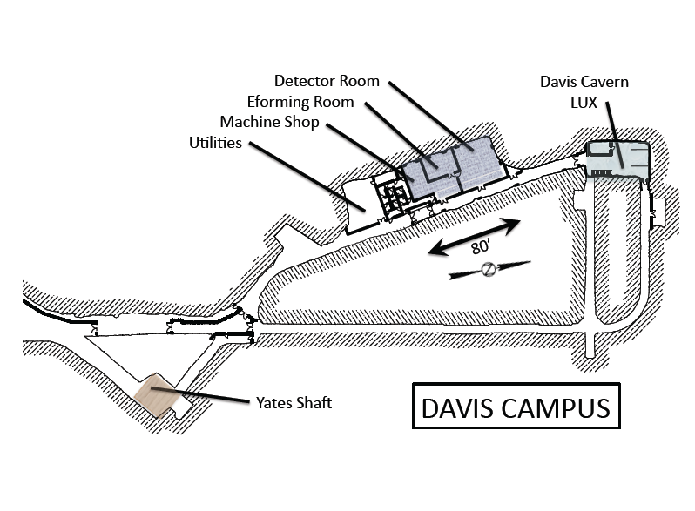
Sanford Underground Research Facility (SURF), Lead, SD
4850 foot ~ 4260 m.w.e
http://sanfordlab.org
50m

Slide 37
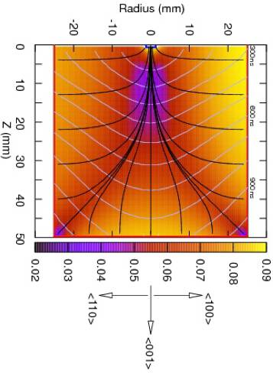
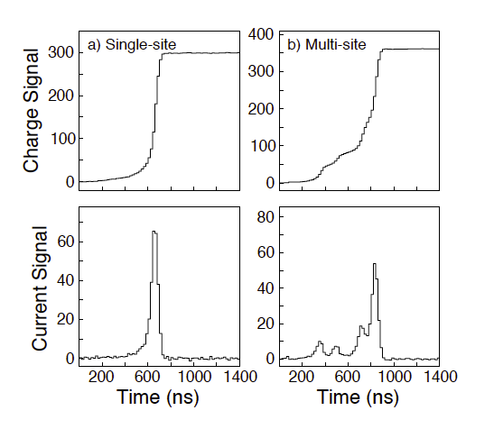
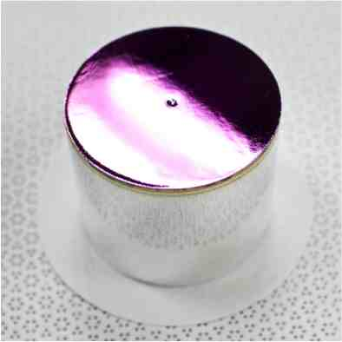
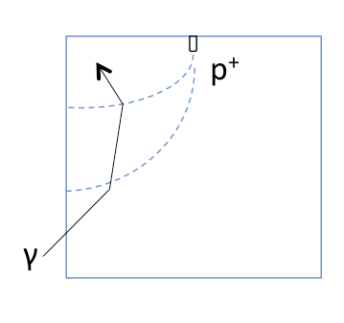
Point Contact Detector
P-type Point Contact Detector
(PPC)
Compton scattering
in PPC weighting field
Point Contact Detector:
Relatively low electrical fields
Larger time spreads for spatially distinct energy depositions
Crucial in distinguishing multi-site γ background from single-site β signals
Pulse-Shape-Discrimination (PSD)
37

Slide 38




Detector Unit Assemble
Point Contact Dimple,
the contact pin touches here
20.5mm x 7mm; total weight ~80mg
HV ring
HV Nut
Hollow Hex Rod
insulator
Mounting
plate
Fused silica substrate
•Au-Cr traces
•Amorphous-Ge resistor
•Low background
•Low noise
Bushing
Contact pin
LMFE (low mass front end board)
Natural or enriched
Ge crystal,
Detector unit
Notes:
55eV FWHM, 85 for a miniPPC

Slide 39

Modular approach
Adaptor Plate Bolt
crystal
HV ring
HV Nut
Hollow Hex Rod
insulator
Mounting
plate
X 4 or 5
Natural or enriched
Ge crystal,
Detector unit
String assembly

Slide 40

Modular approach
Adaptor Plate Bolt
crystal
HV ring
HV Nut
Hollow Hex Rod
insulator
Mounting
plate
X 4 or 5
Natural or enriched
Ge crystal,
Detector unit
Our string #1
String assembly

Slide 41

Modular approach
Adaptor Plate Bolt
crystal
HV ring
HV Nut
Hollow Hex Rod
insulator
Mounting
plate
X 7
X 4 or 5
Module assembly
in its own cryostat
Natural or enriched
Ge crystal,
Detector unit
String assembly

Slide 42
Modular approach
Adaptor Plate Bolt
crystal
HV ring
HV Nut
Hollow Hex Rod
insulator
Mounting
plate
X 7
X 4 or 5
Module assembly
in its own cryostat
Natural or enriched
Ge crystal,
Detector unit
X 2
String assembly
The Demonstrator

Slide 43

The shielding
The veto panels
(scintillating acrylic
2 layers, 2.54cm):
active shielding.
The others
are passive:
Poly shield - 30cm;
Radon enclosure -
0.32-0.635cm Al
(purged with N₂);
Lead - 45 cm;
Outer Cu - 5 cm;
Inner Cu 4 layers
- 1.25 cm each.
Cryogenic system
Notes:
OFHC Oxygen-free high thermal conductivity

Slide 44

Electroformed copper (EFCu)
Assay results for e-form copper ²³²Th: 0.7 ± 0.3 Bq/kg. ²³⁸U: <1.3 Bq/kg
One order of magnitude better than the cleanest commercial copper

Slide 45
Low background is the key
Natural radioactivity:
Pure material (e.g. EFCu, clean plastic and others)
Shielding
Analysis cuts (PSD, granularity cuts)
Cosmologenic:
Deep underground
Muon veto
Limit surface time of Ge (shielded)
E-form Cu underground
Analysis cuts ⁶⁸Ge tag Single-Site Time Correlation Cut
Combined efficiency of two layers of veto panel~99.9%,
Un-vetoed direct muon background<0.03 counts/ROI/t/y.

Slide 46
Low background is the key
Natural radioactivity:
Pure material (e.g. EFCu, clean plastic and others)
Shielding
Analysis cuts (PSD, granularity cuts)
Cosmogenic:
Deep underground
Muon veto
Limit surface time of Ge (shielded)
E-form Cu underground
Analysis cuts ⁶⁸Ge tag Single-Site Time Correlation Cut
Combined efficiency of two layers of veto panel~99.9%,
Un-vetoed direct muon background<0.03 counts/ROI/t/y.

Slide 47
Low background is the key
Natural radioactivity:
Pure material (e.g. EFCu, clean plastic and others)
Shielding
Analysis cuts (PSD, granularity cuts)
Cosmogenic:
Deep underground
Muon veto
Limit surface time of Ge (shielded shipping and storage)
E-form Cu underground
Analysis cuts ⁶⁸Ge tag Single-Site Time Correlation Cut
Combined efficiency of two layers of veto panel~99.9%,
Un-vetoed direct muon background<0.03 counts/ROI/t/y.

Slide 48
Low background is the key
Natural radioactivity:
Pure material (e.g. EFCu, clean plastic and others)
Shielding
Analysis cuts (PSD, granularity cuts)
Cosmogenic:
Deep underground
Muon veto
Limit surface time of Ge (shielded shipping and storage)
E-form Cu underground
Analysis cuts ⁶⁸Ge tag Single-Site Time Correlation Cut
Combined efficiency of two layers of veto panel~99.9%,
Un-vetoed direct muon background<0.03 counts/ROI/t/y.

Slide 49

Demonstrator background budget
in the 4keV Region of Interest
near 2039keV
2νββ background is negligible due to excellent energy resolution

Slide 50

Simulated Background near Q_{ββ} after all cuts
Figure adapted from
J.F.Wilkerson,
DOE ONP Comparative Review
June 25, 2013

Slide 51


Demonstrator Status
Clean Room
Infrastructure and cleanliness established
Assayed all materials
75% required e-form copper produced
42.5 kg of 86% enriched 76Ge procured, refined to
electronic grade with a 98% yield
Accepted 10 enriched Ge det., 9.5kg in total
Built two strings of natural Ge detectors built
Fabricated prototype cryostat
Built the associated vacuum system
Shield construction in progress
SlowControl and DAQ in use
Shields
String
Notes:
(2343 kg of 3127 kg)

Slide 52

Demonstrator schedule
Prototype Cryostat:
Summer 2013
-- Commissioning
Cryostat 1:
Early of 2014
Cryostat 2:
End of 2014
Run for 3 years,
exposure~100kg*y
Sensitive to T ~ 10²⁶ years

Slide 53

Tonne scale sensitivity
Aim for background
< 1count/ROI/t/y to
probe the entire
inverted-hierarchy region
in a practical time period
Notes:
If not found:
Either inverted but Dirac
Or
Normal or degenerated

Slide 54

Background Projection for
Tonne-scale
3 ct/4keV/t-y in the Demonstrator
Let us probe the inverted-hierarchy region

Slide 55
The Majorana Collaboration
Black Hills State University, Spearfish, SD
Kara Keeter
Duke University, Durham, North Carolina , and TUNL
Matthew Busch, James Esterline, Gary Swift, Werner Tornow
Institute for Theoretical and Experimental Physics, Moscow, Russia
Alexander Barabash, Sergey Konovalov, Vladimir Yumatov
Joint Institute for Nuclear Research, Dubna, Russia
Viktor Brudanin, Slava Egorov, K. Gusev,
Oleg Kochetov, M. Shirchenko, V. Timkin, E. Yakushev
Lawrence Berkeley National Laboratory, Berkeley, California and
the University of California - Berkeley
Nicolas Abgrall, Mark Amman, Paul Barton, Yuen-Dat Chan, Alex Hegai,
Paul Luke, Susanne Mertens, Alan Poon, Kai Vetter, Harold Yaver
Los Alamos National Laboratory, Los Alamos, New Mexico
  Melissa Boswell, Steven Elliott,, Johnny Goett, Keith Rielage, Larry Rodriguez, Michael Ronquest, Harry Salazar, Wenqin Xu
North Carolina State University, Raleigh, North Carolina and TUNL
Dustin Combs, Lance Leviner, David G. Phillips II, Albert Young
Oak Ridge National Laboratory, Oak Ridge, Tennessee
Fred Bertrand, Kathy Carney, Alfredo Galindo-Uribarri,
Matthew P. Green, David Radford, Elisa Romero-Romero,
Robert Varner, Brandon White, Timothy Williams, Chang-Hong Yu
Osaka University, Osaka, Japan
Hiroyasu Ejiri, Ryuta Hazama, Masaharu Nomachi, Shima Tatsuji
Pacific Northwest National Laboratory, Richland, Washington
Estanislao Aguayo, Jim Fast, Eric Hoppe, Richard T. Kouzes, Brian LaFerriere, John Orrell, Nicole Overman, Doug Reid, Aleksandr Soin
Shanghai Jiaotong University, Shanghai, China
James Loach
South Dakota School of Mines and Technology, Rapid City, South Dakota
Adam Caldwell, Cabot-Ann Christofferson, Stanley Howard,
Anne-Marie Suriano, Jared Thompson
Tennessee Tech University, Cookeville, Tennessee
Mary Kidd
University of Alberta, Edmonton, Alberta
Aksel Hallin
University of North Carolina, Chapel Hill, North Carolina and TUNL
Florian Fraenkle, Graham K. Giovanetti, Reyco Henning, Mark Howe,
Jacqueline MacMullin, Benjamin Shanks, Christopher O’Shaughnessy,
Kris Vorren, John F. Wilkerson
University of South Carolina, Columbia, South Carolina
Frank Avignone, Vince Guiseppe, Clint Wiseman
University of South Dakota, Vermillion, South Dakota
Dana Byram, Ryan Martin, Nathan Snyder
University of Tennessee, Knoxville, Tennessee
Yuri Efremenko, Sergey Vasilyev
University of Washington, Seattle, Washington
Tom Burritt, Clara Cuesta, Jason Detwiler, Peter J. Doe, Julieta Gruszko, Greg Harper, Jonathan Leon, David Peterson, R. G. Hamish Robertson, Alexis Schubert, Tim
Notes:
Aug 2013

Slide 56


Slide 57
The END
THANK YOU!

Slide 58
backup

Slide 59


Cryogenic System
Pulse Tube
Cooler for
prototype
Cooling: thermosiphon
-> cold plate
-> the string.
-> Detectors temperature ~ 95k
& FET temperature ~ 150k
(self-heating)
Notes:
OFHC Oxygen-free high thermal conductivity

Slide 60

Low Mass Front End
Feedback
FET
Drain
Source
Pulser
Fused silica substrate
•Au-Cr traces
•Amorphous-Ge resistor
•Low background
•Low noise
Self heating
Temperature can be Controlled by Drain to Source Voltage
Notes:
55eV FWHM, 85 for a miniPPC

Slide 61

Low Mass Front End
Fused silica substrate
•Au-Cr traces
•Amorphous-Ge resistor
•Low background
•Low noise
All material are selected to have low radioactivity
Final Design Report, The MAJORANA DEMONSTRATOR, May 2012
Notes:
55eV FWHM, 85 for a miniPPC

Slide 62

Low Mass Front End
Fused silica substrate
•Au-Cr traces
•Amorphous-Ge resistor
•Low background
•Low noise
Equivalent noise:
55eV FWHM
without detector
85eV FWHM
with a small detector
Notes:
55eV FWHM, 85 for a miniPPC

Slide 63

GRETINA digitizer card

Slide 64

Pulse-Shape-Discrimination
Figure adapted from, Ryan D. Martin, for the MAJORANA collaboration, DNP12
Retain 90% Double Escape Peak: single-site events, similar to 0νββ and 2νββ
Reject 89% Full Energy Peaks: multi-site events, background-like
Notes:
90.3 DEP, 27.9 Continuum, 11.8 MSE

Slide 65

Pulse-Shape-Discrimination
Before PSD cuts
After PSD cuts
arXiv:1308.1633
Notes:
90.3 DEP, 27.9 Continuum

Slide 66

Effective mass formula
The physics of neutrinos, V Barger, D Marfatia, K Whisnant, 2012, Princeton University Press

Slide 67

The mass plot
W. Rodejohann, arXiv:1106.1334

Slide 68

Simulated Background near Q_{ββ}
⁶⁰Co
²¹⁴Bi
⁶⁸Ge Continuum
²⁰⁸Tl
Figure adapted from
J.F.Wilkerson,
DOE ONP Comparative Review
June 25, 2013

Slide 69
Low background is the key
Natural radioactivity:
Pure material (e.g. EFCu, clean plastic and others)
Shielding
Analysis cuts (PSD, granularity cuts)
Cosmogenic:
Deep underground
Muon veto
Limit surface time of Ge (shielded shipping and storage)
E-form Cu underground
Analysis cuts ⁶⁸Ge tag Single-Site Time Correlation Cut
Combined efficiency of two layers of veto panel~99.9%,
Un-vetoed direct muon background<0.03 counts/ROI/t/y.

Slide 70

Background model fit of R&D Detector (MALBEK)
χ² / DOF = 97.2 / 114
P-value = 0.87
Geant4 simulations to determine efficiencies for contamination to deposit energy in our detectors
50k CPU hours
8k+ runs, 40+ contaminants, 56 components, 21 materials
A. Schubert,
Univ. Washington,
PhD thesis. 2012
Notes:
still have a good description of energy spectrum
goodness of fit and the spectral components that contribute depends on dead layer

Slide 71

KATRIN sensitivity
https://www.katrin.kit.edu/128.php
KATRIN is expected to achieve the following sensitivities for the mass of the electron neutrino:
Sensitivity: (90% upper limit if neutrino mass is zero)
0.2 eV with about equal contributions of statistical and systematical errors.
Discovery potential:
A neutrino mass of 0.35 eV would be discovered with 5 sigma significance. A neutrino mass of 0.30 eV would be discovered with 3 sigma significance.

