Slide 1

Exploring the Properties of the
Quark Gluon Plasma with
Heavy Flavor Probes
Wei Xie
PURDUE University, Physics Department
Notes:
My talk is about ….. Quark gluon plasma is a state of nuclear matter.
Let me start by asking a fundamental question that has a long histogram: What’s the states of matter and what’s the nature of their phase transition. We had two colloquiums in the last two weeks discussing how to address this question in specific systems at low temperatures. This study is to address the same fundamental question in nuclear matter. Next slides.

Slide 2
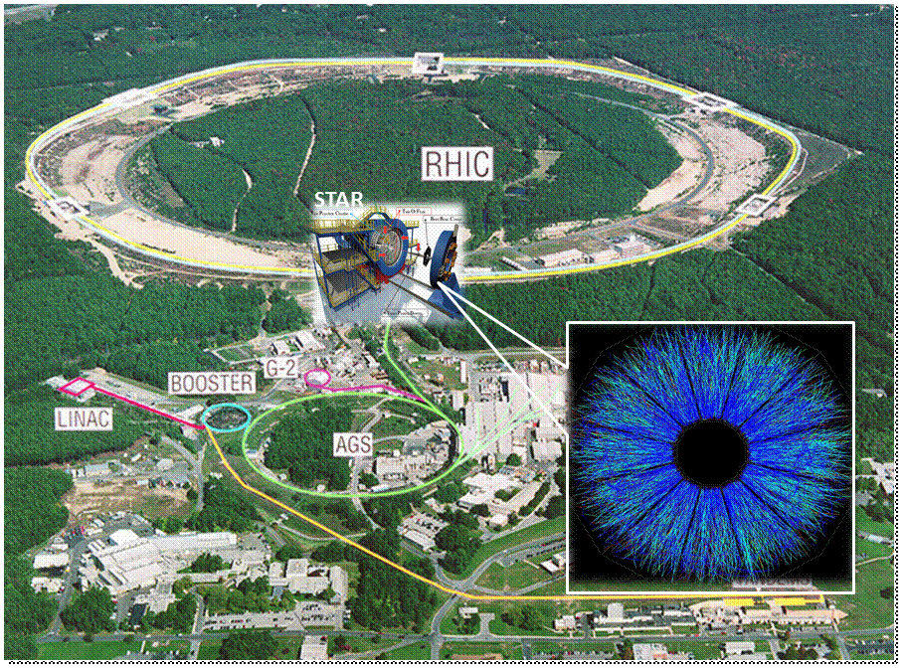
A Fundamental Question
What are the states of Nuclear matter and what is the nature of their phase transitions?
Notes:
I discuss one way to address the this question in the system of nuclear matter.

Slide 3
Acknowledgement
Postdoc:
Daniel Kikola
Graduate Student
Xin Li
Mustafa Mustafa
Kurt Jung
REU Students
Elizabeth Brost
  grad. Of U. of Oregon for ILC
Alex Cimroli
  grad. Of U. of Toledo for photovoltaics
Heavy Flavor Collective Flow
Heavy flavor production
Detector simulation and performance evaluation for Heavy Flavor Tracker

Slide 4
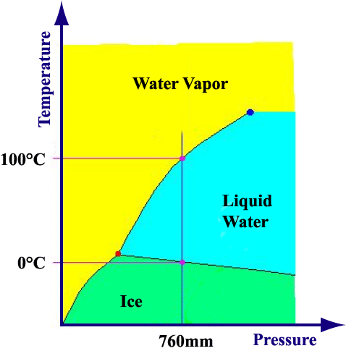
Notes:
By changing the temperature and pressure, the matter can change from one phase to another.

Slide 5
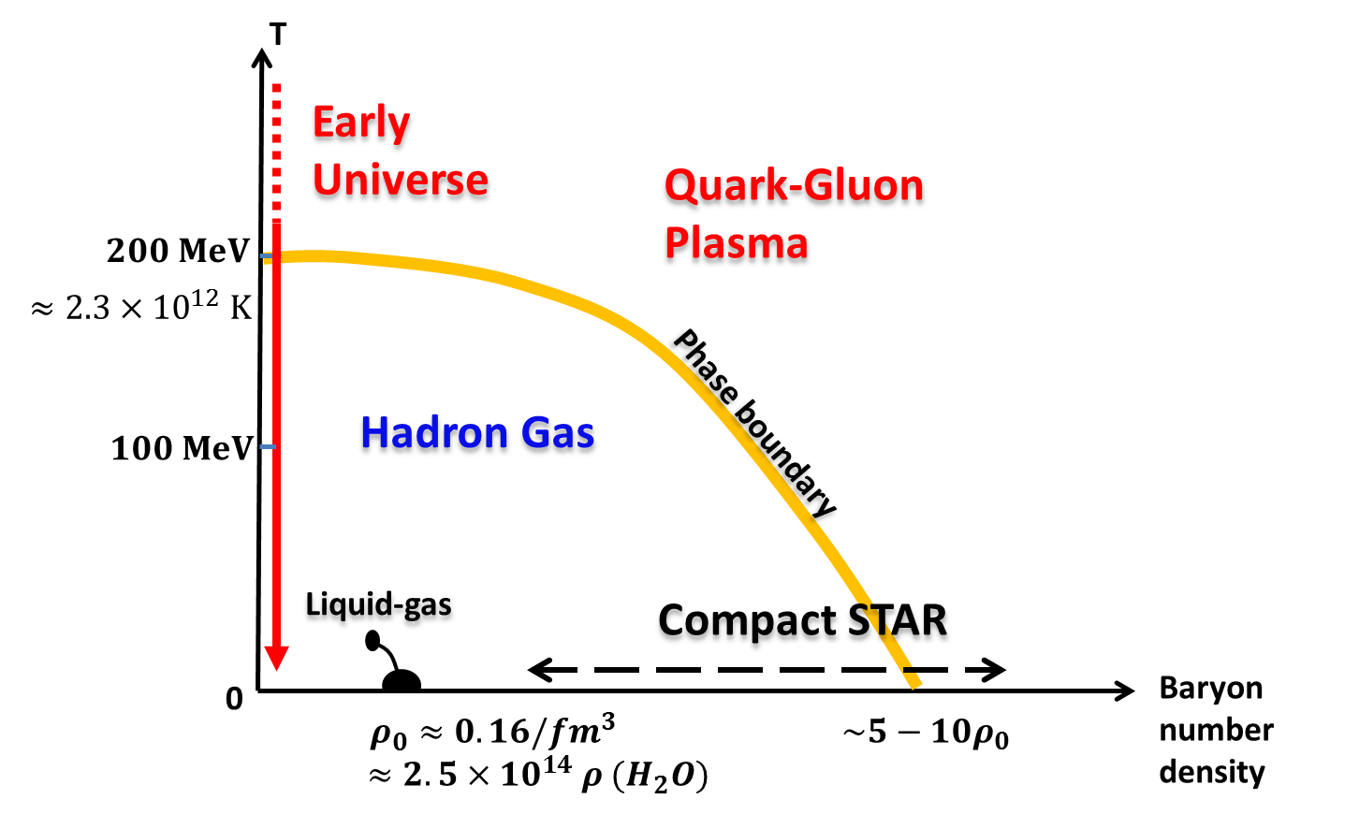
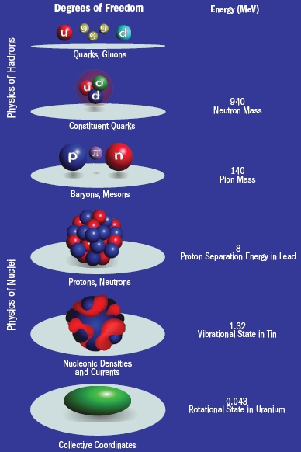
Nuclear Matter Phase Diagram Schematics
Notes:
We can apply the same strategy to nuclear matter.
Introduce the scale. 200 MeV = 2.3x10^12 K, 2.3 trillion kevin, rho0 = 2.5x10^17.
We are living in an area too tiny to be visible in this diagram.
Walk though x-axis first, introduce liquid-gas transitioin, PURDUE group pioneered in this discovery.
walk through y-axis.
At higher temperature, the heat overcome the binding energy and break up the nuclear and form hadron gas.
What’s the difference between hadron gas and quark-gluon plasma.

Slide 6

Nuclear Matter Phase Diagram Schematics
Hadron:
Baryon
  3 quarks
  Proton (uud), neutron (udd)
meson
  1 quark and 1 antiquark
  $π^{+}\left(u\overline{d}\right), D^{0} \left(c\overline{u}\right), B^{+}(u\overline{b})$
Quarks:
up, down, strange,
charm, bottom, top
  Heavy flavor
Gluons:
Force carrier of strong interaction.
Self-interacting
Quantum Chromo-dynamics (QCD).
The theory of strong interactions.
Notes:
Call attention to the D0 and B+ mesons

Slide 7
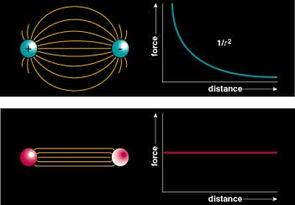
Quarks are Confined inside Hadrons
QED
charges can be free
QCD
quark
anti-quark

Slide 8
Quarks are Confined inside Hadrons
meson
meson
meson
It takes ever more energy to increase the separation between quarks. Color strings fragment into new pairs of quarks. Single quarks are confined inside hadrons.

Slide 9
Nuclear Matter Phase Diagram Schematics
Notes:
Like the phase diagram to relate the water, vapor and ice phase in temperature vs. pressure.
Introduce the scale. 200 MeV = 2.3x10^12 K, rho0 = 2.5x10^17.
We are living in an area too tiny to be visible in this diagram.
Walk though x-axis first, introduce liquid-gas transitioin, PURDUE group pioneered in this discovery.
walk through y-axis.
What’s the difference between hadron gas and quark-gluon plasma.

Slide 10
QGP and QCD Asymptotic Freedom
A feature of QCD:
Interaction between quarks and gluons become weaker when they are closer to each other
Theory by:
David Gross
H. David Politzer
Frank Wilczek
QGP can be realized by increasing
Temperature, energy density
Baryon density
Notes:
Unique feature of QCD
Hadron gas at the beginning.
When system become more dense, the distance between quark and gluons are so close, the hadron boundary disappears.
Quark and gluon can roam anywhere in a system much larger then a single hadron. That system is QGP.

Slide 11

One Way to Increase Temperature or Pressure
Small “Bang”
Heavy alien object hits the heavy earth
Tremendous kinetic energy converted into tremendous heat and pressure.

Slide 12
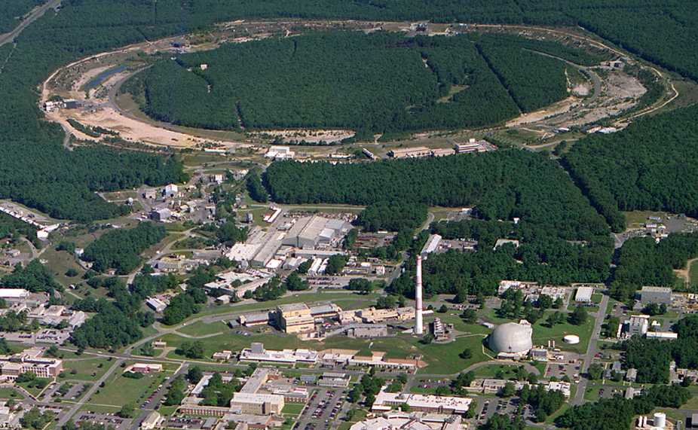
Relativistic Heavy Ion Collider
Brookhaven National Laboratory (BNL), Upton, NY
PHOBOS
BRAHMS
RHIC
PHENIX
STAR
v = 0.99995⋅c = 186,000 miles/sec
Au + Au at 200 GeV
AGS
- RHIC: high-energy
heavy-ion collider
(i) Dedicated QCD collider
(ii) √s_{NN} = 5 - 200 GeV
(iii) p, d, Cu, Au, U
TANDEMS
Notes:
Linac: 200 MeV
Booster synchrotron (2 GeV)
Alternating Gradient synchrotron : 10 GeV
RHIC: 200 GeV

Slide 13

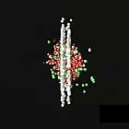
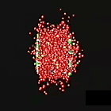
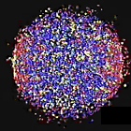
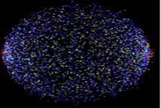
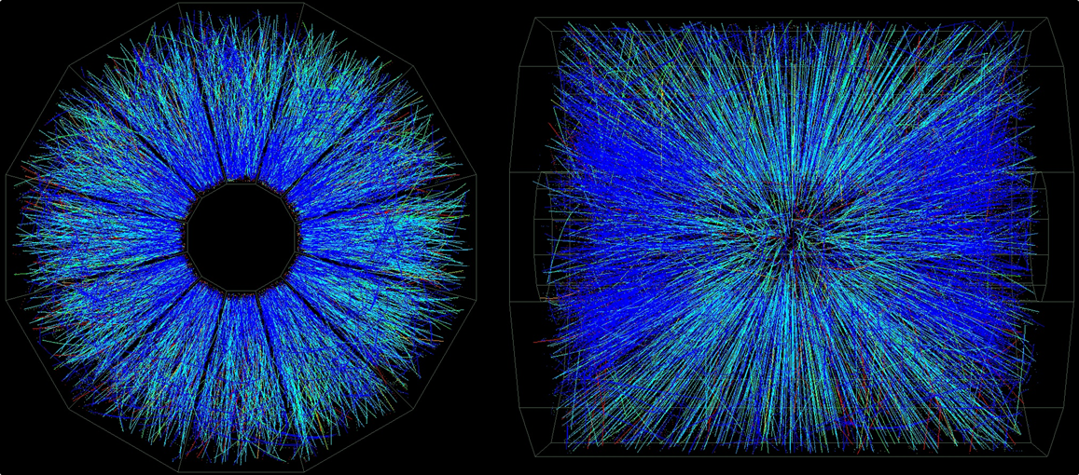
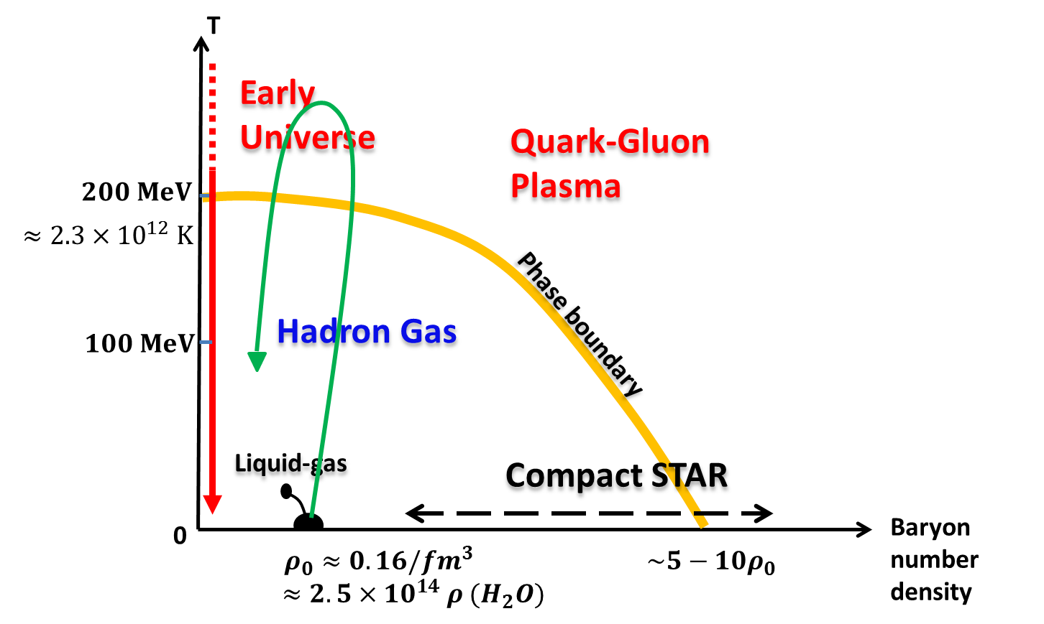
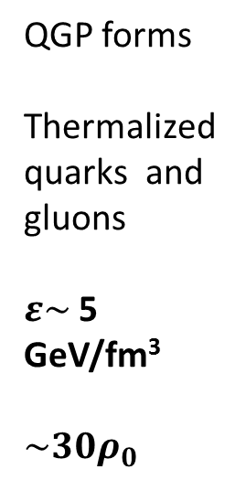


A High Energy Gold-Gold Collision: “Mini-Bang”
Gold ions are spherical
$$γ \sim 100 @$$
$$\sqrt{s_{NN}}\text{ = 200}\text{GeV}\text{,}$$
Size contract by ~100 along beam direction
$E=mc^{2}$
Quarks and gluons are generated or liberated
Pre-equilibrium
QGP forms
Thermalized
quarks and gluons
$ε\sim$ 5 GeV/fm³
$\sim 30ρ_{0}$
QGP expands and cools down
Quarks and gluons are confined into hadrons, “Freezout”
Fly into detectors.
Notes:
At “Freezout”, particle do not interact with each other anymore, fly into detector
Quarks and gluon star to stretch away from each other and form hadrons
RHIC will shed light on the state of the early universe

Slide 14
Heavy and Light Probes
Before collision
Start collision
QGP formation
Expansion
Freezout
flavors | mass (MeV)
charm | ~1270
bottom | ~4200
up | ~3
down | ~5
strange | ~100
Light probes:
Produced anywhere before “freeze-out”.
Probing the bulk properties of QGP.
Results from light probes
Large attenuation of high p_{T} hadrons
Large collective flow
Heavy probes:
Produced in initial hard collisions
Rare but clean probe for early stage of QGP.
Notes:
Almost all hadrons are from light quarks.
Transit from last slide →two of the main probes are heavy and light probe.
Light quarks can be produced anywhere before “freezout” to study the bulk properties of the medium. Heavy quark are produced mostly from initial hard scattering to study early stages of the medium which is most interesting.
Majority of light quark mass are from confinements which put on a gluon dress to the quarks.
Almost all heavy quark masses are from interaction with higges boson. Not affected by the later stage of the medium evolution. It’s clean.

Slide 15
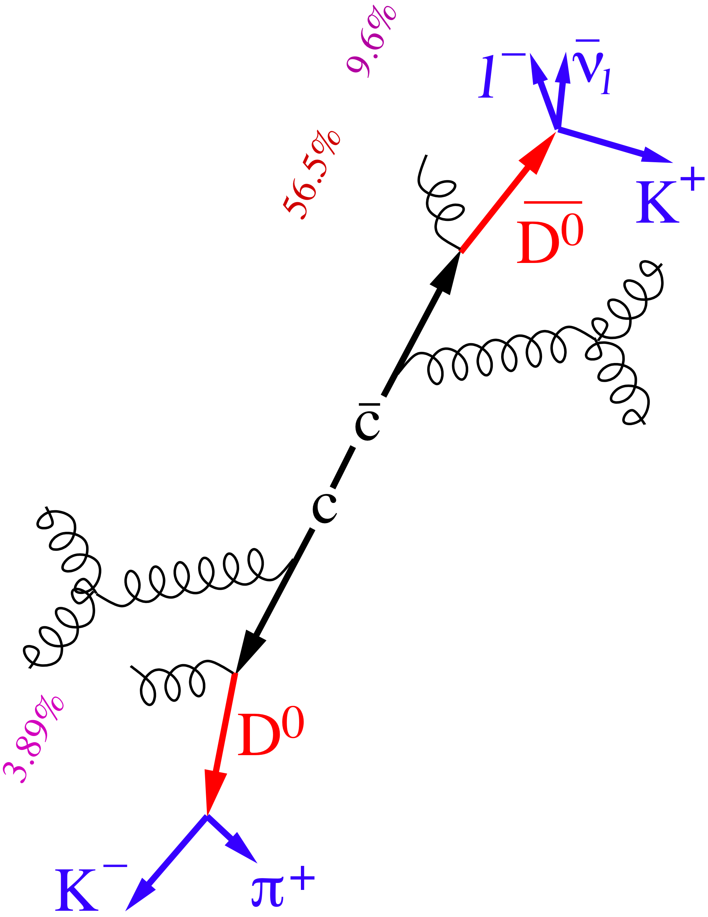

How to Measure Heavy Quarks
Non-photonic electrons
  large background
    Photonic
  difficult analysis
Proxy of heavy quarks
$$e^{−}$$
Direct reconstruction
  large background
    combinatorial
  difficult analysis
Heavy Flavor Tracker
Notes:
Difficult analysis because of backgrounds This is a busy diagram. The first thing to point out is where the heavy quarks are – c – cbar!
What’s a photonic electron
NPE is a mixture of charm and bottom decay electrons.

Slide 16
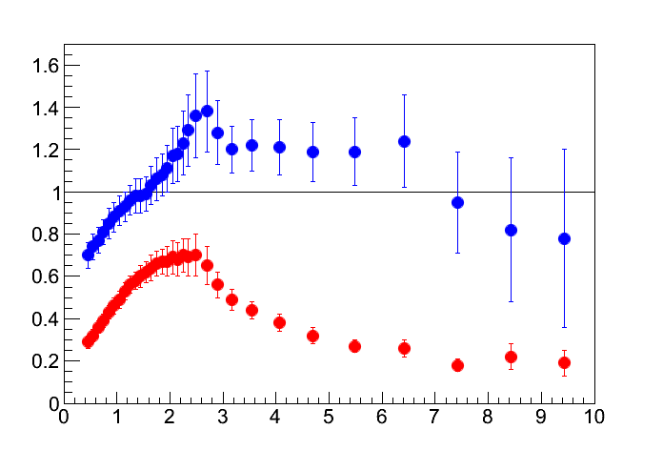
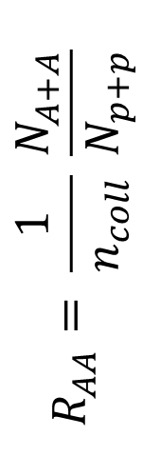
Attenuation of High pT Light Hadrons in QGP
Peripheral Collisions
Central Collisions
$$R_{AA}= \frac{1}{n_{coll}} \frac{N_{A+A}}{N_{p+p}}$$
Transverse momentum (pT: GeV)
Large suppression of high pT light hadrons in head-on collisions
Notes:
Two results, blue =1 w/o attenuation. Red: <1 attenuation.
Results is quantified by R_AA. I will explain in the next a few slide how we measured this.

Slide 17

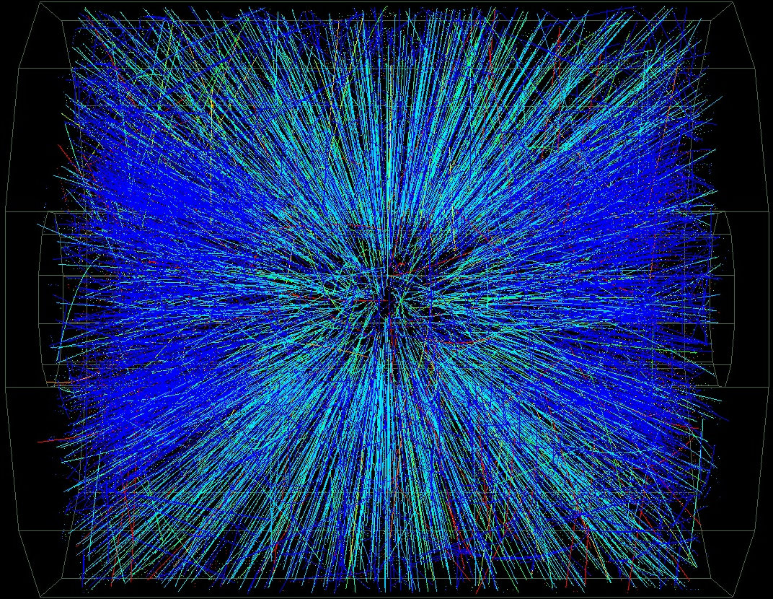
Control the Size of QGP.
y
z
x
Notes:
To study more details of QGP, we need to vary the size of the system.

Slide 18
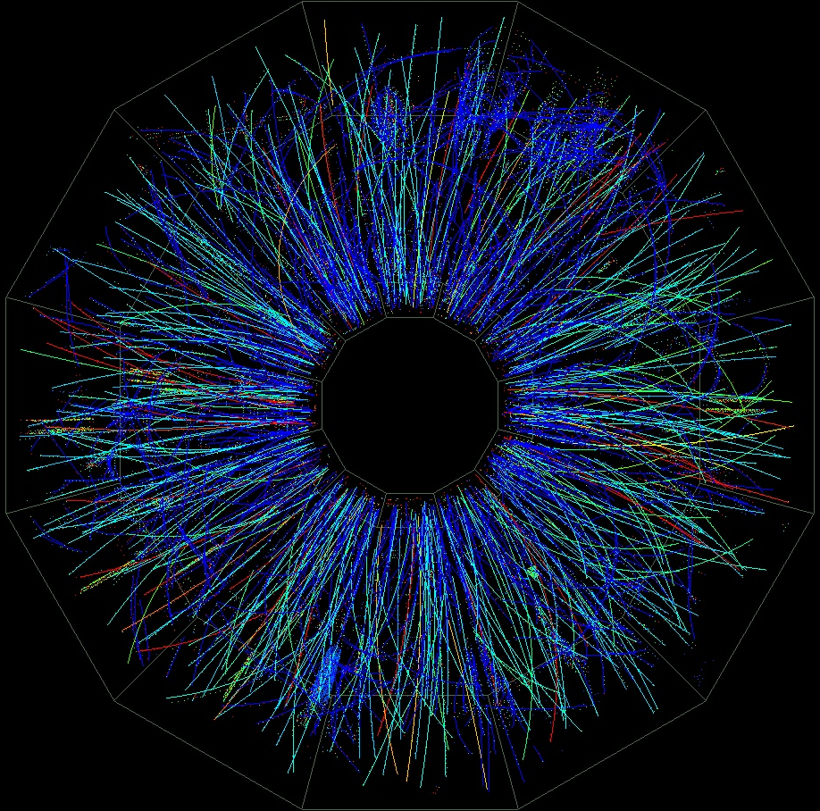
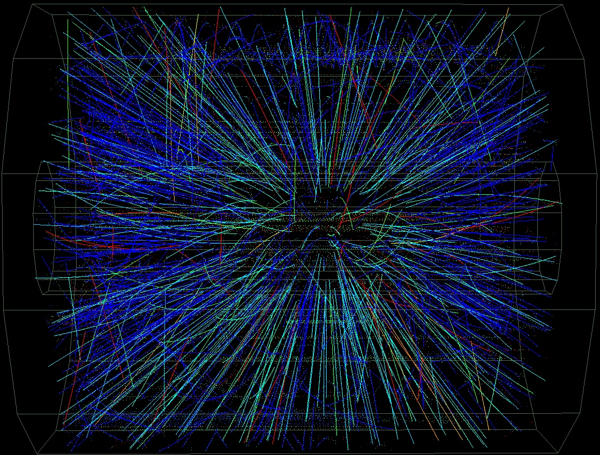
Control the Size of QGP.
y
y
z
x
z
x
Notes:
To study more details of QGP, we need to vary the size of the system.

Slide 19
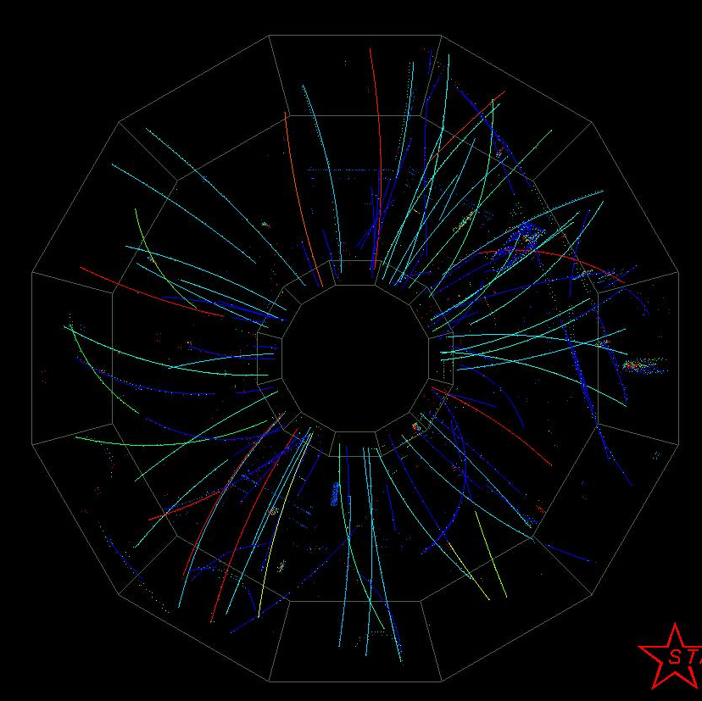
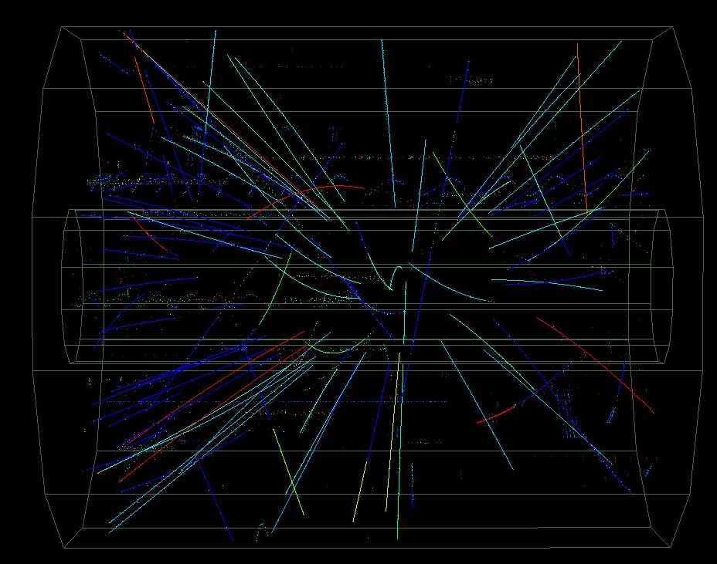
Control the Size of QGP.
y
z
x
Notes:
To study more details of QGP, we need to vary the size of the system.

Slide 20
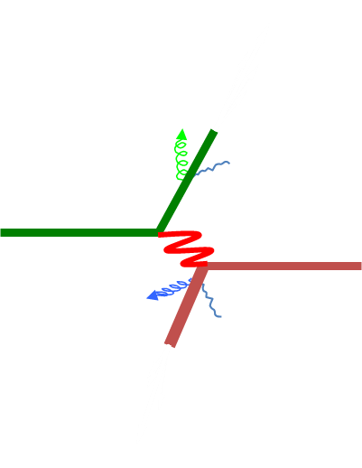
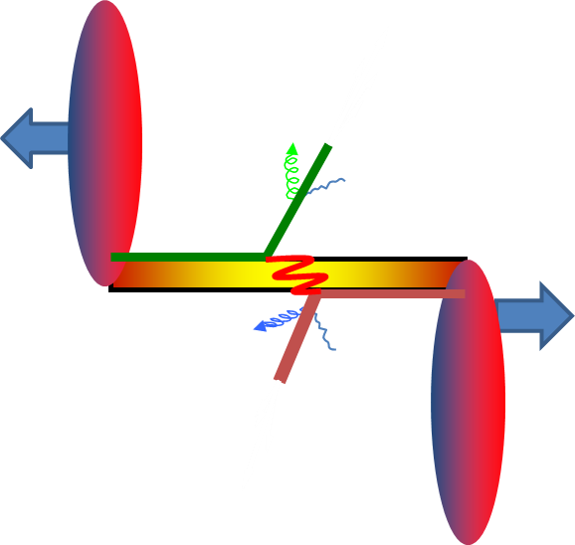
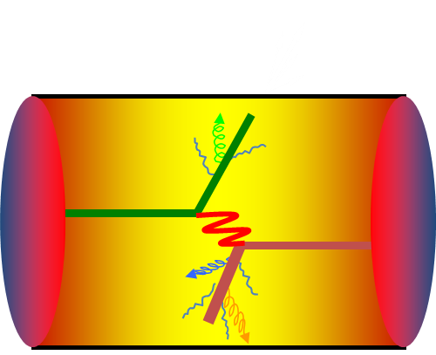
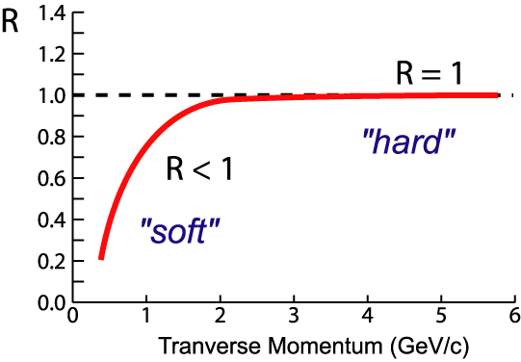


Quantifying the Energy Loss in QGP
p + p Au+Au peripheral Au + Au central
$$R_{AA}$$
Nuclear Modification Factor:
$$R_{AA}= \frac{1}{n_{coll}} \frac{N^{Au+Au}}{N^{p+p}}$$
$n_{coll}$: number of nucleon-nucleon collisions

Slide 21
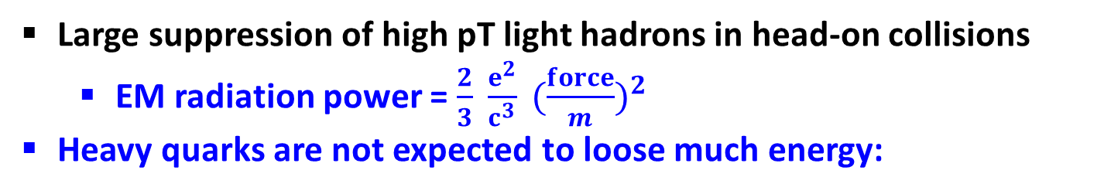
Energy Loss of Light Hadrons in QGP
R_{AA}
peripheral collision
Transverse momentum (p_{T}: GeV)
central collision
Large suppression of high pT light hadrons in head-on collisions
  EM radiation power = $\frac{2}{3} \frac{e^{2}}{c^{3}} ({\frac{force}{m})}^{2}$
Heavy quarks are not expected to loose much energy:
Notes:
Might be useful to add captions to the cartoons at right: peripheral collision, central collision.
You will have to explain why low pt is different than high pt.

Slide 22
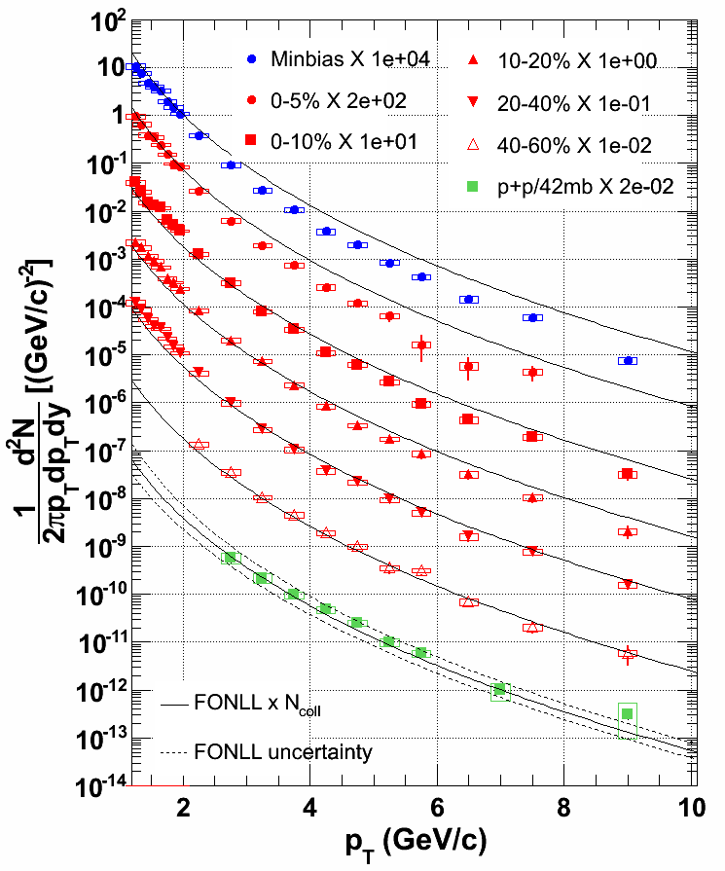
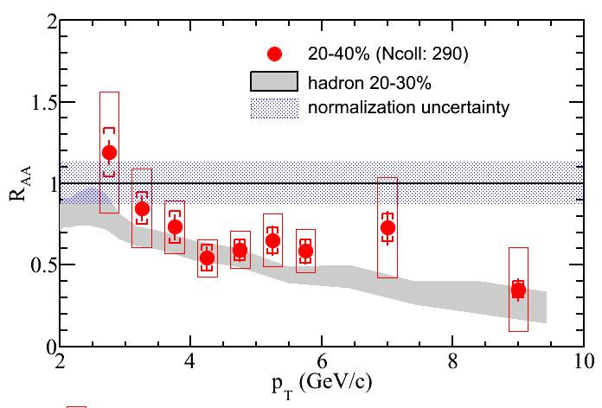
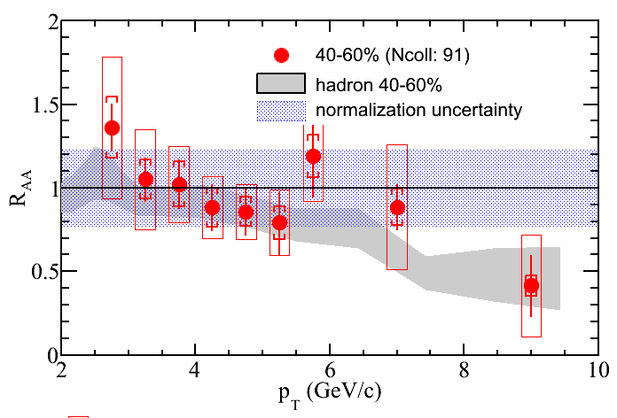
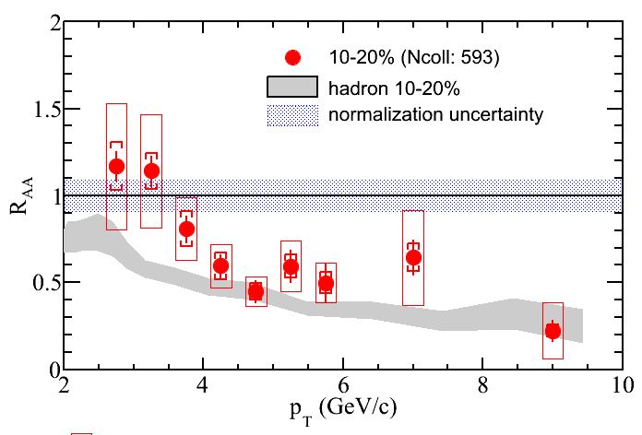
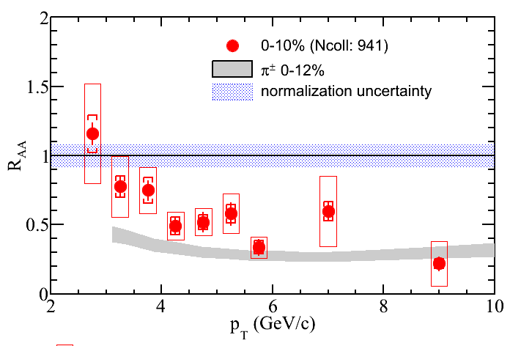
Non-photonic Electron Production
~ 6 billion Au+Au collisions.
~200 billion p+p collisions.
M. Mustafa
X. Li
pQCD
pQCD
Heavy flavor probes suppressed to the level of light hadrons
big surprise
W. Xie et al., Nuclear Physics A 855, 108 (2011)
STAR collaboration, Phys. Rev. D 83, 052006 (2011)
W. Xie et al., Quark Matter 2012
Notes:
What is the “take home message from this slide? It might be good to have that appear after you walk the audience through both figures. Might be useful to remind people of slide 16 results. Flash it up again.

Slide 23
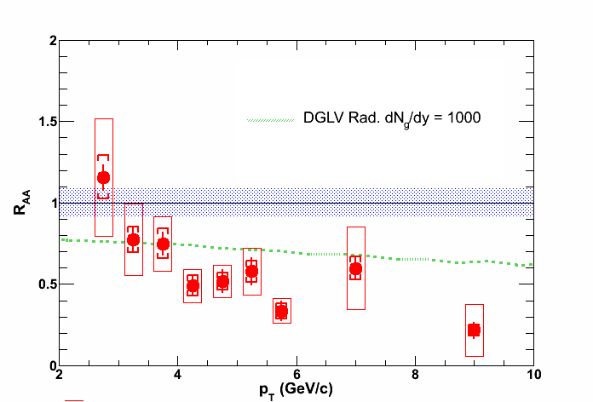
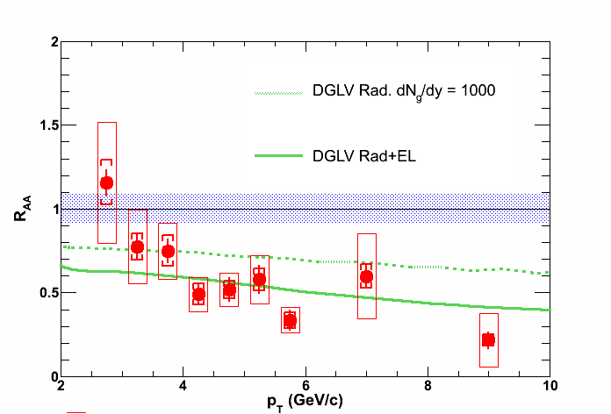
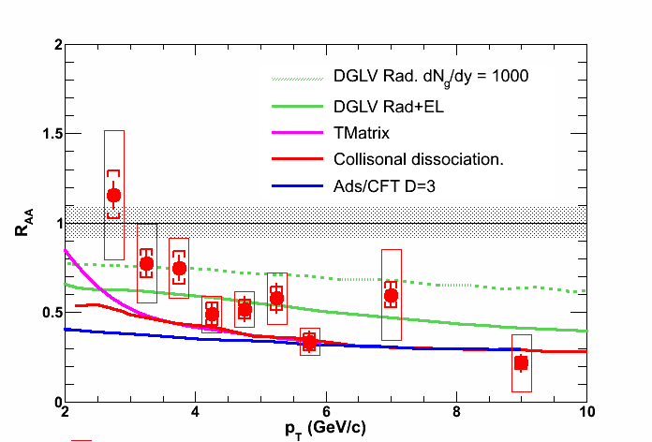
More Energy Loss Mechanisms are Needed
Radiative energy loss alone can not explain the data
Need both radiative and elastic energy loss to describe the data.
Novel mechanisms, e.g. AdS/CFT, try to describe the data
More differential measurements, e.g. separate charm and bottom.
Notes:
Using models for AdS/CFT correspondence (anti de Sitter/conformal field theory correspondence).
the weak coupling o.f the string theory is dual to the strong-coupling limit of the quantum field theory
An example is the duality between Type IIB string theory on AdS₅ × S⁵ space (a product of 5-dimensional AdS space with a 5-dimensional sphere) and a N=4 super Yang-Mills gauge theory (which is a conformal field theory) on the 4-dimensional boundary of AdS₅.

Slide 24
Large attenuation of high p_{T} hadrons
  For both light and heavy probes
Large collective flow
y
z
x
Reaction plane

Slide 25

φ
momenta pointed at random
relative to reaction plane
N
$v_{2}= <cos\left(2Φ\right)>$ $=0$
0
π/4
π/2
3π/4
π
Φ (rad)
Notes:
Quarks and gluons are initially produced randomly. If there’s no interaction among them, their final direction will be iostropic.

Slide 26
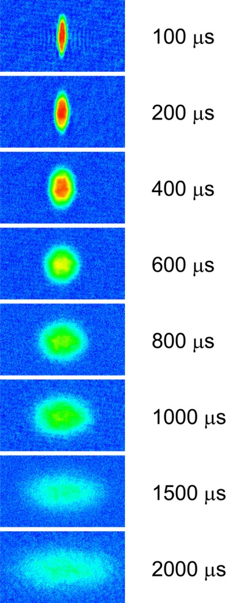
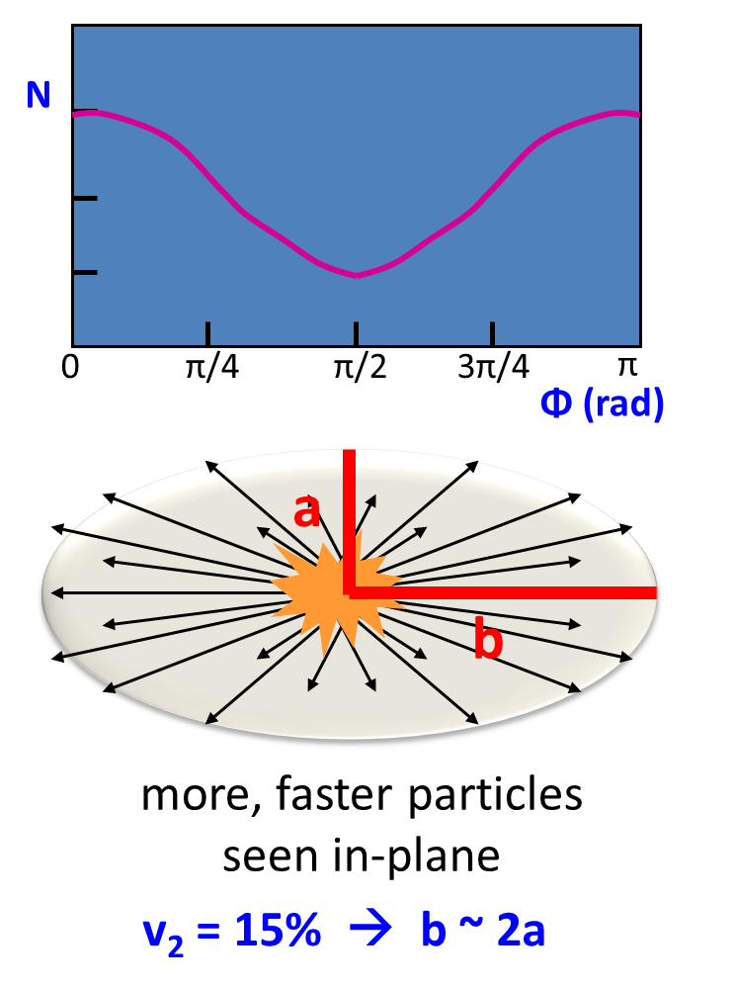
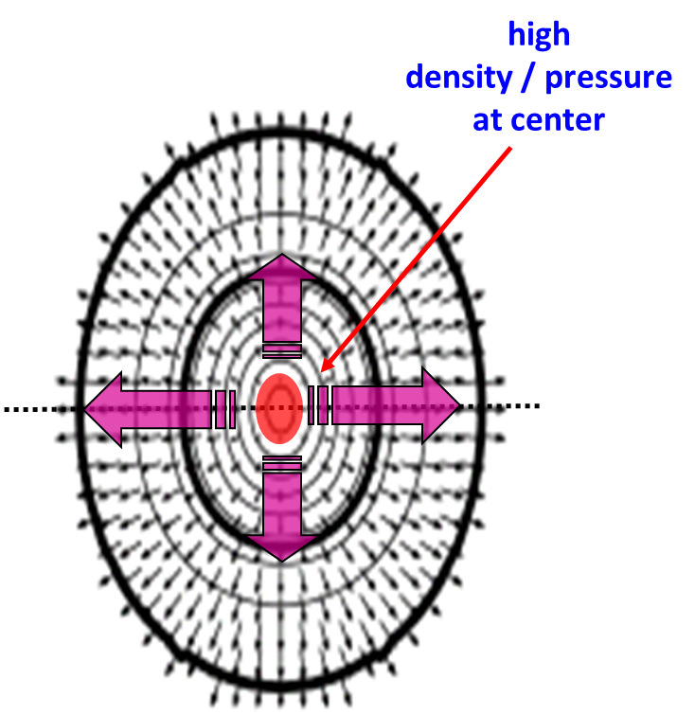
Elliptic Flow: the Collective Behavior of QGP
Strong interaction between constituents
“Observation of a strongly interacting degenerate Fermi gas of atoms”, Science. 2002
Notes:
Semi-major and semi-minor axis
Put 300 million lithium 6 atoms in the tiny cigar-shaped trap (laser trap) and cool it down to very low temperature (1 billionth of a degree above absolute zero) and let it expand. The system expand mostly in one direction.

Slide 27
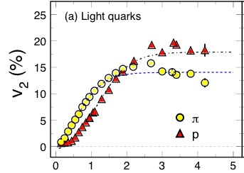
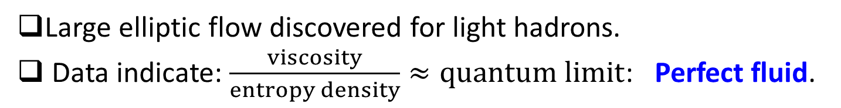
Elliptic Flow Measurements
Transverse momentum (p_{T}: GeV)
Large elliptic flow discovered for light hadrons.
Data indicate: $\frac{viscosity}{entropy density}≈quantum limit$: Perfect fluid.
Notes:
At trillioins of degree, wesee the same phenomena.
Close to the conjectured quantum limit from string thory.

Slide 28

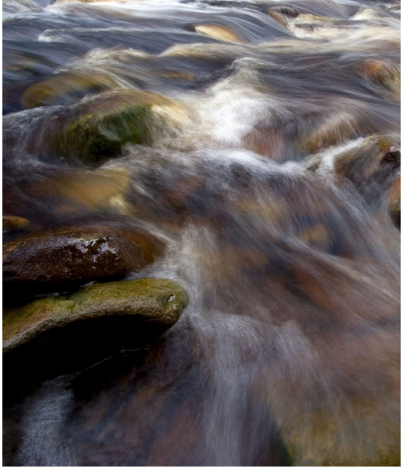
Heavy Quark Flow
Heavy Quark is 100~1000 times heavier than light quark
Expect much less or zero flow
USS John F. Kennedy
Notes:
Flowing stream
A piece of feather
Stone will sink and stay there
Is QGP like a flowing stream or like a tsunami.

Slide 29
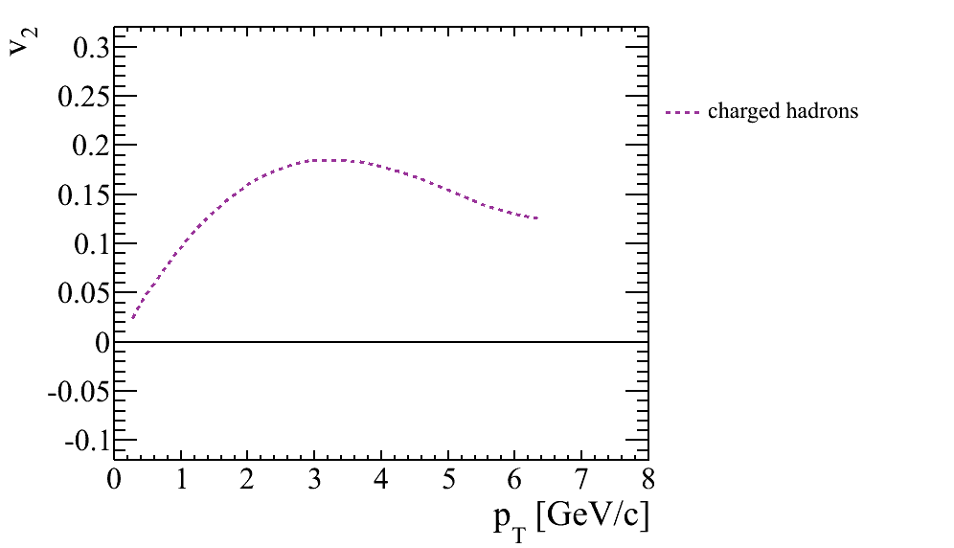
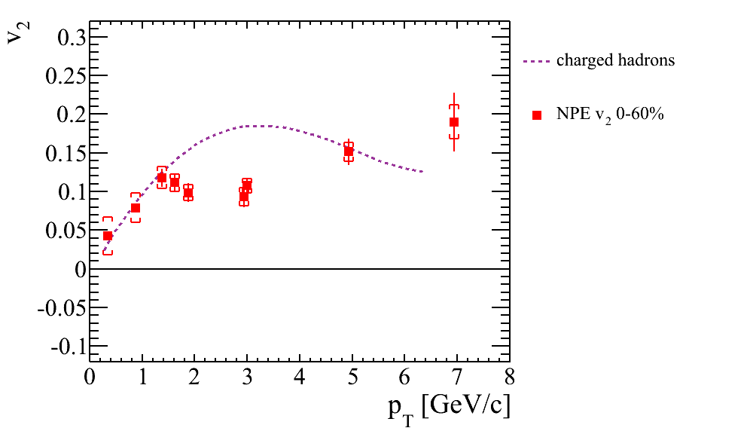
Is the flow Strong Enough to Move Heavy Quarks
Light hadrons
Non-photonic electron v₂
Au+Au 200 GeV
Large non-photonic electron v₂ observed at low p_{T}→strong charm-medium interaction
Notes:
95% of the yield are at pT < 1.5 GeV/c. Where NPE v2 is as large as light hadrons.

Slide 30
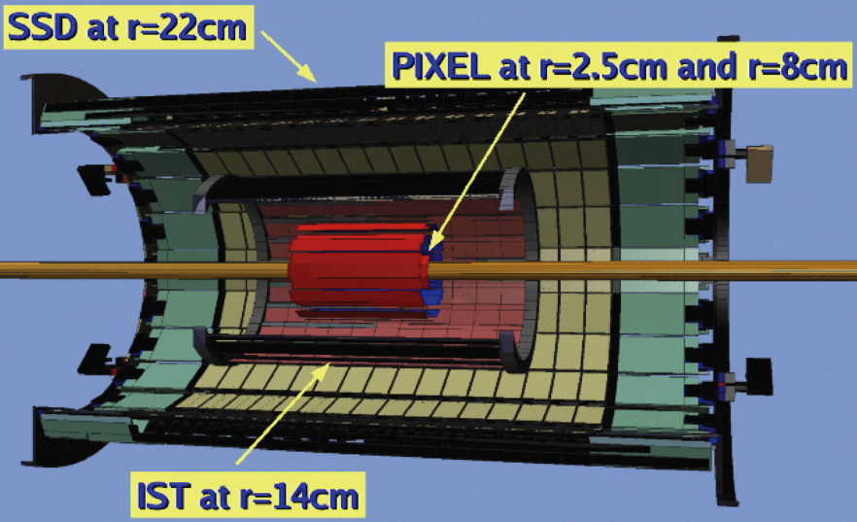

Upgrade Project: Heavy Flavor Tracker (HFT)
$$e^{−}$$
HFT dramatically reduce background
  Precision measurements
Bottom meson lives longer than charm meson
  Disentangle charm and bottom
A few hundred microns

Slide 31
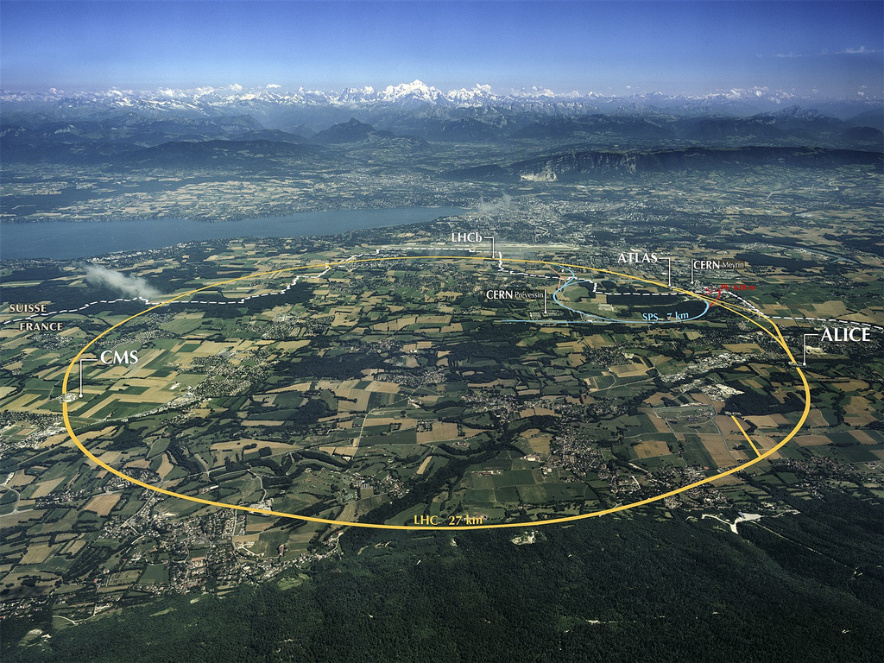
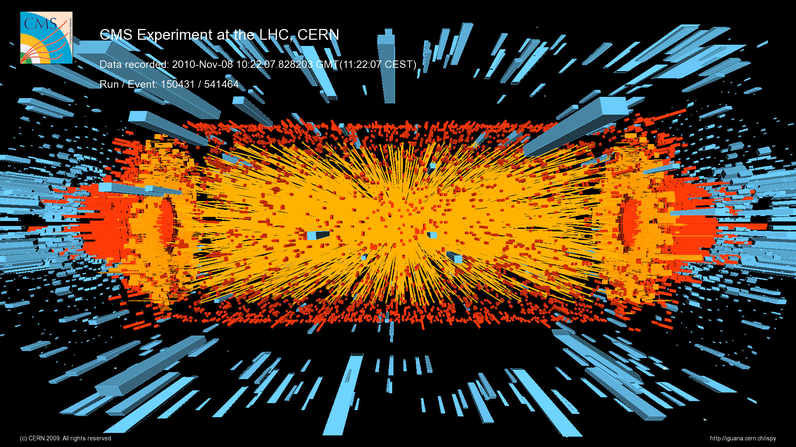

Study QGP at Higher Temperature
Temperature of QGP :
T(LHC) $≈$ 1.3$\sim$2xT(RHIC)
Number of charm quarks
N(LHC) $≈$ 10 x N(RHIC)
Number of bottom quarks
N(LHC) $≈$ 100 x N(RHIC)

Slide 32
Conclusions
Heavy-ion collisions explore the deconfined state of quarks and gluons.
Heavy flavor: unique probe to QGP
  Challenge theory/model to do better
  further our understanding of QCD.
More exciting results to come in near future from RHIC and LHC.

Slide 33
Backups

Slide 34
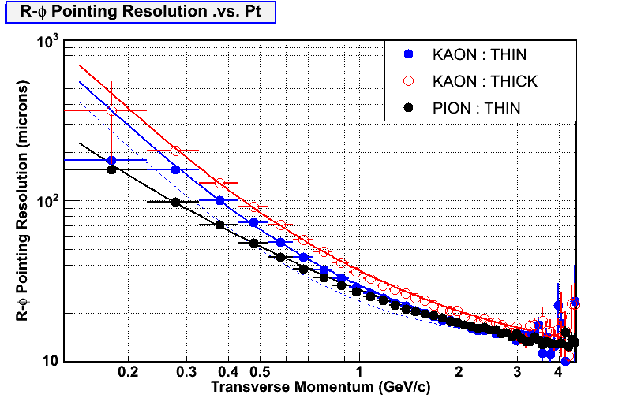
Pointing resolution in r-φ
0.37%
0.52%
<~40 μm
Points : full GEANT simulation : detector geometry+ STAR tracking
Line : hand calculation : MCS + hit resolution
➔Pointing resolution is crucial to distinguish/measure displaced vertex

Slide 35

Heavy Flavor Tracker (HFT)
HFT
Detector | Radius (cm) | Hit Resolution R/ϕ - Z (μm - μm) | Radiation length
SSD | 22 | 30 / 860 | 1% X₀
IST | 14 | 170 / 1800 | 1.32 %X₀
PIXEL | 8 | 8 / 8 | ~0.37 %X₀
 | 2.5 | 8 / 8 | ~0.37% X₀
SSD
IST
PXL
PIXEL
double layers
18.4x18.4 μm pixel pitch
2 cm x 20 cm each ladder
10 ladders, delivering ultimate pointing resolution.
new active pixel technology
SSD
existing single layer detector, double side strips (electronic upgrade)
IST
one layer of silicon strips along beam direction, guiding tracks from the SSD through PIXEL detector. - proven strip technology
Prototype for run2013 and complete for run2014
Notes:
CMOS sensors developed by IPHC Strasbourg
Radiation tolerance ~300 krad. 1 rad = 0.01 J/kg
Each APS sensor size ~2cm x 2cm.
Heat dissipation 100 mW/cm^2 from pixel chip, or 160 W for the whole PIXEL detector.
80 W for ladder signal drivers.
Temperature of operation: best at 0 C and can go up to 34 C w/o too much noise degradation. Goal is to operate at 24 C, ~STAR HALL temperature.
Air cooling.

Slide 36

Comparison with Model Results
➔ Small value of specific viscosity over entropy η/s
➔ Model uncertainty dominated by initial eccentricity ε
Model: Song et al. arXiv:1011.2783

Slide 37



KSS Bound from String Theory
“A Viscosity Bound Conjecture”,
P. Kovtun, D.T. Son, A.O. Starinets, hep-th/0405231

Slide 38

Viscosity ~ mean free path
  Small viscosity ➔ Small λ_{mfp}
  Zero viscosity ➔ λ_{mfp} = 0 (!)
  Kinematic viscosity η / ρ
  is what matters
For a relativistic system:
η/ρ → η/(ε + p ) → (η/sT) = (η/s) (1/T)

