Slide 1
Please Fill the online Course evaluation.
http://www.purdue.edu/eval/
We now have 73 responses
Survey close on 04/30
This is the official survey requested by university

Slide 2
Final Exam
* Friday: 05/05 in 7:00pm - 9:00pm in WTHR 200
* Chapters: all chapters but focus on 19, 20, 21, 22, 23 (4th edition)
* Makeup exam.
.approve only for valid reasons.
. If you need a makeup, please send me a request together with supporting
documents by 04/24 (Monday).
. Any requests after that will not be approved.
* Special needs
. If you has not contact me before, please bring me the letter from the Office
of the Dean of Students by 04/24 (Monday).
. Any request after that will not be approved.
* AOB
. multiple choice.
. Prepare your own scratch paper, pens, pencils, erasers, etc.
. Use only pencil for the answer sheet
. Bring your own calculators: graphic or scientific
. No cell phones, no text messaging which is considered cheating.
. No crib sheet of any kind is allowed. Equation sheet will be provided.
. 20 problems in total.

Slide 3
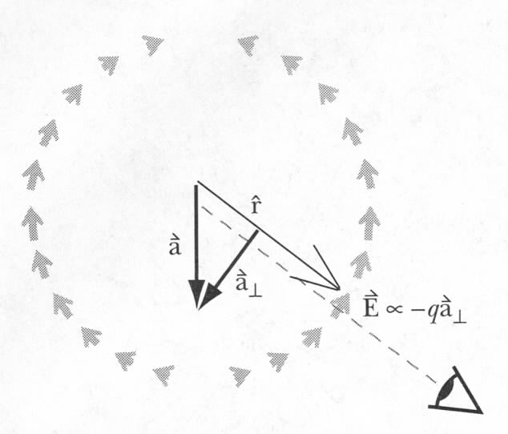
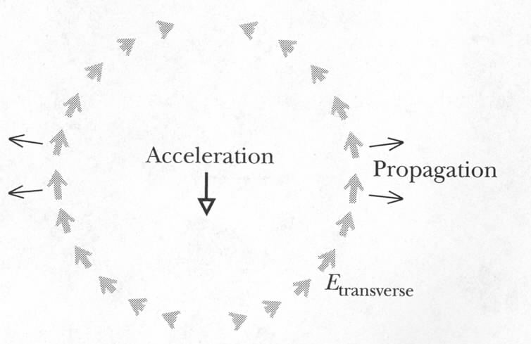
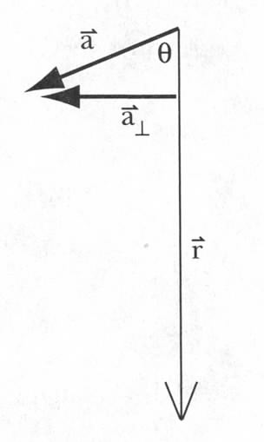
Magnitude of the Transverse Electric Field
We got the direction.
Magnitude can be derived from Gauss’s law*
Field ~ -qa⊥
1. The direction of the transverse
field is opposite to qa⊥
2. The electric field falls off at a rate 1/r
* This was first shown by Edward Purcell, BSEE Purdue, Nobeal Laureate!
Notes:
Derivation is too complex for this course
Kink in the electric field
Much slower than 1/r² – makes it possible to affect matter that is very far from the accelerated charges – that is why we see very distant stars.
Quali

Slide 4
Energy Flux: The Poynting Vector
The direction of the E/M radiation was given by
Energy flux, the “Poynting vector”:
John Henry
Poynting
(1852-1914)
S is the rate of energy flux in E/M radiation
It points in the direction of the E/M radiation
Note energy flux = [Energy/(time * Area)]
Energy flux = Intensity = [Power/Area] Same Thing!

Slide 5
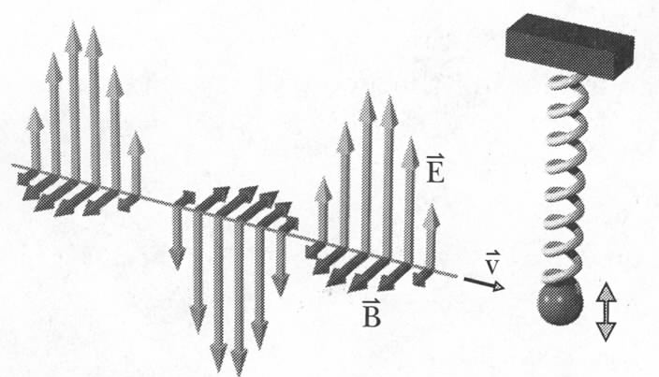
Momentum Flux
Net momentum:
in transverse direction: 0
in longitudinal direction: >0
Relativistic energy:
Quantum view: light consists of photons with zero mass:
Classical (Maxwell): it is also valid, i.e. momentum = energy/speed
Momentum flux:
Units of Pressure
Notes:
N/m² – units of pressure
S =[J/s/m^2}, so S/c = [N*m/(m^3)]=N/m^2

Slide 6
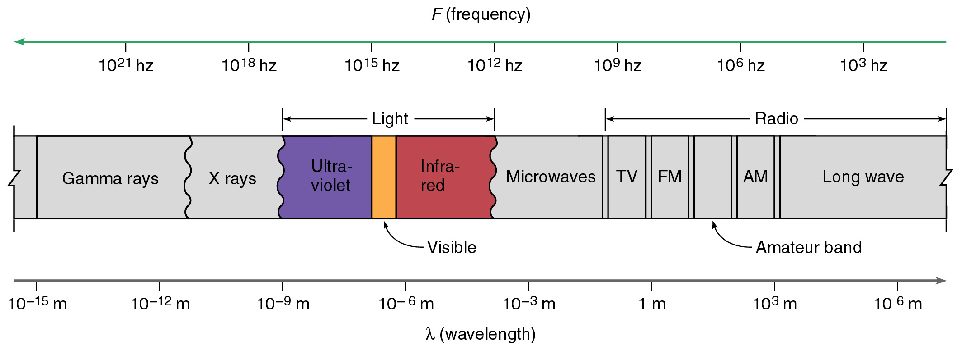
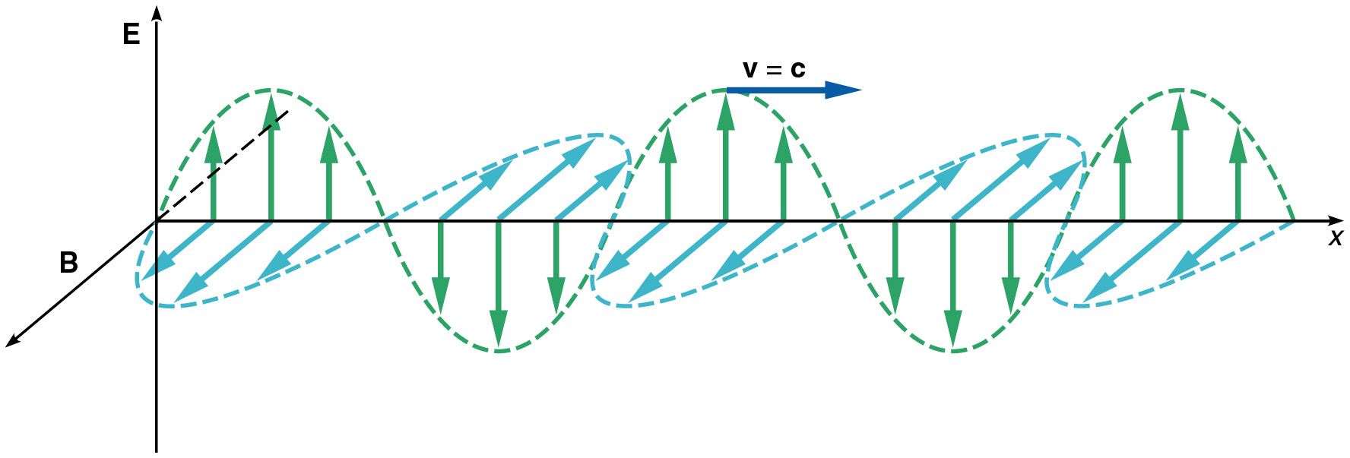
Electromagnetic Spectrum
Notes:
Microwave: not because it is used in microwave, but because it has ~micron wavelength
Visible – the whole spectrum from blue to red – the frequency barely changes twice!

Slide 7
Importance of Resonance
E/M radiation waves with frequency ~10⁶ Hz has big effect on mobile electrons in the metal of radio antenna:
can tune radio to a single frequency
E/M radiation with frequency ~ 10¹⁵ Hz has big effect on organic molecules:
retina in your eye responds to visible light but not radio waves
Very high frequency (X-rays) has little effect on atoms and can pass through matter (your body):
X-ray imaging
Notes:
Organic molecules – electronic system is in resonance with E/M frequencies corresponding to ‘visible’ light

Slide 8
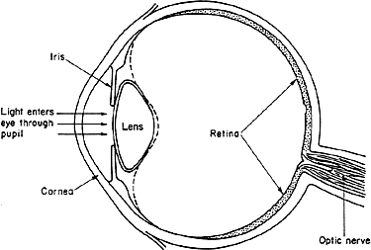
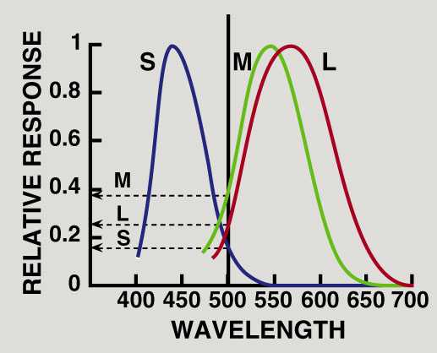
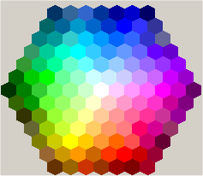
Color Vision
Three types of receptors (cones) in retina which incorporate three different organic molecules which are in resonance with red, green and blue light frequencies (RGB-vision):
Response spectra for three types of receptors
Max response wavelengths:
S – 440 nm (6.81.10¹⁴ Hz)
M – 540 nm (5.56.10¹⁴ Hz)
L – 560 nm (5.36.10¹⁴ Hz)
Refers to length of cone
Notes:
Microwave: not because it is used in microwave, but because it has ~micron wavelength
Visible – the whole spectrum from blue to red – the frequency barely changes twice!
Three types of rhodopsin receptors contain three different opsin molecules (red, green, blue)
Cone absorption spectra: peaks at 440, 540, 560 nm (Short, Medium and Long – type cones, three types of opsin in rhodopsin)
http://psychlops.psy.uconn.edu/swadlow/Senpart2.htm

Slide 9
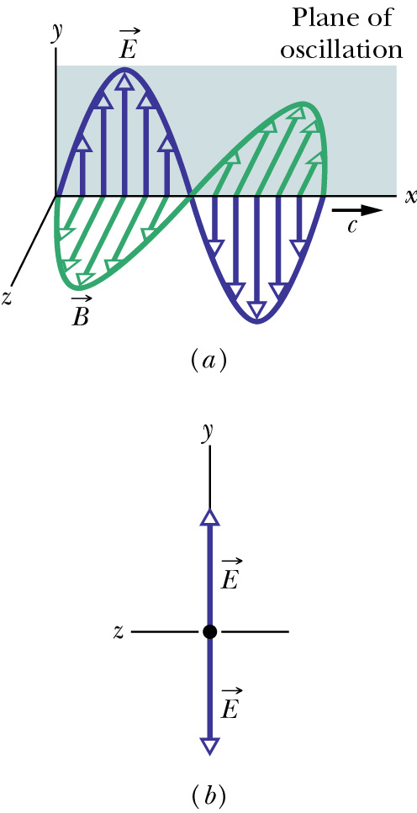
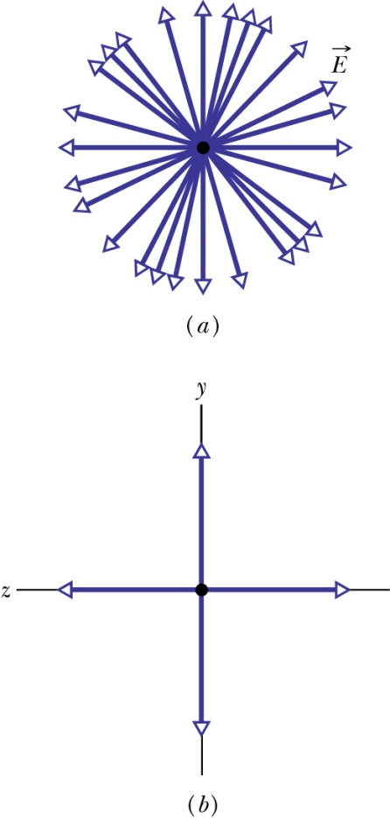
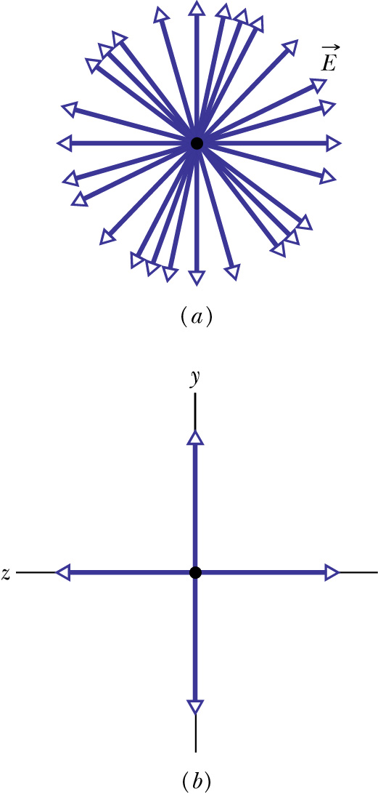
Polarization of Electromagnetic Waves
Polarization is a measure of the degree to which the electric field (or the magnetic field) of an electromagnetic wave oscillates preferentially along a particular direction.
Linear combination of many linearly polarized rays of random orientations
partially polarized
unpolarized
linearly polarized
components
Looking at E head-on
unequal y- and z-amplitudes
equal y- and z-amplitudes

Slide 10
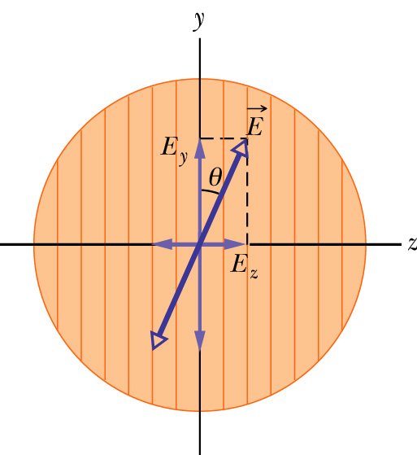
Polarizer: polarization by absorption
An electric field component parallel to the transmission axis is passed by a polarizer; a component perpendicular to it is absorbed.
transmission axis
dichroism (tourmaline, polaroid,…)
So if linearly polarized beam with E is incident on a polarizer as shown,
Zero if θ=π/2, I₀ if θ=0
If unpolarized beam is incident instead,
The intensity will reduce by a factor of two.
The light will become polarized along the transmission axis

Slide 11
iClicker Questions
A beam of un-polarized lights with intensity I is sent through two polarizers with transmission axis perpendicular to each other. What’s the outgoing light intensity?
½ I
2 I
0
1.5 I

Slide 12
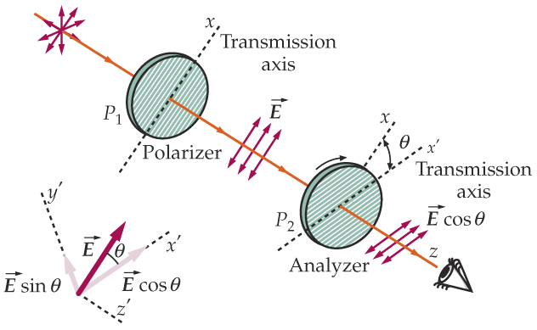
Example: two polarizers
This set of two linear polarizers produces LP (linearly polarized) light. What is the final intensity?
  P₁ transmits 1/2 of the unpolarized light:
  I₁ = 1/2 I₀
  P₂ projects out the E-field component parallel to x’ axis:
= 0 if θ = π/2
(i.e., crossed)

Slide 13
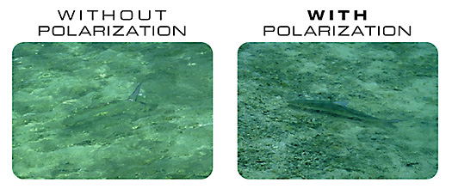
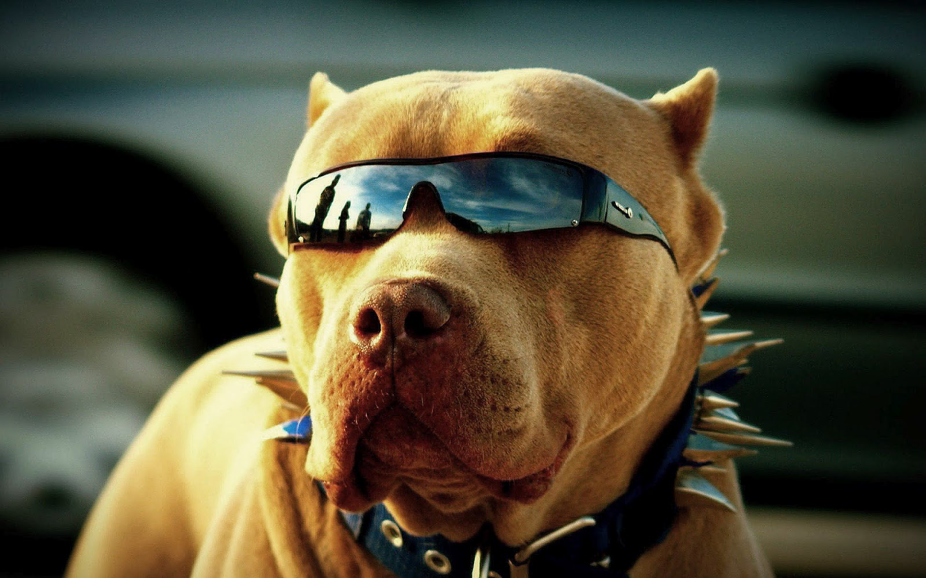
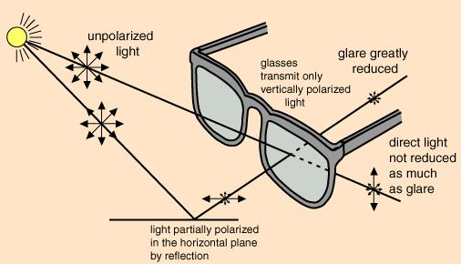
Polarized Light
Polaroid sunglasses and camera filters:
reflected light is highly polarized: can block it
Considered: using polarized car lights and polarizers-windshields
Notes:
Show trick with three polarizers – two crossed ones, add one at 45 degrees in the middle
Sheet of special plastic whose long molecules are aligned with each other
Sunglasses

Slide 14
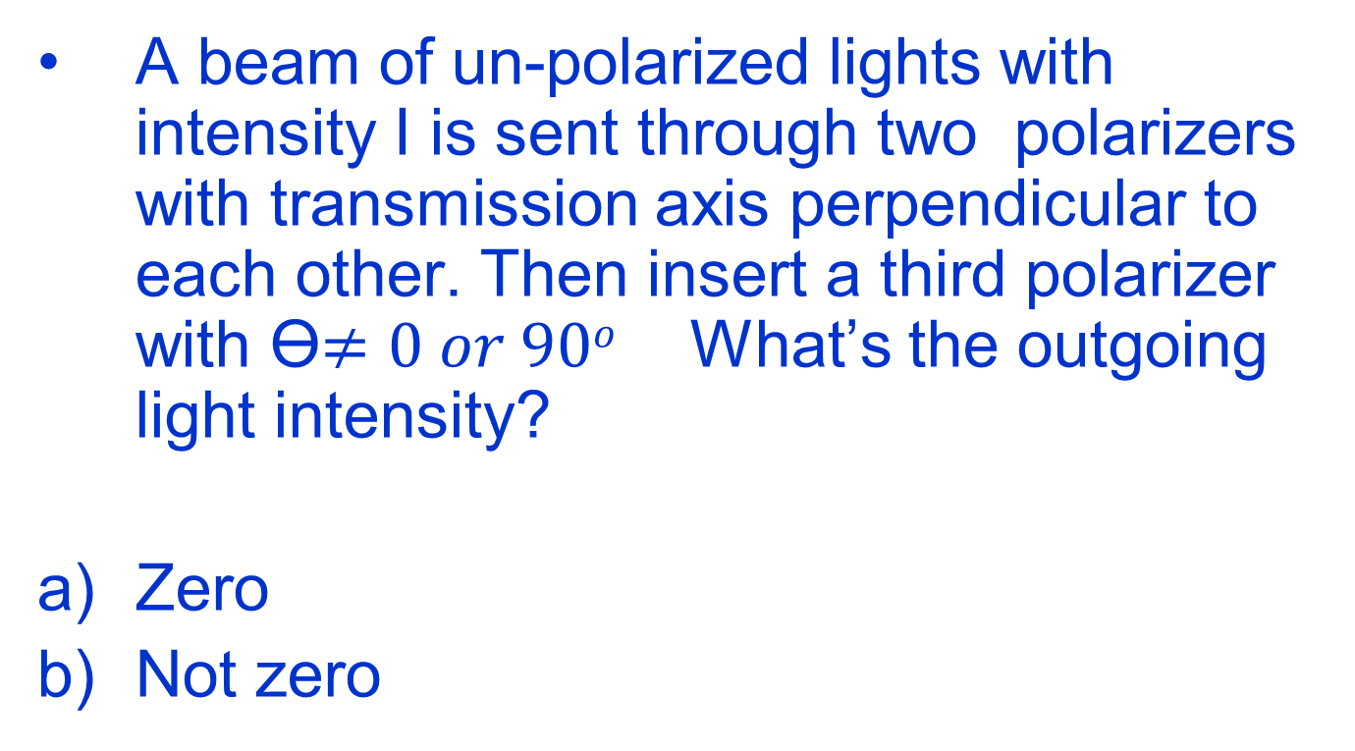
iClicker Questions
A beam of un-polarized lights with intensity I is sent through two polarizers with transmission axis perpendicular to each other. Then insert a third polarizer with ϴ$≠0 or 90o$ What’s the outgoing light intensity?
Zero
Not zero

Slide 15
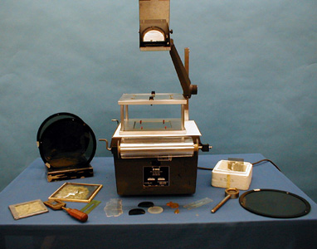
7B-22 Polarizer Effects

Slide 16
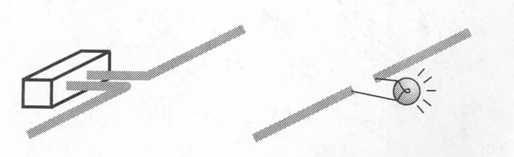
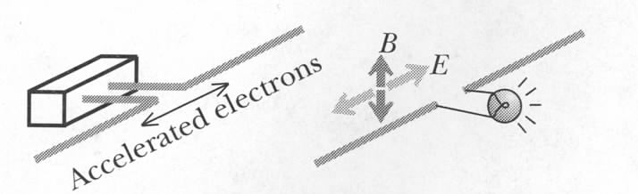
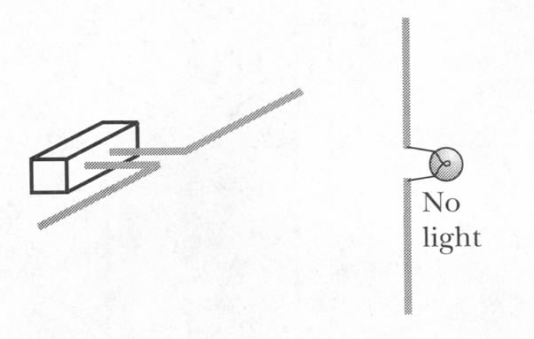
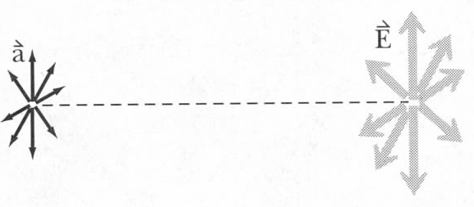
Polarized E/M Radiation
AC voltage
(~300 MHz)
What will happen if distance is increased twice?
E/M radiation can be polarized along one axis…
no
light
…and it can be unpolarized:
Notes:
At every single time E is of course in just one direction, but it changes randomly and rapidly over time
Light from the sun is not polarized!

Slide 17
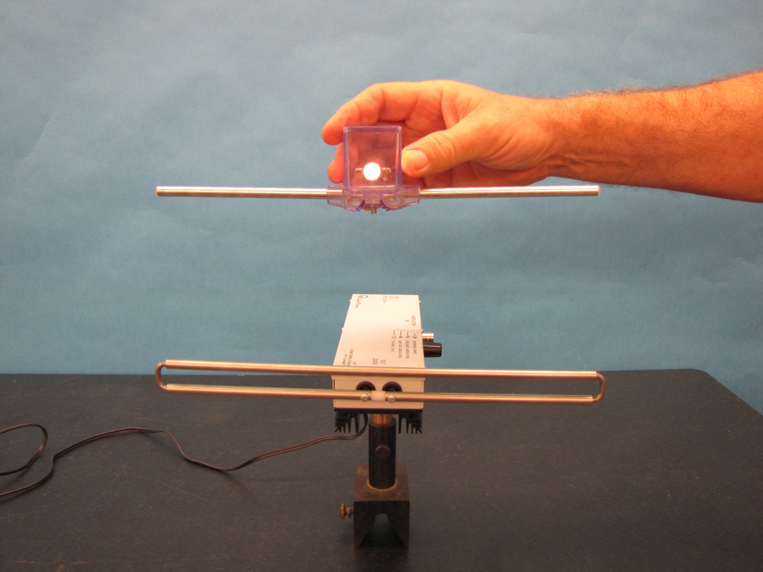
UHF Transmitter and Dipole Receiver (6D-17)
Notes:
Directions for doing the demo: Before powering the transmitter select the operating mode with the mode switch (preferably CW – continuous wave). Turn on the power to the transmitter. Move the receiver dipole close to the transmitter. The intensity of the lamp indicates the field strength of the signal. Move the receiver farther away and the light intensity diminishes. Rotate the receiver 90 degrees and the light goes out completely. Connect the receiver antenna to a voltmeter and you will get numerical readings indicating field strength of the signal.

Slide 18
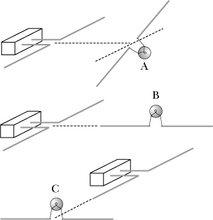
iClicker question
In which of these situations will the bulb light?
A
B
C
None
B and C
Notes:
A

Slide 19
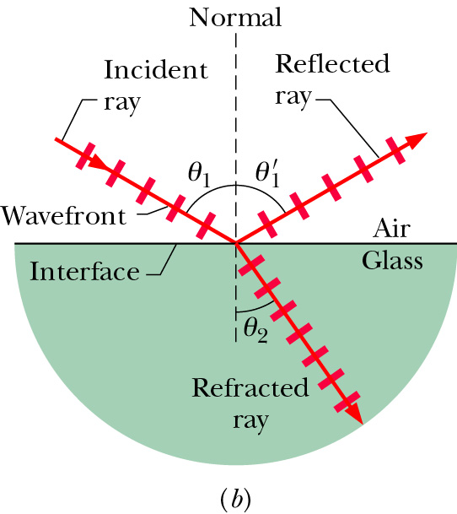

Speed of light in medium
Light can travel through matter medium as well as free space (vacuum). Inside matter, the speed of light v is generally less than c.
index of refraction
When light encounters an interface between different media, it can generally both reflect and refract.
$$θ_{1}= θ_{1}^{′}$$

Slide 20
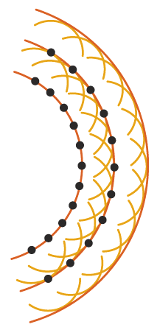
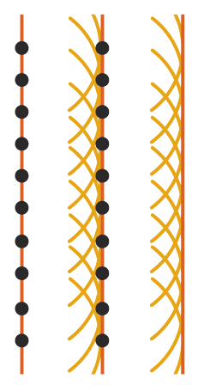
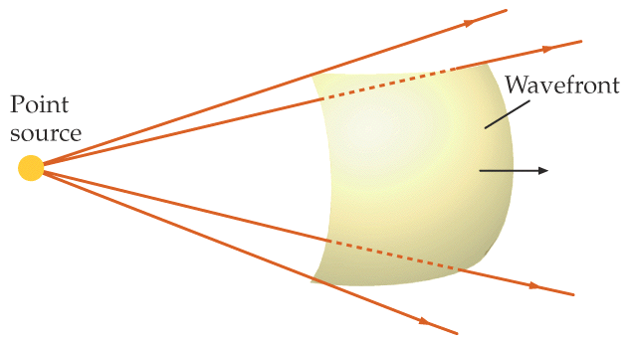
Huygens’s Principle
Each point on a primary wavefront serves as the source of spherical secondary wavelets that advance with a speed and frequency equal to those of the primary wave. The primary wavefront at some later time is the envelope of these wavelets.
t₃
t₂
t₁
wavelet
points of given phase
t₁
t₂
t₃

Slide 21
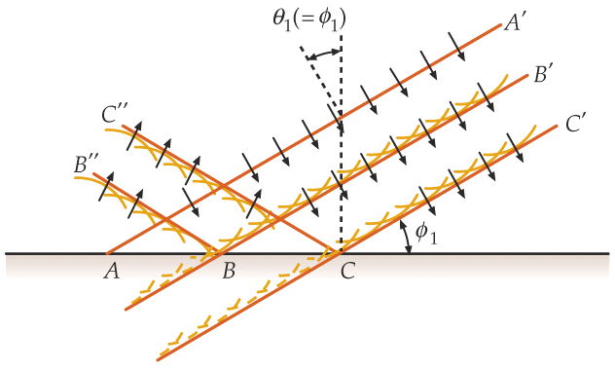
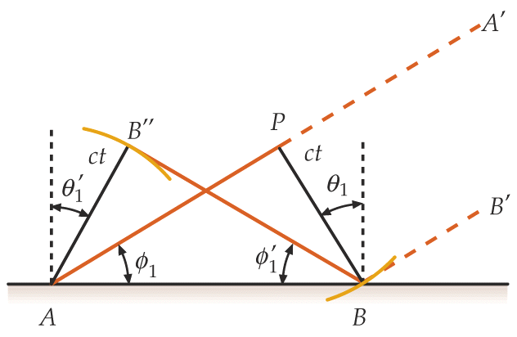
Reflection from Huygens’s Principle

Slide 22
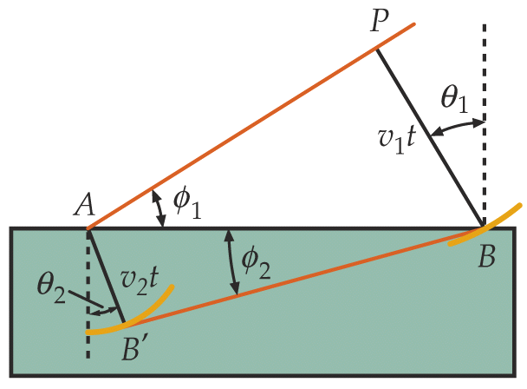
Refraction from Huygens’s Principle
index of refraction
medium | n
vacuum | 1
air | 1.0003
water | 1.33
glass | 1.5 – 1.66
Snell’s Law

Slide 23
iClicker Question
The refraction index for air and glass are 1.0 and 1.5, respectively. The incident angle θ₁ is 30º, what are the reflection angle θ’₁ and refraction angle θ₂ ?
A). θ’₁ =30º and θ₂=19.5º
B). θ’₁ =30º and θ₂=15º
C). θ’₁ =19.5º and θ₂=30º
D). θ’₁ =15º and θ₂=19.5º
E). θ’₁ =30º and θ₂=22.5º
Notes:
A

Slide 24
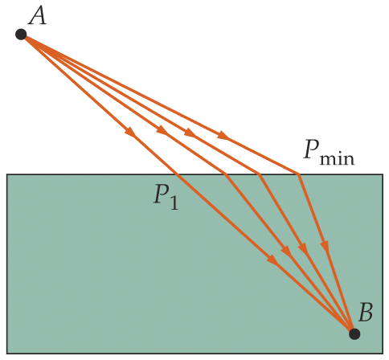
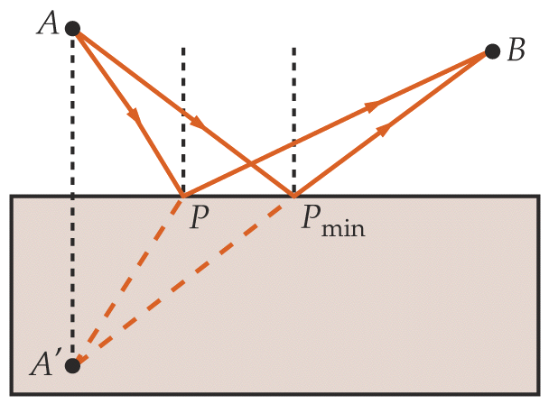
Fermat’s Principle
The path taken by light traveling from one point to another is such that the time of travel is a minimum.
path: geometric ray is assumed for light.
minimum time ≠ shortest path length
reflection
refraction

Slide 25
Summary: Laws of Reflection and Refraction
Law of Reflection
A reflected ray lies in the plane of incidence
The angle of reflection is equal to the angle of incidence
Medium 1
Law of refraction
A refracted ray lies in the plane of incidence
The angle of refraction is related to the angle of incidence by
Snell’s Law
where λ is the wavelength in vacuum
Medium 2

Slide 26
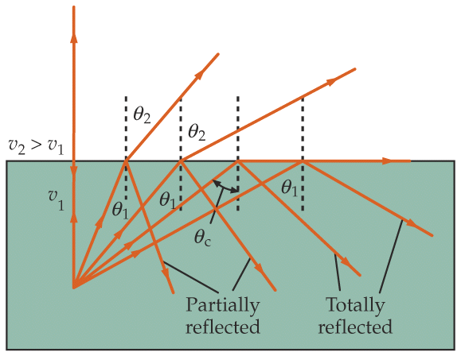
Total Internal Reflection
All light can be reflected, none refracting, when light travels from a medium of higher to lower indices of refraction.
medium 2
e.g., glass (n=1.5) to air (n=1.0)
But θ cannot be greater than 90° !
medium 1
In general, if sin θ₁ > (n₂ / n₁), we have NO refracted ray;
we have TOTAL INTERNAL REFLECTION.
Critical angle above which this occurs.

Slide 27
iClicker Question
The refraction index of water and glass are 1.33 and 1.5 respectively. The refraction index of air is ~1.0. When light incident from air to the glass. What’s the critical angle.
41.8 degree
62.5 degree
There’s no critical angle in this case.
iClicker Question
When light incident from glass to water. What’s the critical angle.
41.8 degree
62.5 degree
There’s no critical angle in this case.
Notes:
C
B

Slide 28
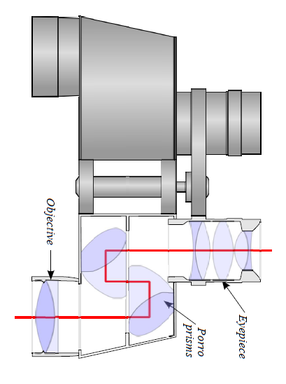
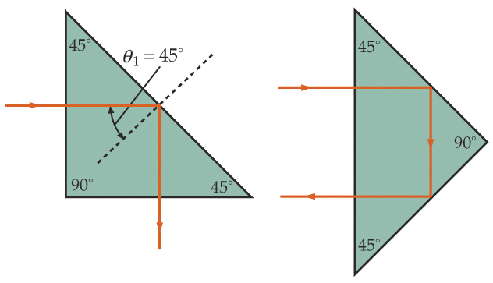
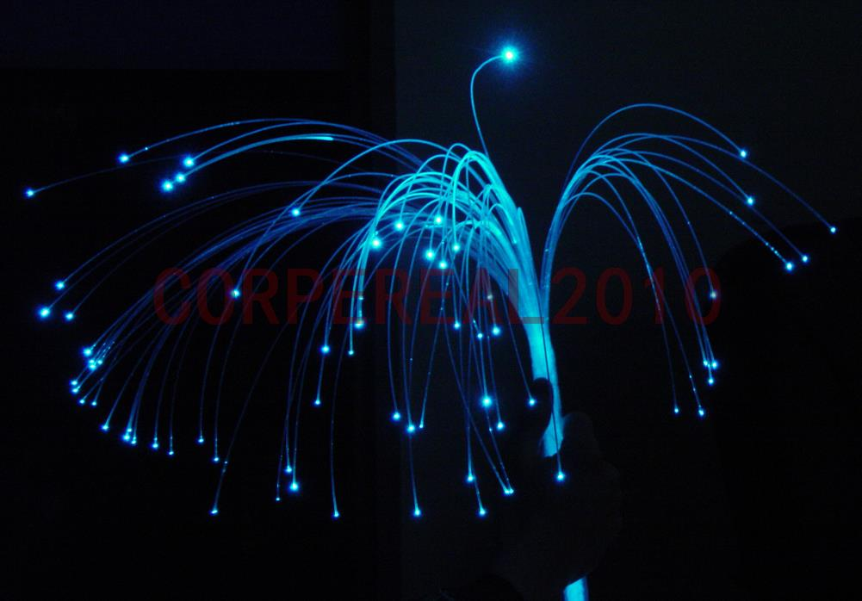
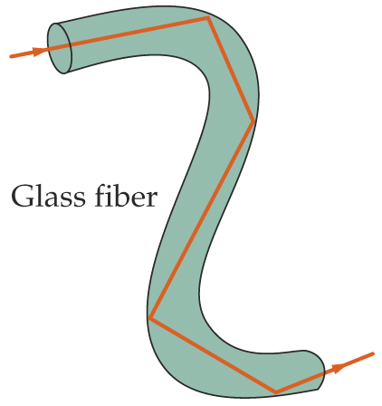
Examples
Prism used as reflectors
(e.g., glass with n=1.5)
Notes:
Field of vision

Slide 29
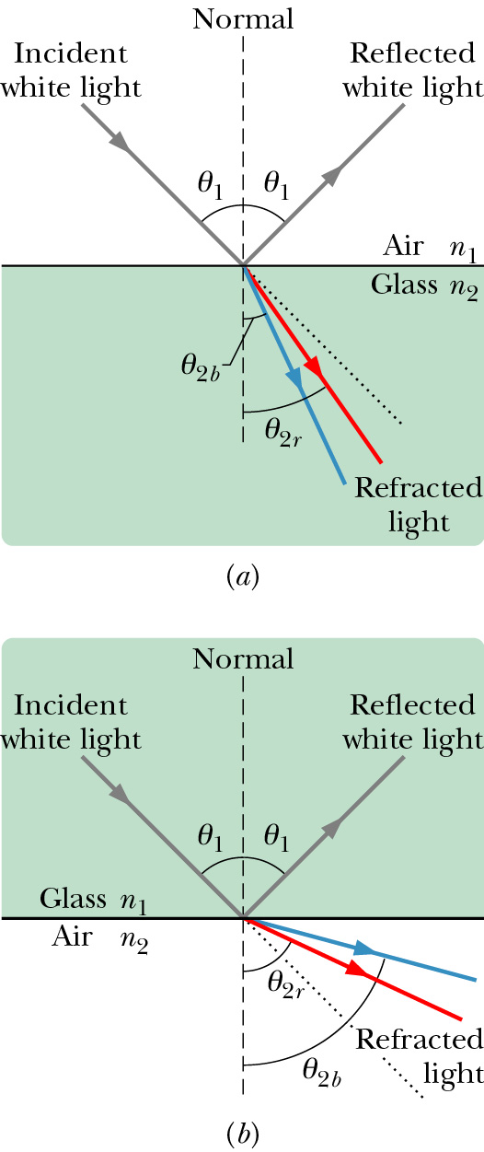
Chromatic Dispersion
The index of refraction of a medium is usually a function of the wavelength of the light. It is larger at shorter wavelengths.
Consequently, a light beam consisting of rays of different wavelength (e.g., sun light) will be
refracted at different angles at the interface of
two different media. This spreading of light is
called chromatic dispersion.
White light: It consists of components of nearly all the colors in the visible spectrum with approximately uniform intensities.
The component of a beam of white light with shorter wavelength tends to be bent more.
Spectrometer (such as a prism)

Slide 30
iClicker Question
Which of the following diagrams correctly demonstrates chromatic dispersion
Left
right
air
blue
red
Glass
Glass
red
blue

Slide 31
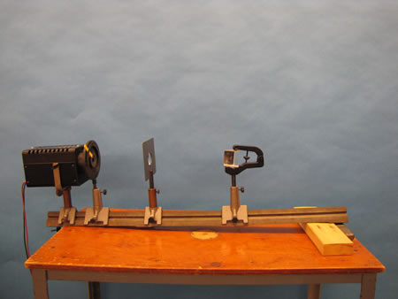
7A-22 Refraction by Prisms
red
Glass
blue
Notes:
A large Plexiglas prism is mounted on the lens board. A narrow beam of light is directed toward one side of the prism causing the light to be refracted. In addition to ordinary refraction, dispersion and minimum angle of deviation can also be shown.

Slide 32
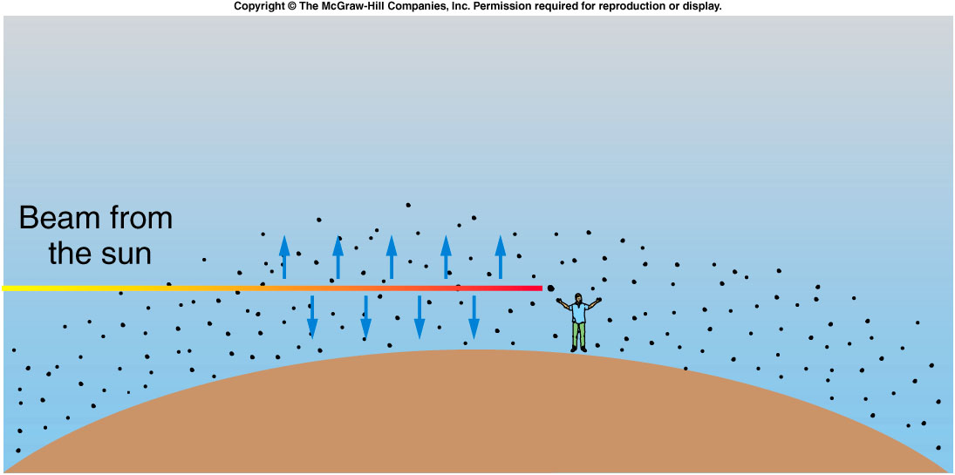
Why is the sunset red?
Why the Sky is Blue
The shorter wavelengths of blue light are scattered by gas molecules in the atmosphere more than longer wavelengths such as red light.
When the sun is low on the horizon, the light must pass through more atmosphere than when the sun is directly above.
By the time the sun’s light reaches our eyes, the shorter wavelengths such as blue and yellow have been removed by scattering, leaving only orange and red light coming straight from the sun.

Slide 33
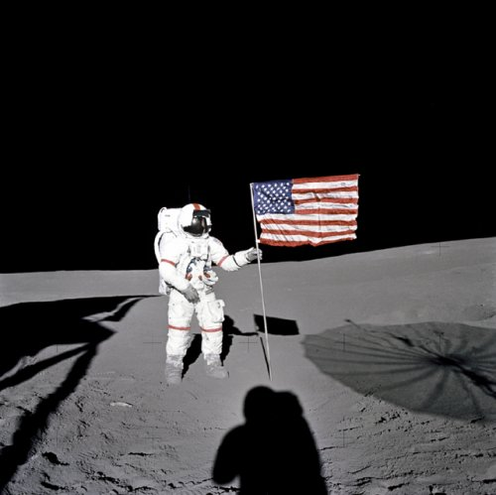
iClicker question: What’s the color of sky on the moon?
Blue
White
Red
Yellow
Black
Shadow indicate daylight time

Slide 34
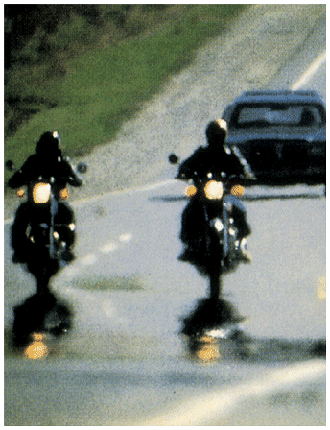
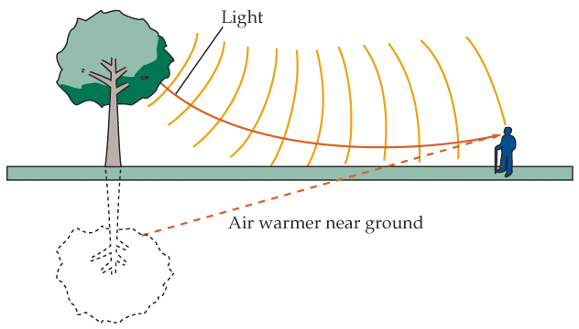
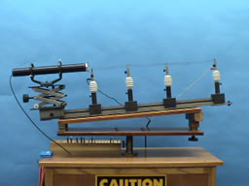
Mirage and Rainbow
Mirage
7A-20 Hot Air Refraction
Notes:
Ripples,
Using a cylindrical lens, a laser beam is spread into a horizontal line. The spread beam passes over a glowing hot wire. As the wire is heated to red hot, the beam, projected onto the wall, shows strong distortions resulting from the varying index of refraction of the turbulent air.
Directions: Turn on the laser to project the horizontal line on the far wall. (You might need to adjust the cylindrical lens up or down a bit.) The beam should be passing just above the wire coil. Slowly turn up the rheostat until the wire starts to glow red. (Do not go beyond this point significantly or you will likely burn out the wire.) Waving a card or fan over the wire will cause further disturbances in the air and create an undulating line on the wall.
Suggestions for Presentation: Ask the students if they have ever observed the distortions associated with the air over a hot pavement or above the desert sands, etc. Discuss what causes a light ray to change direction, other than reflection. (There must be a change in the index of refraction.) The heated air causes turbulence that is sufficient to create considerable changes in the index of refraction locally. The air outside this area is fairly stable and does not undergo index changes of a magnitude to be readily observable.
tch the rainbow.

Slide 35
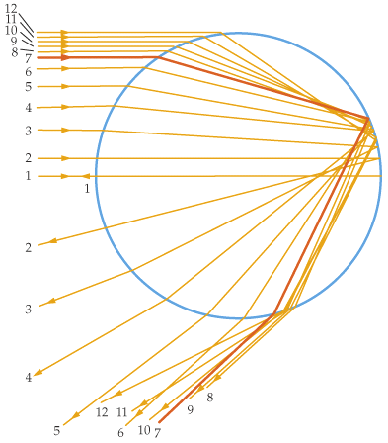
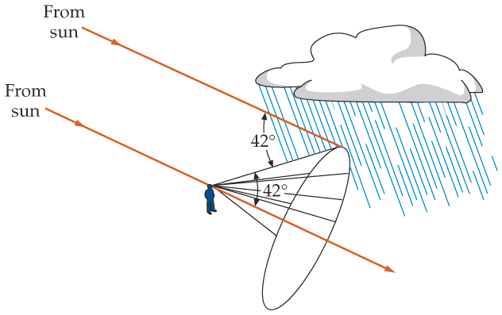
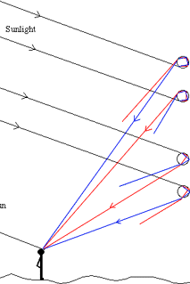
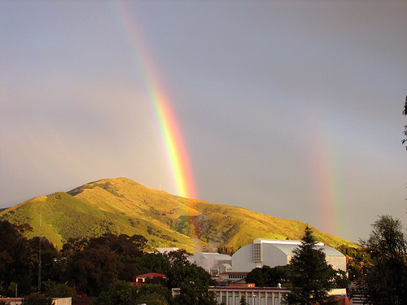
Mirage and Rainbow
water droplet
red is outside.
intensity max at 42°
rainbow
Notes:
Ripples, you can never catch the rainbow.

Slide 36
Intensity of Reflected and Refracted Light
Maxwell’s Equations with proper boundary conditions lead to solutions for E and B for reflected and refracted light in terms of E and B for the incident light and the properties of the media involved.
polarization
The relative intensities
depend on
the direction of E (and B) relative to the plane of incidence.
as well as the incident angle and the media properties.
For normal incidence, all directions are the equivalent, and

