Slide 1
Please Fill the online Course evaluation.
http://www.purdue.edu/idp/courseevaluations/CE_Students.html
We now have 70/264 responses
Survey close on 04/29
This is the official survey requested by university

Slide 2
Final Exam
* Friday: 05/04 in 1:00pm - 3:00pm in ELLT 116
* Chapters: 19, 20, 21, 22, 23 (4th edition)
* Makeup exam.
. approve only for valid reasons.
. If you need a makeup, please send me a request together with supporting
documents by 04/23 (Monday).
. Any requests after that will not be approved.
* Special needs
. If you has not contact me before, please bring me the letter from the Office
of the Dean of Students by 04/23 (Monday).
. Any request after that will not be approved.
* AOB
. multiple choice.
. Prepare your own scratch paper, pens, pencils, erasers, etc.
. Use only pencil for the answer sheet
. Bring your own calculators: graphic or scientific
. No cell phones, no text messaging which is considered cheating.
. No crib sheet of any kind is allowed. Equation sheet will be provided.
. 20 problems in total.

Slide 3
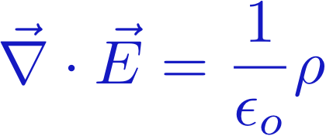
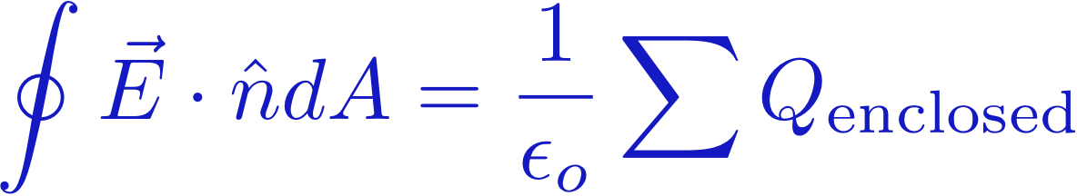
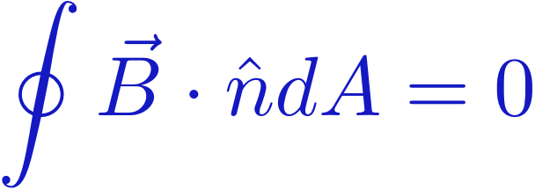

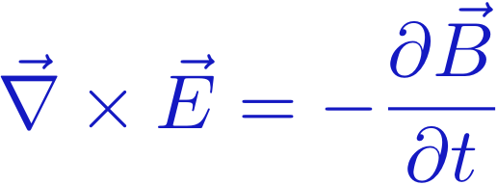
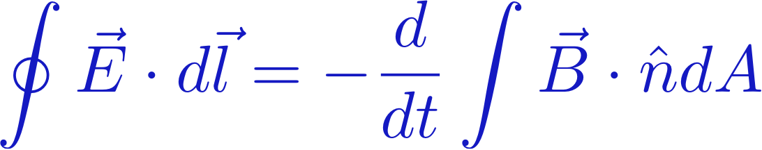
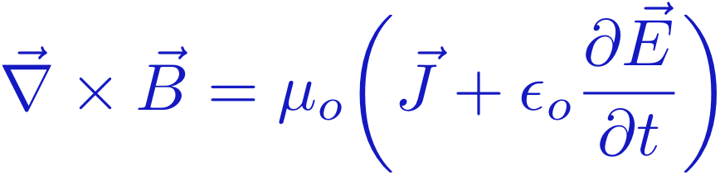
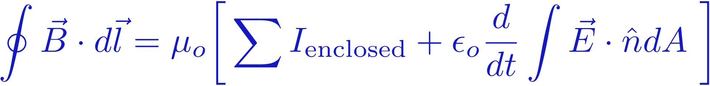
Maxwell's Equations – The Full Story
Divergence
GAUSS' LAW
Flux
GAUSS' LAW
(Magnetism)
Curl
FARADAY'S LAW
Circulation
AMPERE'S LAW

Slide 4
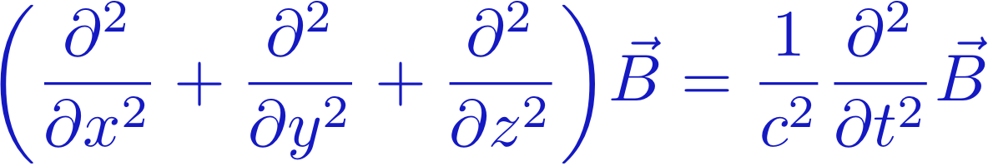
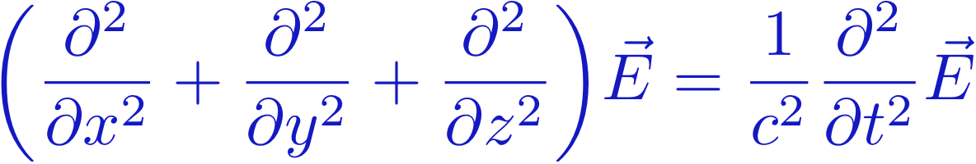

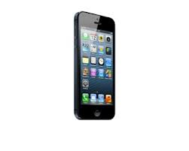
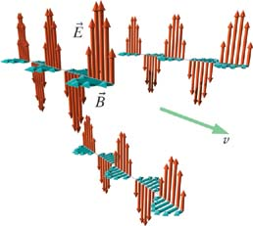
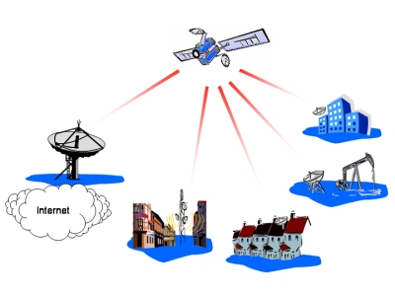
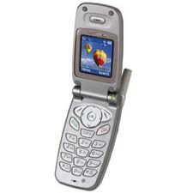
E and B wave solutions
These waves travel
at the speed of light!

Slide 5
A Pulse: Speed of Propagation
E=Bv
E=cB
Based on Maxwell’s equations, pulse must propagate at speed of light
Notes:
Spectacular result: Maxwell predicts speed of light for electromagnetic pulse in mid-1800 – but no one at this time could guess the electromagnetic nature of light, though the speed of light was already known.
He got speed of light theoretically from constants epsilon and mu which are easy to measure in experiment

Slide 6
More for Today
Accelerated Charges
Energy and Poynting Vector
Momentum and Poynting Vector
Re-Radiation (scattering)
Polarized Light
Why the sky is blue

Slide 7
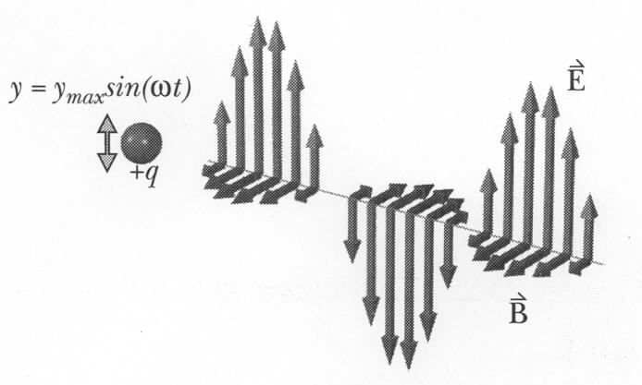
Accelerated Charges
Electromagnetic pulse can propagate in space
How can we initiate such a pulse?
Transverse pulse propagates at speed of light
Since E(t) there must be B
Direction of v is given by:

Slide 8
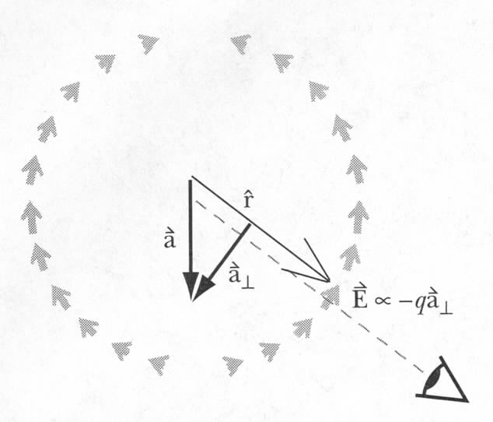
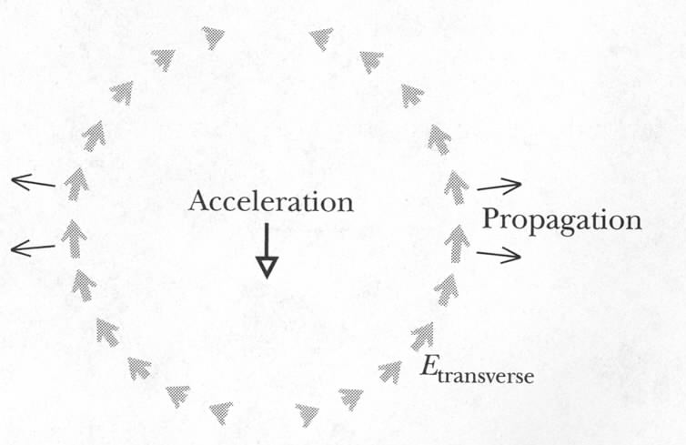
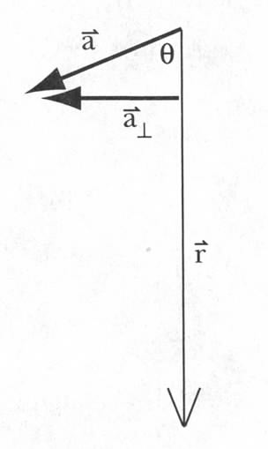
Magnitude of the Transverse Electric Field
We got the direction.
Magnitude can be derived from Gauss’s law*
Field ~ -qa⊥
1. The direction of the transverse
field is opposite to qa⊥
2. The electric field falls off at a rate 1/r
* This was first shown by Edward Purcell, BSEE Purdue, Nobeal Laureate!
Notes:
Derivation is too complex for this course
Kink in the electric field
Much slower than 1/r² – makes it possible to affect matter that is very far from the accelerated charges – that is why we see very distant stars.
Quali

Slide 9
iClicker Question (10 points for any inputs)
A proton is briefly accelerated as shown below. What is the direction of the radiative electric field that will be detected at location A?
A
B
A
D
C
+
Notes:
C

Slide 10
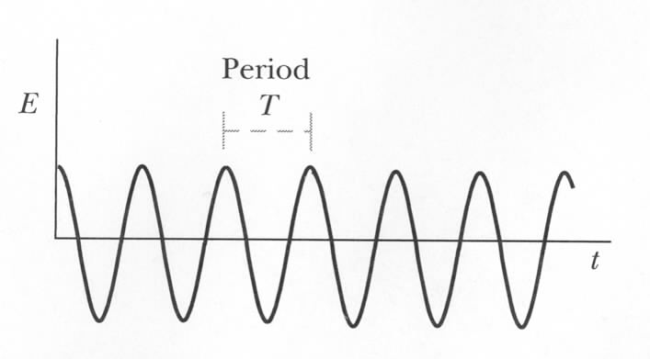
Sinusoidal Electromagnetic Radiation
Acceleration:
Sinusoidal E/M field

Slide 11
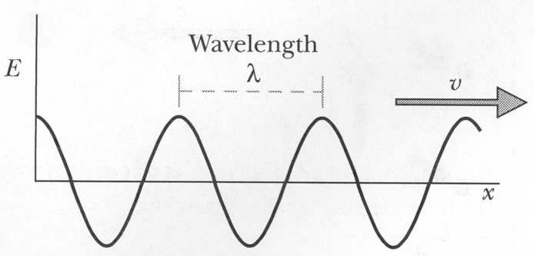
Sinusoidal E/M Radiation: Wavelength
Instead of period can
use wavelength:
Freeze picture in time:
Example of sinusoidal E/M radiation:
atoms
radio stations
E/M noise from AC wires

Slide 12
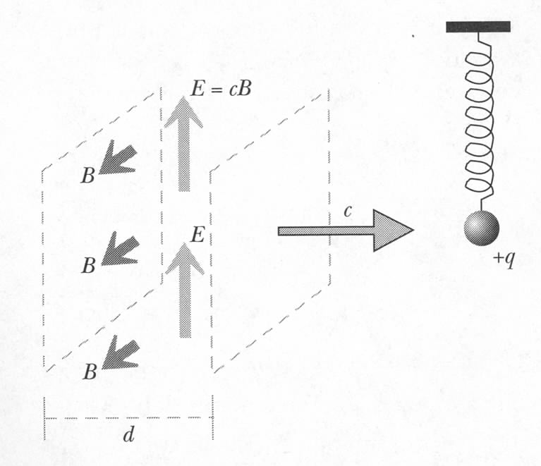
Energy of E/M Radiation
A particle will experience electric force during a short time d/c:
What will happen to the ball?
It will oscillate
Energy was transferred from E/M field to the ball
Amount of energy in the pulse is ~ E²
Notes:
eplison0xE^2 = 1/2eplison0xE^2 + 1/2x1/mu0xB^2

Slide 13
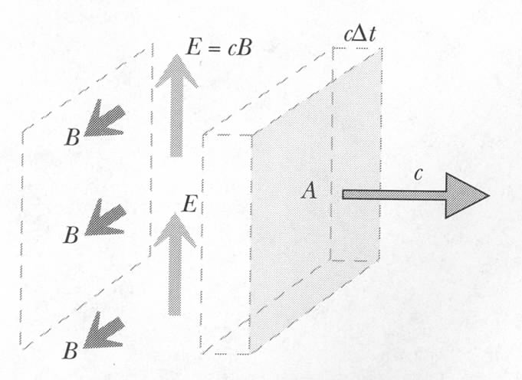
Energy Flux
There is E/M energy stored in the pulse:
Pulse moves in space:
there is energy flux
Units: J/(m²s) = W/m²
During Δt:
used: E=cB, μ₀ε₀=1/c²

Slide 14
Energy Flux: The Poynting Vector
The direction of the E/M radiation was given by
Energy flux, the “Poynting vector”:
John Henry
Poynting
(1852-1914)
S is the rate of energy flux in E/M radiation
It points in the direction of the E/M radiation
Note energy flux = [Energy/(time * Area)]
Energy flux = Intensity = [Power/Area] Same Thing!

Slide 15
Example
In the vicinity of the Earth, the energy intensity of radiation emitted by the sun is ~1400 W/m². What is the approximate magnitude of the electric field in the sunlight?
Solution:
Note: this is an average (rms) value

Slide 16
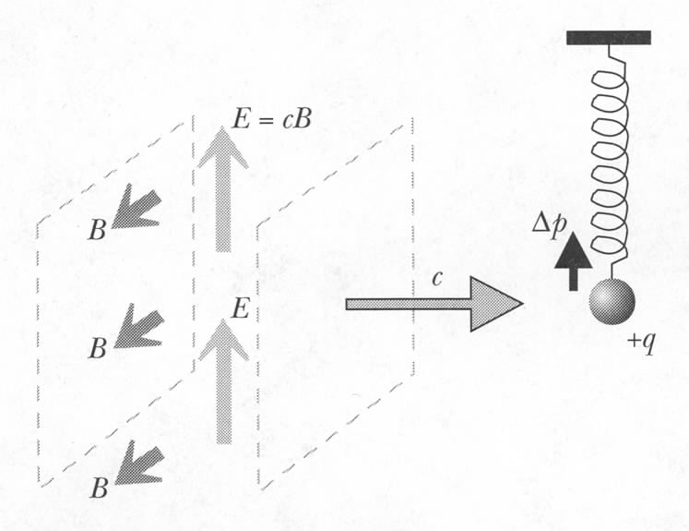
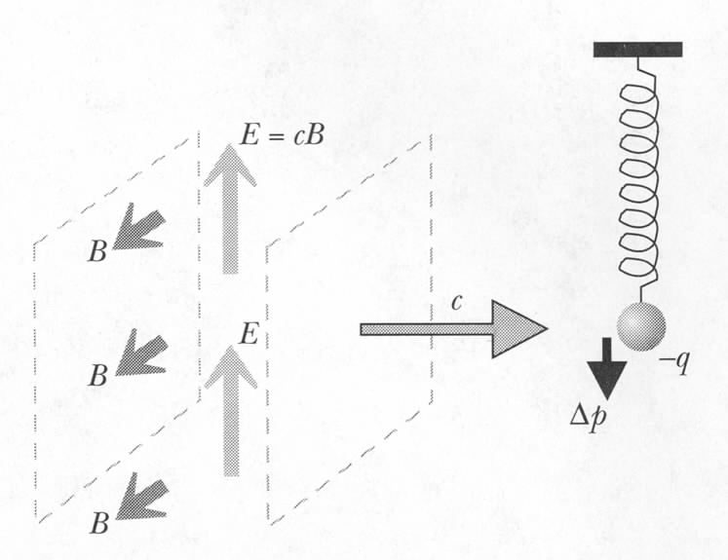
Momentum of E/M Radiation
E field starts motion
Moving charge in magnetic field:
F_{mag}
What if there is negative charge?
‘Radiation pressure’:
What is its magnitude?
Average speed: v/2
F_{mag}
Notes:
Radiation pressure also acts on neutral matter through nucleus and electrons
it is always in the dir of radiation, (SciFi – light-reflecting solar sails on ships, onsidered seriously by scientists as well)
Note that magnetic force does not increase the charge’s kinetic energy - only changes its direction of motion.
Begs the question: if particle gains momentum in the Y direction as a result of E - doesn’t the field have to lose momentum in the Y direction?
Time average of momentum in Y direction is zero!
Last shown

Slide 17
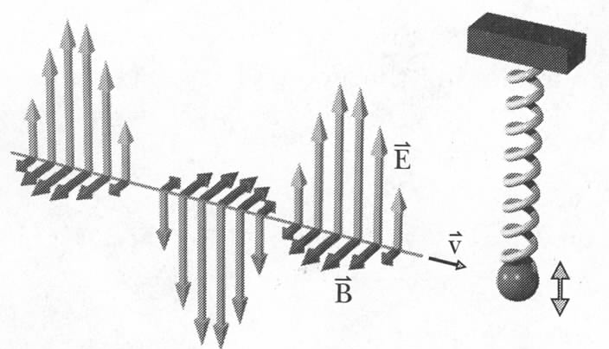
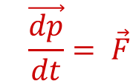
Momentum Flux
Net momentum:
in transverse direction: 0
in longitudinal direction: >0
Relativistic energy:
Quantum view: light consists of photons with zero mass:
Classical (Maxwell): it is also valid, i.e. momentum = energy/speed
Momentum flux:
$$\vec{\frac{dp}{dt}}= \vec{F}$$
Units of Pressure
Notes:
N/m² – units of pressure
S =[J/s/m^2}, so S/c = [N*m/(m^3)]=N/m^2

Slide 18
Exercise: Solar Sail
What is the force due to sun light on a sail with the area 1 km² near the Earth orbit (1400 W/m²)?
Solution:
The pressure on a sail that completely absorbs the light.
Notes:
(Jules Verne, Pierre Boulle , Arthur C. Clarke…) ..1865
Pierre Boulle also wrote: The bridge over the River Kwai
Planet of Apes – includes idea of solar sail
Appropriately, the first great writer of truly scientific fiction was also the first to suggest the possibility of solar sails. In Jules Verne's 1865 novel From the Earth to the Moon, the French adventurer Michel Ardan describes the planned cannon-firing of a space-bound projectile, which he says "will never exceed 9,900 leagues an hour . . . . [I]sn't it obvious that this speed will someday be surpassed by even greater speeds, probably with light or electricity as the mechanical agent?" Walter James Miller, the translator and annotator of the 1978 edition, notes here, "Verne is right on top of new developments in physics . . . . James Clerk Maxwell (1831-1879) has recently discovered that light exerts a pressure on surfaces."
Verne did not develop his idea further, and subsequent science fiction writers made little use of it for nearly a century. Some 60 years after Verne's novel (and inspired by it), two men began to develop the essential concepts of solar sailing: the great Russian space pioneer Konstantin Tsiolkovsky and his Latvian disciple Friderikh Tsander. But their writings on solar sails were not widely disseminated; their most influential work dealt instead with the design of liquid-fueled rockets.
Then in May 1951 the leading SF magazine of its time, Astounding Science Fiction, published a detailed account of how solar sails could be assembled in orbit and used for space travel. The account was a nonfiction article, "Clipper Ships of Space," by an engineer named Carl Wiley. Given that he published his article in a science fiction magazine, and wrote it under a pseudonym (Russell Saunders), Wiley himself apparently feared that respectable scientific circles were not yet ready for the solar sailing concept. It took another seven years for a paper on solar sails (by Richard Garwin) to appear in a professional journal, Jet Propulsion. Meanwhile, however, several influential science fiction writers had absorbed Wiley's Astounding article into their creative preconscious. In the early 1960s, they began to produce.
The April 1960 issue of Galaxy Magazine included a novelet titled "The Lady Who Sailed The Soul," by Cordwainer Smith. The story began with the legendary romance of two sailors of space, Helen America and Mr. Grey-no-more. Thousands of years in the future, everyone knows the legends, but they have forgotten the details. "Out of it all, two things stood forth - their love and the image of the great sails, tissue-metal wings with which the bodies of people finally fluttered out among the stars." The story then describes, according to the omniscient narrator, the reality behind the legend: how Helen and the veteran space sailor Mr. Grey-no-more fall in love, become separated by many light-years of space, and are reunited only after Helen endures the dangers and rigors of a forty-year space voyage as the first female sailship pilot.
Cordwainer Smith was the pseudonym of Paul M. A. Linebarger, a political scientist, psychological warfare expert, and Army intelligence officer. Thirty-five years after his death, Linebarger has come to be regarded as one of the most original writers in the history of science fiction. He was not a writer of hard science fiction, in the usual theoretical/technical sense. He was more often inspired by Chinese history and literature, French poetry, modern European novels, and hardball international politics than by scientific concepts. But he had been interested in astronomy since childhood, and he was a close reader of Astounding, including its nonfiction as well as its fiction. As part of his intelligence work he also consulted Russian scientific literature, so he may have come across the early solar-sail work of Tsiolkovsky and Tsander. Wherever he learned of it, the concept of solar sails captured Linebarger's imagination.
"The Lady Who Sailed The Soul" primarily concerns Helen America's unusual psychological development and her romance with Mr. Grey-no-more. But it also describes, fairly accurately, the structure and motive force of a starfaring sailship. In Cordwainer Smith's elaborate future history (developed in two dozen related stories), sailships are used for many centuries to settle planets across the galaxy. Each sailship carries thousands of frozen settlers; Helen America's particular cargo consists of "religious fanatics" looking for a receptive world. Her ship is christened The Soul by a cynical bureaucrat, who is happy to see the religious fanatics take to the skies. As the next story in the series ("Think Blue, Count Two," Galaxy, February 1963) describes the technology:
Before the great ships whispered between the stars by means of planoforming, people had to fly from star to star with immense sails - huge films assorted in space on long, rigid, coldproof rigging. A small spaceboat provided room for a sailor to handle the sails, check the course, and watch the passengers who were sealed, like knots in immense threads, in their little adiabatic [temperature-constant] pods which trailed behind the ship. The passengers knew nothing, except for going to sleep on Earth and waking up on a strange new world forty, fifty, or two hundred years later. This was a primitive way to do it. But it worked.
In these two stories, Cordwainer Smith first dramatized the concept of solar sailing for many science fiction readers. Thundering rockets were not his thing; he preferred the gentler forces of sunlight and starlight, managed by the subtle skills of a human sailor. But he knew that sailships, "as the miles of their sweep sucked up the push of light itself and accelerated [their] frozen cargo at almost immeasurable speeds across an ocean of unfathomable silence," could get certain important jobs done better than any foreseeable rocketship.
The next author of a sailship story was not, as far as I know, a regular reader of Astounding or of Jet Propulsion. He did have training as an engineer, but he had long since become a professional writer, notably of the semi-autobiographical novel The Bridge over the River Kwai. His name was Pierre Boulle, and in 1963 he published his first science fiction novel, La planete des singes. It was soon translated into English as Planet of the Apes. Neither film based on the novel incorporates much of its satirical content, and both entirely omit its frame story: a "wealthy leisured couple" taking a holiday in space, in a ship described as "a sort of sphere with an envelope - the sail - which was miraculously fine and light and moved through space propelled by the pressure of light-radiation. . . . Furthermore, this elastic envelope could be stretched or contracted as the navigator pleased," to increase or decrease the craft's speed [translation by Xan Fielding]. The craft's direction is controlled by changing the "reflective power of certain sections" of the spherical envelope. Other aspects of the craft's operation sound more literary than scientific in origin. But Boulle clearly had in mind at least the basics of a light-powered sailship.
Now we come to the author who is most often given credit for introducing solar sails into science fiction: the great hard-SF writer, Arthur C. Clarke. His first story of solar sailing was published four years after "The Lady Who Sailed The Soul" (in Boy's Life, the magazine of the Boy Scouts of America, March 1964). Originally titled "Sunjammer," the story is technically much more detailed than Cordwainer Smith's accounts. But its use of solar sails is rather less spectacular: instead of carrying thousands of settlers to new planets, the story's seven "sun yachts" engage in a competitive race from Earth orbit to the Moon. That gives Clarke the opportunity to describe half a dozen different designs for sailships, as well as complex strategies for maneuvering them during the race. The race itself is an exciting one, with collisions and cutthroat yachtsmanship, ending as one of the yachts accidentally becomes "the first of all man's ships to set sail on the long journey to the stars." "Sunjammer" was quickly reprinted in several publications in addition to Boy's Life (usually under the title "The Wind from the Sun"), so it gained much wider distribution than the Cordwainer Smith stories that preceded it. As Clarke himself later wrote, "Many of the bright men and women working to develop solar sails have told me that their lifelong interest began when they first read this story back in the 1960s.
" Finally among these science-fictional progenitors of sailships came a story by another master of hard SF, Poul Anderson. Anderson's story, also titled "Sunjammer," appeared a month after Clarke's, in the April 1964 issue of Astounding Science Fiction, by this time retitled Analog Science Fact/ Science Fiction. Anderson (writing as Winston P. Sanders) produced a typical Analog story: an intriguing puzzle involving great danger in outer space, with an ingenious engineering solution discovered at the last minute. Anderson's sailships serve the cause of interplanetary commerce, hauling industrial chemicals from the Asteroid Belt to Earth. No romance here, but as in Clarke's story, considerable detail about sailship design:
The sail now nearly bisected the sky, four and a half miles across. The foam-filled members that stiffened it were like Brobdingnagian spokes with its slow rotation. That disk massed close to two tons, and yet it was ghostly thin, a micron's breadth of aluminized polymer. . . . They cost money to build, out in free space, yet far less than a powered ship; for they required no engines, no crews, no fuel, simply a metal coating sputtered onto a sheet of carbon compounds, a configuration of sensors and automata, and a means to signal their whereabouts and their occasional needs. Those needs rarely amounted to more than repair of some mechanical malfunction.
"Rarely" for purposes of this story means that an unanticipated solar flare is threatening to set off a mighty explosion of the sailship's volatile cargo, which will contaminate Earth's outer atmosphere and incinerate any human-crewed craft nearby.
These four writers, within a four-year time span, illustrated the major potential uses of solar sails, which not coincidentally have been among the main uses of sailing ships on Earth's waters: hauling freight (Anderson), recreational travel (Boulle), racing (Clarke), exploration and emigration (Smith). Science fiction writers who followed in their wake have either expanded upon these uses or found secondary ones. For instance, Larry Niven and Jerry Pournelle, in The Mote in God's Eye (1974), reversed the usual direction of sailship exploration by depicting an alien sailship that wanders into human territory, providing first contact with a vast alien empire. In George R. R. Martin and Lisa Tuttle's Windhaven (1981), the descendants of a crashed sailship's crew on a windy planet cut up the fabric of the sails and use them to make individual wings for soaring.
Simultaneously with the pioneers of sailship fiction, the technical literature on solar sails began to expand rapidly, giving any SF writer with an interest in the topic a mass of information from which to construct a fictional craft. Some of the scientists working in the area even began to write their own fiction, extrapolating their work into distant decades. For example, Robert L. Forward's Rocheworld (1990; aka The Flight of the Dragonfly in an abbreviated version, 1984) imagined in great detail the twenty-year voyage of a laser-powered sailship to Barnard's Star. Recent science-fictional uses of solar sails are far too numerous to list here. A decade ago a whole book of solar sail fiction and nonfiction, Project Solar Sail, edited by Arthur C. Clarke with David Brin, was published to help fund an early effort by the World Space Foundation (which has now been absorbed by the Planetary Society, who are conducting the Cosmos 1 mission) to build a solar sail. And now some of the first solar sail stories may become part of the cargo on the first sailship to be launched from Earth orbit. Talk about a sense of wonder!

Slide 19
iClicker quiz: Solar Sail
The pressure due to sun light on a sail with the area 1 km² near the Earth orbit (1400 W/m²) that complete absorb the sunlight is
Note: What’s the force if we have a complete reflective surface?
4.65 N
9.3 N
9.3 x 10⁻⁶ N
4.65 x 10⁻⁶ N
Notes:
(Jules Verne, Pierre Boulle , Arthur C. Clarke…) ..1865
Pierre Boulle also wrote: The bridge over the River Kwai
Planet of Apes – includes idea of solar sail
Appropriately, the first great writer of truly scientific fiction was also the first to suggest the possibility of solar sails. In Jules Verne's 1865 novel From the Earth to the Moon, the French adventurer Michel Ardan describes the planned cannon-firing of a space-bound projectile, which he says "will never exceed 9,900 leagues an hour . . . . [I]sn't it obvious that this speed will someday be surpassed by even greater speeds, probably with light or electricity as the mechanical agent?" Walter James Miller, the translator and annotator of the 1978 edition, notes here, "Verne is right on top of new developments in physics . . . . James Clerk Maxwell (1831-1879) has recently discovered that light exerts a pressure on surfaces."
Verne did not develop his idea further, and subsequent science fiction writers made little use of it for nearly a century. Some 60 years after Verne's novel (and inspired by it), two men began to develop the essential concepts of solar sailing: the great Russian space pioneer Konstantin Tsiolkovsky and his Latvian disciple Friderikh Tsander. But their writings on solar sails were not widely disseminated; their most influential work dealt instead with the design of liquid-fueled rockets.
Then in May 1951 the leading SF magazine of its time, Astounding Science Fiction, published a detailed account of how solar sails could be assembled in orbit and used for space travel. The account was a nonfiction article, "Clipper Ships of Space," by an engineer named Carl Wiley. Given that he published his article in a science fiction magazine, and wrote it under a pseudonym (Russell Saunders), Wiley himself apparently feared that respectable scientific circles were not yet ready for the solar sailing concept. It took another seven years for a paper on solar sails (by Richard Garwin) to appear in a professional journal, Jet Propulsion. Meanwhile, however, several influential science fiction writers had absorbed Wiley's Astounding article into their creative preconscious. In the early 1960s, they began to produce.
The April 1960 issue of Galaxy Magazine included a novelet titled "The Lady Who Sailed The Soul," by Cordwainer Smith. The story began with the legendary romance of two sailors of space, Helen America and Mr. Grey-no-more. Thousands of years in the future, everyone knows the legends, but they have forgotten the details. "Out of it all, two things stood forth - their love and the image of the great sails, tissue-metal wings with which the bodies of people finally fluttered out among the stars." The story then describes, according to the omniscient narrator, the reality behind the legend: how Helen and the veteran space sailor Mr. Grey-no-more fall in love, become separated by many light-years of space, and are reunited only after Helen endures the dangers and rigors of a forty-year space voyage as the first female sailship pilot.
Cordwainer Smith was the pseudonym of Paul M. A. Linebarger, a political scientist, psychological warfare expert, and Army intelligence officer. Thirty-five years after his death, Linebarger has come to be regarded as one of the most original writers in the history of science fiction. He was not a writer of hard science fiction, in the usual theoretical/technical sense. He was more often inspired by Chinese history and literature, French poetry, modern European novels, and hardball international politics than by scientific concepts. But he had been interested in astronomy since childhood, and he was a close reader of Astounding, including its nonfiction as well as its fiction. As part of his intelligence work he also consulted Russian scientific literature, so he may have come across the early solar-sail work of Tsiolkovsky and Tsander. Wherever he learned of it, the concept of solar sails captured Linebarger's imagination.
"The Lady Who Sailed The Soul" primarily concerns Helen America's unusual psychological development and her romance with Mr. Grey-no-more. But it also describes, fairly accurately, the structure and motive force of a starfaring sailship. In Cordwainer Smith's elaborate future history (developed in two dozen related stories), sailships are used for many centuries to settle planets across the galaxy. Each sailship carries thousands of frozen settlers; Helen America's particular cargo consists of "religious fanatics" looking for a receptive world. Her ship is christened The Soul by a cynical bureaucrat, who is happy to see the religious fanatics take to the skies. As the next story in the series ("Think Blue, Count Two," Galaxy, February 1963) describes the technology:
Before the great ships whispered between the stars by means of planoforming, people had to fly from star to star with immense sails - huge films assorted in space on long, rigid, coldproof rigging. A small spaceboat provided room for a sailor to handle the sails, check the course, and watch the passengers who were sealed, like knots in immense threads, in their little adiabatic [temperature-constant] pods which trailed behind the ship. The passengers knew nothing, except for going to sleep on Earth and waking up on a strange new world forty, fifty, or two hundred years later. This was a primitive way to do it. But it worked.
In these two stories, Cordwainer Smith first dramatized the concept of solar sailing for many science fiction readers. Thundering rockets were not his thing; he preferred the gentler forces of sunlight and starlight, managed by the subtle skills of a human sailor. But he knew that sailships, "as the miles of their sweep sucked up the push of light itself and accelerated [their] frozen cargo at almost immeasurable speeds across an ocean of unfathomable silence," could get certain important jobs done better than any foreseeable rocketship.
The next author of a sailship story was not, as far as I know, a regular reader of Astounding or of Jet Propulsion. He did have training as an engineer, but he had long since become a professional writer, notably of the semi-autobiographical novel The Bridge over the River Kwai. His name was Pierre Boulle, and in 1963 he published his first science fiction novel, La planete des singes. It was soon translated into English as Planet of the Apes. Neither film based on the novel incorporates much of its satirical content, and both entirely omit its frame story: a "wealthy leisured couple" taking a holiday in space, in a ship described as "a sort of sphere with an envelope - the sail - which was miraculously fine and light and moved through space propelled by the pressure of light-radiation. . . . Furthermore, this elastic envelope could be stretched or contracted as the navigator pleased," to increase or decrease the craft's speed [translation by Xan Fielding]. The craft's direction is controlled by changing the "reflective power of certain sections" of the spherical envelope. Other aspects of the craft's operation sound more literary than scientific in origin. But Boulle clearly had in mind at least the basics of a light-powered sailship.
Now we come to the author who is most often given credit for introducing solar sails into science fiction: the great hard-SF writer, Arthur C. Clarke. His first story of solar sailing was published four years after "The Lady Who Sailed The Soul" (in Boy's Life, the magazine of the Boy Scouts of America, March 1964). Originally titled "Sunjammer," the story is technically much more detailed than Cordwainer Smith's accounts. But its use of solar sails is rather less spectacular: instead of carrying thousands of settlers to new planets, the story's seven "sun yachts" engage in a competitive race from Earth orbit to the Moon. That gives Clarke the opportunity to describe half a dozen different designs for sailships, as well as complex strategies for maneuvering them during the race. The race itself is an exciting one, with collisions and cutthroat yachtsmanship, ending as one of the yachts accidentally becomes "the first of all man's ships to set sail on the long journey to the stars." "Sunjammer" was quickly reprinted in several publications in addition to Boy's Life (usually under the title "The Wind from the Sun"), so it gained much wider distribution than the Cordwainer Smith stories that preceded it. As Clarke himself later wrote, "Many of the bright men and women working to develop solar sails have told me that their lifelong interest began when they first read this story back in the 1960s.
" Finally among these science-fictional progenitors of sailships came a story by another master of hard SF, Poul Anderson. Anderson's story, also titled "Sunjammer," appeared a month after Clarke's, in the April 1964 issue of Astounding Science Fiction, by this time retitled Analog Science Fact/ Science Fiction. Anderson (writing as Winston P. Sanders) produced a typical Analog story: an intriguing puzzle involving great danger in outer space, with an ingenious engineering solution discovered at the last minute. Anderson's sailships serve the cause of interplanetary commerce, hauling industrial chemicals from the Asteroid Belt to Earth. No romance here, but as in Clarke's story, considerable detail about sailship design:
The sail now nearly bisected the sky, four and a half miles across. The foam-filled members that stiffened it were like Brobdingnagian spokes with its slow rotation. That disk massed close to two tons, and yet it was ghostly thin, a micron's breadth of aluminized polymer. . . . They cost money to build, out in free space, yet far less than a powered ship; for they required no engines, no crews, no fuel, simply a metal coating sputtered onto a sheet of carbon compounds, a configuration of sensors and automata, and a means to signal their whereabouts and their occasional needs. Those needs rarely amounted to more than repair of some mechanical malfunction.
"Rarely" for purposes of this story means that an unanticipated solar flare is threatening to set off a mighty explosion of the sailship's volatile cargo, which will contaminate Earth's outer atmosphere and incinerate any human-crewed craft nearby.
These four writers, within a four-year time span, illustrated the major potential uses of solar sails, which not coincidentally have been among the main uses of sailing ships on Earth's waters: hauling freight (Anderson), recreational travel (Boulle), racing (Clarke), exploration and emigration (Smith). Science fiction writers who followed in their wake have either expanded upon these uses or found secondary ones. For instance, Larry Niven and Jerry Pournelle, in The Mote in God's Eye (1974), reversed the usual direction of sailship exploration by depicting an alien sailship that wanders into human territory, providing first contact with a vast alien empire. In George R. R. Martin and Lisa Tuttle's Windhaven (1981), the descendants of a crashed sailship's crew on a windy planet cut up the fabric of the sails and use them to make individual wings for soaring.
Simultaneously with the pioneers of sailship fiction, the technical literature on solar sails began to expand rapidly, giving any SF writer with an interest in the topic a mass of information from which to construct a fictional craft. Some of the scientists working in the area even began to write their own fiction, extrapolating their work into distant decades. For example, Robert L. Forward's Rocheworld (1990; aka The Flight of the Dragonfly in an abbreviated version, 1984) imagined in great detail the twenty-year voyage of a laser-powered sailship to Barnard's Star. Recent science-fictional uses of solar sails are far too numerous to list here. A decade ago a whole book of solar sail fiction and nonfiction, Project Solar Sail, edited by Arthur C. Clarke with David Brin, was published to help fund an early effort by the World Space Foundation (which has now been absorbed by the Planetary Society, who are conducting the Cosmos 1 mission) to build a solar sail. And now some of the first solar sail stories may become part of the cargo on the first sailship to be launched from Earth orbit. Talk about a sense of wonder!

Slide 20
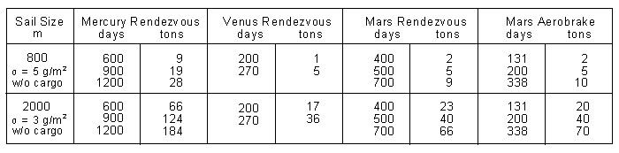
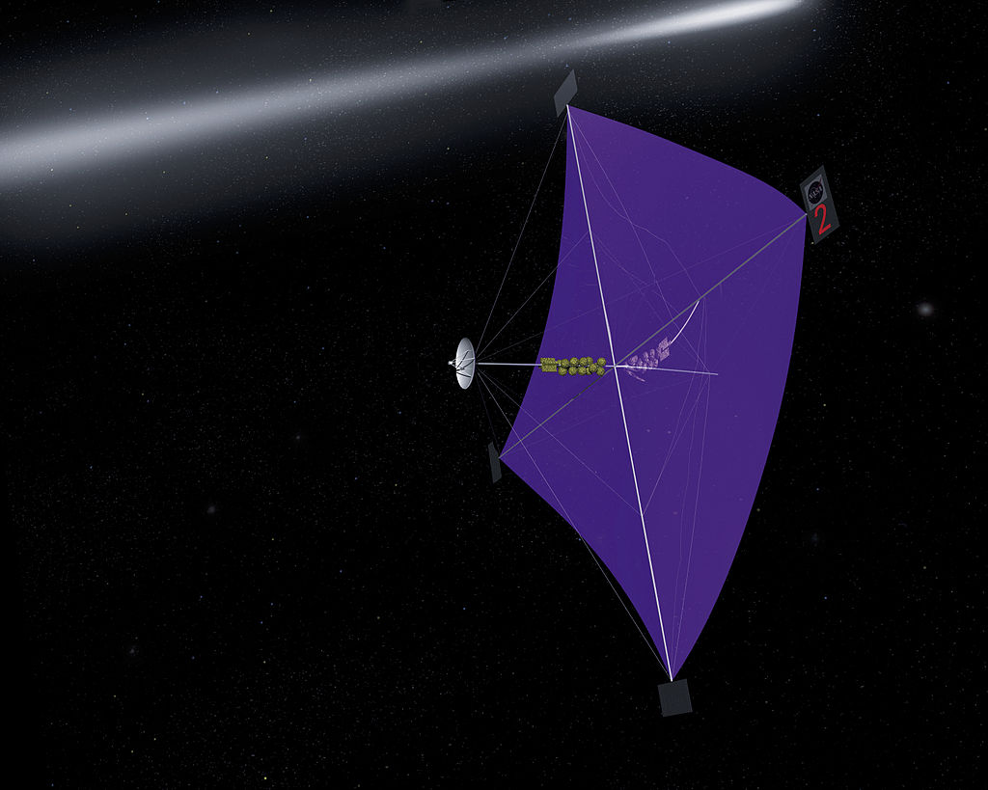
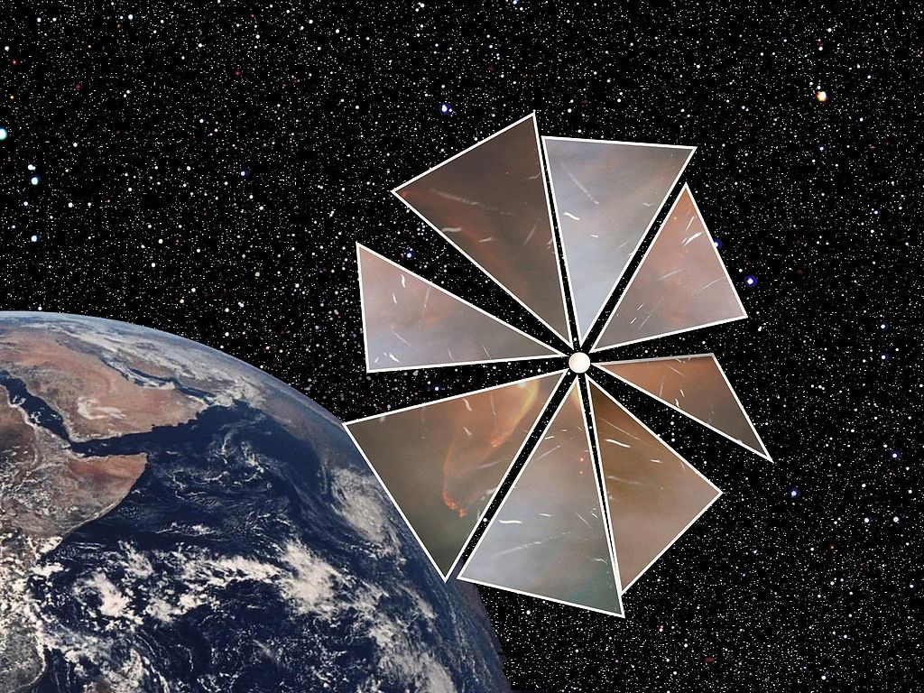
https://en.wikipedia.org/wiki/Solar_sail

Slide 21
Effect of E/M Radiation on Matter
Radiative pressure – too small to be observed in most cases
E/M fields can affect charged particles: nucleus and electrons
https://www.youtube.com/watch?v=QR7vwRC6SFE
Notes:
Laser gun

Slide 22
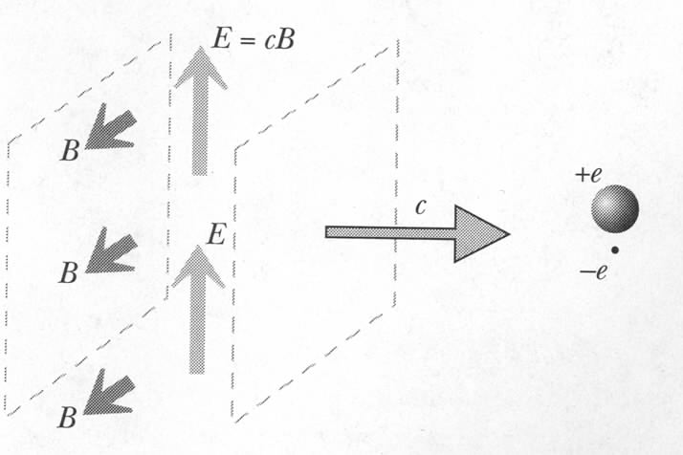
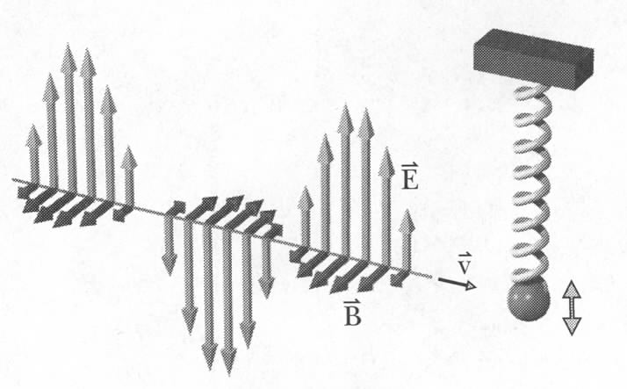
Effect of Radiation on a Neutral Atom
Main effect:
brief electric kick sideways
Neutral atom: polarizes
Electron is much lighter than nucleus:
can model atom as outer electron connected to the rest of the atom by a spring:
F=eE
Notes:
See problem 15.P.47 justifying the spring analogy.

Slide 23
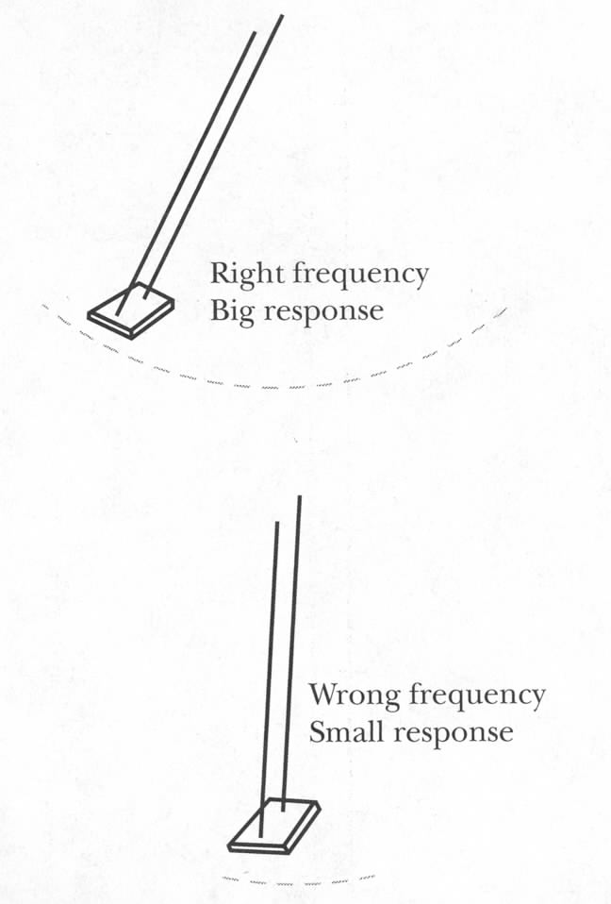
Radiation and Neutral Atom: Resonance
Amplitude of oscillation will depend on how close we are to the natural free-oscillation frequency of the ball-spring system
Resonance
This is why you can tune a radio
Notes:
Organic molecules – electronic system is in resonance with E/M frequencies corresponding to ‘visible’ light

Slide 24
Importance of Resonance
E/M radiation waves with frequency ~10⁶ Hz has big effect on mobile electrons in the metal of radio antenna:
can tune radio to a single frequency
E/M radiation with frequency ~ 10¹⁵ Hz has big effect on organic molecules:
retina in your eye responds to visible light but not radio waves
Very high frequency (X-rays) has little effect on atoms and can pass through matter (your body):
X-ray imaging
Notes:
Organic molecules – electronic system is in resonance with E/M frequencies corresponding to ‘visible’ light

Slide 25
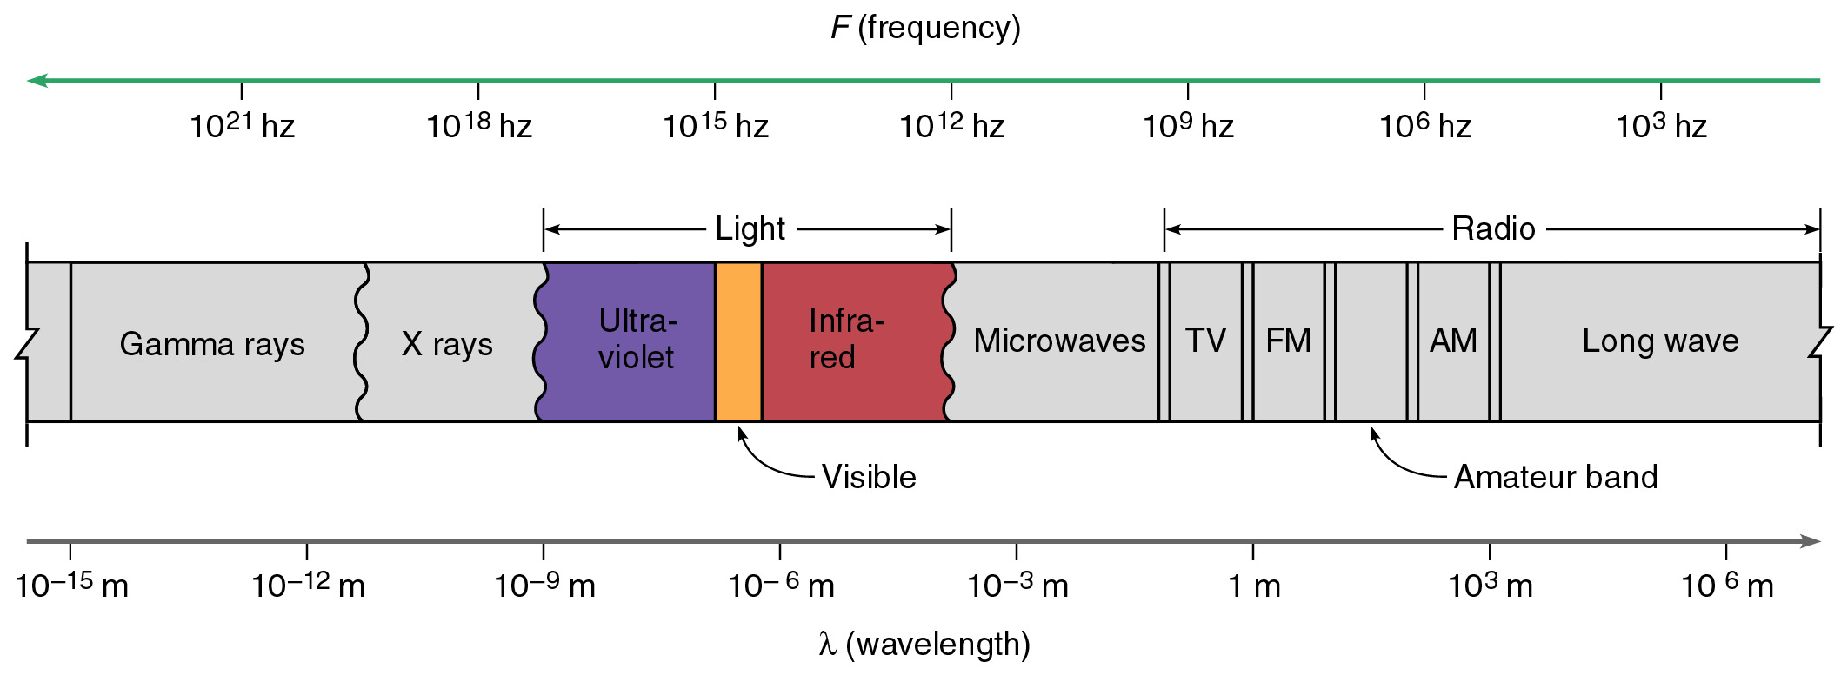
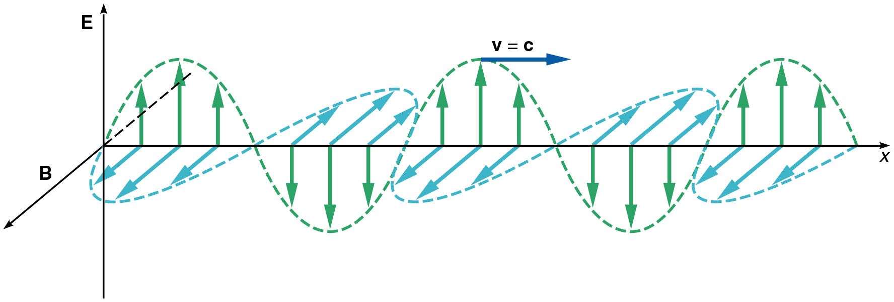
Electromagnetic Spectrum
Notes:
Microwave: not because it is used in microwave, but because it has ~micron wavelength
Visible – the whole spectrum from blue to red – the frequency barely changes twice!

Slide 26
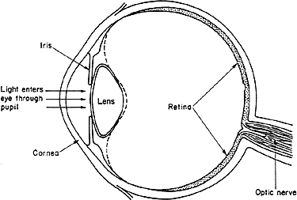
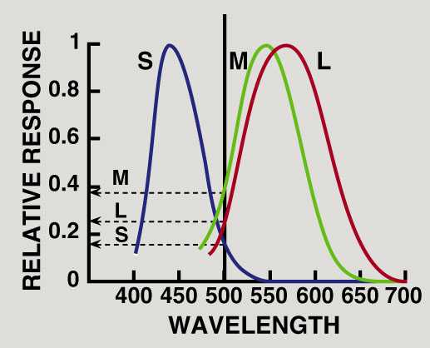

Color Vision
Three types of receptors (cones) in retina which incorporate three different organic molecules which are in resonance with red, green and blue light frequencies (RGB-vision):
Response spectra for three types of receptors
Max response wavelengths:
S – 440 nm (6.81.10¹⁴ Hz)
M – 540 nm (5.56.10¹⁴ Hz)
L – 560 nm (5.36.10¹⁴ Hz)
Refers to length of cone
Notes:
Microwave: not because it is used in microwave, but because it has ~micron wavelength
Visible – the whole spectrum from blue to red – the frequency barely changes twice!
Three types of rhodopsin receptors contain three different opsin molecules (red, green, blue)
Cone absorption spectra: peaks at 440, 540, 560 nm (Short, Medium and Long – type cones, three types of opsin in rhodopsin)
http://psychlops.psy.uconn.edu/swadlow/Senpart2.htm

Slide 27
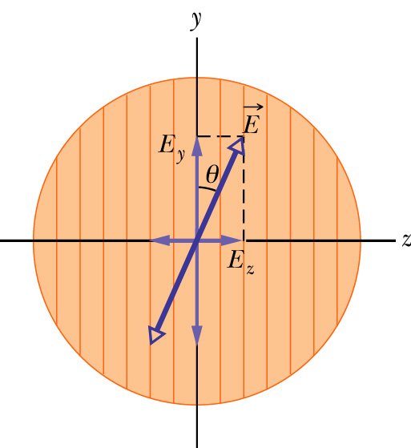
Polarizer: polarization by absorption
An electric field component parallel to the transmission axis is passed by a polarizer; a component perpendicular to it is absorbed.
transmission axis
dichroism (tourmaline, polaroid,…)
So if linearly polarized beam with E is incident on a polarizer as shown,
Zero if θ=π/2, I₀ if θ=0
If unpolarized beam is incident instead,
The intensity will reduce by a factor of two.
The light will become polarized along the transmission axis

Slide 28
iClicker Questions (10 points for all inputs)
A beam of un-polarized lights with intensity I is sent through two polarizers with transmission axis perpendicular to each other. What’s the outgoing light intensity?
½ I
2 I
0
1.5 I

Slide 29
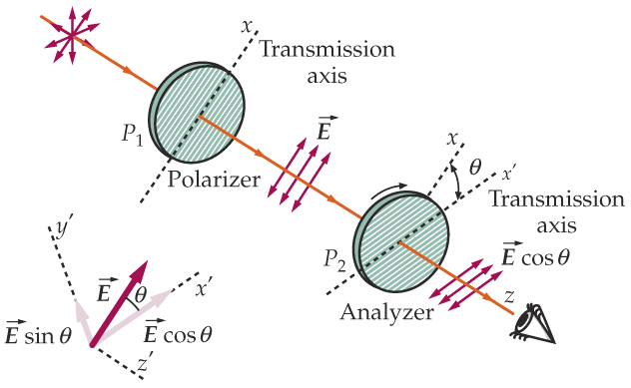
Example: two polarizers
This set of two linear polarizers produces LP (linearly polarized) light. What is the final intensity?
  P₁ transmits 1/2 of the unpolarized light:
  I₁ = 1/2 I₀
  P₂ projects out the E-field component parallel to x’ axis:
= 0 if θ = π/2
(i.e., crossed)

Slide 30
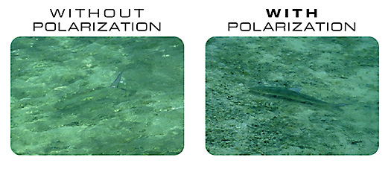

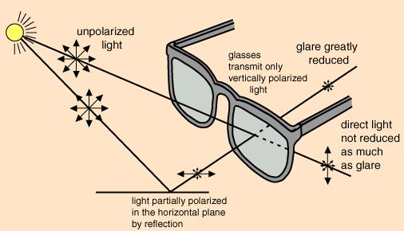
Polarized Light
Polaroid sunglasses and camera filters:
reflected light is highly polarized: can block it
Considered: using polarized car lights and polarizers-windshields
Notes:
Show trick with three polarizers – two crossed ones, add one at 45 degrees in the middle
Sheet of special plastic whose long molecules are aligned with each other
Sunglasses

Slide 31
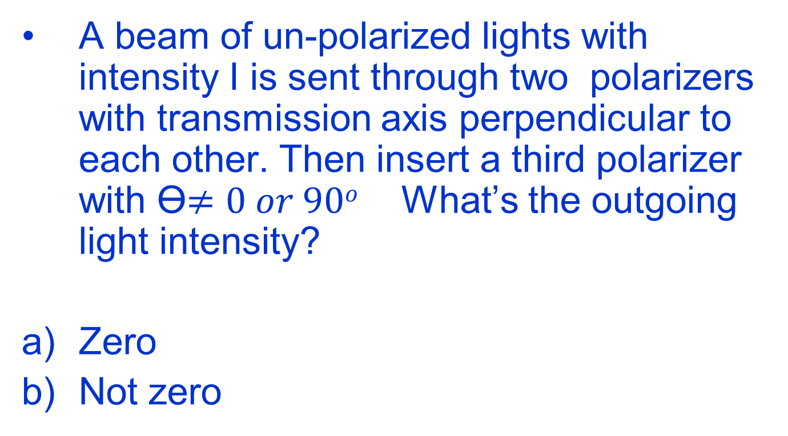
iClicker Questions
A beam of un-polarized lights with intensity I is sent through two polarizers with transmission axis perpendicular to each other. Then insert a third polarizer with ϴ$≠0 or 90o$ What’s the outgoing light intensity?
Zero
Not zero

Slide 32
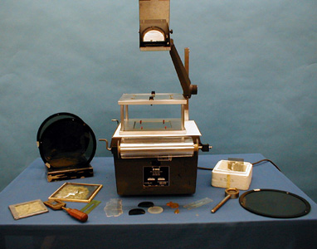
7B-22 Polarizer Effects

Slide 33
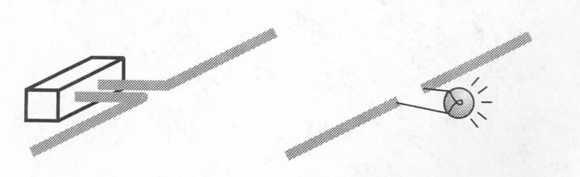
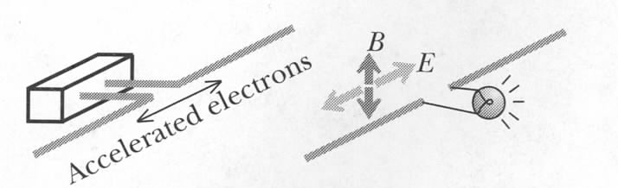
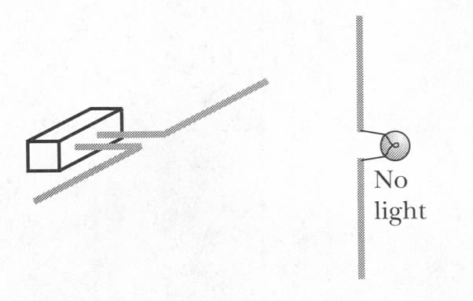
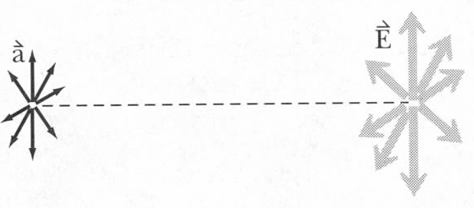
Polarized E/M Radiation
AC voltage
(~300 MHz)
What will happen if distance is increased twice?
E/M radiation can be polarized along one axis…
no
light
…and it can be unpolarized:
Notes:
At every single time E is of course in just one direction, but it changes randomly and rapidly over time
Light from the sun is not polarized!

Slide 34
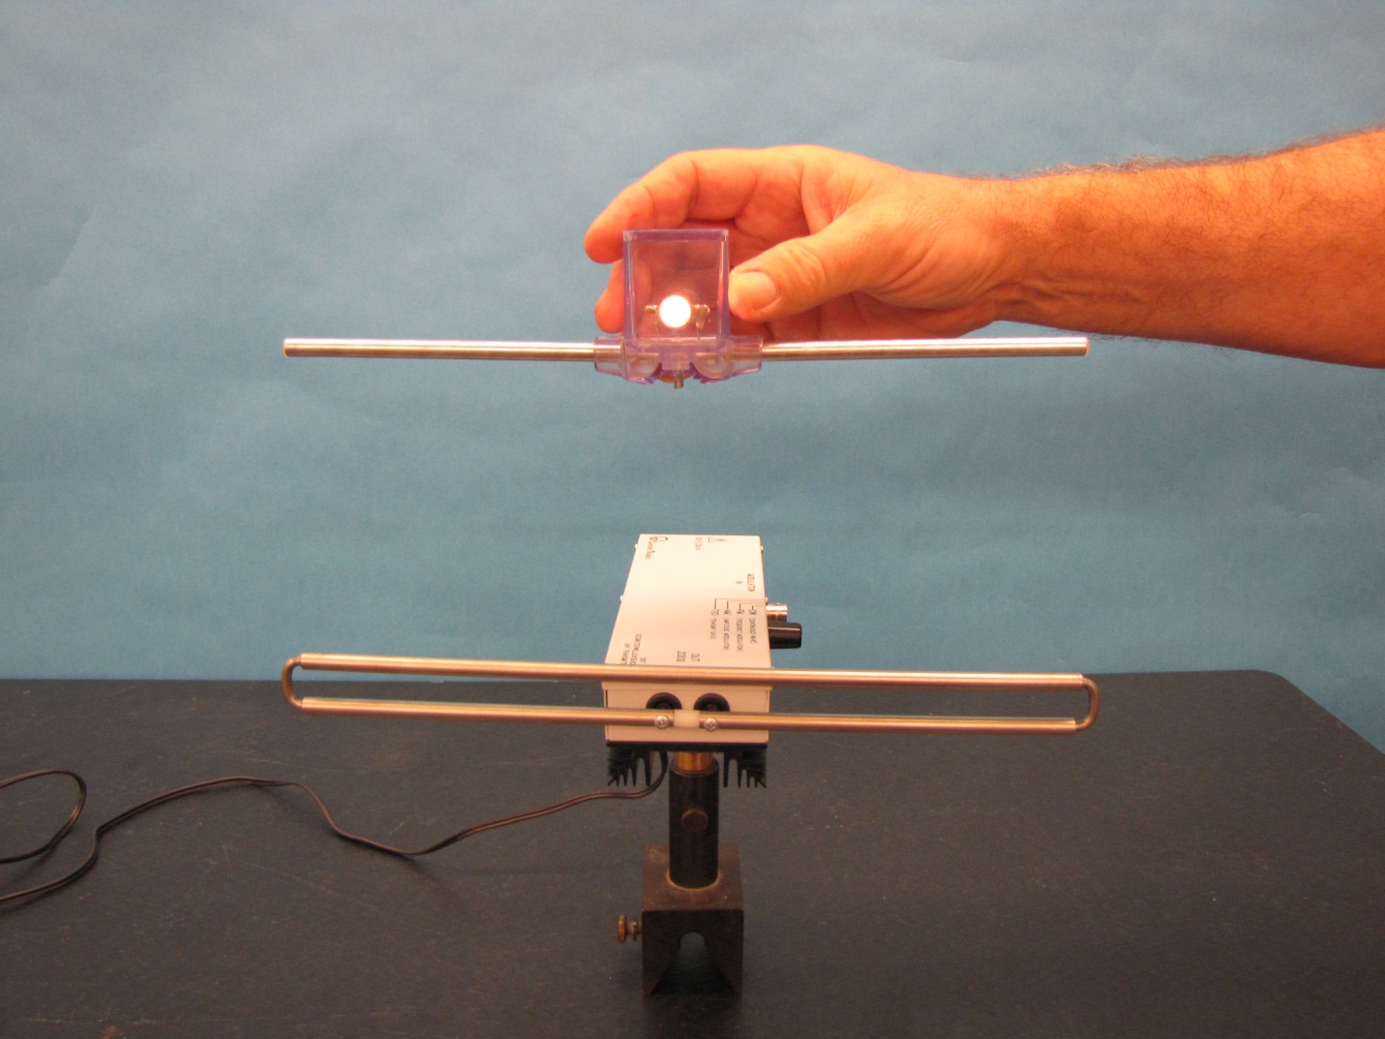
UHF Transmitter and Dipole Receiver (6D-17)
Notes:
Directions for doing the demo: Before powering the transmitter select the operating mode with the mode switch (preferably CW – continuous wave). Turn on the power to the transmitter. Move the receiver dipole close to the transmitter. The intensity of the lamp indicates the field strength of the signal. Move the receiver farther away and the light intensity diminishes. Rotate the receiver 90 degrees and the light goes out completely. Connect the receiver antenna to a voltmeter and you will get numerical readings indicating field strength of the signal.

Slide 35
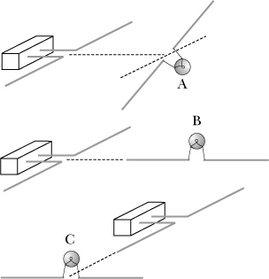
iClicker question (10 points for all inputs)
In which of these situations will the bulb light?
A
B
C
None
B and C
Notes:
A

Slide 36
iClicker Question: Why is sunset red ?
A. sunlight is red.
B. Human eye is more sensitive to red light at dust.
C. Light with other colors are mostly scattered and absorbed by air.

