Slide 1
Please Fill the online Course evaluation.
http://www.purdue.edu/idp/courseevaluations/CE_Students.html
We now have 70/264 responses
Survey close on 04/29
This is the official survey requested by university

Slide 2
Final Exam
* Friday: 05/04 in 1:00pm - 3:00pm in ELLT 116
* Chapters: 19, 20, 21, 22, 23 (4th edition)
* Makeup exam.
. approve only for valid reasons.
. If you need a makeup, please send me a request together with supporting
documents by 04/23 (Monday).
. Any requests after that will not be approved.
* Special needs
. If you has not contact me before, please bring me the letter from the Office
of the Dean of Students by 04/23 (Monday).
. Any request after that will not be approved.
* AOB
. multiple choice.
. Prepare your own scratch paper, pens, pencils, erasers, etc.
. Use only pencil for the answer sheet
. Bring your own calculators: graphic or scientific
. No cell phones, no text messaging which is considered cheating.
. No crib sheet of any kind is allowed. Equation sheet will be provided.
. 20 problems in total.

Slide 3
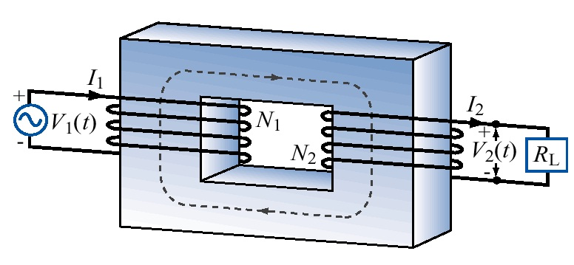
Transformer
Energy conservation:

Slide 4
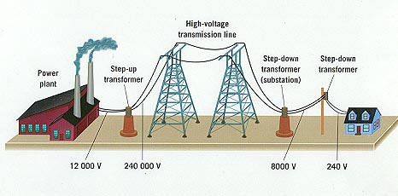
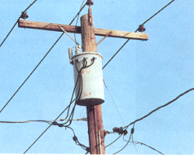
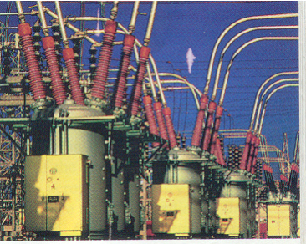
Previously asked question: Why use HV to transport electricity?
Single home current: 100 A service
ΔV_{wires}=IR_{wires}
Transformer: emf_{HV} I_{HV} = emf_{home}I_{home}
emf_{HV} > 100kV
Single home current in HV: <0.1 A
Power loss in wires ~ I²

Slide 5
iClicker Question
A current directed toward the top of the page and a circular loop of wire lie in the plane of the page. If a clockwise current is induced in the loop by the current I, what can you conclude about it?
I
a. I is increasing
b. I is decreasing
c. I remains constant
d. I is discontinuous
e. Nothing can be said.

Slide 6
Behavior of Inductors
Increasing Current
  Initially, the inductor behaves like a battery connected in reverse.
  After a long time, the inductor behaves like a conducting wire.
Decreasing Current
  Initially, the inductor behaves like a reinforcement battery.
  After a long time, the inductor behaves like a conducting wire.

Slide 7
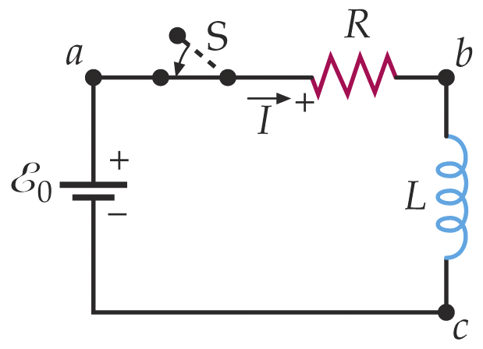
RL Circuits – Starting Current
Switch to e at t=0
As the current tries to begin flowing, self-inductance induces back EMF, thus opposing the increase of I.
+
Loop Rule:
-
3. Solve this differential equation
τ=L/R is the inductive time constant

Slide 8
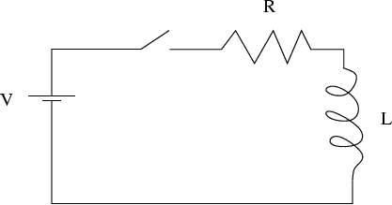
iClicker Question
The switch in this circuit is initially open for a
long time, and then closed at t = 0. What is the
magnitude of the voltage across the inductor
just after the switch is closed?
zero
V
R / L
V / R
2V

Slide 9
Energy Stored By Inductor
Switch on at t=0
As the current tries to begin flowing, self-inductance induces back EMF, thus opposing the increase of I.
+
Loop Rule:
-
3. Multiply through by I
Rate at which energy is stored in inductor L
Rate at which battery is supplying energy
Rate at which energy is dissipated by the resistor

Slide 10
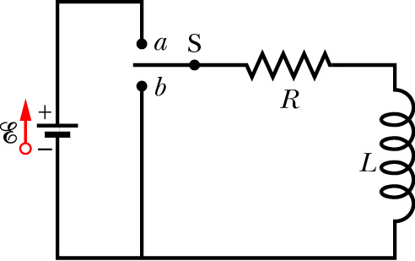
Where is the Energy Stored?
Energy must be stored in the magnetic field!
Energy stored by a capacitor is stored in its electric field
Consider a long solenoid where
area A
So energy density of the magnetic field is
length l
(Energy density of the electric field)

Slide 11
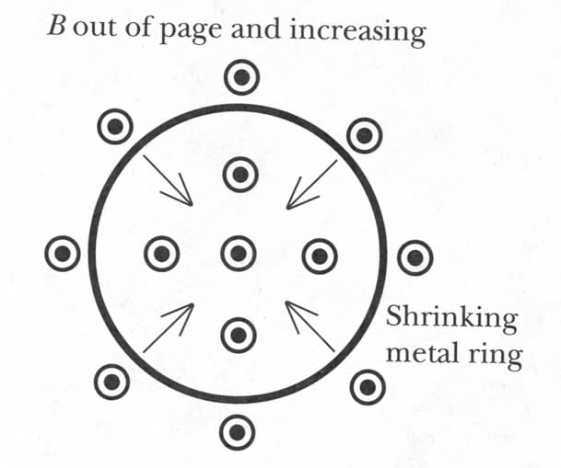
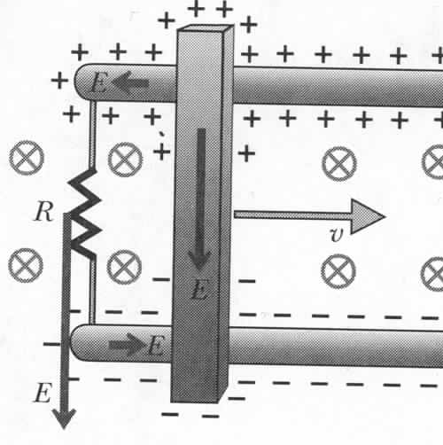
Changing Area and B Simultaneously
emf due to non-coulomb
electric field
Motional emf:
What is the second term due to?
Magnetic force!
Notes:
What if both terms are equal but opposite sign? There is magnetic force compensated by non-coulomb electric field!

Slide 12
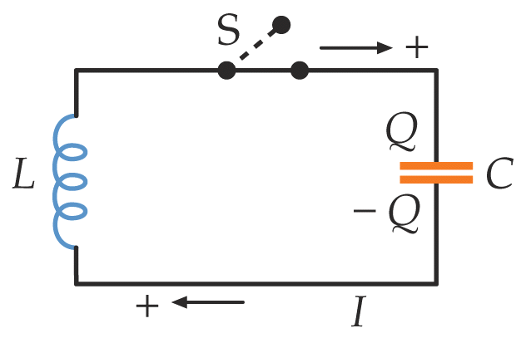
(Ideal) LC Circuit
From Kirchhoff’s Loop Rule
From Energy Conservation
same
harmonic oscillator with angular frequency
Natural Frequency

Slide 13
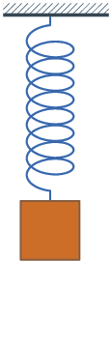
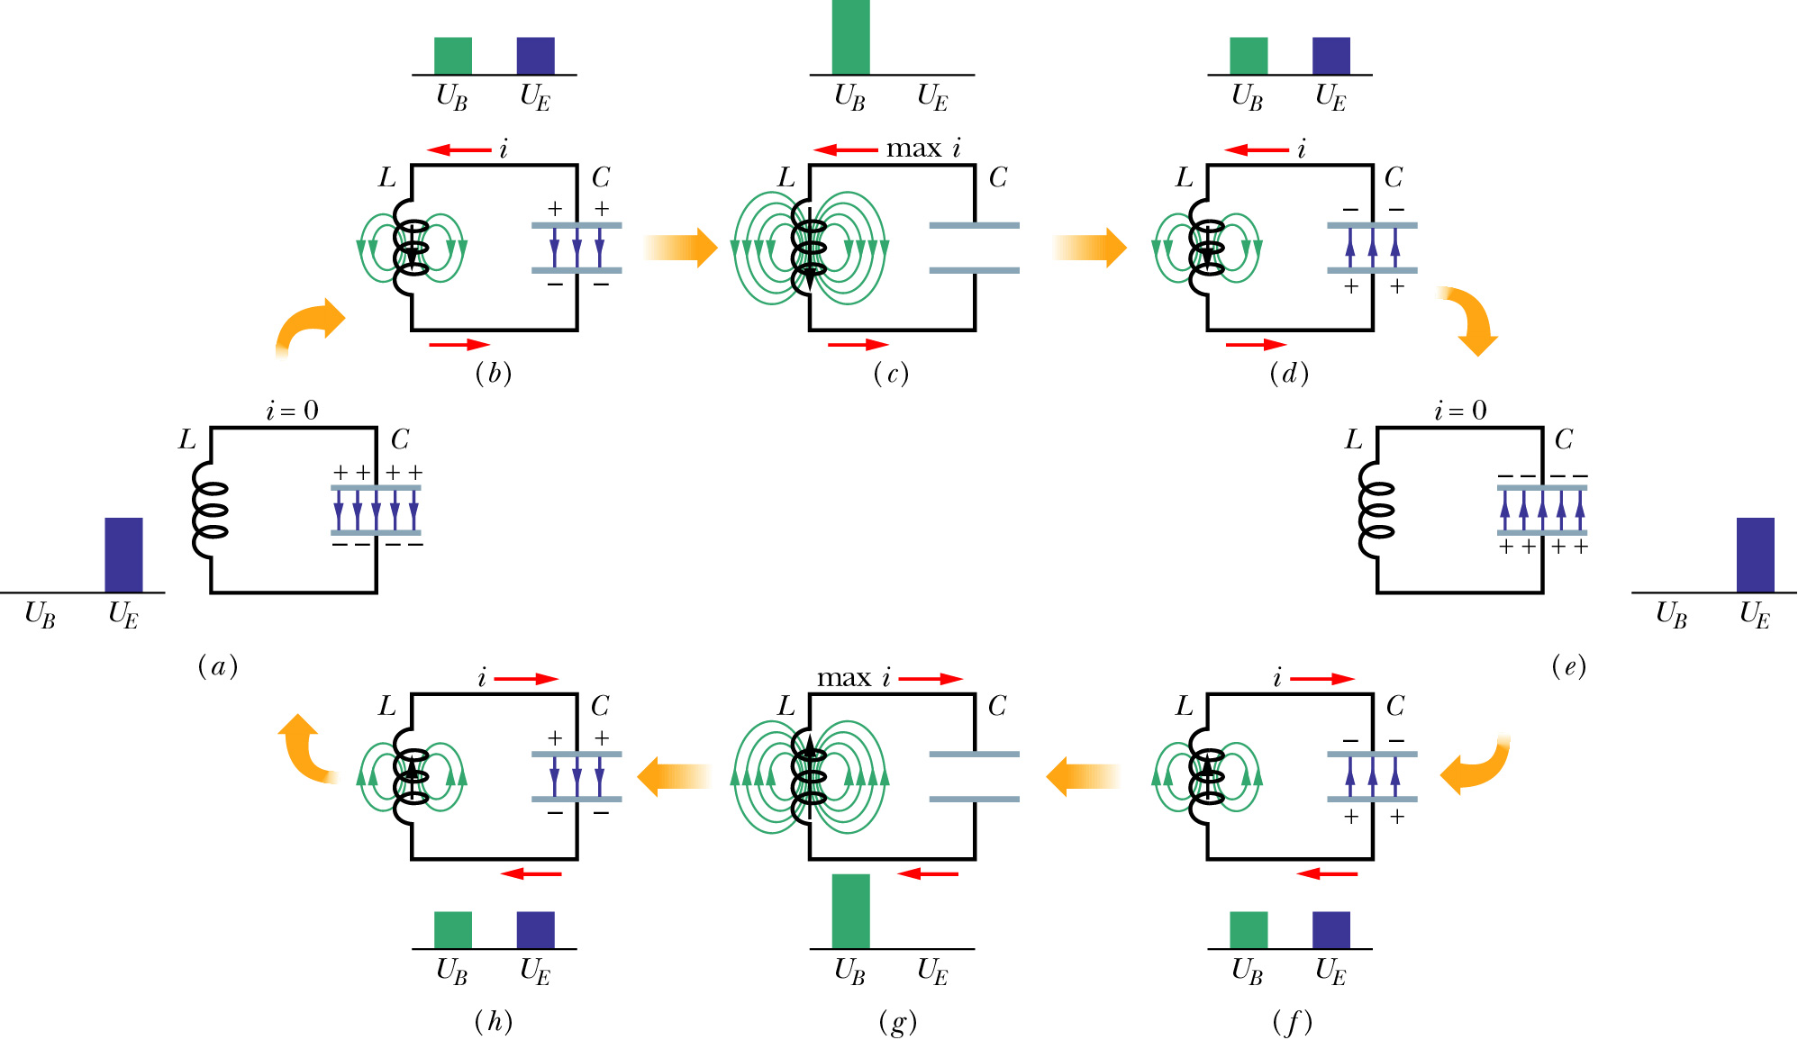
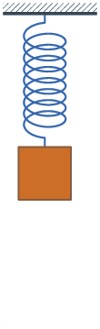
LC Oscillations
No Resistance = No dissipation

Slide 14
More for Today
Maxwell Equations – complete!
Wave solutions

Slide 15
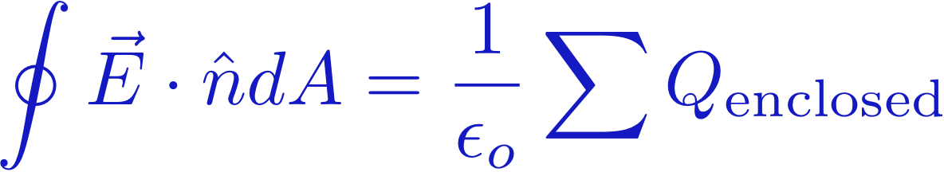
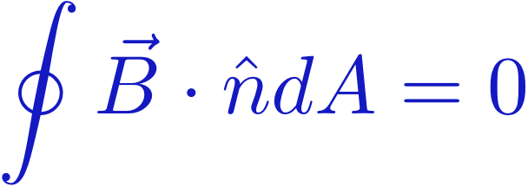
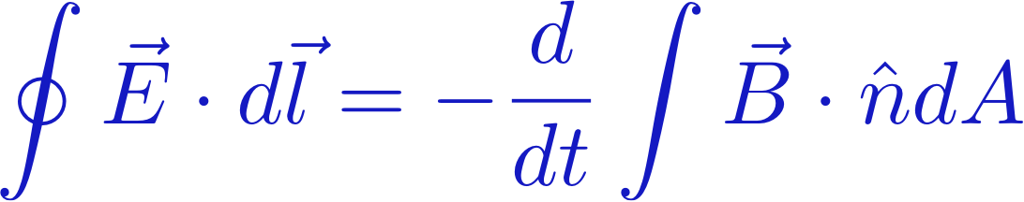

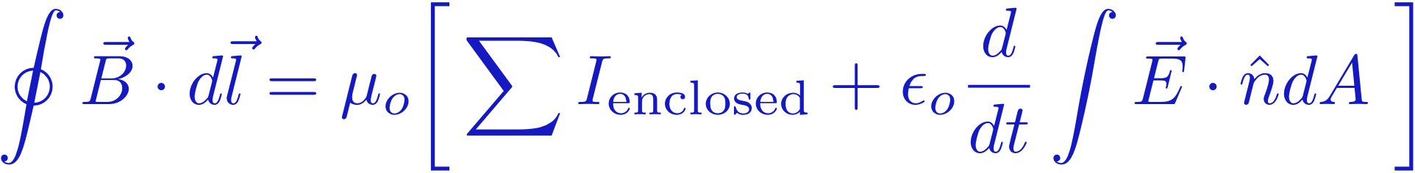
Maxwell's Equations (so far)
GAUSS' LAW
GAUSS' LAW
(Magnetism)

Slide 16
Maxwell's Equations (incomplete)
GAUSS' LAW
GAUSS' LAW
(Magnetism)
Chapter 23 (This week)
FARADAY'S LAW

Slide 17
Maxwell's Equations (incomplete)
GAUSS' LAW
GAUSS' LAW
(Magnetism)
Chapter 23 (Last week)
FARADAY'S LAW

Slide 18
Maxwell's Equations – The Full Story
GAUSS' LAW
GAUSS' LAW
(Magnetism)
Chapter 23 (Last week)
FARADAY'S LAW
AMPERE-MAXWELL
LAW
Chapter 24 (This week)

Slide 19
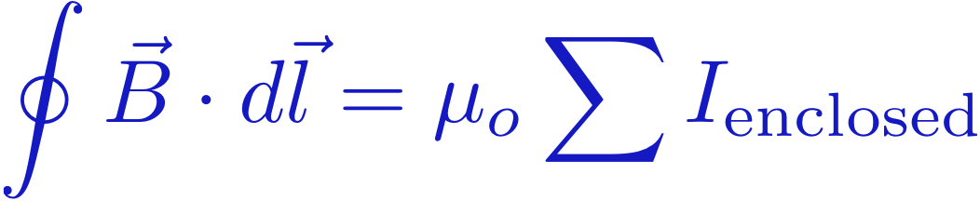
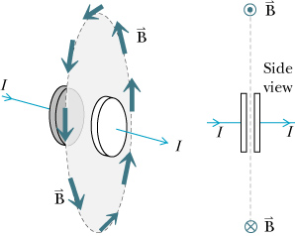
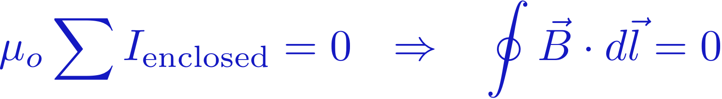
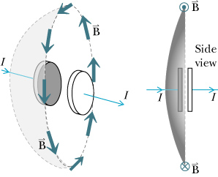
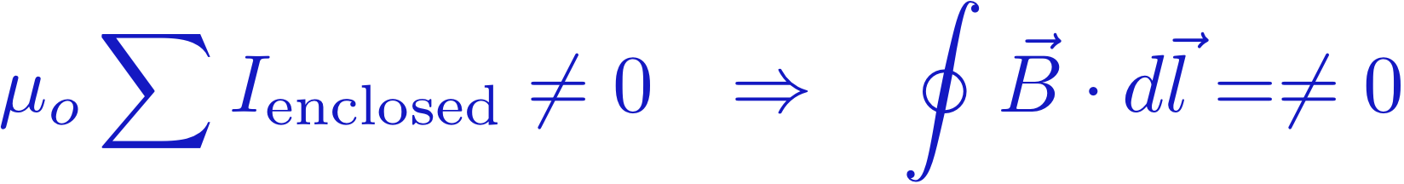
Adding time to Ampere's Law
Ampere's Law (incomplete)
The law stated above gives this contradiction:
Here,
capacitor
But moving the soap film gives this:
Something is amiss!

Slide 20
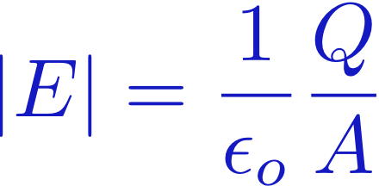
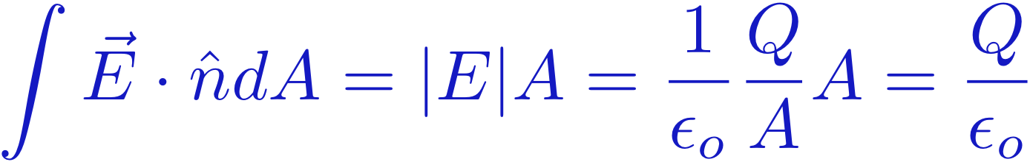
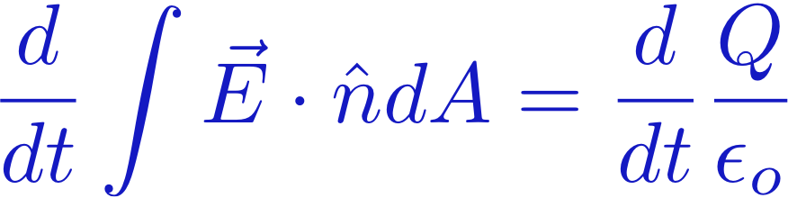
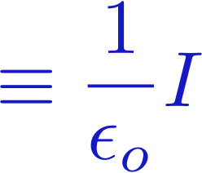
Adding time to Ampere's Law
Inside a capacitor
Electric flux through this surface:
Charge is on
the plate, not
on our surface
Find the time derivative:
Current in the wire,
not on our surface
So the flux acts like a "current" inside the capacitor:
AMPERE'S LAW
(Full form)
This term contributes
outside the capacitor
This term contributes
inside the capacitor

Slide 21
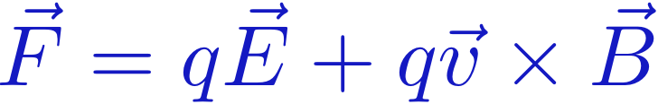
Maxwell's Equations – The Full Story
GAUSS' LAW
GAUSS' LAW
(Magnetism)
FARADAY'S LAW
AMPERE-MAXWELL
LAW
Everything there is to know about electricity & magnetism
is contained in these four laws plus the force law:

Slide 22
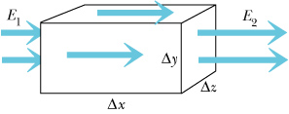
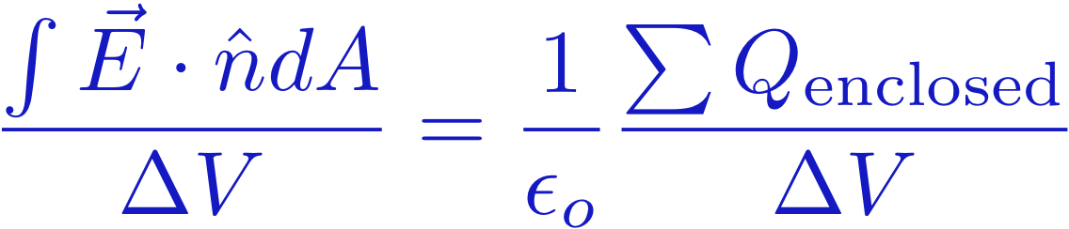
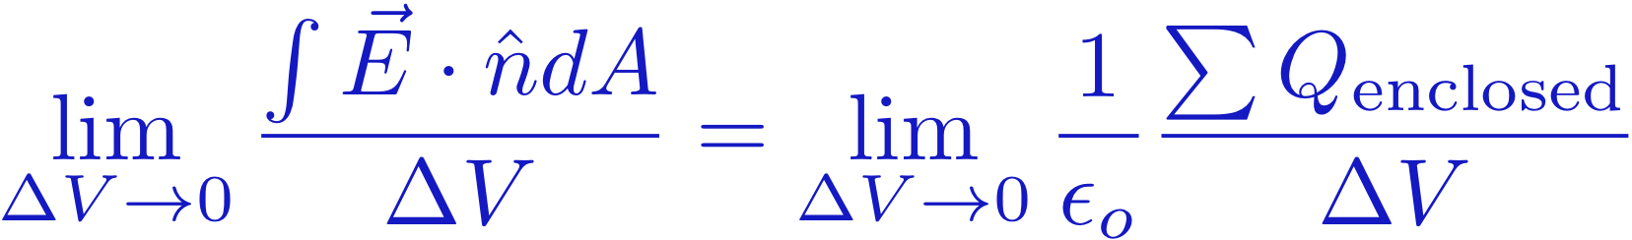
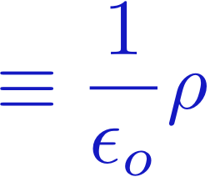
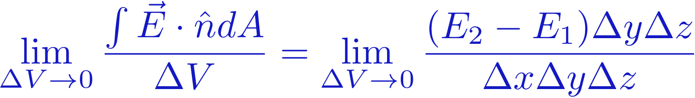
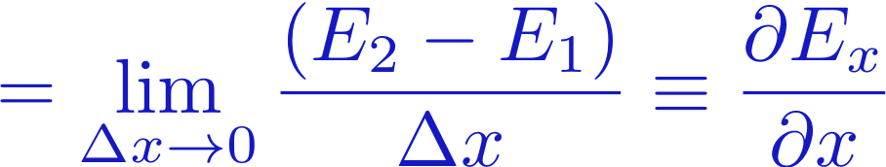
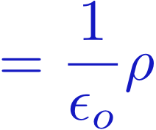
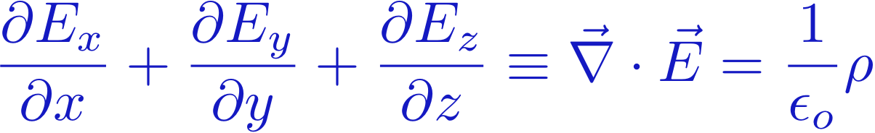
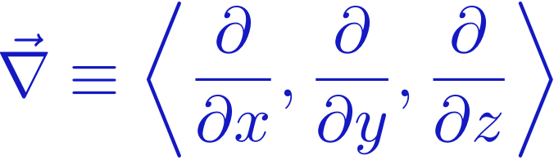
Differential Form of Gauss' Law (Sec. 22.8)
GAUSS' LAW
Think about a region of space, enclosed by a box.
Divide Gauss' law by the volume of the box:
E || x
Take the limit
of a small box
Work on the left hand side of the equation:
For a general case where E can point in any direction:
GAUSS' LAW
Differential Form
where
"Parallel Derivative"

Slide 23

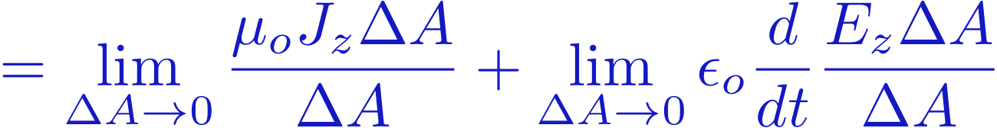
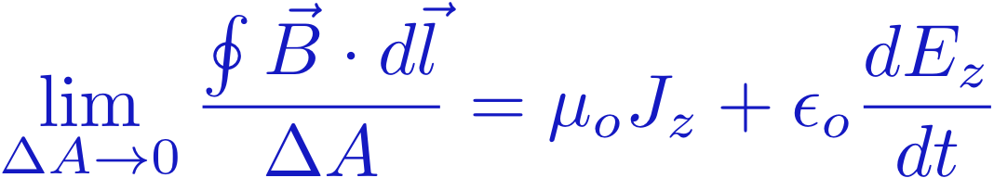
Differential Form of Ampere's Law (Sec. 22.9)
Ampere's Law
y
3
Write I in terms of current density J:
4
2
x
Divide Ampere's Law by a very small ΔA:
1
Current I
out of the board
In our geometry, n = z

Slide 24
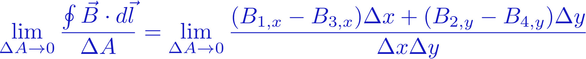
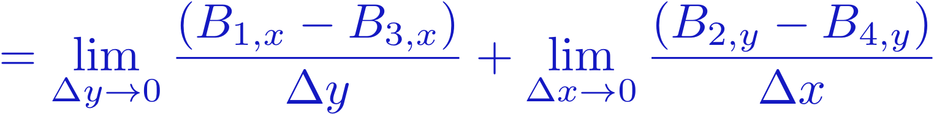
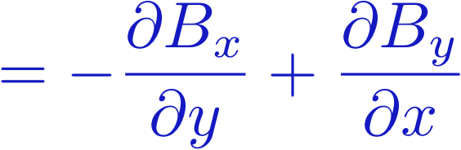
Differential Form of Ampere's Law (Sec. 22.9)
Ampere's Law
y
3
4
2
We divided Ampere's Law by a very small ΔA, and got this:
x
1
Current I
out of the board
Now work on the left hand side:
Definition of
derivative!
"Crossed derivative"

Slide 25
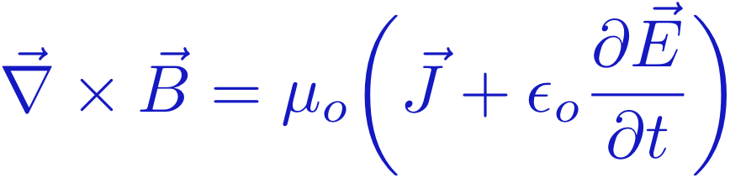
Differential Form of Ampere's Law (Sec. 22.9)
Ampere's Law
y
3
4
2
We divided Ampere's Law by a very small ΔA, and got this:
x
1
Current I
out of the board
For a loop in any direction, this can be re-expressed as:
AMPERE'S LAW
Differential Form

Slide 26

















Curl: Here's the Math
+ ( - )
+ ( - )
+ ( - )
copy 1st two colums
set up the answer
Blast from the Past!
Lecture 12

Slide 27
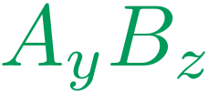
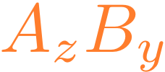



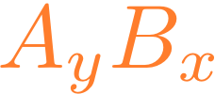

Curl: Here's the Math
+ ( - )
+ ( - )
+ ( - )
Blast from the Past!
Lecture 12

Slide 28
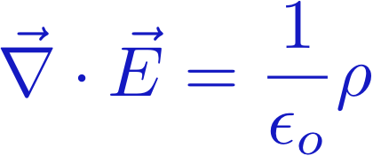

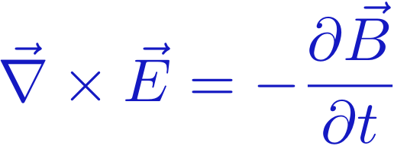
Maxwell's Equations – The Full Story
Divergence
GAUSS' LAW
Flux
GAUSS' LAW
(Magnetism)
Curl
FARADAY'S LAW
Circulation
AMPERE'S LAW

Slide 29

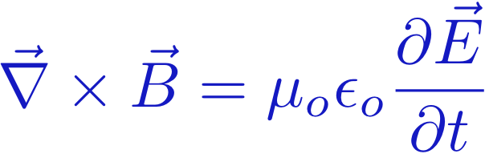
Maxwell's Equations – No Charges
In the ABSENCE of
"sources" = charges, currents:
GAUSS' LAW
GAUSS' LAW
(Magnetism)
FARADAY'S LAW
AMPERE'S LAW

Slide 30
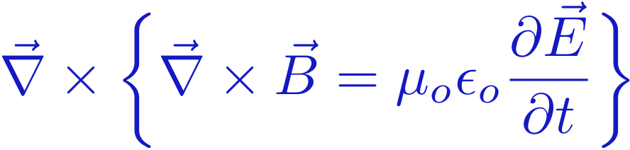
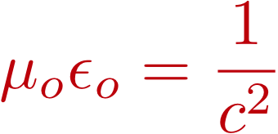



Maxwell's Equations – No Charges
What happens if we feed one equation into the other?
Use
This

Slide 31


Maxwell's Equations – No Charges
What happens if we feed one equation into the other?
("Vector identity" -- see Wolfram alpha)

Slide 32


Maxwell's Equations – No Charges
How do you solve a Differential Equation?
Know the answer! (Ask Wolfram Alpha)
→ This is a WAVE EQUATION, with speed c
Using similar ideas, you can show that E obeys the same equation:

Slide 33


Maxwell's Equations – No Charges
These two equations together
... lead to these two equations:
B is waving
E is waving

Slide 34



E and B wave solutions
These waves travel
at the speed of light!

Slide 35


A Pulse and Gauss’s Laws
Pulse is consistent with Gauss’s law
Pulse is consistent with Gauss’s law
for magnetism
Notes:
very hign and deep slab – fields only insude
Is it consistent with Maxwell’s law?

Slide 36

A Pulse and Faraday’s Law
Since pulse is ‘moving’, B depends on time and thus causes E
Area does
not move
emf
E=Bv
Is direction right (roughly)?
Notes:
Hand waving way to determine the E field direction.

Slide 37

A Pulse and Ampere-Maxwell Law
=0

Slide 38
A Pulse: Speed of Propagation
E=Bv
E=cB
Based on Maxwell’s equations, pulse must propagate at speed of light
Notes:
Spectacular result: Maxwell predicts speed of light for electromagnetic pulse in mid-1800 – but no one at this time could guess the electromagnetic nature of light, though the speed of light was already known.
He got speed of light theoretically from constants epsilon and mu which are easy to measure in experiment

Slide 39
Icliker quiz (10 points for any inputs)
Who is the first person who conclusively proved the existence of electromagnetic waves theorized by Maxwell?
Maxwell himself
H. R. Hertz
Farady
Lentz
Saruman

