Slide 1
Please Fill the online Course evaluation.
http://www.purdue.edu/idp/courseevaluations/CE_Students.html
We now have 24/264 responses
Survey close on 04/29
This is the official survey requested by university

Slide 2
Final Exam
* Friday: 05/04 in 1:00pm - 3:00pm in ELLT 116
* Chapters: 19, 20, 21, 22, 23 (4th edition)
* Makeup exam.
. approve only for valid reasons.
. If you need a makeup, please send me a request together with supporting
documents by 04/23 (Monday).
. Any requests after that will not be approved.
* Special needs
. If you has not contact me before, please bring me the letter from the Office
of the Dean of Students by 04/23 (Monday).
. Any request after that will not be approved.
* AOB
. multiple choice.
. Prepare your own scratch paper, pens, pencils, erasers, etc.
. Use only pencil for the answer sheet
. Bring your own calculators: graphic or scientific
. No cell phones, no text messaging which is considered cheating.
. No crib sheet of any kind is allowed. Equation sheet will be provided.
. 20 problems in total.

Slide 3
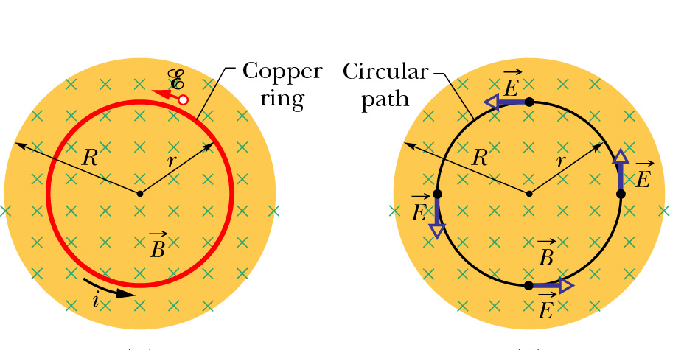


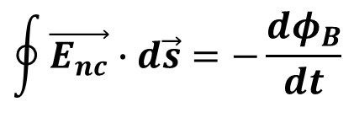
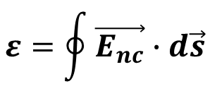
Induced Electric Field from Faraday’s Law
EMF is work done per unit charge:
If work is done on charge q, electric field E must be present:
W$=\oint{q\vec{E_{nc}}∙d\vec{s}}$
$$ε=\oint{\vec{E_{nc}}∙d\vec{s}}$$
Rewrite Faraday’s Law in terms of induced electric field:
$$\oint{\vec{E_{nc}}∙d\vec{s}=−\frac{dφ_{B}}{dt}}$$
This form relates E and B!
$$\oint{\vec{E}∙d\vec{s}=0}$$
Note that for E fields generated by charges at rest (electrostatics) since this would correspond to the potential difference between a point and itself. => Static E is conservative.
The induced E by magnetic flux changes is non-conservative.

Slide 4
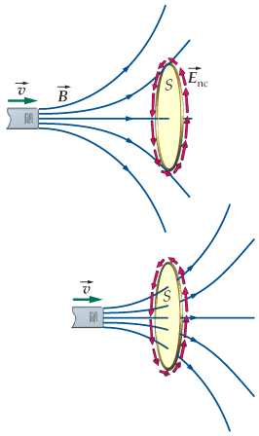
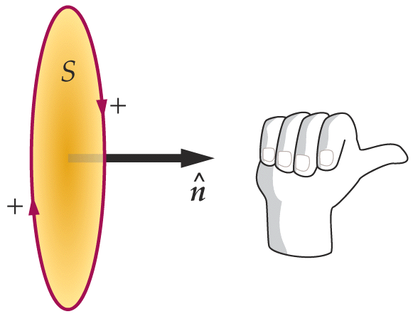
How to use Faraday’s law to determine the induced current direction
define the direction of ; can be any of the two normal direction, e.g. point to right
determine the sign of Φ. Here Φ>0
determine the sign of ∆Φ. Here ∆Φ >0
determine the sign of ε using faraday’s law. Here ε <0
RHR determines the positive direction for EMF ε
  If ε>0, current follow the direction of the curled fingers.
  If ε<0, current goes to the opposite direction of the curled fingers.
N

Slide 5
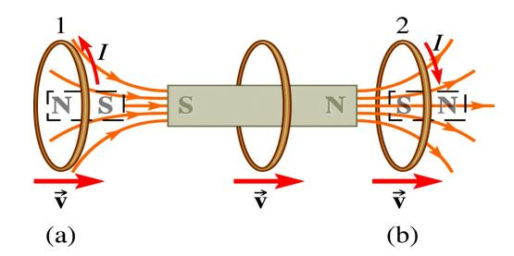
Conducting Loop in a Changing Magnetic Field
Induced EMF has a direction such that it opposes the change in magnetic flux that produced it.
approaching
moving away
Magnetic moment μ created by induced currrent I repels the bar magnet.
Magnetic moment μ created by induced currrent I attracts the bar magnet.
Force on ring is repulsive.
Force on ring is attractive.
Notes:
Now the demonstration again

Slide 6
iClicker Question
The magnetic field is increasing, what’s the direction of the induced currents in the closed rectangular loop?
Clockwise
Counterclockwise
No induced currents.

Slide 7
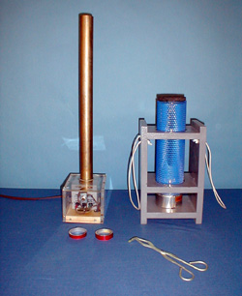
6D-11 Jumping Ring
Is there any differences in the two rings ?
Why one can jump up, the other can’t ?
https://www.youtube.com/watch?v=D2sRVORr2ks

Slide 8
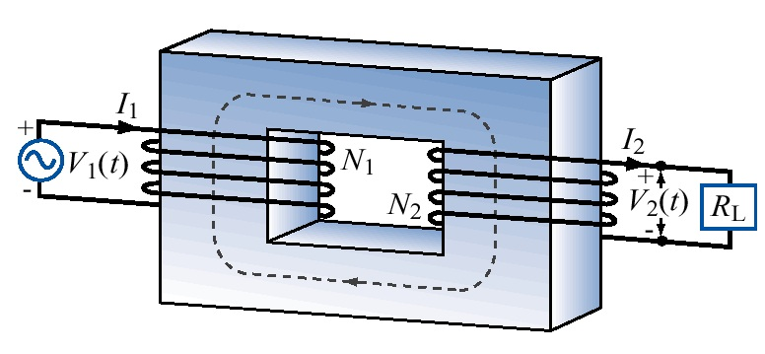
Transformer
Energy conservation:

Slide 9
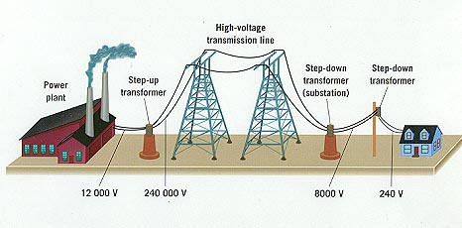
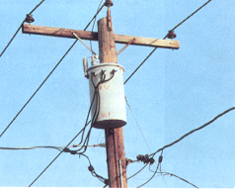
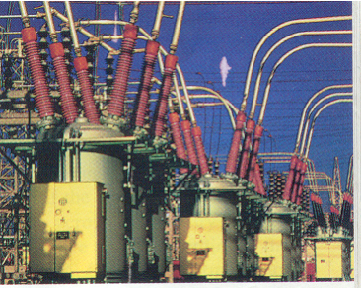
Previously asked question: Why use HV to transport electricity?
Single home current: 100 A service
ΔV_{wires}=IR_{wires}
Transformer: emf_{HV} I_{HV} = emf_{home}I_{home}
emf_{HV} > 100kV
Single home current in HV: <0.1 A
Power loss in wires ~ I²

Slide 10
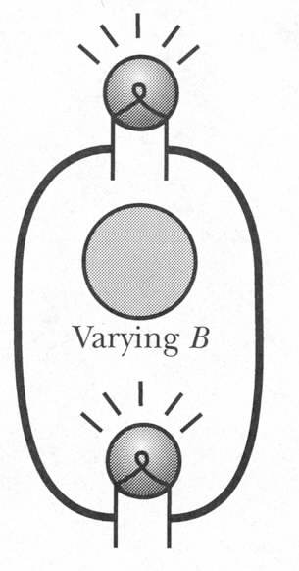
Two Bulbs Near a Solenoid
Varying B is created by AC current in a solenoid
What is the current in this circuit?

Slide 11
Two Bulbs Near a Solenoid
Add a thick wire:
I₁
Loop 1:
Loop 1
Loop 2:
I₂
Node:
Loop 2
I₃
Notes:
Nearly 4 times more power (because it is hotter, R increases)

Slide 12
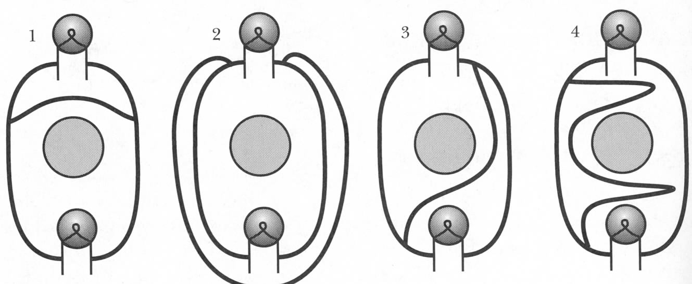
Exercise

Slide 13
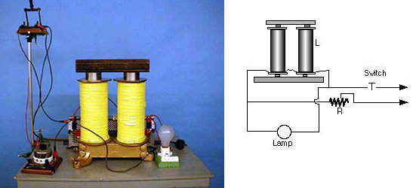
Demos: 6C-07 Energy Stored in an Inductive Circuit
Notes:
An electromagnet is connected to a DC source through a resistance that keeps the voltage across the terminals of the electromagnet below the source voltage when the battery is engaged. A light bulb is connected in parallel with the electromagnet. When the switch is closed, the bulb lights and energy is stored in the inductor. When the switch is opened, the battery is out of the circuit and the bulb and inductor are in series. The self-induced emf in the coil causes a greater potential difference across the coil than was there previously and the light bulb flashes brighter before going out.

Slide 14
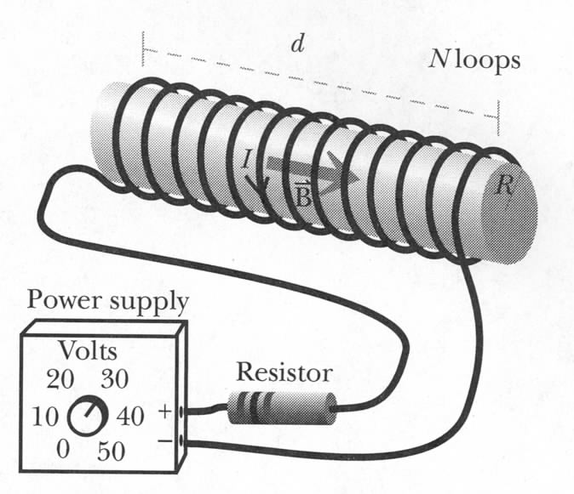
Inductance
R
emf_{bat}
emf_{coil}
Increasing I → increasing B
L – inductance, or self-inductance
R
emf_{bat}
Unit of inductance L:
Henry = Volt.second/Ampere
emf_{ind}
Inductance resists changes in current

Slide 15
Circuit Analysis Tips
Simplify using equivalent resistors
Label currents with arbitary directions
  If the calculated current is negative, the real direction is opposite to the one defined by you.
Apply Junction Rule to all the labeled currents.
  Useful when having multiple loops in a circuit.
Choose independent loops and define loop direction
  Imagine your following the loop and it’s direction to walk around the circuit.
Use Loop Rule for each single loop
  If current I direction across a resistor R is the same as the loop direction, potential drop across R is ∆V = −I×R, otherwise, ∆V = I×R
  For a device, e.g. battery or capacitor, rely on the direction of the electric field in the device and the loop direction to determine the Potential drop across the device
Solve simultaneous linear equations
Blast from the Past
Notes:
Current dirction is the moving direction of positive charge, i.e. the electric field direction, therefore, following the current direction, potential drops

Slide 16

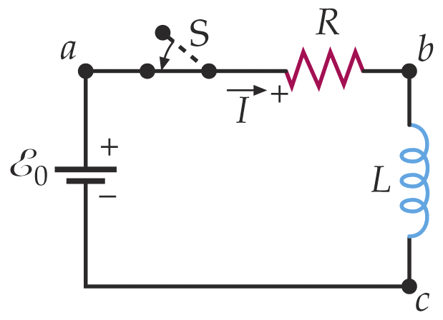
Potential Difference Across Inductor
+ε
internal resistance
ΔV
I
Analogous to a battery
An ideal inductor has r=0
All dissipative effects are to be included in the internal resistance (i.e., those of the iron core if any)
-

Slide 17
RL Circuits – Starting Current
Switch to e at t=0
As the current tries to begin flowing, self-inductance induces back EMF, thus opposing the increase of I.
+
Loop Rule:
-
3. Solve this differential equation
τ=L/R is the inductive time constant

Slide 18
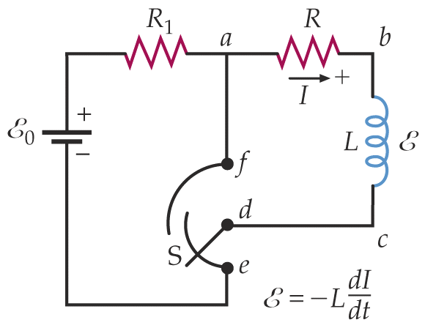
Remove Battery after Steady I already exists in RL Circuits
Initially steady current I_{o} is flowing:
-
Switch to f at t=0, causing back EMF to oppose the change.
+
Loop Rule:
Solve this differential equation
I cannot instantly become zero!
Self-induction
like discharging a capacitor

Slide 19
Behavior of Inductors
Increasing Current
  Initially, the inductor behaves like a battery connected in reverse.
  After a long time, the inductor behaves like a conducting wire.
Decreasing Current
  Initially, the inductor behaves like a reinforcement battery.
  After a long time, the inductor behaves like a conducting wire.

Slide 20
Energy Stored By Inductor
Switch on at t=0
As the current tries to begin flowing, self-inductance induces back EMF, thus opposing the increase of I.
+
Loop Rule:
-
3. Multiply through by I
Rate at which energy is stored in inductor L
Rate at which battery is supplying energy
Rate at which energy is dissipated by the resistor

Slide 21
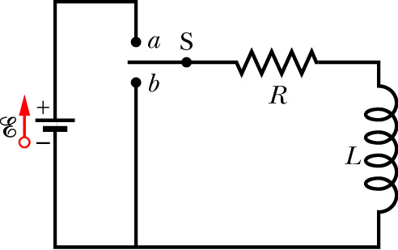
Where is the Energy Stored?
Energy must be stored in the magnetic field!
Energy stored by a capacitor is stored in its electric field
Consider a long solenoid where
area A
So energy density of the magnetic field is
length l
(Energy density of the electric field)

Slide 22
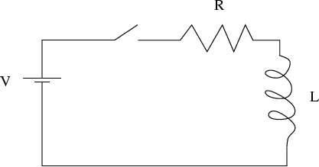
iClicker Question
The switch in this circuit is initially open for a
long time, and then closed at t = 0. What is the
magnitude of the voltage across the inductor
just after the switch is closed?
zero
V
R / L
V / R
2V

Slide 23
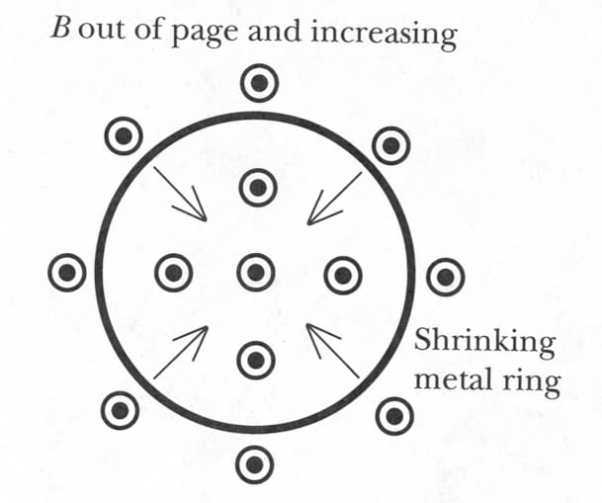
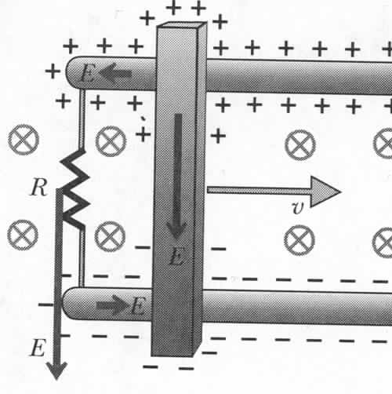
Changing Area and B Simultaneously
emf due to non-coulomb
electric field
Motional emf:
What is the second term due to?
Magnetic force!
Notes:
What if both terms are equal but opposite sign? There is magnetic force compensated by non-coulomb electric field!

Slide 24
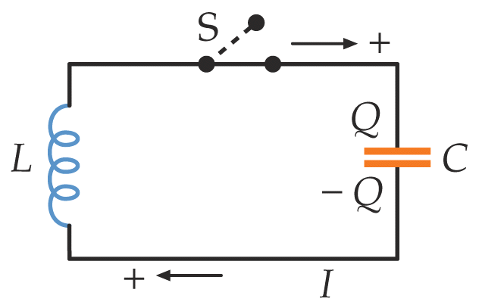
(Ideal) LC Circuit
From Kirchhoff’s Loop Rule
From Energy Conservation
same
harmonic oscillator with angular frequency
Natural Frequency

Slide 25

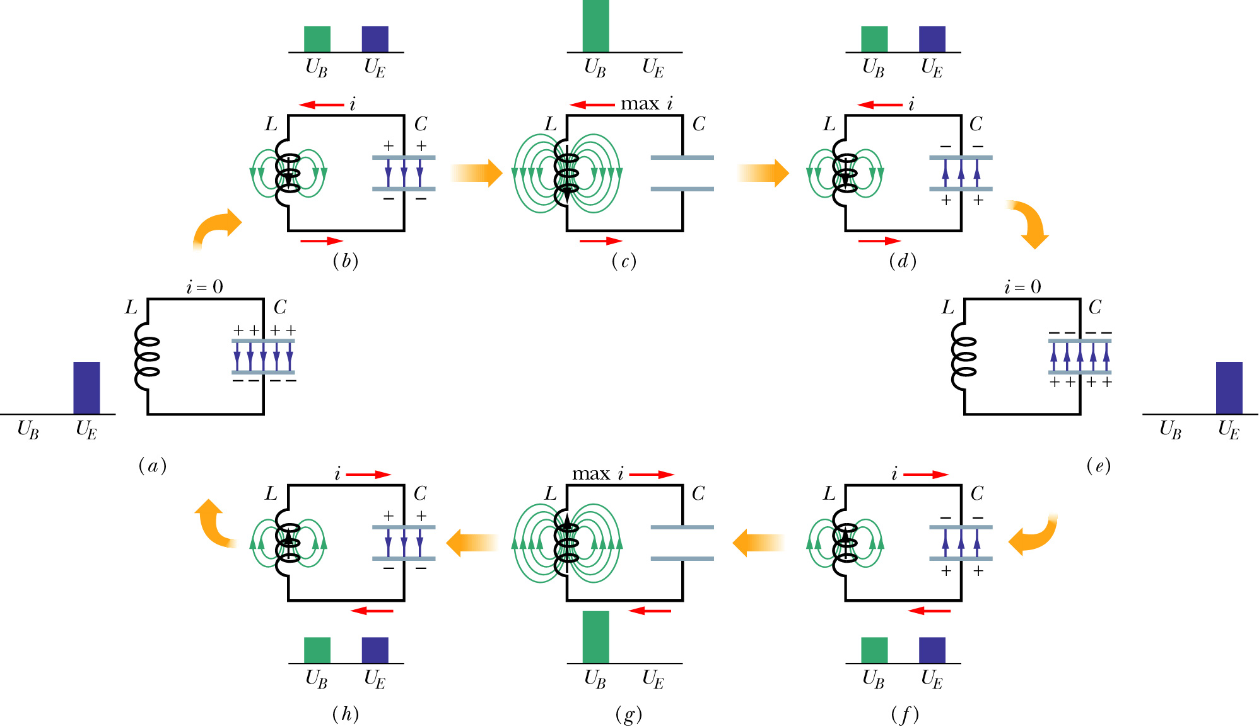
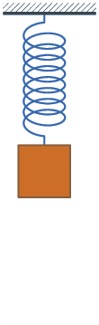
LC Oscillations
No Resistance = No dissipation

Slide 26
Furthermore

Slide 27
iClicker Question
The switch in this circuit is closed at t = 0. What is the magnitude of the voltage across the resistor a long time after the switch is closed?
zero
V
R / L
V / R
2V

Slide 28
iClicker Question
The switch in this circuit has been open for a long time. Then the switch is closed at t = 0. What is the magnitude of the current through the resistor immediately after the switch is closed?
zero
V / L
R / L
V / R
2V / R

Slide 29
iClicker Question
A current directed toward the top of the page and a rectangular loop of wire lie in the plane of the page. Both are held in place by an external force. If the current I is decreasing, what is the direction of the magnetic force on the left edge of the loop?
I
Toward the right
b. Toward the left
c. Toward top of page
d. Toward bottom of page
e. No force acts on it.

Slide 30
iClicker Question
A current directed toward the top of the page and a circular loop of wire lie in the plane of the page. If a clockwise current is induced in the loop by the current I, what can you conclude about it?
I
a. I is increasing
b. I is decreasing
c. I remains constant
d. I is discontinuous
e. Nothing can be said.

Slide 31
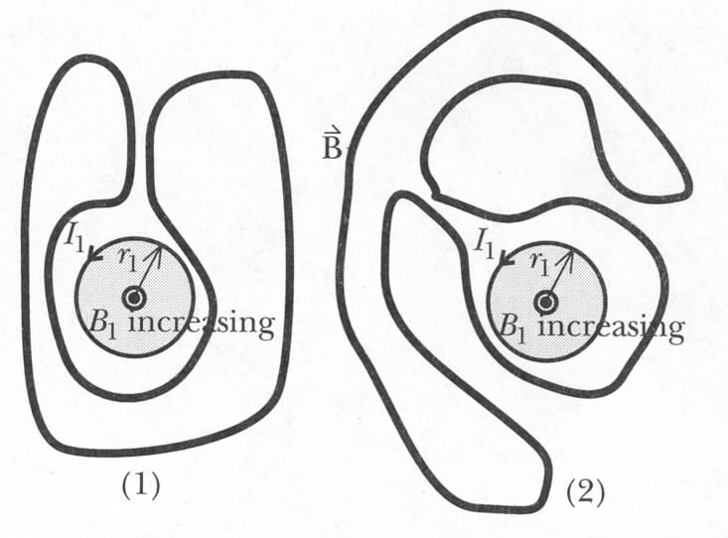
iClicker question:
Is there current in these circuits?
(1) yes, (2) no.
(1) no, (2) yes.
Neither has current

