Slide 1
Please Fill the online Course evaluation.
http://www.purdue.edu/idp/courseevaluations/CE_Students.html
We now have 0 responses
Survey close on 04/29
This is the official survey requested by university

Slide 2
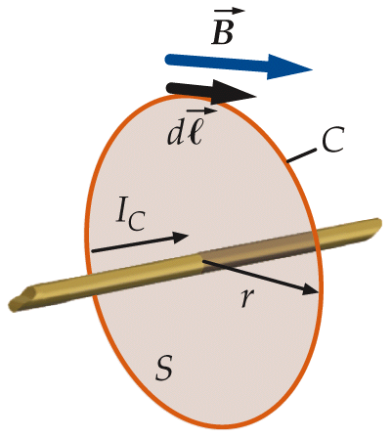
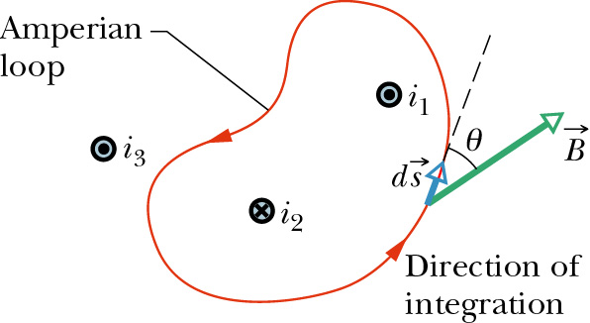
Ampere’s Law in Magnetostatics
Biot-Savart’s Law can be used to derive another relation: Ampere’s Law
The path integral of the dot product of magnetic field and unit vector along a closed loop, Amperian loop, is proportional to the net current encircled by the loop,
Choosing a direction of
integration.
A current is positive if it
flows along the RHR normal
direction of the Amperian
loop, as defined by the
direction of integration.

Slide 3
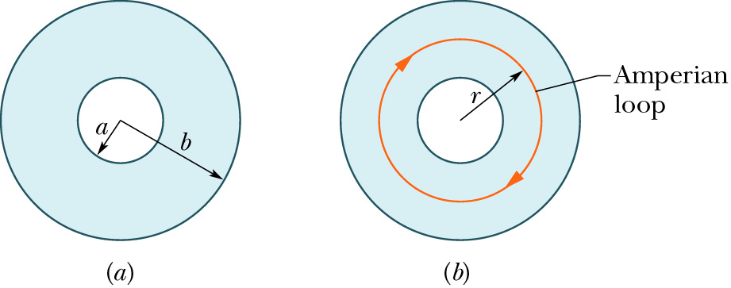
Example: A Non-Uniform Current Distribution
Long, hollow cylindrical current of current density:
Insider the cylinder, the total current encircled by the Amperian loop is

Slide 4
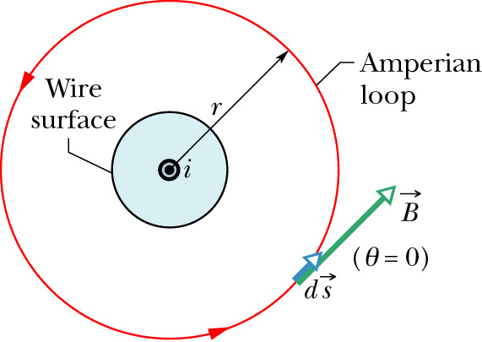
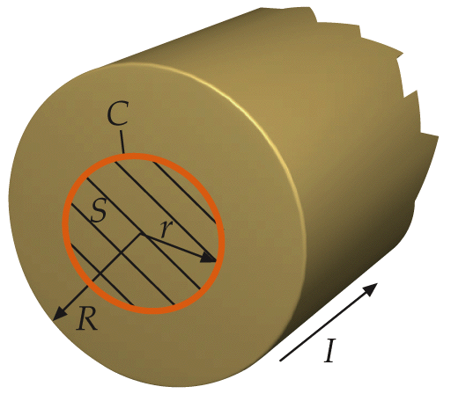
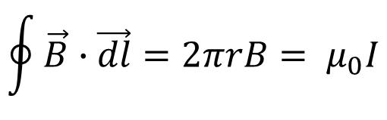
Example: Magnetic field of a long wire
outside the wire
$$\oint{\vec{B}∙\vec{dl}}=2πrB= μ_{0}I$$

Slide 5
iClicker Question
outside the wire
$$\oint{\vec{B}∙\vec{dl}}=2πrB= μ_{0}I$$
Assume uniform current density, what’s the magnetic field vs. r inside the long wire.
A).
C).
B).
D).
Notes:
B

Slide 6
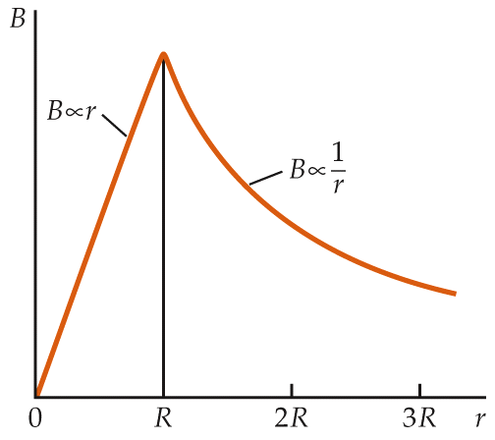
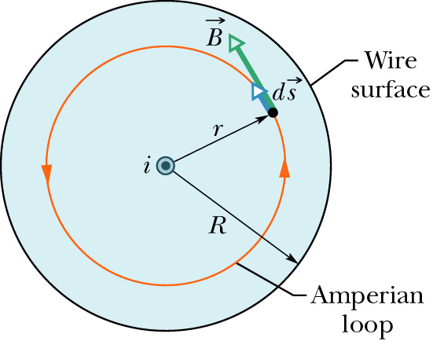

iClicker Question
outside the wire
$$\oint{\vec{B}∙\vec{dl}}=2πrB= μ_{0}I$$
inside the wire
$$\oint{\vec{B}∙\vec{dl}}=2πrB= μ_{0}I\frac{πr^{2}}{πR^{2}}$$

Slide 7
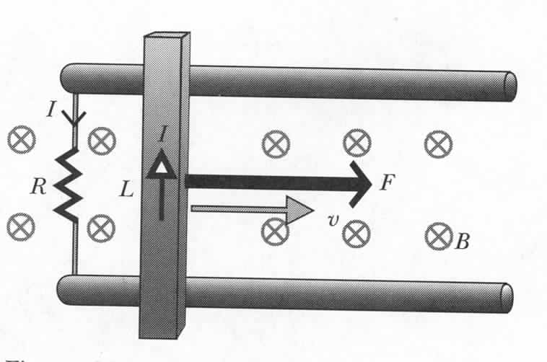

Moving Bar and Energy Conservation
P=IΔV=I(emf)
Are we getting something for nothing?
Bar – current I:
F_{I}
F
F_{m}
Work:
Power:
x
Main principle of electric generators:
Mechanical power is converted to electric power
Blast from the Past

Slide 8
Right now, can you answer the following questions?
The magnetic field is decreasing, what’s the direction of the induced currents in the closed rectangular loop?
(Not graded)
Clockwise
Counterclockwise
No induced currents.
Notes:
Draw student attention with this question and say can do it easily with Faraday’s law

Slide 9
Faraday’s Law: Electromagnetic Induction
We have seen that an electric current produces a magnetic field.
  Can magnetic fields produce electric currents?
An electric field is produced when there is a changing magnetic field.
In a closed electric circuit, that means current is generated due to the changing magnetic field.

Slide 10
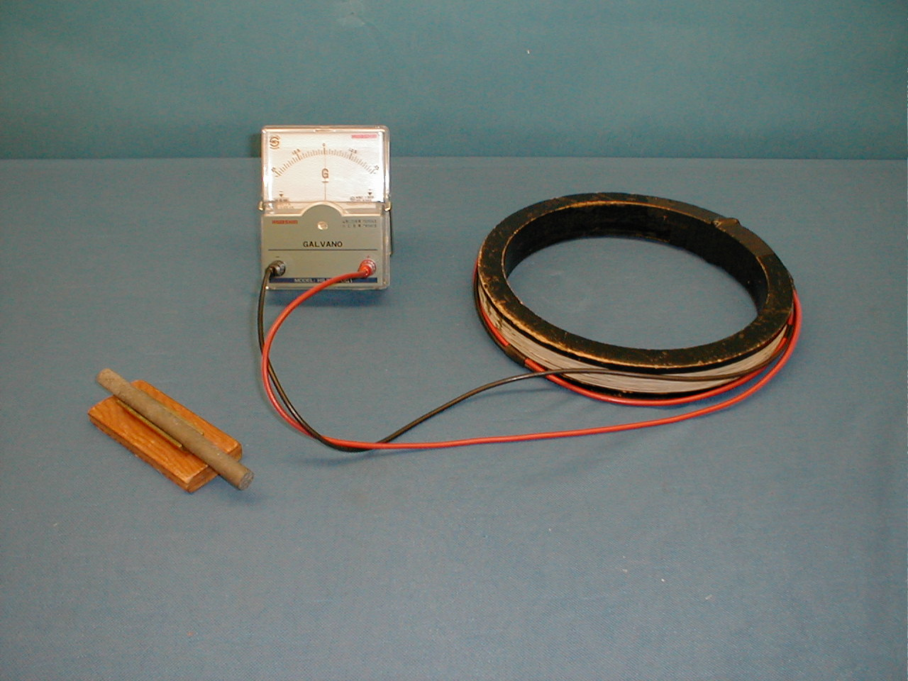
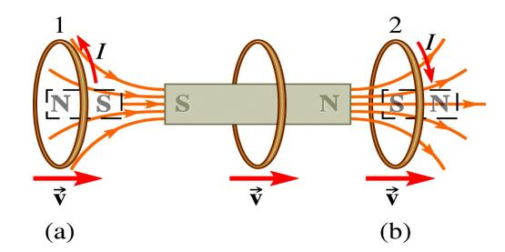
6D-04 Earth Magnetic Field Inductor
approaching
moving away

Slide 11
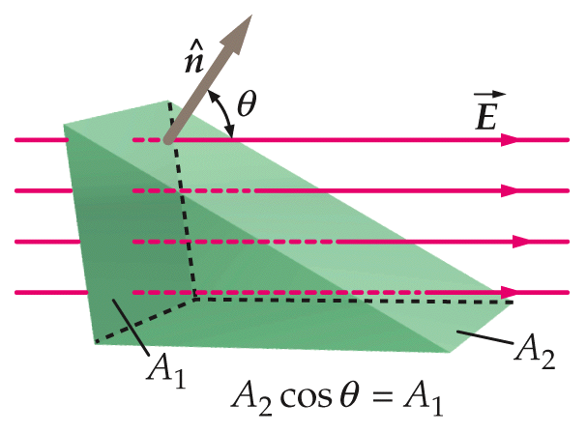
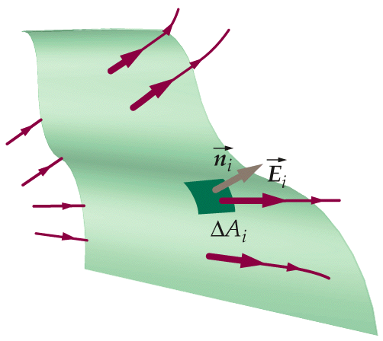
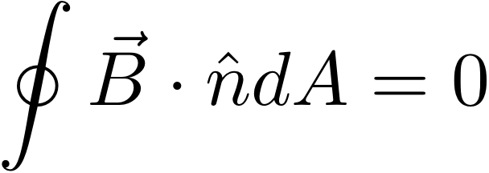
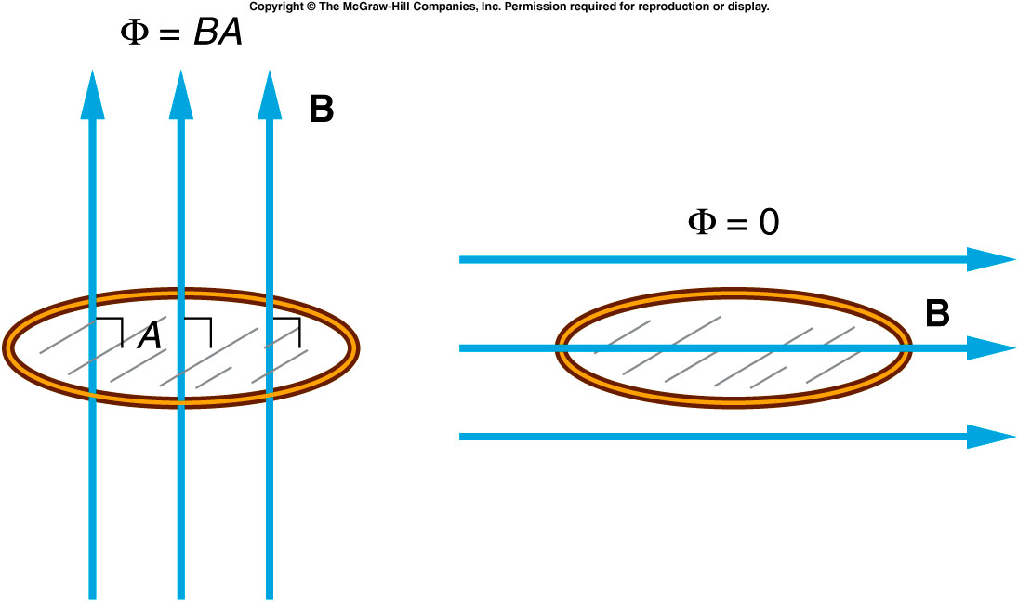
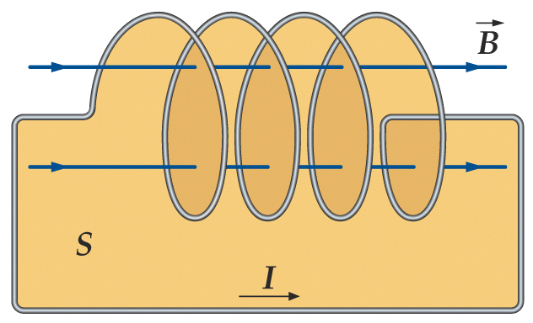
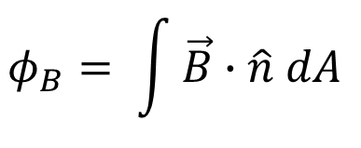

Magnetic Flux
$$φ_{B}=BA_{2}cosθ= \vec{B}∙\hat{n}A$$
1 Wb = 1 T m²
$$φ_{B}= \int{\vec{B}∙\hat{n} dA }$$
Gauss’s Law for Magnetism
over closed surface
(N turns)

Slide 12
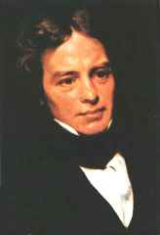
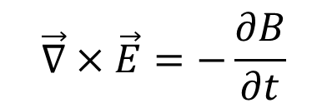
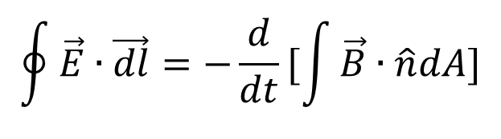
Faraday’s Law
Faraday’s law cannot be derived from the other fundamental principles we have studied
Formal version of Faraday’s law:
$$\oint{\vec{E}∙\vec{dl}}=−\frac{d}{dt}[\int{\vec{B}∙\hat{n}dA}]$$
Sign: given by right hand rule
Michael Faraday
(1791 - 1867)
$$\vec{∇}×\vec{E}=−\frac{∂B}{∂t}$$
Differential form of
Faraday’s law:
Notes:
Unlike motional emf – Faraday cannot be derived.
A British physicist and chemist, he is best known for his discoveries of electro-magnetic rotation, electro-magnetic induction and the dynamo.
Faraday's ideas about conservation of energy led him to believe that since an electric current could cause a magnetic field, a magnetic field should be able to produce an electric current. He demonstrated this principle of induction in 1831. Faraday expressed the electric current induced in the wire in terms of the number of lines of force that are cut by the wire. The principle of induction was a landmark in applied science, for it made possible the dynamo, or generator, which produces electricity by mechanical means

Slide 13
Two Ways to Produce Changing Φ
Two ways to produce curly electric field:
1. Changing B
2. Changing A
Notes:
Changing B field or area (shape, orientation)

Slide 14
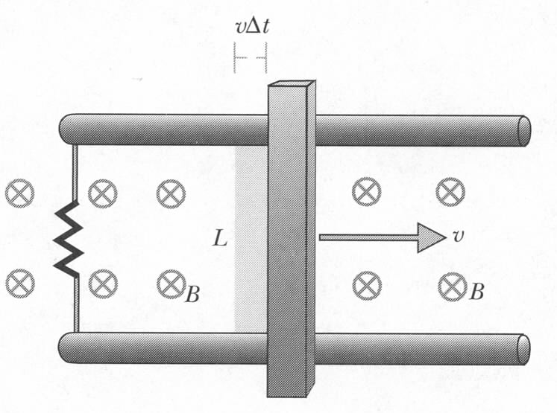
Faraday’s Law and Motional EMF
‘Magnetic force’ approach:
I
Use Faraday law:
I
Notes:
When a wire moves through magnetic field -> magnetic forces drive current through wire

Slide 15
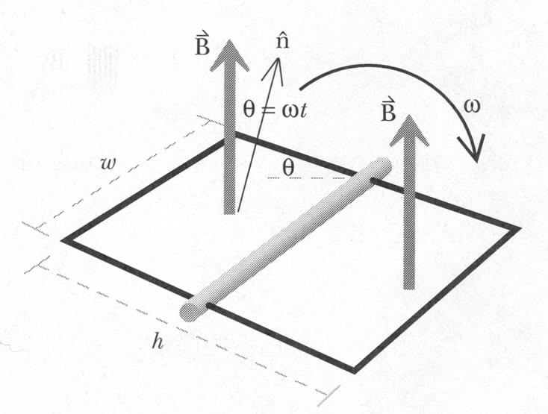
Faraday’s Law and Generator
I
5B-11 Human Power Generator
Notes:
Old problem

Slide 16
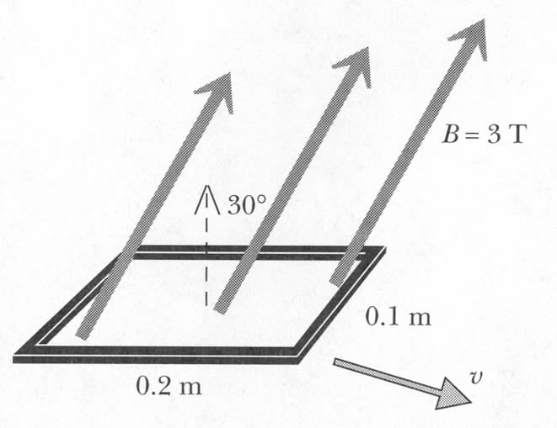
iClicker question
A uniform time-independent magnetic field B=3 T points 30º to
the normal of the rectangular loop.
The loop moves at constant speed v
What is the emf?
1.5v
3v
0
6v
Notes:
Old problem

Slide 17
Exercise
A uniform time-independent magnetic field B=3 T points 30º to
the normal of the rectangular loop.
The loop moves at constant speed v
1. What is the emf?
2. In 0.1 s the loop is stretched to be 0.12 m by 0.22 m. What is average emf during this time?
Notes:
Old problem

Slide 18
Example
R
L
v
I
B₁
B₂
LvΔt
Notes:
Old problem

Slide 19
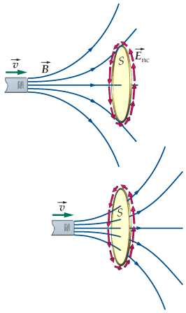
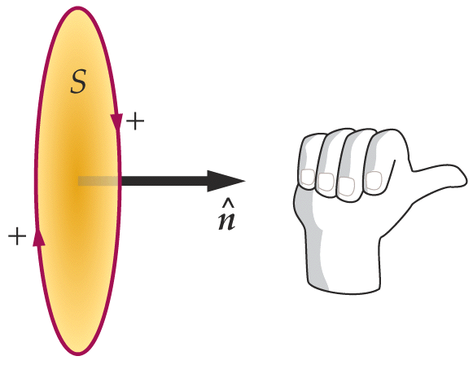
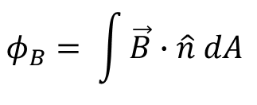
Faraday’s Law of Induction (More Quantitative)
The magnitude of the induced EMF in conducting loop is equal to the rate at which the magnetic flux through the surface spanned by the loop changes with time.
$$φ_{B}= \int{\vec{B}∙\hat{n} dA }$$
where
N
Minus sign indicates the sense of EMF: Lenz’s Law
Decide on which way n goes
Fixes sign of Φ_{B}
N
RHR determines the positive direction for EMF ε

Slide 20
How to use Faraday’s law to determine the induced current direction
define the direction of ; can be any of the two normal direction, e.g. point to right
determine the sign of Φ. Here Φ>0
determine the sign of ∆Φ. Here ∆Φ >0
determine the sign of ε using faraday’s law. Here ε <0
RHR determines the positive direction for EMF ε
  If ε>0, current follow the direction of the curled fingers.
  If ε<0, current goes to the opposite direction of the curled fingers.
N

Slide 21
Conducting Loop in a Changing Magnetic Field
Induced EMF has a direction such that it opposes the change in magnetic flux that produced it.
approaching
moving away
Magnetic moment μ created by induced currrent I repels the bar magnet.
Magnetic moment μ created by induced currrent I attracts the bar magnet.
Force on ring is repulsive.
Force on ring is attractive.
Notes:
Now the demonstration again

Slide 22
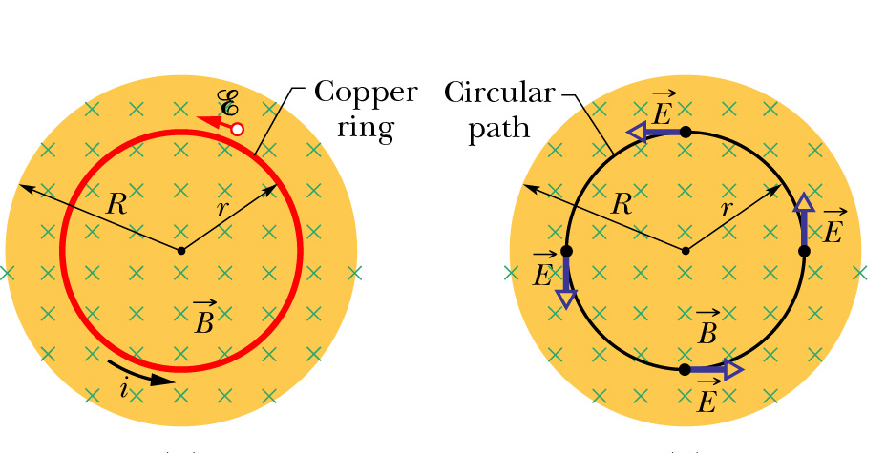


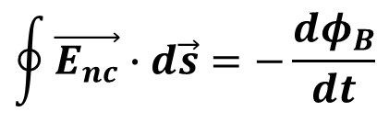
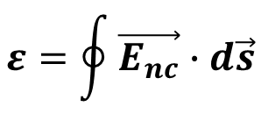
Induced Electric Field from Faraday’s Law
EMF is work done per unit charge:
If work is done on charge q, electric field E must be present:
W$=\oint{q\vec{E_{nc}}∙d\vec{s}}$
$$ε=\oint{\vec{E_{nc}}∙d\vec{s}}$$
Rewrite Faraday’s Law in terms of induced electric field:
$$\oint{\vec{E_{nc}}∙d\vec{s}=−\frac{dφ_{B}}{dt}}$$
This form relates E and B!
$$\oint{\vec{E}∙d\vec{s}=0}$$
Note that for E fields generated by charges at rest (electrostatics) since this would correspond to the potential difference between a point and itself. => Static E is conservative.
The induced E by magnetic flux changes is non-conservative.

Slide 23
iClicker Question
The magnetic field is decreasing, what’s the direction of the induced currents in the closed rectangular loop?
Clockwise
Counterclockwise
No induced currents.
Notes:
A

Slide 24
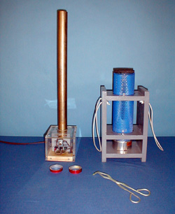
6D-11 Jumping Ring
Is there any differences in the two rings ?
Why one can jump up, the other can’t ?
https://www.youtube.com/watch?v=D2sRVORr2ks

Slide 25
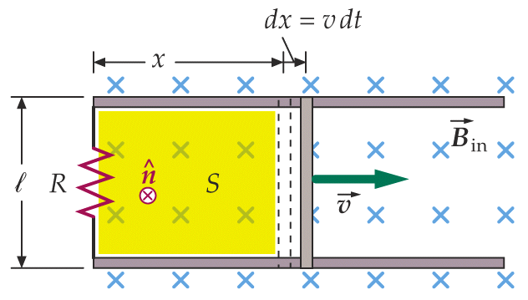
iClicker Question
The magnetic field is fixed, what’s the direction of the induced currents in the closed rectangular loop?
Clockwise
Counterclockwise
No induced currents.
Notes:
B

Slide 26
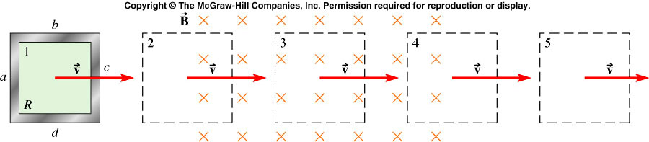
Example
At 1, 3, and 5, Φ_{B} is not changing. So there is no induced emf.
At 4, Φ_{B} in decreasing into page. So current is clockwise.
At 2, Φ_{B} is increasing into page. So emf is induced to produce a counterclockwise current.

Slide 27
iClicker Question
A current directed toward the top of the page and a rectangular loop of wire lie in the plane of the page. Both are held in place by an external force. If the current I is decreasing, what is the direction of the magnetic force on the left edge of the loop?
I
Toward the right
b. Toward the left
c. Toward top of page
d. Toward bottom of page
e. No force acts on it.

Slide 28
iClicker Question
A current directed toward the top of the page and a circular loop of wire lie in the plane of the page. If a clockwise current is induced in the loop by the current I, what can you conclude about it?
I
a. I is increasing
b. I is decreasing
c. I remains constant
d. I is discontinuous
e. Nothing can be said.

Slide 29
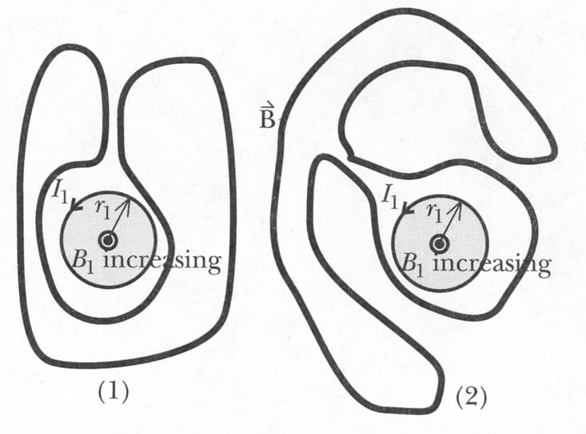
iClicker question:
Is there current in these circuits?
(1) yes, (2) no.
(1) no, (2) yes.
Neither has current

