Slide 1
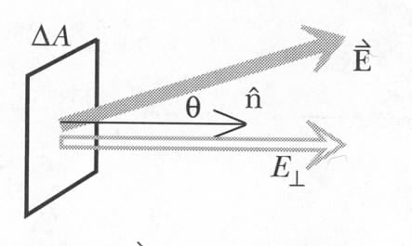
Electric Flux: Perpendicular Field or Area
Perpendicular field
Perpendicular area
Δx
Δy
q

Slide 2
Adding up the Flux

Slide 3
Gauss’s Law
Features:
1. Proportionality constant
2. Size and shape independence
3. Independence on number of charges inside
4. Charges outside contribute zero

Slide 4
Uniformly charged thin, infinite sheet
Gauss’s Law!
A
h
Notes:
For infinitely large plan, at any point in space, one can always find on the plan two symmetrical point who’s vertical component cancel each other. Therefore the total field direction must perpendicular to the plane.

Slide 5
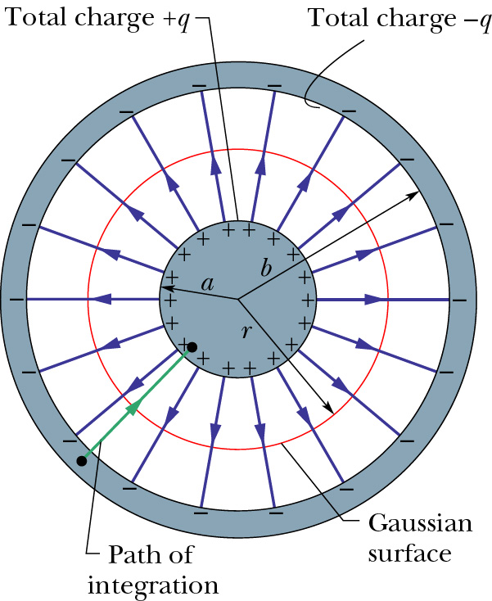
Spherical Capacitor
Put charges +q on inner sphere of radius a, -q on outer shell of inner radius b.
Calculate E by Gauss’s Law
3. Calculate V from E
4. Divide q by V
q is proportional to V
C only depends on a,b
(isolated sphere)
Notes:
Skip this if lack of time.

Slide 6
iClicker Question
Five identical small cubes, each carries charge Q, are placed in or out of a box. Three are inside the box and 2 are outside the box. What’s the total flux through the surface of the box?
Q/ε₀
2Q/ε₀
3Q/ε₀
4Q/ε₀
5Q/ε₀
Notes:
a)

Slide 7
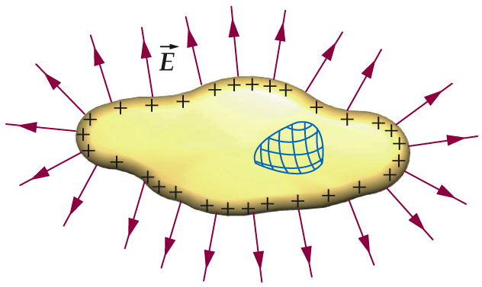
Example: Amount of induced charge inside a conductor
Hollow region
Net charge induced = +q
Net charge Q ( > 0) on the conductor
Net charge –q < 0
+
+
+
+
+
+
Net charge (Q-q) on the outside surface
Hollow region Field ?

Slide 8
iClicker question
A conductor has a net charge of -24μC on it. It also has a hollow region in the interior. If you place a charge of +12 μC in this hollow region, what will be the total charge on the exterior surface of the object?
-24 μC
12 μC
-36 μC
-12 μC
5 μC

Slide 9
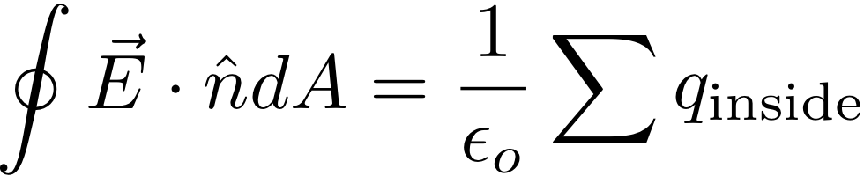
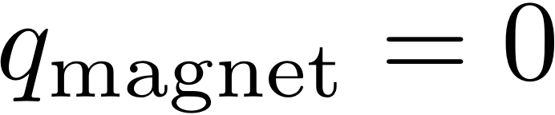
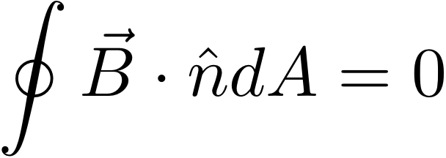
Gauss' Law for Magnetism?
GAUSS' LAW for charge
So far, no experiment has found a "magnetic charge"
(a.k.a. magnetic monopole)
Big fat ZERO!
→ Gauss' Law for Magnetism is simpler:
NO
MAGNETIC
MONOPOLES
GAUSS' LAW
FOR MAGNETISM
http://www.congresshotelstrike.info/

Slide 10
Next Up: Ampere's Law
First review Biot-Savart Law

Slide 11
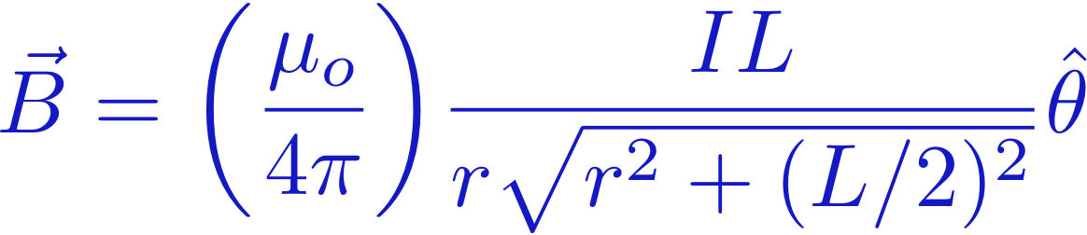
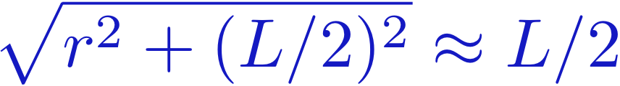
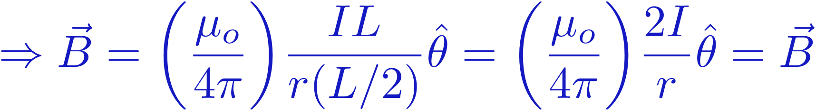
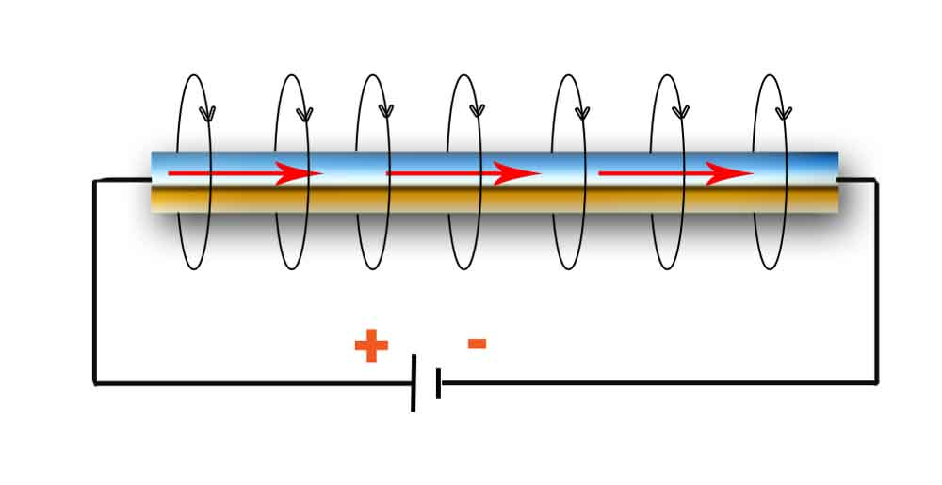
Very Close to the Wire
Very close to the wire: r << L
CLOSE TO
THE WIRE
B
I
Blast from the Past
Lecture 13
http://physick.wikispaces.com/Electric+Current

Slide 12
Very Long Wire
Very Long wire: L >> r
VERY LONG
WIRE
B
I
Blast from the Past
Lecture 13
http://physick.wikispaces.com/Electric+Current

Slide 13
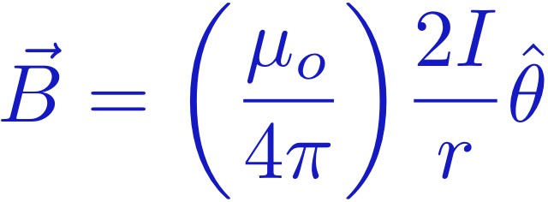
Very Long Wire
Viewed from the end
Current coming out of board
s

Slide 14
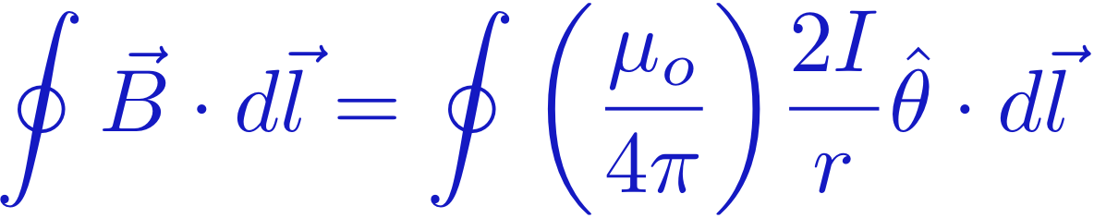

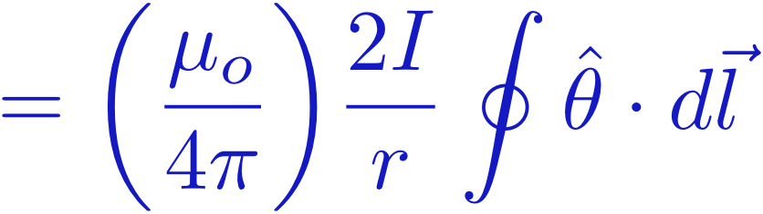

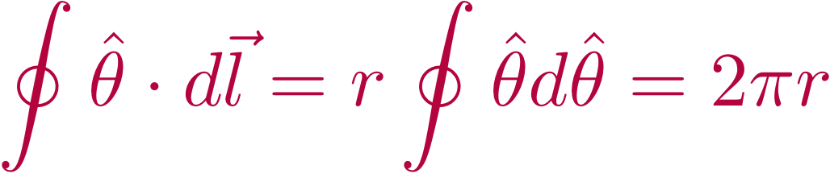
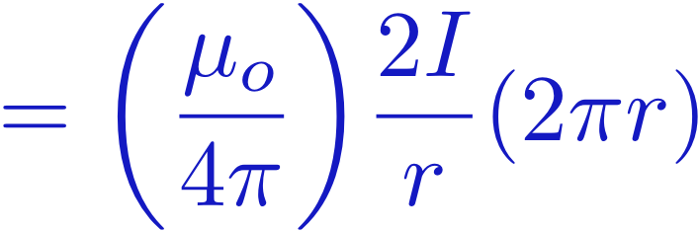

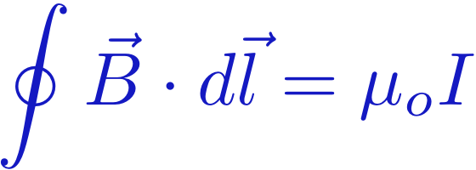
Very Long Wire
Viewed from the end
Current coming out of board
Cylindrical pattern of B-field
→ Let's take a line integral along one circle
is along our circle
AMPERE'S
LAW

Slide 15
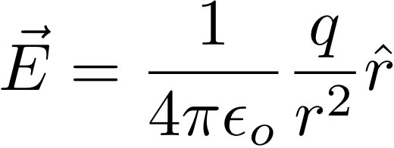
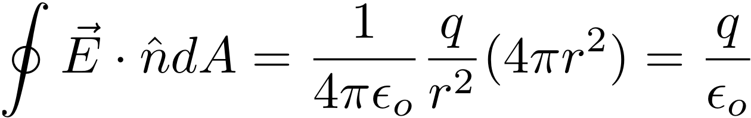
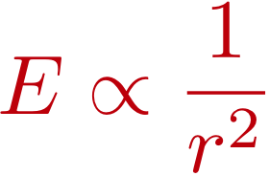

Gauss' Law for Point Charge
Gauss'
Law
E-field
Point Charge
Gauss' Law for Point Charge:
s
Works for any size sphere because r cancels
On each sphere:
Something similar is going
to happen for B of a wire
Field
Remember Me?
Surface Area

Slide 16
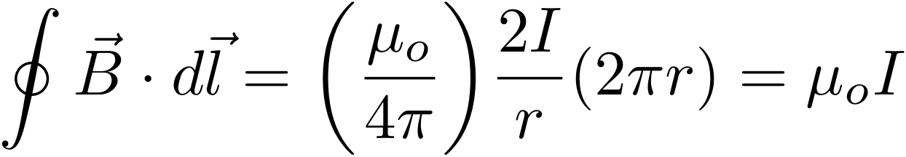
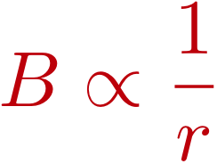

Ampere's Law for Long Wire
Biot-Savart
Law
B-field
Long Wire
Current coming out of board
Ampere's Law for Long Wire:
s
Works for any size circle because r cancels
On each circle:
Field
Circumference

Slide 17
Ampere's Law for Long Wire
Biot-Savart
Law
B-field
Long Wire
Current coming out of board
Ampere's Law for Long Wire:
s
Works for any size circle because r cancels
→ In any segment, the contribution from any
circle is the same. (Like a flashlight.)
On each circle:
Field
Circumference

Slide 18
Ampere's Law for Long Wire
Biot-Savart
Law
B-field
Long Wire
Current coming out of board
In any segment, the contribution from
any "circle" is the same. (Like a flashlight.)
s
Surround the wire with any path
On each circle:
Field
Circumference

Slide 19
Ampere's Law for Long Wire
Biot-Savart
Law
B-field
Long Wire
Current coming out of board
In any segment, the contribution from
any circle is the same. (Like a flashlight.)
s
Surround the wire with any path
by following different circles in different places.
Line integral aruond outer surface is always same.
On each circle:
Field
Circumference

Slide 20
Ampere's Law for Long Wire
Biot-Savart
Law
B-field
Long Wire
Current coming out of board
In any segment, the contribution from
any circle is the same. (Like a flashlight.)
s
Surround the wire with any shape
by following different circles in different places.
On each circle:
Field
Circumference

Slide 21
Ampere's Law for Long Wire
Biot-Savart
Law
B-field
Long Wire
Current coming out of board
In any segment, the contribution from
any circle is the same. (Like a flashlight.)
s
Surround the wire with any path
by following different circles in different places.
Line integral around outer surface is always same.
Limit of small segments
→ works for any smooth path
On each circle:
Field
Circumference

Slide 22
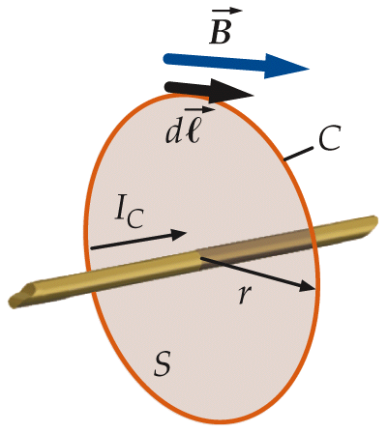
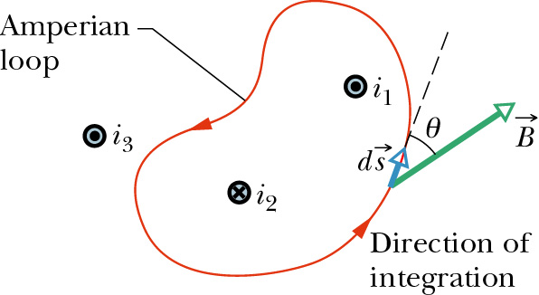
Ampere’s Law in Magnetostatics
Biot-Savart’s Law can be used to derive another relation: Ampere’s Law
The path integral of the dot product of magnetic field and unit vector along a closed loop, Amperian loop, is proportional to the net current encircled by the loop,
Choosing a direction of
integration.
A current is positive if it
flows along the RHR normal
direction of the Amperian
loop, as defined by the
direction of integration.

Slide 23
iClicker Question
Three currents I₁, I₂, and I₃ are directed perpendicular to the plane of this page as shown. The value of the Ampere’s Law line integral of B∙ dl counterclockwise around the square path is +μ₀I₁. What’s the currents in I₂ and I₃?
a. I₂=0, I₃ can be any value
b. I₂=0, I₃ can only be zero
c. I₂=I₁, I₃ can be any value
d. I₂=2I₁, I₃ can be any value
e. I₂=0.5I₁, I₃ can be any value
I₁
I₃
I₂

Slide 24
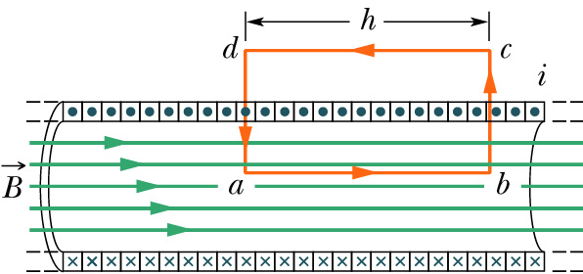
iClicker question
Use Ampere’s law to calculate the magnetic field inside a solenoid. (n is number of wraps per unite length).
A.
B.
Ampere’s Law:
C.
n windings per unit length
D.

Slide 25
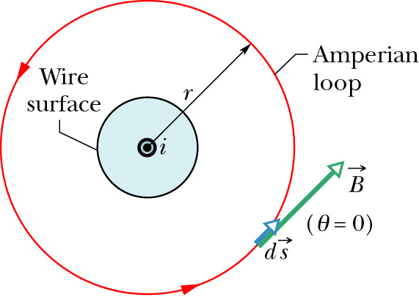
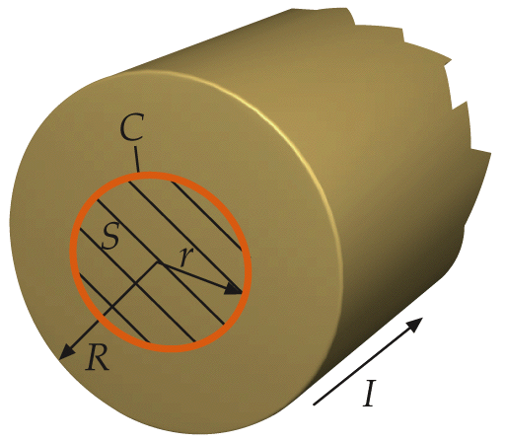
Example: Magnetic field of a long wire
outside the wire

Slide 26
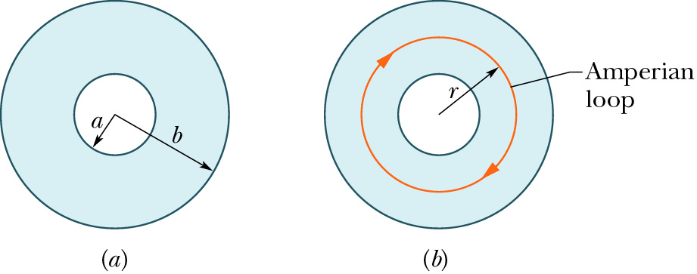
Example: A Non-Uniform Current Distribution
Long, hollow cylindrical current of current density:
Insider the cylinder, the total current encircled by the Amperian loop is

Slide 27
iClicker Question
outside the wire
Assume uniform current density, what’s the magnetic field vs. r inside the long wire.
A).
C).
B).
D).
Notes:
B

Slide 28
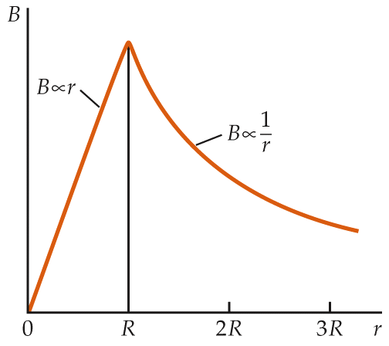
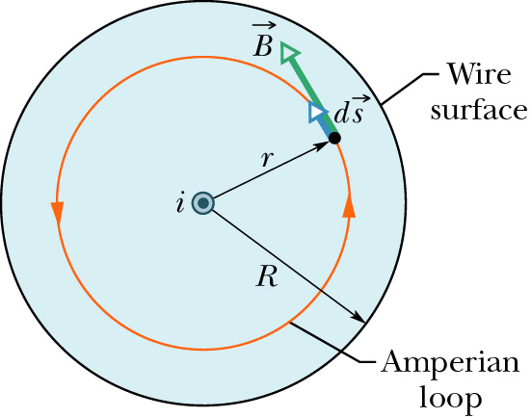
iClicker Question
outside the wire
inside the wire

Slide 29
iClicker Question
Three currents I, 2I, and 3I are directed perpendicular to the plane of this page as shown. What is the value of the Ampere’s Law line integral of B∙ dl counterclockwise around the circular path shown?
a. 4μ₀I
b. −2μ₀I
c. 2μ₀I
d. 6μ₀I
e. zero
2I
3I
I

