Slide 1
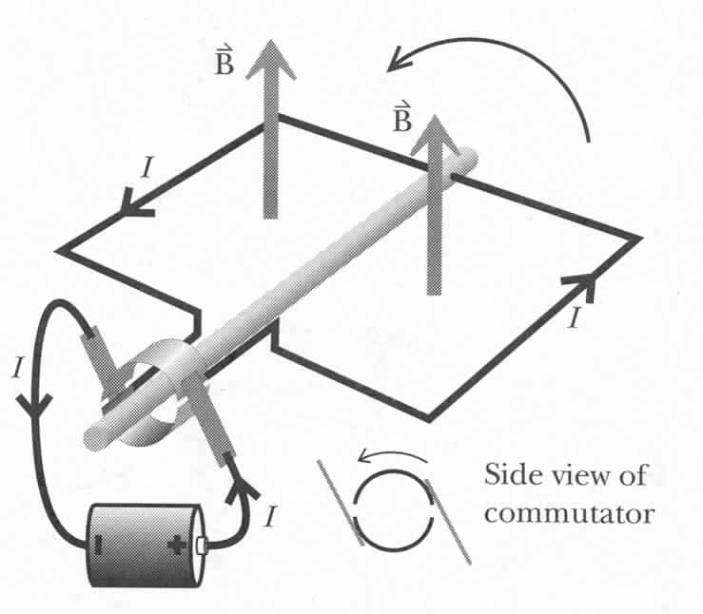
How to Make an Electric Motor
B
Run the current one way
Then reverse the current
B
Torque is in same direction
Notes:
10

Slide 2
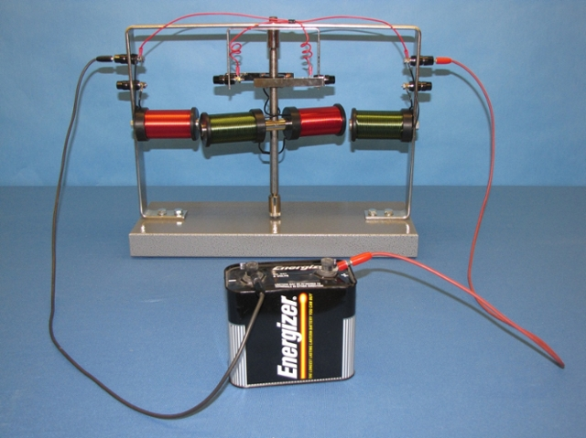
How to Make an Electric Motor
6B-15
Notes:
10

Slide 3
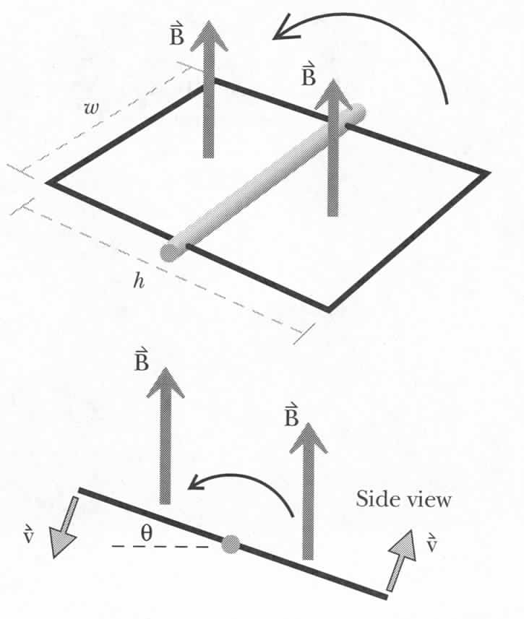
Electric Generators
Tangential speed:
Force on charges:
Notes:
10

Slide 4
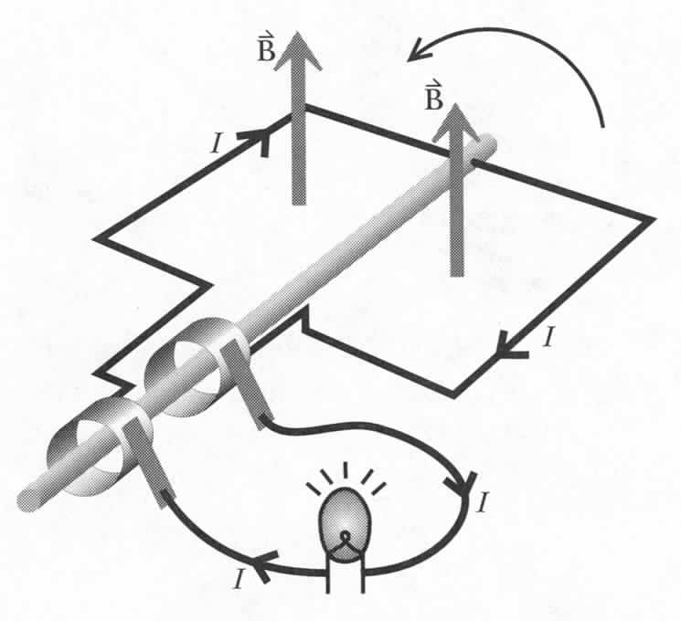
Electric Generators
AC generator
Notes:
10

Slide 5
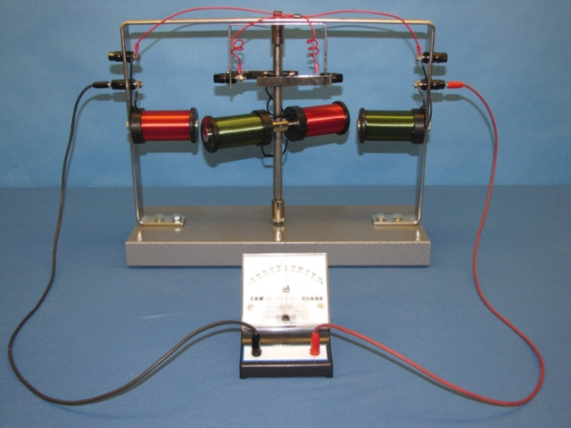
Electric Generator
6B-16
Notes:
10

Slide 6
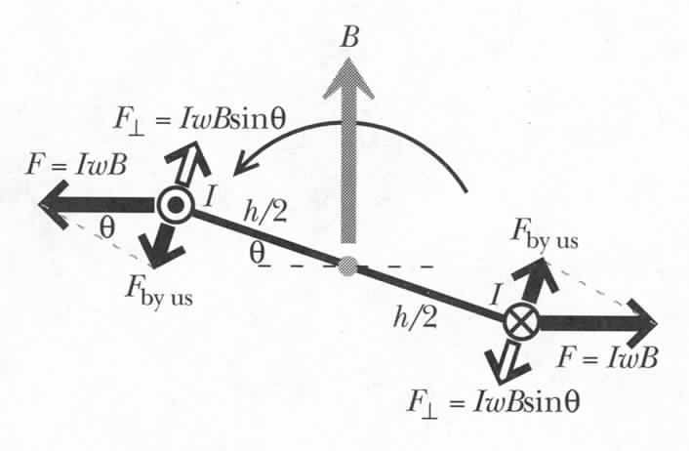

Power Required to Turn a Generator
$$P\sim ω^{2}\sin^{2}(ωt)$$
Notes:
10

Slide 7
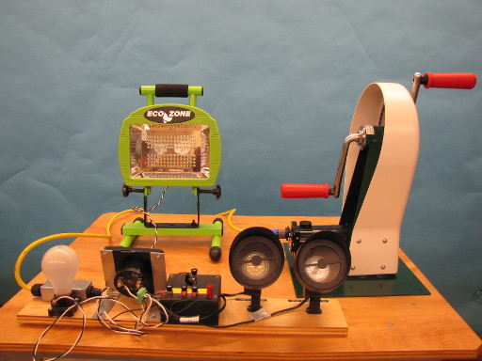
Demos: 5B-11 Human Power Electric Generator

Slide 8
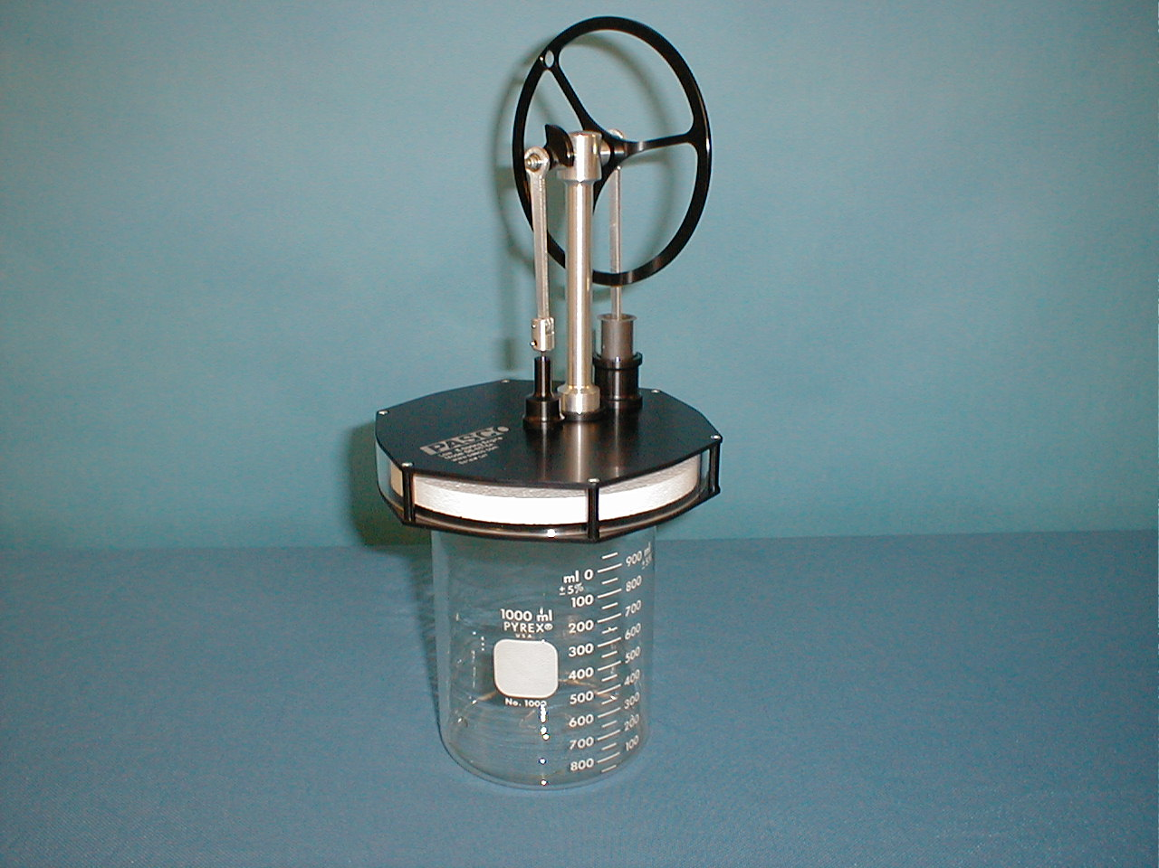
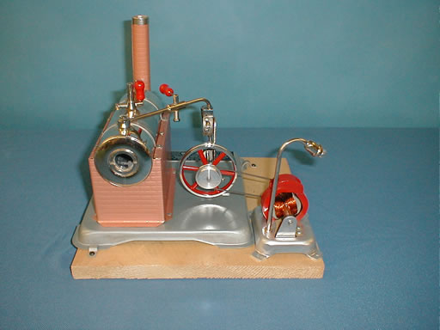
Demos: 6B-09 Magneto (Electric Generator)
3E-09 Stirling Engine
3E-12 Steam Engine

Slide 9
Building up the Solid Sphere
Total Charge:
Total Volume:
Charge
Volume
Uniform charge means
these are the SAME
What if we stop here at r?
Assume: Charge distributed uniformly
Charge so far:
r
Volume so far:
Charge
Volume
Blast from the Past:
Lecture 7
R
Notes:
We spent a lot of time to derive the E field from a solid sphere. With Gauss’s law, it‘s trivial to get the results.

Slide 10
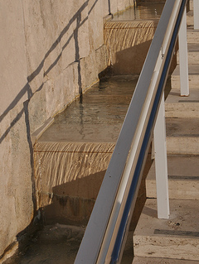
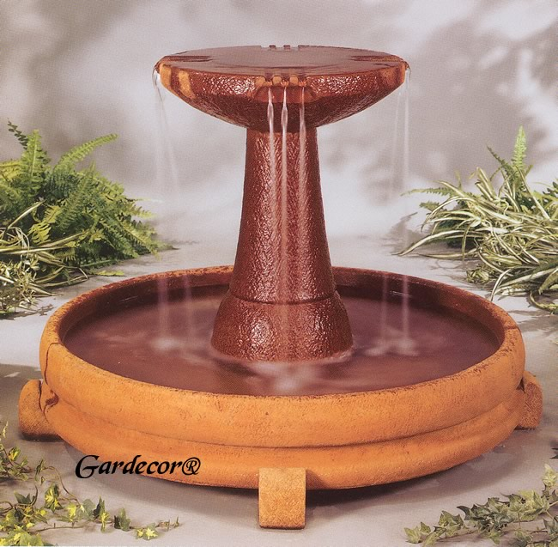
Where's the Source? Follow the Flow!
We see the water flow in.
We see the same amount flow out.
We only see water flowing out.
The source of this fountain
must be in the bowl.
The source of this fountain
is not in the picture.
Notes:
Ghetty museum stair fountain

Slide 11
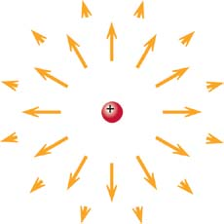
What is the Source?
The Source of Water
is a Water Faucet
The Source of E-Field
is Charge
Water flowing OUT of bowl
→ there is a Source inside
E-field "flowing" out of sphere
→ there is a Source inside
Notes:
Ghetty museum stair fountain

Slide 12
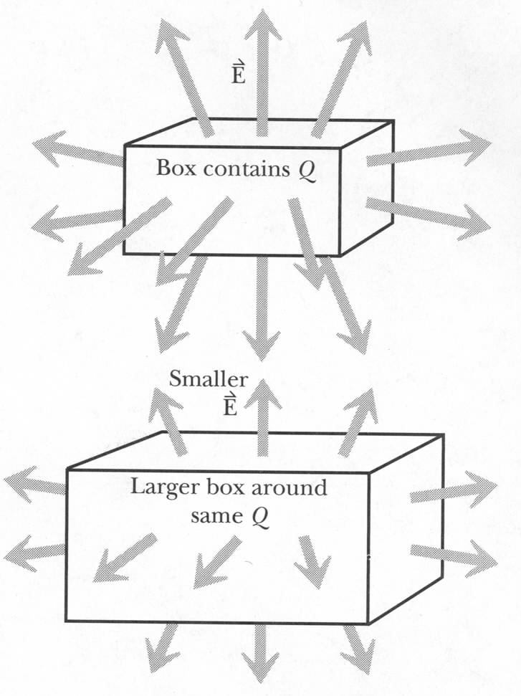
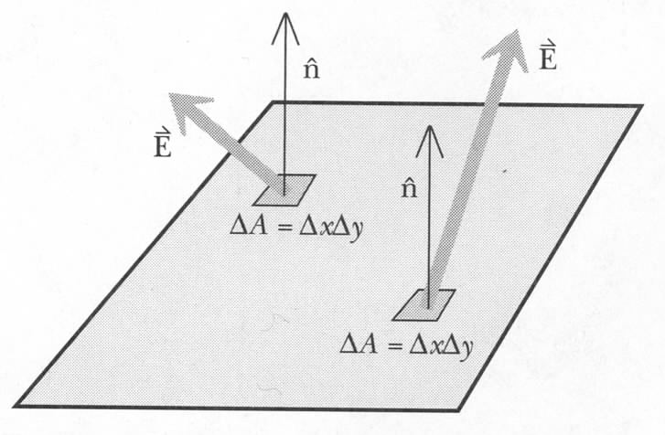
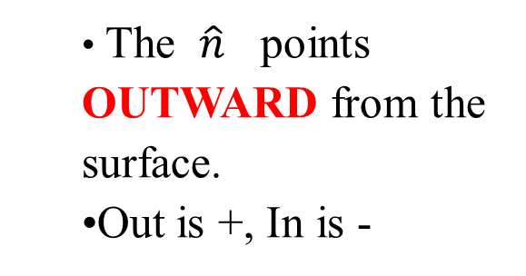
Electric Flux: Surface Area
Flux through small area:
  The $\hat{n}$ points OUTWARD from the surface.
  Out is +, In is -
Definition of electric flux on a surface:

Slide 13
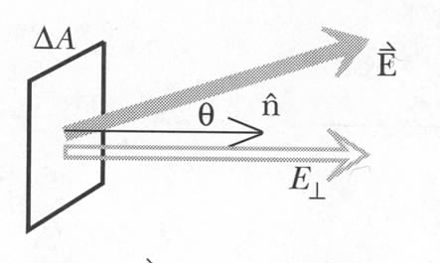
Electric Flux: Perpendicular Field or Area
Perpendicular field
Perpendicular area
Δx
Δy
q

Slide 14
Adding up the Flux

Slide 15
Gauss’s Law
Features:
1. Proportionality constant
2. Size and shape independence
3. Independence on number of charges inside
4. Charges outside contribute zero

Slide 16
iClicker Question
Two identical point charges carry +Q. One is placed inside a cubic box, the other is in a spherical shell. Which of the following statements is correct on the flux through the two surfaces?
It’s not possible to calculate the flux since the size of the objects are not given.
The flux are the same for both surfaces
The location of the charge Q inside the surface is need in order to calculate the flux.
The flux is not zero and must be negative.
Notes:
b

Slide 17
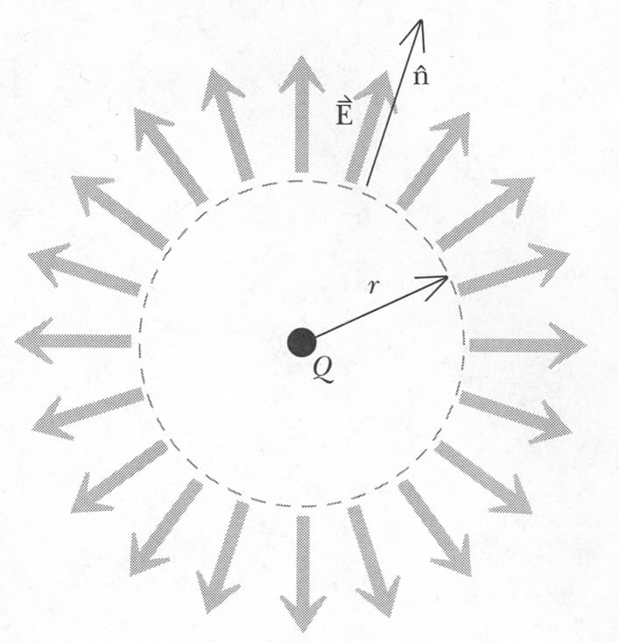
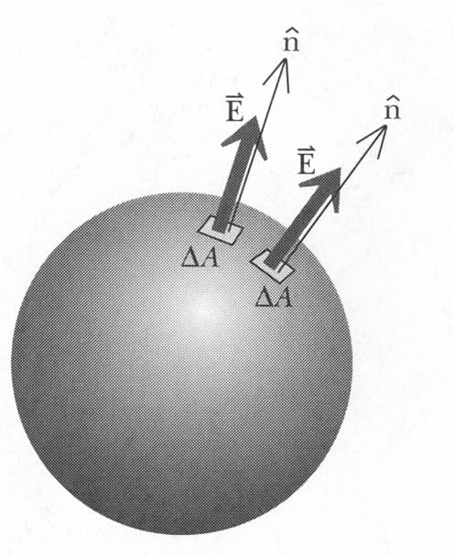
1. Gauss’s Law: Proportionality Constant
What if charge is negative?
Works at least for one charge and spherical surface

Slide 18
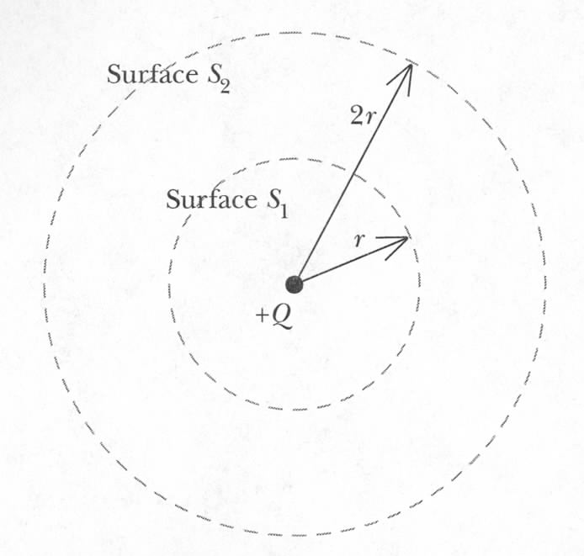
2. Gauss’s Law: The Size of the Surface
universe would be
much different if
exponent was not exactly 2!

Slide 19
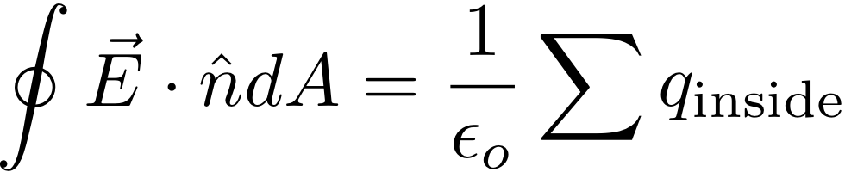
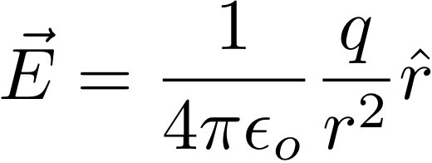
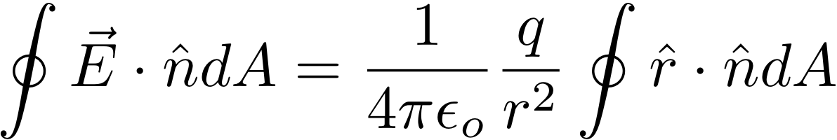
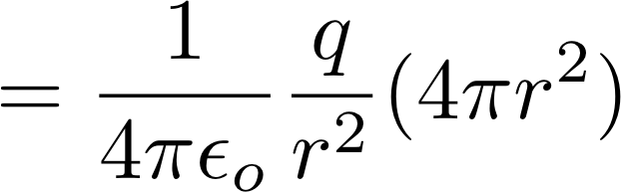
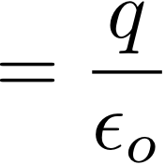
Gauss' Law – Size of Surface
s
Point Charge:
Integrated over any concentric sphere:
✔

Slide 20
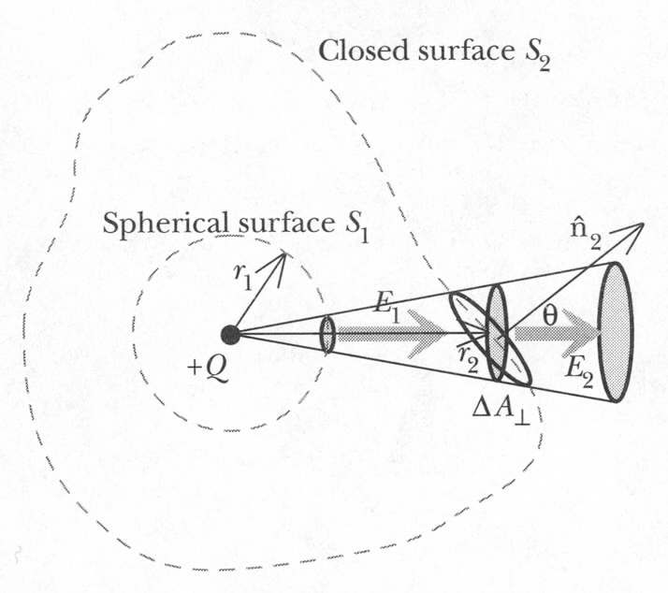
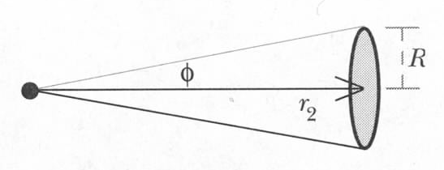
3. Gauss’s Law: The Shape of the Surface
All elements of the outer surface
can be projected onto corresponding
areas on the inner sphere with the
same flux

Slide 21
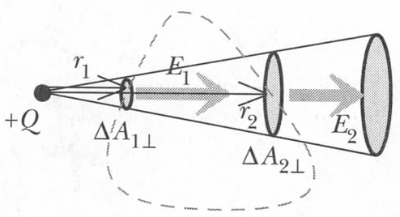
4. Gauss’s Law: Outside Charges
–
Outside charges contribute 0 to total flux

Slide 22
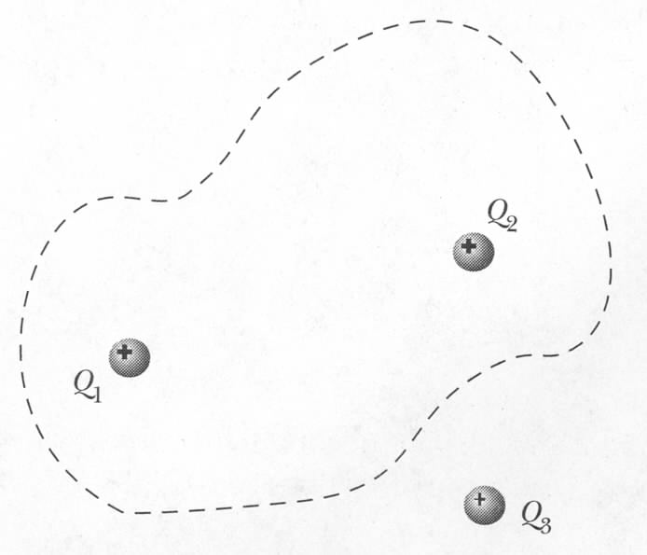
5. Gauss’s Law: Superposition

Slide 23
iClicker Question
Two identical point charges are placed, at the center of a large sphere in one case, and outside an identical sphere in the other case. Which statement about the net electric flux through the surface of the sphere is true?
The flux is larger when the charge is inside.
The flux is larger when the charge is outside.
The flux is the same (and not zero).
Not enough information to tell.
The flux is zero in both cases.
Q>0
Q>0
Notes:
a)

Slide 24
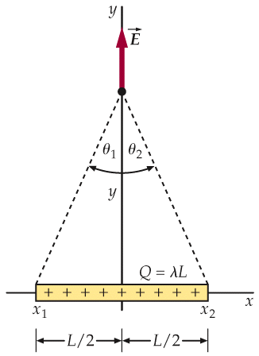
Again: Continuous Charge Distribution 1: Charged Line
At a point P on perpendicular axis:
θ
x
Notes:
The example is more complicate than the previous because the field direction is not along the axis of the coordinate system.

Slide 25
Infinitely long uniformly charged line
E
Gauss’s Law:
h
r
Same result but much less work!
Notes:
For infinitely long wire, at any point in space, one can always find on the wire two symmetrical point who’s horizontal component cancel each other. Therefore, the total field must perpendicular to the long wire.

Slide 26
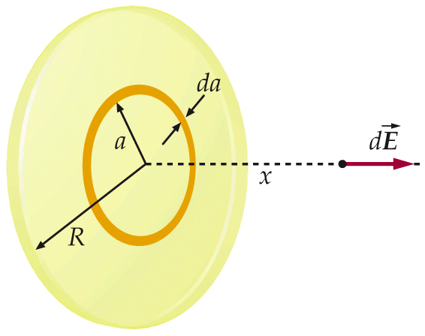
Charged Disk
At a point P on axis:
Notes:
X<<R means
R is infinitly large or
X is extremely small, i.e. right above the surface of a finite size surface.
When walking across a surface of any charge distribution and any shape, the change of electric field is 2 times sigma/2/epsilon_0.

Slide 27
Uniformly charged thin, infinite sheet
Gauss’s Law!
A
h
Notes:
For infinitely large plan, at any point in space, one can always find on the plan two symmetrical point who’s vertical component cancel each other. Therefore the total field direction must perpendicular to the plane.

Slide 28
Long Cylindrical Capacitor
Put charges +q on inner cylinder of radius a, -q on outer cylindrical shell of inner radius b.
Calculate E by Gauss’ Law
a
b
+q
-q
L
3. Calculate V
4. Divide q by V
C dep. log. on a, b
Notes:
Emphaize that C is independent of the Q and V

Slide 29
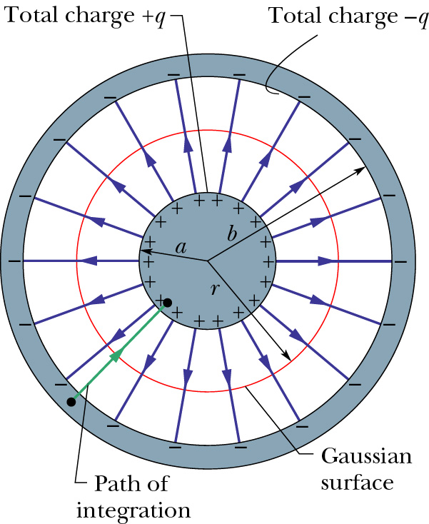
Spherical Capacitor
Put charges +q on inner sphere of radius a, -q on outer shell of inner radius b.
Calculate E by Gauss’s Law
3. Calculate V from E
4. Divide q by V
q is proportional to V
C only depends on a,b
(isolated sphere)
Notes:
Skip this if lack of time.

Slide 30
Today
Gauss' Law

