Slide 1
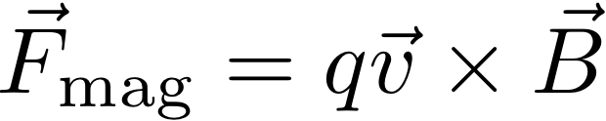
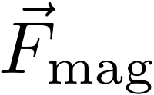


Hall Effect
MAGNETIC FORCE
point charge
A hole in the electron sea
behaves like a proton.
Inside a Material:
+ + + + + + + + + + +
Moving holes
get pushed
to the top
Proton
or "Hole"
x
B_{applied}
x
B_{applied}
Electron
Moving electrons
get pushed
to the bottom
- - - - - - - - - - -
Notes:
EC got here

Slide 2



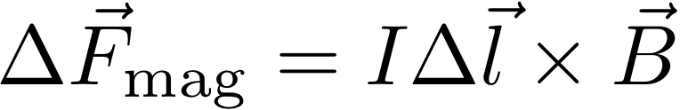

Magnetic Force on a charge or wire
MAGNETIC FORCE
point charge
We just showed how
these are related
MAGNETIC FORCE
current in a wire
= length of this
chunk of wire

Slide 3
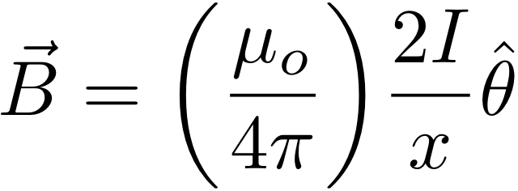
Force Between (Anti) Parallel Wires
B_{applied} = Magnetic field applied by the red wire.
Blue wire feels a force up.
x
B_{applied}
F_{on blue wire}
I
x
B_{applied}
x
B_{applied}
I
F_{on red wire}
x
B_{applied}
B_{applied} = Magnetic field applied by the blue wire.
Red wire feels a force down.

Slide 4
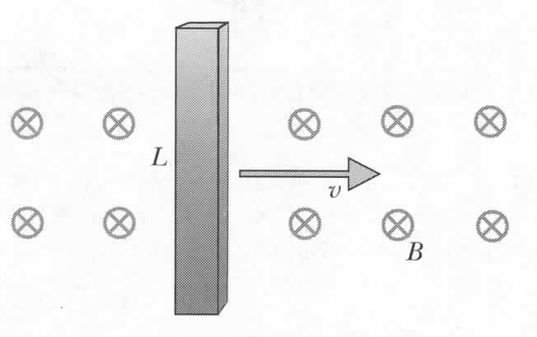

Currents Due to Magnetic Forces
Metal bar
polarization
F_{m}
How much force do we
need to apply to keep
the bar moving at constant
speed?
Notes:
What is direction of E?

Slide 5
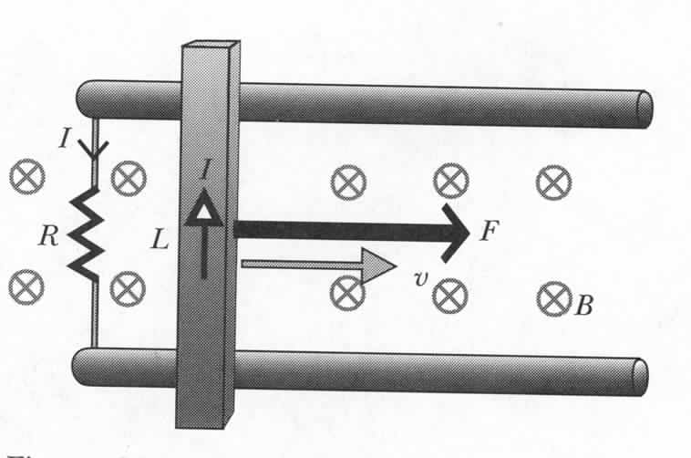
Moving Bar and Energy Conservation
P=IΔV=I(emf)
Are we getting something for nothing?
Bar – current I:
F_{I}
F
F_{m}
Work:
Power:
x
Main principle of electric generators:
Mechanical power is converted to electric power

Slide 6

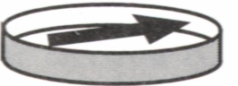
Reference Frame
Any magnetic field?
charged tape
Notes:
What is direction of E?
No work done – static equilibrium, net force is zero.

Slide 7
iClicker Question
Jessie
Jack
charged tape
In case Jack have two positively changed tapes side by side. For the interaction between the two tapes :
A). Jack and Jessie: purely through E force.
B). Jack: only through E force. Jessie: only through B force.
C). Jack and Jessie: through a mixture of B and E forces.
D). Jack: though only E forces. Jessie: through a mixture of B and E forces.
Notes:
What is direction of E?
No work done – static equilibrium, net force is zero.

Slide 8

Magnetic Forces in Moving Reference Frames
Electric force: (assume independent of frame?)
Two protons
+e
v
Magnetic field:
1
r
F_{21,m}
2
B₁
Magnetic force:
+e
v
E₁
F_{21,e}
Notes:
Coulomb force on moving charges: approximation, E is not exactly the same (address later). Recall that we have already said that two current carrying wires experience an attractive magnetic force if current direction is the same.

Slide 9
Magnetic Forces in Moving Reference Frames
Electric force:
+e
1
v
r
F_{21,m}
Magnetic force:
2
B₁
+e
v
Ratio:
E₁
F_{21,e}
Notes:
Coulomb force on moving charges: approximation, E is not exactly the same (address later)

Slide 10
Magnetic Forces in Moving Reference Frames
+e
1
v
r
F_{21,m}
B₁
For v<<c the magnetic force is much
smaller than electric force
2
+e
v
E₁
How can we detect the magnetic force on
a current carrying wire?
F_{21,e}
Full Lorentz force:
downward
Notes:
Ask students to reconcile this with the fact that two wires carrying current in the same direction are attracted to each other.

Slide 11

Magnetic Forces in Moving Reference Frames
15 ns
20 ns
+e
1
v
Who will see protons hit
floor and ceiling first?
r
F_{21,m}
2
B₁
+e
v
Time must run slower in moving frame.
E₁
Einstein 1905:
“On the electrodynamics of moving bodies”
F_{21,e}
Twin paradox
http://en.wikipedia.org/wiki/Twin_paradox
Notes:
This is a kind of phenomenon which led Einstein to develop theory of relativity

Slide 12
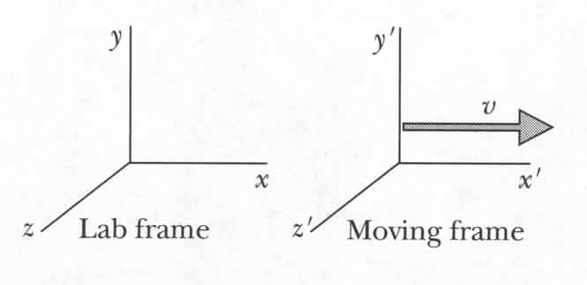
Relativistic Field Transformations
Our detailed derivations are not correct for relativistic speeds,
According to the theory of relativity:

Slide 13
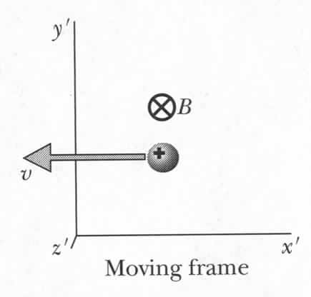
Magnetic Field of a Moving Particle
Still:
Moving:
Slow case: v<<c →
Field transformation is consistent with Biot-Savart law
Electric and magnetic fields are interrelated
Magnetic fields are relativistic consequence of electric fields
Notes:
What about B below particle?

Slide 14
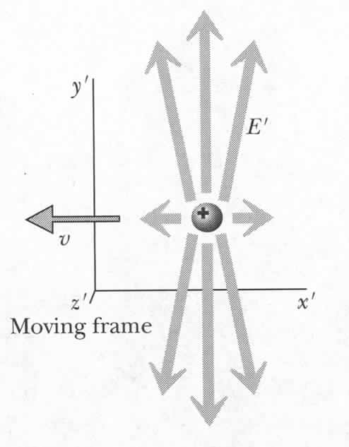
Electric Field of a Rapidly Moving Particle
Notes:
For a single charged particle Ex, Ey, Ez are different when moving rapidly.

Slide 15
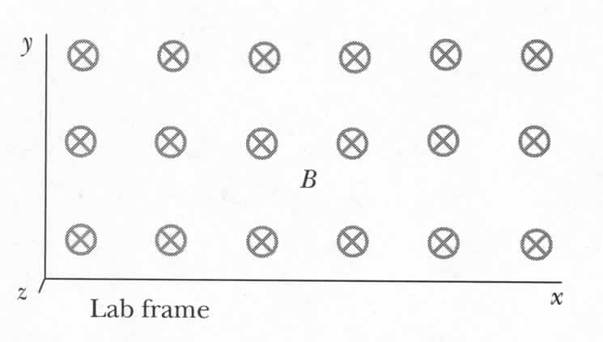

Interpretation depends on reference frame
E
$$E_{lab}= <0, 0, 0>$$
v
Notes:
Uniform B field in lab frame. For observers in the metal bar rest frame, the charge build up because of non-zero E fieid. For lab frame observers, the charge is build up by magnetic force.

Slide 16
Magnetic Forces in Moving Reference Frames
Electric force: (assume independent of frame?)
Two protons
+e
v
Magnetic field:
1
$$E_{lab}= <0, 0, 0>$$
r
F_{21,m}
2
B₁
+e
v
Magnetic force:
E₁
F_{21,e}
Notes:
Coulomb force on moving charges: approximation, E is not exactly the same (address later). Recall that we have already said that two current carrying wires experience an attractive magnetic force if current direction is the same.

Slide 17

Interpretation depends on reference frame
E
$$E_{lab}= <0, 0, 0>$$
v
$${B′}_{z} ≠0$$
However, v’=0, → F_{mag} = 0.
Notes:
Uniform B field in lab frame. For observers in the metal bar rest frame, the charge build up because of non-zero E fieid. For lab frame observers, the charge is build up by magnetic force.

Slide 18
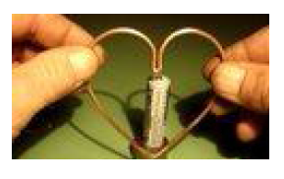
http://www.youtube.com/watch?v=iG0pzGcy4xU

Slide 19
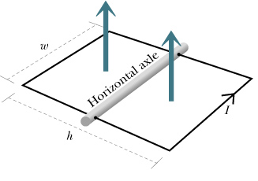
Magnetic Torque
MAGNETIC FORCE -- current in a wire
Seen from the side:
B
I
x
I
Axle

Slide 20
Magnetic Torque
MAGNETIC FORCE -- current in a wire
The current loop can rotate on its axle:
B
I
x
I
x
Axle

Slide 21
iClicker Question
MAGNETIC FORCE -- current in a wire
At this instant, which diagram represents the magnetic forces on the wire?
I
A)
F
B)
F
x
x
F
F
x
Axle
B
C)
F
F
D)
I
x
x
F
F
Notes:
D

Slide 22
Magnetic Torque
MAGNETIC FORCE -- current in a wire
In these orientations, the loop twists counterclockwise.
I
F
B
F
I
x
I
Axle
x
F
Axle
B
F
B
I
F
I
x
I
Axle
F

Slide 23
Magnetic Torque
MAGNETIC FORCE -- current in a wire
In these orientations, the loop twists clockwise.
I
F
B
F
x
I
I
Axle
x
F
Axle
B
F
B
I
F
I
x
I
Axle
F

Slide 24
Stable or Unstable?
MAGNETIC FORCE -- current in a wire
UNSTABLE EQUILIBRIUM
STABLE EQUILIBRIUM
B
B
F
F
F
x
x
I
I
I
Axle
I
F
Axle
F
F
B
B
x
I
x
I
I
I
Axle
Axle
F
F
Slight deviation does not return
Slight deviation returns

Slide 25
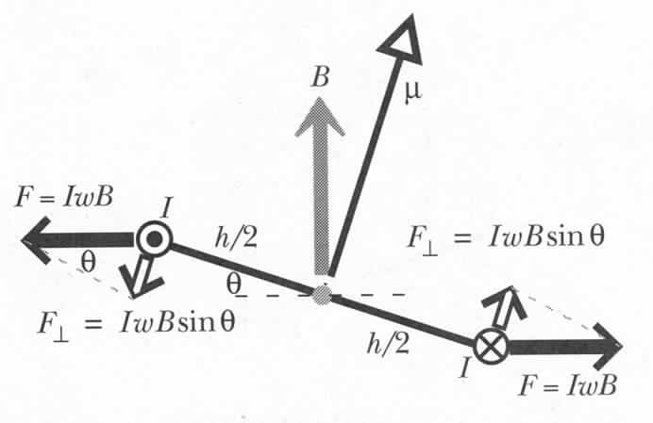
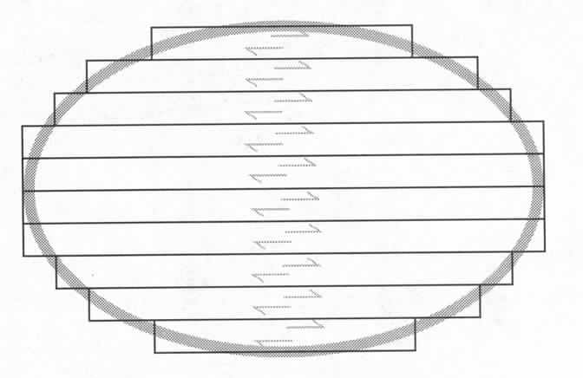
Magnetic Torque: Quantitative Analysis
Torque (τ) = distance from the axle (lever arm) times perpendicular component of the force.
small piece of wire
wire of length w
Use μ=IA
Always true
Works with loops of any shape!

Slide 26
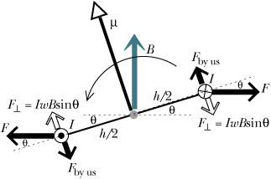
Magnetic Dipole Moment: Potential Energy
Calculate amount of work needed to rotate from angle θ_{I} to θ_{f}:
arclength = r θ
dW
Potential energy for a magnetic dipole moment

Slide 27

iClicker Question
Y
What is the direction of
$$\vec{τ}= \vec{μ}×\vec{B}$$
I
B
I
+Z
-Z
+Y
-Y
None of above
X
Z
I
I
Notes:
A) +Z

Slide 28
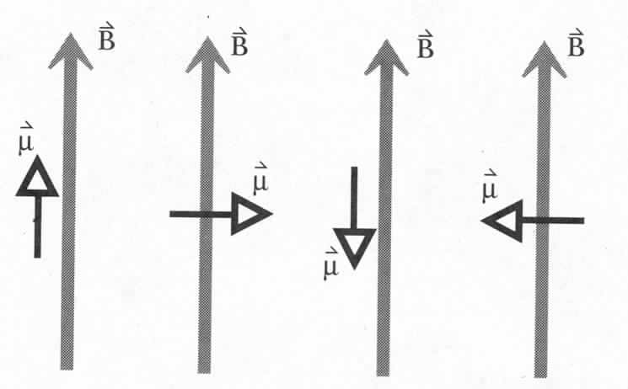
Magnetic Dipole Moment: Potential Energy
Potential energy for a magnetic dipole moment
U=
min
-µB
0
max
µB
0
What is the energy difference between the highest and the lowest state?
Picture of the U and µ in magnetic field – important in atomic and nuclear physics.
Notes:
0 is just convention.
+mB – unstable configuration
Picture of mu and potential energy in magn field – important in atomic and nuclear physics.
Magnetic field – transition between different magnetic dipole states.
Hosptal – magnetic imaging – patient in a coil, magnetic levels of atoms split, equipment can detect transition between different orientations and recreate image.

Slide 29
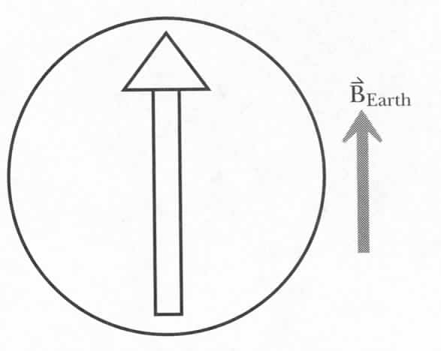
Compass
Compass needle.
Why does it point to north?
What is the direction of μ?
What will happen if the needle is moved away and released?

Slide 30
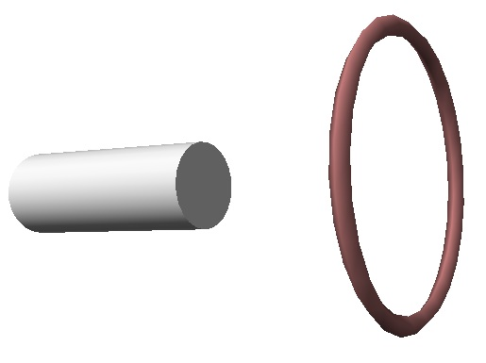
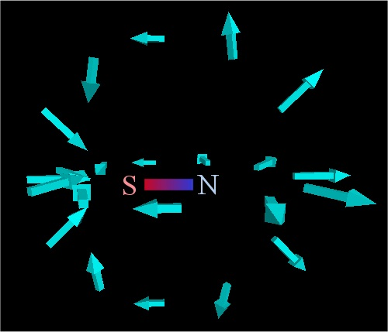
Experiment
F
B
I
What will happen if current
is reversed?
What will happen if magnet
is reversed?

Slide 31
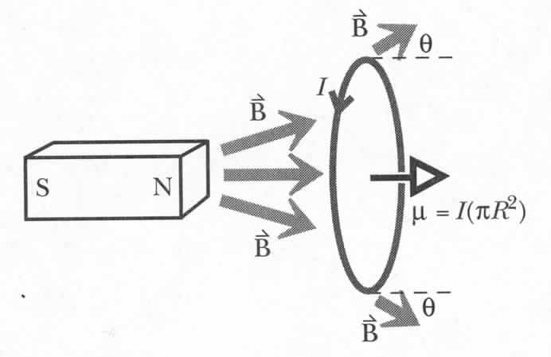
Force on a Magnetic Dipole
dF⊥
dF
If theta=0, i.e. uniform field, then F = 0.
Notes:
Don’t know theta – but nevertheless we can determine force using potential energy argument

Slide 32
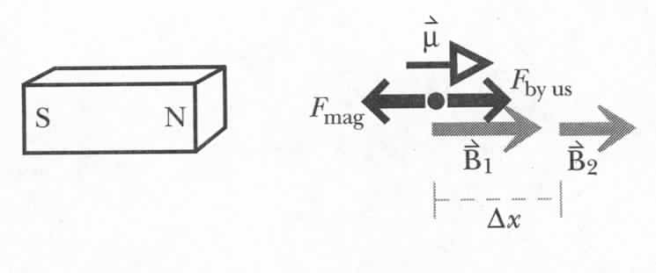
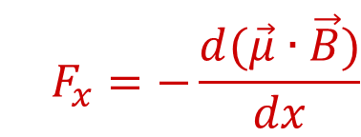
Force on a Magnetic Dipole
x
<0
$$F_{x}=−\frac{d(\vec{μ}∙\vec{B})}{dx}$$
Force exerted on dipole by magnetic field
Notes:
Here B = Bx since u.B =uxBx.
Fx is force exerted by magnet on dipole. System is dipole plus bar magnet. Since change in energy = change in KE(=0) + change in PE = work done by external force, we can equate change in PE to work done by external force.

Slide 33
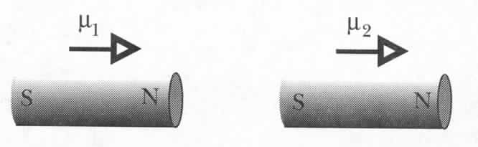
Force on a Magnetic Dipole
Two magnets
Notes:
Negative sign indicates that F due to magnet is such as to draw loop towards the magnet.

Slide 34
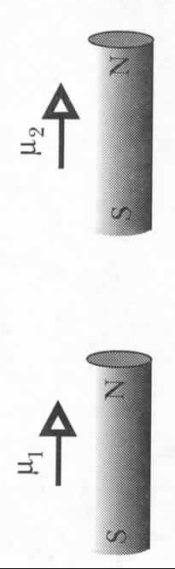
Exercise
What is the distance at which one magnet can
pick up another?
=mg≈0.1 N
Notes:
10

Slide 35
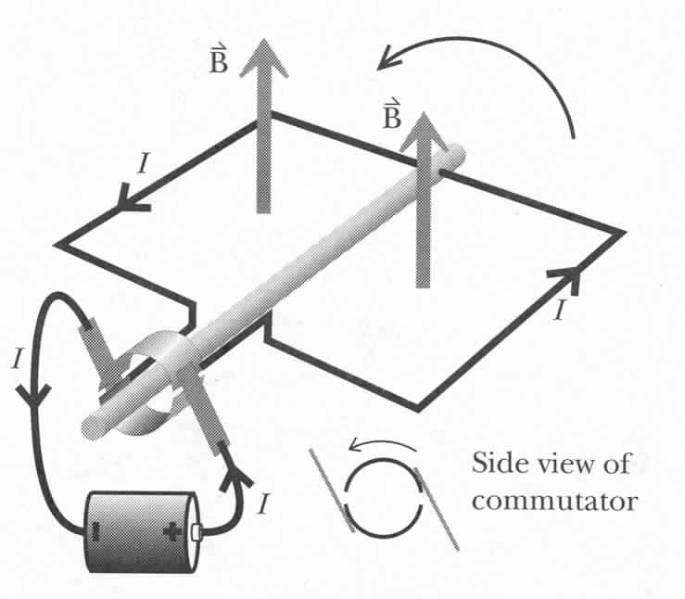
How to Make an Electric Motor
B
Run the current one way
Then reverse the current
B
Torque is in same direction
Notes:
10

Slide 36
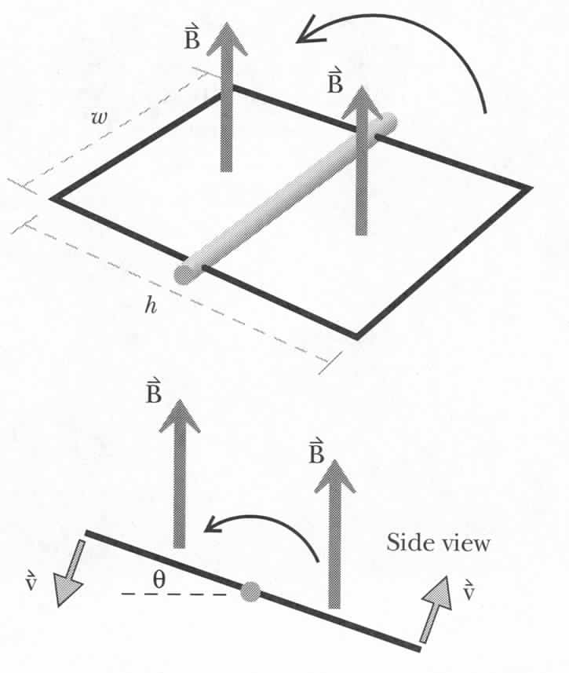
Electric Generators
Tangential speed:
Force on charges:
Notes:
10

Slide 37
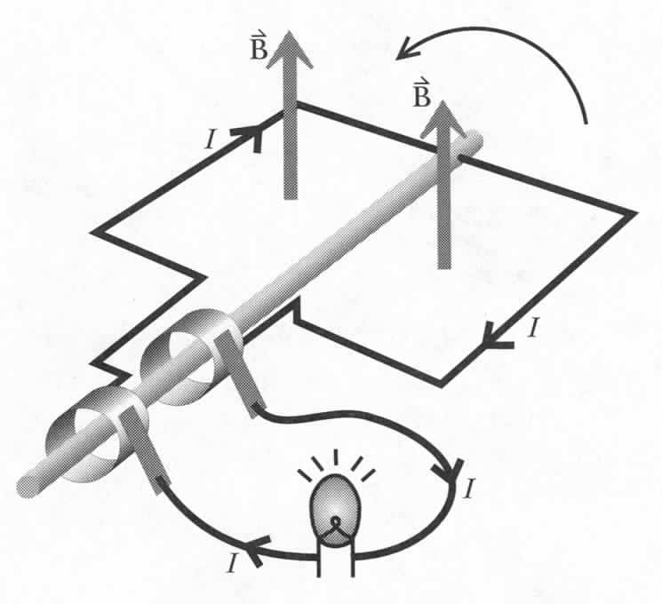
Electric Generators
AC generator
Notes:
10

Slide 38
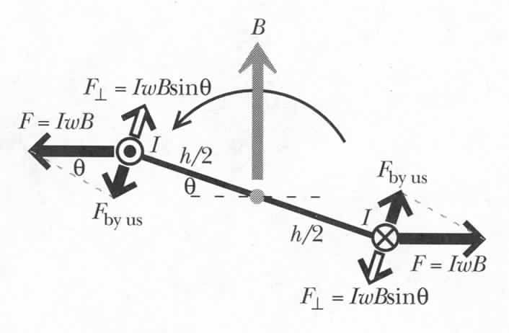
Power Required to Turn a Generator
Notes:
10

Slide 39
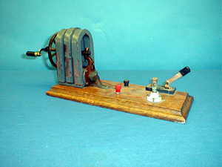
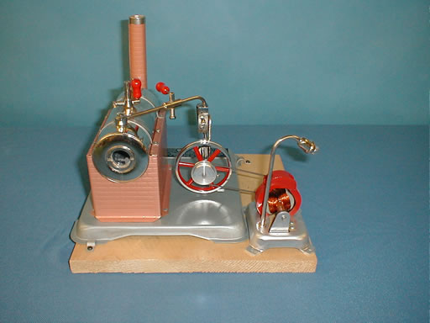
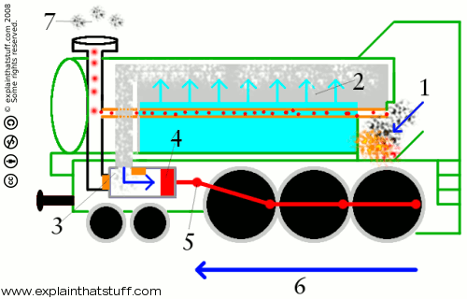
Demos: 6B-09 Magneto (Electric Generator)
3E-12 Steam Engine

