Slide 1
EXAM2
Wednesday, March 21, 2:30pm-3:20 pm
room 112
Chapters 16, 17, 18 (edition#4).
Special needs, e.g. exam time extension, and has not contact me before, please bring me the letter from the Office of the Dean of Students before the end of 03/09 (Friday).
AOB
  multiple choice.
  Prepare your own scratch paper, pens, pencils, erasers, etc.
  Use only pencil for the answer sheet
  Bring your own calculators
  No cell phones, no text messaging which is considered cheating.
  No crib sheet of any kind is allowed. Equation sheet will be provided.
  10 problems in total.

Slide 2
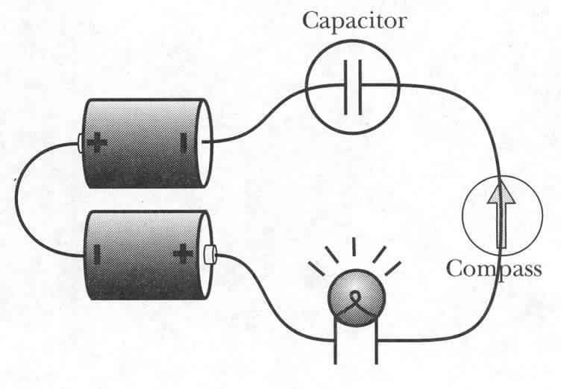
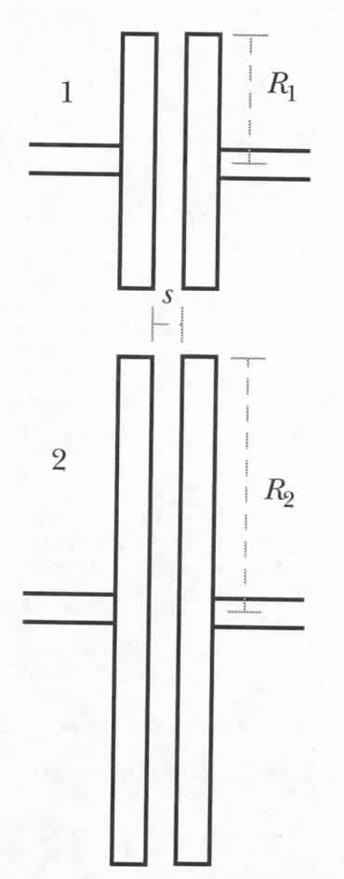
IClicker Question: Effect of the Capacitor Disk Size
Use two different capacitors in the same circuit
Same amount of charge on both capacitors
1. In the first moment of discharging,
which capacitor will make the bulb glow brighter?
2. Which capacitor will make the light bulb glow longer?
Upper longer, lower brighter
Upper longer, upper brighter
Lower longer, lower brighter
Lower longer, upper brighter
Fringe field:
Notes:
Charge it first and then discharge.
Capacitor 2 has large capacitance, i.e. large Q. With smaller fringe field, the current is smaller, i.e. longer.
Capacitor 1 brighter.

Slide 3
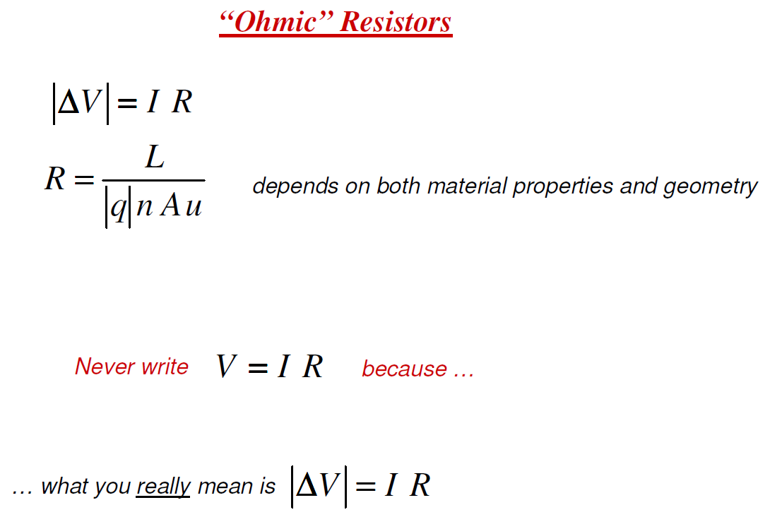
Notes:
3

Slide 4
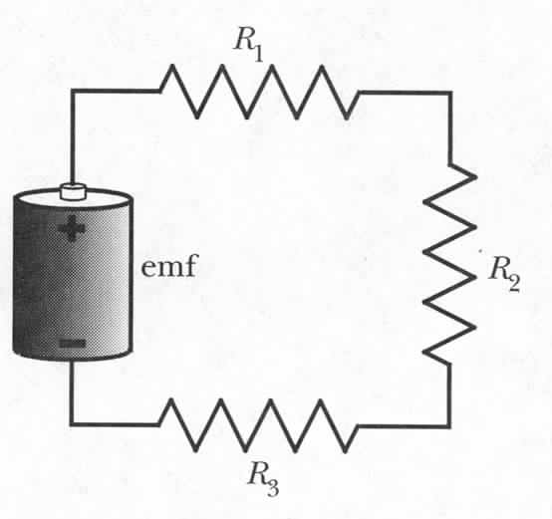
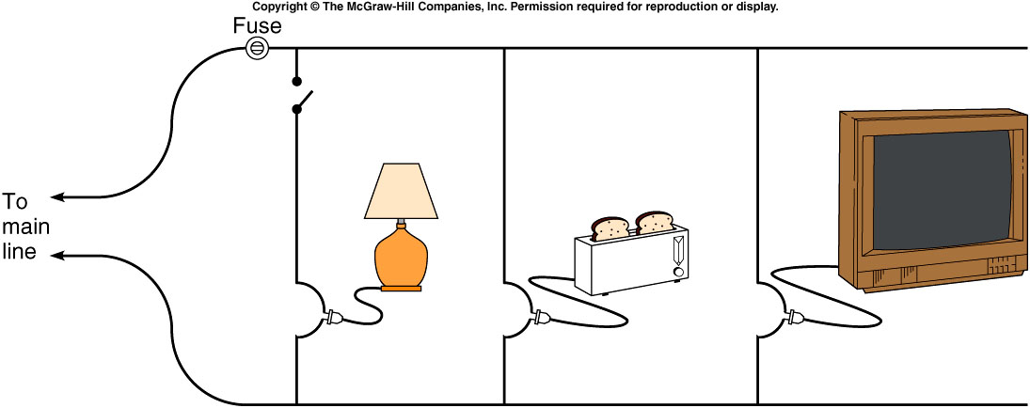
Series Resistance
ΔV_{batt} + ΔV₁ + ΔV₂ + ΔV₃ = 0
emf - R₁I - R₂I - R₃I = 0
emf = R₁I + R₂I + R₃I
emf = (R₁ + R₂ + R₃) I
emf = R_{equivalent} I , where R_{equivalent} = R₁ + R₂ + R₃
Notes:
4
Not an obvious result: depends on definitions we had for R etc.

Slide 5
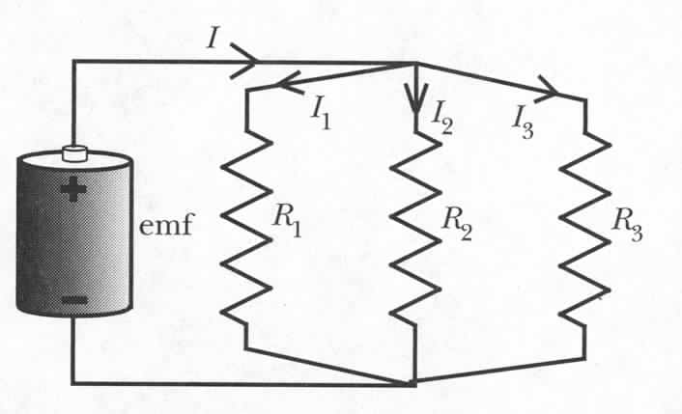
Parallel Resistance
I = I₁ + I₂ + I₃
Notes:
5

Slide 6
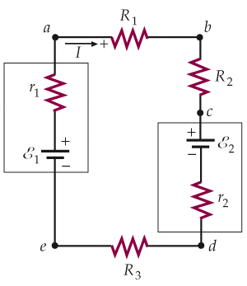
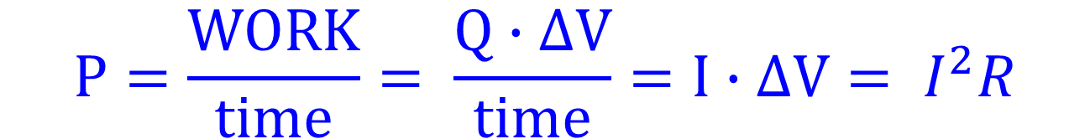
Power in the electric circuit
$$P=\frac{WORK}{time}= \frac{Q∙∆V}{time}=I∙∆V= I^{2}R$$
Power delivered by power sources
Power consumed by electrical devices

Slide 7
Kirchhoff’s Rules
Kirchhoff’s Rule 2: Loop Rule
When any closed loop is traversed completely in a circuit, the algebraic sum of the changes in potential is equal to zero.
Coulomb force is conservative
Kirchhoff’s Rule 1: Junction Rule
The sum of currents entering any junction in a circuit is equal to the sum of currents leaving that junction.
Conservation of charge
In and Out branches
Assign I_{i} to each branch

Slide 8
Analysis Tips for complicated circuit
Simplify using equivalent resistors
Label currents with arbitary directions
  If the calculated current is negative, the real direction is opposite to the one defined by you.
Apply Junction Rule to all the labeled currents.
  Useful when having multiple loops in a circuit.
Choose independent loops and define loop direction
  Imagine your following the loop and it’s direction to walk around the circuit.
Use Loop Rule for each single loop
  If current I direction across a resistor R is the same as the loop direction, potential drop across R is ∆V = −I×R, otherwise, ∆V = I×R
  For a device, e.g. battery or capacitor, rely on the direction of the electric field in the device and the loop direction to determine the Potential drop across the device
Solve simultaneous linear equations
Notes:
Current dirction is the moving direction of positive charge, i.e. the electric field direction, therefore, following the current direction, potential drops

Slide 9
Loop Example with Two EMF Devices
⇒
If ε₁ <ε₂, we have I<0 !?
This just means the actual current flows reverse to the assumed direction. No problem!

Slide 10
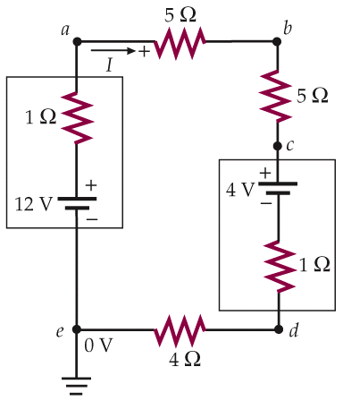
Finding Potential and Power in a Circuit
But what is I? Must solve for I first!
supplied by 12V battery
dissipated by resistors
The rest?
Just means 0 V here
into 4V battery (charging)
Notes:
Current dirction is the moving direction of positive charge, i.e. the electric field direction, therefore, following the current direction, potential drops

Slide 11
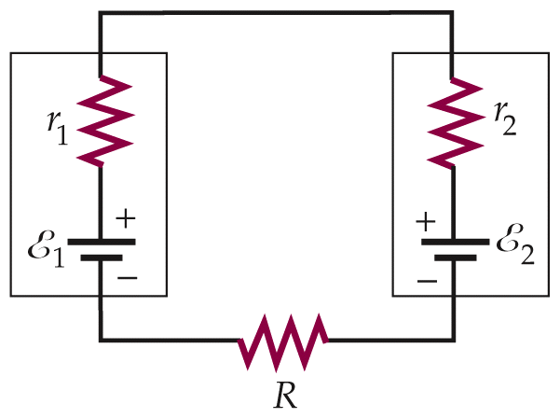
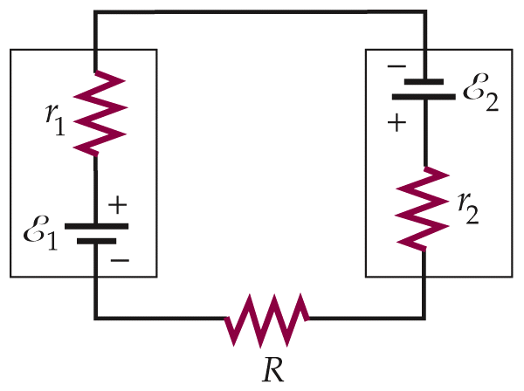
Charging a Battery
Positive terminal to positive terminal
Charging EMF > EMF of charged device
Say, R+r₁+r₂=0.05Ω (R is for jumper cables). Then,
good battery (12V)
battery being charged (11V)
power into battery 2
If connected backward,
Large amount of gas produced
Huge power dissipation in wires

Slide 12
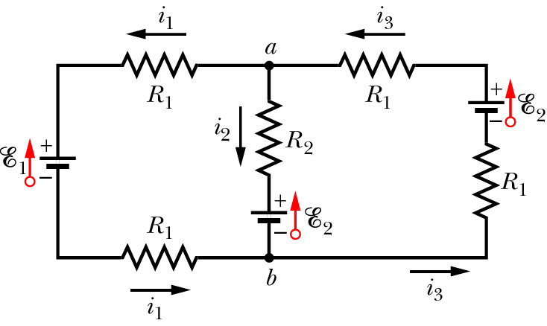
Using Kirchhoff’s Laws in Multiple Loop Circuits
Identify nodes and use Junction Rule:
Identify independent loops and use Loop Rule:
Only two are independent.

Slide 13
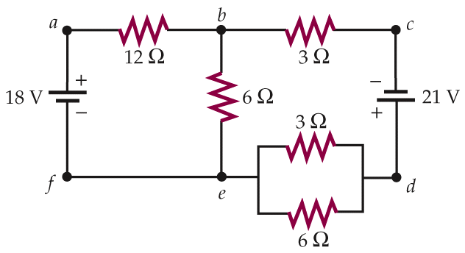
Example (not graded)
I₁+I₂
I₂
What’s the current I₁ ?
I₁
(a). 2.0A
(b). 1.0A
(c). -2.0A
(d). -1.0A
(e). Need more information to calculate the value.

Slide 14
I₁+I₂
I₂
Sketch the diagram
Simplify using equivalent resistors
Label currents with directions
Use Junction Rule in labeling
Choose independent loops
Use Loop Rule
Solve simultaneous linear equations
I₁
Replace by equivalent R=2Ω first.

Slide 15

iClicker Question
What is the current through R₁ ?
30Ω
30Ω
0.575A
0.5A
0.75A
0.33A
1.5A
R₁
R₂
45V
45V
R₃
30Ω
Notes:
b

Slide 16
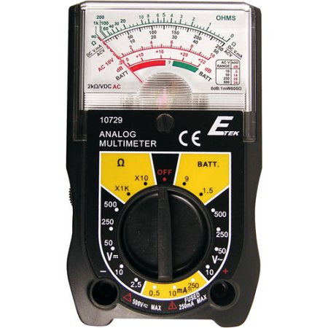
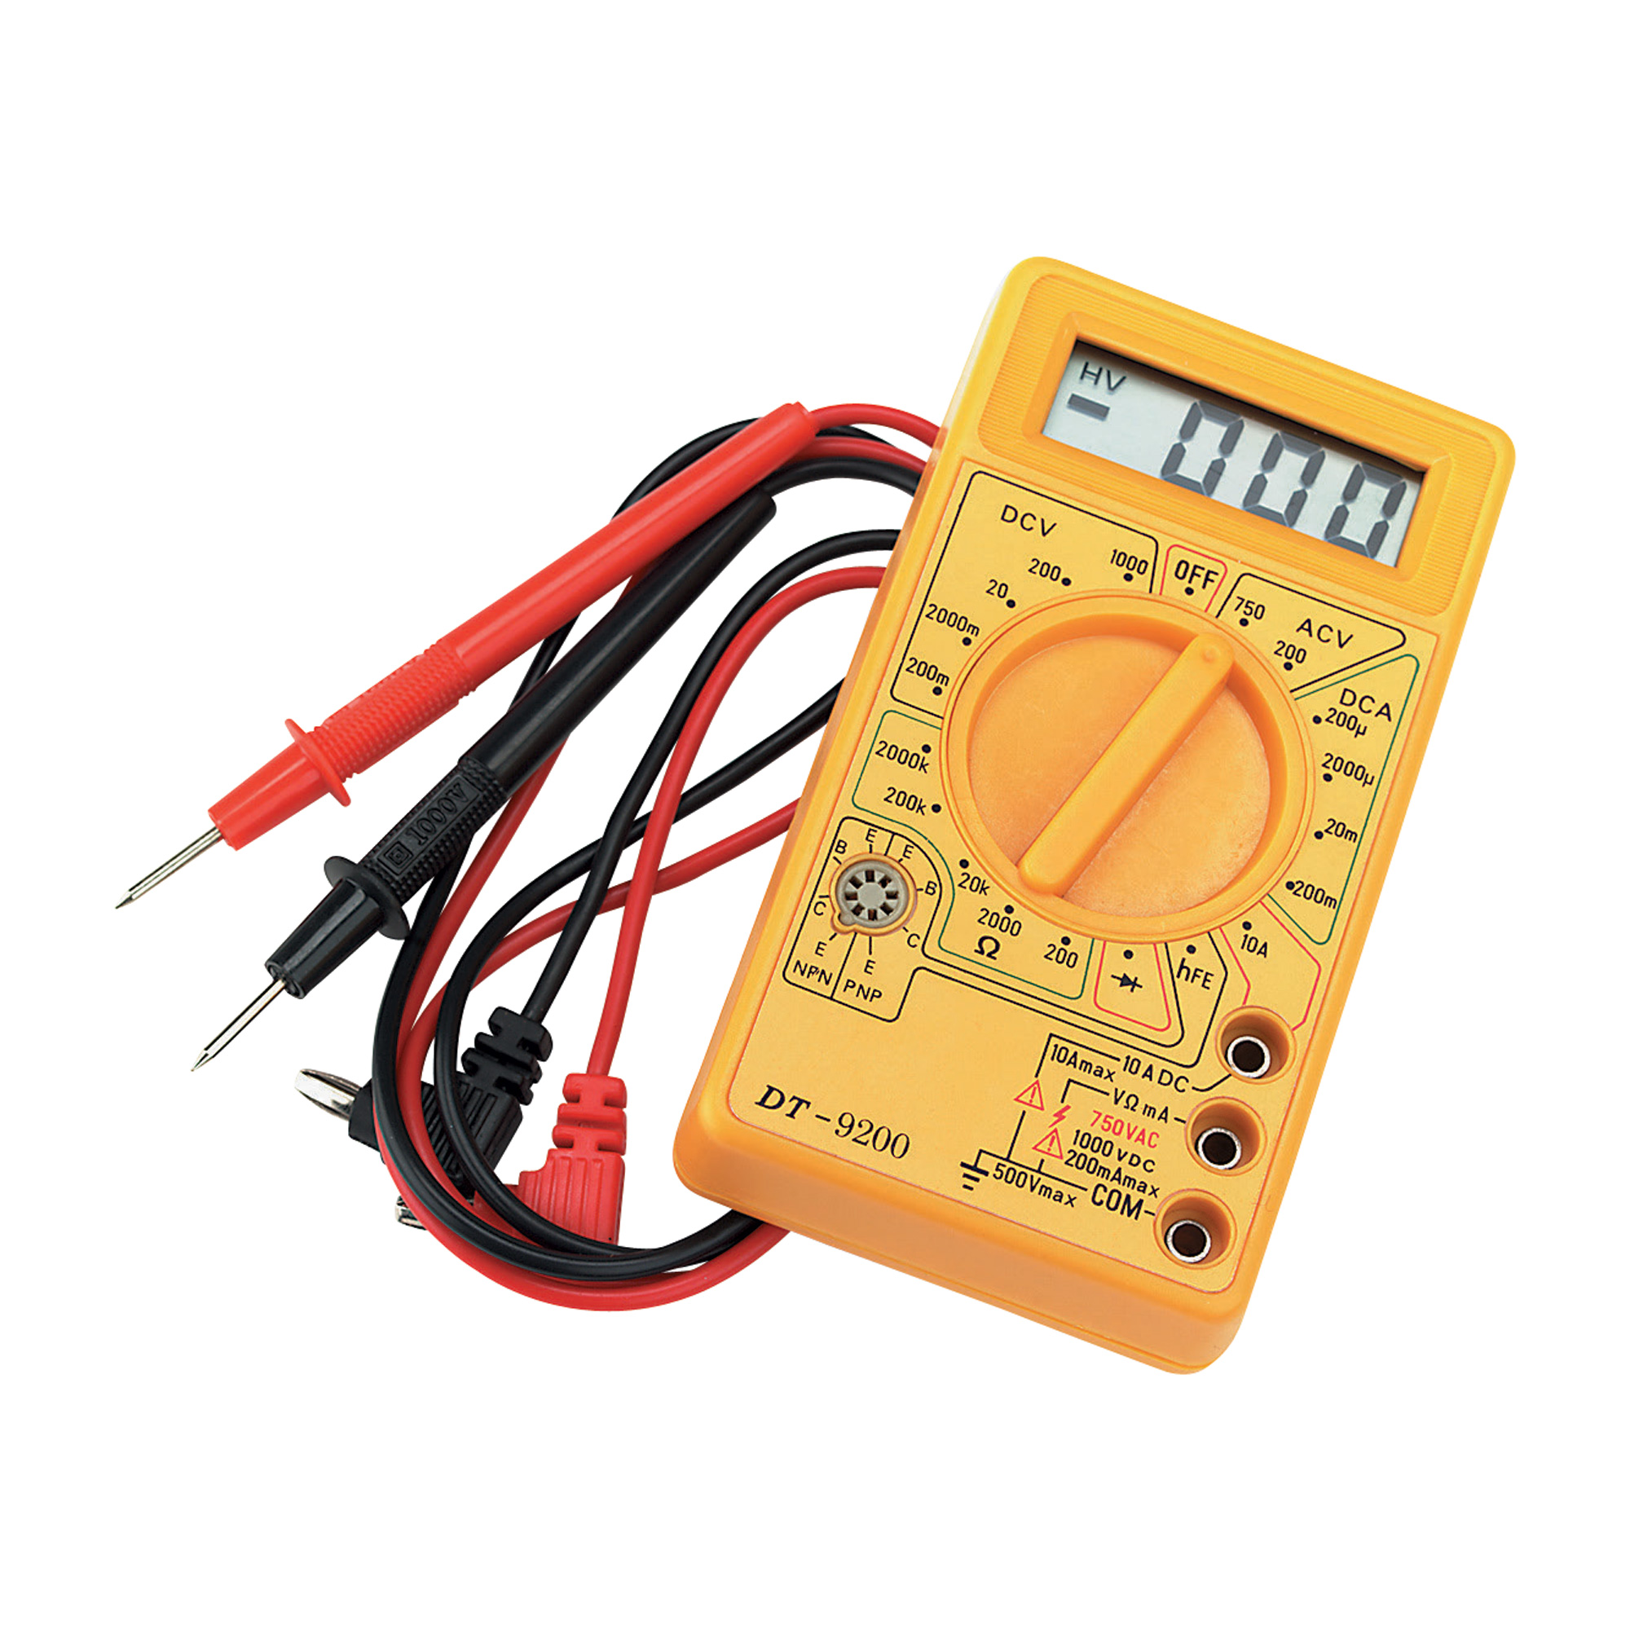
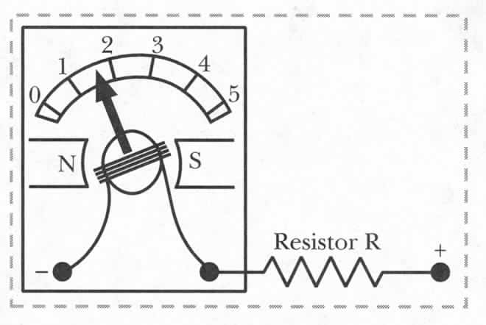
Ammeters, Voltmeters and Ohmmeters
Ammeter: measures current I
Voltmeter: measures voltage difference ΔV
Ohmmeter: measures resistance R
Notes:
16
Start here!

Slide 17
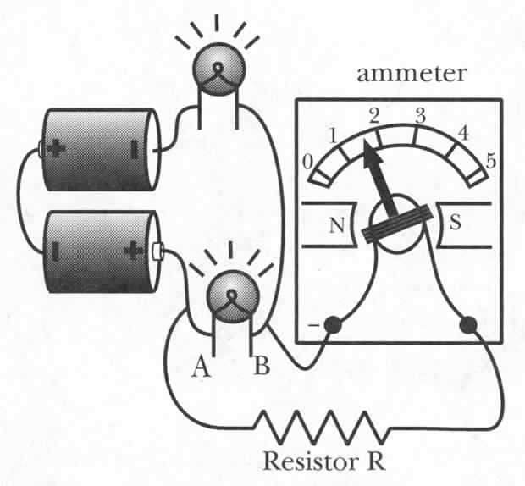
Voltmeter
Voltmeters measure potential difference
ΔV_{AB} – add a series resistor to ammeter
Measure I and convert to ΔV_{AB}=IR
Connecting Voltmeter:
Higher potential must be connected to the ‘+’ socket and lower one to the ‘-’ socket to result in positive reading.
Notes:
17

Slide 18
Ammeter Design: r_{int}
Ammeter is inserted in series into a circuit – measured current flows through it.
A
A
r_{int}
Process of measuring requires
charges to do some work:
Internal resistance
emf
R
No ammeter:
With ammeter:
Internal resistance of an ammeter must be very small
Notes:
18

Slide 19
Voltmeter: Internal Resistance
ΔV_{AB} in absence of a voltmeter
R₁
emf
B
r_{int}
ΔV_{AB} in presence of a voltmeter
R₂
A
A
Internal resistance of a voltmeter must be very large
Notes:
19

Slide 20
Ohmmeter
How would you measure R?
A
R
Ohmmeter
Ammeter with a small voltage source
Notes:
20
Measured current – switched to V to measure V, what will happen?

Slide 21
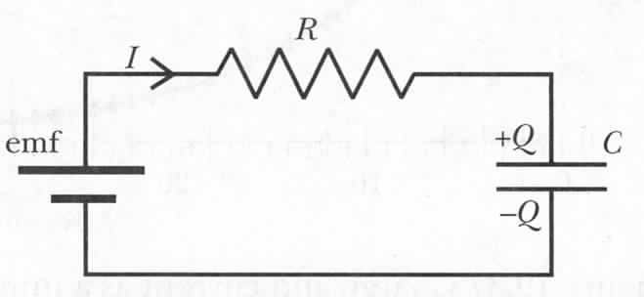
Quantitative Analysis of an RC Circuit
Initial situation: Q=0
Q and I are changing in time
Notes:
21

Slide 22
RC Circuit: Current
Current in an RC circuit
What is I₀ ?
Current in an RC circuit
Notes:
22

Slide 23
RC Circuit: Charge and Voltage
What about charge Q?
Current in an RC circuit
Current in an RC circuit
Check: t=0, Q=0, t--> inf, Q=C*emf
Notes:
23

Slide 24
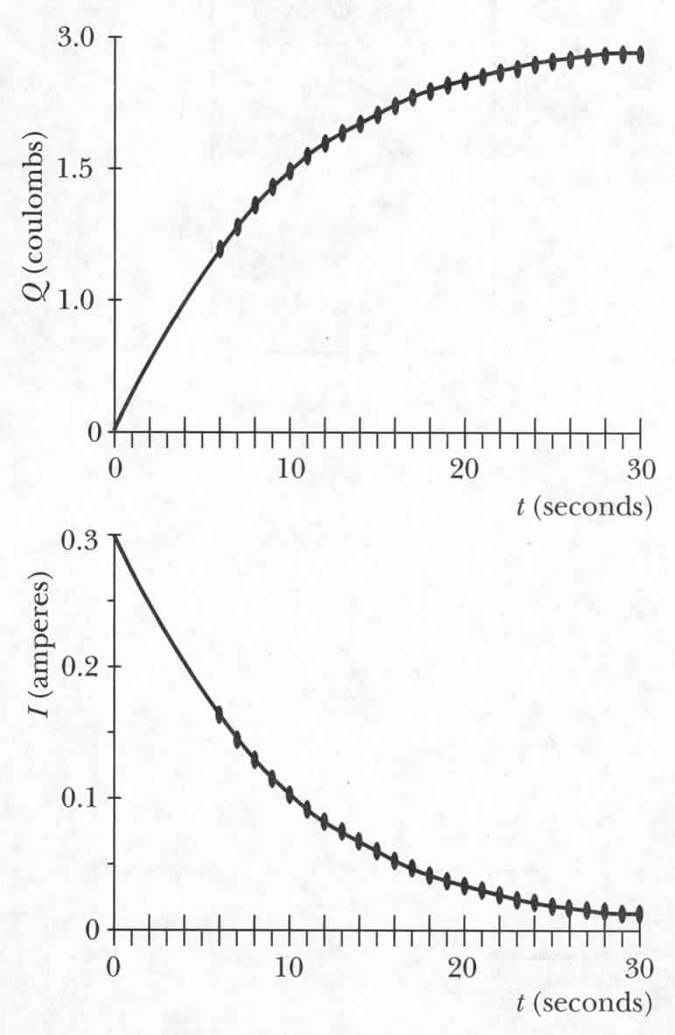
RC Circuit: Summary
Current in an RC circuit
Charge in an RC circuit
Voltage in an RC circuit
Notes:
24

Slide 25
The RC Time Constant
Current in an RC circuit
When time t = RC, the current I drops by a factor of e.
RC is the ‘time constant’ of an RC circuit.
A rough measurement of how long it takes to reach final equilibrium
Notes:
25
For every multiple of the time constant, the current drops an addition factor of e~2.718.

Slide 26
iClicker Questions
When measuring the current in a circuit, your device’s resistance need to be :
as big as possible.
as small as possible.
can be any value, big or small.

