Slide 1
EXAM2
Wednesday, March 21, 2:30pm-3:20 pm
room 112
Chapters 16, 17, 18 (edition#4).
Special needs, e.g. exam time extension, and has not contact me before, please bring me the letter from the Office of the Dean of Students before the end of 03/09 (Friday).
AOB
  multiple choice.
  Prepare your own scratch paper, pens, pencils, erasers, etc.
  Use only pencil for the answer sheet
  Bring your own calculators
  No cell phones, no text messaging which is considered cheating.
  No crib sheet of any kind is allowed. Equation sheet will be provided.
  10 problems in total.

Slide 2
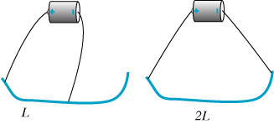
Twice the Length
Nichrome wire (resistive)
Quantitative measurement of current with a compass
Current is halved when increasing the length of the wire by a
factor of 2.
Notes:
Electric field is half -> half the drift speed -> half the current. Note that we are considering the wire to be a “resistive” wire.

Slide 3
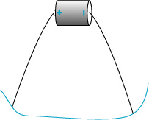
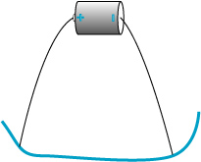
Doubling the Cross-Sectional Area
If A doubles, the current doubles.
Nichrome wire
Notes:
Electric field in the wire doesn’t change when we use a thicker wire -> current doubles

Slide 4
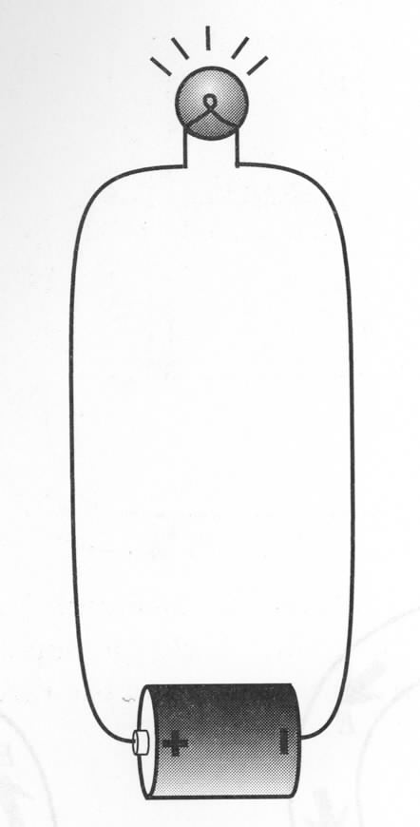
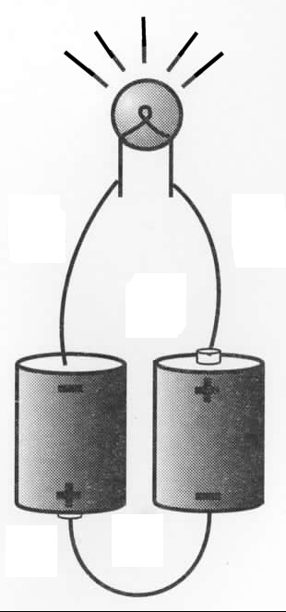
Two Batteries in Series
Why light bulb is brighter with two batteries?
Two batteries in series can drive more current:
Potential difference across two batteries in series is 2emf → doubles electric field everywhere in the circuit → doubles drift speed → doubles current.
Work per second:
Notes:
After getting i for both – ask how much brighter? How much more heat dissipate with 2 batteries?
In reality: not 4x because mobility changes with temperature., I.e. current also does not go twice up.

Slide 5
Capacitance
-Q
+Q
Electric field in a capacitor:
E
In general:
s
Definition of capacitance:
Capacitance of a parallel-plate capacitor:
Wiki: The SI unit of capacitance is the farad (symbol: F), named after the English physicist Michael Faraday
Capacitance
Notes:
The more charge on the capacitor plates, the bigger the electric field in the gap, and the greater the potential difference across the gap. Capacitance is a measure of the ability to store charge. For a given potential difference, larger C means greater Q.

Slide 6
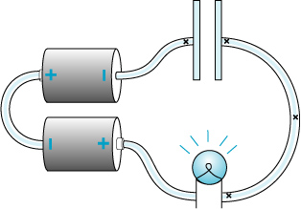
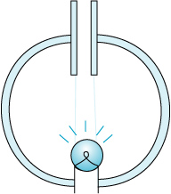
Capacitor: Charging and Discharging
Charging
Discharging
Will the bulb light up during the charging and discharging process?
  neither
  Yes for both
  Yes for charging process only
  Yes for discharging process only.
What happens when the plate is infinitely large?
Notes:
Explain what is charging and discharging process first

Slide 7
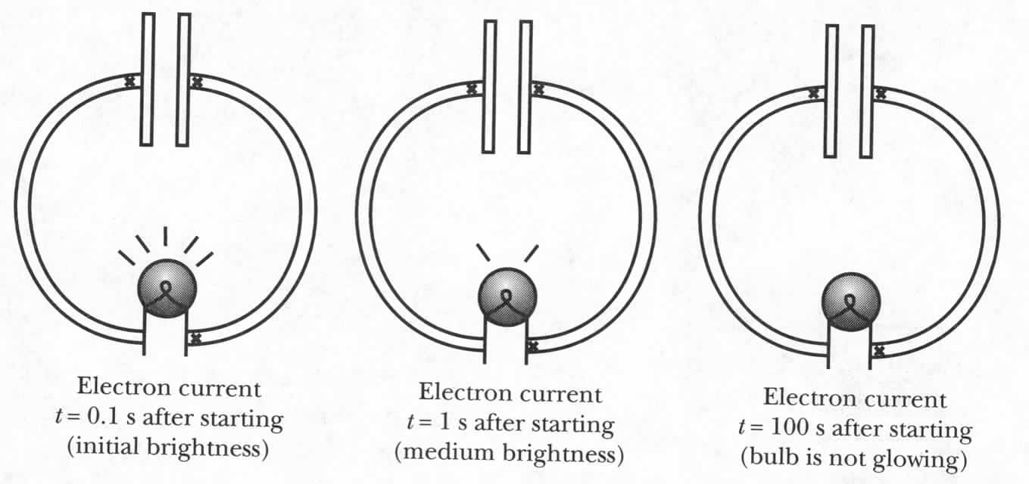
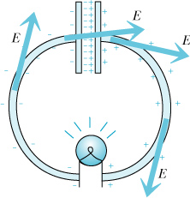
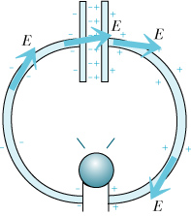
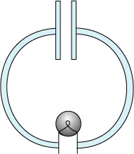
Capacitor: Discharge
Electron
Current
Electric
Field
Notes:
The fringe field of the capacitor plus the electric field of the charges on the surface of the wires drive current in a way to REDUCE the charge of the capacitor plates. The top figure exaggerates the amount of fringe charge and does not show the charge between the plates. Purple arrows represent the electron current, not Efield!
Recall that we derived an expression for the fringe field by considering the superposition of two charged disks separated by a distance s. We ignored the small amount of charge on the exterior of the capacitor.

Slide 8
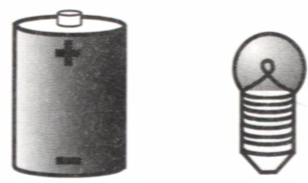
Capacitor: Charging
Fringe field of a capacitor rises until E=0 in a wire – static equilibrium.
Notes:
The fringe field of the capacitor acts in a direction opposite to the conventional current -> decreasing net field. Charges shown on capacitor are meant to represent both interior and external charges (latter being very small). The purple vectors represent the Efield in the conducting wire causing current to flow.
Ultimately, the fringe field is such that it and the field produced by charges on the wire leads to E=0 (static equilibrium) and I=0.

Slide 9
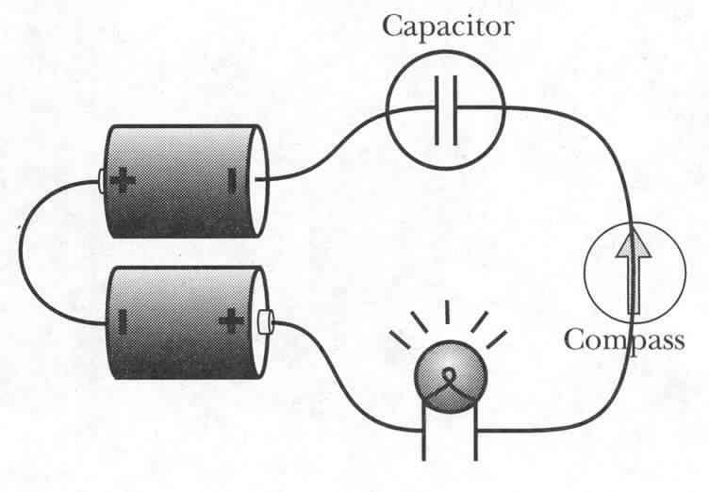
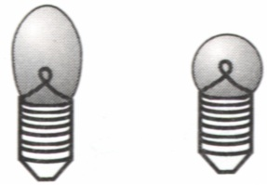
The Effect of Different Light Bulbs
Thin filament
Thick filament
Which light bulb will glow longer?
Which one is initially brighter?
Round is initially brighter → capacitor gets charged more?
2) Long bulb glows longer → capacitor gets charged more?
After current stops,
Voltage across capacitor = Voltage across battery
no matter which bulb is used.
Capacitor charged by same amount in both cases.
Notes:
Demo 6C-14. ask Gary for two different bulb.
Ultimately, same amount of charge on capacitor, independent of bulb since no current flowing and voltage diff across capacitor must equal emf.
Initially, E through bulb = emf/L. Since L is same for both bulbs, E is same. Current depends on Area, so current in long bulb is less than in round bulb.
Experiment: charge 2 capacitors through long and round until they don’t glow.
Then discharge both through long and see which gets discharged faster.

Slide 10
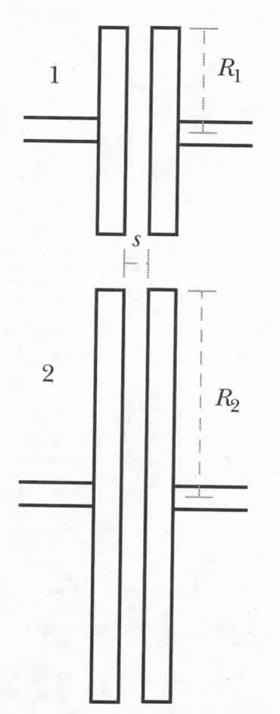
IClicker Question: Effect of the Capacitor Disk Size
Use two different capacitors in the same circuit
Same amount of charge on both capacitors
1. In the first moment of discharging,
which capacitor will make the bulb glow brighter?
2. Which capacitor will make the light bulb glow longer?
Upper longer, lower brighter
Upper longer, upper brighter
Lower longer, lower brighter
Lower longer, upper brighter
Fringe field:
Notes:
Charge it first and then discharge.
Capacitor 2 has large capacitance, i.e. large Q. With smaller fringe field, the current is smaller, i.e. longer.
Capacitor 1 brighter.

Slide 11
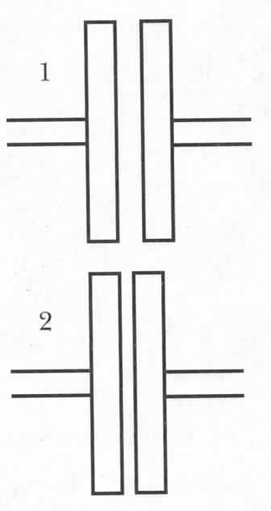
iClicker question: Effect of the Capacitor Disk Separation
Same amount of charge on both capacitors
1. In the first moment of discharging,
which capacitor will make the bulb glow brighter?
2. Which capacitor will make the light bulb glow longer?
Upper longer, lower brighter
Upper longer, upper brighter
Lower longer, lower brighter
Lower longer, similar brightness
Fringe field:
Notes:
Charge it first and then discharge.
Fringe field between the two are similar since they hold different amount of charge and fringe fieid E ~1/R
Capacitor 2 has large capacitance, i.e. large Q. With similar fringe field, the current is smaller, i.e. longer.
Capacitor 1 has similar brightness.

Slide 12
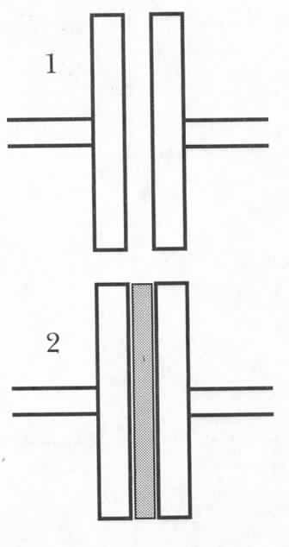

Effect of Insulator in Capacitor
Same amount of charge on both capacitors
Insulator
In the first moment of discharging , which capacitor will cause the bulb to produce more light?
Which capacitor will make the light bulb glow longer?
Fringe field:
Upper longer, lower brighter
Upper longer, upper brighter
Lower longer, lower brighter
Lower longer, upper brighter
Notes:
What if we put a metal plate in between? – equivalent to smaller distance. Metal is easily polarized.

Slide 13
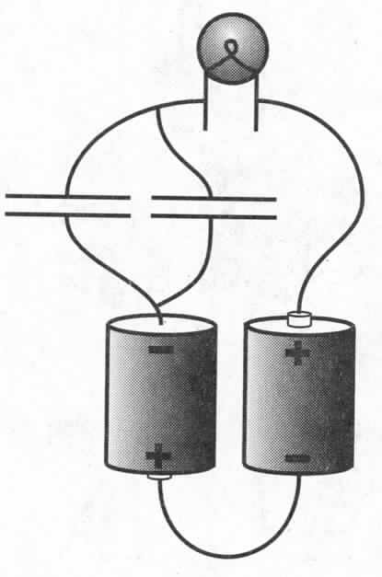
Parallel Capacitors
Initial moment: brighter?
Will it glow longer?
Fringe field:
Capacitors in parallel effectively increase A
Notes:
Equivalent to doubling the area of the plates of one capacitor. Fringe field will half for the same Q. Therefore bulb will grow longer.

Slide 14
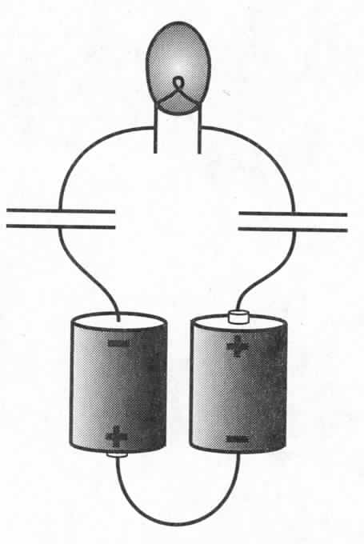
An Isolated Light Bulb
Will it glow at all?
How do electrons flow through
the bulb?
Yes
No because it’s an open circuit.

Slide 15
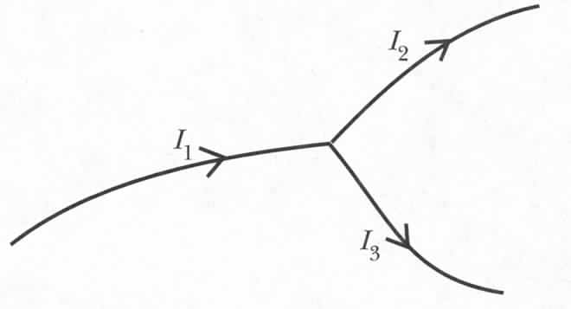
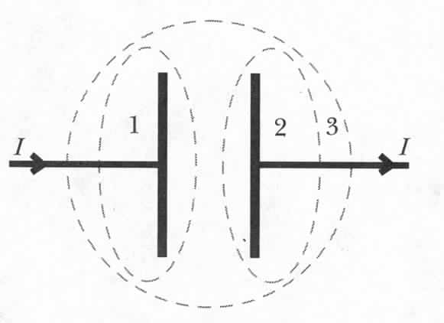
The Current Node Rule in a Capacitor Circuit
Charge conservation:
I_{i} > 0 for incoming
I_{i} < 0 for outgoing
I₁ = I₂+ I₃
…in steady state
Capacitor transients:
not a steady state!
Cannot use Kirchhoff rule for a part of a capacitor (area 1 or 2)
But can use for capacitor as a whole (area 3)

Slide 16
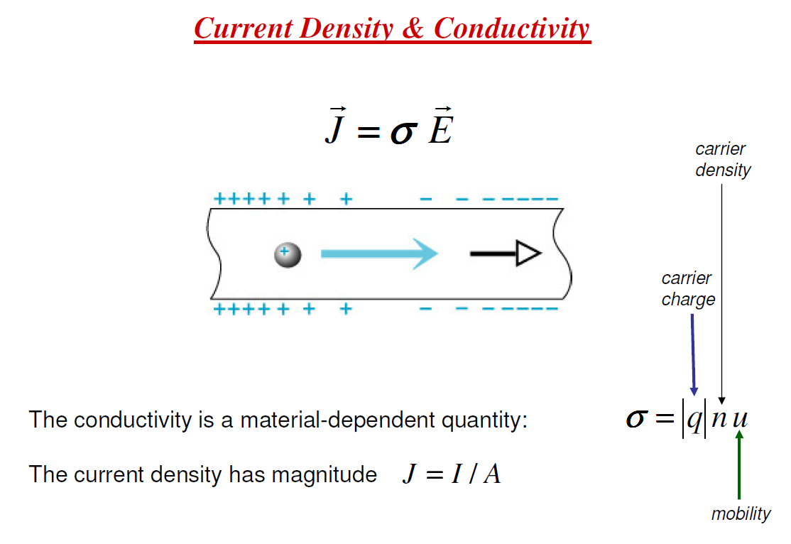
Unit: J, A/m²; E, V/m; σ, (A/m²)/(V/m)

Slide 17
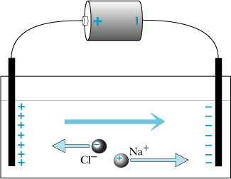
Conductivity with two kinds of charge carrier

Slide 18
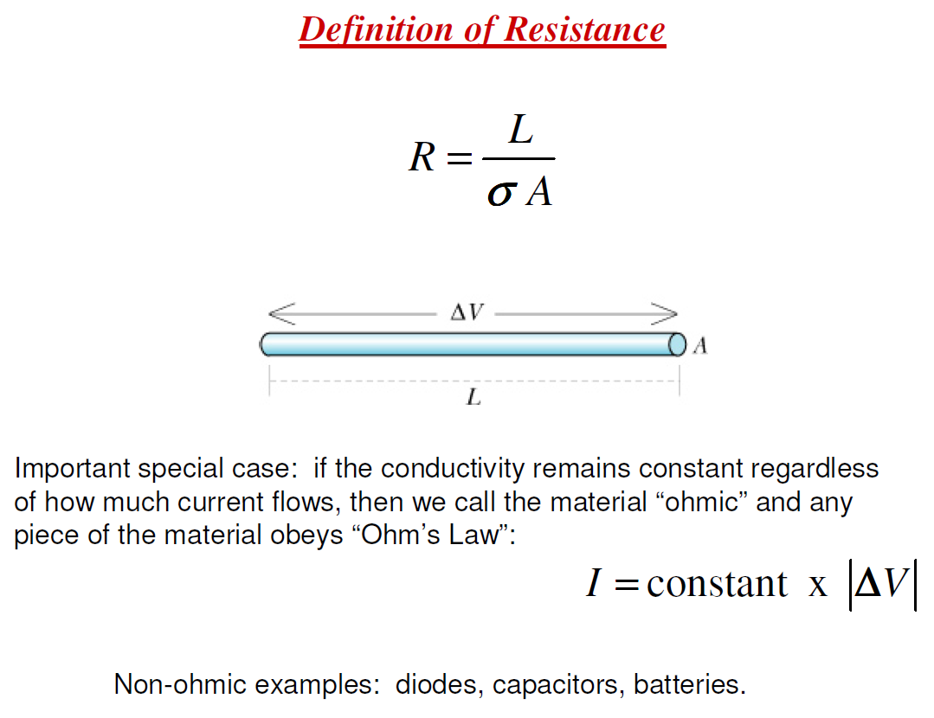
Resistance is in the unit of Ohm.

Slide 19
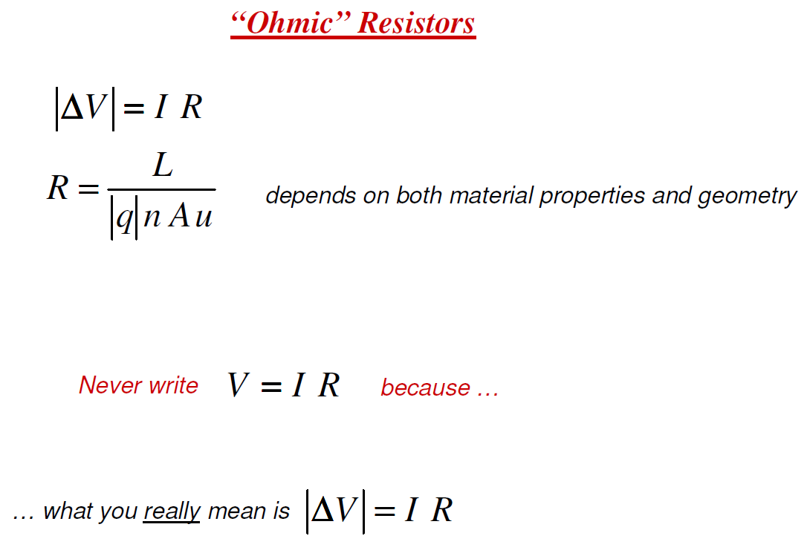
Notes:
19

Slide 20
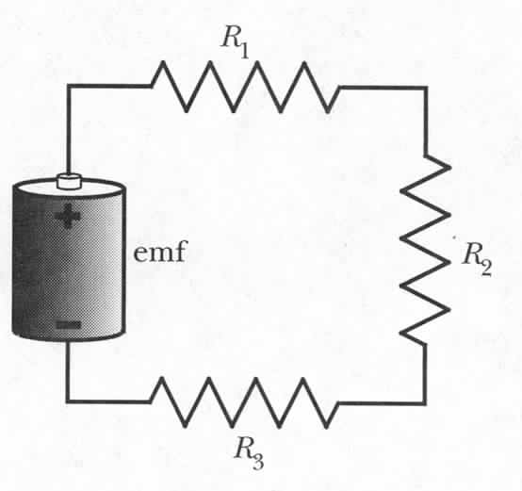
Series Resistance
ΔV_{batt} + ΔV₁ + ΔV₂ + ΔV₃ = 0
emf - R₁I - R₂I - R₃I = 0
emf = R₁I + R₂I + R₃I
emf = (R₁ + R₂ + R₃) I
emf = R_{equivalent} I , where R_{equivalent} = R₁ + R₂ + R₃
For resistors made of the same material and with the same A
it follows straight from the definition of resistance:
Notes:
20
Not an obvious result: depends on definitions we had for R etc.

Slide 21
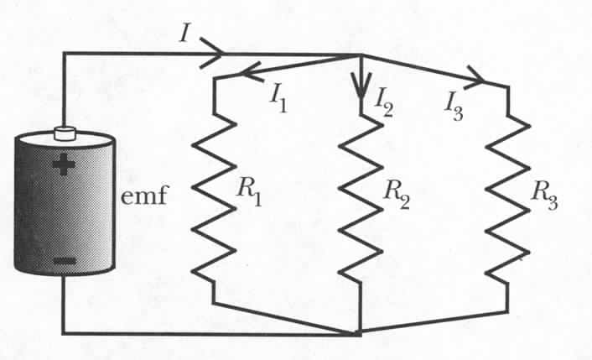
Parallel Resistance
I = I₁ + I₂ + I₃
For resistors made of the same material and with the same A
it follows straight from the definition resistance:
Notes:
21

Slide 22
Kirchhoff’s Rules
Kirchhoff’s Rule 2: Loop Rule
When any closed loop is traversed completely in a circuit, the algebraic sum of the changes in potential is equal to zero.
Coulomb force is conservative
Kirchhoff’s Rule 1: Junction Rule
The sum of currents entering any junction in a circuit is equal to the sum of currents leaving that junction.
Conservation of charge
In and Out branches
Assign I_{i} to each branch

Slide 23
Circuit Analysis Tips
Simplify using equivalent resistors
Label currents with arbitary directions
  If the calculated current is negative, the real direction is opposite to the one defined by you.
Apply Junction Rule to all the labeled currents.
  Useful when having multiple loops in a circuit.
Choose independent loops and define loop direction
  Imagine your following the loop and it’s direction to walk around the circuit.
Use Loop Rule for each single loop
  If current I direction across a resistor R is the same as the loop direction, potential drop across R is ∆V = −I×R, otherwise, ∆V = I×R
  For a device, e.g. battery or capacitor, rely on the direction of the electric field in the device and the loop direction to determine the Potential drop across the device
Solve simultaneous linear equations
Notes:
Current dirction is the moving direction of positive charge, i.e. the electric field direction, therefore, following the current direction, potential drops

Slide 24
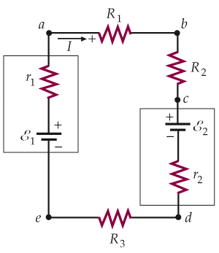
Loop Example with Two EMF Devices
⇒
If ε₁ <ε₂, we have I<0 !?
This just means the actual current flows reverse to the assumed direction. No problem!

Slide 25
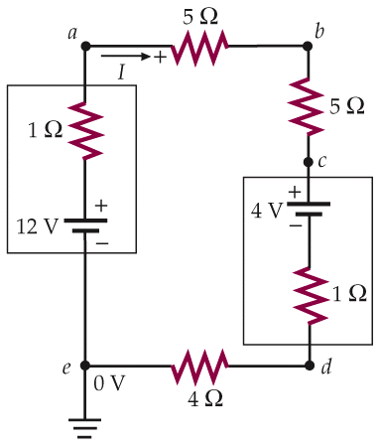
Finding Potential and Power in a Circuit
But what is I? Must solve for I first!
supplied by 12V battery
dissipated by resistors
The rest?
Just means 0 V here
into 4V battery (charging)
Notes:
Current dirction is the moving direction of positive charge, i.e. the electric field direction, therefore, following the current direction, potential drops

Slide 26
iClicker question: Series Resistance
emf = 1.5v, R1 = R2 = R3 =5 ohm, what is the currents inside the circuit?
0.3 A
1.5 A
0.1A
0.15A
1.0A
Notes:
26
Not an obvious result: depends on definitions we had for R etc.

Slide 27
iClicker question: Parallel Resistance
emf = 1.5v, R1 = R2 = R3 =5 ohm, what is the currents going through R1?
0.3 A
1.5 A
0.1A
0.9A
1.0A
Notes:
27

Slide 28
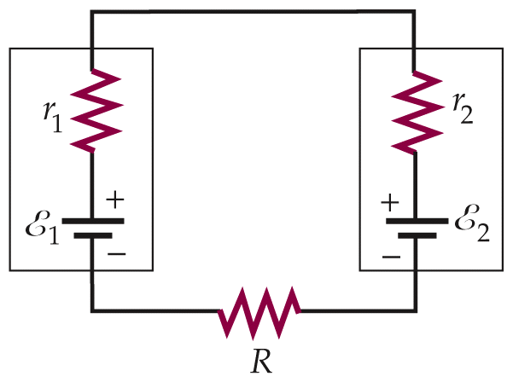
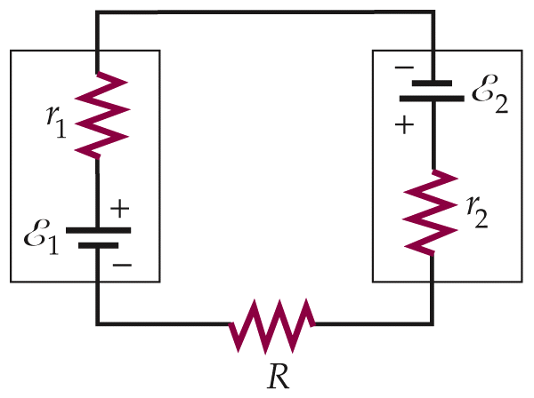
Charging a Battery
Positive terminal to positive terminal
Charging EMF > EMF of charged device
Say, R+r₁+r₂=0.05Ω (R is for jumper cables). Then,
good battery (12V)
battery being charged (11V)
power into battery 2
If connected backward,
Large amount of gas produced
Huge power dissipation in wires

Slide 29
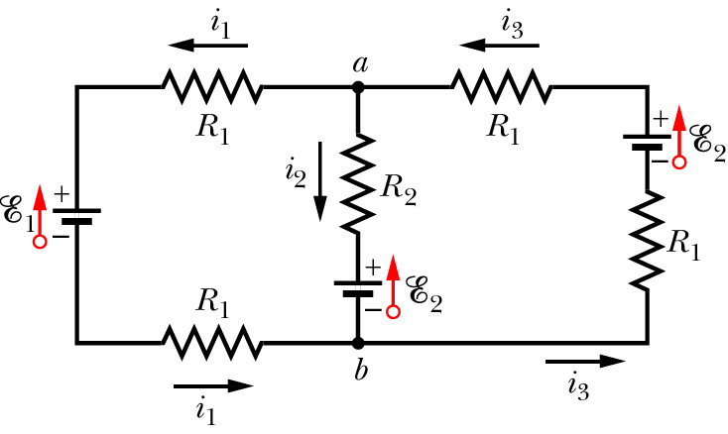
Using Kirchhoff’s Laws in Multiple Loop Circuits
Identify nodes and use Junction Rule:
Identify independent loops and use Loop Rule:
Only two are independent.

Slide 30
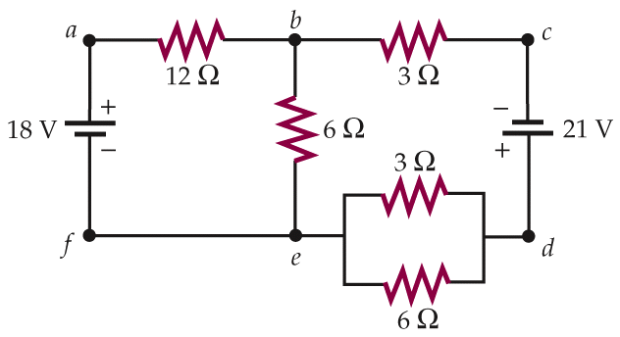
iClicker Question
I₁+I₂
I₂
What’s the current I₁ ?
I₁
(a). 2.0A
(b). 1.0A
(c). -2.0A
(d). -1.0A
(e). Need more information to calculate the value.

Slide 31
I₁+I₂
I₂
Sketch the diagram
Simplify using equivalent resistors
Label currents with directions
Use Junction Rule in labeling
Choose independent loops
Use Loop Rule
Solve simultaneous linear equations
I₁
Replace by equivalent R=2Ω first.

Slide 32

iClicker Question
What is the current through R₁ ?
30Ω
30Ω
0.575A
0.5A
0.75A
0.33A
1.5A
R₁
R₂
45V
45V
R₃
30Ω

Slide 33
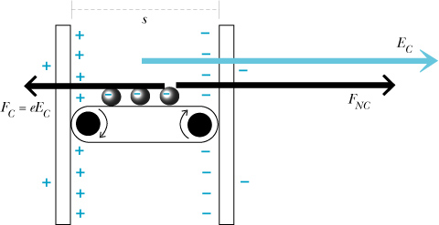
Real Batteries: Internal Resistance
Drift speed of ions
in chemical battery:
In usual circuit elements:
r_{int} - internal
resistance
In a battery:
emf
, assuming uniform field:
Notes:
33
If there is very little internal resistance to movement of ions through the battery, the potential difference across the battery is nearly equivalent to the emf of the battery.
If current is large -> the term rI is sizeable -> potential difference across the rest of the circuit is reduced

Slide 34
Ammeters, Voltmeters and Ohmmeters
Ammeter: measures current I
Voltmeter: measures voltage difference ΔV
Ohmmeter: measures resistance R
Notes:
34
Start here!

Slide 35
Ammeter Design: r_{int}
Ammeter is inserted in series into a circuit – measured current flows through it.
A
A
r_{int}
Process of measuring requires
charges to do some work:
Internal resistance
emf
R
No ammeter:
With ammeter:
Internal resistance of an ammeter must be very small
Notes:
35

Slide 36
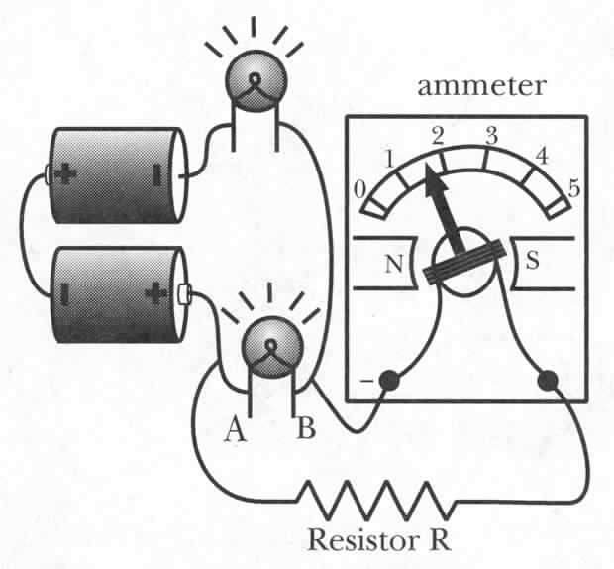
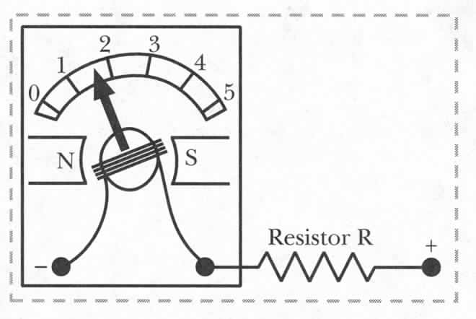
Voltmeter
Voltmeters measure potential difference
ΔV_{AB} – add a series resistor to ammeter
Measure I and convert to ΔV_{AB}=IR
Connecting Voltmeter:
Higher potential must be connected to the ‘+’ socket and lower one to the ‘-’ socket to result in positive reading.
Notes:
36

Slide 37
Voltmeter: Internal Resistance
ΔV_{AB} in absence of a voltmeter
R₁
emf
B
r_{int}
ΔV_{AB} in presence of a voltmeter
R₂
A
A
Internal resistance of a voltmeter must be very large
Notes:
37

Slide 38
Ohmmeter
How would you measure R?
A
R
Ohmmeter
Ammeter with a small voltage source
Notes:
38
Measured current – switched to V to measure V, what will happen?

Slide 39
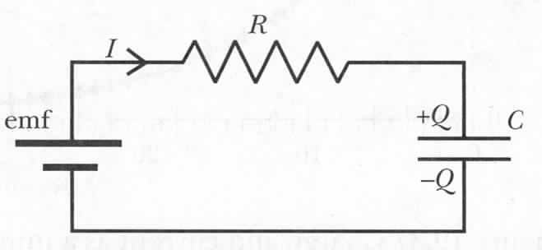
Quantitative Analysis of an RC Circuit
Initial situation: Q=0
Q and I are changing in time
Notes:
39

Slide 40
RC Circuit: Current
Current in an RC circuit
What is I₀ ?
Current in an RC circuit
Notes:
40

Slide 41
RC Circuit: Charge and Voltage
What about charge Q?
Current in an RC circuit
Current in an RC circuit
Check: t=0, Q=0, t--> inf, Q=C*emf
Notes:
41

Slide 42
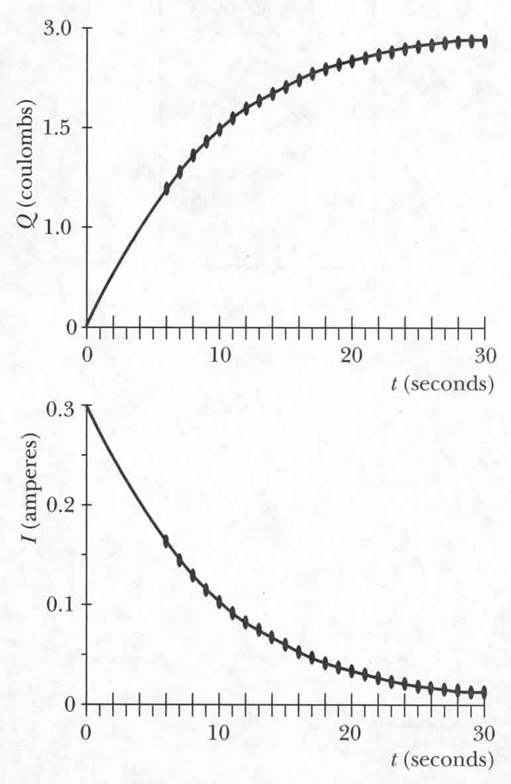
RC Circuit: Summary
Current in an RC circuit
Charge in an RC circuit
Voltage in an RC circuit
Notes:
42

Slide 43
The RC Time Constant
Current in an RC circuit
When time t = RC, the current I drops by a factor of e.
RC is the ‘time constant’ of an RC circuit.
A rough measurement of how long it takes to reach final equilibrium
Notes:
43
For every multiple of the time constant, the current drops an addition factor of e~2.718.

