Slide 1
EXAM2
Wednesday, March 21, 2:30pm-3:20 pm
room 112
Chapters 16, 17, 18 (edition#4).
Special needs, e.g. exam time extension, and has not contact me before, please bring me the letter from the Office of the Dean of Students before the end of 03/09 (Friday).
AOB
  multiple choice.
  Prepare your own scratch paper, pens, pencils, erasers, etc.
  Use only pencil for the answer sheet
  Bring your own calculators
  No cell phones, no text messaging which is considered cheating.
  No crib sheet of any kind is allowed. Equation sheet will be provided.
  10 problems in total.

Slide 2
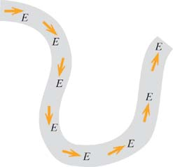
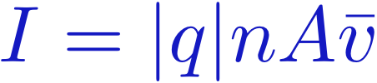
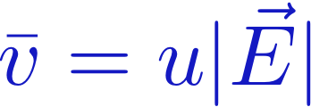
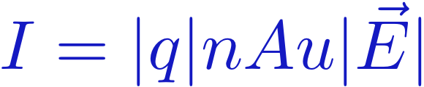
Electric Field Inside the Wire
Constant current in the wire ➔ Constant E in the wire.
I
Conventional Current
I
I
I
I
Drift Velocity controlled by |E|
Mobility (u) set by the material.
I
I
I
Constant current
requires constant |E|

Slide 3
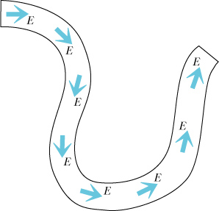
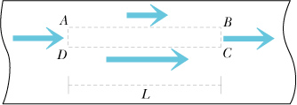
Direction of Electric Field in a Wire
E must be parallel to the wire
E is the same along the wire
Does current fill the wire?
Is E uniform across the wire?
V_{AB}
0
V_{CD}
0
Notes:
B field measurements are the same all along the wire (unless we encounter loops).

Slide 4
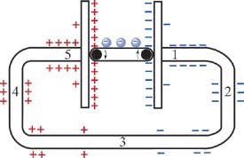
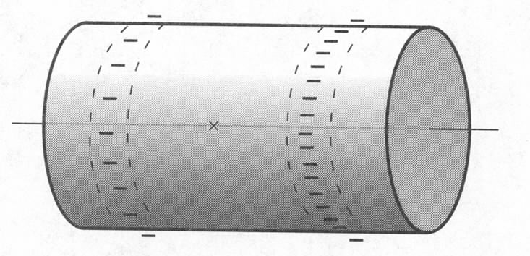
Field due to Battery
E
Smooth transition from + surface charge to – to provide
constant E.
The amount of surface charge is proportional to the voltage.
Notes:
Greater density of surface charge on right end of cylinder (representing the wire) than at left end. Hence, field along axis points to the right.

Slide 5
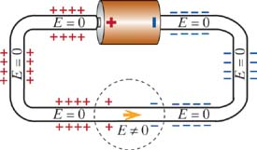
Connecting a Circuit
What happens just before and just after
a circuit is connected?
Just after the circuit is connected:
There is a disturbance in the
previous (equilibrium) E-field.
Now the region next to the disturbance
updates its E-field, and the next region...
How fast does this disturbance propagate?
At the drift speed of the electrons?
At the speed of light?
Notes:
B
At the speed of the fields, which is at the speed of light.

Slide 6
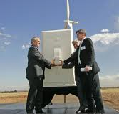
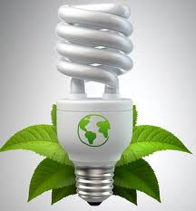
(Last Lecture) iClicker – Reality Physics!
Drift speed of electrons
Speed of light
Flip Light Switch On.
How long until electrons
from the switch reach the light bulb?
L = 5 m
A) About 1 nanosecond
B) About 1 microsecond
C) About 1 minute
D) About 1 day
Notes:
D.
10^5 sec ~ 28 hours.
Images:
http://www.treeliving.com/home-lighting-–-how-save-energy
http://www.nrel.gov/news/features/feature_detail.cfm/feature_id=1616

Slide 7
Today
Transient response when connecting a circuit
How long until steady state is reached?
Introduction to Resistors
Energy conservation in a circuit
Kirchhoff's Voltage Loop Law
Batteries

Slide 8
iClicker – Reality Physics!
Drift speed of electrons
Speed of light
Flip Light Switch On.
How long until information about the
change in E-field reaches the light bulb?
L = 5 m
A) About 16 nanoseconds
B) About 16 microseconds
C) About 16 minutes
D) About 16 days
Notes:
A.
(5/3) x 10^(-8) sec ~ 16 x 10^(-9) seconds.

Slide 9
Reality Physics!
Drift speed of electrons
Speed of light
Flip Light Switch On.
How long until information about the
change in E-field reaches the light bulb?
L = 5 m
≈ 1 day for electrons to travel from light switch to bulb.
≈ 16 nanoseconds for the change in E-field to travel from light switch to bulb.
Because there are sooooo many electrons
in the wire, they don't have to move far to
create a large current.
Notes:
A.
(5/3) x 10^(-8) sec ~ 16 x 10^(-9) seconds.

Slide 10
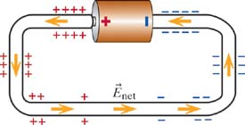
Connecting a Circuit
What happens just before and just after
a circuit is connected?
Just after the circuit is connected:
There is a disturbance in the
previous (equilibrium) E-field.
Now the region next to the disturbance
updates its E-field, and the next region...
The disturbance travels at the speed of light,
and within a few nanoseconds,
steady state is established.
Notes:
B
At the speed of the fields, which is at the speed of light.

Slide 11
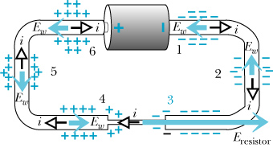
Electric field in Thin and Thick wires
After steady state is reached:
Notes:
Just after connecting the circuit but before equilibrium is established, the electric field in the narrow resistor might temporarily be about the same as the electric field in the thick wires, leading to a comparable drift velocity. But since Athin is less than Athick, electrons accumulate at the right end of the thin wire, increasing the E field in the thin wire. Similarly, a deficiency of electrons develops at the left end because the number of electrons emerging from the wire is too small. These fields reach equilibrium when as many electrons leave the thin wire as enter. This happens when Ethin = Athick/Athin * Ethick.

Slide 12
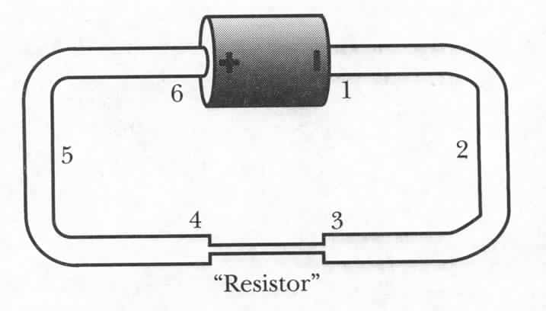
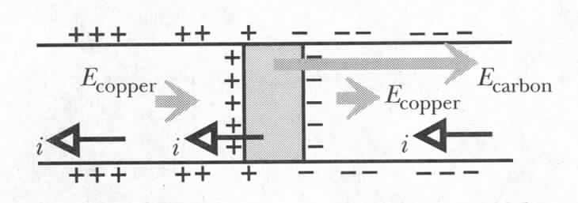
A Wide Resistor
low mobility
Notes:
In the transient electrons pile up not only on the surface BUT also at the interface

Slide 13
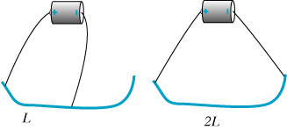
iClicker Questions
Nichrome wire (resistive)
When wire length double, the current will be
  Double
  Halved
  unchanged
Notes:
Electric field is half -> half the drift speed -> half the current. Note that we are considering the wire to be a “resistive” wire.

Slide 14
Twice the Length
Nichrome wire (resistive)
Quantitative measurement of current with a compass
Current is halved when increasing the length of the wire by a
factor of 2.
Notes:
Electric field is half -> half the drift speed -> half the current. Note that we are considering the wire to be a “resistive” wire.

Slide 15
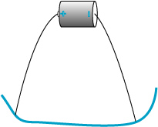
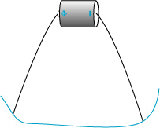
iClicker Question
Nichrome wire (resistive)
When wire cross sectional area is doubled, the current will be
  Double
  Halved
  unchanged
Notes:
Electric field in the wire doesn’t change when we use a thicker wire -> current doubles

Slide 16
Doubling the Cross-Sectional Area
If A doubles, the current doubles.
Nichrome wire
Notes:
Electric field in the wire doesn’t change when we use a thicker wire -> current doubles

Slide 17
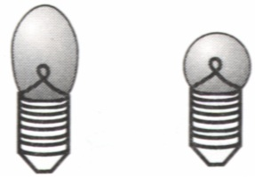
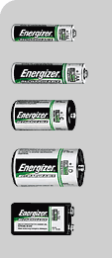
Energy in a Circuit
ΔV_{wire} = EL
ΔV_{battery} = ?
Energy conservation (the Kirchhoff loop rule [2nd law]):
ΔV₁ + ΔV₂ + ΔV₃ + … = 0 along any closed path in a circuit
ΔV= ΔU/q ← energy per unit charge
Notes:
From charge conservation and definition of steady state: Node rule – tells us about relations between currents in different parts. But what about actual current? How large is it.
To answer – turn to energy conservation principle. Consider one electron as it is transported around the circuit.
Energy gained by e as it is transported between terminals in a battery is dissipated in the rest of the circuit.
Use round-trip.

Slide 18
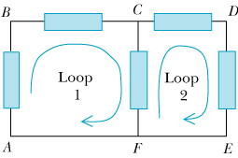
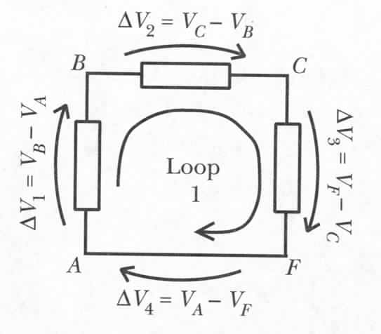

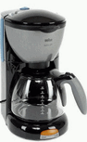
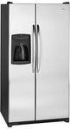
General Use of the Loop Rule
ΔV₁ + ΔV₂ + ΔV₃ + ΔV₄ = 0
(V_{B}-V_{A})+ (V_{C}-V_{B})+ (V_{F}-V_{C})+ (V_{A}-V_{F})=0
Notes:
Add pics of coffeemakers, refrigerators etc. as elements in a circuit.
We will get back to this in a more quantitative way later.

Slide 19
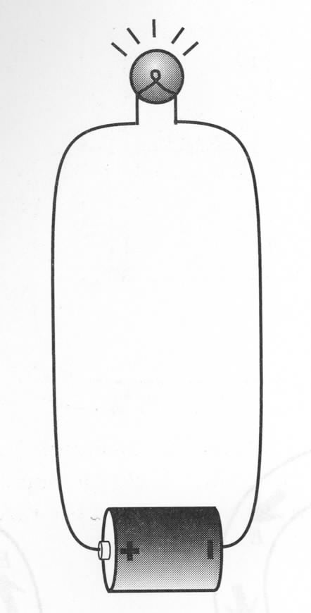
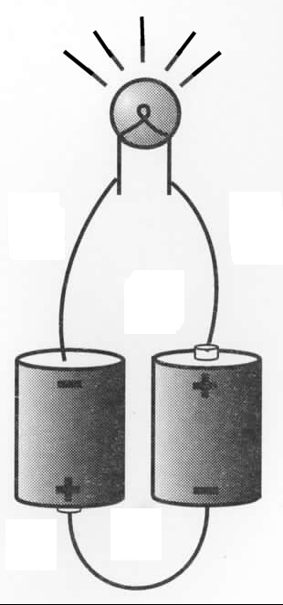
Two Batteries in Series
Why light bulb is brighter with two batteries?
Two batteries in series can drive more current:
Potential difference across two batteries in series is 2emf → doubles electric field everywhere in the circuit → doubles drift speed → doubles current.
Work per second:
Notes:
After getting i for both – ask how much brighter? How much more heat dissipate with 2 batteries?
In reality: not 4x because mobility changes with temperature., I.e. current also does not go twice up.

Slide 20
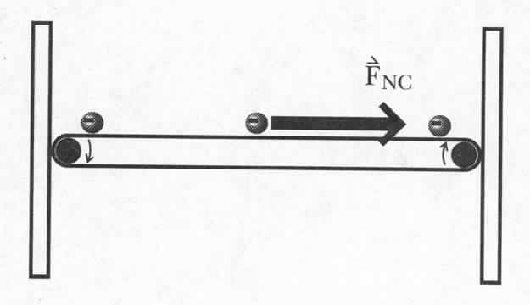
Potential Difference Across the Battery
Coulomb force on each e
F_{C}
non-Coulomb force on each e
1. a=F_{NC}/m
E_{C}
2. F_{C} =eE_{C}
3. F_{C} =F_{NC}
Energy input per unit charge
emf – electromotive force
The function of a battery is to produce and maintain a charge separation.
The emf is measured in Volts, but it is not a potential difference!
The emf is the energy input per unit charge.
chemical, nuclear, gravitational…

Slide 21
iClicker Questions
When plug in two batteries in series instead of one, the current will be
  Double
  Halved
  unchanged

Slide 22
Two Batteries in Series
Why light bulb is brighter with two batteries?
Two batteries in series can drive more current:
Potential difference across two batteries in series is 2emf → doubles electric field everywhere in the circuit → doubles drift speed → doubles current.
Work per second:

Slide 23
More for Today
Charge and discharge capacitors
Different way of connecting capacitors.
(More details on resistance)

Slide 24
Capacitance
-Q
+Q
Electric field in a capacitor:
E
In general:
s
Definition of capacitance:
Capacitance of a parallel-plate capacitor:
Wiki: The SI unit of capacitance is the farad (symbol: F), named after the English physicist Michael Faraday
Capacitance
Notes:
The more charge on the capacitor plates, the bigger the electric field in the gap, and the greater the potential difference across the gap. Capacitance is a measure of the ability to store charge. For a given potential difference, larger C means greater Q.

Slide 25
Exercise
A capacitor is formed by two rectangular plates 50 cm by 30 cm, and the gap between the plates is 0.25 mm. What is its capacitance?

Slide 26
A Capacitor With an Insulator Between the Plates
No insulator:
With insulator:
D
s

Slide 27
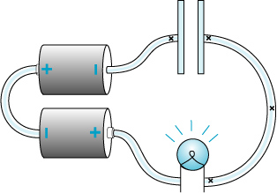
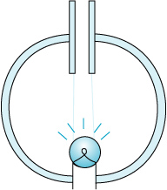
Capacitor: Charging and Discharging
Charging
Discharging
Will the bulb light up during the charging and discharging process?
  neither
  Yes for both
  Yes for charging process only
  Yes for discharging process only.
What happens when the plate is infinitely large?
Notes:
Explain what is charging and discharging process first

Slide 28
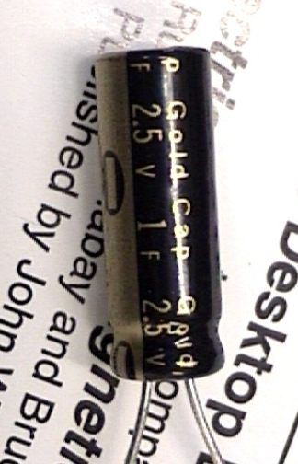
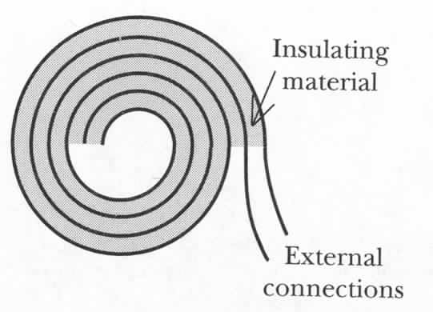
Capacitor: Construction and Symbols
Similar to a large
parallel plate
capacitor
D
s
There is no connecting path through a capacitor

Slide 29
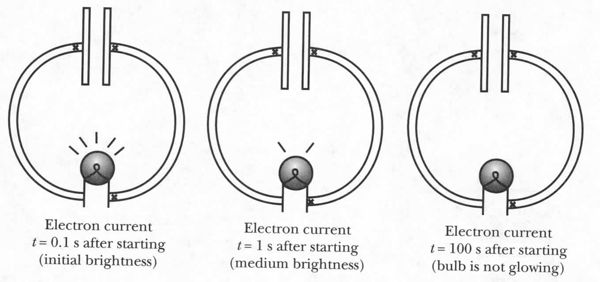
How is Discharging Possible?
Positive and negative charges are attracted to each other: how can they leave the plates?
Fringe field is not zero!
Electrons in the wire near the negative plate feel a force that
moves them away from the negative plate. Electrons near the
positive plate are attracted towards it.
Notes:
Recall, fringe field is due primarily to charges between the plates.

Slide 30
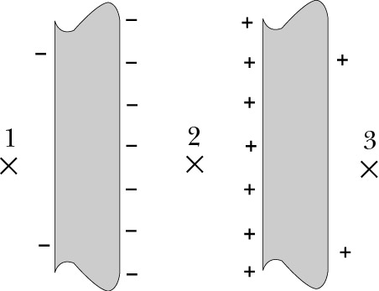
Electric Field of a Capacitor
Inside:
E₊
E_{net}
Fringe:
E₋
s
Step 4: check the results:
z
0
☑
Units:
From Lecture 6

Slide 31
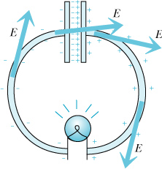
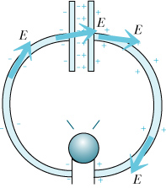
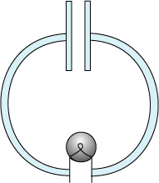
Capacitor: Discharge
Electron
Current
Electric
Field
Notes:
The fringe field of the capacitor plus the electric field of the charges on the surface of the wires drive current in a way to REDUCE the charge of the capacitor plates. The top figure exaggerates the amount of fringe charge and does not show the charge between the plates. Purple arrows represent the electron current, not Efield!
Recall that we derived an expression for the fringe field by considering the superposition of two charged disks separated by a distance s. We ignored the small amount of charge on the exterior of the capacitor.

Slide 32
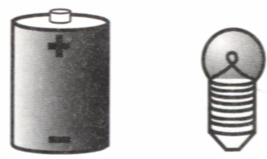
Capacitor: Charging
Fringe field of a capacitor rises until E=0 in a wire – static equilibrium.
Notes:
The fringe field of the capacitor acts in a direction opposite to the conventional current -> decreasing net field. Charges shown on capacitor are meant to represent both interior and external charges (latter being very small). The purple vectors represent the Efield in the conducting wire causing current to flow.
Ultimately, the fringe field is such that it and the field produced by charges on the wire leads to E=0 (static equilibrium) and I=0.

Slide 33
Capacitor: Charging
Why does current ultimately stop flowing in the circuit?
Ultimately, the fringe field of the capacitor and the field
due to charges on the wire are such that E=0 inside the
wire. At this point, i=0.

Slide 34
iClicker Question.
Charging
Which of the following is correct?
The light bulb will glow all the time
The light bulb will glow but will grow darker till completely off.
The light bulb will glow and will grow brighter

Slide 35
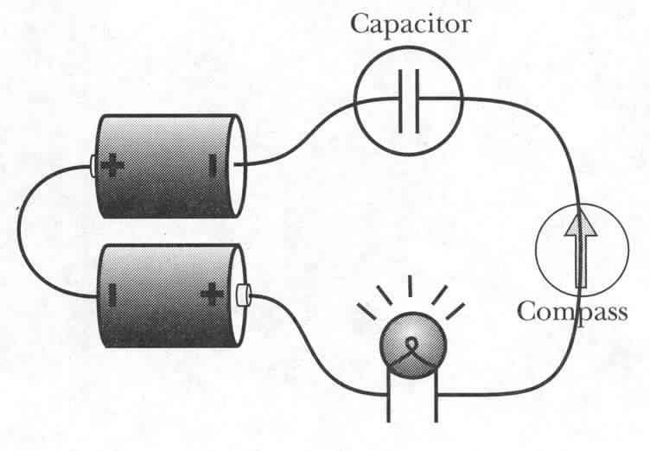
The Effect of Different Light Bulbs
Thin filament
Thick filament
Which light bulb will glow longer?
Which one is initially brighter?
Round is initially brighter → capacitor gets charged more?
2) Long bulb glows longer → capacitor gets charged more?
After current stops,
Voltage across capacitor = Voltage across battery
no matter which bulb is used.
Capacitor charged by same amount in both cases.
Notes:
Demo 6C-14. ask Gary for two different bulb.
Ultimately, same amount of charge on capacitor, independent of bulb since no current flowing and voltage diff across capacitor must equal emf.
Initially, E through bulb = emf/L. Since L is same for both bulbs, E is same. Current depends on Area, so current in long bulb is less than in round bulb.
Experiment: charge 2 capacitors through long and round until they don’t glow.
Then discharge both through long and see which gets discharged faster.

Slide 36
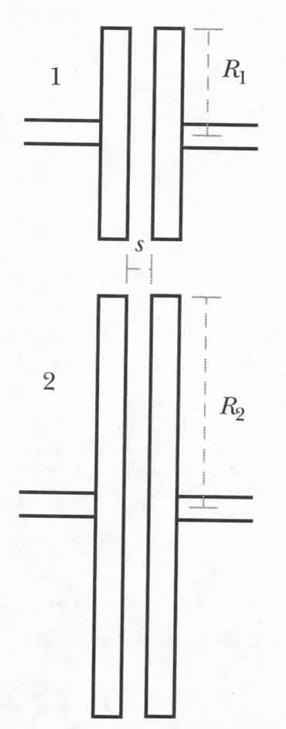
IClicker Question: Effect of the Capacitor Disk Size
Use two different capacitors in the same circuit
Same amount of charge on both capacitors
1. In the first moment of discharging,
which capacitor will make the bulb glow brighter?
2. Which capacitor will make the light bulb glow longer?
Upper longer, lower brighter
Upper longer, upper brighter
Lower longer, lower brighter
Lower longer, upper brighter
Fringe field:
Notes:
Charge it first and then discharge.
Capacitor 2 has large capacitance, i.e. large Q. With smaller fringe field, the current is smaller, i.e. longer.
Capacitor 1 brighter.

Slide 37
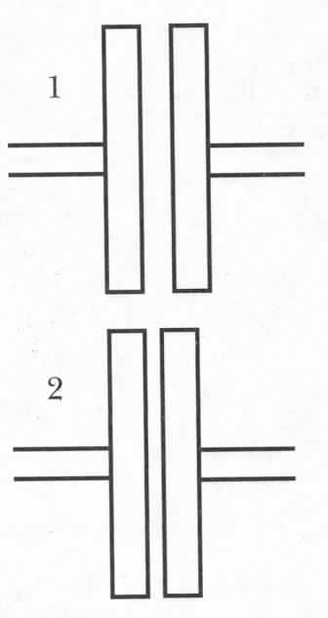
iClicker question: Effect of the Capacitor Disk Separation
Same amount of charge on both capacitors
1. In the first moment of discharging,
which capacitor will make the bulb glow brighter?
2. Which capacitor will make the light bulb glow longer?
Upper longer, lower brighter
Upper longer, upper brighter
Lower longer, lower brighter
Lower longer, similar brightness
Fringe field:
Notes:
Charge it first and then discharge.
Fringe field between the two are similar since they hold different amount of charge and fringe fieid E ~1/R
Capacitor 2 has large capacitance, i.e. large Q. With similar fringe field, the current is smaller, i.e. longer.
Capacitor 1 has similar brightness.

Slide 38
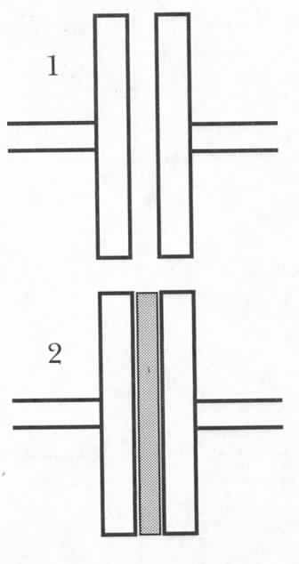

Effect of Insulator in Capacitor
Same amount of charge on both capacitors
Insulator
In the first moment of discharging , which capacitor will cause the bulb to produce more light?
Which capacitor will make the light bulb glow longer?
Fringe field:
Upper longer, lower brighter
Upper longer, upper brighter
Lower longer, lower brighter
Lower longer, upper brighter
Notes:
What if we put a metal plate in between? – equivalent to smaller distance. Metal is easily polarized.

Slide 39
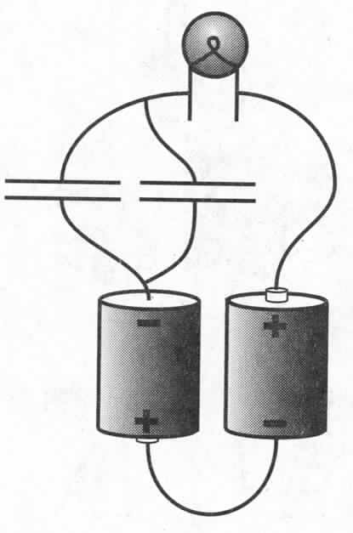
Parallel Capacitors
Initial moment: brighter?
Will it glow longer?
Fringe field:
Capacitors in parallel effectively increase A
Notes:
Equivalent to doubling the area of the plates of one capacitor. Fringe field will half for the same Q. Therefore bulb will grow longer.

Slide 40
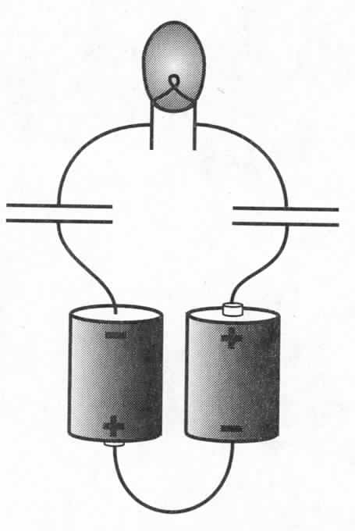
An Isolated Light Bulb
Will it glow at all?
How do electrons flow through
the bulb?
Yes
No because it’s an open circuit.

