Slide 1
Last Time
Magnetic Field of a Straight Wire
Magnetic Field of a Current Loop
Magnetic Dipole Moment
Bar Magnet

Slide 2
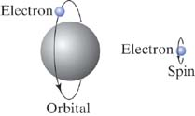
Quantum Magnetism
Magnetic Moment = Orbital Motion + "Spin"
SPIN:
Electron acts like spinning charge
- contributes to μ
Electron spin contribution to μ is of the same order as one due to orbital momentum
proton in nucleus also have spin but their μ‘s are much smaller than for electron
angular momentum:
iClicker question:
Can Neutron has spin dipole moment?
A). No because neutron has no charge
B). Yes, because neutron is not the fundamental building block.
NMR, MRI – use nuclear μ
Notes:
Neutron magnetic dipole moment is the same as proton and is not zero indicating smaller building blocks, i.e. quarks. For point particles, QM says gs = 2, which describe electron well. For proton gs ~5.6 and for neutron gs ~-3.8

Slide 3
More for Today
Equilibrium vs. Steady State in a Circuit
What is "used up" in a circuit?
Kirchhoff's Current Node Law
E-field inside a wire

Slide 4
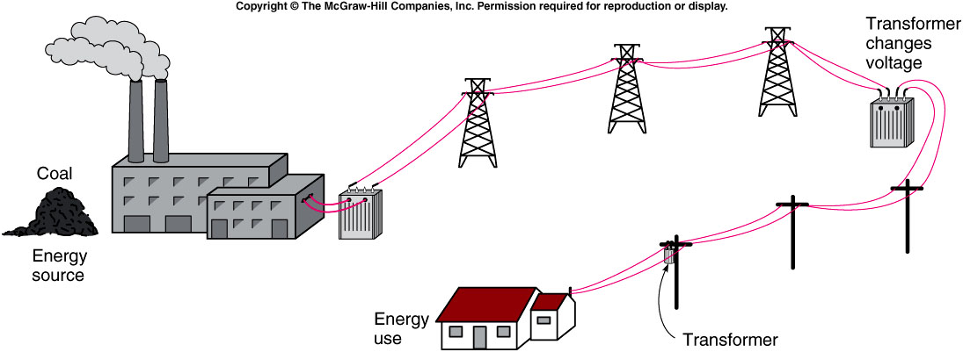
iClicker Question
Why High Voltage is needed to transfer electricity?
Prevent animal from biting the cable.
Reduce energy wasted during transportation.
No reason. People started this way long time ago.
Notes:
Asking student these questions to draw attentation.

Slide 5
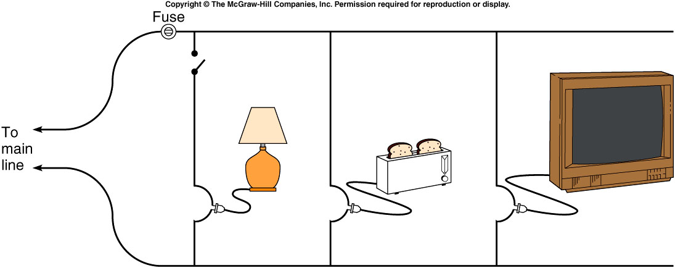
iClicker Question
Which way is preferred.
Left
Right
left and right are equal.
Notes:
Asking student these questions to draw attentation.

Slide 6
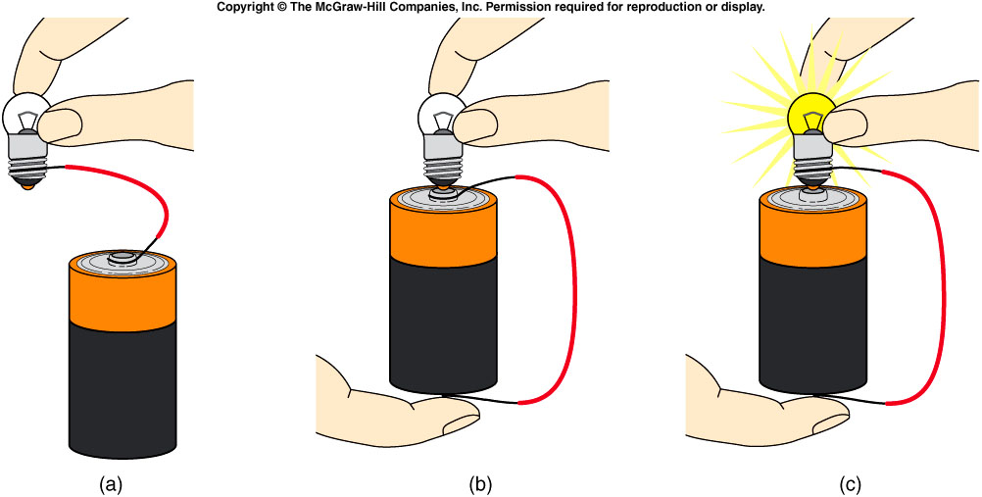
iClicker Question
Which of the following bulb will light up?

Slide 7
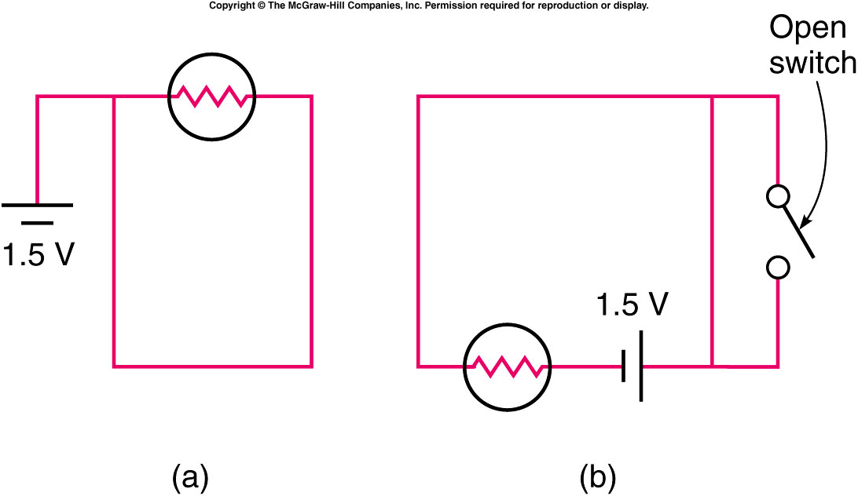
Which of the two circuits shown will cause the light bulb to light?
iClicker Question
Arrangement (a)
Arrangement (b)
Both
Neither

Slide 8
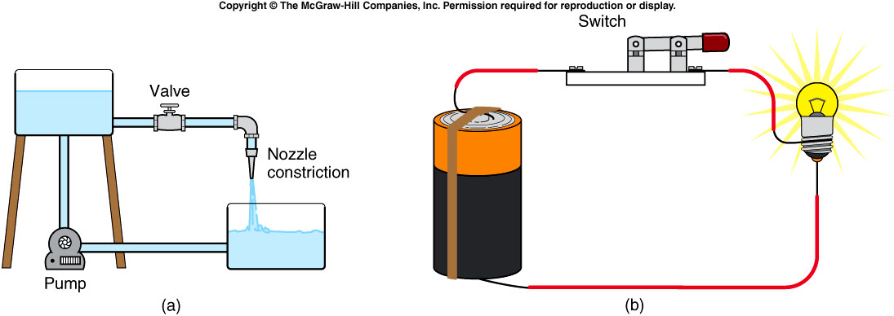
Water flowing in a pipe is similar to electric current flowing in a circuit.
  The battery is like the pump.
  The electric charge is like the water.
  The connecting wires are like the thick pipe.
  The filament is like the nozzle or narrow pipe.
  The switch is like the valve.
Notes:
faucet

Slide 9
We want to find out:
Microscopic Questions:
Are charges used up in a circuit?
Exactly how does a current-carrying wire create and maintain nonzero E inside?
What does the battery do?

Slide 10
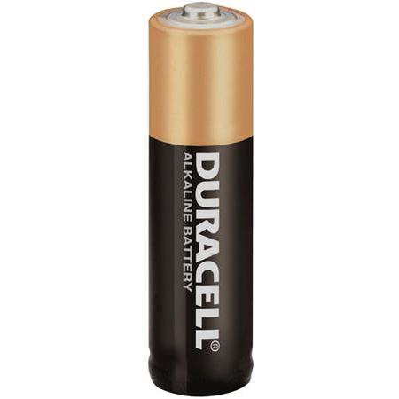
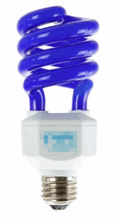
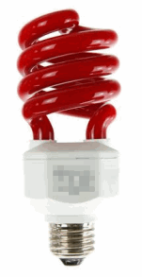
Conventional Current and Electron Current
-
C
Electron Current:
Electrons exit battery at (-) terminal,
and enter battery at (+) terminal
Electron
Current
-
-
+
C
Conventional Current:
+
Positive charges exit battery at (+) terminal,
and enter battery at (-) terminal
Conventional
Current
+

Slide 11
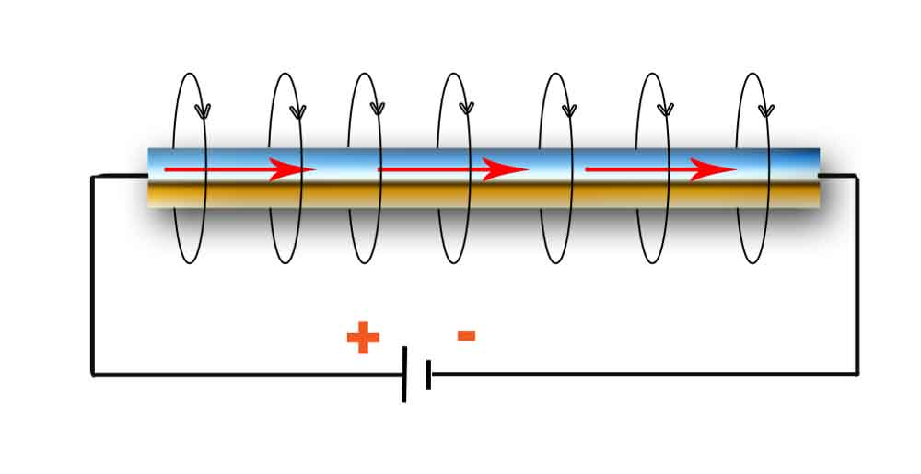


Equilibrium vs. Steady State
Remember: Electrons flow in opposite direction
from conventional current I
Magnetic Field B
Current I
http://physick.wikispaces.com/Electric+Current
Equilibrium:
No current flows. Average drift velocity of electrons is zero
Current Flow is not Equilibrium, but it is Steady State.
Current flows. Average drift velocity of electrons is constant

Slide 12
What IS the bulb using up?
1
-
Can the bulb consume current by
destroying electrons?
C
Electron
Current
➔ No.
Electrons cannot be destroyed.
Can the bulb consume current as
electrons accumulate in the bulb?
-
-
2
➔ No.
Otherwise electric field would change

Slide 13
What IS the bulb using up?
1
-
C
Electron
Current
-
-
2
Chemical Energy of battery converts to:
Light Energy
Heat Energy

Slide 14
Current Node Rule
A.K.A. Kirchhoff's Current Law
Current Node Rule: Current In = Current Out
Node: Any wire junction in the circuit.
I_{in} = 4A
I_{out} = 4A
I_{1-out} = 1A
I_{in} = 4A
I_{2-out} = 2A
I_{3-out} = 1A

Slide 15
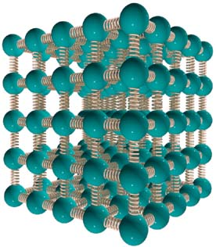
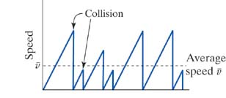
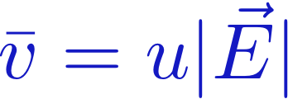
Electric Field in the Circuit
Electrons can surf through a lattice
by finding the right wavelength.
But they do bump into lattice defects/deformations:
Need an Electric Field throughout the wire
to re-accelerate the electrons.
Collision!
Electron loses all
of its kinetic energy.

Slide 16
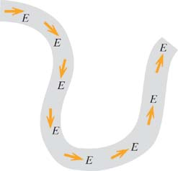
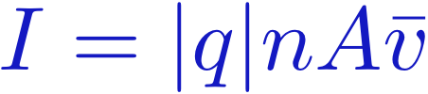
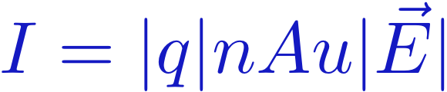
Electric Field Inside the Wire
Constant current in the wire ➔ Constant E in the wire.
I
Conventional Current
I
I
I
I
Drift Velocity controlled by |E|
Mobility (u) set by the material.
I
I
I
Constant current
requires constant |E|

Slide 17
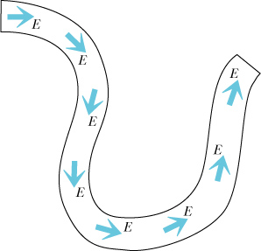
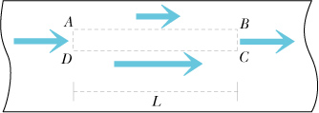
Direction of Electric Field in a Wire
E must be parallel to the wire
E is the same along the wire
Does current fill the wire?
Is E uniform across the wire?
V_{AB}
0
V_{CD}
0
Notes:
B field measurements are the same all along the wire (unless we encounter loops).

Slide 18
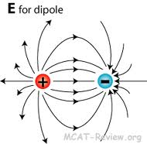
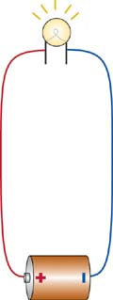
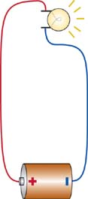
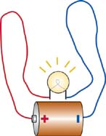
Electric Field in a Wire
What charges make the electric field in the wires?
E
Bulb filament and wires are metals –
there cannot be excess charges in the interior
Are excess charges on the battery?
ASSUME: E due to dipole field of battery.
This cannot be the source of the E which drives current.
E
E
Notes:
SHOW THE BULB DEMO
There must be an electric field in the wires that is responsible for moving the charge carriers around the circuit.
The magnitude of E must be the same throughout a wire of uniform cross section and material.
The wire itself is electrically neutral, so there must be excess charges that give rise to the E-field.
If the excess charges were on the poles of the battery, we might expect the field to be greater closer to the battery. Moving the bulb closer to the battery does not change the current (as indicated by the brightness of the bulb). Also, changing the orientation of the bulb has no effect. If the excess charges responsible for the current resided on the battery poles, we would expect a directionality effect.

Slide 19
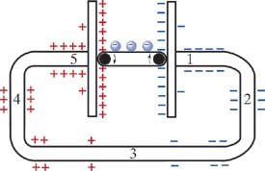
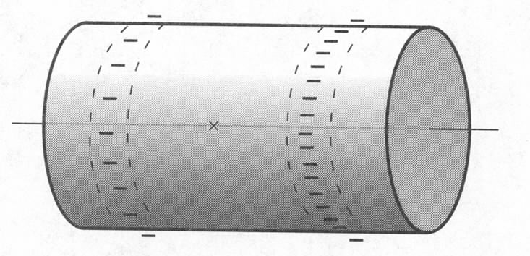
Field due to the Battery
E
Surface charge arranges itself in such a way as to produce a pattern of electric field that follows the direction of the wire and has such a magnitude that current is the same along the wire.
Notes:
If this were not the case, ie, if E varied along the length of the wire (of uniform area, material), we could not conserve charge. If the surface charge were distributed uniformly on the wire surface, current would not flow (no particular direction). Thus, it must not be distributed uniformly!

Slide 20
Field due to Battery
E
Smooth transition from + surface charge to – to provide
constant E.
The amount of surface charge is proportional to the voltage.
Notes:
Greater density of surface charge on right end of cylinder (representing the wire) than at left end. Hence, field along axis points to the right.

Slide 21
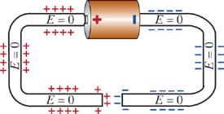
Connecting a Circuit
What happens just before and just after
a circuit is connected?
Before the circuit is connected:
+
-
+
-
No current flows
System is in equilibrium:
+
-
+
-
How is |E| = 0 maintained when there are charges here?
There must be surface charges on the wire
to prevent current from flowing before we connect the circuit.

Slide 22
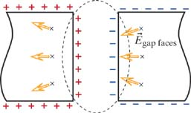
Connecting a Circuit
What happens just before and just after
a circuit is connected?
Before the circuit is connected:
No current flows
System is in equilibrium:
Think about
the gap...
E due only to
gap faces

Slide 23
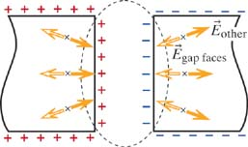
Connecting a Circuit
What happens just before and just after
a circuit is connected?
Before the circuit is connected:
No current flows
System is in equilibrium:
Think about
the gap...
E due to
everything else
cancels E_{gap}

Slide 24
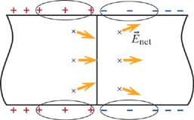
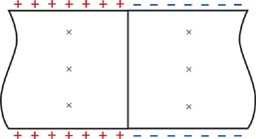
Connecting a Circuit
What happens just before and just after
a circuit is connected?
Before the circuit is connected:
E due to
everything else
cancels E_{gap}
Now close the gap ...
No more
charges here
The gap face charge → 0, and so does E_{gap}

Slide 25
iClicker Question
1
-
C
How would you expect the amount of
current at location 1 to compare to the
electron current at location 2?
Electron
Current
-
-
2
A) There is no current at 2, since the bulb used it up.
B) There is less current at 2 than at 1, since some of it gets
converted to light and heat given off by the bulb.
C) The current at 2 is the same as the current at 1.

Slide 26
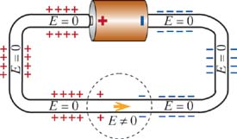
Connecting a Circuit
What happens just before and just after
a circuit is connected?
Just after the circuit is connected:
There is a disturbance in the
previous (equilibrium) E-field.
Now the region next to the disturbance
updates its E-field, and the next region...
How fast does this disturbance propagate?
At the drift speed of the electrons?
At the speed of light?
Notes:
B
At the speed of the fields, which is at the speed of light.

Slide 27
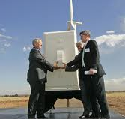

iClicker – Reality Physics!
Drift speed of electrons
Speed of light
Flip Light Switch On.
How long until electrons
from the switch reach the light bulb?
L = 5 m
A) About 1 nanosecond
B) About 1 microsecond
C) About 1 minute
D) About 1 day
Notes:
D.
10^5 sec ~ 28 hours.
Images:
http://www.treeliving.com/home-lighting-–-how-save-energy
http://www.nrel.gov/news/features/feature_detail.cfm/feature_id=1616

Slide 28
iClicker – Reality Physics!
Drift speed of electrons
Speed of light
Flip Light Switch On.
How long until information about the
change in E-field reaches the light bulb?
L = 5 m
A) About 16 nanoseconds
B) About 16 microseconds
C) About 16 minutes
D) About 16 days
Notes:
A.
(5/3) x 10^(-8) sec ~ 16 x 10^(-9) seconds.

Slide 29
Reality Physics!
Drift speed of electrons
Speed of light
Flip Light Switch On.
How long until information about the
change in E-field reaches the light bulb?
L = 5 m
≈ 1 day for electrons to travel from light switch to bulb.
≈ 16 nanoseconds for the change in E-field to travel from light switch to bulb.
Because there are sooooo many electrons
in the wire, they don't have to move far to
create a large current.
Notes:
A.
(5/3) x 10^(-8) sec ~ 16 x 10^(-9) seconds.

Slide 30
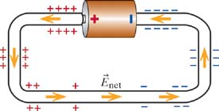
Connecting a Circuit
What happens just before and just after
a circuit is connected?
Just after the circuit is connected:
There is a disturbance in the
previous (equilibrium) E-field.
Now the region next to the disturbance
updates its E-field, and the next region...
The disturbance travels at the speed of light,
and within a few nanoseconds,
steady state is established.
Notes:
B
At the speed of the fields, which is at the speed of light.

Slide 31
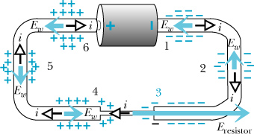
Surface Charge and Resistors
After steady state is reached:
Notes:
Just after connecting the circuit but before equilibrium is established, the electric field in the narrow resistor might temporarily be about the same as the electric field in the thick wires, leading to a comparable drift velocity. But since Athin is less than Athick, electrons accumulate at the right end of the thin wire, increasing the E field in the thin wire. Similarly, a deficiency of electrons develops at the left end because the number of electrons emerging from the wire is too small. These fields reach equilibrium when as many electrons leave the thin wire as enter. This happens when Ethin = Athick/Athin * Ethick.

Slide 32
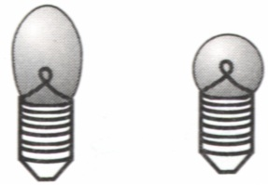
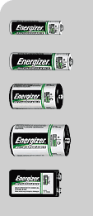
Energy in a Circuit
ΔV_{wire} = EL
ΔV_{battery} = ?
Energy conservation (the Kirchhoff loop rule [2nd law]):
ΔV₁ + ΔV₂ + ΔV₃ + … = 0 along any closed path in a circuit
ΔV= ΔU/q ← energy per unit charge
Notes:
From charge conservation and definition of steady state: Node rule – tells us about relations between currents in different parts. But what about actual current? How large is it.
To answer – turn to energy conservation principle. Consider one electron as it is transported around the circuit.
Energy gained by e as it is transported between terminals in a battery is dissipated in the rest of the circuit.
Use round-trip.

Slide 33
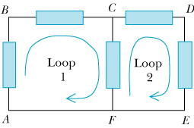
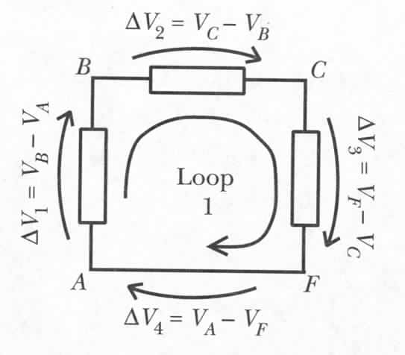

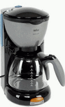

General Use of the Loop Rule
ΔV₁ + ΔV₂ + ΔV₃ + ΔV₄ = 0
(V_{B}-V_{A})+ (V_{C}-V_{B})+ (V_{F}-V_{C})+ (V_{A}-V_{F})=0
Notes:
Add pics of coffeemakers, refrigerators etc. as elements in a circuit.

Slide 34
Kirchhoff’s Rules
Kirchhoff’s Rule 2: Loop Rule
When any closed loop is traversed completely in a circuit, the algebraic sum of the changes in potential is equal to zero.
Coulomb force is conservative
Kirchhoff’s Rule 1: Junction Rule
The sum of currents entering any junction in a circuit is equal to the sum of currents leaving that junction.
Conservation of charge
In and Out branches
Assign I_{i} to each branch

Slide 35
Circuit Analysis Tips
Simplify using equivalent resistors
Label currents with arbitary directions
  If the calculated current is negative, the real direction is opposite to the one defined by you.
Apply Junction Rule to all the labeled currents.
  Useful when having multiple loops in a circuit.
Choose independent loops and define loop direction
  Imagine your following the loop and it’s direction to walk around the circuit.
Use Loop Rule for each single loop
  If current I direction across a resistor R is the same as the loop direction, potential drop across R is ∆V = −I×R, otherwise, ∆V = I×R
  For a device, e.g. battery or capacitor, rely on the direction of the electric field in the device and the loop direction to determine the Potential drop across the device
Solve simultaneous linear equations
Notes:
Current dirction is the moving direction of positive charge, i.e. the electric field direction, therefore, following the current direction, potential drops

Slide 36
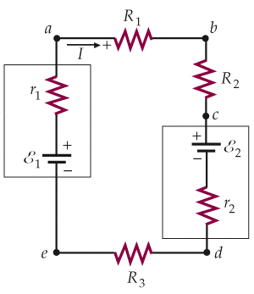
Loop Example with Two EMF Devices
⇒
If ε₁ <ε₂, we have I<0 !?
This just means the actual current flows reverse to the assumed direction. No problem!

Slide 37
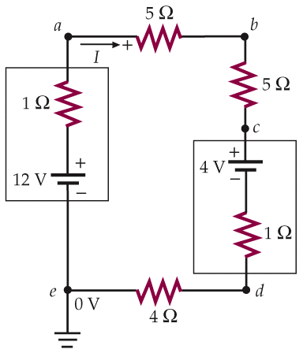
Finding Potential and Power in a Circuit
But what is I? Must solve for I first!
supplied by 12V battery
dissipated by resistors
The rest?
Just means 0 V here
into 4V battery (charging)
Notes:
Current dirction is the moving direction of positive charge, i.e. the electric field direction, therefore, following the current direction, potential drops

Slide 38
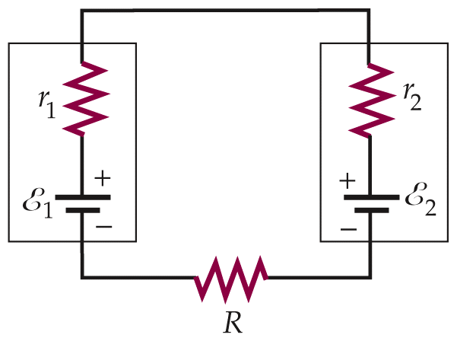
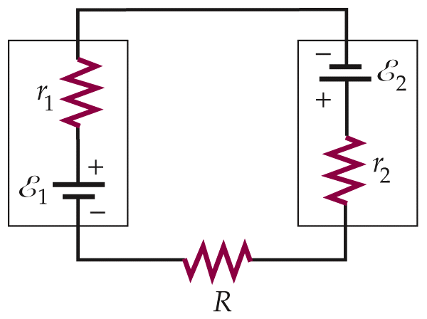
Charging a Battery
Positive terminal to positive terminal
Charging EMF > EMF of charged device
Say, R+r₁+r₂=0.05Ω (R is for jumper cables). Then,
good battery (12V)
battery being charged (11V)
power into battery 2
If connected backward,
Large amount of gas produced
Huge power dissipation in wires

Slide 39
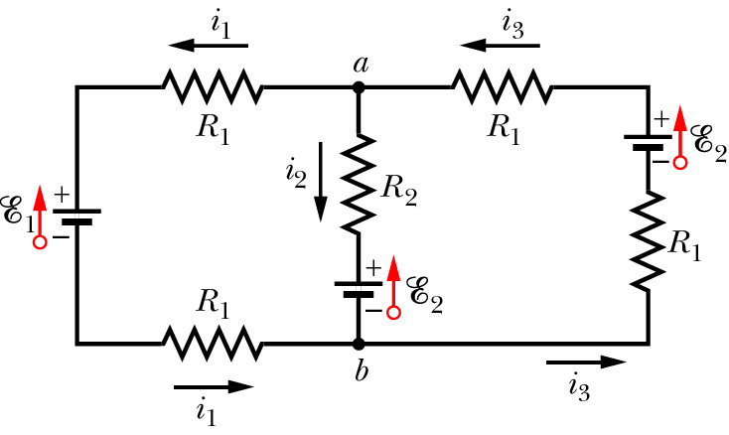
Using Kirchhoff’s Laws in Multiple Loop Circuits
Identify nodes and use Junction Rule:
Identify independent loops and use Loop Rule:
Only two are independent.

Slide 40
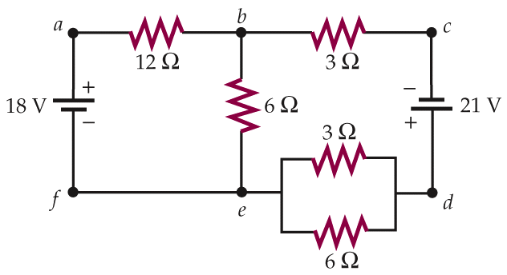
iClicker Question
I₁+I₂
I₂
What’s the current I₁ ?
I₁
(a). 2.0A
(b). 1.0A
(c). -2.0A
(d). -1.0A
(e). Need more information to calculate the value.

Slide 41
I₁+I₂
I₂
Sketch the diagram
Simplify using equivalent resistors
Label currents with directions
Use Junction Rule in labeling
Choose independent loops
Use Loop Rule
Solve simultaneous linear equations
I₁
Replace by equivalent R=2Ω first.

Slide 42
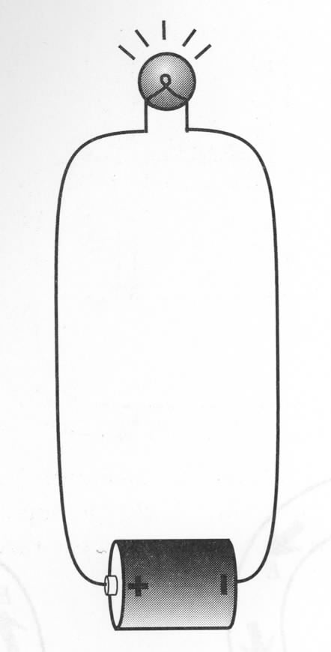
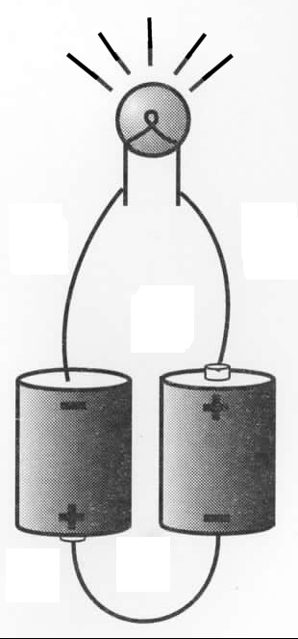
Two Batteries in Series
Why light bulb is brighter with two batteries?
Two batteries in series can drive more current:
Potential difference across two batteries in series is 2emf → doubles electric field everywhere in the circuit → doubles drift speed → doubles current.
Work per second:
Notes:
After getting i for both – ask how much brighter? How much more heat dissipate with 2 batteries?
In reality: not 4x because mobility changes with temperature., I.e. current also does not go twice up.

Slide 43
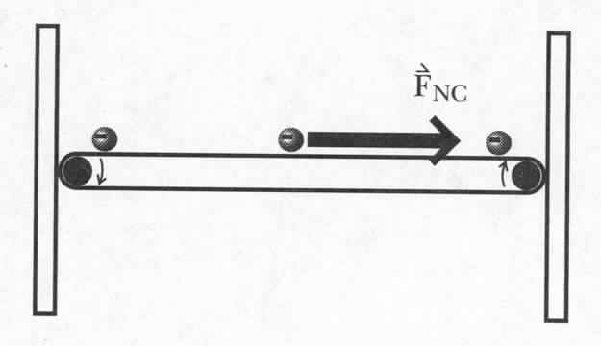
Potential Difference Across the Battery
Coulomb force on each e
F_{C}
non-Coulomb force on each e
1. a=F_{NC}/m
E_{C}
2. F_{C} =eE_{C}
3. F_{C} =F_{NC}
Energy input per unit charge
emf – electromotive force
The function of a battery is to produce and maintain a charge separation.
The emf is measured in Volts, but it is not a potential difference!
The emf is the energy input per unit charge.
chemical, nuclear, gravitational…

Slide 44
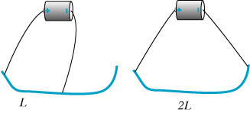
Twice the Length
Nichrome wire (resistive)
Quantitative measurement of current with a compass
Current is halved when increasing the length of the wire by a
factor of 2.
Notes:
Electric field is half -> half the drift speed -> half the current. Note that we are considering the wire to be a “resistive” wire.

Slide 45
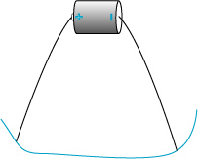
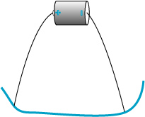
Doubling the Cross-Sectional Area
If A doubles, the current doubles.
Nichrome wire
Notes:
Electric field in the wire doesn’t change when we use a thicker wire -> current doubles

Slide 46
Two Batteries in Series
Why light bulb is brighter with two batteries?
Two batteries in series can drive more current:
Potential difference across two batteries in series is 2emf → doubles electric field everywhere in the circuit → doubles drift speed → doubles current.
Work per second:
Notes:
After getting i for both – ask how much brighter? How much more heat dissipate with 2 batteries?
In reality: not 4x because mobility changes with temperature., I.e. current also does not go twice up.

Slide 47


How Do the Currents Know How to Divide?
Notes:
After connection there is a larger current through the battery and a larger gradient of surface charge along the wires to drive this larger current.

Slide 48
Today
Transient response when connecting a circuit
How long until steady state is reached?
Introduction to Resistors
Energy conservation in a circuit
Kirchhoff's Voltage Loop Law
Batteries

