Slide 1
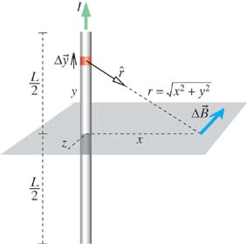
Magnetic Field of a Straight Wire
Calculate B in the
bisecting plane
Observation point x
does not change
during the integration
Look up the integral
B of a Long
Straight Wire

Slide 2
Magnetic Field of a Straight Wire
B in the
bisecting plane
I
Which direction does B point?
→ Always along concentric circles
In cylindrical coordinates,
it points in the " " direction
r
Will the y axis look different from the x axis?
Cylindrical
Coordinates
No, so we can trade x → r
B of a Long
Straight Wire
(Cylindrical
Coordinates)

Slide 3
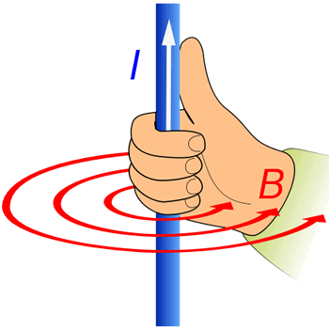
Very Close to the Wire
Very close to the wire: r << L
CLOSE TO
THE WIRE
Another Right-Hand Rule

Slide 4
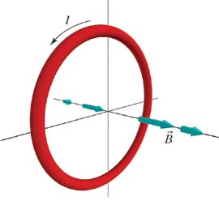
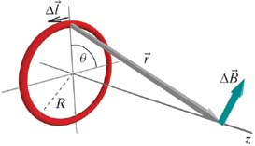
B along Axis of Circular Loop of Wire
BIOT-SAVART LAW
current in a wire
1) Draw for one piece
NET
MAGNETIC
FIELD
→ Symmetry: only z component survives!

Slide 5
B along Axis of Circular Loop of Wire
BIOT-SAVART LAW
current in a wire
1) Draw for one piece
NET
MAGNETIC
FIELD
→ Symmetry: only z component survives!
2) Write _{z} due to one piece
(lots of math!)

Slide 6
B along Axis of Circular Loop of Wire
BIOT-SAVART LAW
current in a wire
1) Draw for one piece
NET
MAGNETIC
FIELD
→ Symmetry: only z component survives!
2) Write _{z} due to one piece
(lots of math!)
3) Integrate to find total B
4) Doulbecheck
✔ UNITS
Right-hand Rule
✔

Slide 7
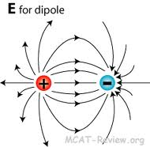
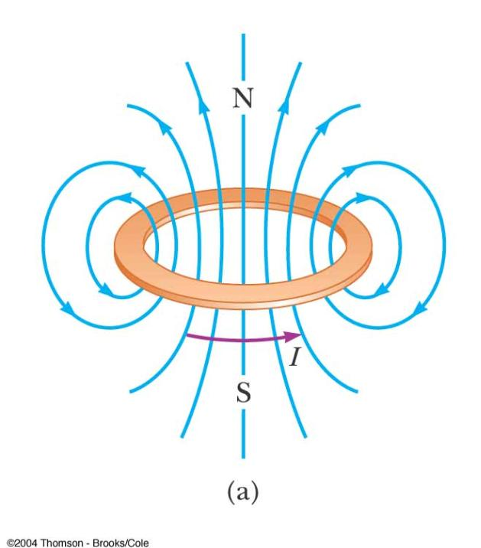
B along Axis of Circular Loop of Wire
Far from the loop:
z>>R
B Along Axis
Far from Loop
B for dipole
Both fall off like 1/r³ far from the dipole

Slide 8
Electric and Magnetic Dipole Moments
B Along Axis
Far from Loop
B for dipole
Electric Dipole Moment:
Magnetic Dipole Moment:
E Along Axis
Far from Dipole
B Along Axis
Far from Loop

Slide 9
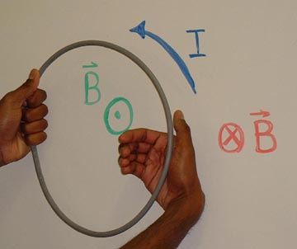
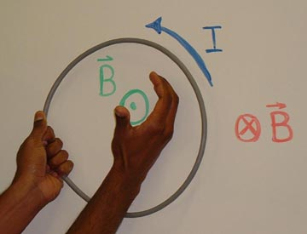
B along Axis of Circular Loop of Wire
Yet Another Right Hand Rule!

Slide 10
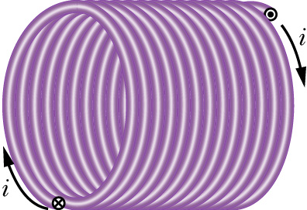
Magnetic field of a solenoid
L
A constant magnetic field could be produced by an infinite sheet of current. In practice, however, it is easier and more convenient to use a solenoid.
R
A solenoid is defined by a current I flowing through a wire that is wrapped n turns per unit length on a cylinder of radius R and length L.

Slide 11
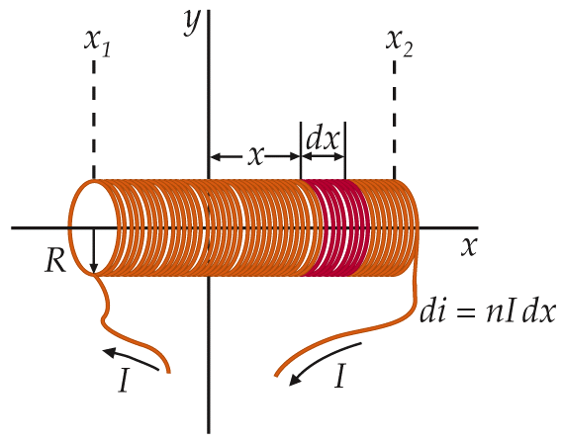
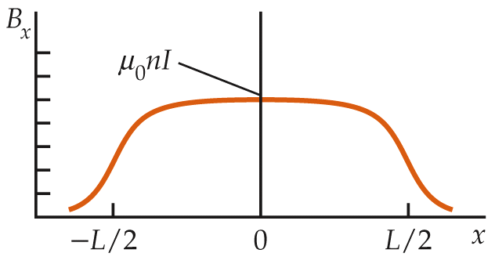
Magnetic field of a solenoid (continued)
Contribution to B at origin from length dx
# turns in length dx
one turn
(or for L>>R)

Slide 12
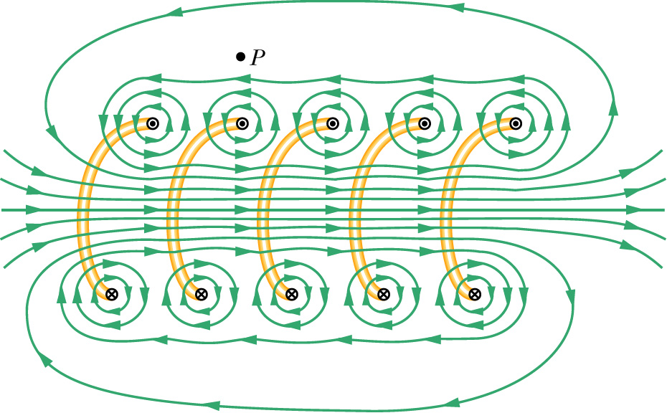
Solenoid’s B field synopsis
Long solenoid (R<<L):
B inside solenoid
B outside solenoid
// to axis
nearly zero
(not very close to the ends or wires)

Slide 13
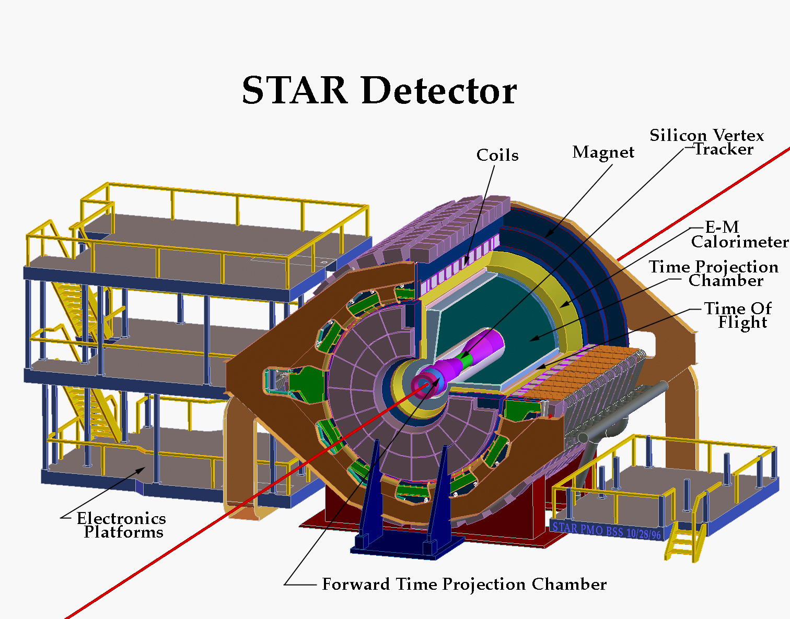
RHIC STAR Experiment
STAR

Slide 14
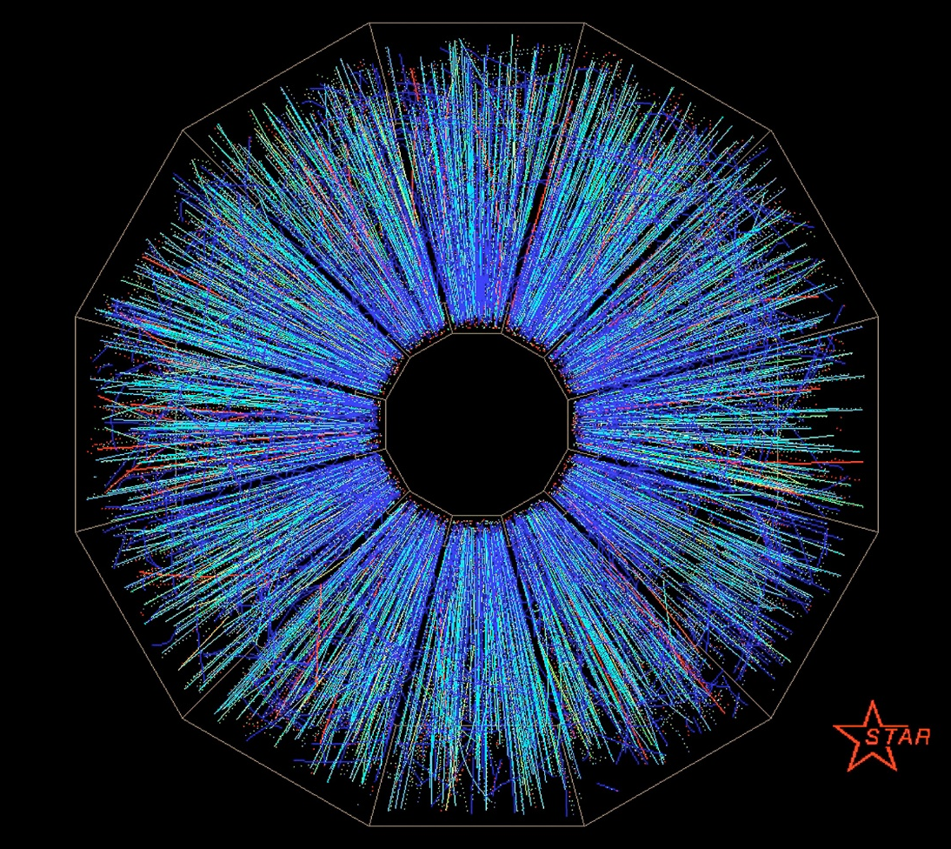
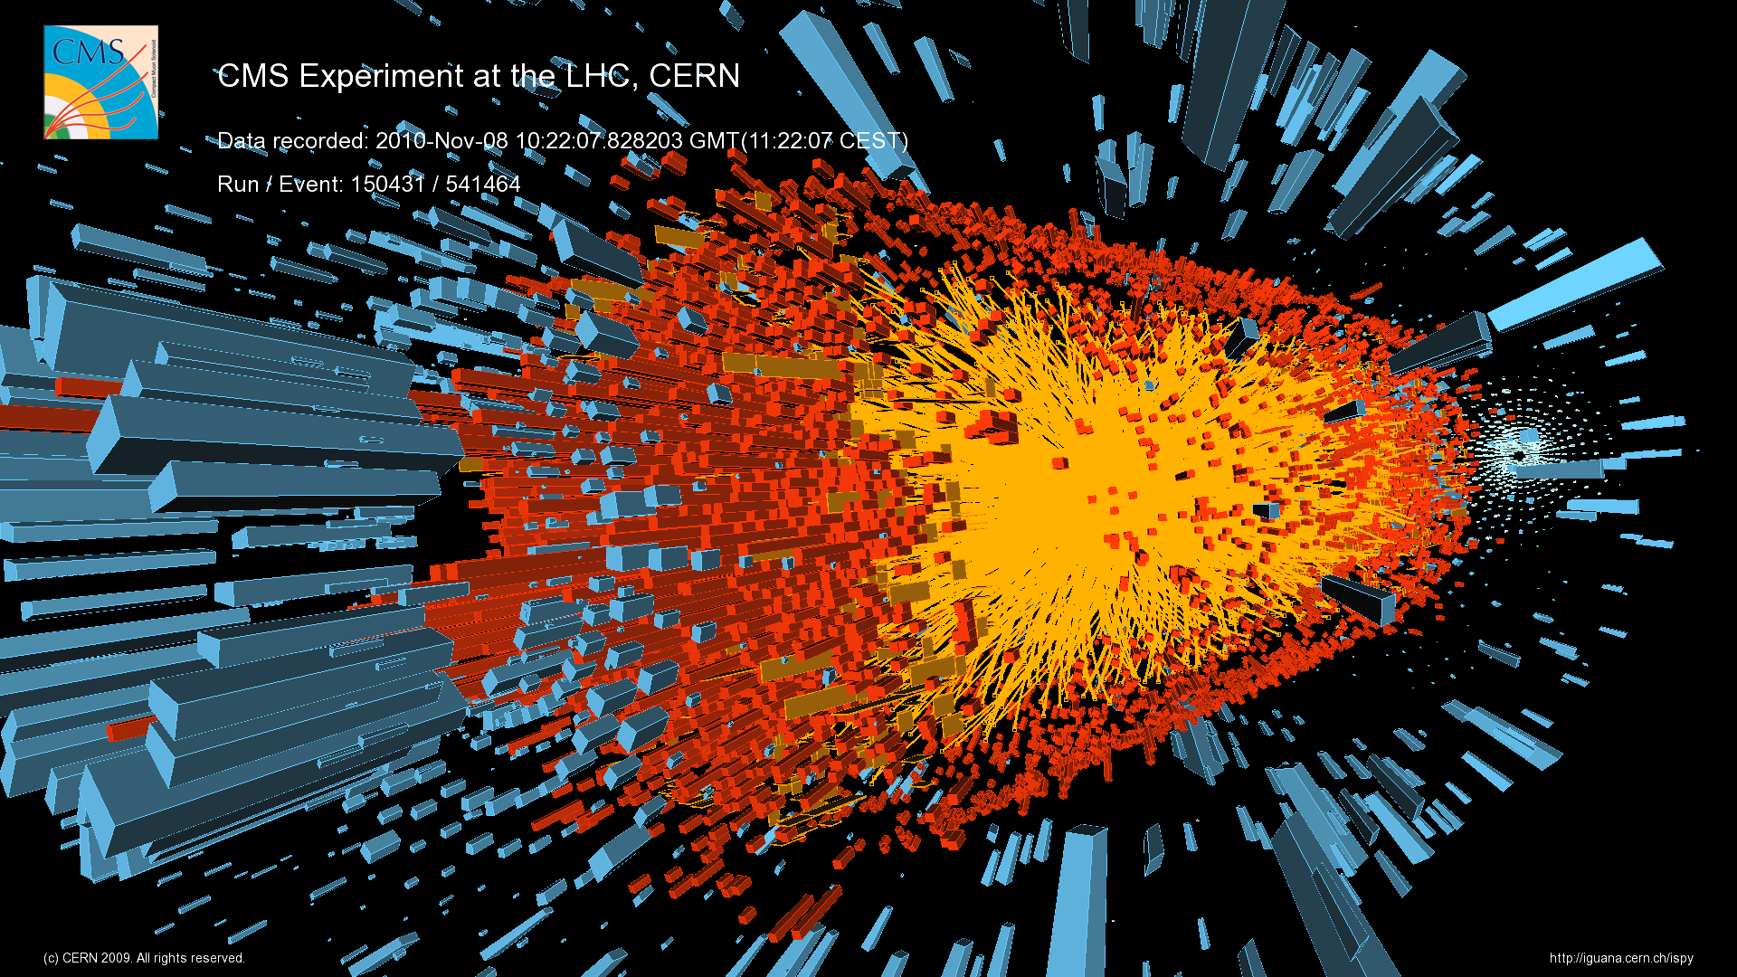
The Heavy-Ion experiments at the Relativistic Heavy-Ion Collider (RHIC) and the Large Hadron Collider (LHC) study the Quark-Gluon-Plasma (QGP), a soup of fundamental building blocks of the universe, thought to have existed a few microseconds after the “Big-Bang.”

Slide 15
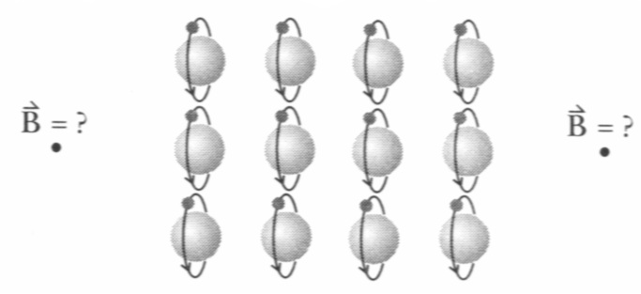
Atomic Structure of Magnets
Assume: Electrons make circular current loops
Electrons
(iClicker Quiz:
What is the direction?)
Left
Right
Up
Down
Zero B field.
These are electrons
Notes:
Also – distnce dependence 1/r3. EC here 10/3

Slide 16
Atomic Structure of Magnets
Assume: Electrons make circular current loops
Electrons
What is the direction?
What is the average current I per loop?
current=charge/second:
N
S
Notes:
Also – distnce dependence 1/r3. EC here 10/3

Slide 17
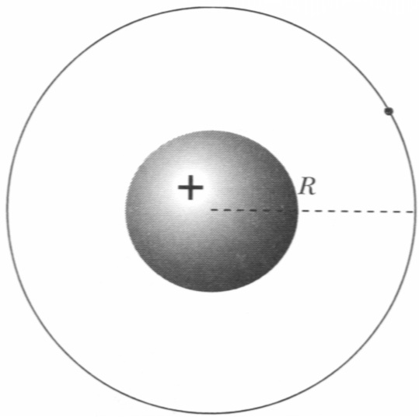
Atomic Structure of Magnets
Assume: Electrons make circular current loops
Dipole Moment of 1 Atom
Angular Momentum is Quantized:
Orbital angular momentum:
Quantum mechanics: L is quantized:
Notes:
Also assume only 1 electron in one atom

Slide 18
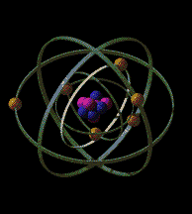
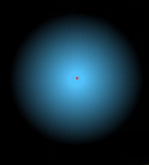
Quantum Magnetism
Magnetic Moment = Orbital Motion + "Spin"
ORBITAL MOTION:
Fuzzy electron cloud.
Shapes are set by "spherical harmonics"
Spherically symmetric cloud (s-orbital, i.e. l = 0) has no μ
Only non spherically symmetric orbitals (p, d, f) contribute to μ
There is more than 1 electron in an atom (except hydrogen atom)

Slide 19
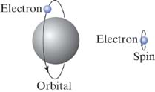
Quantum Magnetism
Magnetic Moment = Orbital Motion + "Spin"
SPIN:
Electron acts like spinning charge
- contributes to μ
Electron spin contribution to μ is of the same order as one due to orbital momentum
proton in nucleus also have spin but their μ‘s are much smaller than for electron
angular momentum:
NMR, MRI – use nuclear μ
Notes:
Neutron magnetic dipole moment is not zero indicating smaller building blocks, i.e. quarks.

Slide 20
Quantum Magnetism
Magnetic Moment = Orbital Motion + "Spin"
SPIN:
Electron acts like spinning charge
- contributes to μ
Electron spin contribution to μ is of the same order as one due to orbital momentum
proton in nucleus also have spin but their μ‘s are much smaller than for electron
angular momentum:
iClicker question:
Can Neutron has spin dipole moment?
A). No because neutron has no charge
B). Yes, because neutron is not the fundamental building block.
NMR, MRI – use nuclear μ
Notes:
Neutron magnetic dipole moment is the same as proton and is not zero indicating smaller building blocks, i.e. quarks.

Slide 21
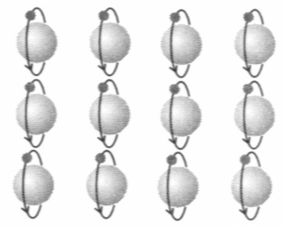
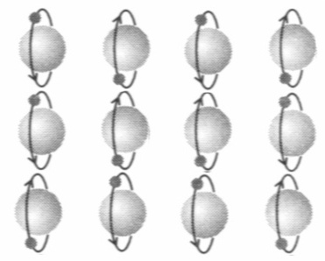
Refrigerator Magnets
Alignment of atomic dipole moments:
ferromagnetic materials:
iron, cobalt, nickel
most materials
Notes:
Professor Xie, We do not have a number assigned to this demo. We have an insulated wire wrapped around a nail (like a solenoid). When we attach it to a battery, we will use it to pick up paper clips. Would that be OK? Gary

Slide 22
iClicker Question
Notes:
B

Slide 23
Magnetic Dipole Moment
Magnetic dipole moment of 1 atom:
Method 2: estimate speed of electron
Momentum principle:
Circular motion:
– angular speed
Notes:
R = 0.5 x 10^-10 meters.

Slide 24
More for Today
Equilibrium vs. Steady State in a Circuit
What is "used up" in a circuit?
Kirchhoff's Current Node Law
E-field inside a wire

Slide 25
Key Ideas in Chapter 19: Electric Circuits
Surface charges make the electric field that drives the current in a circuit.
  Transient effects precede the steady state.
  A battery maintains a charge separation and a potential difference.
How to analyze circuits:
  Current-node rule: Current into a node equals current out of the node.
  Voltage-loop rule: The total potential difference around a loop is zero.
Notes:
START TIME HERE:

Slide 26
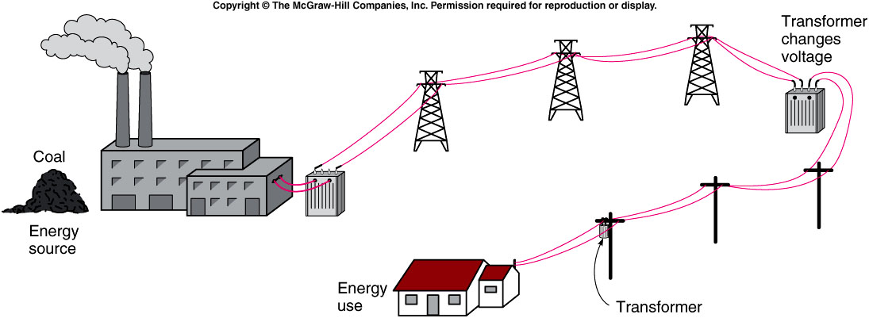
iClicker Question
Why High Voltage is needed to transfer electricity?
Prevent animal from biting the cable.
Reduce energy wasted during transportation.
No reason. People started this way long time ago.
Notes:
Asking student these questions to draw attentation.

Slide 27
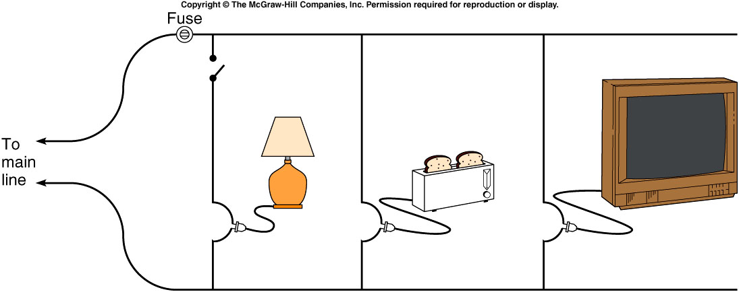
iClicker Question
Which way is preferred.
Left
Right
left and right are equal.
Notes:
Asking student these questions to draw attentation.

Slide 28
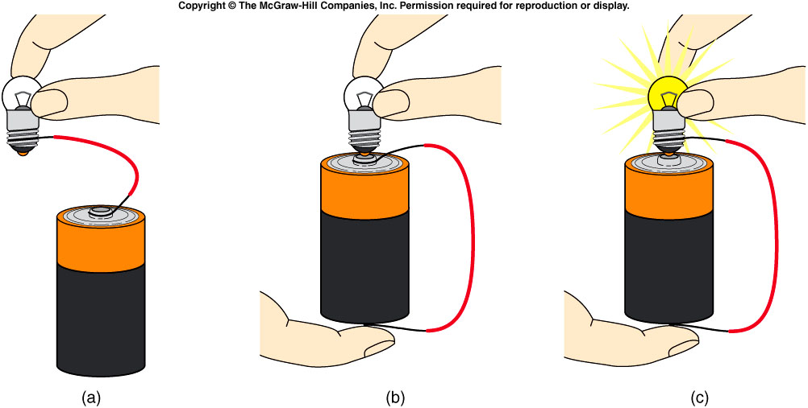
iClicker Question
Which of the following bulb will light up?

Slide 29
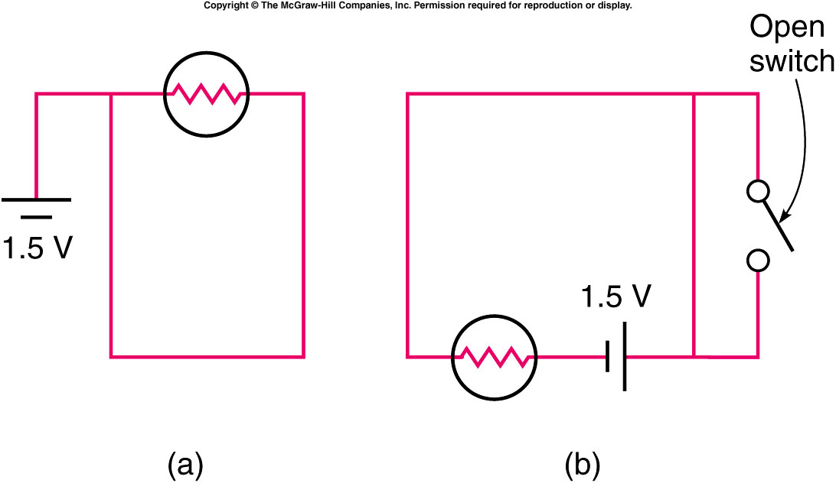
Which of the two circuits shown will cause the light bulb to light?
iClicker Question
Arrangement (a)
Arrangement (b)
Both
Neither

Slide 30
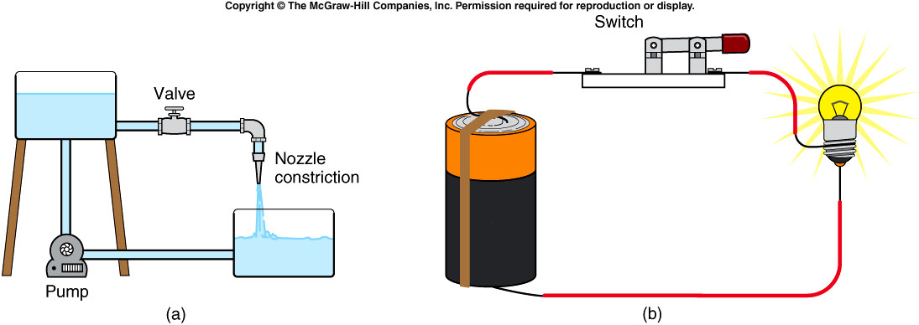
Water flowing in a pipe is similar to electric current flowing in a circuit.
  The battery is like the pump.
  The electric charge is like the water.
  The connecting wires are like the thick pipe.
  The filament is like the nozzle or narrow pipe.
  The switch is like the valve.
Notes:
faucet

