Slide 1
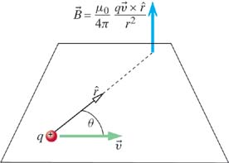
Biot-Savart Law
Key Idea: Moving charges create a Magnetic Field
BIOT-SAVART LAW
point charge
= charge
= velocity of charge
= observation point
(charge at origin)
Notes:
Charles Augustin de Coulomb – French engineer and scientist. Created science of friction (first), after that stopped engineering and became involved full time in physics, in 1785-1791 published 7 papers on electricity and magnetism:
... had obtained some remarkable results by using the torsion balance method: law of attraction and repulsion, the electric point charges, magnetic poles, distribution of electricity on the surface of charged bodies and others. The importance of Coulomb's law for the development of electromagnetism is examined and discussed. In these he developed a theory of attraction and repulsion between bodies of the same and opposite electrical charge. He demonstrated an inverse square law for such forces and went on to examine perfect conductors and dielectrics. He suggested that there was no perfect dielectric, proposing that every substance has a limit above which it will conduct electricity. These fundamental papers put forward the case for action at a distance between electrical charges in a similar way as Newton's theory of gravitation was based on action at a distance between masses.

Slide 2
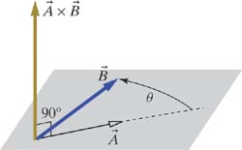
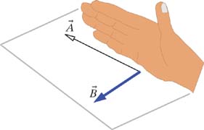
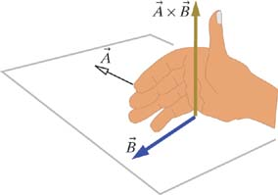
Right-Hand Rule
BIOT-SAVART LAW
point charge
Result of Cross Product
is Perpendicular to both and
Right-Hand Rule:
1)
2)

Slide 3
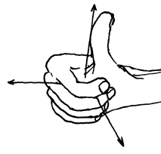
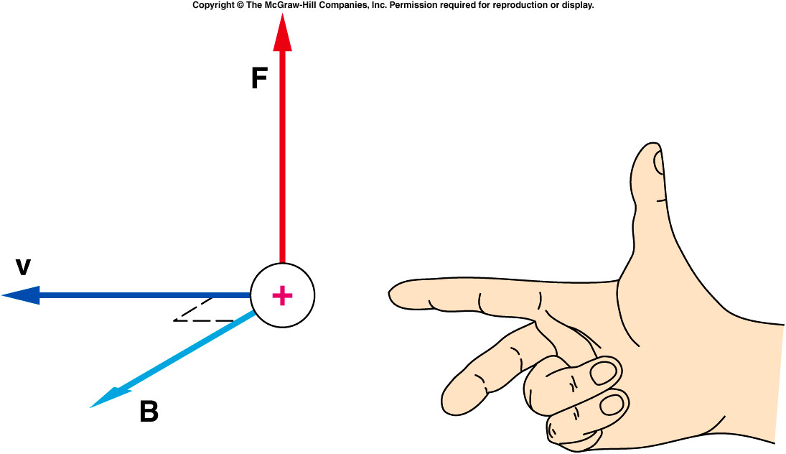
Alternatives to the Right-Hand Rule

Slide 4
Cross Product: Here's the Math
+ ( - )
+ ( - )
+ ( - )
copy 1st two colums
set up the answer

Slide 5
Cross Product: Here's the Math
+ ( - )
+ ( - )
+ ( - )

Slide 6
Cross Product: Here's the Math
( - ),
( - ),
( - )
The resulting vector has magnitude:

Slide 7
iClicker Question
An electron passing through the origin is traveling at a constant velocity in the negative y direction. What is the direction of the magnetic field at a point on the positive z axis?
y
-x
+x
-z
+z
No magnetic field
x
v
z
Notes:
B

Slide 8
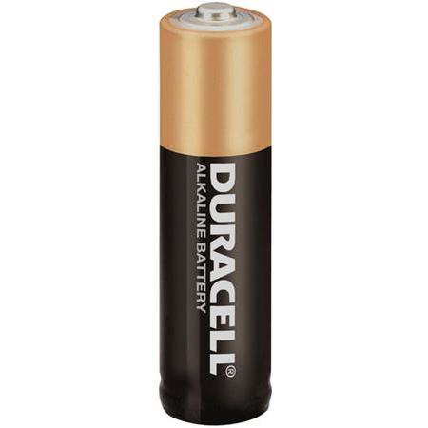
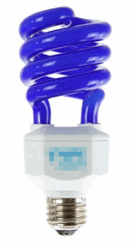
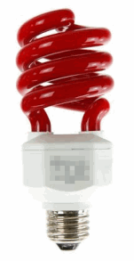
Conventional Current and Electron Current
-
C
Electron Current:
Electrons exit battery at (-) terminal,
and enter battery at (+) terminal
Electron
Current
-
-
+
C
Conventional Current:
+
Fictitious Positive charges
exit battery at (+) terminal,
and enter battery at (-) terminal
Conventional
Current
+

Slide 9
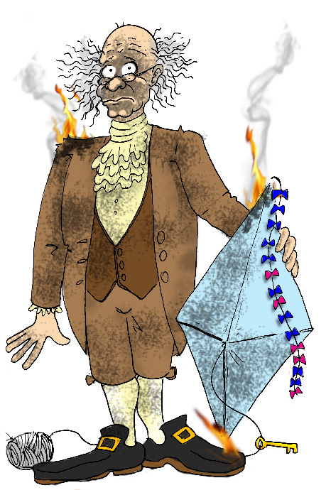
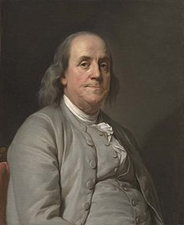
Conventional Current and Electron Current
-
C
Why the difference? Benjamin Franklin guessed
that current is carried by positive charges.
Electron
Current
Sorry!
-
-
+
C
+
Conventional
Current
+
http://blog.marshotelonline.com/2012/01/08/if-grounded/

Slide 10
“In 1750^{[citation needed]}, he published a proposal for an experiment to prove that lightning is electricity by flying a kite in a storm that appeared capable of becoming a lightning storm. On May 10, 1752, Thomas-François Dalibard of France conducted Franklin's experiment using a 40-foot-tall (12 m) iron rod instead of a kite, and he extracted electrical sparks from a cloud. On June 15 Franklin may possibly have conducted his well-known kite experiment in Philadelphia, successfully extracting sparks from a cloud. Franklin described the experiment in the Pennsylvania Gazetteon October 19, 1752,^{[49][50]} without mentioning that he himself had performed it.^{[51]}This account was read to the Royal Society on December 21 and printed as such in the Philosophical Transactions.^{[52]} Joseph Priestley published details in his 1767 History and Present Status of Electricity. Franklin was careful to stand on an insulator, keeping dry under a roof to avoid the danger of electric shock.^{[53]} Others, such as Prof. Georg Wilhelm Richmann in Russia, were indeed electrocuted during the months following Franklin's experiment”. From Wikipedia

Slide 11
Conventional Current and Electron Current
-
C
Electron Current:
Electron
Current
-
-
1e = 1.6x10⁻¹⁹ C
Square Brackets [ ]
Mean "Units"
+
C
Conventional Current:
+
Conventional
Current
+

Slide 12
Conventional Current and Electron Current
-
C
Electron Current:
Electron
Current
-
-
We start with
this one
+
C
Conventional Current:
+
Conventional
Current
+

Slide 13
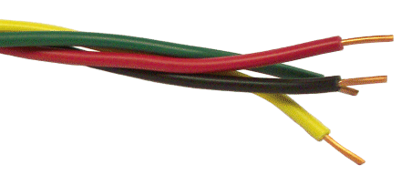
Calculating Electron Current
Find electron current in terms of:
Density of Electrons in the Wire
Cross Sectional Area of the Wire
Average Velocity of Electrons in the Wire

Slide 14
Calculating Electron Current
Cross Sectional
Area of Wire
Average Velocity
of Electrons
1. How many Electrons are in here?
A
✔ UNITS
L
2. Electrons are moving at velocity .
How long does this take to pass through L?
✔ UNITS

Slide 15
Calculating Electron Current
3. How many Electrons pass by per second?
A
L
✔ UNITS
ELECTRON
CURRENT

Slide 16
iClicker Question
A typical electron current in a circuit is 10¹⁸ electrons/s.
What is the conventional current?
1.6 A
16A
32A
0.16A
Unknown

Slide 17

Biot-Savart Law
BIOT-SAVART LAW
point charge
We need to understand
how these are related
BIOT-SAVART LAW
current in a wire
= length of this
chunk of wire

Slide 18
GOAL: Show
(point charge)
(wire)
(POSITIVE)
POINT CHARGE
MANY POINT
CHARGES
N particles
particles per
volume ΔV
ΔV

Slide 19
GOAL: Show
(point charge)
(wire)
(POSITIVE)
POINT CHARGE
MANY POINT
CHARGES
N particles
particles per
volume ΔV
ΔV
Move the vector symbol
CHUNK
OF WIRE
= length of this
chunk of wire

Slide 20
Biot-Savart Law
BIOT-SAVART LAW
point charge
That is how
these are related
BIOT-SAVART LAW
current in a wire
= length of this
chunk of wire

Slide 21

iClicker Question
Bob and his classmates are at rest w.r.t. a charged object on table. Jessie is running nearby. Both of them measure the B field produced by the charged object. Which of the following is correct:
B(Bob) = 0, B(Jessie) = 0
B(Bob) != 0, B(Jessie) != 0
B(Bob) = 0, B(Jessie) != 0
Jessie
Bob
charged tape

Slide 22
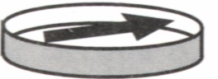
iClicker Question
Biot-Savart Law is an Approximation
Electric fields: produced by charges
Magnetic fields: produced by moving charges
Any magnetic field?
charged tape

Slide 23
Frame of Reference
Must use the velocities of the charges as you observe them in
your reference frame!
There is a deep connection between
Electric Field E and Magnetic Field B.
Einstein’s special theory of relativity!

Slide 24
Problem #2: Retardation
Biot-Savart Law is an Approximation
If we suddenly change the current in a wire:
Magnetic field will not change instantaneously.
Electron and positron collide:
Produce both electric and magnetic field, these fields exist even after annihilation.
Changes propagate at speed of light
Why is there no time in Biot-Savart law?
→ We assume speed of charges is small

Slide 25
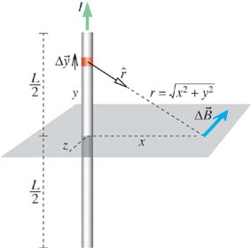
Magnetic Field of a Straight Wire
Calculate B in the
bisecting plane
Observation point x
does not change
during the integration
Look up the integral
B of a Long
Straight Wire

Slide 26
Magnetic Field of a Straight Wire
B in the
bisecting plane
I
Which direction does B point?
→ Always along concentric circles
In cylindrical coordinates,
it points in the " " direction
r
Will the y axis look different from the x axis?
Cylindrical
Coordinates
No, so we can trade x → r
B of a Long
Straight Wire
(Cylindrical
Coordinates)

Slide 27
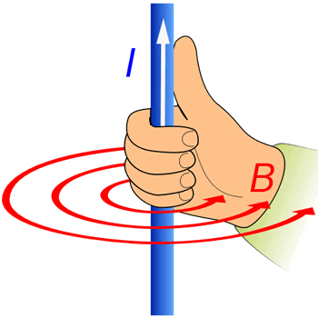
Very Close to the Wire
Very close to the wire: r << L
CLOSE TO
THE WIRE
Another Right-Hand Rule

Slide 28
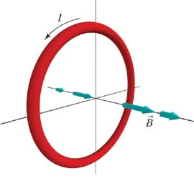
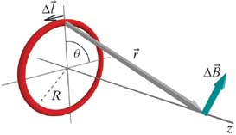
B along Axis of Circular Loop of Wire
BIOT-SAVART LAW
current in a wire
1) Draw for one piece
NET
MAGNETIC
FIELD
→ Symmetry: only z component survives!

Slide 29
B along Axis of Circular Loop of Wire
BIOT-SAVART LAW
current in a wire
1) Draw for one piece
NET
MAGNETIC
FIELD
→ Symmetry: only z component survives!
2) Write _{z} due to one piece
(lots of math!)

Slide 30
B along Axis of Circular Loop of Wire
BIOT-SAVART LAW
current in a wire
1) Draw for one piece
NET
MAGNETIC
FIELD
→ Symmetry: only z component survives!
2) Write _{z} due to one piece
(lots of math!)
3) Integrate to find total B
4) Doulbecheck
✔ UNITS
Right-hand Rule
✔

Slide 31
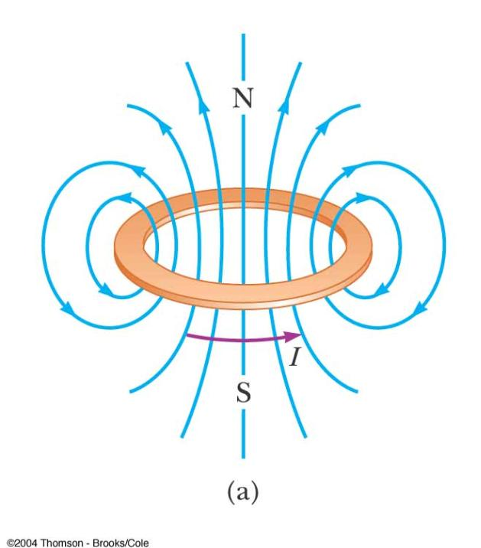
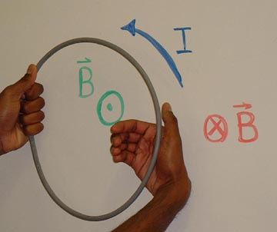
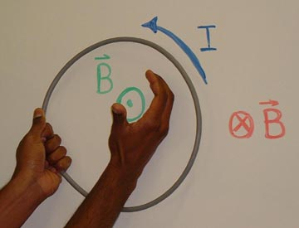
B along Axis of Circular Loop of Wire
Yet Another Right Hand Rule!

Slide 32
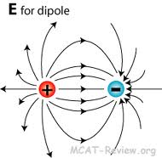
B along Axis of Circular Loop of Wire
Far from the loop:
z>>R
B Along Axis
Far from Loop
B for dipole
Both fall off like 1/r³ far from the dipole

Slide 33
Electric and Magnetic Dipole Moments
B Along Axis
Far from Loop
B for dipole
Electric Dipole Moment:
Magnetic Dipole Moment:
E Along Axis
Far from Dipole
B Along Axis
Far from Loop

Slide 34
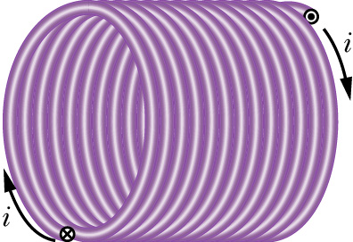
Magnetic field of a solenoid
L
A constant magnetic field could be produced by an infinite sheet of current. In practice, however, it is easier and more convenient to use a solenoid.
R
A solenoid is defined by a current I flowing through a wire that is wrapped n turns per unit length on a cylinder of radius R and length L.

Slide 35
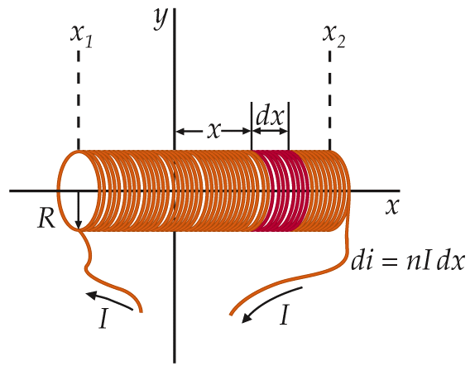
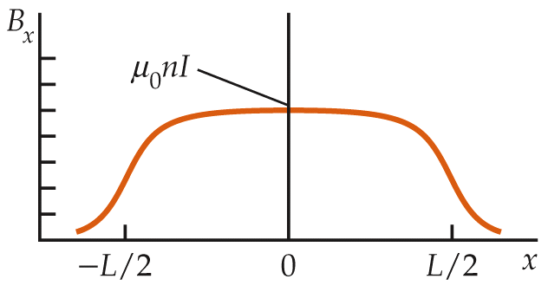
Magnetic field of a solenoid (continued)
Contribution to B at origin from length dx
# turns in length dx
one turn
(or for L>>R)

Slide 36
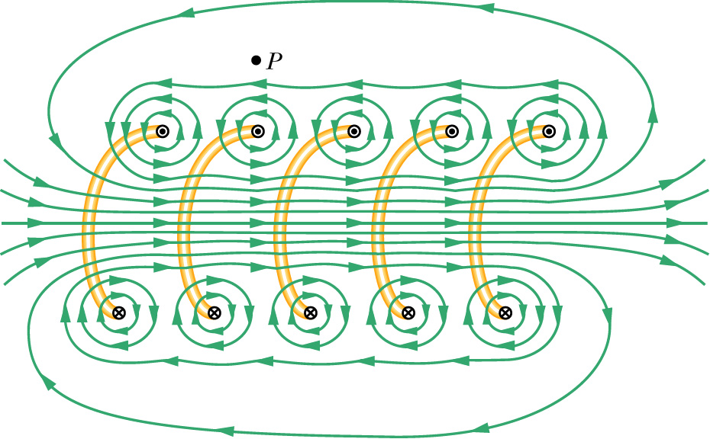
Solenoid’s B field synopsis
Long solenoid (R<<L):
B inside solenoid
B outside solenoid
// to axis
nearly zero
(not very close to the ends or wires)

Slide 37
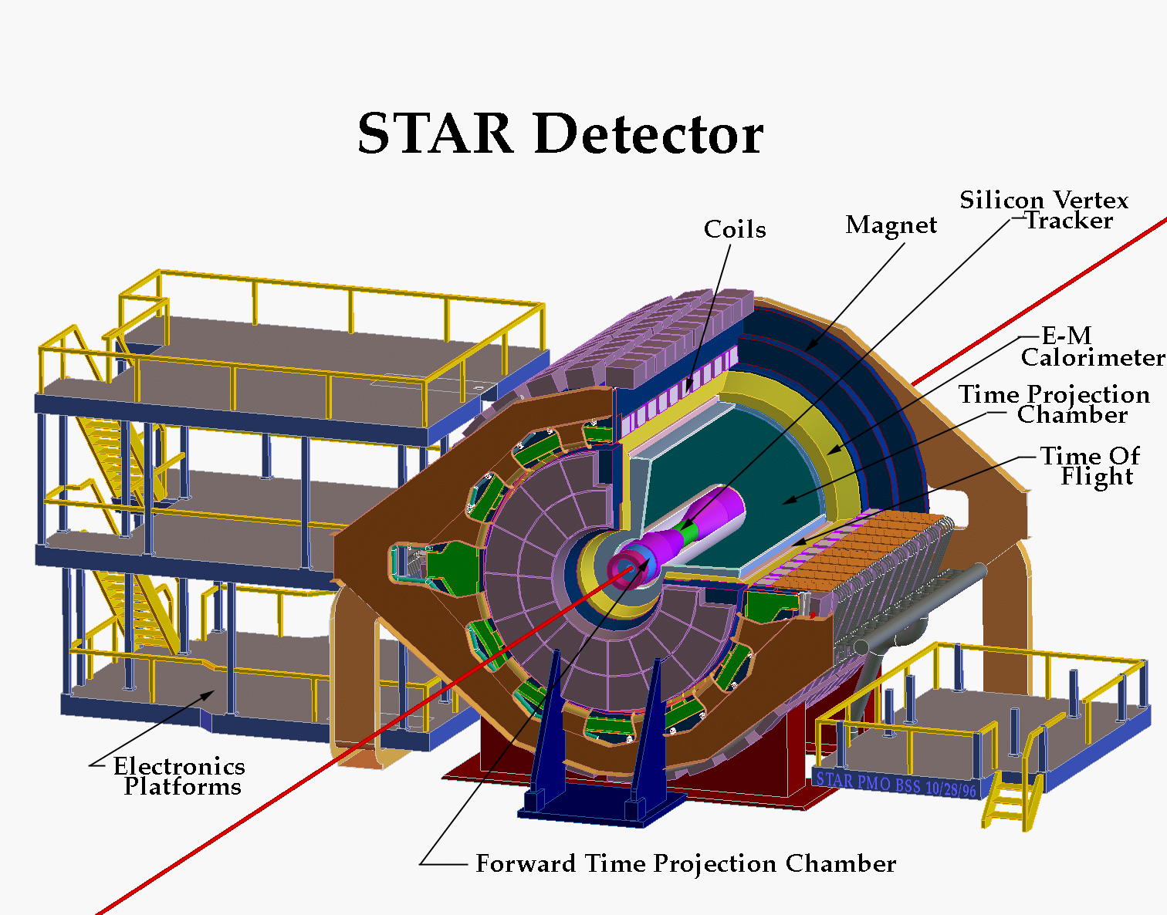
RHIC STAR Experiment
STAR

Slide 38
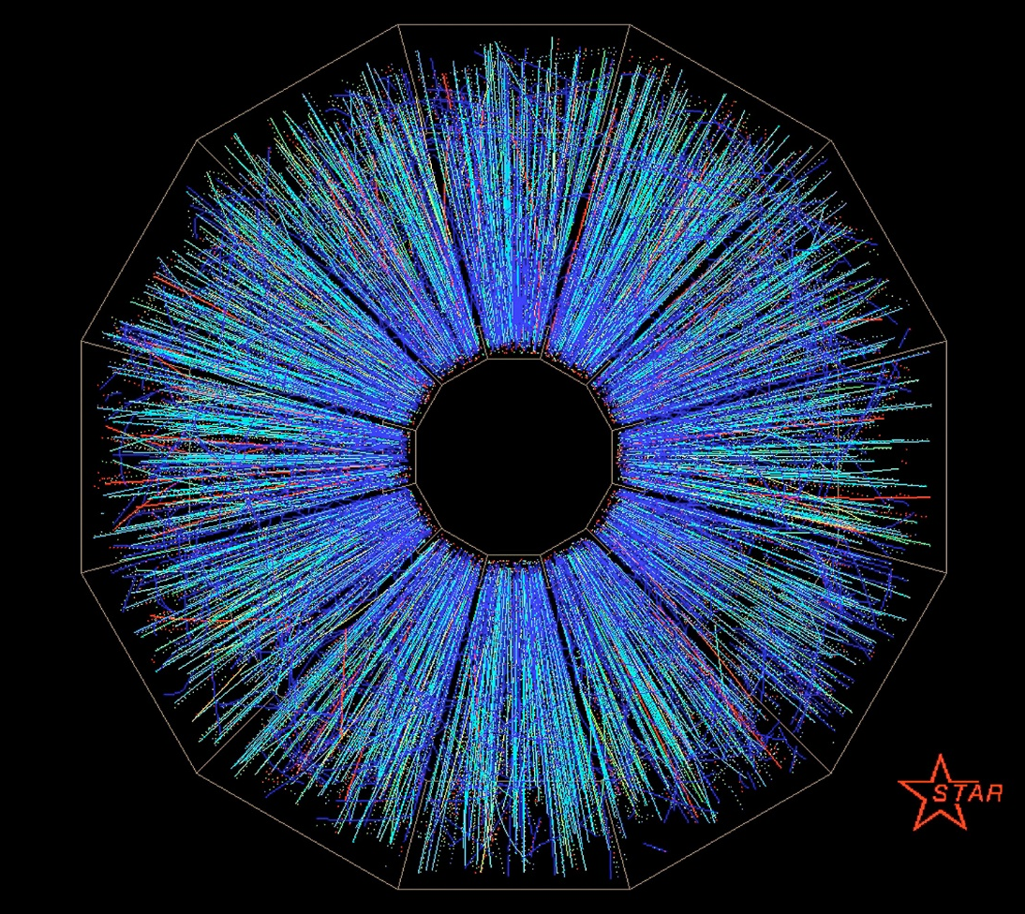
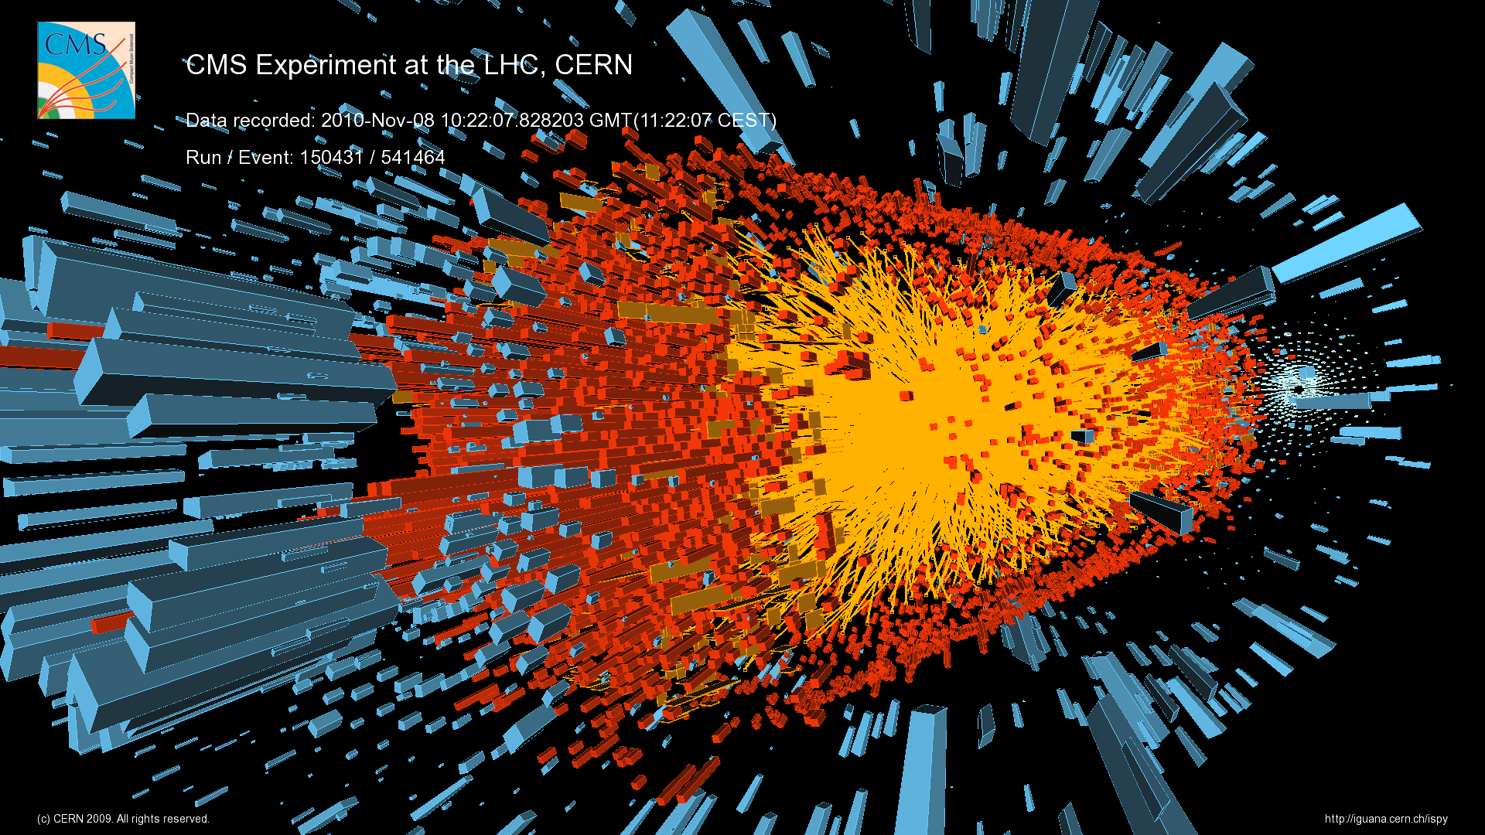
The Heavy-Ion experiments at the Relativistic Heavy-Ion Collider (RHIC) and the Large Hadron Collider (LHC) study the Quark-Gluon-Plasma (QGP), a soup of fundamental building blocks of the universe, thought to have existed a few microseconds after the “Big-Bang.”

Slide 39
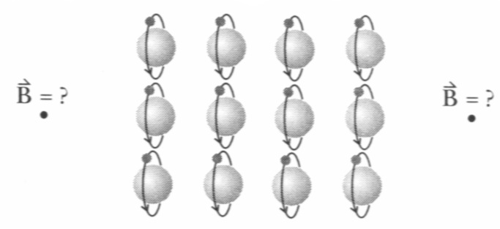
Atomic Structure of Magnets
Assume: Electrons make circular current loops
Electrons
(iClicker Quiz:
What is the direction?)
Left
Right
Up
Down
Zero B field.
These are electrons
Notes:
Also – distnce dependence 1/r3. EC here 10/3

Slide 40
Atomic Structure of Magnets
Assume: Electrons make circular current loops
Electrons
What is the direction?
What is the average current I per loop?
current=charge/second:
N
S
Notes:
Also – distnce dependence 1/r3. EC here 10/3

Slide 41
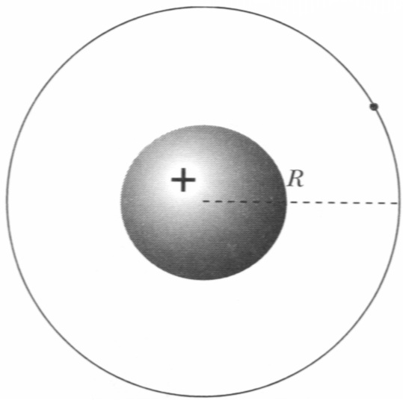
Atomic Structure of Magnets
Assume: Electrons make circular current loops
Dipole Moment of 1 Atom
Angular Momentum is Quantized:
Orbital angular momentum:
Quantum mechanics: L is quantized:
Notes:
Also assume only 1 electron in one atom

Slide 42
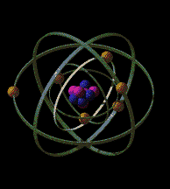
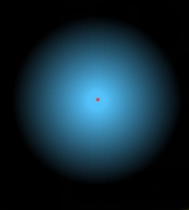
Quantum Magnetism
Magnetic Moment = Orbital Motion + "Spin"
ORBITAL MOTION:
Fuzzy electron cloud.
Shapes are set by "spherical harmonics"
Spherically symmetric cloud (s-orbital, i.e. l = 0) has no μ
Only non spherically symmetric orbitals (p, d, f) contribute to μ
There is more than 1 electron in an atom (except hydrogen atom)

Slide 43
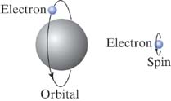
Quantum Magnetism
Magnetic Moment = Orbital Motion + "Spin"
SPIN:
Electron acts like spinning charge
- contributes to μ
Electron spin contribution to μ is of the same order as one due to orbital momentum
proton in nucleus also have spin but their μ‘s are much smaller than for electron
angular momentum:
NMR, MRI – use nuclear μ
Notes:
Neutron magnetic dipole moment is not zero indicating smaller building blocks, i.e. quarks.

Slide 44
Quantum Magnetism
Magnetic Moment = Orbital Motion + "Spin"
SPIN:
Electron acts like spinning charge
- contributes to μ
Electron spin contribution to μ is of the same order as one due to orbital momentum
proton in nucleus also have spin but their μ‘s are much smaller than for electron
angular momentum:
iClicker question:
Can Neutron has spin dipole moment?
A). No because neutron has no charge
B). Yes, because neutron is not the fundamental building block.
NMR, MRI – use nuclear μ
Notes:
Neutron magnetic dipole moment is the same as proton and is not zero indicating smaller building blocks, i.e. quarks.

Slide 45
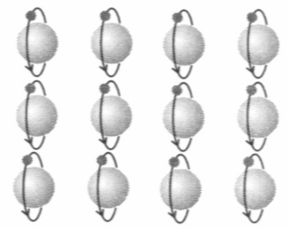
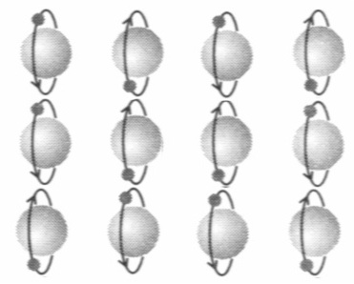
Refrigerator Magnets
Alignment of atomic dipole moments:
ferromagnetic materials:
iron, cobalt, nickel
most materials
Notes:
Professor Xie, We do not have a number assigned to this demo. We have an insulated wire wrapped around a nail (like a solenoid). When we attach it to a battery, we will use it to pick up paper clips. Would that be OK? Gary

Slide 46
iClicker Question
Notes:
B

Slide 47
backup

Slide 48
Magnetic Dipole Moment
Magnetic dipole moment of 1 atom:
Method 2: estimate speed of electron
Momentum principle:
Circular motion:
– angular speed
Notes:
R = 0.5 x 10^-10 meters.

Slide 49
More for Today
Equilibrium vs. Steady State in a Circuit
What is "used up" in a circuit?
Kirchhoff's Current Node Law
E-field inside a wire

Slide 50
Key Ideas in Chapter 19: Electric Circuits
Surface charges make the electric field that drives the current in a circuit.
  Transient effects precede the steady state.
  A battery maintains a charge separation and a potential difference.
How to analyze circuits:
  Current-node rule: Current into a node equals current out of the node.
  Voltage-loop rule: The total potential difference around a loop is zero.
Notes:
START TIME HERE:

Slide 51
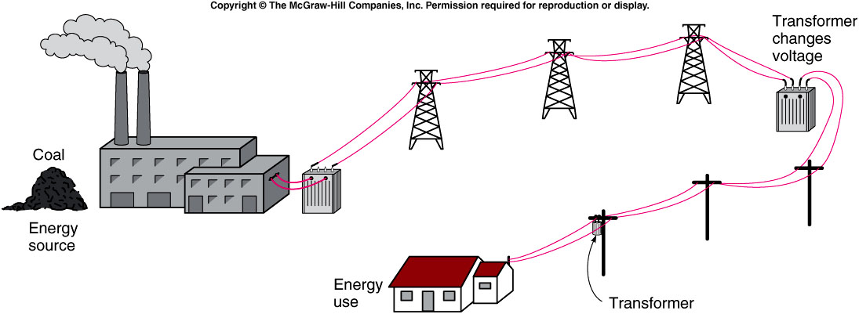
iClicker Question
Why High Voltage is needed to transfer electricity?
Prevent animal from biting the cable.
Reduce energy wasted during transportation.
No reason. People started this way long time ago.
Notes:
Asking student these questions to draw attentation.

Slide 52
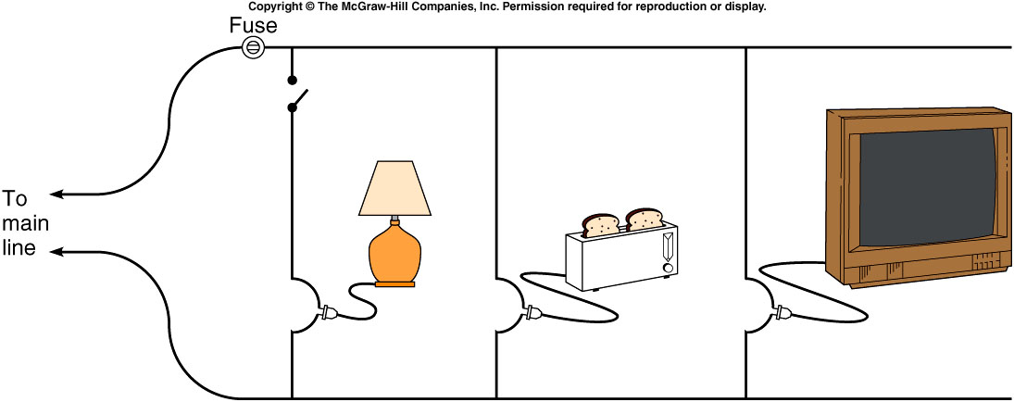
iClicker Question
Which way is preferred.
Left
Right
left and right are equal.
Notes:
Asking student these questions to draw attentation.

Slide 53
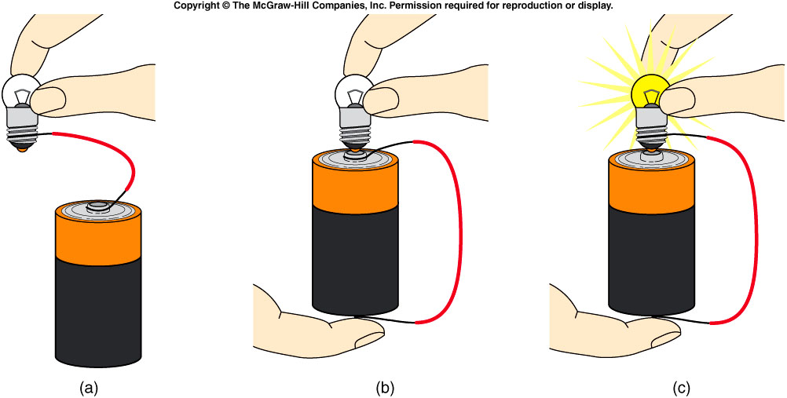
iClicker Question
Which of the following bulb will light up?

Slide 54
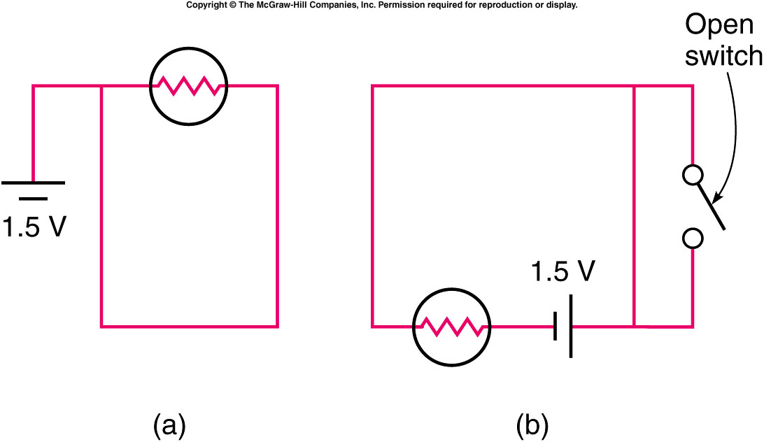
Which of the two circuits shown will cause the light bulb to light?
iClicker Question
Arrangement (a)
Arrangement (b)
Both
Neither

Slide 55
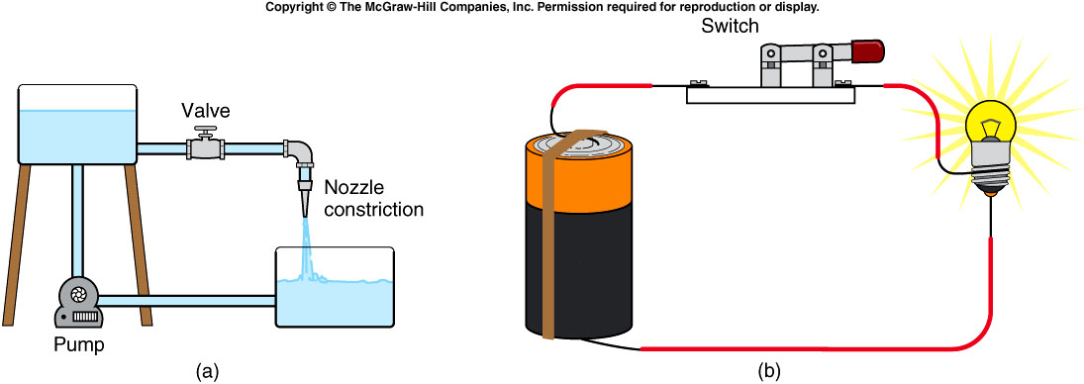
Water flowing in a pipe is similar to electric current flowing in a circuit.
  The battery is like the pump.
  The electric charge is like the water.
  The connecting wires are like the thick pipe.
  The filament is like the nozzle or narrow pipe.
  The switch is like the valve.
Notes:
faucet

