Slide 1
Today
Sources of Magnetic Field
Magnetic Field due to Moving Charges
Cross Products: Right-hand Rule
(Cross Products: Mathematically)

Slide 2
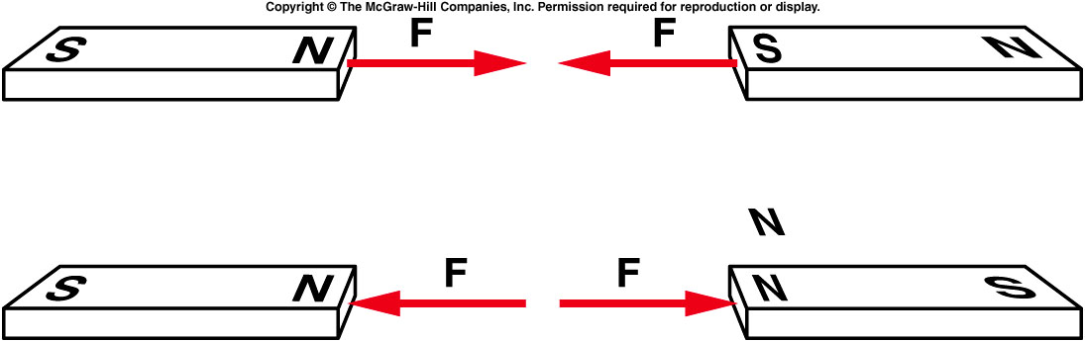
The force that two poles exert on one another varies with distance or pole strength.
  The magnetic force between two poles decreases with the square of the distance between the two poles, just as the electrostatic force does.
  Like poles repel one another, and unlike poles attract one another.
Notes:
Demo: all different kind of magnet

Slide 3
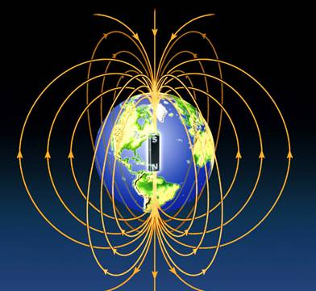
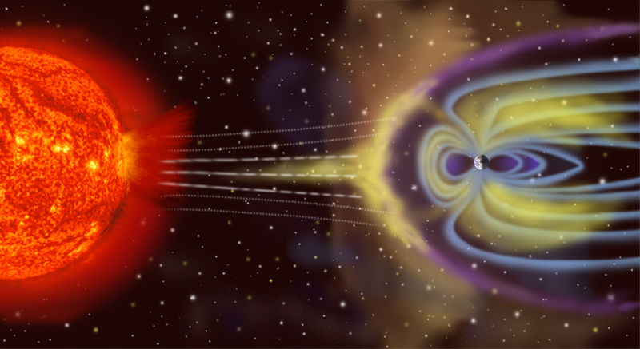
Is the Earth a magnet?
The north (north-seeking) pole of a compass needle points toward the Earth’s “North Pole.”

Slide 4
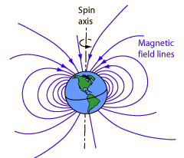
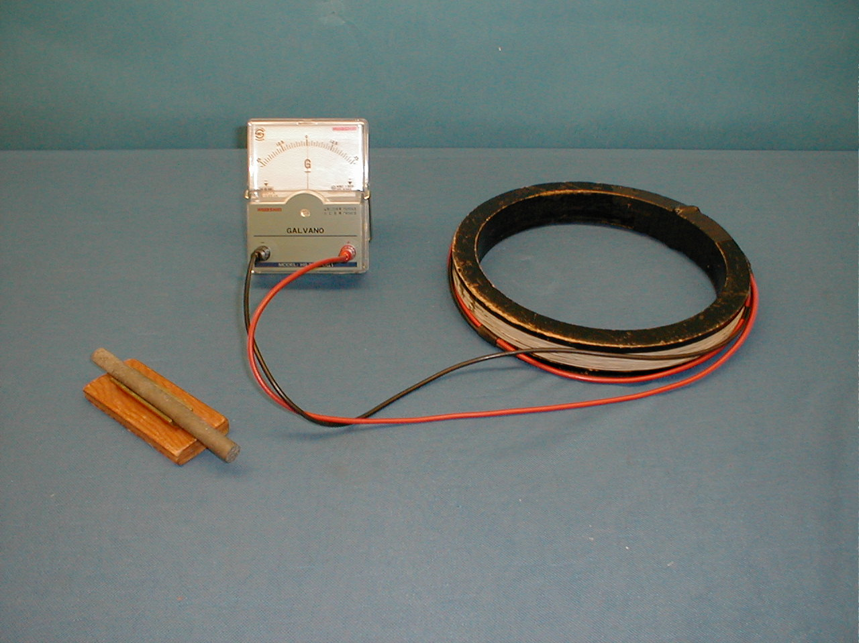
Fun Facts: Earth's Magnetic Field
|B_{Earth}| ~ 20 microTesla = 2 x 10⁻⁵ T
Tilted by 11.3 degrees from Rotational Axis
"Sign reversals" throughout Earth's history
6D-04
http://hyperphysics.phy-astr.gsu.edu/hbase/magnetic/magearth.html
http://www.ngdc.noaa.gov/geomag/WMM/data/WMM2010/WMM2010_F_MERC.pdf
Notes:
Charles Augustin de Coulomb – French engineer and scientist. Created science of friction (first), after that stopped engineering and became involved full time in physics, in 1785-1791 published 7 papers on electricity and magnetism:
... had obtained some remarkable results by using the torsion balance method: law of attraction and repulsion, the electric point charges, magnetic poles, distribution of electricity on the surface of charged bodies and others. The importance of Coulomb's law for the development of electromagnetism is examined and discussed. In these he developed a theory of attraction and repulsion between bodies of the same and opposite electrical charge. He demonstrated an inverse square law for such forces and went on to examine perfect conductors and dielectrics. He suggested that there was no perfect dielectric, proposing that every substance has a limit above which it will conduct electricity. These fundamental papers put forward the case for action at a distance between electrical charges in a similar way as Newton's theory of gravitation was based on action at a distance between masses.

Slide 5
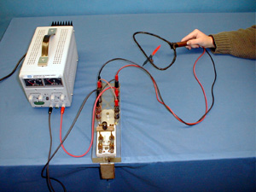
Demos: 6B-01 Oersted's Experiment

Slide 6
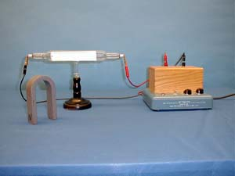
Demos: 6B-02 Force on a Moving Charge

Slide 7
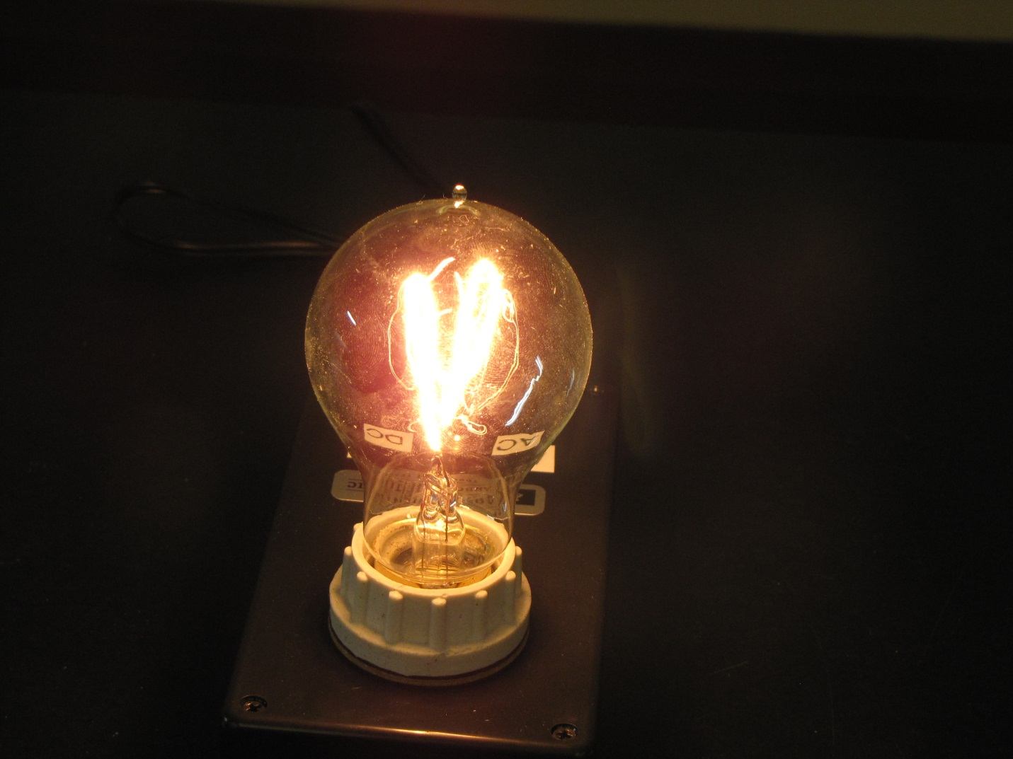
Demos: 6B-17 Electricity and Magnetism Light Bulb
http://www.youtube.com/watch?v=iG0pzGcy4xU&list=PLCE35CBBBFEF6E365

Slide 8
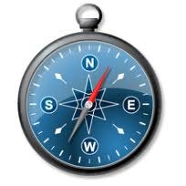
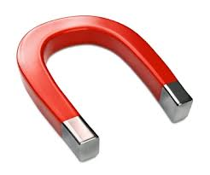
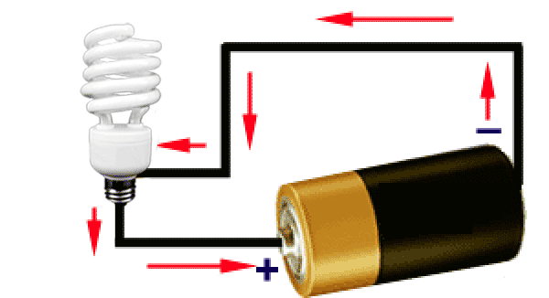
What happens when...
Compass is isolated?
Magnet is near a compass?
Current-carrying wire is near compass?
Notes:
Charles Augustin de Coulomb – French engineer and scientist. Created science of friction (first), after that stopped engineering and became involved full time in physics, in 1785-1791 published 7 papers on electricity and magnetism:
... had obtained some remarkable results by using the torsion balance method: law of attraction and repulsion, the electric point charges, magnetic poles, distribution of electricity on the surface of charged bodies and others. The importance of Coulomb's law for the development of electromagnetism is examined and discussed. In these he developed a theory of attraction and repulsion between bodies of the same and opposite electrical charge. He demonstrated an inverse square law for such forces and went on to examine perfect conductors and dielectrics. He suggested that there was no perfect dielectric, proposing that every substance has a limit above which it will conduct electricity. These fundamental papers put forward the case for action at a distance between electrical charges in a similar way as Newton's theory of gravitation was based on action at a distance between masses.

Slide 9
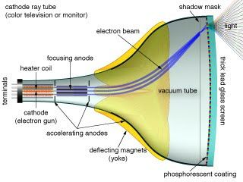
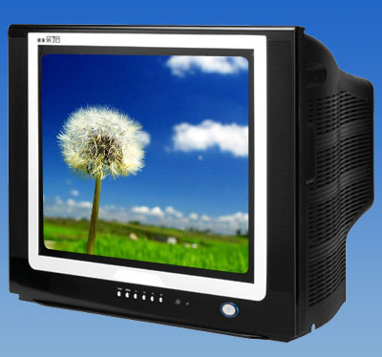
TV with Visible Cathode Ray Tube
When a strong magnet is placed in front of this TV screen, the image shown on TV will most likely
be distorted.
Not affected

Slide 10
What happens when...
Compass is isolated?
Points to Earth's (magnetic) North Pole
Magnet is near a compass?
Needle deflects
Current-carrying wire is near compass?
Needle deflects!

Slide 11
Compass Near a Wire
Depends on amount of current in wire
No current → no Magnetic field (B) from wire
B-field of wire is perpendicular to the wire
What happens when wire is below vs. above compass?
B-field switches direction!
Key Idea: Needle of a compass aligns with the net magnetic field.
Notes:
Charles Augustin de Coulomb – French engineer and scientist. Created science of friction (first), after that stopped engineering and became involved full time in physics, in 1785-1791 published 7 papers on electricity and magnetism:
... had obtained some remarkable results by using the torsion balance method: law of attraction and repulsion, the electric point charges, magnetic poles, distribution of electricity on the surface of charged bodies and others. The importance of Coulomb's law for the development of electromagnetism is examined and discussed. In these he developed a theory of attraction and repulsion between bodies of the same and opposite electrical charge. He demonstrated an inverse square law for such forces and went on to examine perfect conductors and dielectrics. He suggested that there was no perfect dielectric, proposing that every substance has a limit above which it will conduct electricity. These fundamental papers put forward the case for action at a distance between electrical charges in a similar way as Newton's theory of gravitation was based on action at a distance between masses.

Slide 12
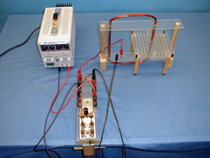
Demos: 6B-03 Magnetic Field Around A Wire

Slide 13
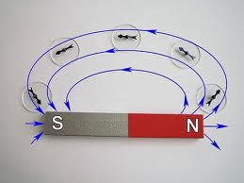
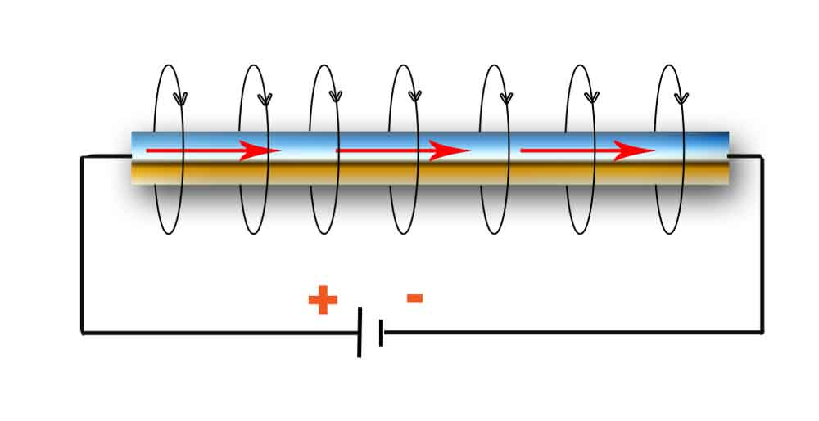
Current and Magnetic Field
Why does the wire act like a magnet?
?
=
Magnetic Field B
Current I
http://physick.wikispaces.com/Electric+Current
Key Idea: Moving charges create a Magnetic Field
Notes:
Bend the straight wire and form a dipole magnet. Inside the loop→inside bar magnet. Outside the loop→outside the bar magnet.

Slide 14
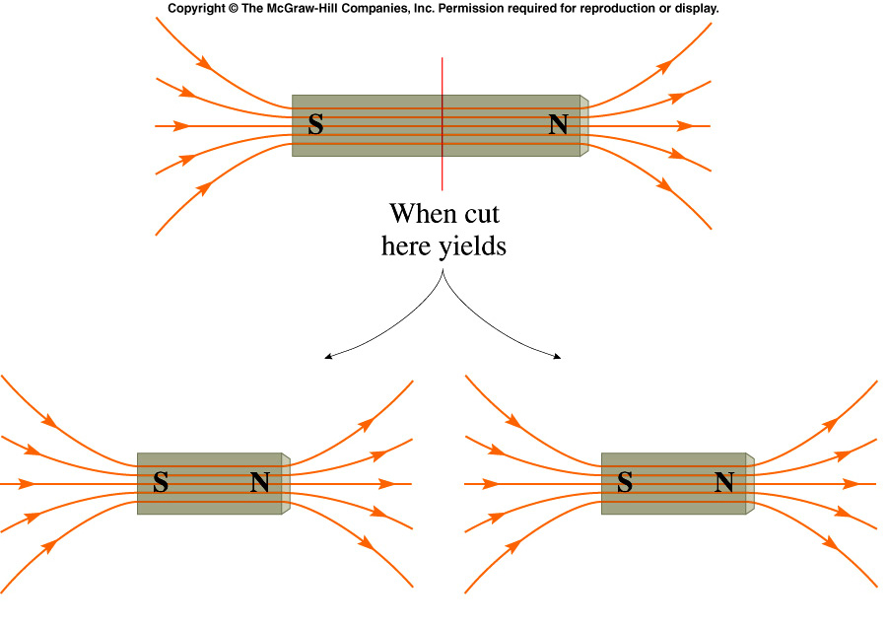
Magnetic Monopoles
Does there exist magnetic charge, just like electric charge? An entity which carried such magnetic charge would be called a magnetic monopole (having + or - magnetic charge).
How can you isolate this magnetic charge? Try cutting a bar magnet in half.
In fact no attempt has been successful in finding magnetic monopoles in nature.
Notes:
Break a bar magnet to demo

Slide 15
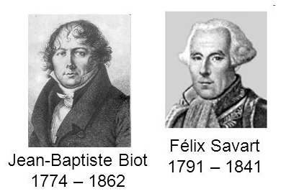
Biot-Savart Law for a Single Charge
Electric field of a point charge:
Moving charge makes a curly magnetic field:
B units: T (tesla) = kg s⁻²A⁻¹
Notes:
Short:
Biot&Savart – french. Biot: professor of math at age 23, three years later Prof. of math. physics. Interested in applied math primarily. Considered magnetic field as fundamental property. 1/r^2 dependence (not trivial – for wire will be 1/r)
Tesla –serbian-american inventor. Discovered rotating magnetic field – basis for alternating machinery. Emigrated to US at age 28 and sold patents for alternating current generator, motor and transformer to George Westinghouse. Later designed Tesla coil used in radio technology. high tension coils.
Biot, Jean-Baptiste
21 Apr 1774 - 3 Feb 1862
French
Educated at École Polytechnique in Paris, he became professor of mathematics at the University of Beauvais in 1797. Three years later he became professor of mathematical physics at the Collège de France. He studied a wide range of mathematical topics, mostly on the applied mathematics side. Biot made advances in astronomy, elasticity, electricity and magnetism, heat and optics on the applied side while he also did important work in geometry. He collaborated with Arago on refractive properties of gases. He, together with Savart, discovered that the intensity of the magnetic field set up by a current flowing through a wire varies inversely with the distance from the wire. This is now known as Biot-Savart's Law and is fundamental to modern electromagnetic theory. For his work on the polarisation of light passing through chemical solutions he was awarded the Rumford Medal of the Royal Society.
Savart, Felix
30 June 1791 - 16 Mar 1841
French
He taught at the Collège de France from 1828, becoming a professor there in 1836. He collaborated with Biot on a theory of magnetism. They took magnetism as the fundamental property rather than the Ampère approach which treated it as derived from electric circuits. Savart also carried out experiments on sound which became important for later students of acoustics.
Tesla, Nikola
(b. July 9/10, 1856, Smiljan, Croatia--d. Jan. 7, 1943, New York City), Serbian-American inventor and researcher who discovered the rotating magnetic field, the basis of most alternating-current machinery. He emigrated to the United States in 1884 and sold the patent rights to his system of alternating-current dynamos, transformers, and motors to George Westinghouse the following year. In 1891 he invented the Tesla coil, an induction coil widely used in radio technology. Tesla was from a family of Serbian origin. His father was an Orthodox priest; his mother was unschooled but highly intelligent. A dreamer with a poetic touch, as he matured Tesla added to these earlier qualities those of self-discipline and a desire for precision.
http://www.neuronet.pitt.edu/~bogdan/tesla/bio.htm

Slide 16
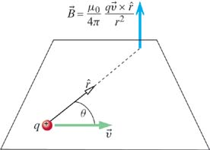
Biot-Savart Law
Key Idea: Moving charges create a Magnetic Field
BIOT-SAVART LAW
point charge
= charge
= velocity of charge
= observation point
(charge at origin)
Notes:
Charles Augustin de Coulomb – French engineer and scientist. Created science of friction (first), after that stopped engineering and became involved full time in physics, in 1785-1791 published 7 papers on electricity and magnetism:
... had obtained some remarkable results by using the torsion balance method: law of attraction and repulsion, the electric point charges, magnetic poles, distribution of electricity on the surface of charged bodies and others. The importance of Coulomb's law for the development of electromagnetism is examined and discussed. In these he developed a theory of attraction and repulsion between bodies of the same and opposite electrical charge. He demonstrated an inverse square law for such forces and went on to examine perfect conductors and dielectrics. He suggested that there was no perfect dielectric, proposing that every substance has a limit above which it will conduct electricity. These fundamental papers put forward the case for action at a distance between electrical charges in a similar way as Newton's theory of gravitation was based on action at a distance between masses.

Slide 17
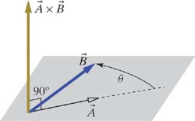
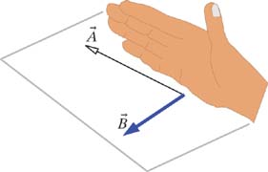
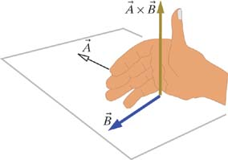
Right-Hand Rule
BIOT-SAVART LAW
point charge
Result of Cross Product
is Perpendicular to both and
Right-Hand Rule:
1)
2)

Slide 18
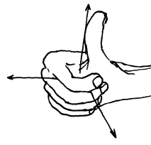
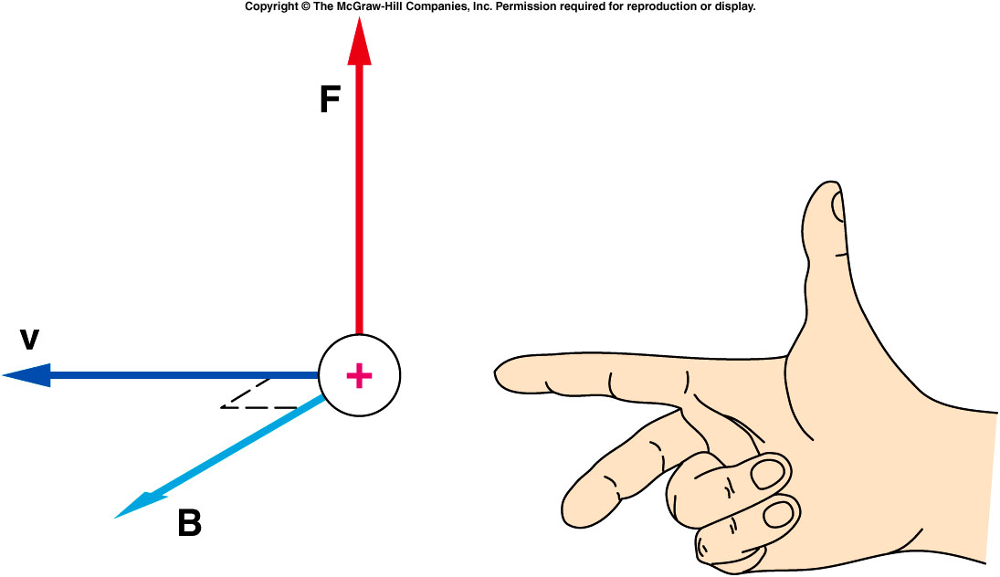
Alternatives to the Right-Hand Rule

Slide 19
Cross Product: Here's the Math
+ ( - )
+ ( - )
+ ( - )
copy 1st two colums
set up the answer

Slide 20
Cross Product: Here's the Math
+ ( - )
+ ( - )
+ ( - )

Slide 21
Cross Product: Here's the Math
( - ),
( - ),
( - )
The resulting vector has magnitude:

Slide 22
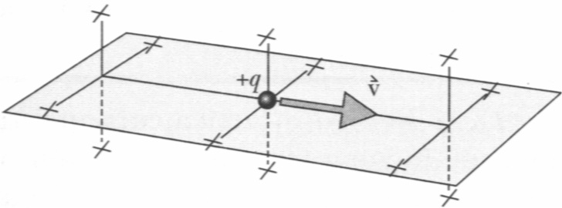

Exercise
What if the charge is negative?

Slide 23
iClicker Question
A
) +x
W
h
a
t i
s
t
he
d
ir
e
ct
i
o
n
o
f
B
) –
x
C
) +y
<
0
,
0
,
3
> x < 0
,
4
,
0
>
?
D
) –
y
E
)
z
er
o m
ag
n
it
u
d
e
Notes:
B

Slide 24

Exercise
What is the magnetic field created by an electron orbiting around the nucleus in the simple Bohr model of the H atom?
v = 2.2×10⁶ m/s
r = 0.5×10⁻¹⁰ m
v
r
(B_{Earth}=2×10⁻⁵ T)

Slide 25
iClicker Question
An electron passing through the origin is traveling at a constant velocity in the negative y direction. What is the direction of the magnetic field at a point on the positive z axis?
y
-x
+x
-z
+z
No magnetic field
x
v
z
Notes:
B

Slide 26
backup

Slide 27
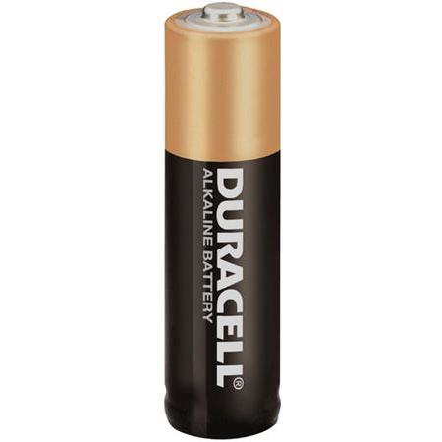
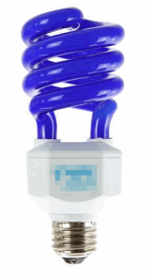
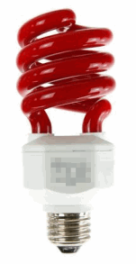
Conventional Current and Electron Current
-
C
Electron Current:
Electrons exit battery at (-) terminal,
and enter battery at (+) terminal
Electron
Current
-
-
+
C
Conventional Current:
+
Fictitious Positive charges
exit battery at (+) terminal,
and enter battery at (-) terminal
Conventional
Current
+

Slide 28
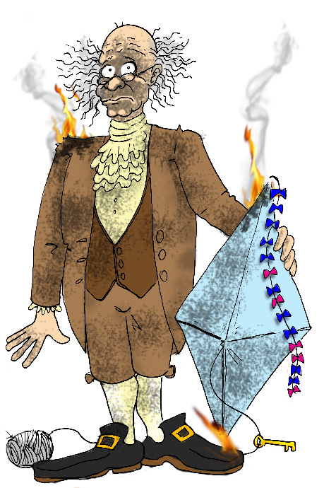
Conventional Current and Electron Current
-
C
Why the difference? Benjamin Franklin guessed
that current is carried by positive charges.
Electron
Current
Sorry!
-
-
+
C
+
Conventional
Current
+
http://blog.marshotelonline.com/2012/01/08/if-grounded/

Slide 29
Conventional Current and Electron Current
-
C
Electron Current:
Electron
Current
-
-
1e = 1.6x10⁻¹⁹ C
Square Brackets [ ]
Mean "Units"
+
C
Conventional Current:
+
Conventional
Current
+

Slide 30
Conventional Current and Electron Current
-
C
Electron Current:
Electron
Current
-
-
We start with
this one
+
C
Conventional Current:
+
Conventional
Current
+

Slide 31
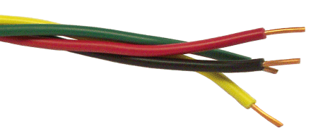
Calculating Electron Current
Find electron current in terms of:
Density of Electrons in the Wire
Cross Sectional Area of the Wire
Average Velocity of Electrons in the Wire

Slide 32
Calculating Electron Current
Cross Sectional
Area of Wire
Average Velocity
of Electrons
1. How many Electrons are in here?
A
✔ UNITS
L
2. Electrons are moving at velocity .
How long does this take to pass through L?
✔ UNITS

Slide 33
Calculating Electron Current
3. How many Electrons pass by per second?
A
L
✔ UNITS
ELECTRON
CURRENT

Slide 34
iClicker Question
A typical electron current in a circuit is 10¹⁸ electrons/s.
What is the conventional current?
1.6 A
16A
32A
0.16A
Unknown

Slide 35

Biot-Savart Law
BIOT-SAVART LAW
point charge
We need to understand
how these are related
BIOT-SAVART LAW
current in a wire
= length of this
chunk of wire

Slide 36
GOAL: Show
(point charge)
(wire)
(POSITIVE)
POINT CHARGE
MANY POINT
CHARGES
N particles
particles per
volume ΔV
ΔV

Slide 37
GOAL: Show
(point charge)
(wire)
(POSITIVE)
POINT CHARGE
MANY POINT
CHARGES
N particles
particles per
volume ΔV
ΔV
Move the vector symbol
CHUNK
OF WIRE
= length of this
chunk of wire

Slide 38
Biot-Savart Law
BIOT-SAVART LAW
point charge
That is how
these are related
BIOT-SAVART LAW
current in a wire
= length of this
chunk of wire

Slide 39
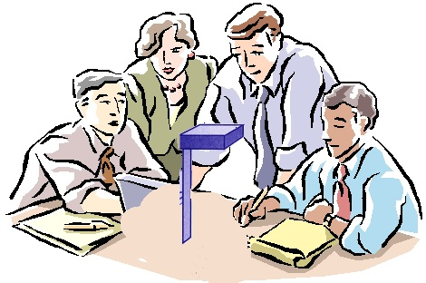
iClicker Question
Bob and his classmates are motionless w.r.t. a charged object on table. Jessie is running nearby. Both of them measure the B field produced by the charged object. Which of the following is correct:
B(Bob) = 0, B(Jessie) = 0
B(Bob) != 0, B(Jessie) != 0
B(Bob) = 0, B(Jessie) != 0
Jessie
Bob
charged tape

Slide 40
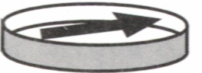
iClicker Question
Biot-Savart Law is an Approximation
Electric fields: produced by charges
Magnetic fields: produced by moving charges
Any magnetic field?
charged tape

Slide 41
Frame of Reference
Must use the velocities of the charges as you observe them in
your reference frame!
There is a deep connection between
Electric Field E and Magnetic Field B.
Einstein’s special theory of relativity!

Slide 42
Problem #2: Retardation
Biot-Savart Law is an Approximation
If we suddenly change the current in a wire:
Magnetic field will not change instantaneously.
Electron and positron collide:
Produce both electric and magnetic field, these fields exist even after annihilation.
Changes propagate at speed of light
Why is there no time in Biot-Savart law?
→ We assume speed of charges is small

Slide 43
Today
(Cross Products: Mathematically)
Electron Current and Conventional Current
Calculating the Electron Current
True vs. Useful
Biot-Savart Law in a Wire
Relativity!!

Slide 44
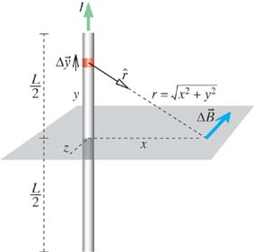
Magnetic Field of a Straight Wire
BIOT-SAVART LAW
current in a wire
Calculate B in the
bisecting plane
Calculate B in the
bisecting plane
We want to calculate B in the bisecting plane.
How did we do this for E?
Break the rod up into point charges.
Add up E due to all point charges.

Slide 45
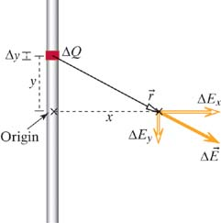
Electric Field in the Bisecting Plane
for a point charge
Δq_{i}
We only need the x component
θ
Break the rod up into point charges.
Add up E due to all point charges.
Blast from the Past
Lecture 5

Slide 46


Magnetic Field of a Straight Wire
BIOT-SAVART LAW
current in a wire
Break the rod up into point charges.
Add up B due to all point charges.
Calculate B in the
bisecting plane
Calculate B in the
bisecting plane
-

Slide 47
Magnetic Field of a Straight Wire
Calculate B in the
bisecting plane
Does x change
during the integration?

Slide 48
Magnetic Field of a Straight Wire
Calculate B in the
bisecting plane
Observation point x
does not change
during the integration
Look up the integral
B of a Long
Straight Wire

Slide 49
Magnetic Field of a Straight Wire
B in the
bisecting plane
I
Which direction does B point?
→ Always along concentric circles
In cylindrical coordinates,
it points in the " " direction
r
Will the y axis look different from the x axis?
Cylindrical
Coordinates
No, so we can trade x → r
B of a Long
Straight Wire
(Cylindrical
Coordinates)

Slide 50
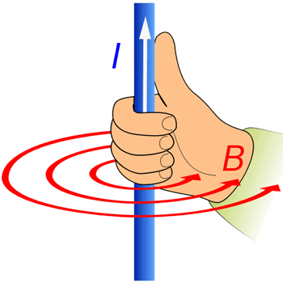
Very Close to the Wire
Very close to the wire: r << L
CLOSE TO
THE WIRE
Another Right-Hand Rule

