Slide 1
Last Time
Potential Difference and Electric Field
Path Independence of Potential Difference
Potential at one point
Potential inside a conductor
Potential inside an insulator
Energy stored in a field

Slide 2

Potential Difference: Path Independence
f
i
Path independence principle:
ΔV between two points does not depend on integration path

Slide 3
Potential at a Single Point?
Definition of
Potential Difference
Potential at a single point is the potential relative to infinite separation
What does this equation imply about ?
We define the potential at infinity
to be zero, by convention.

Slide 4
iClicker
The electric field is zero inside a conductor. What does this mean for the electric potential?
The electric potential must be zero inside the conductor
The electric potential must go to zero on the surface of the conductor, but on both the inside and outside, it can do anything.
The electric potential is constant inside the conductor
Notes:
C

Slide 5
Inside a Metal
For a metal in EQUILIBRIUM, E = 0 inside,
and the potential is constant, (note: not necessarily zero)
E=0
V is constant
E not = 0, V changes
+
point charge
metal @ equilibrium

Slide 6
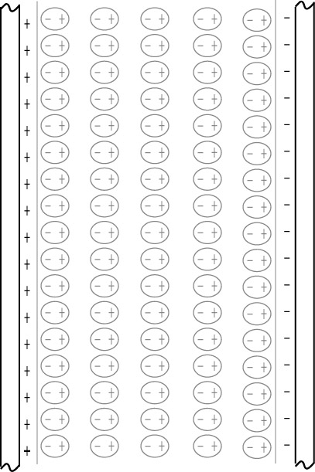
Potential Difference in an Insulator
Electric field in capacitor filled with insulator: E_{net}=E_{plates}+E_{dipoles}
E_{plates}=const (in capacitor)
E_{dipoles}=f(x,y,z)
E_{dipoles,A}
E_{dipoles,B}
A
B
Travel from B to A:
E_{dipoles} is sometimes parallel to dl, and sometimes antiparallel to dl
Average Field from induced dipoles
is opposite to the field from the plates
Effect of dielectric is to reduce the potential difference.
1
2
3
4
5
Notes:
Situation in insulator is more complex than in metals.
Polarized molecules contribute to net electric field
A … inside ”capacitor”
B … between two “capacitors”

Slide 7
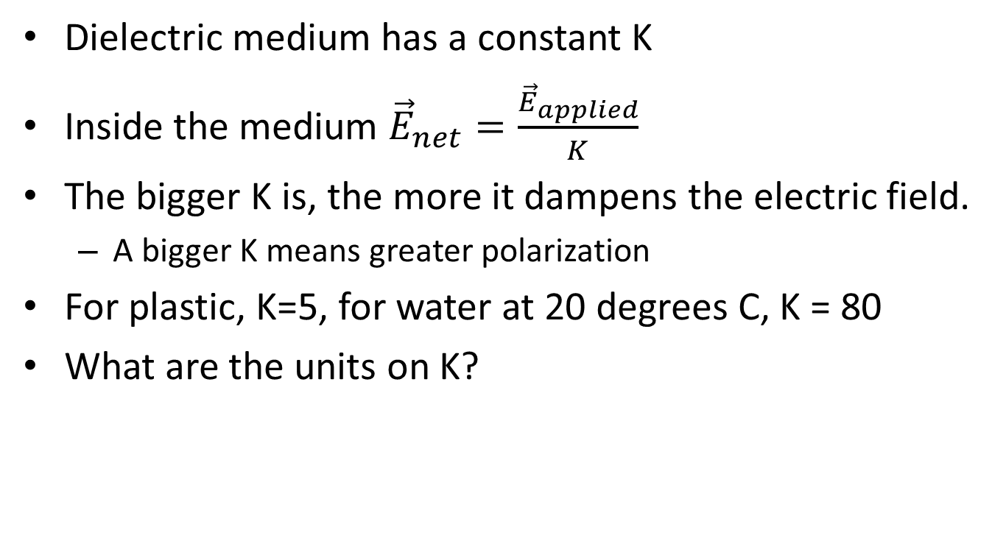
Dielectric constant
vacuum 1 (by definition)
air 1.0006
typical plastic 5
NaCl 6.1
water 80
strontium titanate 310

Slide 8
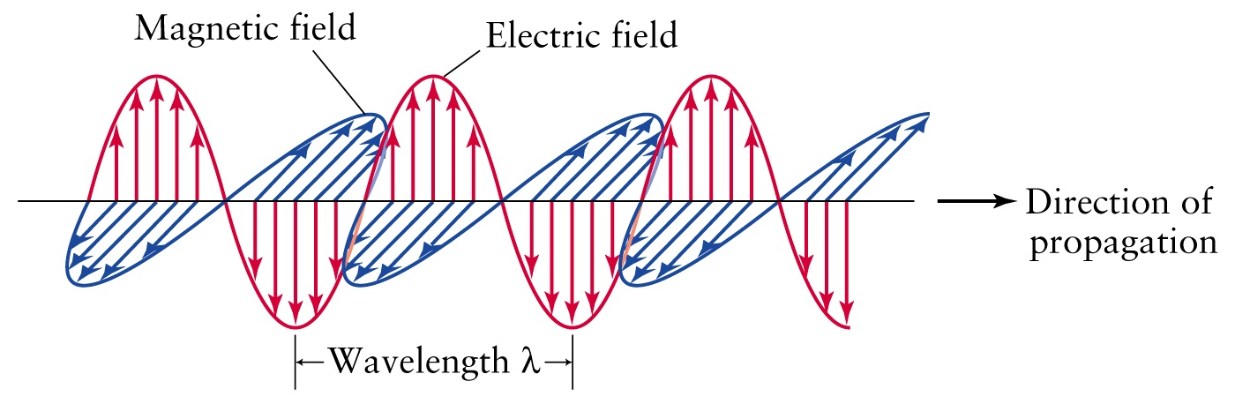
Energy stored in a field
Rather than potential energy, we can talk about the energy of the EM field
This is useful because radiation (e.g. light) carries energy, and we may want to know how much
Instead of a change in potential energy, we can say that rearranging charges changes the field energy
What is the energy density of a field (Energy/m³)?
PHOTON:
http://www.physast.uga.edu/~jss/1010/ch5/ovhd05.html

Slide 9
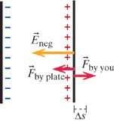
iClicker question
Inside a capacitor:
To find the field energy density, let’s start by thinking about work
Consider a capacitor with two plates. The charge on each plate is +Q and –Q
How much work does it take to move the second plate a distance Δs
0
(Q/Aε_{ο}) Δs
(Q²/Aε_{ο}) Δs
d) (Q²/2Aε_{ο}) Δs
Notes:
d – use the field due to ONE PLATE ONLY

Slide 10
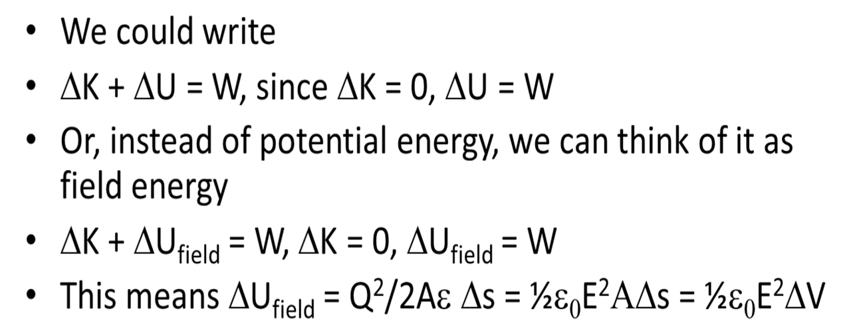
Field energy density
W = (Q²/2Aε_{ο}) Δs
o
Volume
ELECTRIC FIELD
ENERGY
DENSITY
So the Energy Density is:

Slide 11
iClicker Question
300 V/m
0 V/m
300 V/m
A
B
0.02m
0.03m
0.04m
What is V_{B}-V_{A?}
270 V
-270 V
-18 V
6 V
-6 V
Notes:
D

Slide 12
Question
0 V/m
A
B
0.02m
0.03m
0.04m
x
0
V_{B}-V_{A} = -300*(0.02-0) - (-300)*(0.09-0.05)=-6+12 V = +6 V
Notes:
D

Slide 13
More for Today
Sources of Magnetic Field
Magnetic Field due to Moving Charges
Cross Products: Right-hand Rule
Cross Products: Mathematically

Slide 14
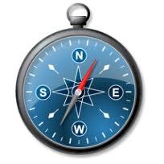
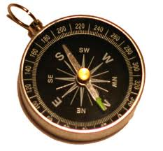
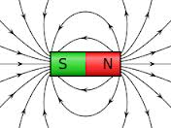
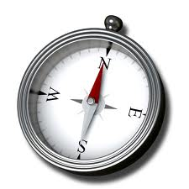
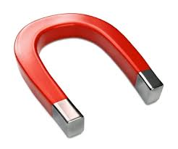
Key Ideas in Chapter 18: Magnetic Field
Moving charged particles make a magnetic field, which is different
from an electric field.
The needle of a magnetic compass aligns with the direction of
the net magnetic field at its location.
A current is a continuous flow of charge.
  Electron current is a number of electrons per second
  entering a section of a conductor.
  Conventional current (Coulombs/second) is opposite in direction to the
  electron current, and is assumed to be due to positively charged particles.
The superposition principle can be applied to calculate the expected
magnetic field from current-carrying wires in various configurations.
  A current-carrying loop is a magnetic dipole.
  A bar magnet is also a magnetic dipole.
  Even a single atom can be a magnetic dipole!
Notes:
START TIME HERE:

Slide 15
Magnets and the Magnetic Force
We are generally more familiar with magnetic forces than with electrostatic forces.
  Like the gravitational force and the electrostatic force, this force acts even when the objects are not touching one another
  .
Is there a relationship between electrical effects and magnetism?
  Maxwell discovered that the electrostatic force and the magnetic force are really just different aspects of one fundamental electromagnetic force.
Our understanding of that relationship has led to numerous inventions such as electric motors, electric generators, transformers, etc.

Slide 16
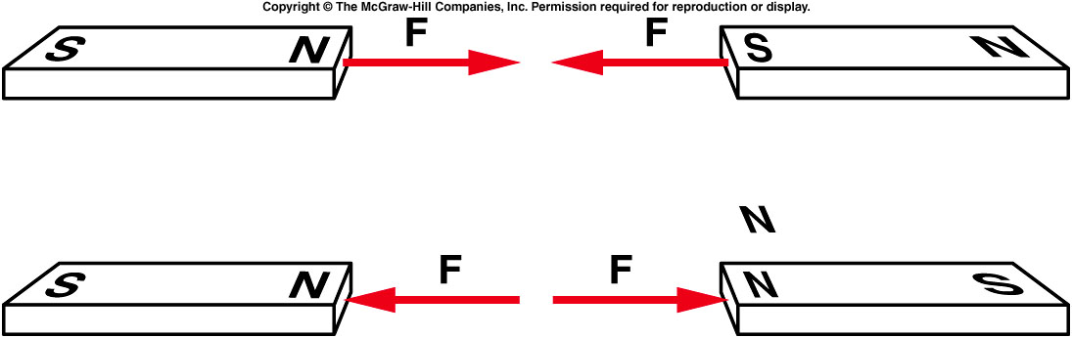
The force that two poles exert on one another varies with distance or pole strength.
  The magnetic force between two poles decreases with the square of the distance between the two poles, just as the electrostatic force does.
  Like poles repel one another, and unlike poles attract one another.
Notes:
Demo: all different kind of magnet

Slide 17
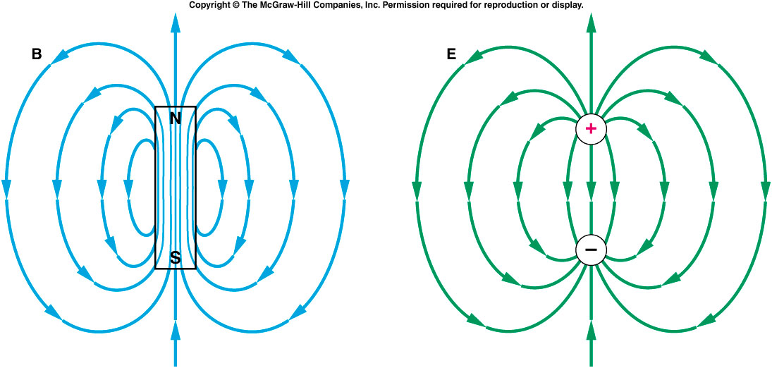
Magnetic field lines produced by a magnetic dipole form a pattern similar to the electric field lines produced by an electric dipole.
  Static electric field lines originate on positive charges and terminate on negative charges.
  Magnetic field lines form continuous loops: they emerge from the north pole and enter through the south pole, pointing from the north pole to the south pole outside the magnet.
  Inside the magnet, they point from the south pole to the north pole.

Slide 18
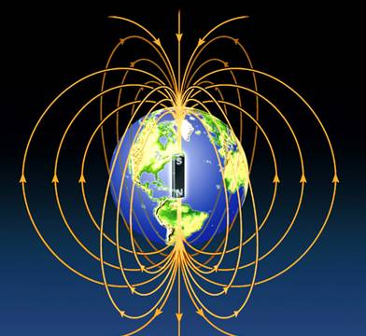
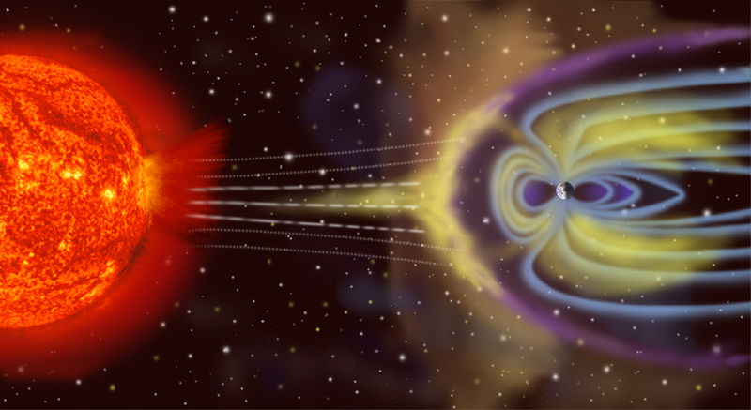
Is the Earth a magnet?
The north (north-seeking) pole of a compass needle points toward the Earth’s “North Pole.”

Slide 19
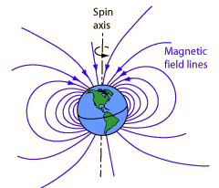
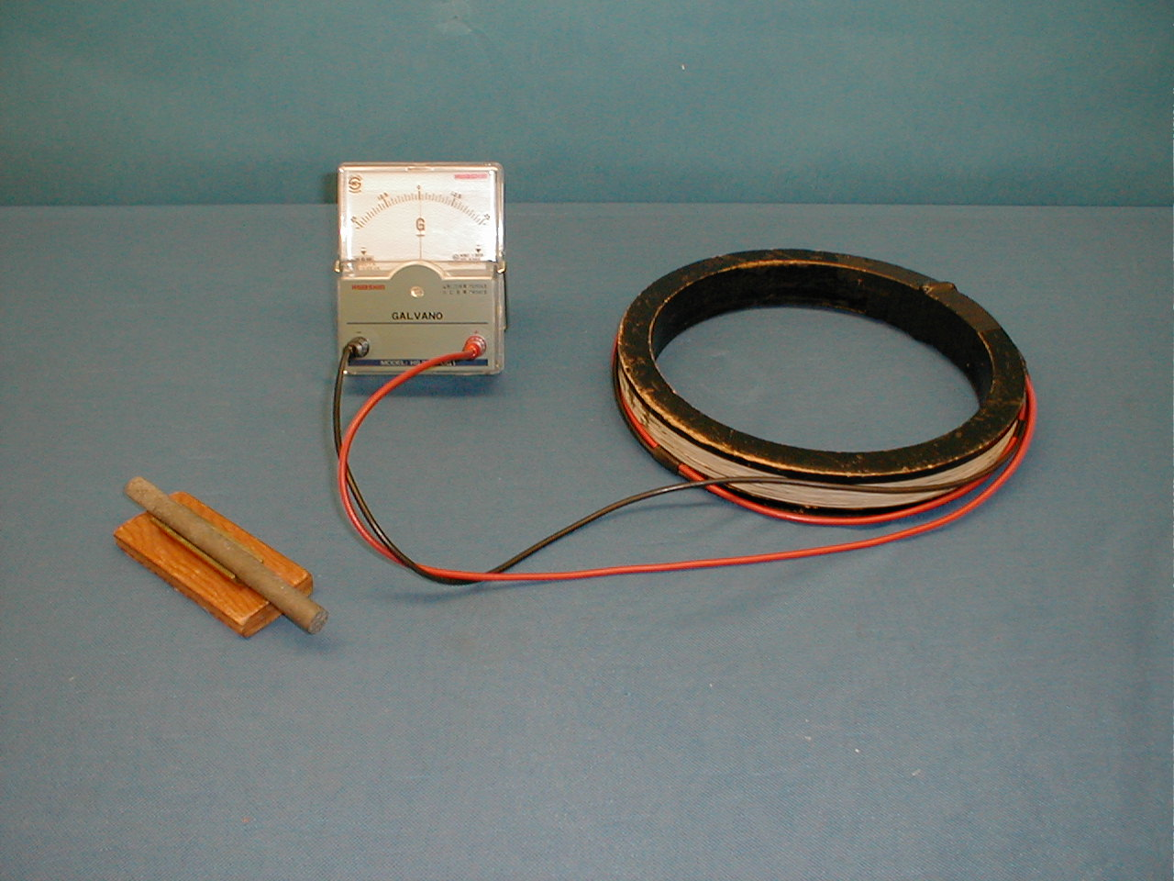
Fun Facts: Earth's Magnetic Field
|B_{Earth}| ~ 20 microTesla = 2 x 10⁻⁵ T
Tilted by 11.3 degrees from Rotational Axis
"Sign reversals" throughout Earth's history
6D-04
http://hyperphysics.phy-astr.gsu.edu/hbase/magnetic/magearth.html
http://www.ngdc.noaa.gov/geomag/WMM/data/WMM2010/WMM2010_F_MERC.pdf
Notes:
Charles Augustin de Coulomb – French engineer and scientist. Created science of friction (first), after that stopped engineering and became involved full time in physics, in 1785-1791 published 7 papers on electricity and magnetism:
... had obtained some remarkable results by using the torsion balance method: law of attraction and repulsion, the electric point charges, magnetic poles, distribution of electricity on the surface of charged bodies and others. The importance of Coulomb's law for the development of electromagnetism is examined and discussed. In these he developed a theory of attraction and repulsion between bodies of the same and opposite electrical charge. He demonstrated an inverse square law for such forces and went on to examine perfect conductors and dielectrics. He suggested that there was no perfect dielectric, proposing that every substance has a limit above which it will conduct electricity. These fundamental papers put forward the case for action at a distance between electrical charges in a similar way as Newton's theory of gravitation was based on action at a distance between masses.

Slide 20
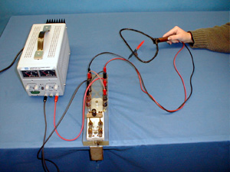
Demos: 6B-01 Oersted's Experiment

Slide 21
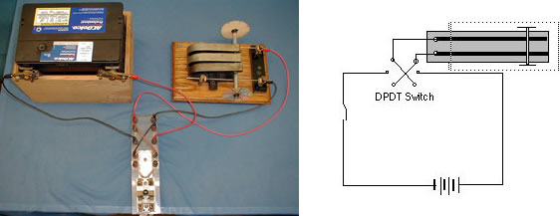
Demos: 6B-06 Magnetic Force on a Current-Carrying Conductor

Slide 22
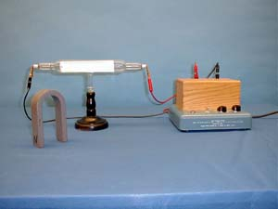
Demos: 6B-02 Force on a Moving Charge

Slide 23
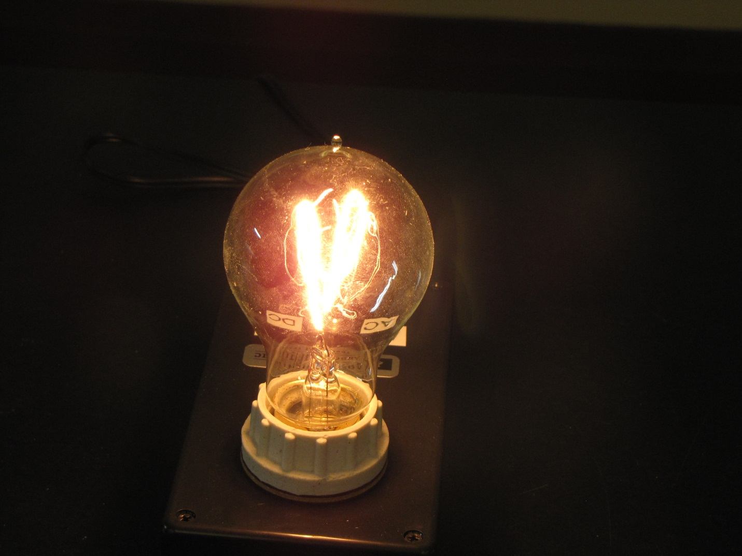
Demos: 6B-17 Electricity and Magnetism Light Bulb
http://www.youtube.com/watch?v=iG0pzGcy4xU&list=PLCE35CBBBFEF6E365

Slide 24
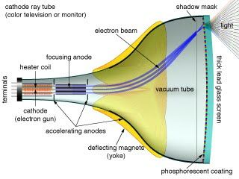
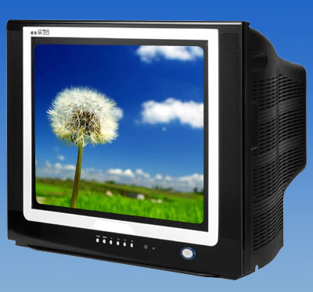
TV with Visible Cathode Ray Tube
When a strong magnet is placed in front of this TV screen, the image shown on TV will most likely
be distorted.
Not affected

Slide 25
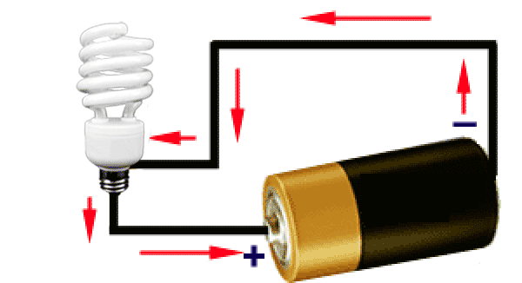
What happens when...
Compass is isolated?
Magnet is near a compass?
Current-carrying wire is near compass?
Notes:
Charles Augustin de Coulomb – French engineer and scientist. Created science of friction (first), after that stopped engineering and became involved full time in physics, in 1785-1791 published 7 papers on electricity and magnetism:
... had obtained some remarkable results by using the torsion balance method: law of attraction and repulsion, the electric point charges, magnetic poles, distribution of electricity on the surface of charged bodies and others. The importance of Coulomb's law for the development of electromagnetism is examined and discussed. In these he developed a theory of attraction and repulsion between bodies of the same and opposite electrical charge. He demonstrated an inverse square law for such forces and went on to examine perfect conductors and dielectrics. He suggested that there was no perfect dielectric, proposing that every substance has a limit above which it will conduct electricity. These fundamental papers put forward the case for action at a distance between electrical charges in a similar way as Newton's theory of gravitation was based on action at a distance between masses.

Slide 26
What happens when...
Compass is isolated?
Points to Earth's (magnetic) North Pole
Magnet is near a compass?
Needle deflects
Current-carrying wire is near compass?
Needle deflects!

Slide 27
Fun Facts: Earth's Magnetic Field
|B_{Earth}| ~ 20 microTesla = 2 x 10⁻⁵ T
Tilted by 11.3 degrees from Rotational Axis
"Sign reversals" throughout Earth's history
http://hyperphysics.phy-astr.gsu.edu/hbase/magnetic/magearth.html
http://www.ngdc.noaa.gov/geomag/WMM/data/WMM2010/WMM2010_F_MERC.pdf
Notes:
Charles Augustin de Coulomb – French engineer and scientist. Created science of friction (first), after that stopped engineering and became involved full time in physics, in 1785-1791 published 7 papers on electricity and magnetism:
... had obtained some remarkable results by using the torsion balance method: law of attraction and repulsion, the electric point charges, magnetic poles, distribution of electricity on the surface of charged bodies and others. The importance of Coulomb's law for the development of electromagnetism is examined and discussed. In these he developed a theory of attraction and repulsion between bodies of the same and opposite electrical charge. He demonstrated an inverse square law for such forces and went on to examine perfect conductors and dielectrics. He suggested that there was no perfect dielectric, proposing that every substance has a limit above which it will conduct electricity. These fundamental papers put forward the case for action at a distance between electrical charges in a similar way as Newton's theory of gravitation was based on action at a distance between masses.

Slide 28
Compass Near a Wire
Depends on amount of current in wire
No current → no Magnetic field (B) from wire
B-field of wire is perpendicular to the wire
What happens when wire is below vs. above compass?
B-field switches direction!
Key Idea: Needle of a compass aligns with the net magnetic field.
Notes:
Charles Augustin de Coulomb – French engineer and scientist. Created science of friction (first), after that stopped engineering and became involved full time in physics, in 1785-1791 published 7 papers on electricity and magnetism:
... had obtained some remarkable results by using the torsion balance method: law of attraction and repulsion, the electric point charges, magnetic poles, distribution of electricity on the surface of charged bodies and others. The importance of Coulomb's law for the development of electromagnetism is examined and discussed. In these he developed a theory of attraction and repulsion between bodies of the same and opposite electrical charge. He demonstrated an inverse square law for such forces and went on to examine perfect conductors and dielectrics. He suggested that there was no perfect dielectric, proposing that every substance has a limit above which it will conduct electricity. These fundamental papers put forward the case for action at a distance between electrical charges in a similar way as Newton's theory of gravitation was based on action at a distance between masses.

Slide 29
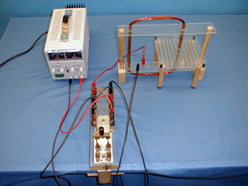
Demos: 6B-03 Magnetic Field Around A Wire

Slide 30
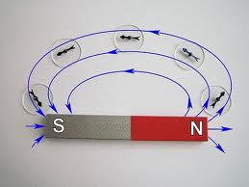
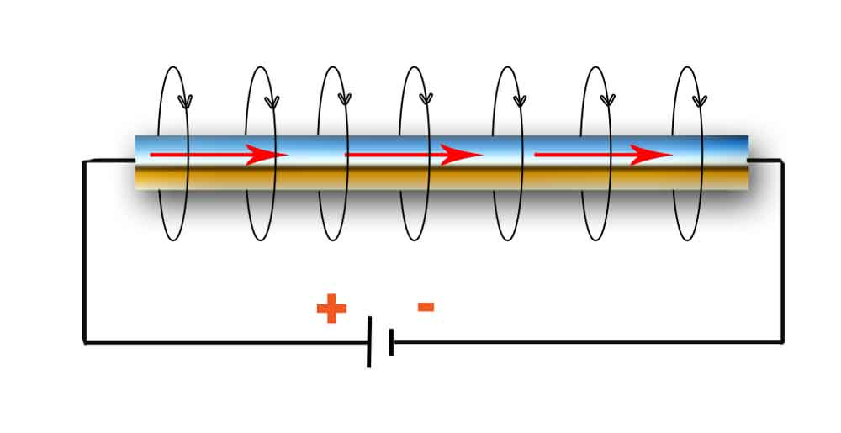
Current and Magnetic Field
Why does the wire act like a magnet?
?
=
Magnetic Field B
Current I
http://physick.wikispaces.com/Electric+Current
Key Idea: Moving charges create a Magnetic Field

Slide 31
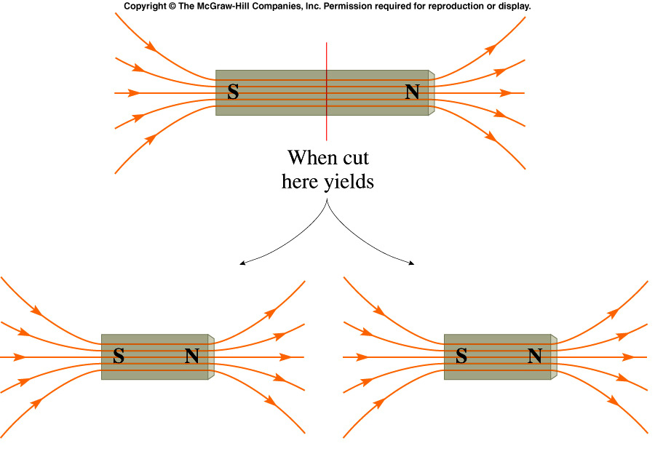
Magnetic Monopoles
Does there exist magnetic charge, just like electric charge? An entity which carried such magnetic charge would be called a magnetic monopole (having + or - magnetic charge).
How can you isolate this magnetic charge? Try cutting a bar magnet in half.
In fact no attempt has been successful in finding magnetic monopoles in nature.
Notes:
Break a bar magnet to demo

Slide 32
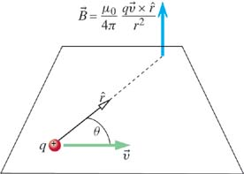
Biot-Savart Law
Key Idea: Moving charges create a Magnetic Field
BIOT-SAVART LAW
point charge
= charge
= velocity of charge
= observation point
(charge at origin)
Notes:
Charles Augustin de Coulomb – French engineer and scientist. Created science of friction (first), after that stopped engineering and became involved full time in physics, in 1785-1791 published 7 papers on electricity and magnetism:
... had obtained some remarkable results by using the torsion balance method: law of attraction and repulsion, the electric point charges, magnetic poles, distribution of electricity on the surface of charged bodies and others. The importance of Coulomb's law for the development of electromagnetism is examined and discussed. In these he developed a theory of attraction and repulsion between bodies of the same and opposite electrical charge. He demonstrated an inverse square law for such forces and went on to examine perfect conductors and dielectrics. He suggested that there was no perfect dielectric, proposing that every substance has a limit above which it will conduct electricity. These fundamental papers put forward the case for action at a distance between electrical charges in a similar way as Newton's theory of gravitation was based on action at a distance between masses.

Slide 33
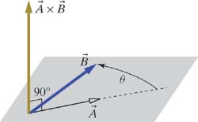
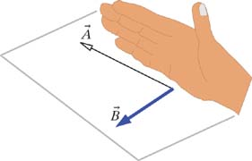
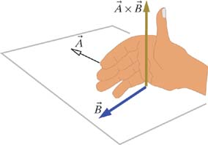
Right-Hand Rule
BIOT-SAVART LAW
point charge
Result of Cross Product
is Perpendicular to both and
Right-Hand Rule:
1)
2)

Slide 34
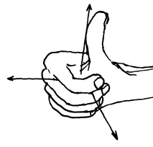
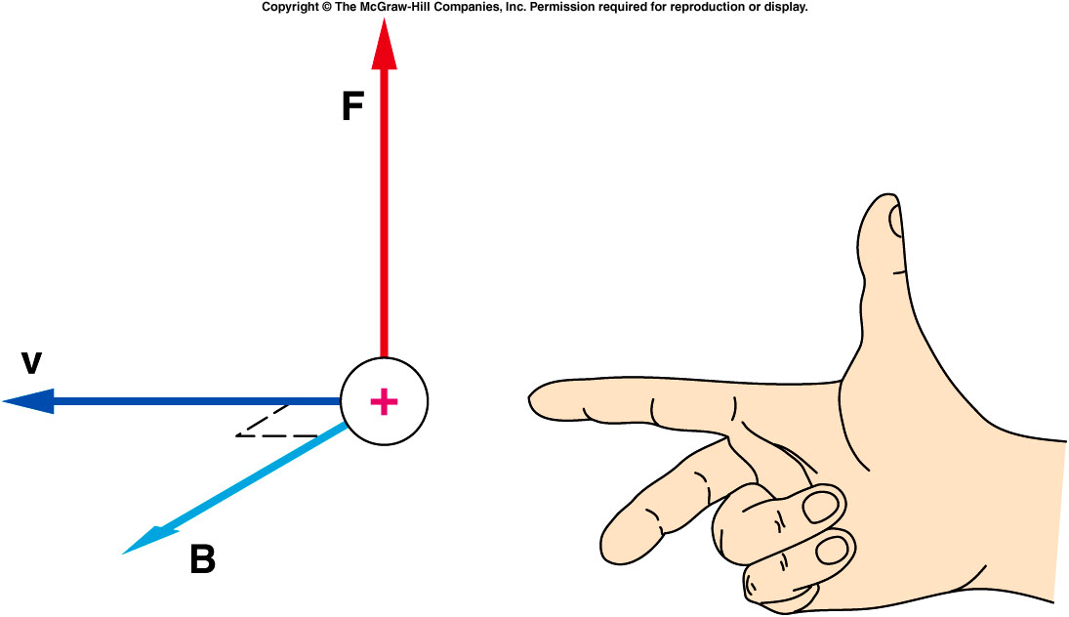
Alternatives to the Right-Hand Rule

Slide 35
iClicker
BIOT-SAVART LAW
point charge
y
A positively charged particle initially
at <3,0,0>m has velocity
x
Which vector has a direction closest
to that of the magnetic field at
position <0,0,3>m?
z
A) <1,0,0> m
B) <0,1,0> m
C) <1,0,1> m
D) <0,1,1> m
Notes:
C

Slide 36
Cross Product: Here's the Math
+ ( - )
+ ( - )
+ ( - )
copy 1st two colums
set up the answer

Slide 37
Cross Product: Here's the Math
+ ( - )
+ ( - )
+ ( - )

Slide 38
Cross Product: Here's the Math
( - ),
( - ),
( - )
The resulting vector has magnitude:

Slide 39
Today
Sources of Magnetic Field
Magnetic Field due to Moving Charges
Cross Products: Right-hand Rule
Cross Products: Mathematically

