Slide 1
Last Time
Review of potential energy
Electric potential energy
Electric Potential (Voltage relative to infinite separation)
Notes:
A fluorescent lamp, or fluorescent tube, is a low-pressure mercury-vapor gas-discharge lamp that uses fluorescence to produce visible light. An electric current in the gas excitesmercury vapor, which produces short-wave ultraviolet light that then causes a phosphorcoating on the inside of the lamp to glow. A fluorescent lamp converts electrical energy into useful light much more efficiently than incandescent lamps

Slide 2
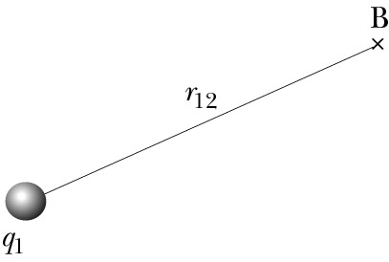

V due to One Particle
Single charge has no electric potential energy
q₂
Single charge has potential to interact with other charge –
it creates electric potential
probe charge
J/C, or Volts

Slide 3
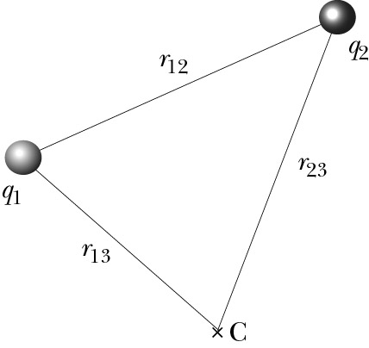
V due to Two Particles
Electric potential is scalar:
Electric potential energy of the system:
q₃
If we add one more charge q₃:

Slide 4
Today
Potential Difference and Electric Field
Path Independence of Potential Difference
Potential at one point
Potential inside a conductor
Potential inside an insulator
Energy stored in a field

Slide 5
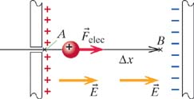
Example
The System = 2 charged plates + proton
Uniform Electric Field
QUESTION: As proton moves from A to B, what is the change in
potential energy of The System?
iClicker: The answer is...
A)
B)
C)
D)
ANSWER:
In a uniform field
Notes:
The system is comprised of the charged capacitor plates and the electron. this example, the electric force is in the direction opposite to the displacement through which the force acts. Remember that e is a number. Also remember that the F in this expression is that due to sources within the system (F_internal).

Slide 6
Example
The System = 2 charged plates + proton
Uniform Electric Field
QUESTION: As proton moves from A to B, what is the change in
potential energy of The System?
ANSWER:
Notes:
The system is comprised of the charged capacitor plates and the electron. this example, the electric force is in the direction opposite to the displacement through which the force acts. Remember that e is a number. Also remember that the F in this expression is that due to sources within the system (F_internal).

Slide 7
Electric Potential
(Uniform field)
The System = 2 charged plates + proton
Uniform Electric Field
In this example, the change in Electric Potential is:
Which is larger, V_{A} or V_{B}?
Positive charges move toward
lower voltages, like water
running down a hill.
Notes:
C
The system is comprised of the charged capacitor plates and the electron. this example, the electric force is in the direction opposite to the displacement through which the force acts. Remember that e is a number. Also remember that the F in this expression is that due to sources within the system (F_internal).

Slide 8
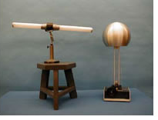
Will the tube light up?
Yes
No
Depend on the tube orentation
5A-16
Notes:
A proof plane is connected to a projectable electrostatic voltmeter rated at 0-300 V. The Van de Graff electrostatic generator is started and the proof plane taken near it. A voltage is registered by the voltmeter indicating a potential associated with the electric field. A potential difference is evident when when the proof plane is moved along a radius. The closer the proof plane is to the sphere, the higher the voltage reading.
a fluorescent bulb is brought near the sphere in one of two ways: First the bulb is held with its long axis oriented along a radius. A potential difference between the ends of the bulb causes it to light. If the bulb is turned 90° so that each end is the same distance from the center of the sphere, the bulb will not light, indicating that the ends are at the same potential.

Slide 9
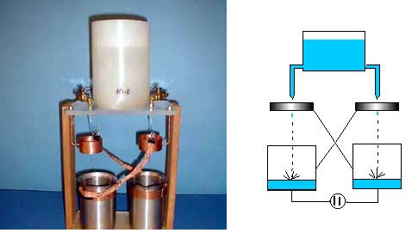
5A-05 Kelvin Water Dropper
Notes:
Two smooth water jets flowing down from a common tank break into droplets within metal collars, and the drops fall into metal cans, insulated from the table top. Each collar is connected to the opposite can, as illustrated. Differing effects of ionized air drifting past the cans insures an initial difference of potential. If, for example, the right hand can becomes momentarily positive, its connected collar becomes positive also. The other can and collar then become negative. The jets of water and the supply tank nozzle form a continuous conductor. The charges on the collar induce opposite charges on the ends of the jets. When the jets break up into droplets, these droplets are charged opposite to the collar and will transfer these charges to the can underneath. Once started, the charges build up very rapidly. One terminal of a neon lamp (or several in series) is attached to one base base plate while the other is approximately 1/8 to 1/4 inch from the other plate. The voltage can build up to 5,000 V or more causing the tube(s) to flash.

Slide 10
What's an eV?
(Uniform field)
The System = 2 charged plates + proton
Uniform Electric Field
An electron-Volt (eV) is the energy required to move q=1e through 1V.
The proton lost of potential energy in this example.
A 10²⁰ eV nucleus (cosmic way) →~10 J. If totally absorbed, can raise a 1kg weight up by 1 meter.
Notes:
C
The system is comprised of the charged capacitor plates and the electron. this example, the electric force is in the direction opposite to the displacement through which the force acts. Remember that e is a number. Also remember that the F in this expression is that due to sources within the system (F_internal).

Slide 11
Potential Difference: The Full Story
Uniform E-Field, E||x:
for uniform E||x
For a uniform E-field pointing in any direction:
If E is not uniform, but varies in space:
POTENTIAL DIFFERENCE
IN NONUNIFORM E-FIELD

Slide 12
Potential Difference: Path Independence
Uniform E-Field:
Uniform E-Field
in a Capacitor

Slide 13
Potential Difference: Path Independence
Uniform E-Field:
d
Particle moves a distance d to the right.
Uniform E-Field
in a Capacitor
Part 1:
a
d
Part 2:
Part 3:
y
Total is Independent of the Path taken
x

Slide 14
Potential Difference: Path Independence
f
i
Path independence principle:
ΔV between two points does not depend on integration path

Slide 15
Potential Difference and Electric Field
i
dl
F
f
For very short path:
Example: E = 3.10⁶ N/C, Δl = 1 mm:

Slide 16
Example: Different Paths near Point Charge
1. Along straight radial path:
r_{f}
r_{i}
Origin at +q
+q
Notes:
For final r greater than initial r, the change in potential is less than zero as expected since the path direction is the same as that of the electric field. Likewise, if we go from a larger r to a small r, the potential increases.

Slide 17
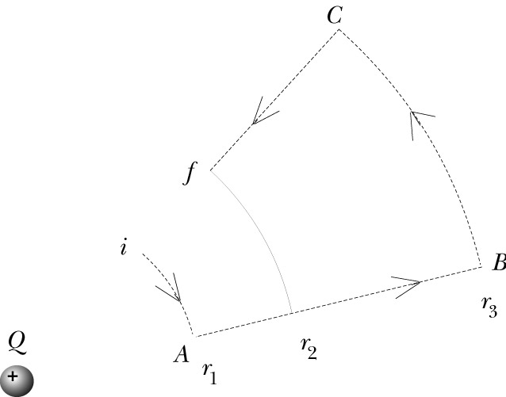
Example: Different Paths near Point Charge
2. Special case
iA:
AB:
BC:
+
Cf:

Slide 18
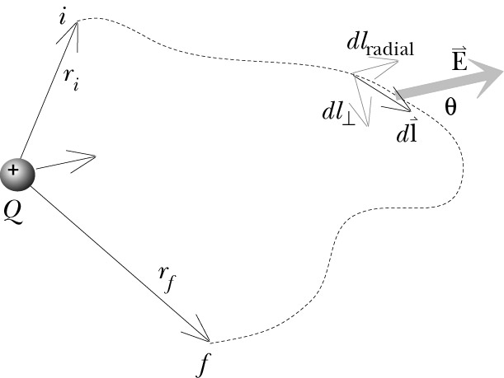
Example: Different Paths near Point Charge
3. Arbitrary path
+

Slide 19
Potential at a Single Point?
Definition of
Potential Difference
Potential at a single point is the potential relative to infinite separation
What does this equation imply about ?
We define the potential at infinity
to be zero, by convention.

Slide 20
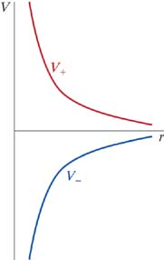
Potential of a point charge
Positive Charge
Potential of a
Point Charge
Negative Charge

Slide 21
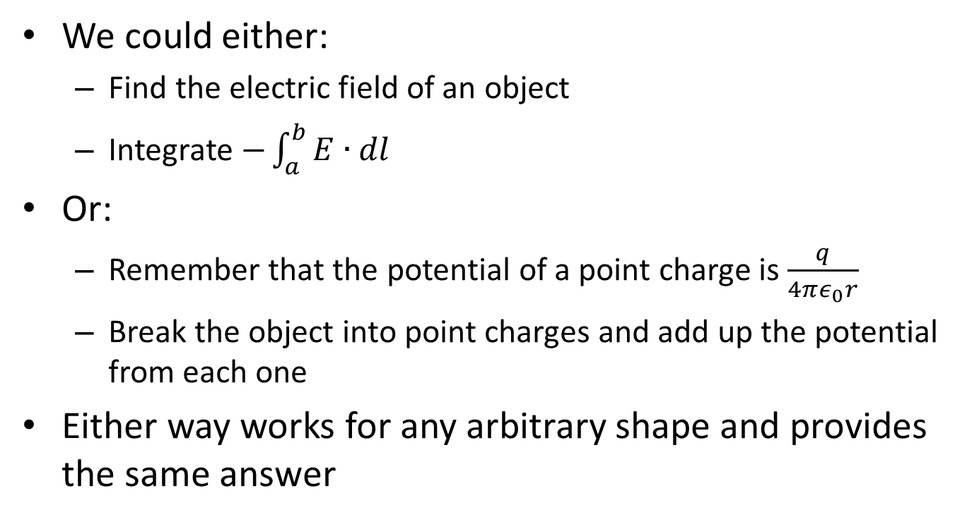
Two ways to get the potential
This odd shape can be broken into point charges. They can be used directly to find the electric field or potential.
++=++++++++++++++++++++++++++++++++++++++++++++++++++++++++++++++

Slide 22
iClicker question
Does knowing the electric field at one point (and only that one point) allow you to calculate the electric potential at that point?
Yes
No
Notes:
b

Slide 23
iClicker
The electric field is zero inside a conductor. What does this mean for the electric potential?
The electric potential must be zero inside the conductor
The electric potential must go to zero on the surface of the conductor, but on both the inside and outside, it can do anything.
The electric potential is constant inside the conductor
Notes:
C

Slide 24
Inside a Metal
For a metal in EQUILIBRIUM, E = 0 inside,
and the potential is constant:
E=0
V is constant
E not = 0, V changes
+
point charge
metal @ equilibrium

Slide 25
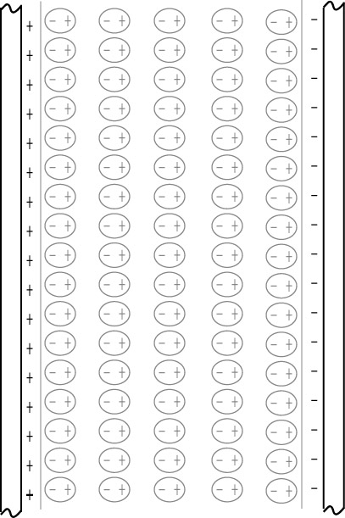
Potential Difference in an Insulator
Electric field in capacitor filled with insulator: E_{net}=E_{plates}+E_{dipoles}
E_{plates}=const (in capacitor)
E_{dipoles}=f(x,y,z)
E_{dipoles,A}
E_{dipoles,B}
A
B
Travel from B to A:
E_{dipoles} is sometimes parallel to dl, and sometimes antiparallel to dl
Average Field from induced dipoles
is opposite to the field from the plates
Effect of dielectric is to reduce the potential difference.
1
2
3
4
5
Notes:
Situation in insulator is more complex than in metals.
Polarized molecules contribute to net electric field
A … inside ”capacitor”
B … between two “capacitors”

Slide 26
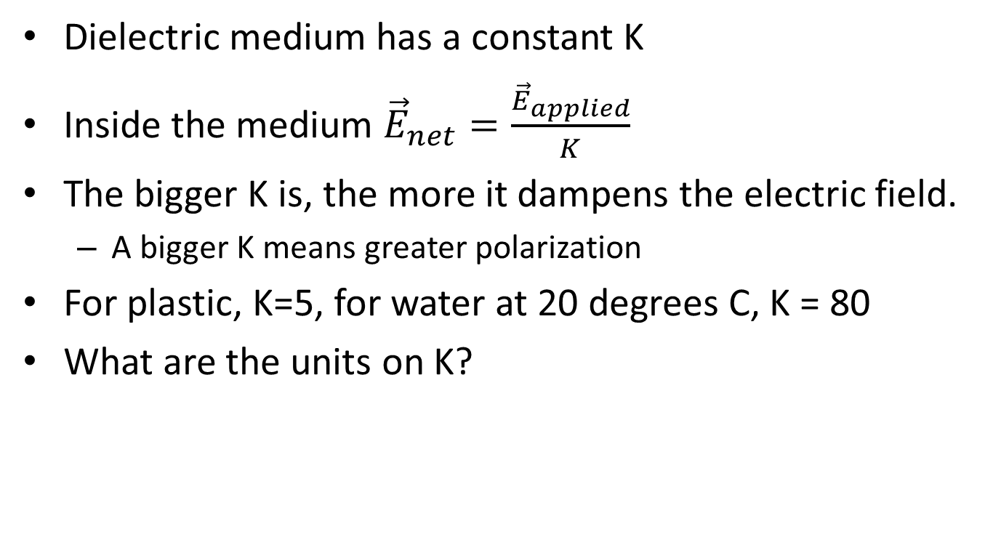
Dielectric constant
vacuum 1 (by definition)
air 1.0006
typical plastic 5
NaCl 6.1
water 80
strontium titanate 310

Slide 27
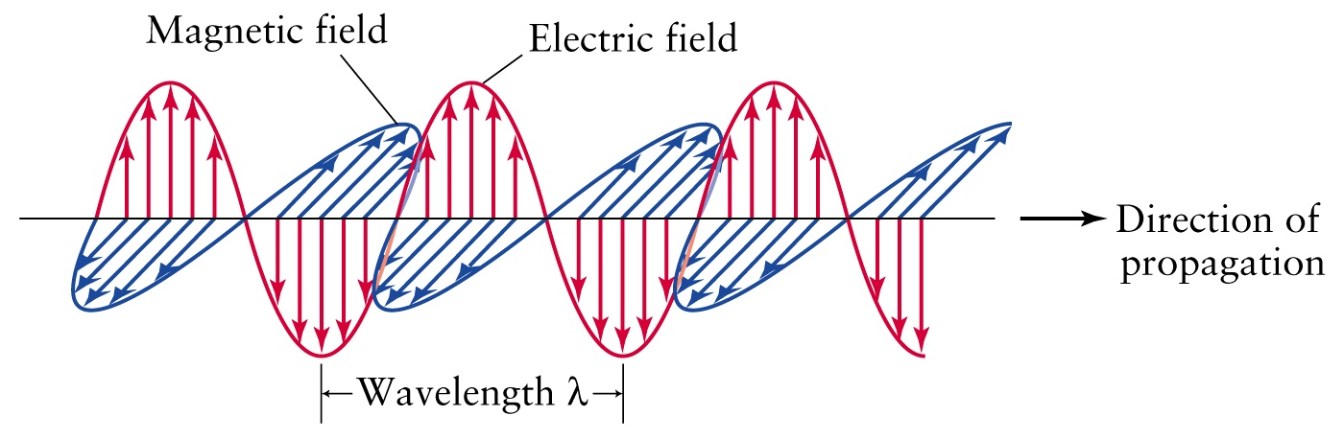
Energy stored in a field
Rather than potential energy, we can talk about the energy of the EM field
This is useful because radiation (e.g. light) carries energy, and we may want to know how much
Instead of a change in potential energy, we can say that rearranging charges changes the field energy
What is the energy density of a field (Energy/m³)?
PHOTON:
http://www.physast.uga.edu/~jss/1010/ch5/ovhd05.html

Slide 28
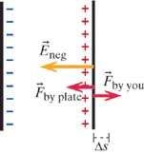
iClicker question
Inside a capacitor:
To find the field energy density, let’s start by thinking about work
Consider a capacitor with two plates. The charge on each plate is +Q and –Q
How much work does it take to move the second plate a distance Δs
0
(Q/Aε_{ο}) Δs
(Q²/Aε_{ο}) Δs
d) (Q²/2Aε_{ο}) Δs
Notes:
d – use the field due to ONE PLATE ONLY

Slide 29
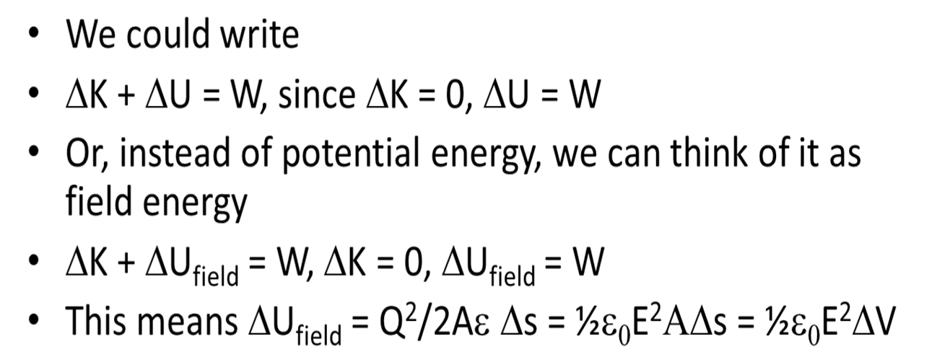
Field energy density
W = (Q²/2Aε_{ο}) Δs
o
Volume
ELECTRIC FIELD
ENERGY
DENSITY
So the Energy Density is:

Slide 30
iClicker Question
300 V/m
0 V/m
300 V/m
A
B
0.02m
0.03m
0.04m
What is V_{B}-V_{A?}
270 V
-270 V
-18 V
6 V
-6 V
Notes:
D

