Slide 1
EXAM1
Wednesday, Feb. 7, 2:30pm-3:20 pm
room 112
Chapters 13, 14, & 15 (textbook 4th edition)
Special needs, e.g. exam time extension, and has not contact me before, please bring me the letter from the Office of the Dean of Students before the end of 01/31 (Wednesday).
AOB
  multiple choice.
  Prepare your own scratch paper, pens, pencils, erasers, etc.
  Use only pencil for the answer sheet
  Bring your own calculators (scientific or graphic)
  No cell phones, no text messaging which is considered cheating.
  No crib sheet of any kind is allowed. Equation sheet will be provided.
  10 problems in total.

Slide 2
Last Time
Electric field of a hollow sphere
Electric field of a solid sphere
+
+
+
+
+
+
+
+
+
+
E = 0
+
+
+
+
INSIDE
THE SPHERE
+
+
OUTSIDE
THE SPHERE
+
+
+
+
+
+
+
+
INSIDE
THE SPHERE
OUTSIDE
THE SPHERE

Slide 3
Today
Review of potential energy
Electric potential
Potential due to charges

Slide 4
Review: Single Particle Energy
Energy of a Single Particle:
Rest energy
Kinetic Energy (v<<c)
The Energy Principle for a Particle:
W = Work done ON the particle
If the rest energy does not change,

Slide 5
iClicker
A horizontal force of 10 N pushes a bead along a wire. The wire has a length of 25 m. The horizontal displacement of the bead when it reaches the end of the wire is 10m. The vertical displacement is 1m. How much work was done moving the bead? Ignore gravity.
10 J
250 J
100 J
100 N
Need to specify the path to get the result
L=25m
dx
dx
F=10 N
dx
dx
Δy = 1 m
Δx=10 m
Notes:
C

Slide 6
Review: Multiparticle Energy Principle
Energy Principle for Each Particle:
1
2
Work done ON particle 1
Work done ON particle 2

Slide 7
Review: Multiparticle Energy Principle
Energy Principle for Each Particle:
1
2
Work done ON particle 1
Work done ON particle 2
Total change in
Single Particle Energies

Slide 8
Review: Potential Energy
Total change in
Single Particle Energies
1
2
just rearrange!
Change in Kinetic Energy
+ Change in Potential Energy
of The System
Potential Energy
is Meaningless
for a Single Particle

Slide 9
Potential energy of charges
Remember: potential energy comes from interaction of TWO objects
We can find potential energy by checking the interaction of 2 particles
q1
q2
Hold q1 fixed and move q2.
How much work do we have to do?

Slide 10

Work to move q₂
q1
q2
r
a
b
Work we have to do
against q1’s influence

Slide 11
Where did the Energy go?
q1
q2
r
a
b
Assume v_{f} = v_{i} -- Then ΔK = 0.
Work always changes E_{sys}, so the potential energy must have changed:
Work done by
the surroundings
(our hand)
ELECTRIC
POTENTIAL
ENERGY

Slide 12
iClicker
Two particles with charge q sit a distance d apart. What is the potential energy of the system, including both particles?
2q1q2/4πε₀d
q1q2/4πε₀d
2q1q2/4πε₀d²
q1q2/4πε₀d²
q1
d
q2
Notes:
b

Slide 13


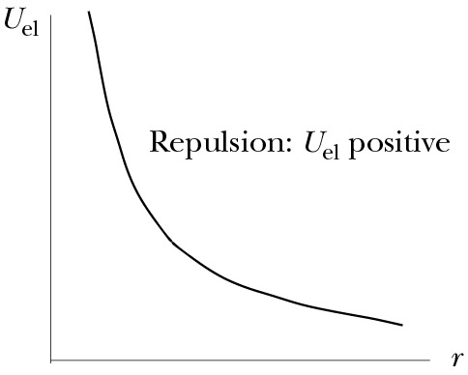
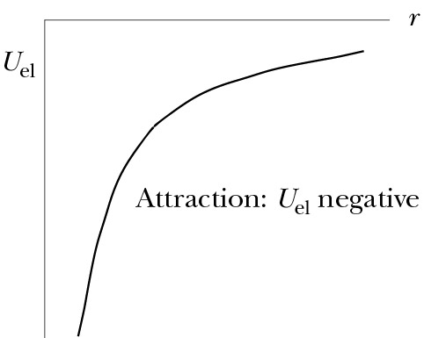
Electric Potential Energy of Two Particles
q₂
q₂
q₁
q₁
U_{el} > 0 for two like charges
(repulsion)
U_{el} < 0 for two opposite charges
(attraction)

Slide 14
Electric and Gravitational Potential Energy
q₂
m₂
q₁
m₁

Slide 15
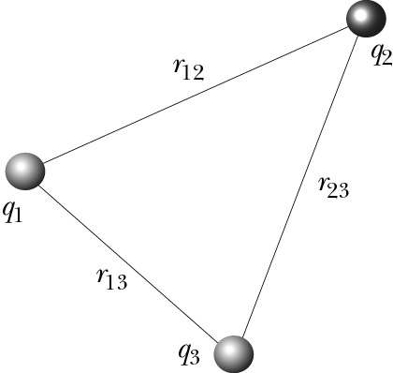
Three Electric Charges
Interaction between q₁ and q₂ is independent of q₃
There are three interacting pairs:
q₁ ↔ q₂
q₂ ↔ q₃
q₃ ↔ q₁
U₁₂
U₂₃
U₃₁
U= U₁₂+ U₂₃+ U₃₁

Slide 16
Multiple Electric Charges
q₁
q₃
q₆
Each (i,j) pair interacts:
potential energy U_{ij}
q₂
q₅
q₄

Slide 17
Electric Potential
Electric potential ≡ electric potential energy per unit charge
Units: J/C = V (Volt)
Volts per meter = Newtons per Coulomb
Electric potential – often called potential
Electric potential difference – often called voltage

Slide 18
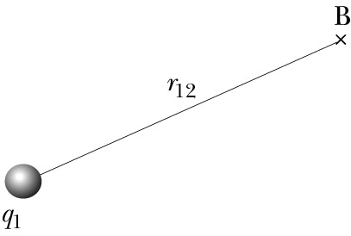
V due to One Particle
Single charge has no electric potential energy
q₂
Single charge has potential to interact with other charge –
it creates electric potential
probe charge
J/C, or Volts

Slide 19
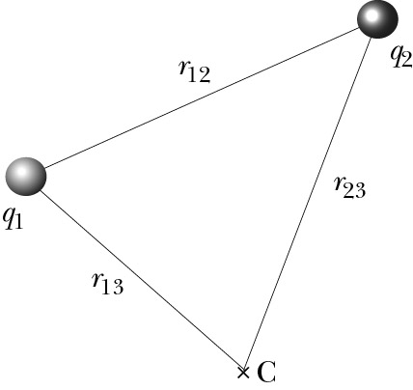
V due to Two Particles
Electric potential is scalar:
Electric potential energy of the system:
q₃
If we add one more charge q₃:

Slide 20
iClicker Questions
One negative charge perform a constant speed circular motion around a positive charge on a flat table. What happens to the electric potential energy of the system?
Keep on changing since the velocity direction change all the time.
Is a constant since the potential energy has nothing to do with the direction of velocity
Need to specify the direction of the external force
Potential energy is always zero since gravity does not play a role here.

Slide 21
Today
Review of potential energy
Electric potential
Potential due to charges

Slide 22
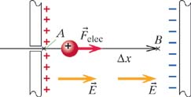
Example
The System = 2 charged plates + proton
Uniform Electric Field
QUESTION: As proton moves from A to B, what is the change in
potential energy of The System?
iClicker: The answer is...
A)
B)
C)
D)
ANSWER:
In a uniform field
Notes:
C
The system is comprised of the charged capacitor plates and the electron. this example, the electric force is in the direction opposite to the displacement through which the force acts. Remember that e is a number. Also remember that the F in this expression is that due to sources within the system (F_internal).

Slide 23
Example
The System = 2 charged plates + proton
Uniform Electric Field
QUESTION: As proton moves from A to B, what is the change in
potential energy of The System?
ANSWER:
Notes:
C
The system is comprised of the charged capacitor plates and the electron. this example, the electric force is in the direction opposite to the displacement through which the force acts. Remember that e is a number. Also remember that the F in this expression is that due to sources within the system (F_internal).

Slide 24
Electric Potential
With the "test charge" (proton)
in the capacitor, there is potential energy
between the proton and capacitor.
Remove the "test charge" (proton)
→ E-field due to plates is still present
ELECTRIC POTENTIAL
is "the potential" to have potential energy
if a test charge enters the system
Notes:
C
The system is comprised of the charged capacitor plates and the electron. this example, the electric force is in the direction opposite to the displacement through which the force acts. Remember that e is a number. Also remember that the F in this expression is that due to sources within the system (F_internal).

Slide 25
Electric Potential
(Uniform field)
The System = 2 charged plates + proton
Uniform Electric Field
Test Charge
This part exists independent of the test charge.
It is "the potential" to have a potential energy difference
This part is "The Potential Difference"
Notes:
C
The system is comprised of the charged capacitor plates and the electron. this example, the electric force is in the direction opposite to the displacement through which the force acts. Remember that e is a number. Also remember that the F in this expression is that due to sources within the system (F_internal).

Slide 26
Electric Potential
(Uniform field)
The System = 2 charged plates + proton
Uniform Electric Field
V has units of "Volts"
Units of Electric Field
Notes:
C
The system is comprised of the charged capacitor plates and the electron. this example, the electric force is in the direction opposite to the displacement through which the force acts. Remember that e is a number. Also remember that the F in this expression is that due to sources within the system (F_internal).

Slide 27
Electric Potential
(Uniform field)
The System = 2 charged plates + proton
Uniform Electric Field
In this example, the change in Electric Potential is:
Which is larger, V_{A} or V_{B}?
Positive charges move toward
lower voltages, like water
running down a hill.
Notes:
C
The system is comprised of the charged capacitor plates and the electron. this example, the electric force is in the direction opposite to the displacement through which the force acts. Remember that e is a number. Also remember that the F in this expression is that due to sources within the system (F_internal).

Slide 28
What's an eV?
(Uniform field)
The System = 2 charged plates + proton
Uniform Electric Field
An electron-Volt (eV) is the energy required to move q=1e through 1V.
The proton lost of potential energy in this example.
Notes:
C
The system is comprised of the charged capacitor plates and the electron. this example, the electric force is in the direction opposite to the displacement through which the force acts. Remember that e is a number. Also remember that the F in this expression is that due to sources within the system (F_internal).

Slide 29
Potential Difference: The Full Story
Uniform E-Field, E||x:
for uniform E||x
For a uniform E-field pointing in any direction:
If E is not uniform, but varies in space:
POTENTIAL DIFFERENCE
IN NONUNIFORM E-FIELD

Slide 30
Potential Difference: Path Independence
Uniform E-Field:
Uniform E-Field
in a Capacitor

Slide 31
Potential Difference: Path Independence
Uniform E-Field:
d
Particle moves a distance d to the right.
Uniform E-Field
in a Capacitor
Part 1:
a
d
Part 2:
Part 3:
y
Total is Independent of the Path taken
x

Slide 32
Potential Difference: Path Independence
f
i
Path independence principle:
ΔV between two points does not depend on integration path

Slide 33
Today
Electric Potential (Voltage relative to infinite separation)
Potential Difference and Electric Field
Path Independence of Potential Difference

Slide 34
Potential Difference and Electric Field
i
dl
F
f
For very short path:
Example: E = 3.10⁶ N/C, Δl = 1 mm:

Slide 35
Example: Different Paths near Point Charge
1. Along straight radial path:
r_{f}
r_{i}
Origin at +q
+q
Notes:
For final r greater than initial r, the change in potential is less than zero as expected since the path direction is the same as that of the electric field. Likewise, if we go from a larger r to a small r, the potential increases.

Slide 36
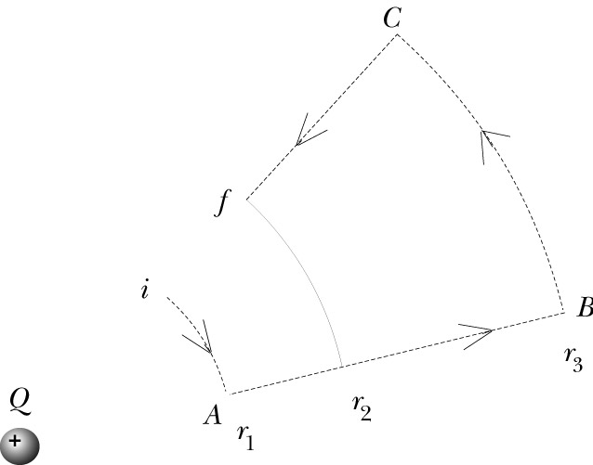
Example: Different Paths near Point Charge
2. Special case
iA:
AB:
BC:
+
Cf:

Slide 37
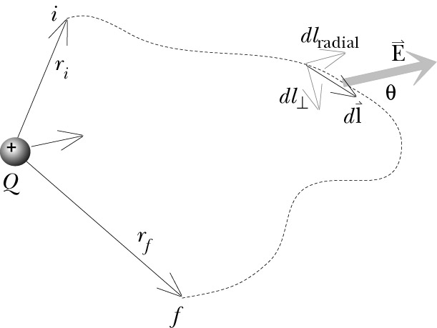
Example: Different Paths near Point Charge
3. Arbitrary path
+

