Slide 1
EXAM1
Wednesday, Feb. 7, 2:30pm-3:20 pm
room 112
Chapters 13, 14, & 15 (textbook 4th edition)
Special needs, e.g. exam time extension, and has not contact me before, please bring me the letter from the Office of the Dean of Students before the end of 01/31 (Wednesday).
AOB
  multiple choice.
  Prepare your own scratch paper, pens, pencils, erasers, etc.
  Use only pencil for the answer sheet
  Bring your own calculators (scientific or graphic)
  No cell phones, no text messaging which is considered cheating.
  No crib sheet of any kind is allowed. Equation sheet will be provided.
  10 problems in total.

Slide 2
Last Time
FIELD OF RING
ALONG AXIS
Ring
FIELD OF DISK
ALONG AXIS
Disk
Infinite
Plane
Two Infinite
Planes
+
+
-

Slide 3
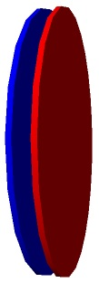
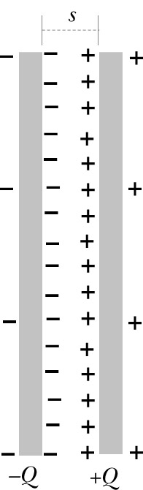
Capacitor
Two disks of opposite charges, s<<R:
charges distribute uniformly:
-Q
+Q
Almost all the charge is nearly uniformly distributed on the inner surfaces of the disks; very little charge on the outer surfaces.
We will calculate E both inside and outside of the disk close to the center
s
Notes:
We will use the previous result for disks made of insulating material.

Slide 4
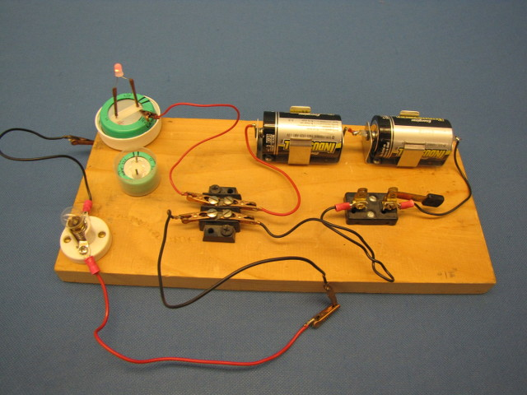
Demos: 6C-14
Notes:
Also show the dissembled capacitor

Slide 5
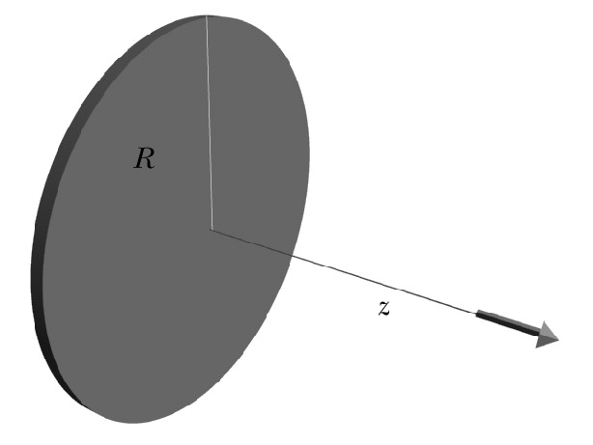
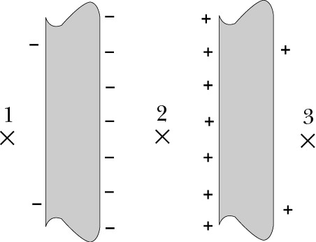
Step 1: Cut Charge Distribution into Pieces
We know the field for a single disk
There are only 2 “pieces”
-Q
+Q
E₊
E_{net}
s
E₋
Notes:
Note that our diagram shows that each metal disk has almost the entire charge Q on the surface facing the other disk! This allows us to use the previous result to a good approximation. Treat each disk as if it had zero thickness.

Slide 6
Step 2: Contribution of one Piece
Origin: left disk, center
Location of disks: z=0, z=s
Distance from disk to ⊗2
z, (s-z)
E₊
E_{net}
Left:
E₋
Right:
s
z
0
Notes:
Note that are making the approximation that all of the charge lies on the facing surfaces and thus the small amount of charge on the outside surfaces do not contribute to E.

Slide 7
Step 3: Add up Contributions
Location: ⊗2 (inside a capacitor)
E_{net}
E₊
E₋
s
z
0
← Does not depend on z
When s << R,

Slide 8
Step 3: Add up Contributions
Location: ⊗3 (fringe field)
E_{net}
E₊
E₋
s
z
0
For s<<R: E₁=E₃≈0
Fringe field is very small compared to the field inside the capacitor.
Far from the capacitor (z>>R>>s): E₁=E₃~1/z³ (like dipole)
Notes:
Note that we are dealing only with magnitudes of the electric fields here. Must take care when superimposing (summing) the contributions from the negative and positive plates.
Note also that the fringe field points in a direction that would “discharge” the capacitor if connected in a circuit. That is, electrons would be drawn towards the positive plate.

Slide 9
Electric Field of a Capacitor
Inside:
E₊
E_{net}
Fringe:
E₋
s
Step 4: check the results:
z
0
☑
Units:

Slide 10
Exercise
Given: capacitor, radius R=50 cm, gap s=1 mm (air).
Find: maximum charge before sparks are formed (E_{crit}=3×10⁶ N/C)
Solution:
What is the attractive force between the plates?
F=QE= (2.1×10⁻⁵C)(3×10⁶ N/C)=63 N
F=Q(E_{crit}/2)= (2.1×10⁻⁵C)(3×10⁶/2 N/C)=31.5 N
Notes:
The second equation is correct since the electric field of one plate is Ecrit/2 and it acts on the Q of the other plate.

Slide 11
More for Today
Electric field of a hollow sphere
Electric field of a solid sphere
+
+
+
+
+
+
+
+
+
+
E = 0
+
+
+
+
INSIDE
THE SPHERE
+
+
OUTSIDE
THE SPHERE
+
+
+
+
+
+
+
+
INSIDE
THE SPHERE
OUTSIDE
THE SPHERE

Slide 12
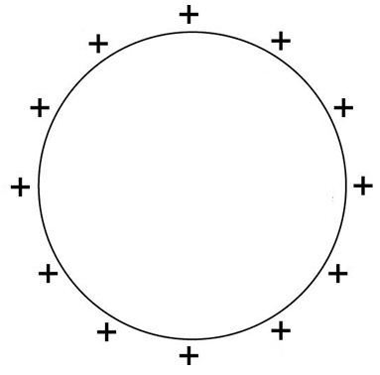
Insulating Spherical Shell
Total Charge = Q
Area = 4πR²
Charge Density = Q/(4πR²)
(How did I know to use
area, and not volume?)

Slide 13
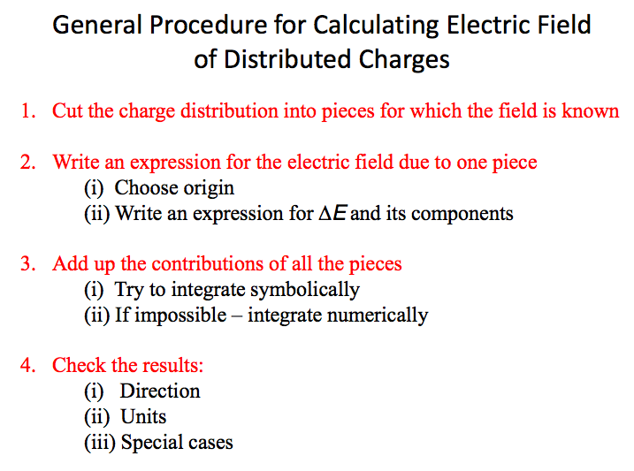
Notes:
ROD, RING, DISK, PLANE...
Sphere? It will work, but it will be a LOT of work....
Later, Gauss’ Law will make this easy peazy lemon squeezy.

Slide 14
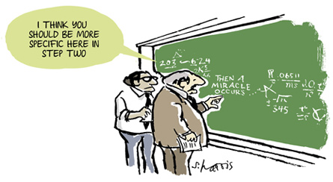
General Procedure – NOT!
We integrated the charge density to find the total field E for:
- Rod, Ring, Disk, Plane.
For a the spherical shell, it’s a LOT more work.
Later, we will learn Gauss’ Law, a sneaky trick for calculating these fields.
For now, let’s use SYMMETRY, and skip the actual calculation.
Notes:
There is no animation, but no one could tell even if we had rotated the sphere.

Slide 15
Symmetries of a sphere
What direction do you expect for E?
→ Watch this animated rotation closely:
E field has the
same symmetries
as the sphere
Did You
See It?
In physics, if you can't tell the difference, there is no difference!
Notes:
There is no animation, but no one could tell even if we had rotated the sphere.

Slide 16
Electric field from far away
From far away, every charged object looks like a point charge
I'm still here
Far from Sphere: Looks EXACTLY like a point charge

Slide 17
E Outside Insulating Spherical Shell
Total Charge = Q
Area = 4πR²
Charge Density = Q/(4πR²)
Combine these 2 ideas:
1) E has same symmetries as the sphere.
2) Far away, looks like point charge.
E field has the
same symmetries
as the sphere
FIELD OUTSIDE
SPHERICAL SHELL
for r > R

Slide 18
iClicker question
A charged insulating sphere with Q sits a distance D from a point charge q. Is the force that the point charge q exerts on the sphere the same as the force that the point charge would exert on another point charge Q?
Yes
No
Hint: Newton’s Laws
How do we know?
Q
q
D
Notes:
a)

Slide 19
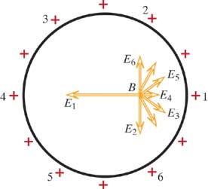
E Inside the Spherical Shell
For uniformly charged shell.
+
+
+
+
+
+
E = 0
Inside
+
+
+
+
+
+
Complete Cancellation
Everywhere Inside!
Notes:
Use conducting sphere for comparison to prove field inside is zero since charge is also uniformly distributed on shell.

Slide 20
Summary: E of an Insulating Spherical Shell
+
+
+
+
+
+
E = 0
Inside
+
+
+
+
+
+
for r > R
for r < R

Slide 21
iClicker question
A metal shell uniformly charged with Q, is filled with plastic materials. Will the plastic materials be polarized?
Yes
No
Q

Slide 22
iClicker question
A plastic shell uniformly charged with Q, is filled with plastic materials. Will the plastic materials be polarized?
Yes
No
Q

Slide 23
iClicker question
A point charge q2 is placed inside a charged plastic spherical shell with Q. There is a point change q1 outside the shell . The distance between q1 and q2 is D. What’s the force between q1 and q2? (note: neglect the small polarization effect).
Kq1q2/D²
Kq2/D²
Kq1/D²
Too complicated to calculated in 1 minutes.
Dependent on the location of t q2 (same D)
Q
q2
q1
D

Slide 24
E Inside the Insulating Spherical Shell
+
+
+
+
+
Put a
Negative
Charge
Inside
+
+
-
+
+
+
+
+
What is the field inside now?
What force is on the negative charge?
What if the sphere were conducting?
Notes:
For insulator, field is not zero but the force on the negative charge is zero since external field is zero.
In case of conductor, the force is not zero since induced positive charge is closer than the equal amount of negative charge, i.e. attractive force.

Slide 25
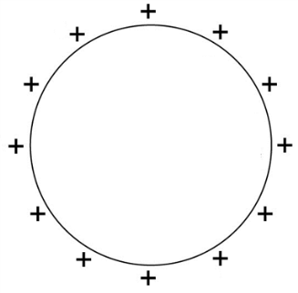
First: Two Spherical Shells
for r > R
FIELD OF ONE
SPHERICAL SHELL
for r < R
Goal: Build up the solid sphere out of spherical shells.
First: What about only TWO spherical shells?
+
+
+
+
+
+
+
+
+
+
+
+

Slide 26
iClicker: Two Spherical Shells
for r > R
FIELD OF ONE
SPHERICAL SHELL
for r < R
Two concentric insulating spherical shells each have charge +Q.
+
What is E between the two shells?
+
+
+
+
A)
+
+
B)
+
+
+
+
+
C)
Notes:
B

Slide 27
First: Two Spherical Shells
for r > R
FIELD OF ONE
SPHERICAL SHELL
for r < R
Goal: Build up the solid sphere out of spherical shells.
First: What about only TWO spherical shells? Assume radii a < b.
+
+
+
for r > b
+
+
for a < r < b
+
+
for r < a
+
+
+
+
Field outside of both shells is sum of both shells.
+

Slide 28
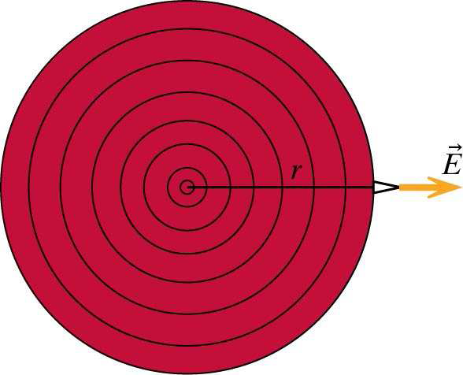
Electric field of a solid sphere
for r > R
FIELD OF ONE
SPHERICAL SHELL
for r < R
Make a solid sphere by adding up concentric spherical shells.
First: What is the field outside of all of the spherical shells?
Let each “shell” have charge Q.
What is the field outside of all 8 shells?

Slide 29
Electric field of a solid sphere
How can we build a solid sphere out of hollow spheres?
→ Build it out of several concentric hollow spheres
→ Add up their fields

Slide 30
Building up the Solid Sphere
Total Charge:
Total Volume:
Charge
Volume
R

Slide 31
Building up the Solid Sphere
Total Charge:
Total Volume:
Charge
Volume
Uniform charge means
these are the SAME
What if we stop here at r?
Assume: Charge distributed uniformly
Charge so far:
r
Volume so far:
Charge
Volume
R

Slide 32
Building up the Solid Sphere
Charge
Volume
Charge
Volume
Charge so far:
Electric Field so far:
r
E-FIELD
INSIDE
SPHERE
for
r < R
R

Slide 33
What We Did Today
Electric field of a hollow sphere
Electric field of a solid sphere
+
+
+
+
+
+
+
+
+
+
E = 0
+
+
+
+
INSIDE
THE SPHERE
+
+
OUTSIDE
THE SPHERE
+
+
+
+
+
+
+
+
INSIDE
THE SPHERE
OUTSIDE
THE SPHERE

Slide 34
backups

Slide 35
Review: Single Particle Energy
Energy of a Single Particle:
Rest energy
Kinetic Energy (v<<c)
The Energy Principle for a Particle:
W = Work done ON the particle
If the rest energy does not change,

Slide 36
iClicker
A horizontal force of 10 N pushes a bead along a wire. The wire has a length of 25 m. The horizontal displacement of the bead when it reaches the end of the wire is 10m. The vertical displacement is 1m. How much work was done moving the bead? Ignore gravity.
10 J
250 J
100 J
100 N
L=25m
dx
dx
F=10 N
dx
dx
Δy = 1 m
Δx=10 m

Slide 37
Review: Multiparticle Energy Principle
Energy Principle for Each Particle:
1
2
Work done ON particle 1
Work done ON particle 2

Slide 38
Review: Multiparticle Energy Principle
Energy Principle for Each Particle:
1
2
Work done ON particle 1
Work done ON particle 2
Total change in
Single Particle Energies

Slide 39
Review: Potential Energy
Total change in
Single Particle Energies
1
2
just rearrange!
Change in Kinetic Energy
+ Change in Potential Energy
of The System
Potential Energy
is Meaningless
for a Single Particle

Slide 40
Potential energy of charges
Remember: potential energy comes from interaction of TWO objects
We can find potential energy by checking the interaction of 2 particles
q1
q2
Hold q1 fixed and move q2.
How much work do we have to do?

Slide 41

Work to move q₂
q1
q2
r
a
b
Work we have to do
against q1’s influence

Slide 42
Where did the Energy go?
q1
q2
r
a
b
Assume v_{f} = v_{i} -- Then ΔK = 0.
Work always changes E_{sys}, so the potential energy must have changed:
Work done by
the surroundings
(our hand)
ELECTRIC
POTENTIAL
ENERGY

