Slide 1
EXAM1
Wednesday, Feb. 7, 2:30pm-3:20 pm
room 112
Chapters 13, 14, & 15 (textbook 4th edition)
Special needs, e.g. exam time extension, and has not contact me before, please bring me the letter from the Office of the Dean of Students before the end of 01/31 (Wednesday).
AOB
  multiple choice.
  Prepare your own scratch paper, pens, pencils, erasers, etc.
  Use only pencil for the answer sheet
  Bring your own calculators (scientific or graphic)
  No cell phones, no text messaging which is considered cheating.
  No crib sheet of any kind is allowed. Equation sheet will be provided.
  10 problems in total.

Slide 2
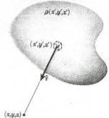
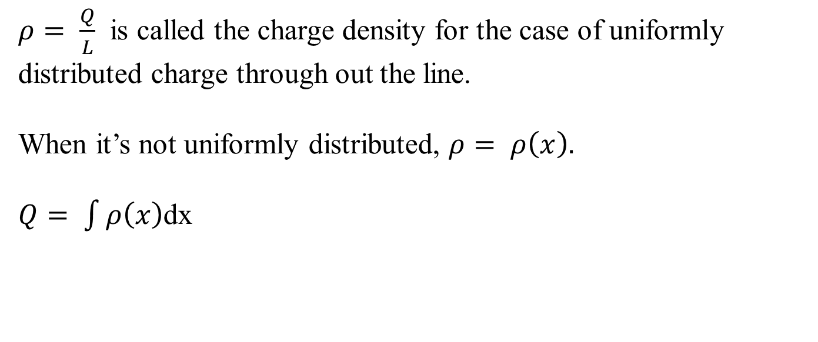
Calculus We Will Need
$ρ= \frac{Q}{L}$ is called the charge density for the case of uniformly distributed charge through out the line.
When it’s not uniformly distributed, $ρ= ρ\left(x\right).$
$Q= \int{ρ\left(x\right)}$dx
For 3-D case:

Slide 3
iClicker Question
What does the Electric Field look like when
viewing the positively charged rod from the top?
A)
B)
+ + + + + + + + + + + + + + + + + + + + + + + + + + + + + + + + + + + + + + + + + + + +
C)
D)
Notes:
A

Slide 4
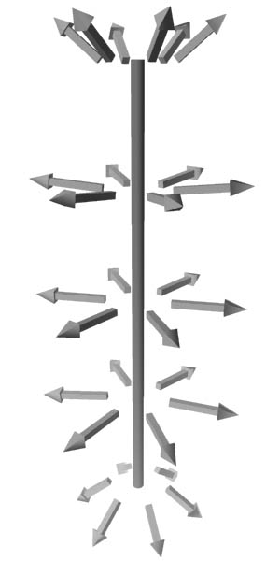
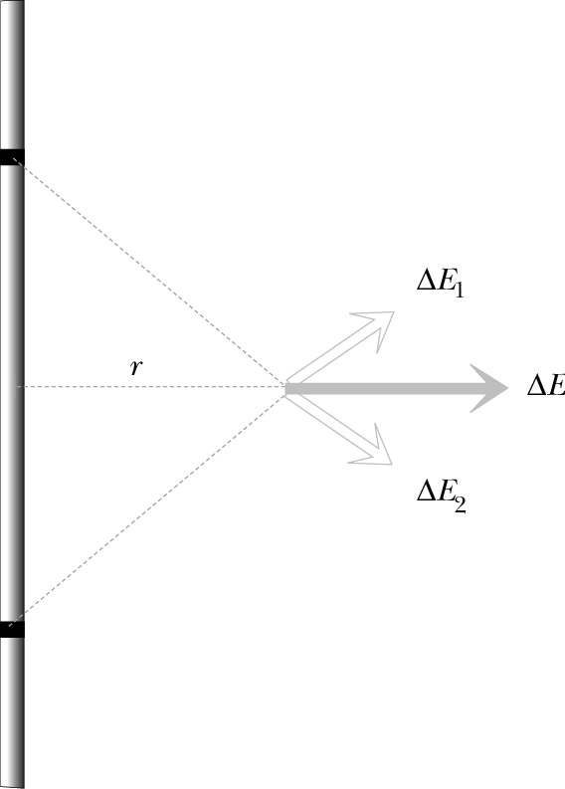
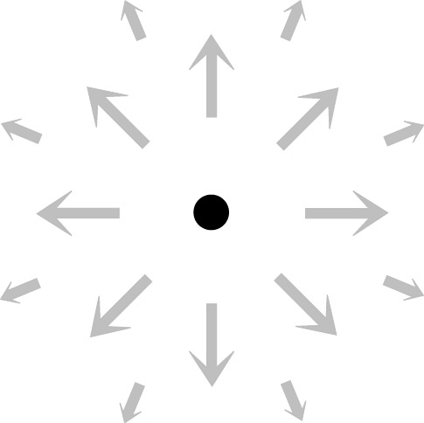
Uniformly Charged Thin Rod
Length: L
Charge: Q
What is the pattern of electric field
around the rod?
Cylindrical symmetry
Could the rod be a conductor and be uniformly charged?
Notes:
Rod – dielectric, not metal! (Ask: can it be metal?)

Slide 5
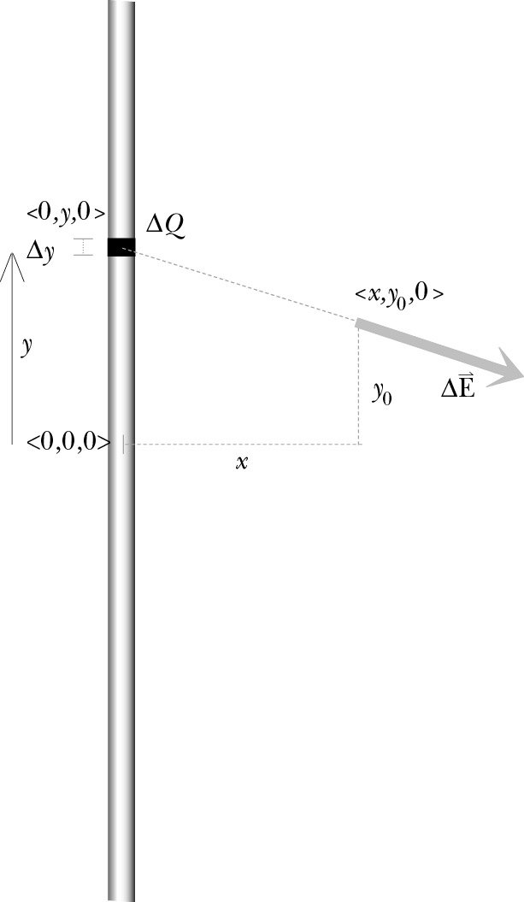
Step 1: Divide Distribution into Pieces
Apply superposition principle:
Divide rod into small sections Δy with charge ΔQ
Assumptions:
Rod is so thin that we can ignore its thickness.
If Δy is very small – ΔQ can be considered as a point charge
Notes:
Ask: Why do we require the rod to be so thin that we can disregard its thickness?

Slide 6
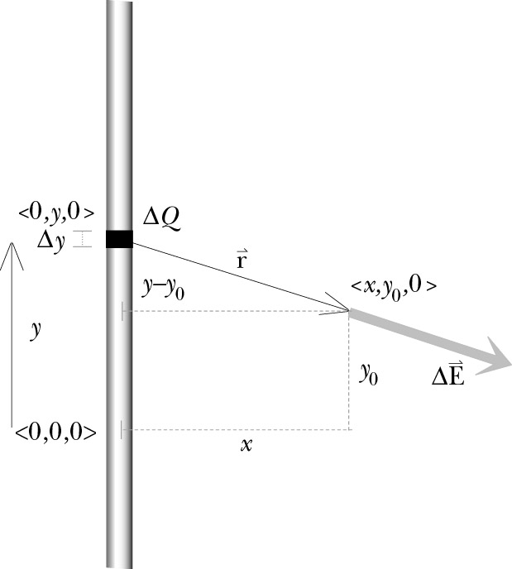
Step 2: E due to one Piece
What variables should remain in our answer?
⇒ origin location, Q, x, y₀
What variables should not remain in our answer?
⇒ rod segment location y, ΔQ
y – integration variable
Vector r from the source to the observation location:
Notes:
Remind class that we do not need to know if Q is + or – at this point.

Slide 7
Step 2: E due to one Piece
Magnitude of r:
Unit vector r:
Magnitude of ΔE:

Slide 8
Step 2: E due to one Piece
Vector ΔE:

Slide 9
Step 2: E due to one Piece
ΔQ in terms of integration variable y:

Slide 10
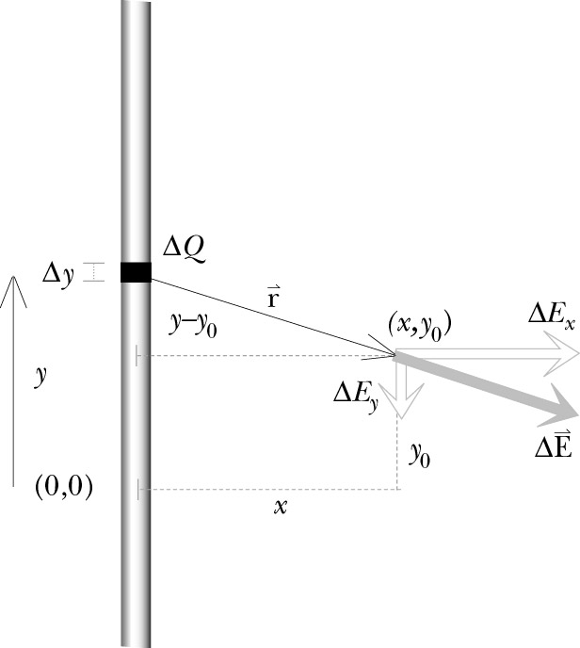
Step 2: E due to one Piece
Components of ΔE:

Slide 11
Step 3: Add up Contribution of all Pieces
Simplified problem: find electric field at the location <x,0,0>
Notes:
Show students how the y-component integrad, being odd in y, must give zero upon integration.

Slide 12
Step 3: Add up Contribution of all Pieces
Integration: taking an infinite number of slices
← definite integral
Notes:
dy – infinitesimal increment along y axis

Slide 13
Step 3: Add up Contribution of all Pieces
Evaluating integral:
Cylindrical symmetry:
replace x→r

Slide 14
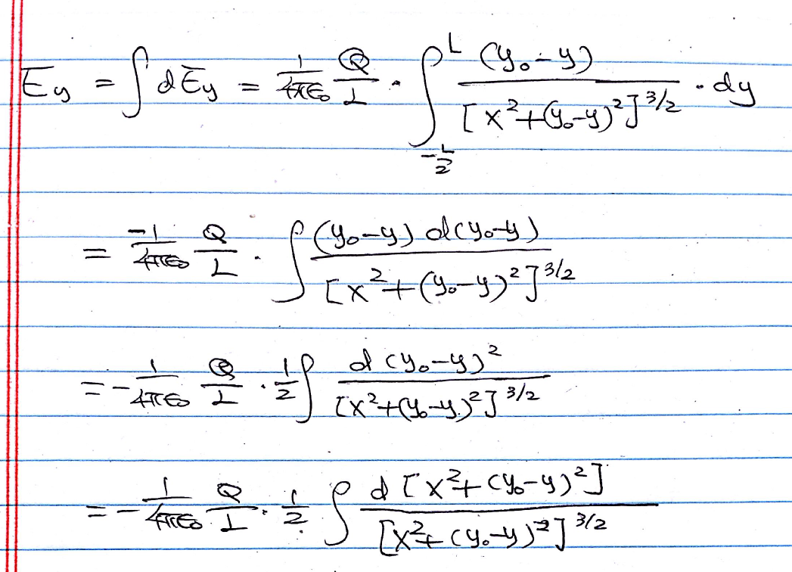
Formal derivation for y component

Slide 15
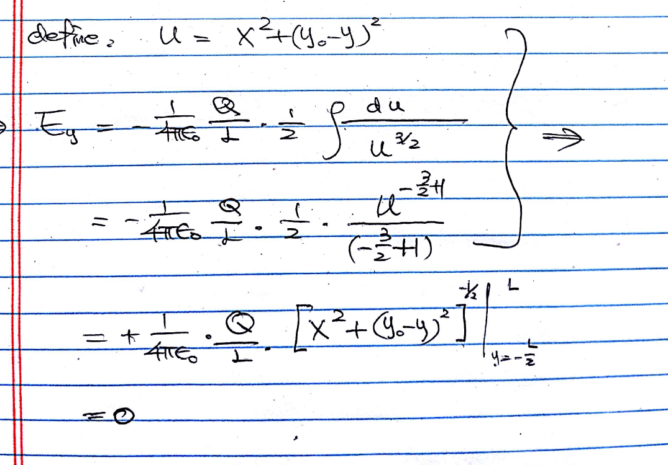
Formal derivation for y component

Slide 16
E of Uniformly Charged Thin Rod
At center plane
In vector form:
Check the results:
☑
Direction:
☑
Units:
☑
Special case r>>L:
☑
Compare with numerical calculation:
L=1 m, r=0.5 m

Slide 17
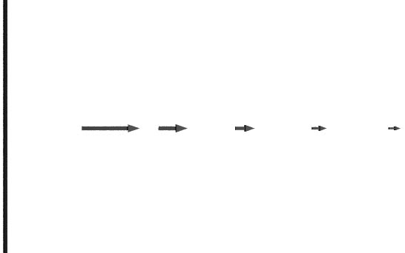
Special Case: A Very Long Rod
Very long rod: L>>r
Q/L – linear charge density
1/r dependence!
Notes:
For a very long (infinite) rod, it does not make sense to keep Q and L separately. Let both Q and L approach infinity while the ratio, Q/L remains constant.

Slide 18
E of Uniformly Charged Rod
At distance r from midpoint along a line perpendicular to the rod:
For very long rod:
Field at the ends:
Numerical calculation

Slide 19
General Procedure for Calculating Electric Field of Distributed Charges
Cut the charge distribution into pieces for which the field is known
Write an expression for the electric field due to one piece
(i) Choose origin
(ii) Write an expression for ΔE and its components
Add up the contributions of all the pieces
(i) Try to integrate symbolically
(ii) If impossible – integrate numerically
Check the results:
(i) Direction
(ii) Units
(iii) Special cases

Slide 20
iClicker Question
What does the Electric Field look like when
viewing the rod from the side?
A)
B)
+ + + + + + + + + + + + + + + + + + + + + + + + + + + + + + + + + + + + + + + + + + + +
C)
D)
Notes:
B

Slide 21
More Today
Find the fields of:
Ring
Disk
Infinite
Plane
Two Infinite
Planes

Slide 22
General Procedure for Calculating Electric Field of Distributed Charges
Cut the charge distribution into pieces for which the field is known
Write an expression for the electric field due to one piece
(i) Choose origin
(ii) Write an expression for ΔE and its components
Add up the contributions of all the pieces
(i) Try to integrate symbolically
(ii) If impossible – integrate numerically
Check the results:
(i) Direction
(ii) Units
(iii) Special cases

Slide 23
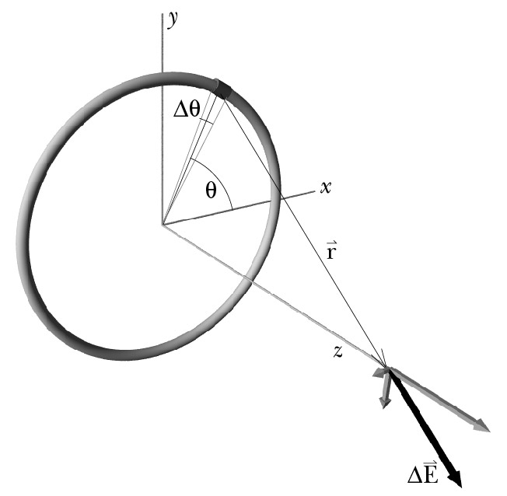
A Uniformly Charged Thin Ring
Origin: center of the ring
Location of piece: described by θ, where θ = 0 is along the x axis.
Step 1: Cut up the charge distribution into small pieces
Step 2: Write E due to one piece
Notes:
Can it be metal?

Slide 24
A Uniformly Charged Thin Ring
Step 2: Write ΔE due to one piece

Slide 25
A Uniformly Charged Thin Ring
Step 2: Write ΔE due to one piece
Components x and y:

Slide 26
A Uniformly Charged Thin Ring
Step 2: Write ΔE due to one piece
Component z:

Slide 27
A Uniformly Charged Thin Ring
Step 3: Add up the contributions of all the pieces

Slide 28
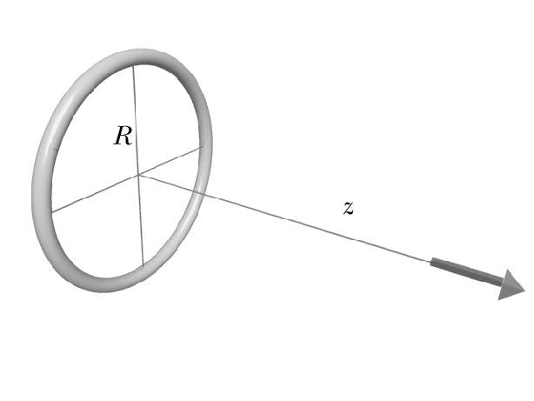
A Uniformly Charged Thin Ring
Step 4: Check the results
☑
Direction
☑
Units
Special cases:
☑
Center of the ring (z=0):
E_{z}=0
☑
Far from the ring (z>>R):

Slide 29
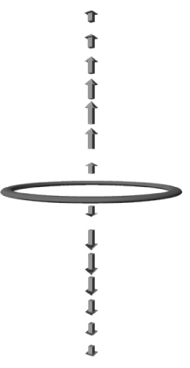
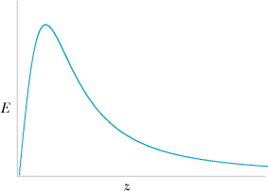
A Uniformly Charged Thin Ring
Distance dependence:
Far from the ring (z>>R):
E_{z}~1/z²
Close to the ring (z<<R):
E_{z}~z

Slide 30
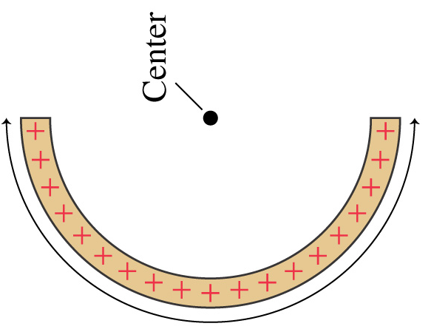
A total charge Q is uniformly distributed over a half ring with radius R. The total charge inside a small element dθ is given by:
Clicker Question
dθ
θ
R
Q
A.
B.
C.
D.
E.
Choice One
Choice Two
Choice Three
Choice Four
Choice Five
Choice Six
Notes:
D

Slide 31
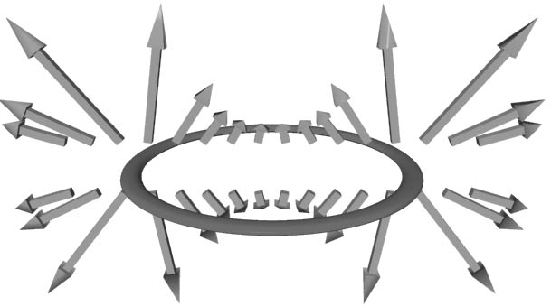
A Uniformly Charged Thin Ring
Electric field at other locations:
needs numerical calculation
http://www.falstad.com/vector3de/

Slide 32
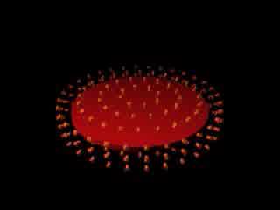
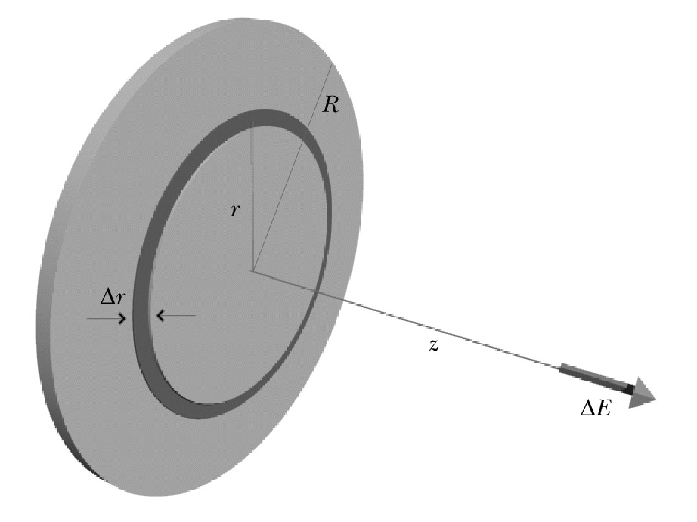
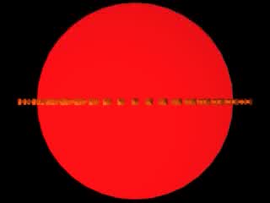
A Uniformly Charged Disk
Find out the answer by yourself
offline step by step
http://www.falstad.com/vector3de/

Slide 33
A Uniformly Charged Disk
Along z axis
For z>>R
Point Charge
Notes:
This is the result for disk on which has been placed a total charge Q uniformly distributed over its front and back surfaces. It is NOT a conducting disk.
What is E_{z} for z>>R?
Note: To a good degree of approximation when Z/R <<1, the field is independent of the distance from the disk. It is as if the disk is infinite in R.

Slide 34
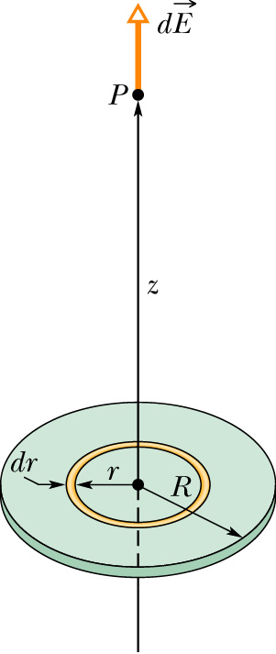
Charged Disk
Problem: calculate the electric field along z-axis due to a (circular) disk (of radius R) of uniform positive charge (with density σ).
Pick any ring element (of infinitesimal width dr) of the disk. The charge of the element is:
The electric field due to the ring element

Slide 35
Field due to the disk
Integrate over the entire disk
Use substitution of variables

Slide 36
Field due to the disk
Check Limiting Cases
z>>R:
point-like charge → ~Q/z²
z>0: upper sign
z<0: lower sign

Slide 37
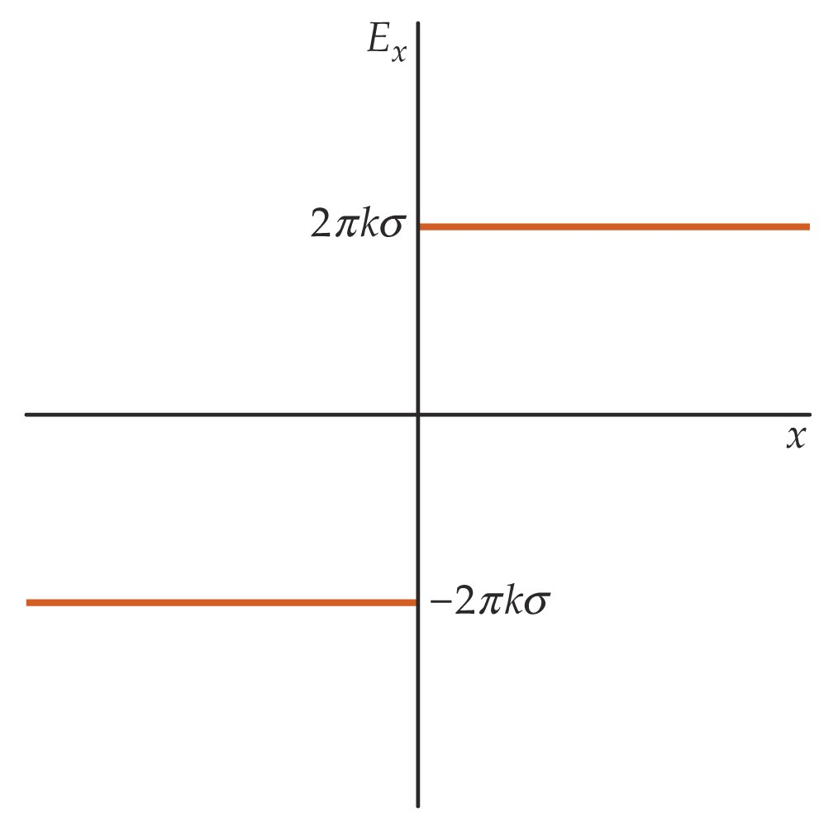
Important limiting cases for charged disk
z<<R:
E_{z}
There is a discontinuity
at z= 0.
z

Slide 38
A Uniformly Charged Disk
Along z axis
Approximations:
Close to the disk (0 < z < R)
Very close to disk (0 < z << R)
If z/R is extremely small
Notes:
This is the result for disk on which has been placed a total charge Q uniformly distributed over its front and back surfaces. It is NOT a conducting disk.
What is E_{z} for z>>R?
Note: To a good degree of approximation when Z/R <<1, the field is independent of the distance from the disk. It is as if the disk is infinite in R.

Slide 39
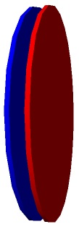
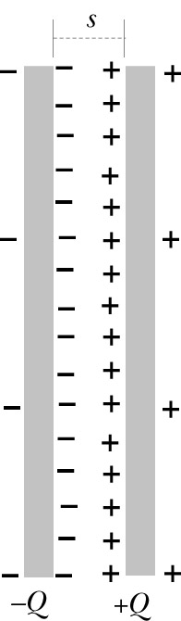
Capacitor
Two disks of opposite charges, s<<R:
charges distribute uniformly:
-Q
+Q
Almost all the charge is nearly uniformly distributed on the inner surfaces of the disks; very little charge on the outer surfaces.
We will calculate E both inside and outside of the disk close to the center
s
Notes:
We will use the previous result for disks made of insulating material.

Slide 40
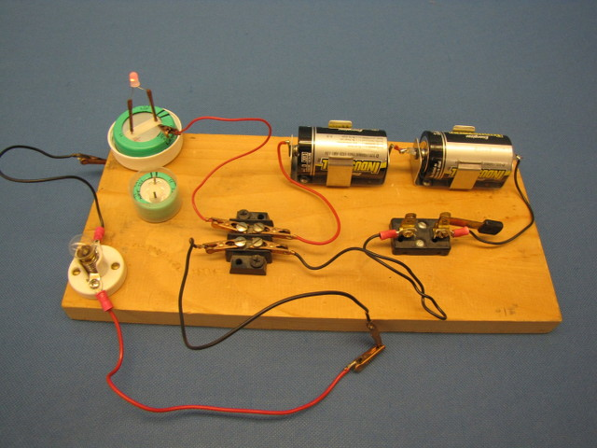
Demos: 6C-14
Notes:
Also show the dissembled capacitor

Slide 41
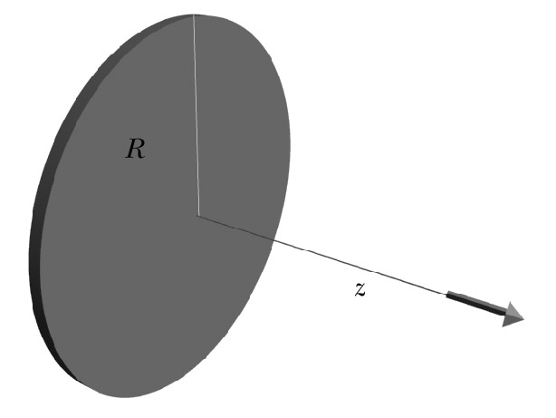
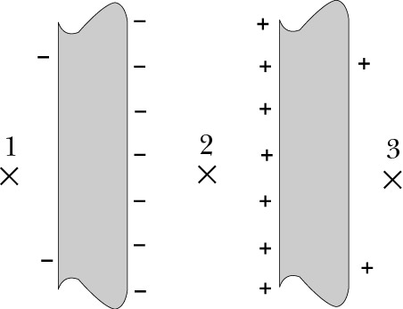
Step 1: Cut Charge Distribution into Pieces
We know the field for a single disk
There are only 2 “pieces”
-Q
+Q
E₊
E_{net}
s
E₋
Notes:
Note that our diagram shows that each metal disk has almost the entire charge Q on the surface facing the other disk! This allows us to use the previous result to a good approximation. Treat each disk as if it had zero thickness.

Slide 42
Step 2: Contribution of one Piece
Origin: left disk, center
Location of disks: z=0, z=s
Distance from disk to ⊗2
z, (s-z)
E₊
E_{net}
Left:
E₋
Right:
s
z
0
Notes:
Note that are making the approximation that all of the charge lies on the facing surfaces and thus the small amount of charge on the outside surfaces do not contribute to E.

Slide 43
Step 3: Add up Contributions
Location: ⊗2 (inside a capacitor)
E_{net}
E₊
E₋
s
z
0
← Does not depend on z
When s << R,

Slide 44
Step 3: Add up Contributions
Location: ⊗3 (fringe field)
E_{net}
E₊
E₋
s
z
0
For s<<R: E₁=E₃≈0
Fringe field is very small compared to the field inside the capacitor.
Far from the capacitor (z>>R>>s): E₁=E₃~1/z³ (like dipole)
Notes:
Note that we are dealing only with magnitudes of the electric fields here. Must take care when superimposing (summing) the contributions from the negative and positive plates.
Note also that the fringe field points in a direction that would “discharge” the capacitor if connected in a circuit. That is, electrons would be drawn towards the positive plate.

Slide 45
Electric Field of a Capacitor
Inside:
E₊
E_{net}
Fringe:
E₋
s
Step 4: check the results:
z
0
☑
Units:

Slide 46
Exercise
Given: capacitor, radius R=50 cm, gap s=1 mm (air).
Find: maximum charge before sparks are formed (E_{crit}=3×10⁶ N/C)
Solution:
What is the attractive force between the plates?
F=QE= (2.1×10⁻⁵C)(3×10⁶ N/C)=63 N
F=Q(E_{crit}/2)= (2.1×10⁻⁵C)(3×10⁶/2 N/C)=31.5 N
Notes:
The second equation is correct since the electric field of one plate is Ecrit/2 and it acts on the Q of the other plate.

Slide 47
A total charge Q is uniformly distributed over a half ring with radius R. The Y component of electric field at the center created by a short element dθ is given by:
Clicker Question
+y
dθ
θ
R
A.
B.
Q
C.
D.
Choice One
Choice Two
Choice Three
Choice Four
Notes:
B

