Slide 1
Last Time
Insulators: Electrons stay close to their own atoms
Conductors: Charges are free to move
  E = 0 inside conductor in equilibrium
  Ionic solutions
  Metals
  Drude model (electrons whack into defects)

Slide 2
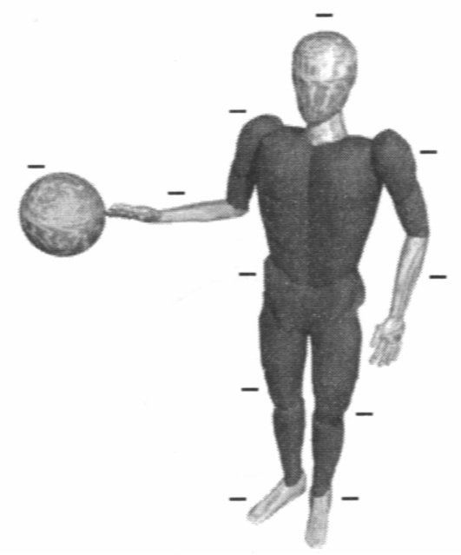
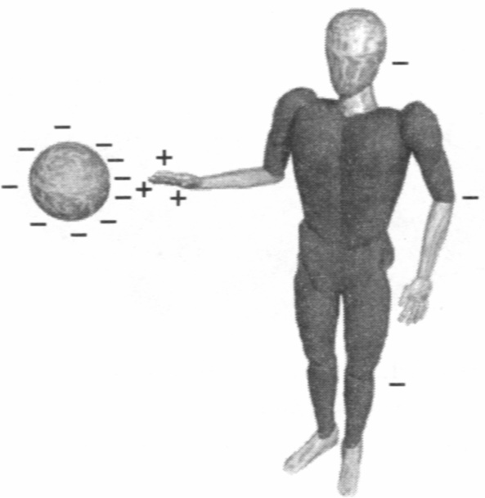
Charging and Discharging
Discharging by contact:
On approach: body polarizes
On contact:
charge redistributes over larger surface
Grounding: connection to earth (ground) – very large object
Notes:
Use a grounding wire and a electroscope to demonstrate the effect.

Slide 3
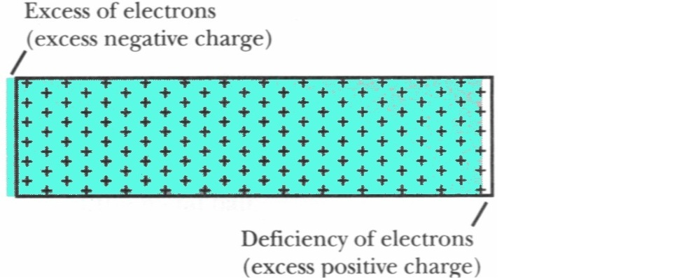
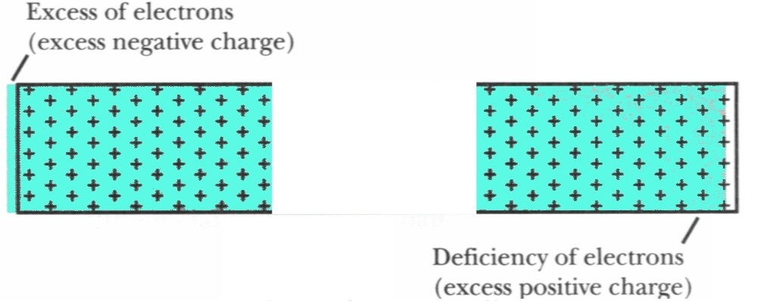
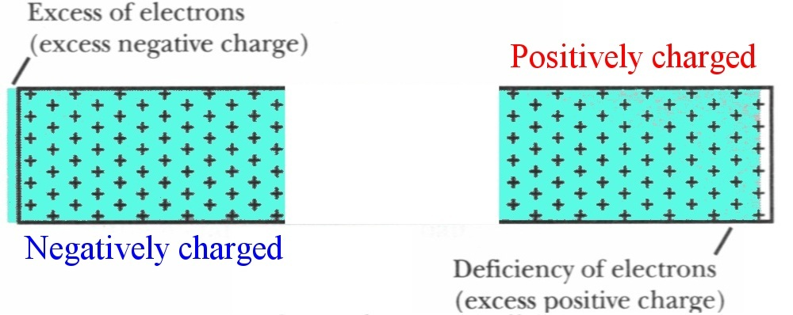
Charging by Induction

Slide 4
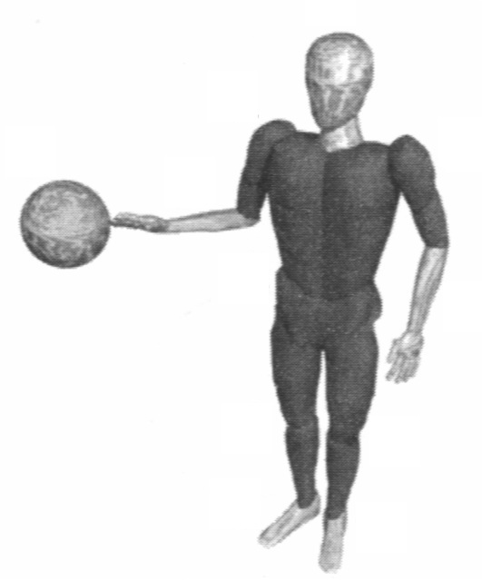
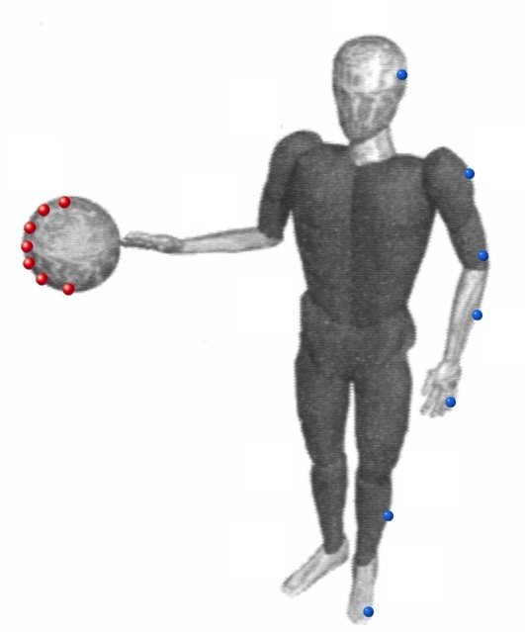
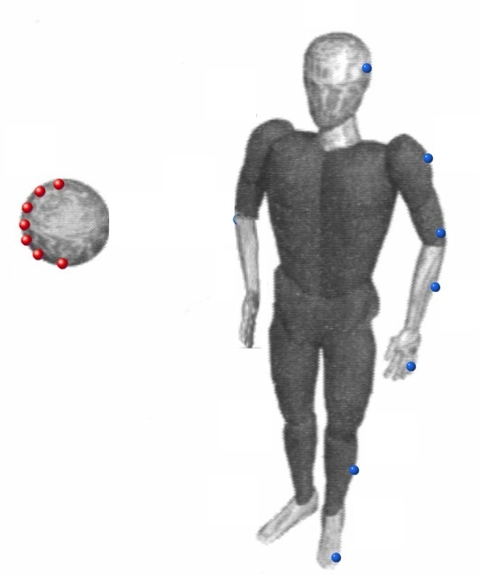
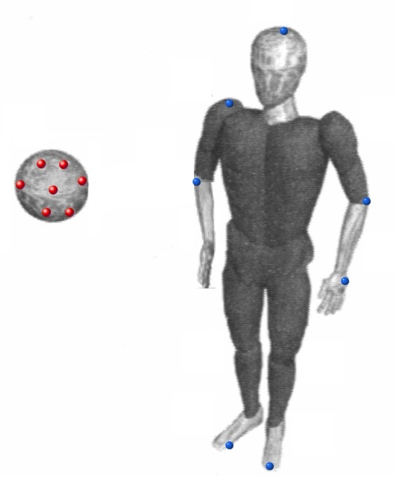
Charging by Induction

Slide 5
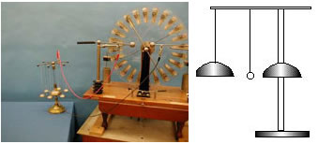
5A-10 Motion in an Electric Field
+
+
-
-
Notes:
This a set of demonstrations related to effects resulting from electric field forces.
(a) A ping pong ball is free to roll inside a horizontally mounted glass tube mounted between the terminals of the small Wimshurst machine. When the machine is in operation, the ball moves back and forth in the tube as it first receives a charge from one terminal and then is repelled to the other terminal, where it is charged oppositely.
(b) A set of electric “chimes,” consisting of four bells suspended from conducting threads, and a central bell affixed to an insulating stand. A small ball is suspended from an insulating thread so it hangs between the two bells. The central bell is grounded (or attached to the opposite terminal), whereas the other four bells are are charged from a small Wimshurst machine. The hanging ball is attracted to the hanging bell by charge induction, causing the ball to strike the bell. The ball then picks up up the charge of the bell and is repelled, causing it to strike the central (grounded) bell. The ball is discharged and the process begins all over again

Slide 6
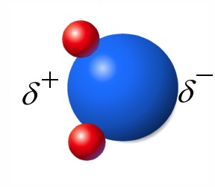
Humidity and Discharging Process
Charged tapes (and other objects) become discharged after some time.
Higher humidity – faster discharge
Water molecule - dipole
Thin film of water is formed on surfaces – conductor (poor)

Slide 7
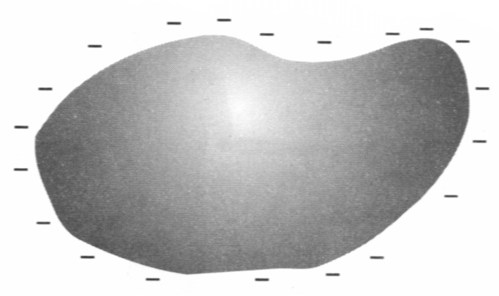
Excess Charge on Conductors
Excess charges in any conductor are always found on an inner or outer surface!
+
+
+
+
-
-
+
-
-
+
-
-
+
+
+
+
5A-13 Gauss' Law--No Internal Field
5A-12 Gauss' Law: Charge Within a Conductor. And radio in Faraday cage
Notes:
Polarized insulator: collection of tiny dipoles
Polarized metal: forms a giant dipole
Do demo of charge on outside of sphere.

Slide 8
Conductors versus Insulators
 | Conductor | Insulator
Mobile charges | yes | no
Polarization | entire sea of mobile charges moves | individual atoms/molecules polarize
Static equilibrium | E_{net}= 0 inside | E_{net} nonzero inside
Excess charges | only on surface | anywhere on or inside material
Distribution of excess charges | Spread over entire surface | located in patches

Slide 9
Clicker Question
An electric field polarizes a metal block as shown below. Select
the diagram that represents the final state of the metal.
E
+
+
+
-
-
-
A)
+
-
+
-
C)
+
-
+
-
+
-
+
-
+
-
+
-
B)
+
+
+
-
-
-
-
-
-
+
+
+
D)
-
+
-
+
-
+
-
+
Notes:
B

Slide 10
iClicker Question
If I put a radio with music on into a cage completely covered by a sheet of metal, what will happen:
The music will be off since the signal is lost.
The music will stay on.
Notes:
B

Slide 11
More for Today
Charge Density
Electric Field of a Charge Distribution
Electric Field of a Charged Rod

Slide 12
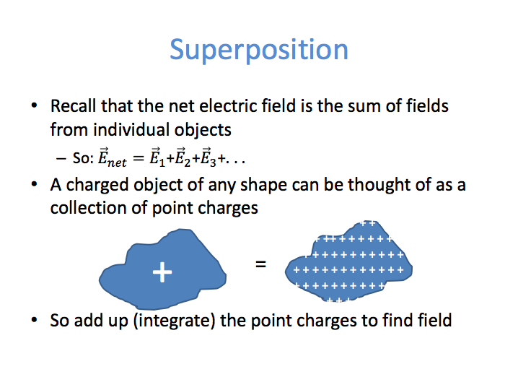

Slide 13
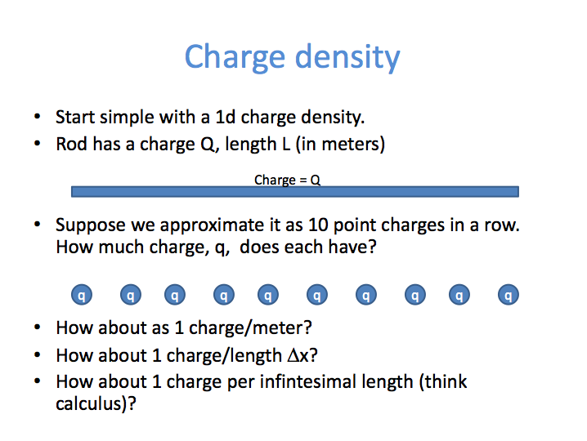
+ + + + + + + + + + + + + + + + + + + + + + + + + + + + + + + + + + + + + + + + + + + +
Δq,
Δq
Δq
Δq
Δq
Δq
Δq
Δq
Δq
Δq
Δq
Δx
L/Δx = 10
Δq = Q/10 = (Q/L)Δx

Slide 14
Calculus We Will Need
Δq
Δq
Δq
Δq
Δq
Δq
Δq
Δq
Δq
Δq
Δx
L/Δx = 10
Δq = Q/10 = (Q/L)Δx
Recall how to convert a sum to an integral:
UNITS = [Length]
UNITS = [Length]
We will need to sum over all charges:
UNITS = [Charge]
UNITS = [Charge]

Slide 15
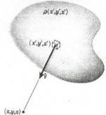
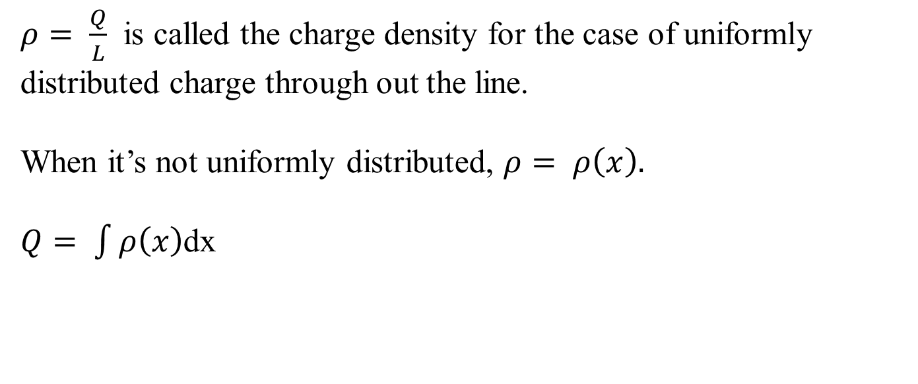
Calculus We Will Need
$ρ= \frac{Q}{L}$ is called the charge density for the case of uniformly distributed charge through out the line.
When it’s not uniformly distributed, $ρ= ρ\left(x\right).$
$Q= \int{ρ\left(x\right)}$dx
For 3-D case:

Slide 16
iClicker Question
What does the Electric Field look like when
viewing the positively charged rod from the top?
A)
B)
+ + + + + + + + + + + + + + + + + + + + + + + + + + + + + + + + + + + + + + + + + + + +
C)
D)
Notes:
A

Slide 17
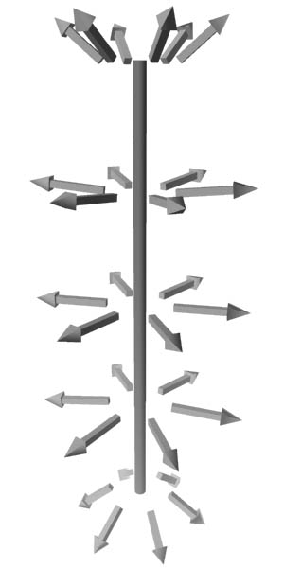
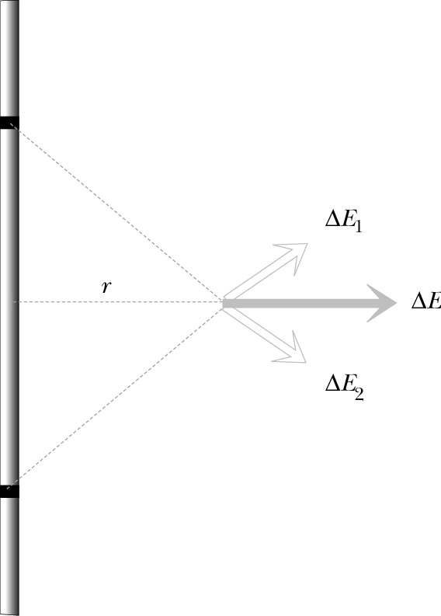
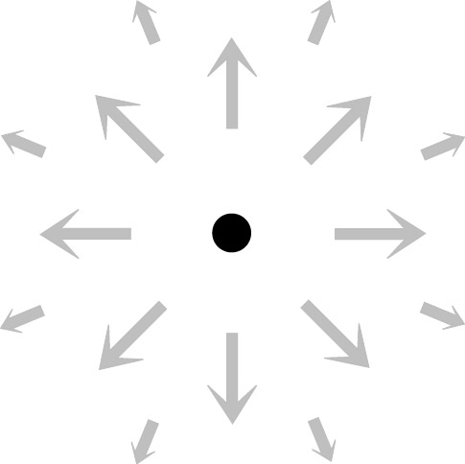
Uniformly Charged Thin Rod
Length: L
Charge: Q
What is the pattern of electric field
around the rod?
Cylindrical symmetry
Could the rod be a conductor and be uniformly charged?
Notes:
Rod – dielectric, not metal! (Ask: can it be metal?)

Slide 18
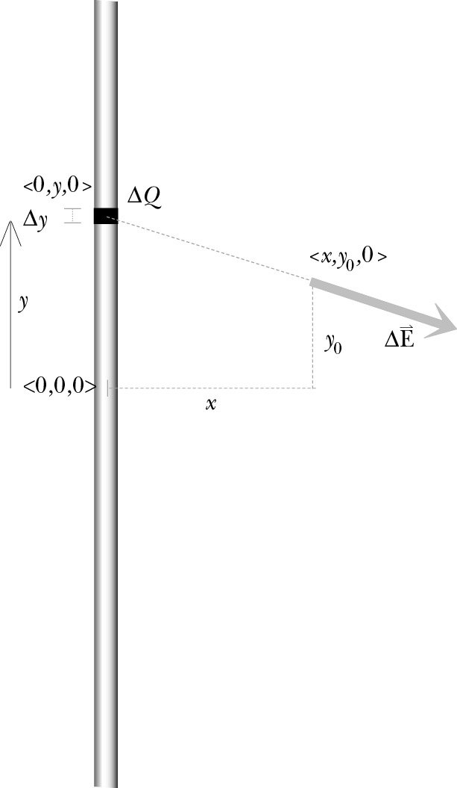
Step 1: Divide Distribution into Pieces
Apply superposition principle:
Divide rod into small sections Δy with charge ΔQ
Assumptions:
Rod is so thin that we can ignore its thickness.
If Δy is very small – ΔQ can be considered as a point charge
Notes:
Ask: Why do we require the rod to be so thin that we can disregard its thickness?

Slide 19
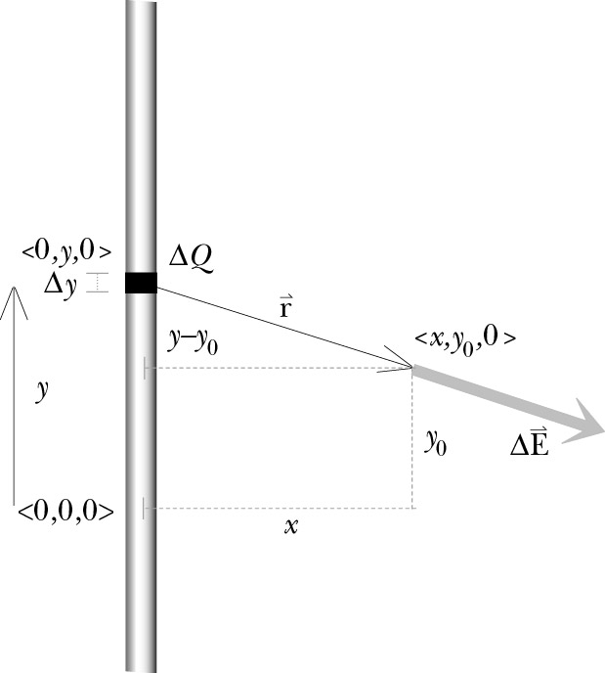
Step 2: E due to one Piece
What variables should remain in our answer?
⇒ origin location, Q, x, y₀
What variables should not remain in our answer?
⇒ rod segment location y, ΔQ
y – integration variable
Vector r from the source to the observation location:
Notes:
Remind class that we do not need to know if Q is + or – at this point.

Slide 20
Step 2: E due to one Piece
Magnitude of r:
Unit vector r:
Magnitude of ΔE:

Slide 21
Step 2: E due to one Piece
Vector ΔE:

Slide 22
Step 2: E due to one Piece
ΔQ in terms of integration variable y:

Slide 23
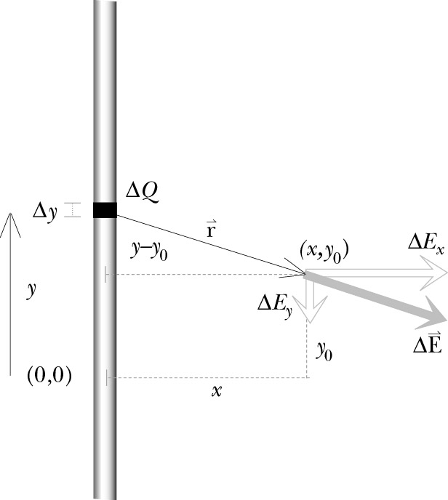
Step 2: E due to one Piece
Components of ΔE:

Slide 24
Step 3: Add up Contribution of all Pieces
Simplified problem: find electric field at the location <x,0,0>
Notes:
Show students how the y-component integrad, being odd in y, must give zero upon integration.

Slide 25
Step 3: Add up Contribution of all Pieces
Integration: taking an infinite number of slices
← definite integral
Notes:
dy – infinitesimal increment along y axis

Slide 26
Step 3: Add up Contribution of all Pieces
Evaluating integral:
Cylindrical symmetry:
replace x→r

Slide 27
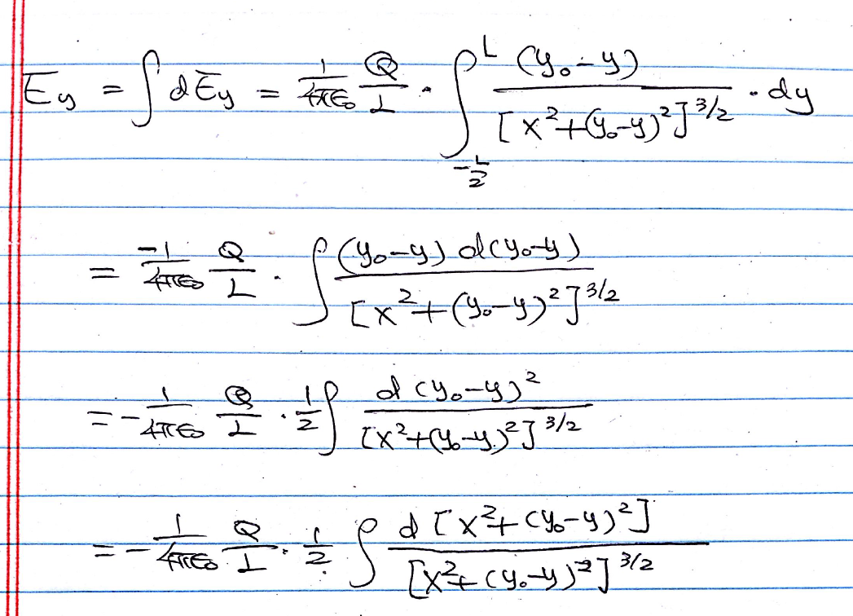
Formal derivation for y component

Slide 28
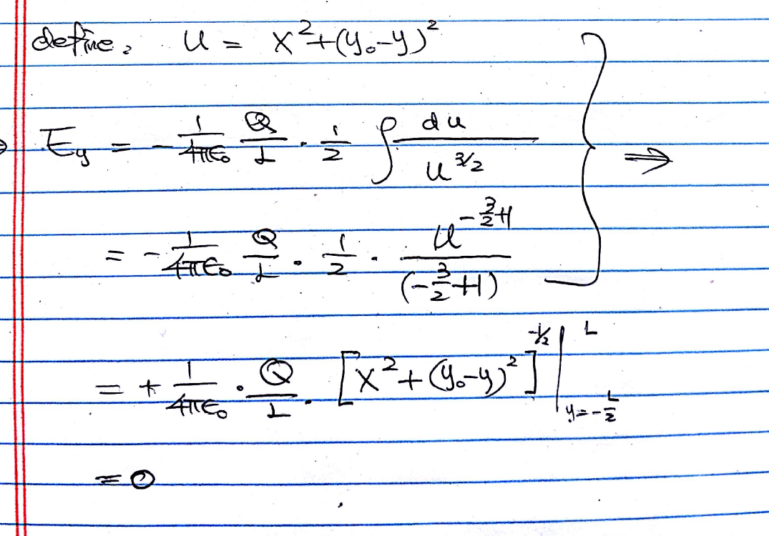
Formal derivation for y component

Slide 29
E of Uniformly Charged Thin Rod
At center plane
In vector form:
Check the results:
☑
Direction:
☑
Units:
☑
Special case r>>L:
☑
Compare with numerical calculation:
L=1 m, r=0.5 m

Slide 30
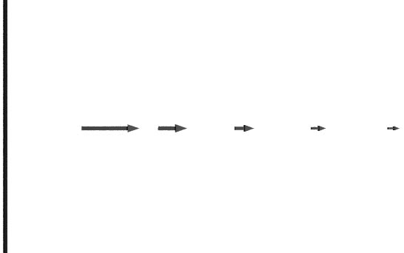
Special Case: A Very Long Rod
Very long rod: L>>r
Q/L – linear charge density
1/r dependence!
Notes:
For a very long (infinite) rod, it does not make sense to keep Q and L separately. Let both Q and L approach infinity while the ratio, Q/L remains constant.

Slide 31
E of Uniformly Charged Rod
At distance r from midpoint along a line perpendicular to the rod:
For very long rod:
Field at the ends:
Numerical calculation

Slide 32
General Procedure for Calculating Electric Field of Distributed Charges
Cut the charge distribution into pieces for which the field is known
Write an expression for the electric field due to one piece
(i) Choose origin
(ii) Write an expression for ΔE and its components
Add up the contributions of all the pieces
(i) Try to integrate symbolically
(ii) If impossible – integrate numerically
Check the results:
(i) Direction
(ii) Units
(iii) Special cases

Slide 33
iClicker Question
What does the Electric Field look like when
viewing the rod from the side?
A)
B)
+ + + + + + + + + + + + + + + + + + + + + + + + + + + + + + + + + + + + + + + + + + + +
C)
D)
Notes:
B

Slide 34
Today
Charge Density
Electric Field of a Charge Distribution
Electric Field of a Charged Rod

Slide 35
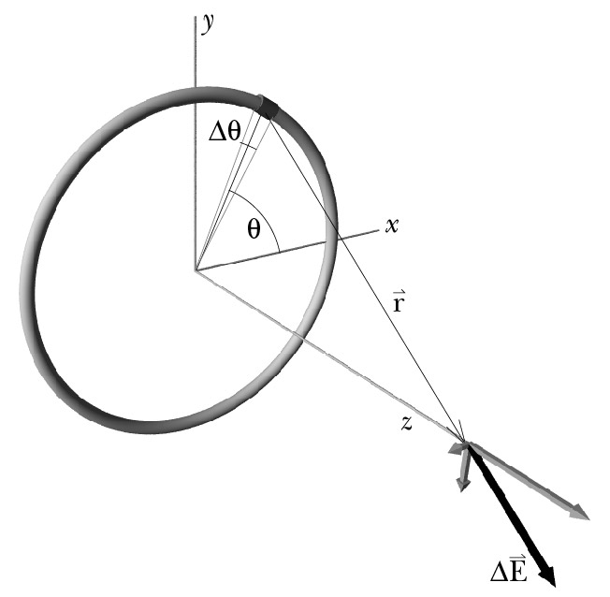
A Uniformly Charged Thin Ring
Origin: center of the ring
Location of piece: described by θ, where θ = 0 is along the x axis.
Step 1: Cut up the charge distribution into small pieces
Step 2: Write E due to one piece
Notes:
Can it be metal?

Slide 36
A Uniformly Charged Thin Ring
Step 2: Write ΔE due to one piece

Slide 37
A Uniformly Charged Thin Ring
Step 2: Write ΔE due to one piece
Components x and y:

Slide 38
A Uniformly Charged Thin Ring
Step 2: Write ΔE due to one piece
Component z:

Slide 39
A Uniformly Charged Thin Ring
Step 3: Add up the contributions of all the pieces

Slide 40
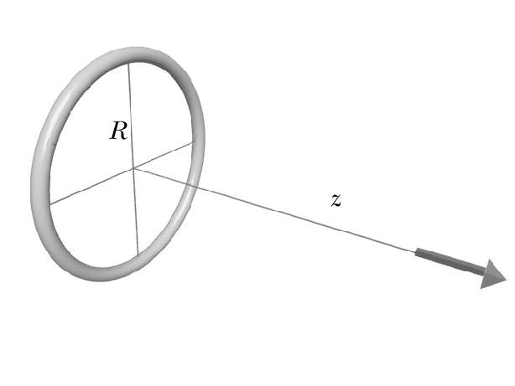
A Uniformly Charged Thin Ring
Step 4: Check the results
☑
Direction
☑
Units
Special cases:
☑
Center of the ring (z=0):
E_{z}=0
☑
Far from the ring (z>>R):

Slide 41
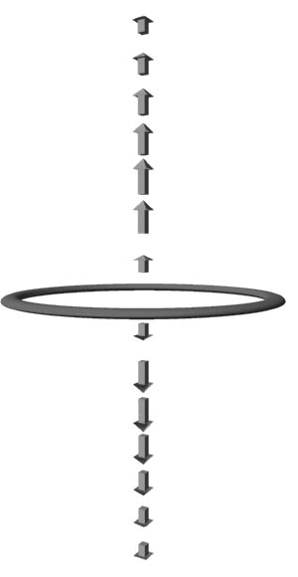
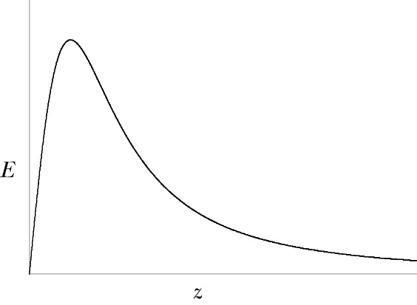
A Uniformly Charged Thin Ring
Distance dependence:
Far from the ring (z>>R):
E_{z}~1/z²
Close to the ring (z<<R):
E_{z}~z
Notes:
Ask students where in z does the maximum field strength occur? Z = R/sqrt(2).

Slide 42
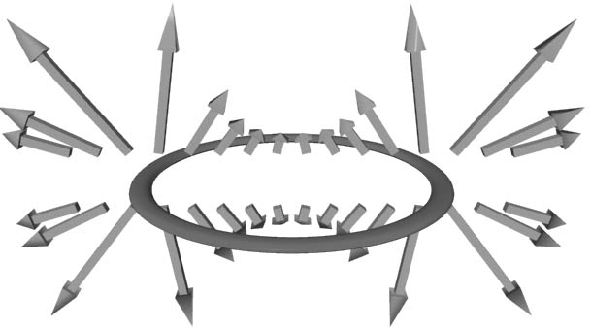
A Uniformly Charged Thin Ring
Electric field at other locations:
needs numerical calculation

Slide 43
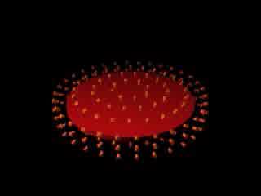
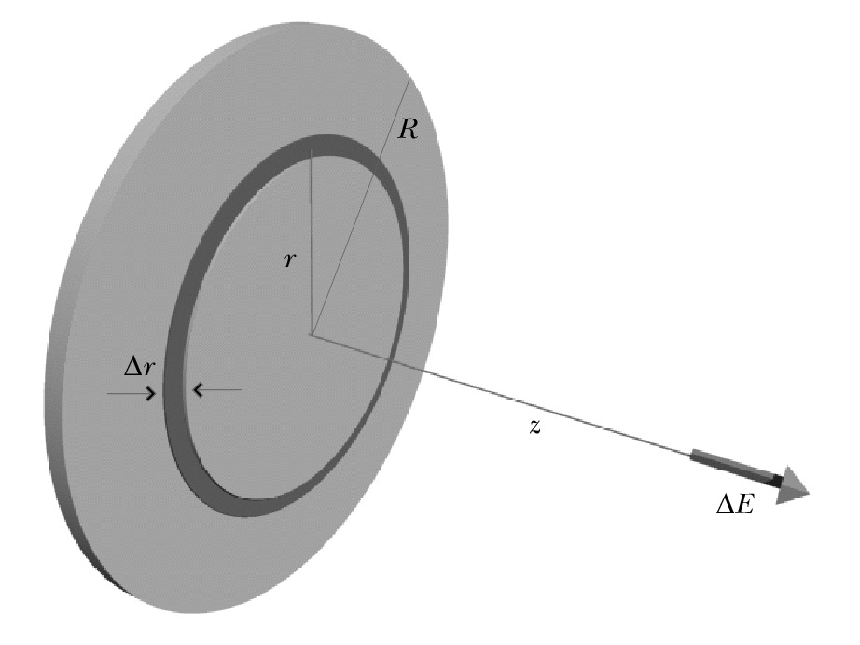
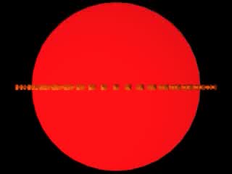
A Uniformly Charged Disk
Section 16.5 – Study this!

