Slide 1
Last Time
Charge is conserved:
  You can move charge around
  It can be destroyed/created in (+/-) pairs
Atoms can polarize ("induced dipole")
Neutral Atoms are attracted by Point Charges
  The force between them ~ 1/r⁵

Slide 2
Polarization
p = qs
DIPOLE MOMENT
POLARIZATION
α - “polarizability” of a material
Magnitude of polarization = dipole moment of the atoms/molecules
In an induced dipole, is the distance between the charges fixed?
No. The distance is proportional to the strength of the applied field.

Slide 3
Example
A typical atomic polarizability is α=10⁻⁴⁰ C•m/(N/C).
If q=e (proton charge), what is the charge separation by applying a field E=3•10⁶ N/C?
Shift is five orders of magnitude smaller than the atom itself!
Notes:
The value chosen for E here is that which causes air to become conducting. Turning the above argument around, we see that a displacement of only 2x10^-15 m causes an E field capable of ionizing air.

Slide 4
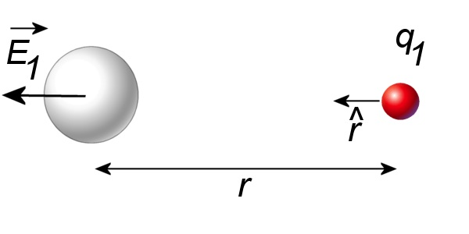
Force of a Point Charge on an Atom
1)
1. Point charge creates field E₁ at atom

Slide 5
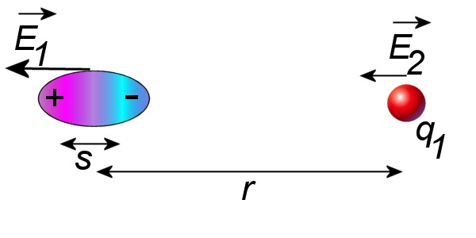
Force of a Point Charge on an Atom
1)
2)
2. Field E₁ polarizes atom

Slide 6
Force of a Point Charge on an Atom
1)
3)
2)
3. Induced dipole creates field E₂ at point charge
~ 1/r⁵

Slide 7
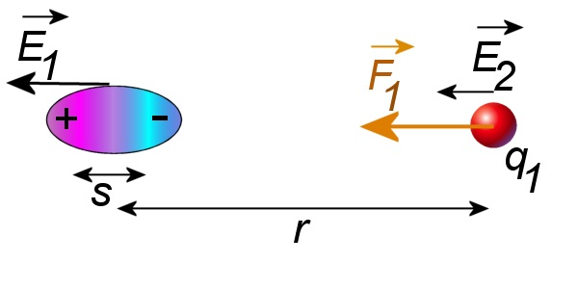
Force of a Point Charge on an Atom
1)
3)
2)
4)
4. Field E₂ exerts force on point charge
Notes:
1/r^5 because induced p proportional to 1/r^2 and it produces a field at q1 proportional to p/r^3.

Slide 8
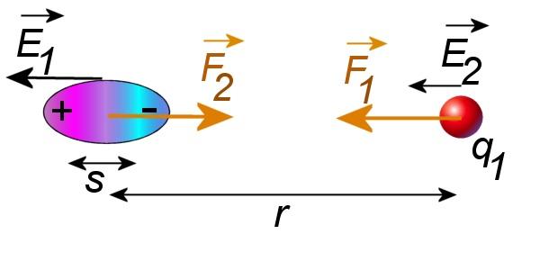
Force of a Point Charge on an Atom
1)
3)
2)
4)
5. F₁ is the force the atom exerts on the charge.
What is the force the charge exerts on the atom?
Equal and opposite forces! (Reciprocity)

Slide 9
Force of a Point Charge on an Atom
1) Point charge creates field E₁ at atom
2) Field E₁ polarizes atom
3) Induced dipole creates field E₂ at point charge
4) Field E₂ exerts force on point charge
5) Equal and opposite forces
Neutral atoms are attracted by charges!
Interaction strength ~ 1/r⁵

Slide 10
iClicker
Which one of the following is not true?
The electric force exerted by a induced electric dipole on an electron along the dipole moment direction:
A. decreases by a factor of 32 if the distance is increased by a factor of 2.
B. has the same magnitude as the electric force exerted by the same dipole on a proton at the same distance.
C. has the same direction as the electric force exerted by the same dipole on a proton at the same distance.
D. has the opposite direction as the electric force exerted by the same dipole on a proton at the same distance.
Notes:
Answer: D

Slide 11
iClicker: Is my pencil charged?
Suppose tape is negatively charged, and you rub a wooden pencil on a wool sweater and bring it near the tape.
-

-
-
-
-
If tape swings toward the pencil, does it show that the pencil had been charged positively?
A). Yes.
B). Definitely not.
C). Not necessarily.
Notes:
Suppose tape is negatively charged, and you rub a wooden pencil on a wool sweater and bring it near the tape:

Slide 12
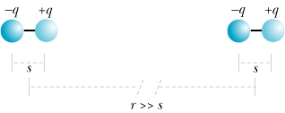
Clicker Question
The force of one of the permanent dipoles on the other is:
Attractive
Repulsive
The force is zero
Notes:
A: The LH dipole produced an E-field pointing to the right at the location of the RH dipole. The E-field is stronger at the – charge (and attractive) than at the + charge (and repulsive). Therefore the net force on the RH dipole points towards the LH dipole.

Slide 13
More Today
Insulators: Electrons stay close to their own atoms
Conductors: Charges are free to move
  E = 0 inside conductor in equilibrium
  Ionic solutions
  Metals
Charging and Discharging Objects

Slide 14
Conductors and Insulators
Different materials respond differently to electric field
Conductor: contains mobile charges that can move through material
Insulator: contains no mobile charges
Notes:
All materials are made of atoms that contain electrons and protons, but different materials respond in different ways to electric fields.
Insulator: electrons are tightly bound to the molecules
Conductors: free moving charged particles

Slide 15
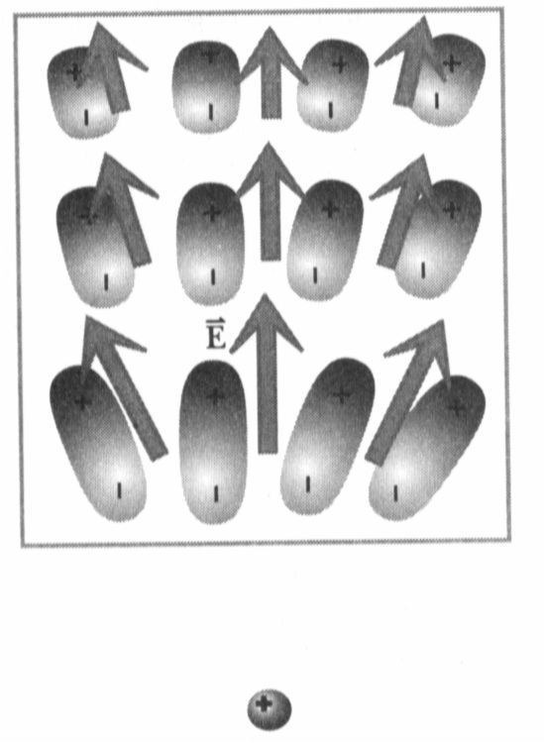
Polarization of Insulators
Insulator: Electrons are bound to the atoms or molecules.
Electrons can shift slightly (<1 Å), but remain bound to the molecule.
Individual atoms or molecules can be polarized by external electric field.
There are a lot of molecules – the net effect produced by the induced dipoles can be very large.
Notes:
We have seen that an individual atom or molecule can be polarized by an applied electric field, producing an induced dipole of atomic or molecular dimension.
No charged particles can move more than 10⁻¹⁰ m

Slide 16
Low Density Approximation
Field E at a location of a molecule is a superposition of the external applied field and the field created by other induced dipoles:
Simplifying assumption:
Notes:
What happens if we apply an electric field to an insulator?
No mobile charges in an insulator, excess charges stay where they are.

Slide 17
Conductors
There are charges which can move freely throughout the material
E
In contrast to an insulator, where electrons and nuclei can move only very small distances, the charged particles in a conductor are free to move large distances.
Polarization of conductors differs from that of insulators.

Slide 18
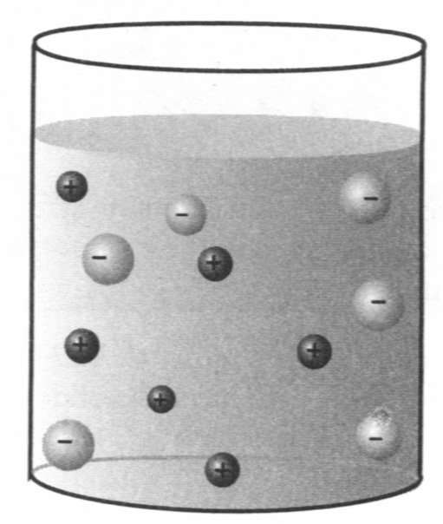
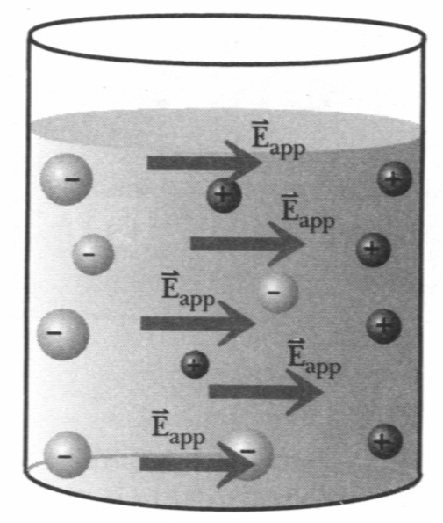
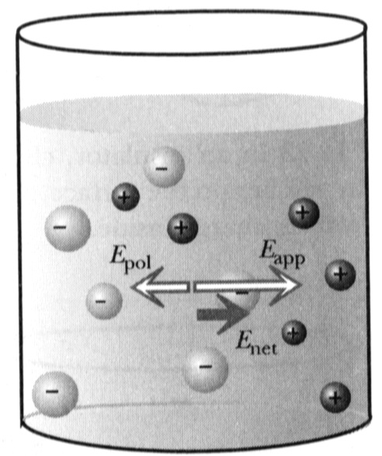
Ionic Solutions are Conductors
Salt water:
Na⁺ and Cl⁻
H⁺ and OH⁻
Apply external
electric field
When an electric filed is applied to a conductor, the mobile charged particles begin to move in the direction of the force exerted on them by the field.
As the charges move, they begin to pile up in one location, creating a concentration of charge → creates electric field.
The net electric field is the superposition of the applied field and field created by the relocated charges.
Notes:
Example: Sodium chloride : sodium ions and chloride ions
When electric field is applied:
Put electrodes in – field at all times, no static equilibrium.

Slide 19
Ionic Solutions are Conductors
Assumption: charges will move until E_{net}=0 (static equilibrium)
Proof: by contradiction:
Assume E_{net}≠0
Mobile ions will move
This is not equilibrium
Assumption E_{net}≠0 is wrong
E_{net}=0
It is not a shielding effect, but a consequence of superposition!
Notes:
Polarization occurs very rapidly but it is not instantaneous (10⁻¹⁸ s).
Only few ions move and only short distances until equilibrium is reached!
Put electrodes in – field at all times, no static equilibrium.

Slide 20
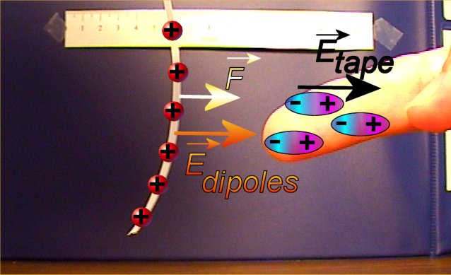
Polarization of Salt Water in the Body
Your body consists mainly of salt water
Polarization of salt water has much higher effect than polarization of atoms!
Notes:
Use a charged sphere to attract a stream of water from faucet instead. Prepare a container to hold the water.

Slide 21
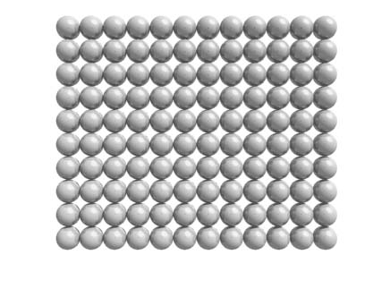
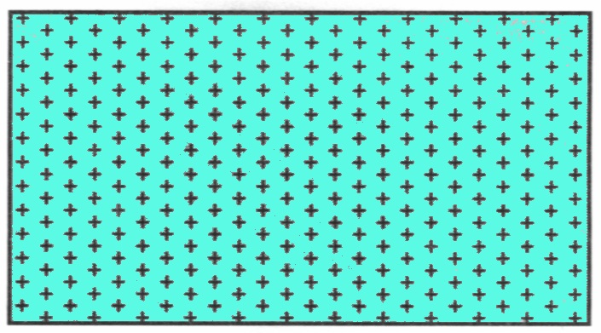
A Model of a Metal
Positive atomic cores
and mobile-electron sea
Metal lattice
Electrons are not completely free – they are bound to the metal as a whole.
We will return to this idea when we discuss the force on a current carrying wire in a magnetic field.
There is no net interaction between mobile electrons

Slide 22
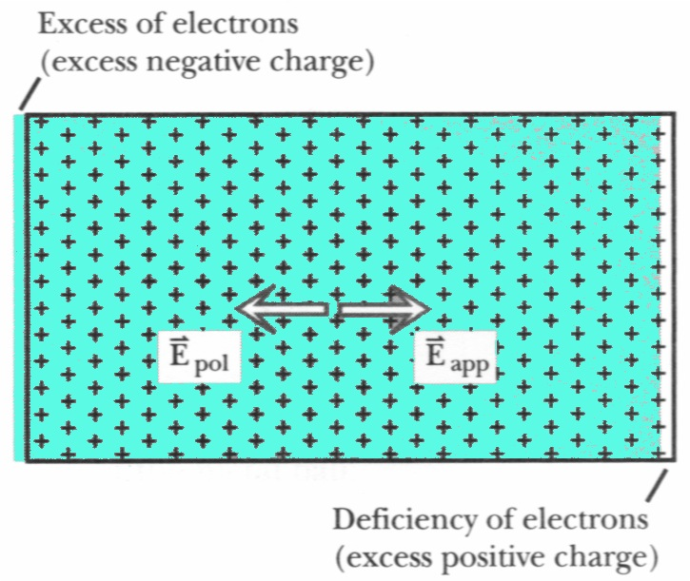
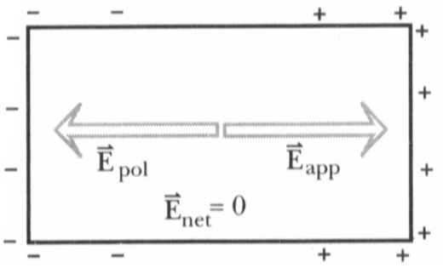
Metal in Electric Field
Simplified diagram of polarized metal
Note: It is not charged!
Net charge is still zero
Notes:
Metal polarizes!
Polarized is nor equal to charged

Slide 23
Electric Field inside Metal
In static equilibrium:
E_{net}= 0 everywhere inside the metal!
Mobile charges on surface rearrange to achieve E_{net}= 0
Actual arrangement might be very complex!
It is a consequence of 1/r² distance dependence
E_{net}= 0 only in static equilibrium!

Slide 24
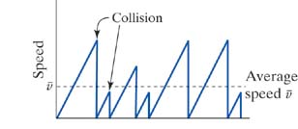
Drude Model of Electron Motion in a Metal
Blast from the Past!
The Momentum Principle
-
Negligible net interaction between mobile electrons
Forget previous velocity after collision
Later we will show that
conductivity (σ) ∝ μ
Bar means average:
Some important sources of collision:
- impurities
- thermal motion of atoms
(more motion at higher temperature T
→ shorter → lower σ
[common feature of metals])
μ is “Mobility”

Slide 25
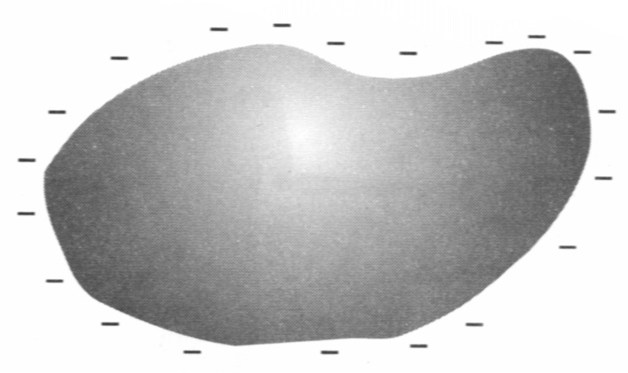
Excess Charge on Conductors
Excess charges in any conductor are always found on an inner or outer surface!
+
+
+
+
-
-
+
-
-
+
-
-
+
+
+
+
5A-13 Gauss' Law--No Internal Field
5A-12 Gauss' Law: Charge Within a Conductor. And radio in Faraday cage
Notes:
Polarized insulator: collection of tiny dipoles
Polarized metal: forms a giant dipole
Do demo of charge on outside of sphere.

Slide 26
Conductors versus Insulators
 | Conductor | Insulator
Mobile charges | yes | no
Polarization | entire sea of mobile charges moves | individual atoms/molecules polarize
Static equilibrium | E_{net}= 0 inside | E_{net} nonzero inside
Excess charges | only on surface | anywhere on or inside material
Distribution of excess charges | Spread over entire surface | located in patches

Slide 27
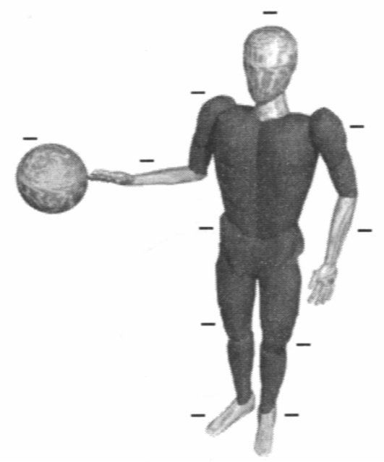
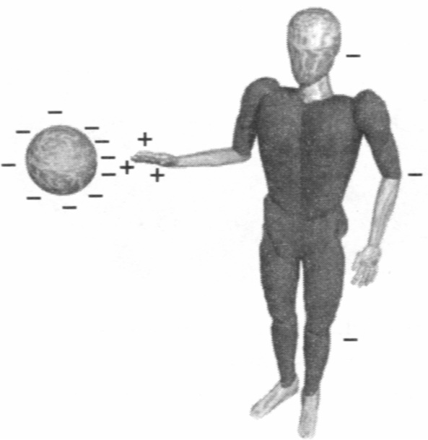
Charging and Discharging
Discharging by contact:
On approach: body polarizes
On contact:
charge redistributes over larger surface
Grounding: connection to earth (ground) – very large object
Notes:
Use a grounding wire and a electroscope to demonstrate the effect.

Slide 28
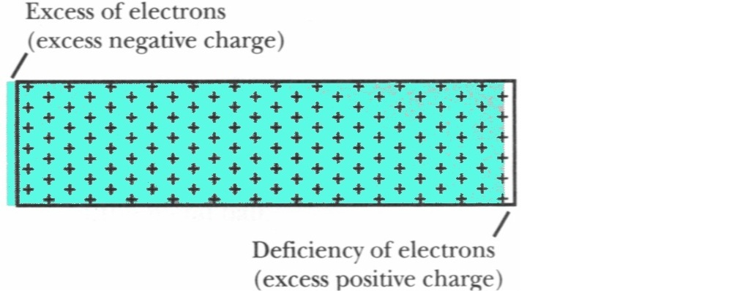
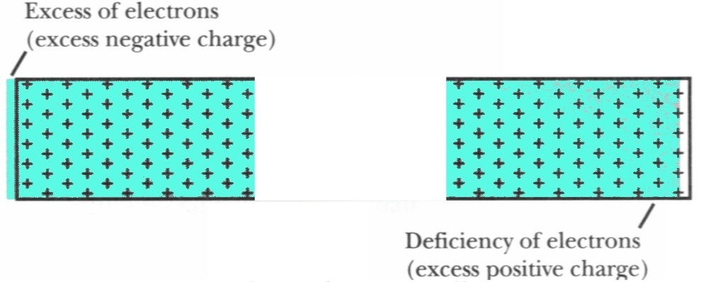
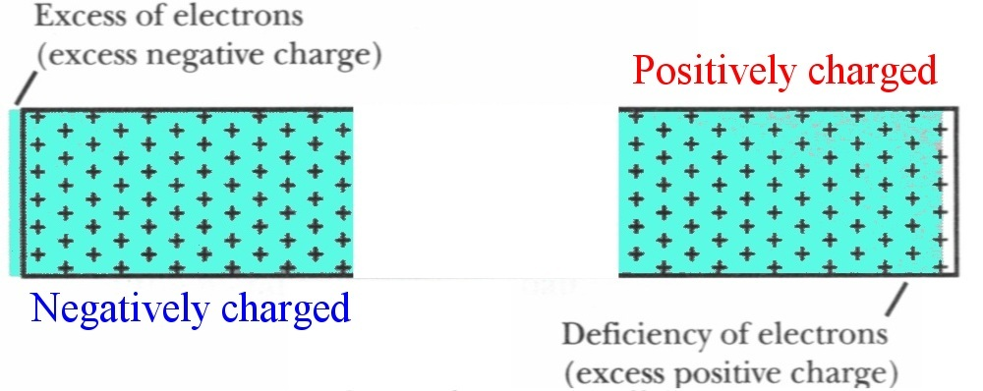
Charging by Induction

Slide 29
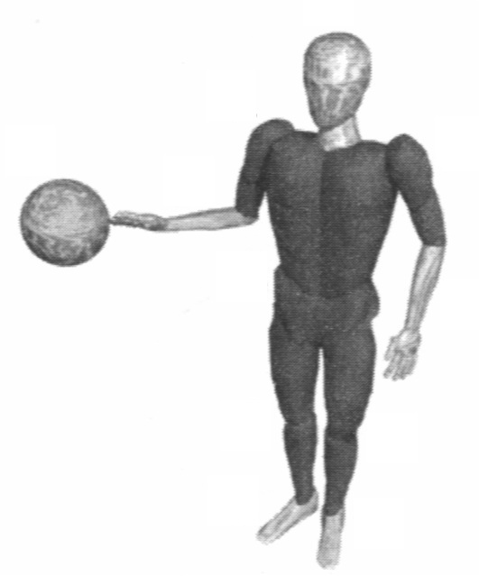
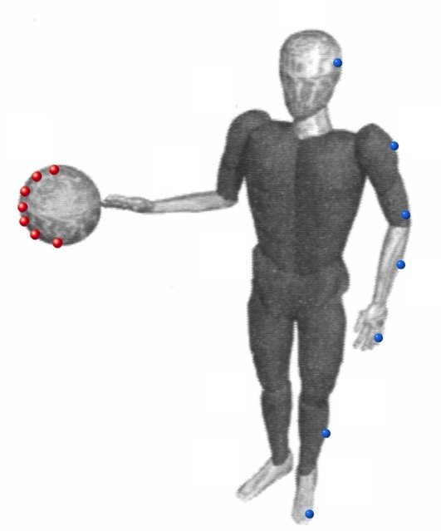
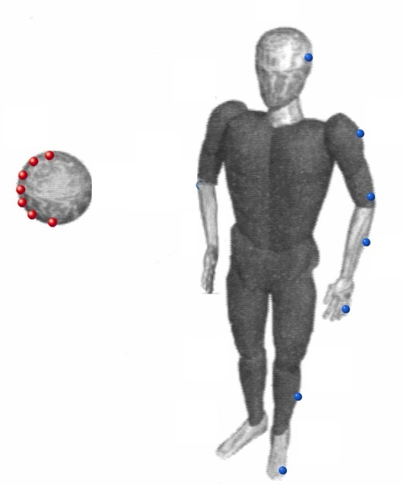
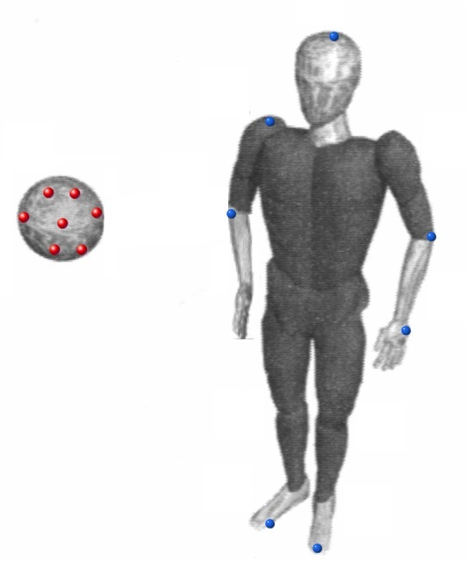
Charging by Induction

Slide 30
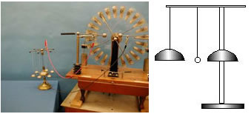
5A-10 Motion in an Electric Field
+
+
-
-
Notes:
This a set of demonstrations related to effects resulting from electric field forces.
(a) A ping pong ball is free to roll inside a horizontally mounted glass tube mounted between the terminals of the small Wimshurst machine. When the machine is in operation, the ball moves back and forth in the tube as it first receives a charge from one terminal and then is repelled to the other terminal, where it is charged oppositely.
(b) A set of electric “chimes,” consisting of four bells suspended from conducting threads, and a central bell affixed to an insulating stand. A small ball is suspended from an insulating thread so it hangs between the two bells. The central bell is grounded (or attached to the opposite terminal), whereas the other four bells are are charged from a small Wimshurst machine. The hanging ball is attracted to the hanging bell by charge induction, causing the ball to strike the bell. The ball then picks up up the charge of the bell and is repelled, causing it to strike the central (grounded) bell. The ball is discharged and the process begins all over again

Slide 31
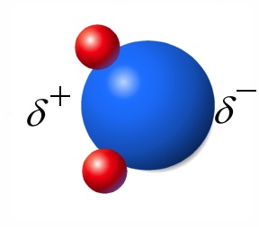
Humidity and Discharging Process
Charged tapes (and other objects) become discharged after some time.
Higher humidity – faster discharge
Water molecule - dipole
Thin film of water is formed on surfaces – conductor (poor)

Slide 32
Clicker Question
An electric field polarizes a metal block as shown below. Select
the diagram that represents the final state of the metal.
E
+
+
+
-
-
-
A)
+
-
+
-
C)
+
-
+
-
+
-
+
-
+
-
+
-
B)
+
+
+
-
-
-
-
-
-
+
+
+
D)
-
+
-
+
-
+
-
+
Notes:
B

Slide 33
Today
Insulators: Electrons stay close to their own atoms
Conductors: Charges are free to move
  E = 0 inside conductor in equilibrium
  Ionic solutions
  Metals
Charging and Discharging Objects

Slide 34
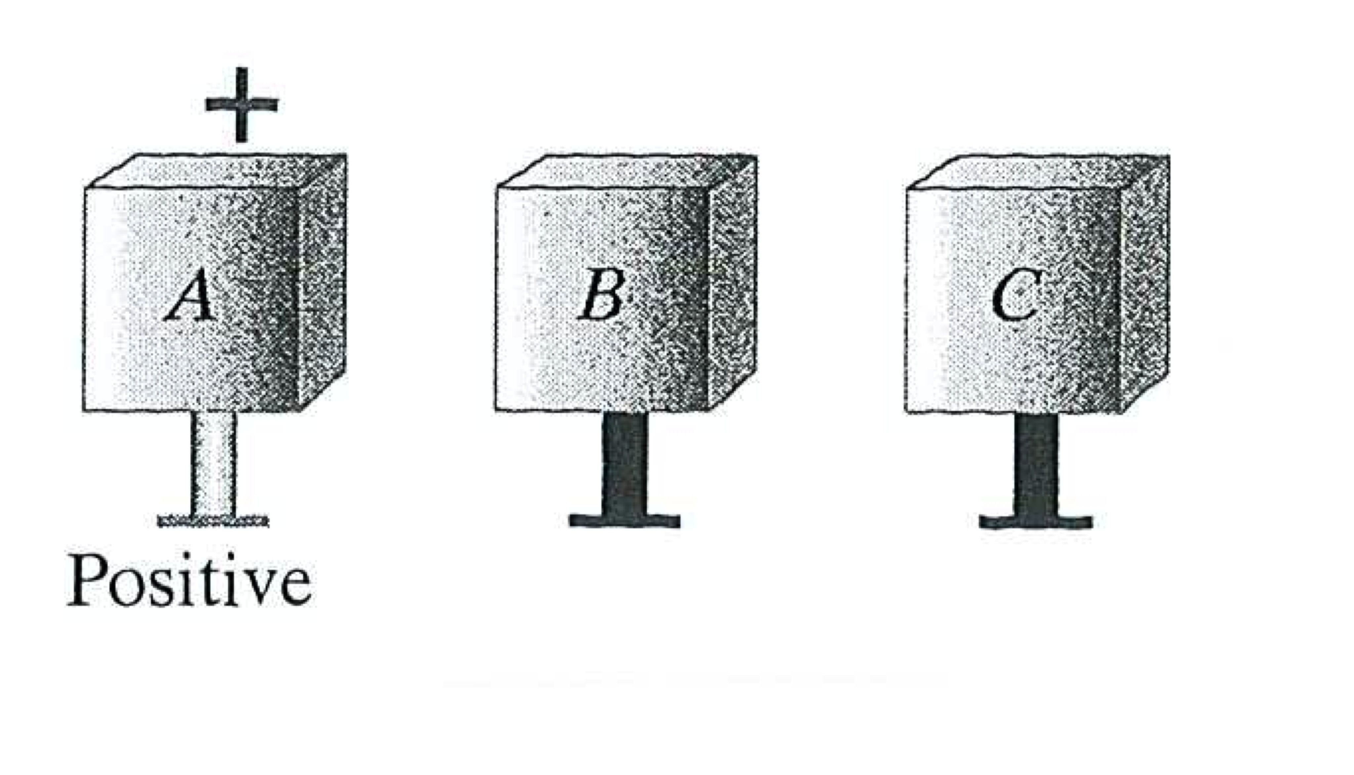
You have three metal blocks marked A, B, and C, sitting on insulating stands. Block A is charged +, but blocks B and C are neutral. Without using any additional equipment, and without altering the amount of charge on block A, can you make block B be charged + and block C be charged -?
Yes, but one must change the ordering of blocks B & C as an intermediate step.
Yes, this can be done without changing the order of blocks B & C.
No way!
Notes:
Do demo. Ask Tammi for electronic electrometer. Ask students what is in the blue box.

