Slide 1
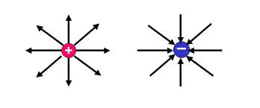
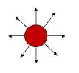
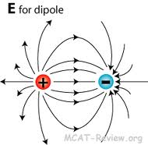
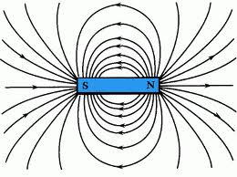
Last Time
Electric forces are stronger than gravitational forces
Electric field of:
Point Charges
Charged Sphere
Superposition Principle
  E_{tot} is the sum from all charges

Slide 2
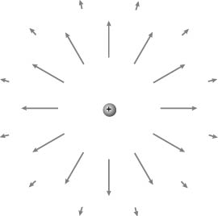
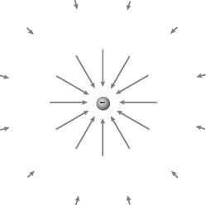


Summary: Point Charge and Dipole
Point Charge:
+
-
Dipole:
for r>>s :
at <r,0,0>
y
s
at <0,r,0>
-q
+q
x
z
at <0,0,r>
Notes:
Note that the magnitude of the electric field at a location along the y axis is HALF of the magnitude of the electric field at a location the same distance away on the x axis!

Slide 3
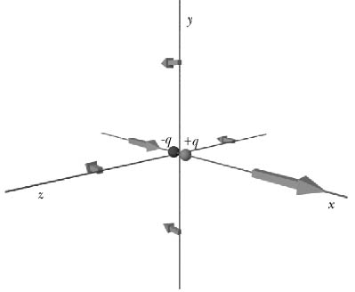
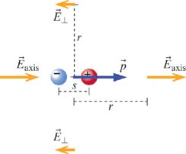
Definition of "Dipole Moment"
x:
r>>s
y, z:
The electric field of a dipole is proportional to the
Dipole moment: p = qs
, direction from –q to +q
Dipole moment is a vector pointing from negative to positive charge
Notes:
Note – aproximate

Slide 4
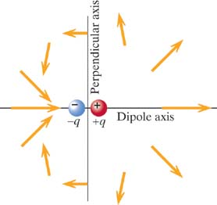
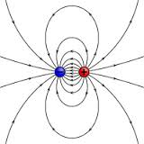
Shape of Dipole Electric Field
Wikimedia Commons
Demo: 5A-23
Notes:
t consists of three parts: a Static Genecon, which is a hand held electrostatic generator; an observation tank which consists of a fine electrified powder in oil; several different electrode plates.
Directions: Slide an electrode into the observation chamber. Attach the leads of the Static Genecon to the observation chamber and turn the crank. Electrical charge will collect on the electrodes and the powder will align itself in the oil following electric field lines.

Slide 5
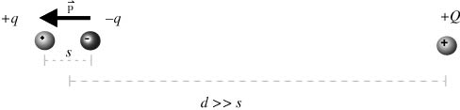
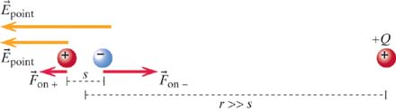
Interaction of a Point Charge and a Dipole
Direction makes sense?
- negative end of dipole is closer, so its net contribution is larger
What is the force exerted on the dipole by the point charge?
- Newton’s third law: equal but opposite sign
Notes:
Why is it possible? Total charge of dipole is zero! – the key lays in distance dependence

Slide 6

Dipole in a Uniform Field
Forces on +q and –q have the same magnitude but opposite direction
What happens in this case?
What’s the direction of force on each charge?
  blue→negative
  red→ positive
Notes:
What would be equi

Slide 7
Dipole in a Uniform Field
Forces on +q and –q have the same magnitude but opposite direction
Dipole experiences a torque about its center of mass.
What is the equilibrium position?
Electric dipole can be used to measure the direction of electric field.
Notes:
What would be equi

Slide 8
A Fundamental Rationale
If know E at some location, then we know the electric force on any charge:
Can describe the electric properties of matter in terms of electric field – independent of how this field was produced.
Example: if E>3×10⁶ N/C air becomes conductor
Retardation
Nothing can move faster than light c
c = 300,000 km/s = 30 cm/ns
Coulomb’s law is not completely correct – it does not contain time t nor speed of light c.
v <<c !!!
Notes:
Example: Suppose I am negatively charged sphere, move to one side ask student in back row to show the direction of E due to this charge.
Then move to the other side at ~speed of light and ask student what will happen to E. It is ~5 meters, so it takes 15 ns for E to change direction after I moved!
More drastic example – pretend that I hold electron and positron (dipole), ask student to show E. Collapse (annihilate) charges and count time.
Conclusion: E can exist independently of charges!!!
Does not contain v – works only when speed is << c

Slide 9
Clicker Question
Two point charges are separated by distance d as shown. Where can you put a third charge of
+1 C so that there is no net electric force acting on it? (Take Q > 0.)
to the right of charge -Q
to the left of charge 2Q
between the two charges
some other place
nowhere
2Q
- Q
d
e = 1.6×10⁻¹⁹ C
k = 8.99×10⁹ Nm²/C²

Slide 10
More For Today
Conservation of Charge
Polarization of Atoms
Neutral Atom and Point Charge

Slide 11
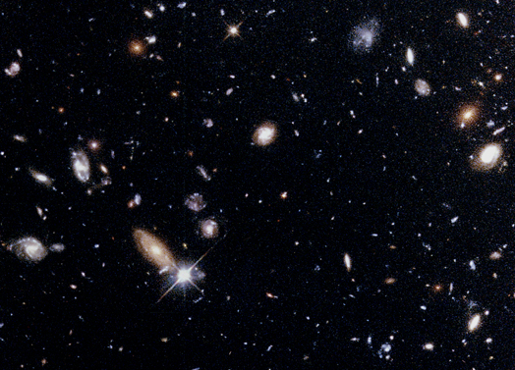
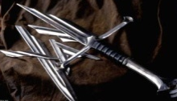
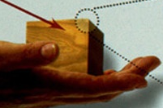
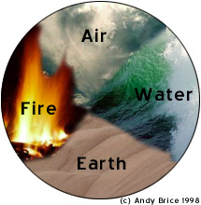
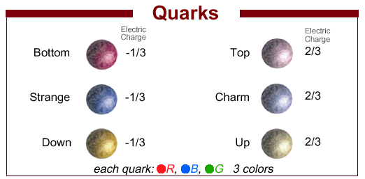
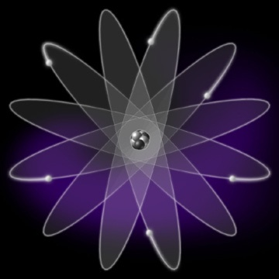
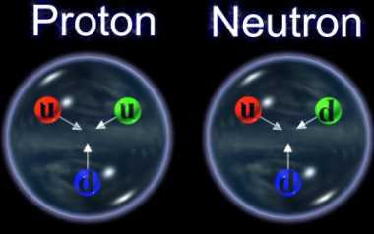
Structure of matter in the Universe
Wood
Huge scale
Iron
Gravitational
Universe
Current building block
Leptons: electron, muon, etc
scale ~ 10⁻¹⁰ m
Electromagnetic
scale ~ 10⁻¹⁵ m
Strong

Slide 12
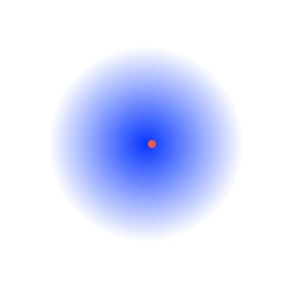
The Structure of an Atom
Hydrogen
10⁻¹⁰ m (1 Å)
Nucleus, ~10⁻¹⁵ m
Charge of electron cloud equals that of nucleus → neutral atom.
If the electron cloud is centered on the nucleus → electric field produced by electrons exactly cancels the field produced by nucleus.
WHY?
Notes:
Superposition of point charge + charged sphere.

Slide 13
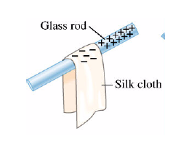

Charge an object
Why get charged?
Breaking large molecules, transfer ions
Transfer electrons
Demo 5A-01
Notes:
Van de Graff generator
Plastic shopping bag cut as a loop
Balloons
Scotch Tape
Metal plate
Plastic rod and fur
Demonstration 5A-03 “Two-by-Four Electroscope”
Demonstration 5A-10 “Motion in an Electric Field”
Demonstration 2C-06 “Ball in Air Stream”
camera

Slide 14
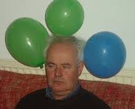
Conservation of Charge
The net charge of a system and
its surroundings cannot change
You can move charge from the system to surroundings
  Example: Rub a balloon (or comb) on your hair
-
-
+
-
Can you create or destroy charge?
Yes!
Charges can be created or destroyed in (+,-) pairs
    Example: electron-positron annihilation.
Notes:
Example: when you comb your hair the comb gets charged and so does your hair, the magnitude is equal, sign is different.
http://scienceblogs.com/startswithabang/2011/06/29/static-electricity-isnt-what-y/

Slide 15
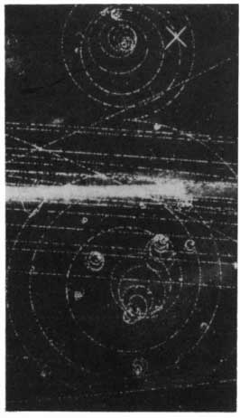
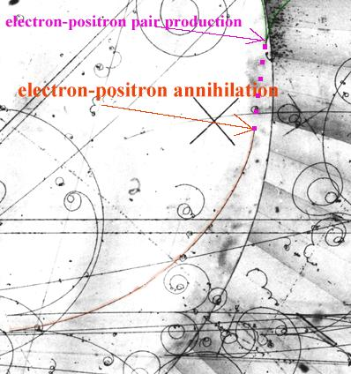

Slide 16
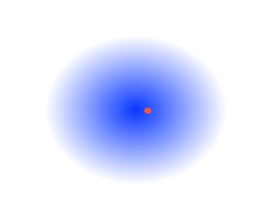
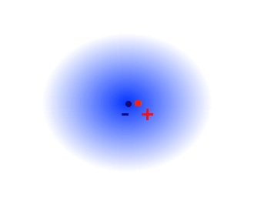
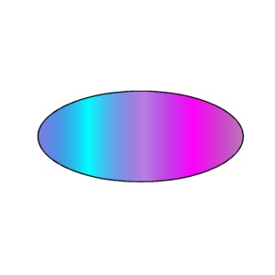
Polarization of Atoms
-
E
+
+
Atom becomes polarized by Electric Field
"Induced Dipole"

Slide 17

Polarization of Atoms
DIPOLE
MOMENT
+
p = qs
Atom becomes polarized by Electric Field
"Induced Dipole"

Slide 18
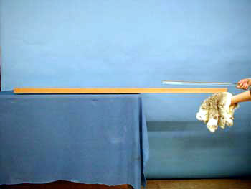
Interaction of charged rod and Neutral Matter
Demo: 5A-03

Slide 19
Clicker Question
Atom A is easier to polarize than atom B. Which atom would experience a greater attraction to a point charge a distance r away?
A
-
+
-
F_{A}
-
B
-
+
F_{B}
Notes:
A

Slide 20
Polarization
p = qs
DIPOLE MOMENT
POLARIZATION
α - “polarizability” of a material
Magnitude of polarization = dipole moment of the atoms/molecules
In an induced dipole, is the distance between the charges fixed?
No. The distance is proportional to the strength of the applied field.

Slide 21
Example
A typical atomic polarizability is α=10⁻⁴⁰ C•m/(N/C).
If q=e (proton charge), what is the charge separation by applying a field E=3•10⁶ N/C?
Shift is five orders of magnitude smaller than the atom itself!
Notes:
The value chosen for E here is that which causes air to become conducting. Turning the above argument around, we see that a displacement of only 2x10^-15 m causes an E field capable of ionizing air.

Slide 22
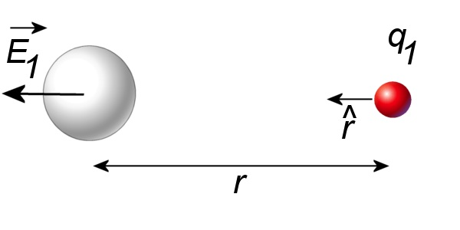
Force of a Point Charge on an Atom
1)
1. Point charge creates field E₁ at atom

Slide 23
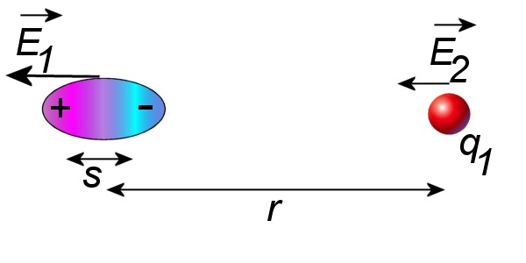
Force of a Point Charge on an Atom
1)
2)
2. Field E₁ polarizes atom

Slide 24
Force of a Point Charge on an Atom
1)
3)
2)
3. Induced dipole creates field E₂ at point charge
~ 1/r⁵

Slide 25
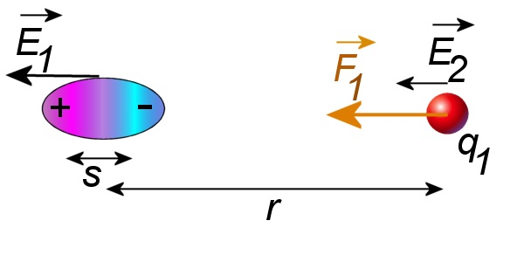
Force of a Point Charge on an Atom
1)
3)
2)
4)
4. Field E₂ exerts force on point charge
Notes:
1/r^5 because induced p proportional to 1/r^2 and it produces a field at q1 proportional to p/r^3.

Slide 26
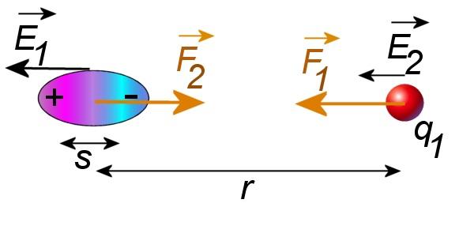
Force of a Point Charge on an Atom
1)
3)
2)
4)
5. F₁ is the force the atom exerts on the charge.
What is the force the charge exerts on the atom?
Equal and opposite forces! (Reciprocity)

Slide 27
Force of a Point Charge on an Atom
1) Point charge creates field E₁ at atom
2) Field E₁ polarizes atom
3) Induced dipole creates field E₂ at point charge
4) Field E₂ exerts force on point charge
5) Equal and opposite forces
Neutral atoms are attracted by charges!
Interaction strength ~ 1/r⁵

Slide 28
iClicker
Which one of the following is not true?
The electric force exerted by a induced electric dipole on an electron along the dipole moment direction:
A. decreases by a factor of 32 if the distance is increased by a factor of 2.
B. has the same magnitude as the electric force exerted by the same dipole on a proton at the same distance.
C. has the same direction as the electric force exerted by the same dipole on a proton at the same distance.
D. has the opposite direction as the electric force exerted by the same dipole on a proton at the same distance.
Notes:
Answer: D

Slide 29
More Today
Insulators: Electrons stay close to their own atoms
Conductors: Charges are free to move
  E = 0 inside conductor in equilibrium
  Ionic solutions
  Metals
Charging and Discharging Objects

Slide 30
Conductors and Insulators
Different materials respond differently to electric field
Conductor: contains mobile charges that can move through material
Insulator: contains no mobile charges
Notes:
All materials are made of atoms that contain electrons and protons, but different materials respond in different ways to electric fields.
Insulator: electrons are tightly bound to the molecules
Conductors: free moving charged particles

Slide 31
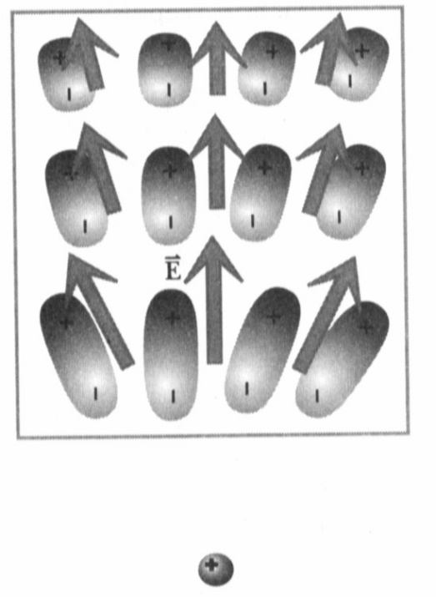
Polarization of Insulators
Insulator: Electrons are bound to the atoms or molecules.
Electrons can shift slightly (<1 Å), but remain bound to the molecule.
Individual atoms or molecules can be polarized by external electric field.
There are a lot of molecules – the net effect produced by the induced dipoles can be very large.
Notes:
We have seen that an individual atom or molecule can be polarized by an applied electric field, producing an induced dipole of atomic or molecular dimension.
No charged particles can move more than 10⁻¹⁰ m

Slide 32
Low Density Approximation
Field E at a location of a molecule is a superposition of the external applied field and the field created by other induced dipoles:
Simplifying assumption:
Notes:
What happens if we apply an electric field to an insulator?
No mobile charges in an insulator, excess charges stay where they are.

Slide 33
Conductors
There are charges which can move freely throughout the material
E
In contrast to an insulator, where electrons and nuclei can move only very small distances, the charged particles in a conductor are free to move large distances.
Polarization of conductors differs from that of insulators.

Slide 34
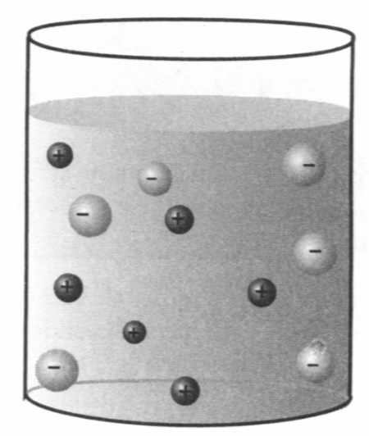
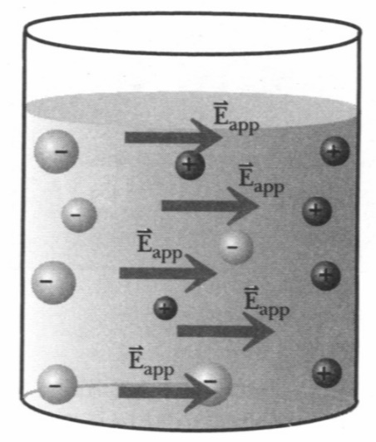
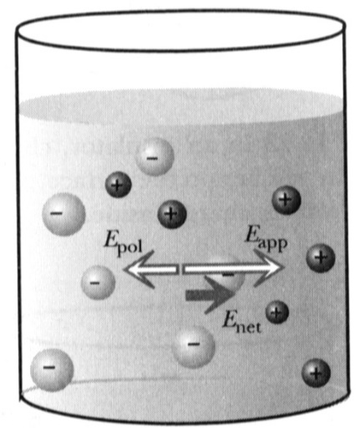
Ionic Solutions are Conductors
Salt water:
Na⁺ and Cl⁻
H⁺ and OH⁻
Apply external
electric field
When an electric filed is applied to a conductor, the mobile charged particles begin to move in the direction of the force exerted on them by the field.
As the charges move, they begin to pile up in one location, creating a concentration of charge → creates electric field.
The net electric field is the superposition of the applied field and field created by the relocated charges.
Notes:
Example: Sodium chloride : sodium ions and chloride ions
When electric field is applied:
Put electrodes in – field at all times, no static equilibrium.

Slide 35
Ionic Solutions are Conductors
Assumption: charges will move until E_{net}=0 (static equilibrium)
Proof: by contradiction:
Assume E_{net}≠0
Mobile ions will move
This is not equilibrium
Assumption E_{net}≠0 is wrong
E_{net}=0
It is not a shielding effect, but a consequence of superposition!
Notes:
Polarization occurs very rapidly but it is not instantaneous (10⁻¹⁸ s).
Only few ions move and only short distances until equilibrium is reached!
Put electrodes in – field at all times, no static equilibrium.

Slide 36
Today
Conservation of Charge
Polarization of Atoms
Neutral Atom and Point Charge

