Slide 1
Key Ideas in Chapter 14: Electric Field
A charged particle makes an electric field at every location in space
  (except its own location).
The electric field due to one particle affects other charged particles.
The electric force on a charged particle is proportional to
  the net electric field at the location of that particle.
The Superposition Principle:
  The net electric field at any lecation is the vector sum
  of the individual electric fields of all charge particles at other locations.
  The field due to one charged particle is not changed
  by the presence of other charged particles.
An electric dipole consists of two particles with charges equal in magnitude
and opposite in sign, separated by a short distance.
Changes in electric fields travel at the speed of light ("retardation").
Notes:
START TIME HERE:

Slide 2
The Coulomb Force Law
Key Idea: Charges exert forces on each other
Q₁
Q₂
F
F
Direction of Force is:
ATTRACTIVE if charges have OPPOSITE sign
REPULSIVE if charges have SAME sign
Always acts along a line connecting the charges
Lecture 1
Notes:
Charles Augustin de Coulomb – French engineer and scientist. Created science of friction (first), after that stopped engineering and became involved full time in physics, in 1785-1791 published 7 papers on electricity and magnetism:
... had obtained some remarkable results by using the torsion balance method: law of attraction and repulsion, the electric point charges, magnetic poles, distribution of electricity on the surface of charged bodies and others. The importance of Coulomb's law for the development of electromagnetism is examined and discussed. In these he developed a theory of attraction and repulsion between bodies of the same and opposite electrical charge. He demonstrated an inverse square law for such forces and went on to examine perfect conductors and dielectrics. He suggested that there was no perfect dielectric, proposing that every substance has a limit above which it will conduct electricity. These fundamental papers put forward the case for action at a distance between electrical charges in a similar way as Newton's theory of gravitation was based on action at a distance between masses.

Slide 3
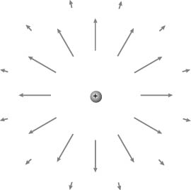
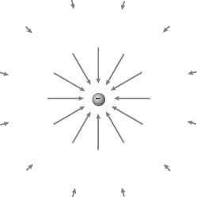
Which way does the field point?
Key Idea: A charged particle makes an electric field at every location in space
Point Particle
Here is a useful mnemonic:
+
-
-
Positive people
care about others
Negative people
care only about
themselves

Slide 4
Example 1: Electric Field
Key Idea: A charged particle makes an electric field at every location in space
Problem:
A particle with charge q₁=2 nC = 2 x 10⁻⁹ C
is located at the origin. What is the electric field
due to this particle at a location <-0.2,-0.2,-0.2> m?
observed
location
source
location
Notes:
Note: r – direction is from source to point of observation.

Slide 5
Example 1: Electric Field
Key Idea: A charged particle makes an electric field at every location in space
Problem:
A particle with charge q₁=2 nC = 2 x 10⁻⁹ C
is located at the origin. What is the electric field
due to this particle at a location <-0.2,-0.2,-0.2> m?
Solution:
Distance and direction:
observed
location
source
location
Notes:
Note: r – direction is from source to point of observation.

Slide 6
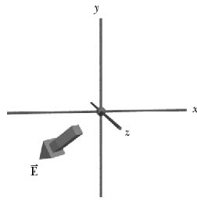
Problem:
A particle with charge q₁=2 nC = 2 x 10⁻⁹ C
is located at the origin. What is the electric field
due to this particle at a location <-0.2,-0.2,-0.2> m?
Solution:
2. The magnitude of the electric field:
3. The electric field in vector form:

Slide 7
Example 2: Electric Force
Key Idea: A charged particle makes an electric field at every location in space
Electron: q = -e
Problem: The electric field at a particular location
is <-300,0,0> N/C. What force would an electron experience if it were placed in this location?
Y
E
e
F
X
Solution:

Slide 8
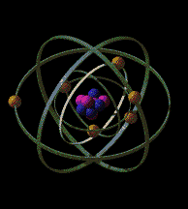
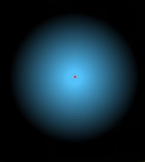
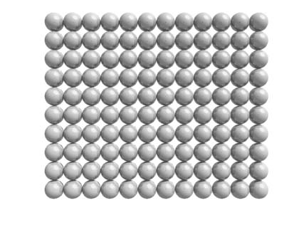
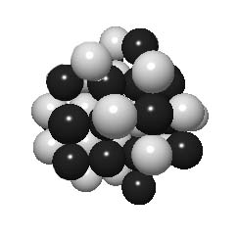
Structure of Atom
Matter consists of atoms
1 cm³ : ~10²⁴ atoms
1Å=10⁻¹⁰m
Nucleus of the iron atom
Size: ~10^{–15} m
Atoms are 99.999999999999999% EMPTY SPACE
Notes:
Iron: 26 protons and 30 neutrons

Slide 9
iClicker
A penny carrying a positive charge Q_{p} exerts an electric force of magnitude F on a nickel carrying positive charge Q_{n} that is a distance d away (Q_{n} > Q_{p} ). Which one of the following is not true?
The electric force exerted on the penny by the nickel is
also equal to F.
B. The number of electrons in the penny is less than the
number of protons in the penny.
C. The number of electrons in the penny is larger than
the number of protons in the penny.
D. , if d is large compared to the size of the
coins.
Notes:
Answer: C

Slide 10
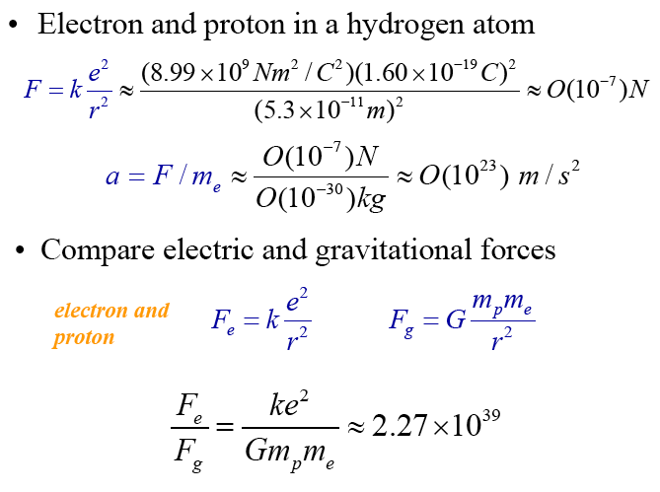
How Strong is the Coulomb Force?
Example: Hydrogen Atom = proton and electron
F_{elec} =
F_{grav} =
F_{elec}
Electricity is much stronger
than Gravity
F_{grav}

Slide 11
iClicker
A person weighs 150 lbs. Which of the following statements is correct.
The weight is caused by gravity
The weight is caused by electric interaction since it’s so much stronger than gravity
C. The weight is an intrinsic number to describe a body mass, regardless of existence of gravity or electric force.
Notes:
Answer: C

Slide 12
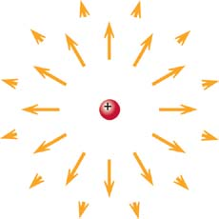
Electric Field of Point Charges
Key Idea: A charged particle makes an electric field
at every location in space (except its own location).
What happens as ?
Can the particle exert a force on itself?
No.
E is undefined at the origin, since
is self-contradictory.
If there were a force at the origin, which way would it point?
Notes:
EC: CLASS DISCUSSION.
Does E blow up? Is it undefined, since r-hat is self-contradictory?
Even if there were a force, which way would it point?

Slide 13
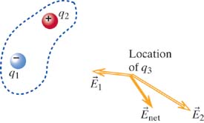
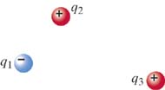
The Superposition Principle
Key Idea: The net electric field at a location in space is a vector sum of the individual electric fields contributed by all charged particles located elsewhere.
Key Idea: The electric field contributed by a charged particle is unaffected by the presence of other charged particles.

Slide 14
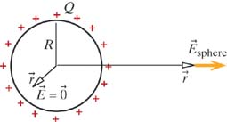
Electric Field of a
Uniformly Charged Spherical Shell
for a point particle
What should the electric field
look like from far away?
for r >> R
Which direction does the field point close to the sphere?
Spherical symmetry The field is in the direction
even close up to the sphere
Notes:
Uniformly charged sphere acts like a point charge! Not only its field is the same (outside), but it also interacts with other charge particles as a point charge.

Slide 15
Electric Field of a
Uniformly Charged Spherical Shell
We'll calculate the whole thing later
using the principle of superposition:
for r >R (outside)
for r <R (inside)
Notes:
Uniformly charged sphere acts like a point charge! Not only its field is the same (outside), but it also interacts with other charge particles as a point charge.

Slide 16


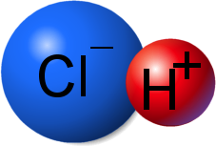
The Superposition Principle
The electric field of a dipole:
Electric dipole:
Made of two equally but oppositely charged point-like objects
s
-q
+q
Example of electric dipole: HCl molecule
What is the E field far from the dipole (r >> s)?

Slide 17
Calculating Electric Field
Choice of the origin
y
s
-q
+q
x
z
Choice of origin: use symmetry

Slide 18

1. E along the x-axis
Point Particle
Dipole Electric Field
(Along X-Axis)

Slide 19
Far from the Dipole along the x-axis
Dipole Electric Field
(Along X-Axis)
To find the Electric field far from the dipole (r >> s):
Dipole Electric Field
(Far Away Along X-Axis)
Electric Field of Point Particle: ~ 1/r²
Electric Field of Dipole: ~ 1/r³

Slide 20

2. E along the y-axis
for a point particle

Slide 21
2. E along the y-axis
if r>>s, then
at <0,r,0>
Notes:
Ask now about coordinate <0,0,r> - make them think about symmetry.

Slide 22
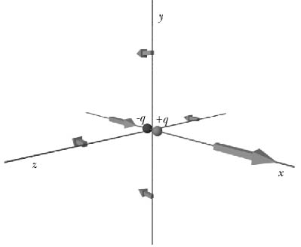
3. E along the z-axis
at <r,0,0>
at <0,r,0>
or <0,0,r>
By symmetry,
E along the z-axis must be the same as
E along the y-axis!
Notes:
Point out difference – direction and magnitude

Slide 23
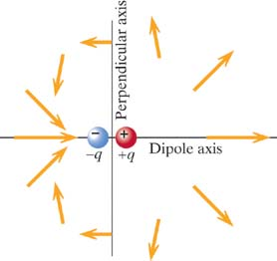
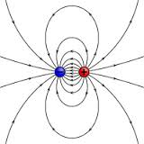
Shape of Dipole Electric Field
Wikimedia Commons
Notes:
Carlson got here, 8/22/12.
Ask students where is + and where is -.

Slide 24
Summary: Point Charge and Dipole
Point Charge:
+
-
Dipole:
for r>>s :
at <r,0,0>
y
s
at <0,r,0>
-q
+q
x
z
at <0,0,r>
Notes:
Note that the magnitude of the electric field at a location along the y axis is HALF of the magnitude of the electric field at a location the same distance away on the x axis!

Slide 25
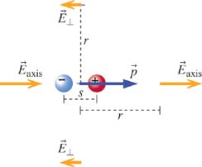
Definition of "Dipole Moment"
x:
r>>s
y, z:
The electric field of a dipole is proportional to the
Dipole moment: p = qs
, direction from –q to +q
Dipole moment is a vector pointing from negative to positive charge
Notes:
Note – aproximate

Slide 26
Example Problem
y
A dipole is located at the origin, and is composed of particles with charges e and –e, separated by a distance 2×10⁻¹⁰ m along the x-axis. Calculate the magnitude of the E field at <0,2×10⁻⁸,0> m.
E=?
Since r>>s:
200Å
x
2Å
Using exact solution:
Notes:
A dipole is located at the origin, and is composed of particles with charge e and –e, separated by a distance 2×10⁻¹⁰ m along the x-axis. Calculate the magnitude of the E field at <0,2×10⁻⁸,0> m.

Slide 27
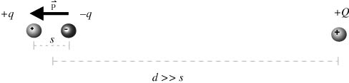
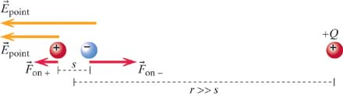
Interaction of a Point Charge and a Dipole
Direction makes sense?
- negative end of dipole is closer, so its net contribution is larger
What is the force exerted on the dipole by the point charge?
- Newton’s third law: equal but opposite sign
Notes:
Why is it possible? Total charge of dipole is zero! – the key lays in distance dependence

Slide 28

Dipole in a Uniform Field
Forces on +q and –q have the same magnitude but opposite direction
What happens in this case?
What’s the direction of force on each charge?
  blue→negative
  red→ positive
Notes:
What would be equi

Slide 29
Dipole in a Uniform Field
Forces on +q and –q have the same magnitude but opposite direction
Dipole experiences a torque about its center of mass.
What is the equilibrium position?
Electric dipole can be used to measure the direction of electric field.
Notes:
What would be equi

Slide 30
A Fundamental Rationale
If know E at some location, then we know the electric force on any charge:
Can describe the electric properties of matter in terms of electric field – independent of how this field was produced.
Example: if E>3×10⁶ N/C air becomes conductor
Retardation
Nothing can move faster than light c
c = 300,000 km/s = 30 cm/ns
Coulomb’s law is not completely correct – it does not contain time t nor speed of light c.
v <<c !!!
Notes:
Example: Suppose I am negatively charged sphere, move to one side ask student in back row to show the direction of E due to this charge.
Then move to the other side at ~speed of light and ask student what will happen to E. It is ~5 meters, so it takes 15 ns for E to change direction after I moved!
More drastic example – pretend that I hold electron and positron (dipole), ask student to show E. Collapse (annihilate) charges and count time.
Conclusion: E can exist independently of charges!!!
Does not contain v – works only when speed is << c

Slide 31
Key Ideas in Chapter 14: Electric Field
A charged particle makes an electric field at every location in space
  (except its own location).
The electric field due to one particle affects other charged particles.
The electric force on a charged particle is proportional to
  the net electric field at the location of that particle.
The Superposition Principle:
  The net electric field at any lecation is the vector sum
  of the individual electric fields of all charge particles at other locations.
  The field due to one charged particle is not changed
  by the presence of other charged particles.
An electric dipole consists of two particles with charges equal in magnitude
and opposite in sign, separated by a short distance.
Changes in electric fields travel at the speed of light ("retardation").
Notes:
START TIME HERE:

Slide 32
iClicker
Which one of the following is not true?
The electric force exerted by an electron on an electron:
A. decreases by a factor of 25 if the distance is increased by a factor of 5.
B. has the same magnitude as the electric force exerted by a proton on a proton at the same distance.
C. has the same direction as the electric force exerted by a proton on a proton at the same distance.
D. is much weaker than the gravitational force between them.
Notes:
Answer: D

