Slide 1
PHYSICS 272
Electric & Magnetic Interactions
Professor in Charge: Prof. Wei Xie WebAsssign Administrator: Dr. D. Huckleberry
Office: PHYS 254 Office: PHYS 176
Email: wxie@purdue.edu E-Mail: dhuckleb@purdue.edu
Office Hours: by appointment
Laboratory Coordinator: Riddhi Mehta
Office: PHYS 136
E-Mail: mehta74@purdue.edu
Office Hours: by appointment

Slide 2
Today
General Course Information
Charges, forces, and electric field.

Slide 3
Announcements
Prof Xie Office Hours:
by appointment
Find everything you need in Blackboard:
Lecture Notes
Lecture Audio (Boilercast): requested
Syllabus
Homework (WebAssign)
Gradebook
Labs
iClicker registration
Course website:
http://www.physics.purdue.edu/phys272/

Slide 4
Syllabus & General Information:
This is a 4 credit hour course.
Lectures will not cover everything you need to learn from this course.
Expect to spend 2 x 4 = 8 hours outside of class time:
  Reading the textbook
  Homework (HW)
  Recitation
  Lab assignments

Slide 5
Syllabus & General Information:
Mid-term Exams (2) | 30%
Final Exam | 15%
Labs | 15%
Homework (WebAssign) | 15%
Clicker questions | 10%
Recitation | 15%
TOTAL | 100%

Slide 6
Syllabus & General Information:
Reminders:
For help with homework problems, go to the Physics Learning Center in Room 11 (PHYS Bldg) during the assigned hours. Schedule announced in in Blackboard and course website. It is staffed by trained teaching assistants assigned to this course. Use it!
50% credit is given until 24x7=168 hours after the primary deadline and within the attempt number limits. No credit will be given after that.
Extensions can be granted for Homework assignments, if you have a good reason and don’t abuse the privilege.
To request an Excused Grade for a lab, recitation, or an exam due to a valid reason (illness, etc), go to room 144 and fill a class exemption form. Do this in advance if at all possible. Advance notification is required for Exams.

Slide 7
Syllabus & General Information:
You are encouraged to work on homework together – discussing ideas and concepts reinforces the material for everyone involved in the conversation. Just be sure that what you turn in is your own work that you fully understand.
The following are examples of cheating:
    Any effort to represent somebody else’s work as your own, or allowing your work to be represented as somebody else’s
    Having somebody else solve assigned problems for you
    Entering iClicker responses for anybody else.
    Being in possession of more than one iClicker in lecture
  Academic Honesty
Read the syllabus.

Slide 8

Got an iClicker?
Turn the Power on. “AB” frequency
After the question is declared “Open”, choose one:
I got 8 or more hours of sleep last night
I got 7 hours of sleep last night
I got 5 or 6 hours of sleep last night
I got less than 5 hours of sleep last night
Sleep? What's sleep?
CLICKER POLL (not graded):
"Clicker Poll"
= Not Graded ☺
NOTE: From now on, always bring your iClicker to lecture with you. The clicker questions count towards 10% of your grade.
iClicker questions may be asked any time during lecture: don’t be late!

Slide 9
EMERGENCY PREPAREDNESS – A MESSAGE FROM PURDUE
To report an emergency, call 911. To obtain updates regarding an ongoing emergency, sign up for Purdue Alert text messages, view www.purdue.edu/ea.
There are nearly 300 Emergency Telephones outdoors across campus and in parking garages that connect directly to the PUPD. If you feel threatened or need help, push the button and you will be connected immediately.
If we hear a fire alarm during class we will immediately suspend class, evacuate the building, and proceed outdoors. Do not use the elevator.
If we are notified during class of a Shelter in Place requirement for a tornado warning, we will suspend class and shelter in [the basement].
If we are notified during class of a Shelter in Place requirement for a hazardous materials release, or a civil disturbance, including a shooting or other use of weapons, we will suspend class and shelter in the classroom, shutting the door and turning off the lights.
Please review the Emergency Preparedness website for additional information. http://www.purdue.edu/ehps/emergency_preparedness/index.html
Notes:
One final piece of Purdue business before we begin: as we start this semester I want to take a few minutes to discuss emergency preparedness. Purdue University is a very safe campus and there is a low probability that a serious incident will occur here. However, just as we receive a safety briefing each time we get on an aircraft, we want to emphasize our emergency procedures for evacuation and shelter in place incidents. Our preparedness will be critical if an unexpected event occurs.
Purdue prepares for natural disasters or human‑caused incidents with the ultimate goal of maintaining a safe and secure campus, but nin the end, emergency preparedness is your personal responsibility. Let’s quickly review the following procedures:

Slide 10
Counseling and Psychological Services
Purdue University is committed to advancing the mental health and well-being of its students. If you or someone you know is feeling overwhelmed, depressed, and/or in need of support, services are available. For help, such individuals should contact Counseling and Psychological Services (CAPS) at (765)494-6995 and http://www.purdue.edu/caps/ during and after hours, on weekends and holidays, or through its counselors physically located in the Purdue University Student Health Center (PUSH) during business hours.

Slide 11
Key Ideas in Chapter 14: Electric Field
A charged particle makes an electric field at every location in space
  (except its own location).
The electric field due to one particle affects other charged particles.
The electric force on a charged particle is proportional to
  the net electric field at the location of that particle.
The Superposition Principle:
  The net electric field at any location is the vector sum
  of the individual electric fields of all charge particles at other locations.
  The field due to one charged particle is not changed
  by the presence of other charged particles.
An electric dipole consists of two particles with charges equal in magnitude
and opposite in sign, separated by a short distance.
Changes in electric fields travel at the speed of light ("retardation").
Notes:
START TIME HERE:

Slide 12
Point Charges
Key Idea: Charges exert forces on each other
Two types: positive and negative
Like charges: repel
Opposite charges: attract
Charge is quantized in units of e
Point charge: Size is small compared to the distance between it and other objects of interest
Electric charge is an intrinsic property of the fundamental particles that everything is made of
Notes:
Positive/negative – just definition, can call red-green.
Electron/protons – often are treated as point charges. Proton=1e-15 m.

Slide 13
The Coulomb Force Law
Key Idea: Charges exert forces on each other
Q₁
Q₂
F
F
Magnitude of Force is:
Proportional to the magnitude of each charge
Inversely proportional to the distance squared
Notes:
Charles Augustin de Coulomb – French engineer and scientist. Created science of friction (first), after that stopped engineering and became involved full time in physics, in 1785-1791 published 7 papers on electricity and magnetism:
... had obtained some remarkable results by using the torsion balance method: law of attraction and repulsion, the electric point charges, magnetic poles, distribution of electricity on the surface of charged bodies and others. The importance of Coulomb's law for the development of electromagnetism is examined and discussed. In these he developed a theory of attraction and repulsion between bodies of the same and opposite electrical charge. He demonstrated an inverse square law for such forces and went on to examine perfect conductors and dielectrics. He suggested that there was no perfect dielectric, proposing that every substance has a limit above which it will conduct electricity. These fundamental papers put forward the case for action at a distance between electrical charges in a similar way as Newton's theory of gravitation was based on action at a distance between masses.

Slide 14
The Coulomb Force Law
Key Idea: Charges exert forces on each other
Q₁
Q₂
F
F
Direction of Force is:
ATTRACTIVE if charges have OPPOSITE sign
Notes:
Charles Augustin de Coulomb – French engineer and scientist. Created science of friction (first), after that stopped engineering and became involved full time in physics, in 1785-1791 published 7 papers on electricity and magnetism:
... had obtained some remarkable results by using the torsion balance method: law of attraction and repulsion, the electric point charges, magnetic poles, distribution of electricity on the surface of charged bodies and others. The importance of Coulomb's law for the development of electromagnetism is examined and discussed. In these he developed a theory of attraction and repulsion between bodies of the same and opposite electrical charge. He demonstrated an inverse square law for such forces and went on to examine perfect conductors and dielectrics. He suggested that there was no perfect dielectric, proposing that every substance has a limit above which it will conduct electricity. These fundamental papers put forward the case for action at a distance between electrical charges in a similar way as Newton's theory of gravitation was based on action at a distance between masses.

Slide 15
The Coulomb Force Law
Key Idea: Charges exert forces on each other
Q₁
Q₂
F
F
Direction of Force is:
ATTRACTIVE if charges have OPPOSITE sign
REPULSIVE if charges have SAME sign
Notes:
Charles Augustin de Coulomb – French engineer and scientist. Created science of friction (first), after that stopped engineering and became involved full time in physics, in 1785-1791 published 7 papers on electricity and magnetism:
... had obtained some remarkable results by using the torsion balance method: law of attraction and repulsion, the electric point charges, magnetic poles, distribution of electricity on the surface of charged bodies and others. The importance of Coulomb's law for the development of electromagnetism is examined and discussed. In these he developed a theory of attraction and repulsion between bodies of the same and opposite electrical charge. He demonstrated an inverse square law for such forces and went on to examine perfect conductors and dielectrics. He suggested that there was no perfect dielectric, proposing that every substance has a limit above which it will conduct electricity. These fundamental papers put forward the case for action at a distance between electrical charges in a similar way as Newton's theory of gravitation was based on action at a distance between masses.

Slide 16
The Coulomb Force Law
Key Idea: Charges exert forces on each other
Q₁
Q₂
F
F
Direction of Force is:
ATTRACTIVE if charges have OPPOSITE sign
REPULSIVE if charges have SAME sign
Always acts along a line connecting the charges
Notes:
Charles Augustin de Coulomb – French engineer and scientist. Created science of friction (first), after that stopped engineering and became involved full time in physics, in 1785-1791 published 7 papers on electricity and magnetism:
... had obtained some remarkable results by using the torsion balance method: law of attraction and repulsion, the electric point charges, magnetic poles, distribution of electricity on the surface of charged bodies and others. The importance of Coulomb's law for the development of electromagnetism is examined and discussed. In these he developed a theory of attraction and repulsion between bodies of the same and opposite electrical charge. He demonstrated an inverse square law for such forces and went on to examine perfect conductors and dielectrics. He suggested that there was no perfect dielectric, proposing that every substance has a limit above which it will conduct electricity. These fundamental papers put forward the case for action at a distance between electrical charges in a similar way as Newton's theory of gravitation was based on action at a distance between masses.

Slide 17
Units and Constants
SI units of electric charge: Coulomb, C
Constants:
ε₀ = 8.85x10⁻¹² C²/N.m² permittivity constant
1/4πε₀ = 9x10⁹ N.m²/C²
e = 1.602x10⁻¹⁹ C
Electrons: Q = -e
Protons: Q = +e

Slide 18
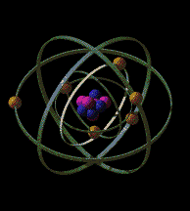
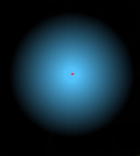
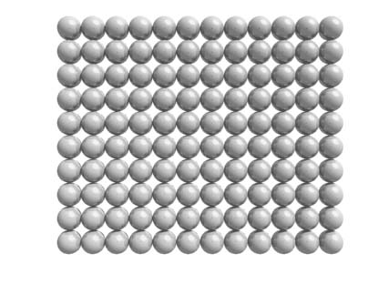
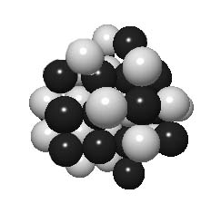
Structure of Atom
Matter consists of atoms
1 cm³ : ~10²⁴ atoms
1Å=10⁻¹⁰m
Nucleus of the iron atom
Size: ~10^{–15} m
Atoms are 99.999999999999999% EMPTY SPACE
Notes:
Iron: 26 protons and 30 neutrons

Slide 19
The Concept of Electric Field
Key Idea: A charged particle makes an electric field at every location in space
Accelerates at 9.8 m/s² – why?
Notes:
Follow movement for longer time – can differentiate between scenarios
If place electron instead of proton – what will happen?

Slide 20
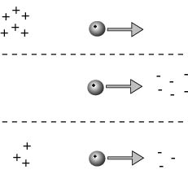
The Concept of Electric Field
Key Idea: A charged particle makes an electric field at every location in space
Accelerates at 10¹¹ m/s² – why?
Many charge configurations
could cause the motion
Notes:
Follow movement for longer time – can differentiate between scenarios
If place electron instead of proton – what will happen?
Many possible charge configurations

Slide 21
Electric Field
Key Idea: A charged particle makes an electric field at every location in space
Something is already there,
waiting to push any charge.
An Electric Field created by other charges is present throughout space at all times, whether or not there is another charge around to feel its effect.

Slide 22
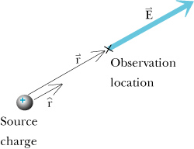
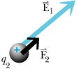
The Electric Field of a Point Charge
Key Idea: A charged particle makes an electric field at every location in space
Point Particle
q₁

Slide 23
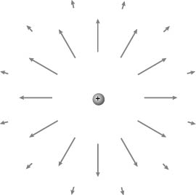
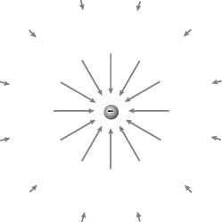
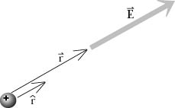
The Electric Field of a Point Charge
Key Idea: A charged particle makes an electric field at every location in space
+
Including direction:
-

Slide 24
Which way does the field point?
Key Idea: A charged particle makes an electric field at every location in space
Point Particle
Here is a useful mnemonic:
+
-
-
Positive people
care about others
Negative people
care only about
themselves

Slide 25
Example 1: Electric Field
Key Idea: A charged particle makes an electric field at every location in space
Problem:
A particle with charge q₁=2 nC = 2 x 10⁻⁹ C
is located at the origin. What is the electric field
due to this particle at a location <-0.2,-0.2,-0.2> m?
observed
location
source
location
Notes:
Note: r – direction is from source to point of observation.

Slide 26
Example 1: Electric Field
Key Idea: A charged particle makes an electric field at every location in space
Problem:
A particle with charge q₁=2 nC = 2 x 10⁻⁹ C
is located at the origin. What is the electric field
due to this particle at a location <-0.2,-0.2,-0.2> m?
Solution:
Distance and direction:
observed
location
source
location
Notes:
Note: r – direction is from source to point of observation.

Slide 27
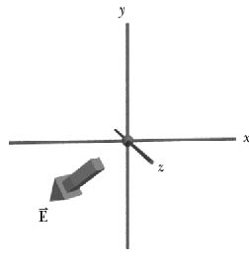
Problem:
A particle with charge q₁=2 nC = 2 x 10⁻⁹ C
is located at the origin. What is the electric field
due to this particle at a location <-0.2,-0.2,-0.2> m?
Solution:
2. The magnitude of the electric field:
3. The electric field in vector form:

Slide 28
Example 2: Electric Force
Key Idea: A charged particle makes an electric field at every location in space
Electron: q = -e
Problem: The electric field at a particular location
is <-300,0,0> N/C. What force would an electron experience if it were placed in this location?
Y
E
e
F
X
Solution:

Slide 29
Key Ideas in Chapter 14: Electric Field
A charged particle makes an electric field at every location in space
  (except its own location).
The electric field due to one particle affects other charged particles.
The electric force on a charged particle is proportional to
  the net electric field at the location of that particle.
The Superposition Principle:
  The net electric field at any lecation is the vector sum
  of the individual electric fields of all charge particles at other locations.
  The field due to one charged particle is not changed
  by the presence of other charged particles.
An electric dipole consists of two particles with charges equal in magnitude
and opposite in sign, separated by a short distance.
Changes in electric fields travel at the speed of light ("retardation").
Notes:
START TIME HERE:

Slide 30
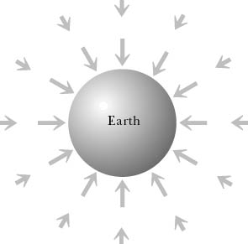
The Physical Concept of ‘Field’
Key Idea: A charged particle makes an electric field at every location in space
Field: physical quantity, can be scalar or vector
Examples:
Temperature T(x,y,z,t)
Air flow, gravitational field
m
q

Slide 31
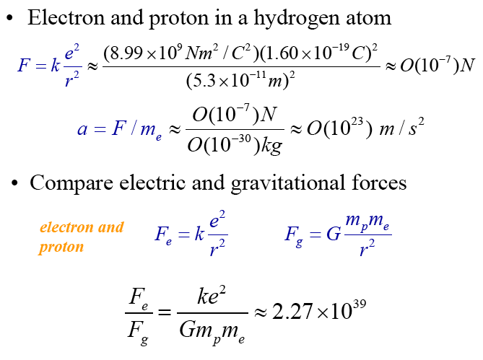
How Strong is the Coulomb Force?
Example: Hydrogen Atom = proton and electron
F_{elec} =
F_{grav} =
F_{elec}
Electricity is much stronger
than Gravity
F_{grav}

Slide 32
iClicker
A person weighs 150 lbs. Which of the following statements is correct.
The weight is caused by gravity
The weight is caused by electric interaction.
C. The weight is an intrinsic number to describe a body mass, regardless of existence of gravity of electric force.
Notes:
Answer: C

