Slide 1
Exam#1 (chapter 1-8)
time: Wednesday 03/24 8:30 am- 9:20 am
Location: physics building room 112
If you have special needs, e.g. exam time extension, and has not contact me before, please bring me the letter from the Office of the Dean of Students before 03/17.
AOB
  multiple choice problems.
  Prepare your own scratch paper, pencils, erasers, etc.
  Use only pencil for the answer sheet
  Bring your own calculators
  No cell phones, no text messaging, no computers
  No crib sheet of any kind is allowed. Equation sheet will be provided.

Slide 2
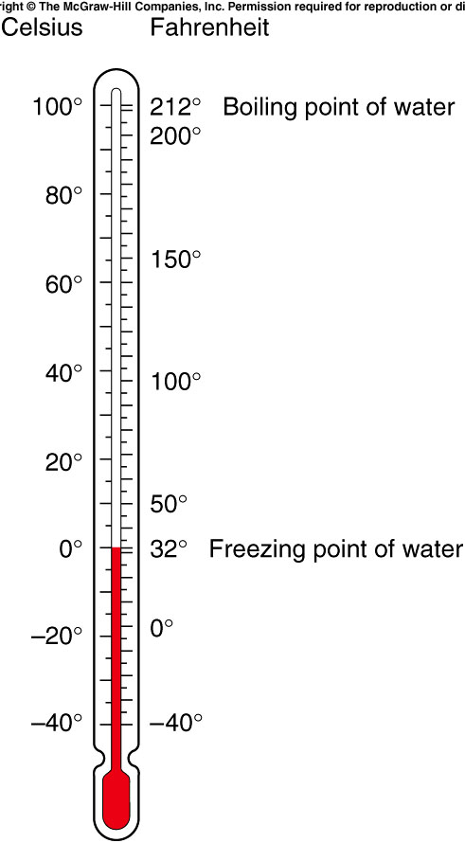
The first widely used temperature scale was devised by Gabriel Fahrenheit.
Another widely used scale was devised by Anders Celsius.
The Celsius degree is larger than the Fahrenheit degree
They are both equal at -40°.
Notes:
0F ~ -18c,

Slide 3
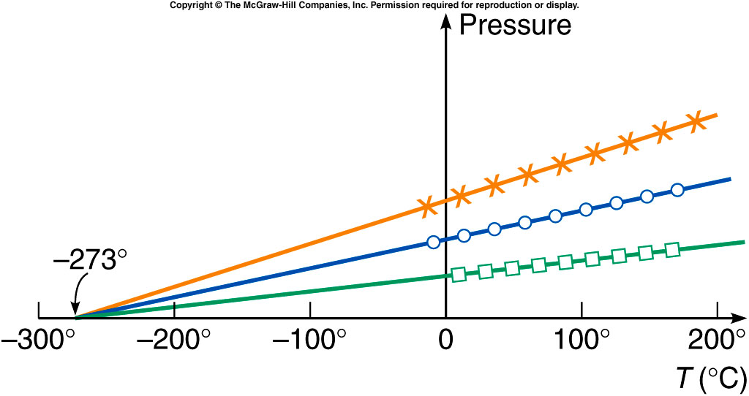
We can then plot the pressure of a gas as a function of the temperature. PV= nkT
The curves for different gases or amounts are all straight lines.
When these lines are extended backward to zero pressure, they all intersect at the same temperature, -273.2°C.
Since negative pressure has no meaning, this suggests that the temperature can never get lower than -273.2°C, or 0 K (kelvin).

Slide 4
Temperature and Its Measurement
When the physical properties are no longer changing, the objects are said to be in thermal equilibrium.
Two or more objects in thermal equilibrium have the same temperature.
  If two objects are in contact with one another long enough, the two objects have the same temperature.
This is the zeroth law of thermodynamics.

Slide 5
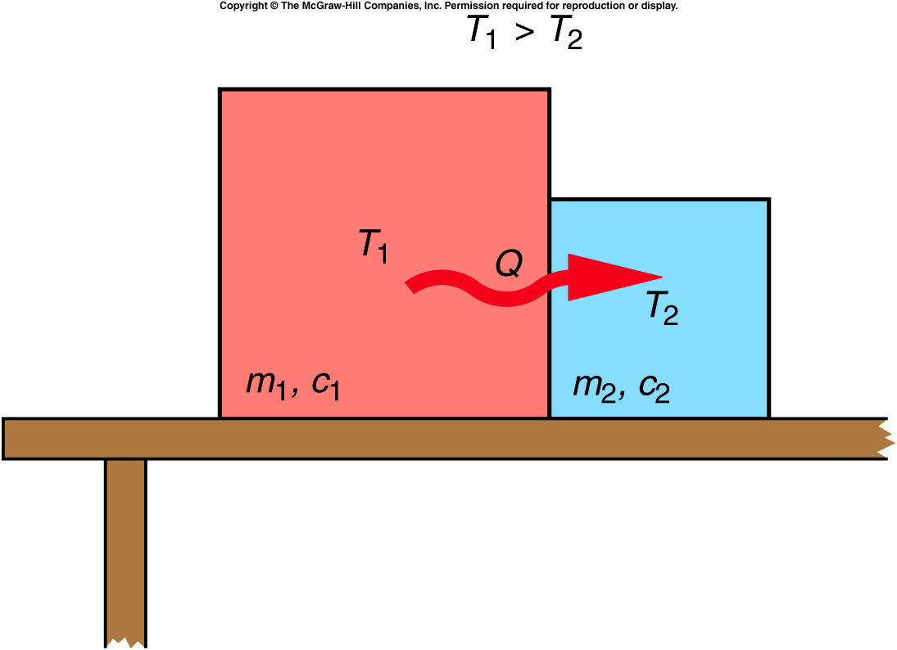
When two objects at different temperatures are placed in contact, heat will flow from the object with the higher temperature to the object with the lower temperature.
Heat added increases temperature, and heat removed decreases temperature.
Heat and temperature
are not the same.
Temperature is a
quantity that tells us
which direction the
heat will flow.

Slide 6
The specific heat capacity of a material is the quantity of heat needed to change a unit mass of the material by a unit amount in temperature.
  For example, to change 1 gram by 1 Celsius degree.
  It is a property of the material, determined by experiment.
  The specific heat capacity of water is 1 cal/g⋅C°: it takes 1 calorie of heat to raise the temperature of 1 gram of water by 1°C.
We can then calculate how much heat must be absorbed by a material to change its temperature by a given amount:
Q = mcΔT where Q = quantity of heat
m = mass
c = specific heat capacity
ΔT = change in temperature

Slide 7
Phase Changes and Latent Heat
When an object goes through a change of phase or state, heat is added or removed without changing the temperature. Instead, the state of matter changes: solid to liquid, for example.
The amount of heat needed per unit mass to produce a phase change is called the latent heat.
  The latent heat of fusion of water corresponds to the amount of heat needed to melt one gram of ice. (80 cal/g)
  The latent heat of vaporization of water corresponds to the amount of heat needed to turn one gram of water into steam.

Slide 8
If the specific heat capacity of ice is 0.5 cal/g⋅C°, how much heat would have to be added to 200 g of ice, initially at a temperature of -10°C, to raise the ice to the melting point?
m = 200 g
c = 0.5 cal/g⋅C°
T = -10°C
Q = mcΔT
= (200 g)(0.5 cal/g⋅C°)(10°C) = 1,000 cal
(heat required to raise the temperature)
1,000 cal
2,000 cal
4,000 cal
0 cal

Slide 9
Quiz: If the specific heat capacity of ice is 0.5 cal/g⋅C°, how much heat would have to be added to 200 g of ice, initially at a temperature of -10°C, to completely melt the ice? (Latent heat is 80 cal/g)
L_{f} = 80 cal/g Q = mL_{f}
= (200 g)(80 cal/g) = 16,000 cal
(heat required to melt the ice)
Total heat required to raise the ice to 0 °C and then to melt the ice is:
1,000 cal + 16,000 cal = 17,000 cal = 17 kcal
1,000 cal
14,000 cal
16,000 cal
17,000 cal

Slide 10
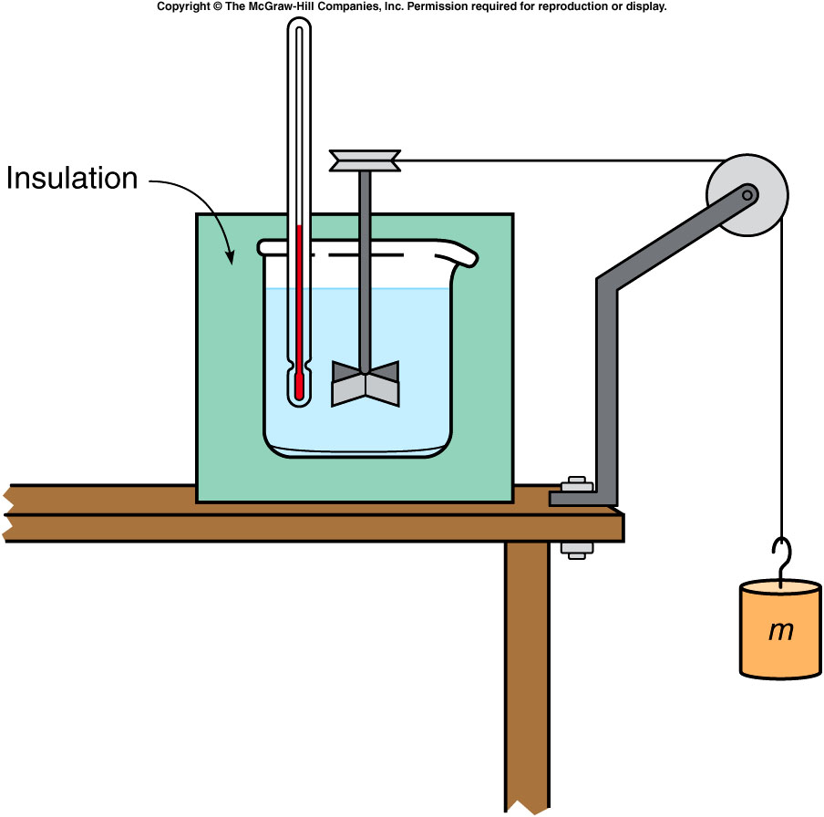
Joule’s Experiment and the First Law of Thermodynamics
Joule performed a series of experiments showing that mechanical work could raise the temperature of a system.
In one such experiment, a falling mass turns a paddle in an insulated beaker of water, producing an increase in temperature.
Notes:
Is adding heat the only way of increasing the temperature? Two pullys

Slide 11
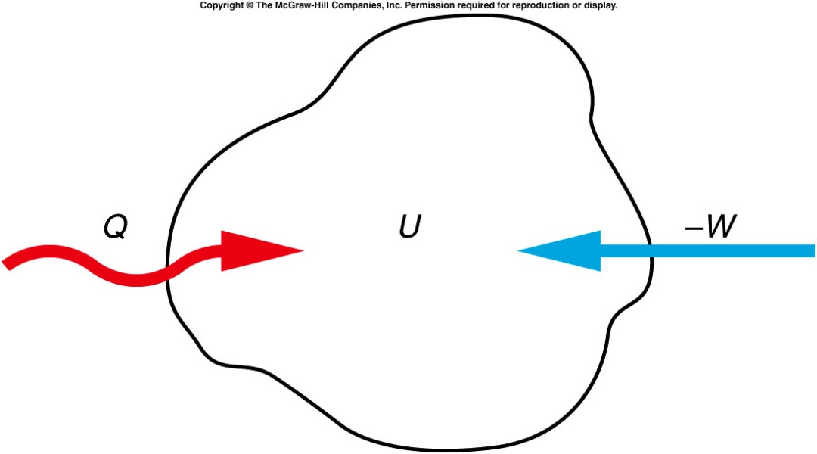
Joule’s Experiment and the First Law of Thermodynamics
Joule’s experiments led to Kelvin’s statement of the first law of thermodynamics.
  Both work and heat represent transfers of energy into or out of a system.
  If energy is added to a system either as work or heat, the internal energy of the system increases accordingly.
The increase in the internal
energy of a system is equal
to the amount of heat added
to a system minus the
amount of work done by the
system. ΔU = Q - W

Slide 12
Joule’s Experiment and the First Law of Thermodynamics
The internal energy of the system is the sum of the kinetic and potential energies of the atoms and molecules making up the system.
An increase in internal energy may show up as an increase in temperature, or as a change in phase, or any other increase in the kinetic and/or potential energy of the atoms or molecules making up the system.
Internal energy is a property of the system uniquely determined by the state of the system.

Slide 13
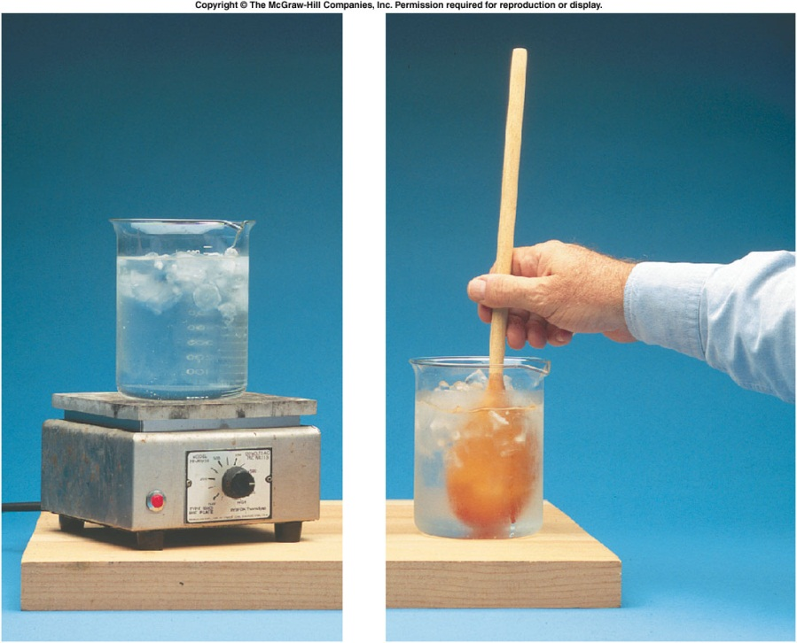
A hot plate is used to transfer 400 cal of heat to a beaker containing ice and water; 500 J of work are also done on the contents of the beaker by stirring. What is the increase in internal energy of the ice-water mixture? (note: 1 cal = 4.19J)
900 J
1180 J
1680 J
2180 J
W = -500 J
Q = 400 cal
= (400 cal)(4.19 J/cal)
= 1680 J
ΔU = Q - W
= 1680 J - (-500 J)
= 2180 J

Slide 14
A hot plate is used to transfer 400 cal of heat to a beaker containing ice and water; 500 J of work are also done on the contents of the beaker by stirring. How much ice melts in this process? (latent heat: 80 cal/g. 1 cal = 4.19J).
0.037 g
0.154 g
6.5 g
27.25 g
L_{f} = 80 cal/g
= (80 cal/g)(4.19 J/cal)
= 335 J/g
ΔU = mL_{f}
m = ΔU / L_{f}
= (2180 J) / (335 J/g)
= 6.5 g

Slide 15
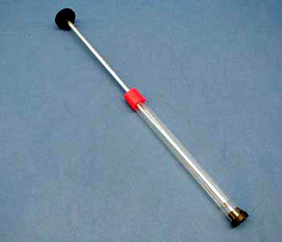
3E-03 Fire Syringe
Compression and rise in air temperature
What will happen to the combustible material when the plunger is rapidly pushed down ?
https://www.youtube.com/watch?v=SkWJdWGdgaM
RAPID COMPRESSION IS ADIABATIC GIVING RAPID RISE OF AIR TEMPERATURE IN THE CHAMBER WHICH EXCEEDS THE IGNITION TEMPERATURE OF THE FLAMMABLE MATERIAL.
Notes:
Rapid adiabatic compression causes a rapid rise in temperature in a chamber of confined air. The temperature reached is sufficient to initiate combustion of a flammable material.
Directions: A small amount of combustible material is placed in the bottom of a thick-walled glass tube. Insert the piston and with the lights dimmed in the room, drive the piston downward into the tube with a rapid, forceful stroke. (You may need to do this a couple of times.) If done properly, the material in the tube will ignite, creating a brilliant flash of light in the tube. (You might wish to practice this ahead of time to make sure it works. It is very reliable, so the success rate is high.)

Slide 16
The Flow of Heat
There are three basic processes for heat flow:
  Conduction
  Convection
  Radiation

Slide 17
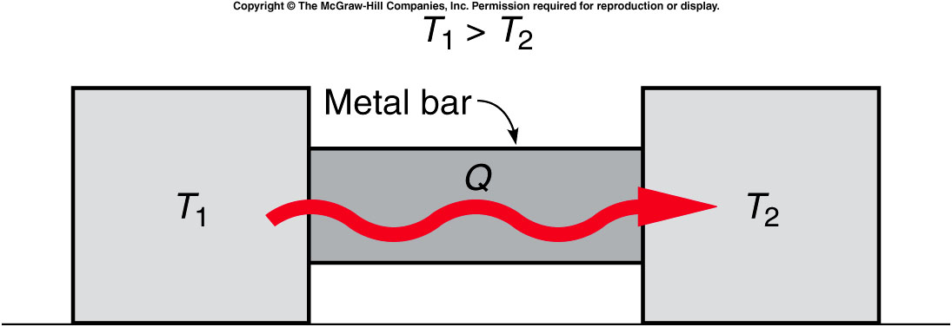
  In conduction, heat flows through a material when objects at different temperatures are placed in contact with one another.

Slide 18
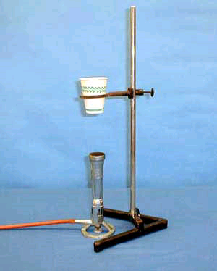
3B-04 Boiling Water in Cup
When there’s water inside, will the paper cup burn?
yes.
No.
Notes:
A paper cup is filled with water and supported in a ring on a stand. A flame is put beneath the cup and eventually the water boils without burning the cup. This demonstration actually illustrates two concepts: (1) The thinness of the cup allows heat to pass through quickly (conduction); (2) Because water boils at well below the kindling temperature of paper, the paper will not burn. Also, the convection of the water keeps the temperature of the water fairly uniform throughout, even though water itself is a poor conductor.

Slide 19

  In convection, heat is transferred by the motion of a fluid containing thermal energy.
    Convection is the main method of heating a house.
    It is also the main method heat is lost from buildings.
Notes:
Heater

Slide 20
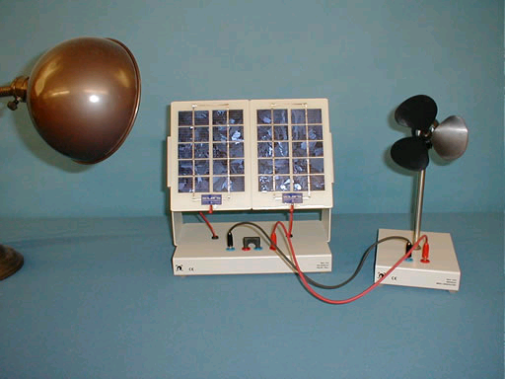
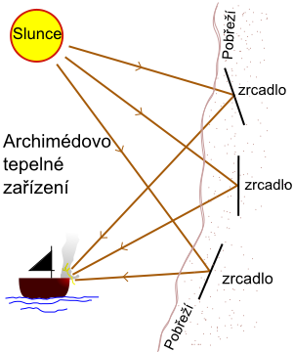
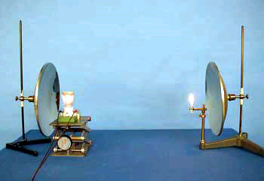
3D-05 Solar Panel
3D-03 Radiation--Match
https://www.youtube.com/watch?v=ptUj8JRAYu8
"Archimedes heat ray", was used to focus sunlight onto approaching ships, causing them to catch fire.
Notes:
A coil-wire heater is placed at the focal point of a spherical mirror. An unlighted match is placed at the focal point of an identical mirror located about a meter away. Upon reflection from the mirror, the rays from the heater are parallel so that when they encounter the other mirror, these rays focus at the focal point. The concentrated radiation is enough to ignite the match.

Slide 21
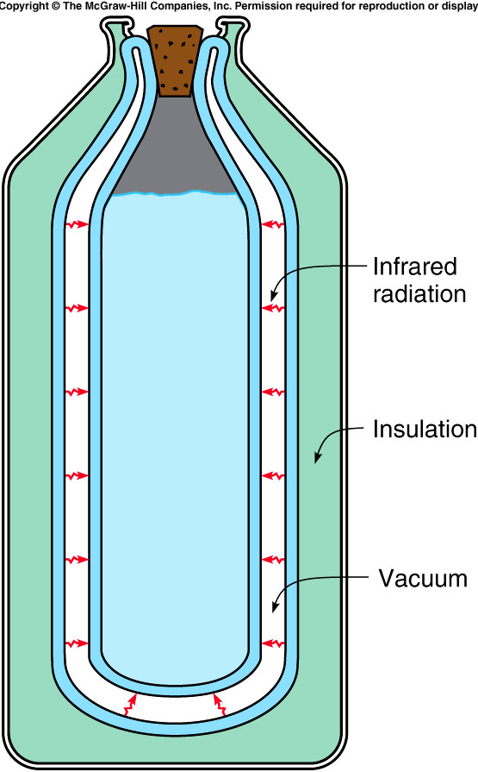
  To minimize heat loss
    Minimize all three kind of heat exchange.
Notes:
thermo bottle, cork （软木塞）

Slide 22
Quiz
When there’s
NO water inside, will the paper cup burn?
yes.
No.
Notes:
A paper cup is filled with water and supported in a ring on a stand. A flame is put beneath the cup and eventually the water boils without burning the cup. This demonstration actually illustrates two concepts: (1) The thinness of the cup allows heat to pass through quickly (conduction); (2) Because water boils at well below the kindling temperature of paper, the paper will not burn. Also, the convection of the water keeps the temperature of the water fairly uniform throughout, even though water itself is a poor conductor.

Slide 23
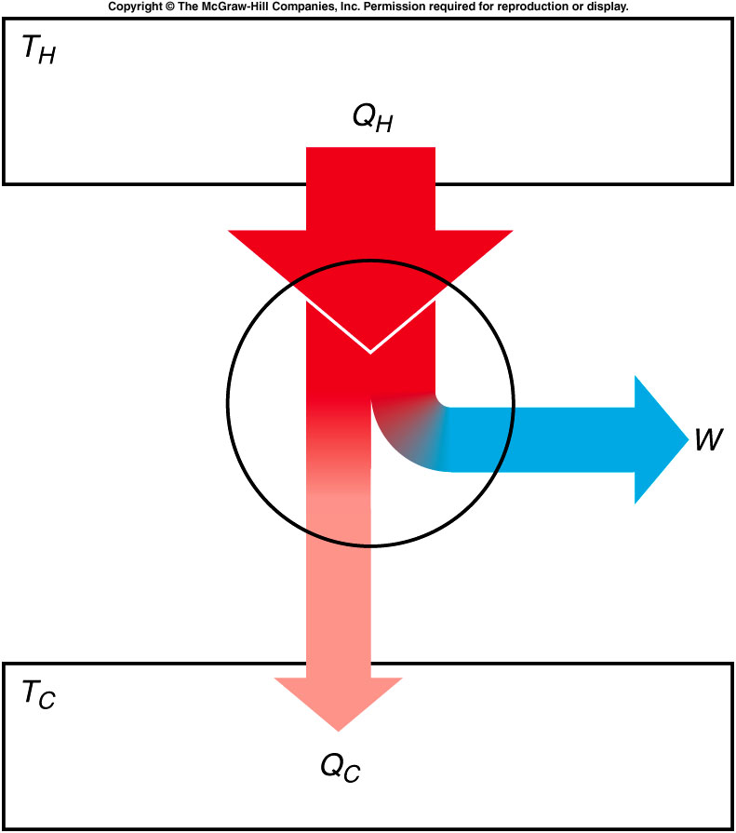
Heat Engines
All heat engines share these main features of operation:
  Thermal energy (heat) is introduced into the engine.
  Some of this energy is converted to mechanical work.
  Some heat (waste heat) is released into the environment at a temperature lower than the input temperature.

Slide 24
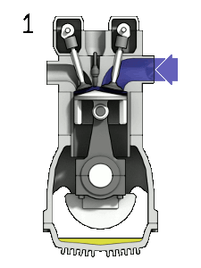
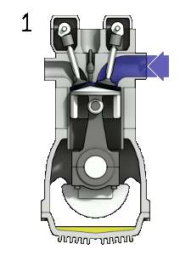
Heat Engines
A gasoline engine is a form of a heat engine, e.g. a 4-stroke engine
INTAKE stroke:
  the piston descends from the top to the bottom of the cylinder, reducing the pressure inside. A mixture of fuel and air, is forced by atmospheric pressure into the cylinder through the intake port. The intake valve then close.
COMPRESSION stroke:
  with both intake and exhaust valves closed, the piston returns to the top of the cylinder compressing the fuel-air mixture.
POWER stroke:
  the compressed air–fuel mixture in a gasoline engine is ignited by a spark plug. The compressed fuel-air mixture expand and move the piston back
EXHAUST stroke:
  during the exhaust stroke, the piston once again returns to top while the exhaust valve is open and expel the spent fuel-air mixture out through the exhaust valve(s).
Notes:
Crank the starter

Slide 25
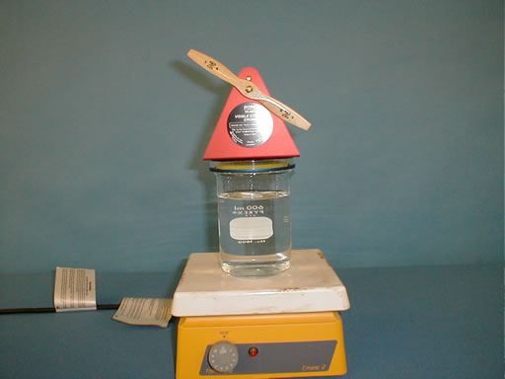
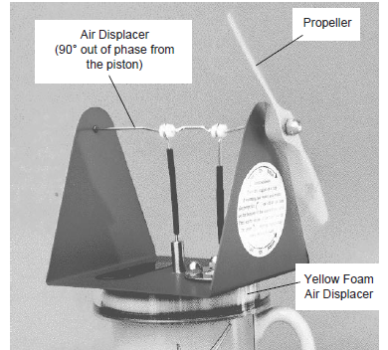
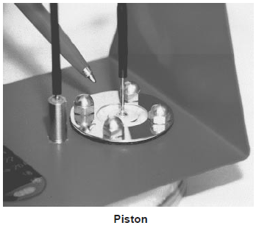
3E09, 3E10, 2E12 Engines
running on a cup of hot water:
When the yellow foam inside the engine is near the top of the cylinder most of the air is on the bottom side (the hot side) where it is heated.
When the air gets hot it expands and pushes up on the piston. When the foam moves to the bottom of the engine it moves most of the air to the top of the engine.
The top of the engine is cool, allowing the air inside the engine to cool off (reject heat to the environment) and
the piston receives a downward push.
Stirling Engine
Steam Engine

Slide 26
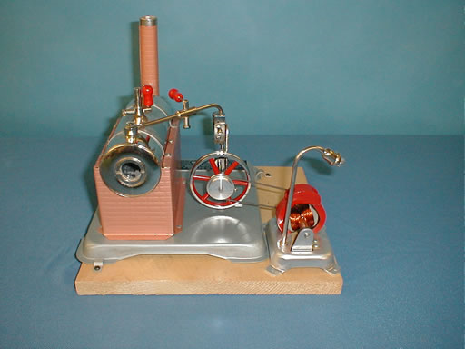
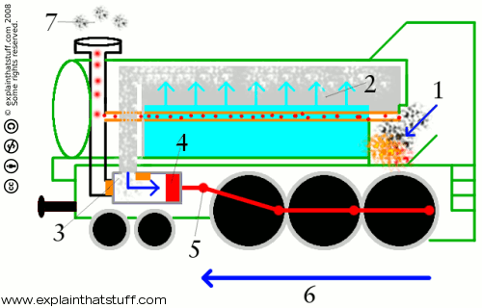
3E09, 3E10, 2E12 Engines
A fire where the coal burns.
A boiler full of water that the fire heats up to make steam.
A cylinder and piston. Steam from the boiler is piped into the cylinder, causing the piston to move first one way then the other. This in and out movement (which is also known as "reciprocating") is used to drive...
A machine attached to the piston. That could be anything from a water pump to a factory machine... or even a giant steam locomotive running up and down a railroad.
Steam Engine
Steam Engine
Notes:
Boiler chimney

Slide 27
Efficiency
Efficiency is the ratio of the net work done by the engine to the amount of heat that must be supplied to accomplish this work.

Slide 28
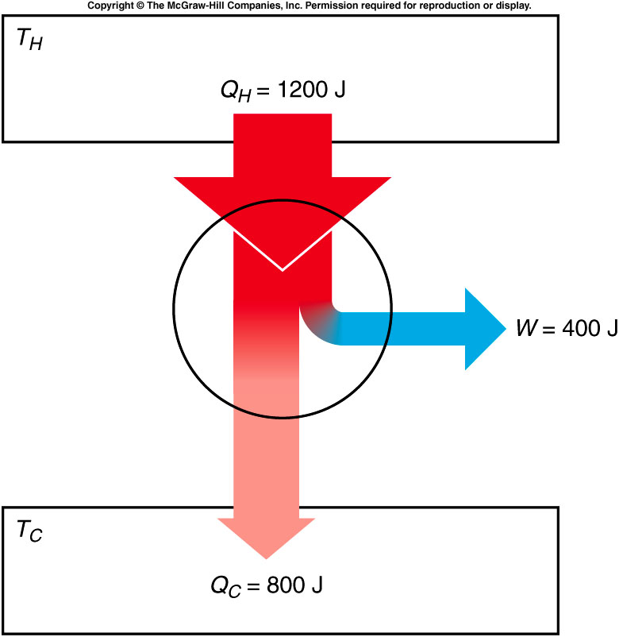
A heat engine takes in 1200 J of heat from the high-temperature heat source in each cycle, and does 400 J of work in each cycle. What is the efficiency of this engine?
33%
40%
66%
Q_{H} = 1200 J
W = 400 J
e = W / Q_{H}
= (400 J) / (1200 J)
= 1/3 = 0.33
= 33%

Slide 29
How much heat is released into the environment in each cycle?
33 J
400 J
800 J
1200 J
Q_{C} = Q_{H} - W
= 1200 J - 400 J
= 800 J

Slide 30
Carnot Engine
The efficiency of a typical automobile engine is less than 30%.
  This seems to be wasting a lot of energy.
  What is the best efficiency we could achieve?
  What factors determine efficiency?
The cycle devised by Carnot that an ideal engine would have to follow is called a Carnot cycle.
An (ideal, not real) engine following this cycle is called a Carnot engine.
Notes:
Can not be 100% efficiency since you can not completely control heat which is the kinetic energy of each moleclur.

Slide 31
Different Thermal Process
If the process is adiabatic, no heat flows into or out of the gas
In an isothermal process, the temperature does not change.
  The internal energy must be constant.
  The change in internal energy, ΔU, is zero.
  If an amount of heat Q is added to the gas, an equal amount of work W will be done by the gas on its surroundings, from ΔU = Q - W.
In an isobaric process, the pressure of the gas remains constant.
  The internal energy increases as the gas is heated, and so does the temperature.
  The gas also expands, removing some of the internal energy.
Experiments determined that the pressure, volume, and absolute temperature of an ideal gas are related by the equation of state:
  PV = NkT where N is the number of molecules
  and k is Boltzmann’s constant.

Slide 32
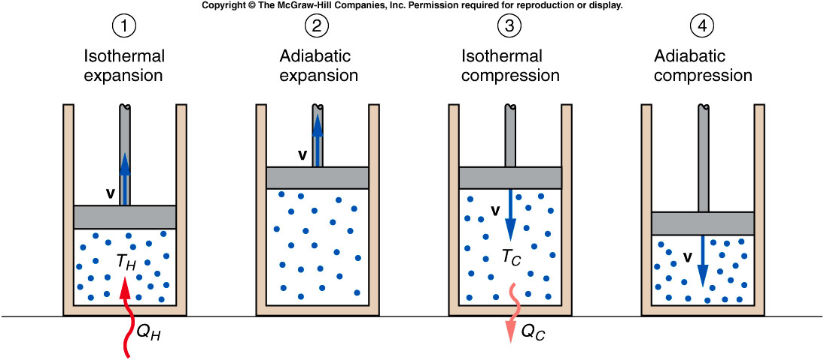
Heat flows into cylinder at temperature T_{H}. The fluid expands isothermally and does work on the piston.
The fluid continues to expand, adiabatically.
Work is done by the piston on the fluid, which undergoes an isothermal compression.
The fluid returns to its initial condition by an adiabatic compression.
Notes:
The 2nd step can not continue to be isothermal since the piston will not come back.
The last step need to be adiabatic otherwise the piston will hit the cylinder and got damaged.

Slide 33
Carnot Efficiency
The efficiency of Carnot’s ideal engine is called the Carnot efficiency and is given by:
Note: T is in the unit of Kelvin.
This is the maximum efficiency possible for any engine taking in heat from a reservoir at absolute temperature T_{H} and releasing heat to a reservoir at temperature T_{C}.
  The temperature must be measured in absolute degrees.
Even Carnot’s ideal engine is less than 100% efficient.

Slide 34
A steam turbine takes in steam at a temperature of 400°C and releases steam to the condenser at a temperature of 120°C. What is the Carnot efficiency for this engine?
30%
41.6%
58.4%
70%
T_{H} = 400°C = 673 K
T_{C} = 120°C = 393 K
e_{C} = (T_{H} - T_{C} ) / T_{H}
= (673 K - 393 K) / (673 K)
= 280 K / 673 K
= 0.416 = 41.6%

Slide 35
Quiz: If the turbine takes in 500 kJ of heat in each cycle, what is the maximum amount of work that could be generated by the turbine in each cycle?
0.83 J
16.64 kJ
28 kJ
208 kJ
Q_{H} = 500 kJ
e = W / Q_{H} ,
so W = e Q_{H}
= (0.416)(500 kJ)
= 208 kJ

