Slide 1
Exam#1 (chapter 1-8)
time: Wednesday 03/24 8:30 am- 9:20 am
Location: physics building room 112
If you have special needs, e.g. exam time extension, and has not contact me before, please bring me the letter from the Office of the Dean of Students before 03/17.
AOB
  multiple choice problems.
  Prepare your own scratch paper, pencils, erasers, etc.
  Use only pencil for the answer sheet
  Bring your own calculators
  No cell phones, no text messaging, no computers
  No crib sheet of any kind is allowed. Equation sheet will be provided.

Slide 2
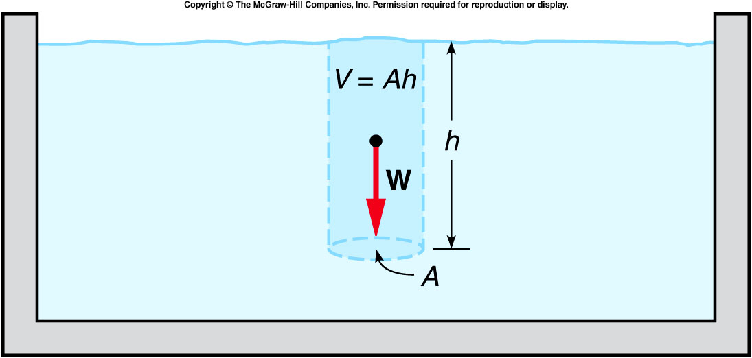
Archimedes’ Principle
Archimedes’ Principle: The buoyant force acting on an object fully or partially submerged in a fluid is equal to the weight of the fluid displaced by the object.
pressure = density*g*height →
buoyant force = difference between forces on top and bottom surface
  = (area*density*h)*g = mg
  = weight of the fluid displaced by the object.

Slide 3
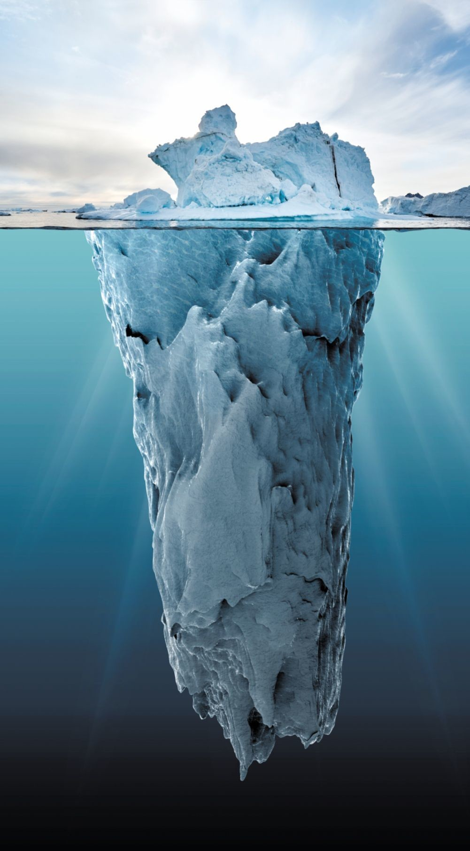
Tip of the Iceberg
Density:
Ice: 0.9168 g/cm³
water: 1 g/cm³
~90% of the iceberg is under water.
https://scienceisbeauty.tumblr.com/image/189512554325

Slide 4
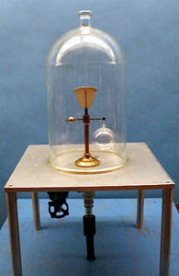
2A-08 Buoyancy of Air
Investigating the Buoyant force resulting from Air
After air being pumped out
m_{b} will move downward
m_{a} will move downward
Apparatus remain balanced
ρ_{air}gV_{b}
ρ_{air}gV_{a}
m_{a}g
m_{b}g
Setting the sum of torques on equal-arm balance about pivot equal to zero, we have in the presence of air:
m_{a}g – ρ_{air}gV_{a} = ρ_{air}gV_{b} – m_{a}g
V_{b} > V_{a} implies m_{b} > m_{a} which is demonstrated in vacuum
IF SENSITIVE WEIGHING OF AN OBJECT IS REQUIRED, UNEQUAL BUOYANT FORCES COULD AFFECT THE RESULTS.
Notes:
A small balance supports a glass bulb on one arm and a balancing weight of much smaller volume on the other. A bell jar is placed over the apparatus and evacuated. The glass sphere now appears heavier, due to its greater loss of buoyancy.

Slide 5

https://www.technology.org/2018/05/31/how-can-a-heavy-iron-anvil-float-on-liquid-mercury-video/
Notes:
Sulfur hexafluoride

Slide 6
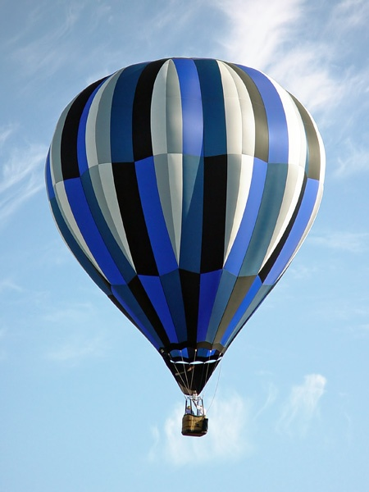
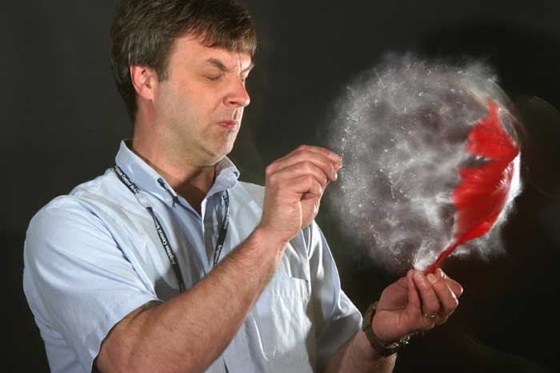
Balloons
Any object in the atmosphere is subject to a buoyant force and Archimedes law applies so if the buoyant force is greater than the weight of an object it will rise. So since the material of a balloon has a density greater than air then the balloon must be filled with a gas having a density less than air. In practice balloons either use Helium or hot air.
As the balloon rises the buoyant force decreases and the balloon will float at constant altitude when the buoyant force is equal to the weight.
F_{B}
mg

Slide 7
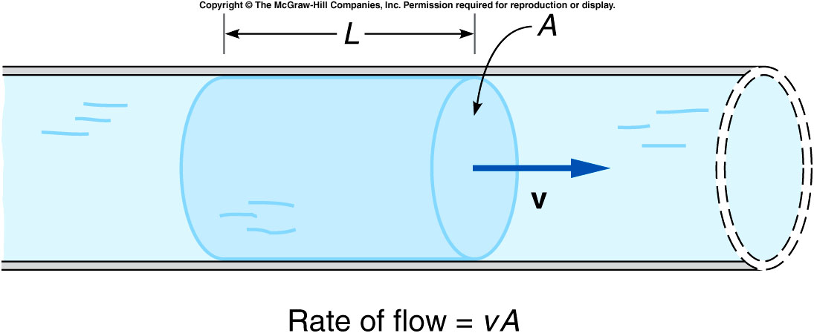
Fluids in Motion
The volume of a portion of water of length L flowing past some point in a pipe is the product of the length times the cross-sectional area A, or LA.
The rate at which water moves through the pipe is this volume divided by time: LA / t.
Since L / t = v, the rate of flow = vA.

Slide 8
If the flow is continuous, the rate of flow must be the same at any point along the pipe.
If the cross-sectional area A decreases, the speed v must increase to maintain the same rate of flow.

Slide 9
Ch 9 E 14
Stream moves at v₁ = 0.5 m/s in cross sectional area A₁.
Stream reaches point where A₂ = ¼ A₁. Assume constant rate. What is v₂?
V₁
V₂
4 m/s
2m/s
5 m/s
1 m/s
0.5 m/s
A₂
A₁
v₁A₁ = v₂A₂
(0.5 m/s)(A₁) = v₂(¼A₁)
v₂ = 2 m/s

Slide 10
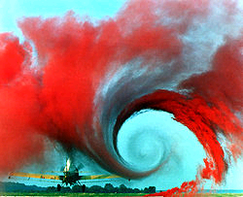
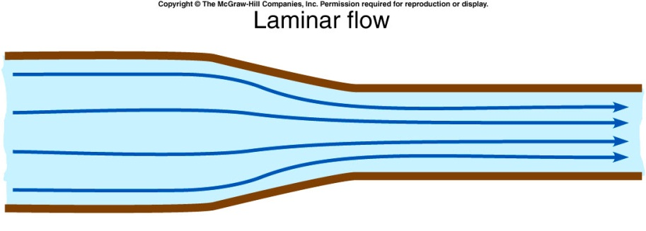

Laminar flow is smooth flow, with no eddies or other disturbances.
  The streamlines are roughly parallel.
  The speeds of different layers may vary, but one layer moves smoothly past another.
Turbulent flow does have eddies and whorls; the streamlines are no longer parallel.
Higher speeds are more likely to exhibit turbulent flow.
Higher viscosities are less likely to exhibit turbulent flow.

Slide 11
Bernoulli’s Principle
  The sum of the pressure plus the
  kinetic energy per unit volume of
  a flowing fluid must remain constant.
To keep the sum P + 1/2 dv² constant, the pressure must be larger where the fluid speed is smaller.
https://www.youtube.com/watch?v=xuiiEQlY_lI
Notes:
It’s hard to stand on the flash flood because of the pressure since the want speed slow down on you.

Slide 12
quiz:
Can a pinpong ball suspended in mid-air?
Yes
No
Notes:
Start the air flow and ask what would happen if you placed a ball on top of the stream. A small glass tube, tapered at the end, is attached to the lecture desk air supply. The rubber tubing connected to the air supply is clamped just below the glass tube so that the latter is held in a vertical position but is free to be pivoted. After the air is turned on, a ping pong ball is placed in the air stream and released. The ball remains “floating” in the air stream and will remain there even if the glass tube is tipped several degrees away from the vertical.

Slide 13
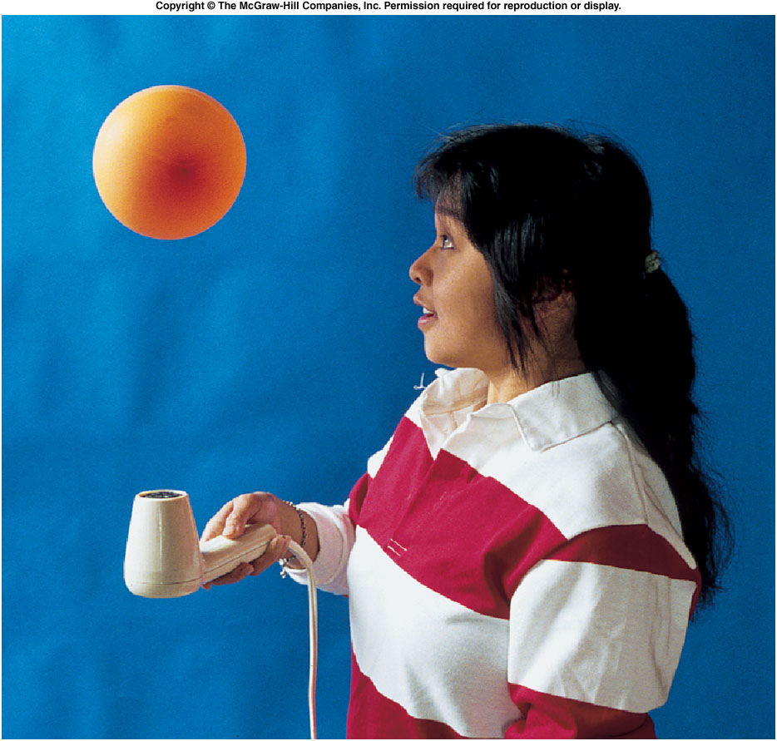
How can a ball be suspended in mid-air?
2C-06 Ball in Air Stream
A ball is suspended in an upward-moving column of air produced by a hair dryer. The air pressure is smallest in the center of the column, where the air is moving the fastest.
Notes:
Start the air flow and ask what would happen if you placed a ball on top of the stream. A small glass tube, tapered at the end, is attached to the lecture desk air supply. The rubber tubing connected to the air supply is clamped just below the glass tube so that the latter is held in a vertical position but is free to be pivoted. After the air is turned on, a ping pong ball is placed in the air stream and released. The ball remains “floating” in the air stream and will remain there even if the glass tube is tipped several degrees away from the vertical.

Slide 14
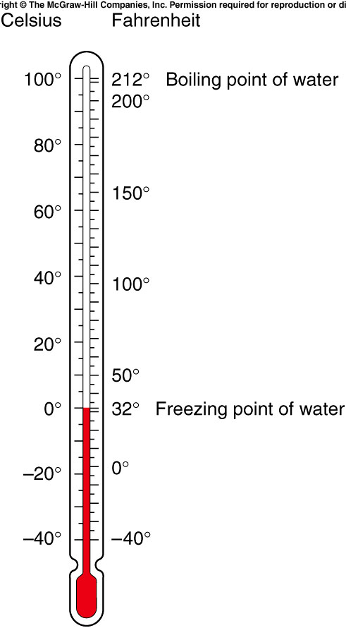
The first widely used temperature scale was devised by Gabriel Fahrenheit.
Another widely used scale was devised by Anders Celsius.
The Celsius degree is larger than the Fahrenheit degree
They are both equal at -40°.
Notes:
0F ~ -18c,

Slide 15
The zero point on the Fahrenheit scale was based on the temperature of a mixture of salt and ice in a saturated salt solution.
The zero point on the Celsius scale is the freezing point of water.
Both scales go below zero.
  0 F = -17.8 C
Is there such a thing as absolute zero?

Slide 16
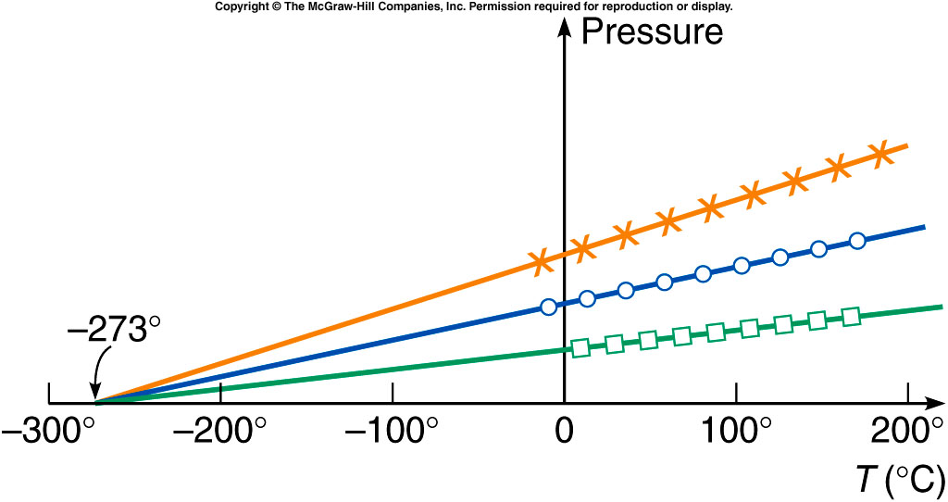
We can then plot the pressure of a gas as a function of the temperature. PV= nkT
The curves for different gases or amounts are all straight lines.
When these lines are extended backward to zero pressure, they all intersect at the same temperature, -273.2°C.
Since negative pressure has no meaning, this suggests that the temperature can never get lower than -273.2°C, or 0 K (kelvin).

Slide 17
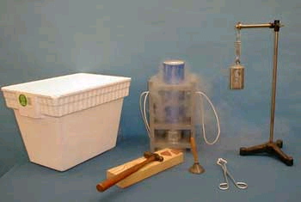
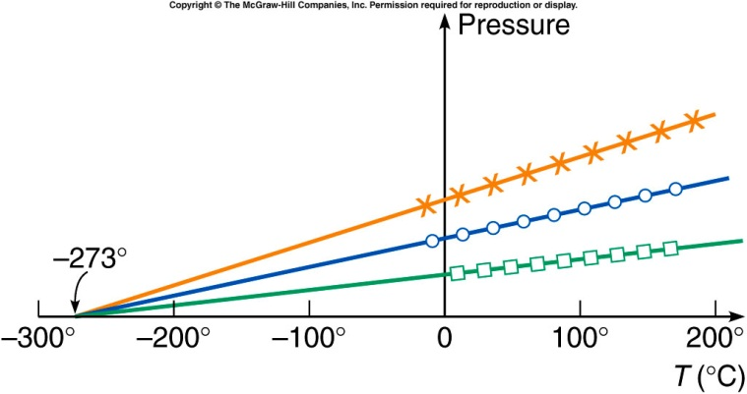
3E-01 Liquid Nitrogen Demos
liquid nitrogen boils at 77 K (−196 °C; −321 °F)
freezes at 63 K (−210 °C; −346 °F)
https://www.youtube.com/watch?v=mW90BvCFr0Y
Notes:
Dewar flask. A piece of rubber or plastic tubing may also be immersed and become brittle and can be shattered.
A lead “bell” and one essentially hears no recognizable ringing sound because of the softness of the metal. But after immersion in the LN, the bell has a more noticeable ring due to the hardness. A piece of soft rubber, shaped like a wedge is held with tongs and immersed in the LN. The wedge is then placed point down on a piece of pine and a hammer drives the wedge into the wood. Place a handball in the LN and when it gets really hard, throw it against the side wall (or down onto the floor). It will smash into several pieces.
Pour the LN into the cooler. Place an inflated balloon in the cooler. After a brief time, remove the balloon. It will be shriveled and somewhat rigid. Place it on the desk and watch it expand as it heats up.

Slide 18
Bonus quiz: What’s the minimum temperature one can reach
0K
-273.2°C
All above are correct

Slide 19
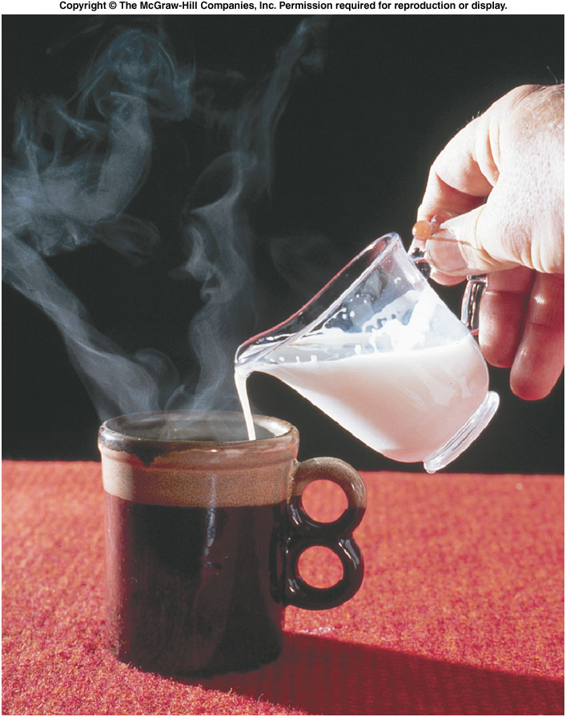
Heat and Specific Heat Capacity
What happens when objects or fluids at different temperatures come in contact with one another?
  The colder object gets hotter, and the hotter object gets colder, until they both reach the same temperature.
  What is it that flows between the objects to account for this?
We use the term heat for this quantity.
  Unit: Joule (SI unit), calorie
  1 cal = 4.1868 J

Slide 20
Temperature and Its Measurement
When the physical properties are no longer changing, the objects are said to be in thermal equilibrium.
Two or more objects in thermal equilibrium have the same temperature.
  If two objects are in contact with one another long enough, the two objects have the same temperature.
This is the zeroth law of thermodynamics.

Slide 21
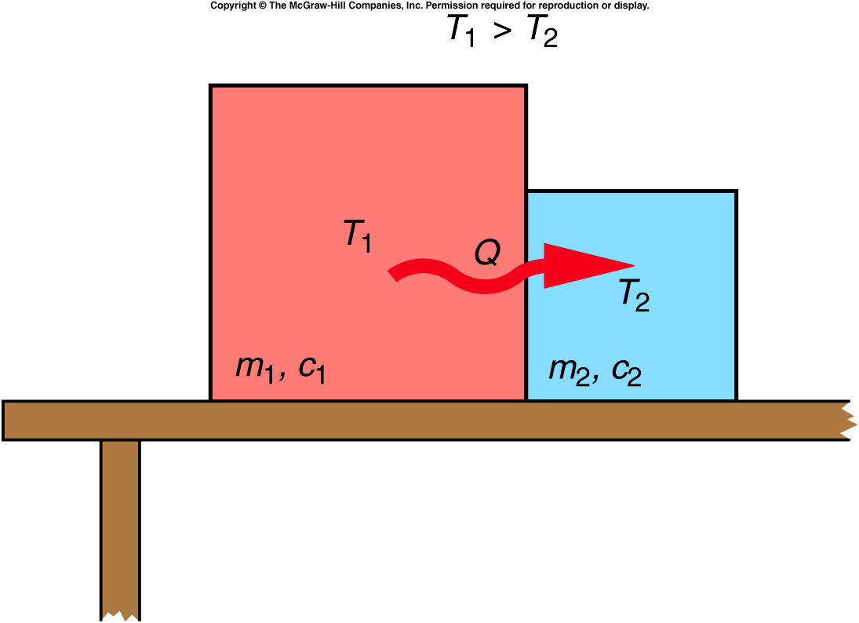
When two objects at different temperatures are placed in contact, heat will flow from the object with the higher temperature to the object with the lower temperature.
Heat added increases temperature, and heat removed decreases temperature.
Heat and temperature
are not the same.
Temperature is a
quantity that tells us
which direction the
heat will flow.

Slide 22
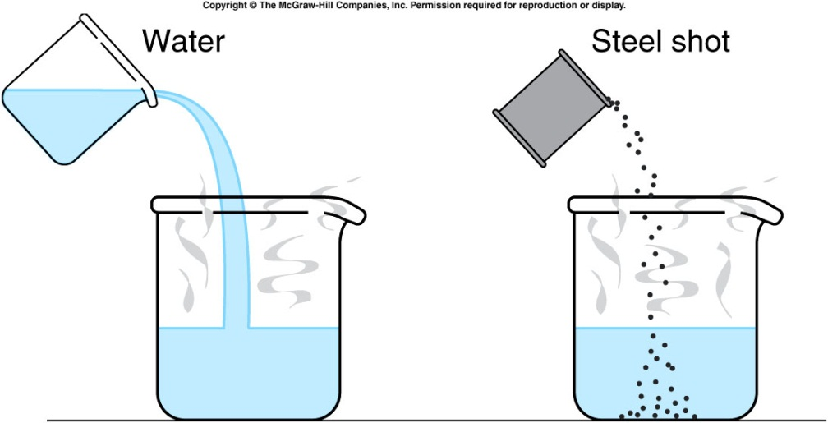
Heat and Specific Heat Capacity
One-hundred grams of room-temperature water is more effective than 100 grams of room-temperature steel shot in cooling a hot cup of water.
Steel has a lower specific heat capacity than water.
Notes:
Ocean water is warmer than air

Slide 23
The specific heat capacity of a material is the quantity of heat needed to change a unit mass of the material by a unit amount in temperature.
  For example, to change 1 gram by 1 Celsius degree.
  It is a property of the material, determined by experiment.
  The specific heat capacity of water is 1 cal/g⋅C°: it takes 1 calorie of heat to raise the temperature of 1 gram of water by 1°C.
We can then calculate how much heat must be absorbed by a material to change its temperature by a given amount:
Q = mcΔT where Q = quantity of heat
m = mass
c = specific heat capacity
ΔT = change in temperature

Slide 24
Phase Changes and Latent Heat
When an object goes through a change of phase or state, heat is added or removed without changing the temperature. Instead, the state of matter changes: solid to liquid, for example.
The amount of heat needed per unit mass to produce a phase change is called the latent heat.
  The latent heat of fusion of water corresponds to the amount of heat needed to melt one gram of ice. (80 cal/g)
  The latent heat of vaporization of water corresponds to the amount of heat needed to turn one gram of water into steam.

Slide 25
If the specific heat capacity of ice is 0.5 cal/g⋅C°, how much heat would have to be added to 200 g of ice, initially at a temperature of -10°C, to raise the ice to the melting point?
m = 200 g
c = 0.5 cal/g⋅C°
T = -10°C
Q = mcΔT
= (200 g)(0.5 cal/g⋅C°)(10°C) = 1,000 cal
(heat required to raise the temperature)
1,000 cal
2,000 cal
4,000 cal
0 cal

Slide 26
Quiz: If the specific heat capacity of ice is 0.5 cal/g⋅C°, how much heat would have to be added to 200 g of ice, initially at a temperature of -10°C, to completely melt the ice? (Latent heat is 80 cal/g)
L_{f} = 80 cal/g Q = mL_{f}
= (200 g)(80 cal/g) = 16,000 cal
(heat required to melt the ice)
Total heat required to raise the ice to 0 °C and then to melt the ice is:
1,000 cal + 16,000 cal = 17,000 cal = 17 kcal
1,000 cal
14,000 cal
16,000 cal
17,000 cal

