Slide 1
Exam#1 (chapter 1-8)
time: Wednesday 03/24 8:30 am- 9:20 am
Location: physics building room 112
If you have special needs, e.g. exam time extension, and has not contact me before, please bring me the letter from the Office of the Dean of Students before 03/17.
AOB
  multiple choice problems.
  Prepare your own scratch paper, pencils, erasers, etc.
  Use only pencil for the answer sheet
  Bring your own calculators
  No cell phones, no text messaging, no computers
  No crib sheet of any kind is allowed. Equation sheet will be provided.

Slide 2
Atmospheric Pressure and the Behavior of Gases
Living on the surface of the earth, we are at the bottom of a sea of air.
This sea of air is thinner at higher altitudes.
It is also thinner during certain weather conditions.
We describe this property by atmospheric pressure: the pressure of the layer of air that surrounds the earth.
  At sea level, the atmospheric pressure is 100 kPa, or 14.7 pounds per square inch, but it decreases with altitude.
Notes:
Windy weather smaller air pressure.

Slide 3
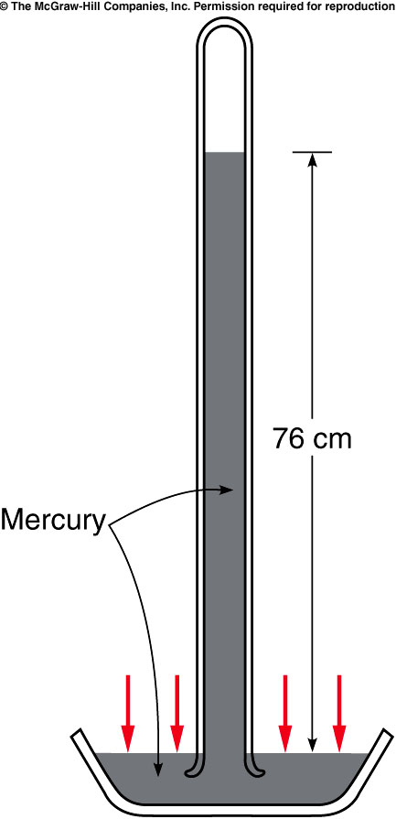
Torricelli invented the barometer, a device for measuring atmospheric pressure.
He filled a tube with mercury and inverted it into an open container of mercury.
Air pressure acting on the mercury in the dish supported a column of mercury, of height proportional to the atmospheric pressure.
  For water: 32 feet = 975.36 cm
  For mercury: 975.36cm/13.6 = 72 cm.
http://www.youtube.com/watch?v=BSo9fSTJcEE
Notes:
Capillarity

Slide 4
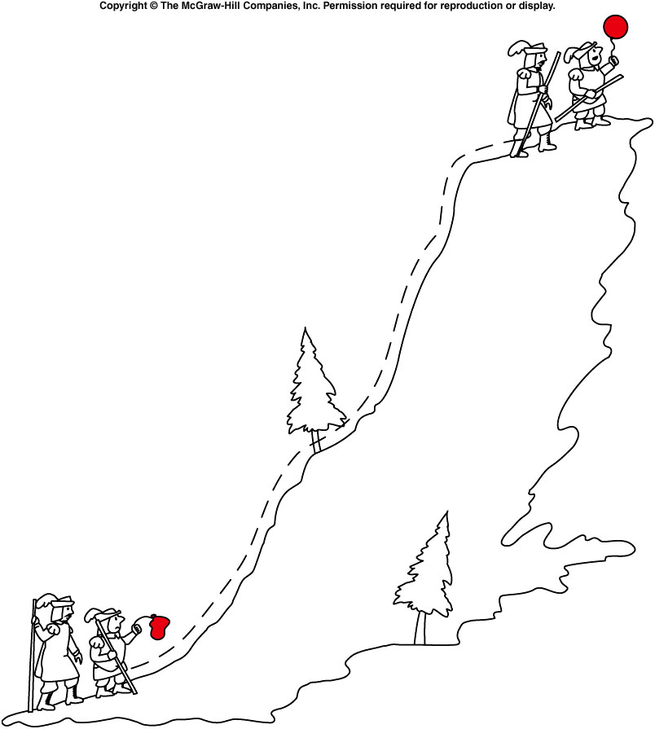
Boyle’s Law
Boyle discovered that the volume of a gas is inversely proportional to the pressure.
Boyle’s Law: PV = constant
  When temperature is contant.
  PV = nkT
  P = (n/V)kT.
    Number Density = n/V
If the pressure increases, the volume decreases.
P₁V₁ = P₂V₂
At higher altitude, the air density become smaller, i.e. larger volume, the air pressure become smaller.
  This is the reason of the balloon inflation.

Slide 5
Quiz: A fixed quantity of gas is held in a cylinder capped at one end by a movable piston. The pressure of the gas is initially 1 atmosphere (101 kPa) and the volume is initially 0.3 m³. What is the final volume of the gas if the pressure is increased to 3 atmospheres at constant temperature?
P₁ = 1 atm P₂ = 3 atm
V₁ = 0.3 m³ V₂ = ?
V₂ = P₁V₁ / P₂
= (1 atm)(0.3 m³) / 3 atm
= 0.1 m³
0.1 m³
0.3 m³
1 m³
3 m³

Slide 6
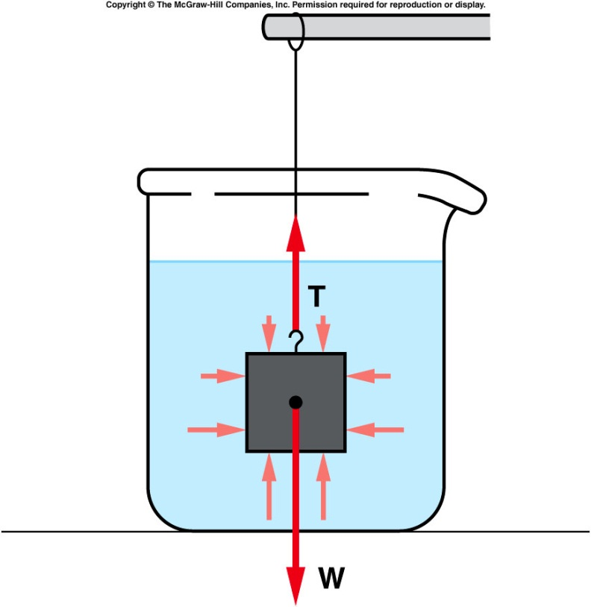
buoyant force
consider a block submerged in water, suspended from a string.
  The pressure of the water pushes on the block from all sides.
  Because the pressure increases with depth, the pressure at the bottom of the block is greater than at the top.
  There is a larger force (F = PA) pushing up at the bottom than there is pushing down at the top.
  The difference between these two forces is the buoyant force.
Pascal’s principle says: density*g*height
is the same everywhere at the same height and in all directions.
Notes:
Think of 3 people standing on top of each other. The person at the bottom feels the pressure of two people. The person at the middle feels the pressure of one person

Slide 7
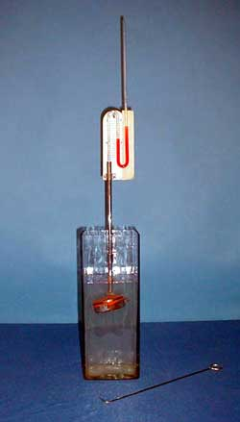
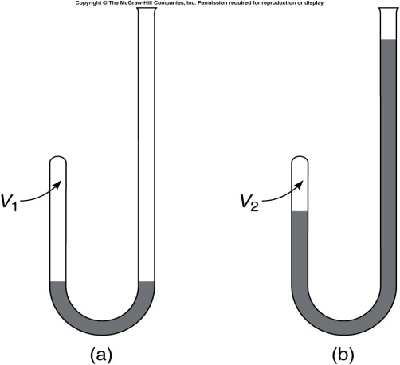
2B-04 Liquid Pressure
Investigating Pressure in different directions within a liquid in equilibrium.
What will happen to the reading on the manometer as the sensor is rotated ?
The increase in pressure ρgh is measured by the difference in height of the liquid in the U tube.
g
h
A
B
A
B
AT ANY GIVEN POINT IN A STATIONARY LIQUID, THE PRESSURE IS THE SAME IN ALL DIRECTIONS.
Notes:
A pillbox shaped sensor has a rubber diaphragm and is attached to a liquid manometer. The sensor is lowered into a deep vessel to a certain depth. The pressure at that depth is indicated on the manometer. The reading on the manometer does not change as the sensor is rotated. The tube holding the sensor is held in place by a clamp that allows the tube to slide downward into the water. DO THIS VERY SLOWLY or you will find yourself drenched with red liquid from the manometer!!!. Once the sensor is at the desired depth, use the wire hook to rotate the sensor.

Slide 8
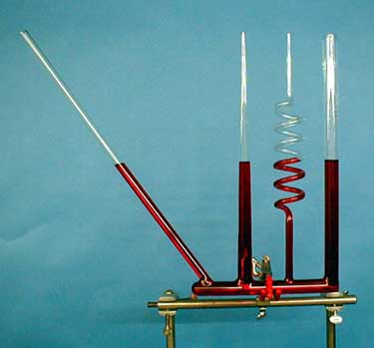
2B-03 Water Seeks Own Level
Liquid pressure depends on the “height” of the liquid column. But how is this height measured ?
Investigating the Dependence of Pressure on Height
The slanted cylinder and twisted cylinder hold a longer “total length” of water. But in each case the vertical height is the same.
P = ρgh
LIQUID PRESSURE DEPENDS ONLY ON VERTICAL HEIGHT (MEASURED STRAIGHT DOWN THAT IS PARALLEL TO g).
Notes:
Same liquid. Same pressure in the bottom

Slide 9
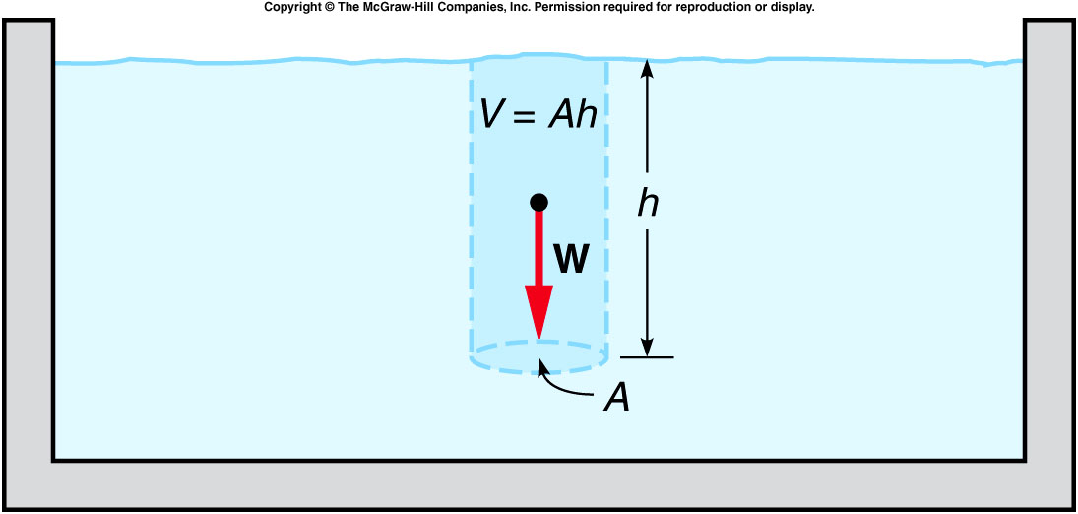
Archimedes’ Principle
Archimedes’ Principle: The buoyant force acting on an object fully or partially submerged in a fluid is equal to the weight of the fluid displaced by the object.
pressure = density*g*height →
buoyant force = difference between forces on top and bottom surface
  = (area*density*h)*g = mg
  = weight of the fluid displaced by the object.

Slide 10
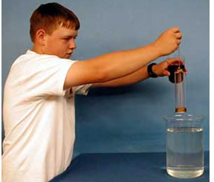
2B-05 Pressure Forces in Liquids
What happens as the submerged cylinder filled with air is filled with water ?
An open ended cylinder kept shut by liquid pressure
There are two forces acting on the plate. It’s weight down and PA up. When PA exceeds the weight the cylinder stays intact
Air
PA
In this situation the plate has to now support the weight of the water and when the weight of the water plus plate exceeds PA the cylinder opens
Water
PA
Notes:
An aluminum disk is held tightly by a string against the bottom of an open cylinder. The cylinder is then slowly lowered into a large beaker of water and held in place. The string is released and the disk stays in place because of the pressure forces exerted upward from the water. Water containing red food coloring is slowly poured into the cylinder. When the red liquid reaches the height of the water in the beaker, the pressure is the same on both sides of the disk which then drops away from the cylinder.

Slide 11
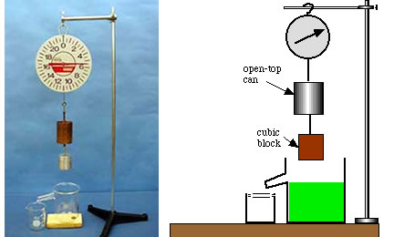
2B-10 Archimedes II
Take the 1st reading before put the object into large beaker where the water level is just at the overflow point.
One then submerge the object into the water while the displaced water is caught in a small beaker. Take the 2nd reading on the scale.
One then put the overflowed water to the copper container, take the 3rd reading. The 3rd reading of the scale will
Be the same as the 2nd reading.
Be the same as the 1st reading
Be smaller than the 1st reading.
Notes:
Preparation: Fill the overflow beaker until water begins to come out the spout. (Catch it in the small beaker.) After the water has stopped dripping, discard the water from the small beaker and place the beaker back under the spout. After recording the scale reading, VERY SLOWLY lower the block into the water until it is just submerged. Wait a bit until the water has finished dripping from the spout. Record the new scale reading. Then take the beaker and pour the caught water into the open-top can.

Slide 12
2B-10 Archimedes II
Use a scale to establish the relationship between the Buoyant Force on an object and the Weight of Fluid Displaced by the object
T₁
T₂
T₃
F_{B}
F_{B}
A
B
C
Mg
W_{DF}
Mg
Mg
A. The block is not immersed T₁ = Mg
B. The block is immersed but the liquid runs out T₂ = Mg – F_{B}
C. The displaced liquid is poured into the can T₃ = Mg – F_{B} + W_{DF}
T₁ is found to equal T₃ which means that the bouyant force FB is
equal to W_{DF} the Weight of the displaced Fluid
THE BUOYANT FORCE IS EQUAL TO THE WEIGHT OF THE FLUID DISPLACED.
Notes:
level is just at the overflow point. The displaced water is caught in a small beaker

Slide 13
Quiz: Boat displaces 2.5 m³ of water. Density of water ρ_{H2O} = 1000 kg/m³. What is the mass of water displaced? What is the buoyant force?
A). Mass = 2500 kg, buoyant force = 24500N
B). Mass = 250 kg, buoyant force = 2450N
C). Mass = 25 kg, buoyant force = 245N
D). Mass = 2500 kg, buoyant force = 2450N
E). Mass = 2500 kg, buoyant force = 245N
Mass of fluid displaced
(m_{FD}) = volume x density of fluid.
M_{FD} = V_{FD}ρ_{H2O} = (2.5 m³)(1000 kg/m³) = 2500 kg
F_{b} = W_{FD}
Buoyant force equals weight of fluid displaced.
F_{b} = W_{FD} = m_{FD} g = (2500 kg)(9.8 m/s²) = 24500 N

Slide 14
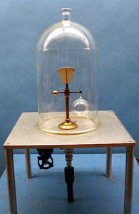
2A-08 Buoyancy of Air
Investigating the Buoyant force resulting from Air
After air being pumped out
m_{b} will move downward
m_{a} will move downward
Apparatus remain balanced
ρ_{air}gV_{b}
ρ_{air}gV_{a}
m_{a}g
m_{b}g
Setting the sum of torques on equal-arm balance about pivot equal to zero, we have in the presence of air:
m_{a}g – ρ_{air}gV_{a} = ρ_{air}gV_{b} – m_{a}g
V_{b} > V_{a} implies m_{b} > m_{a} which is demonstrated in vacuum
IF SENSITIVE WEIGHING OF AN OBJECT IS REQUIRED, UNEQUAL BUOYANT FORCES COULD AFFECT THE RESULTS.
Notes:
A small balance supports a glass bulb on one arm and a balancing weight of much smaller volume on the other. A bell jar is placed over the apparatus and evacuated. The glass sphere now appears heavier, due to its greater loss of buoyancy.

Slide 15
Questions Chapter 9
Q1 Is it possible for a 100-lb woman to exert a greater pressure on the ground than a 250-lb man? Explain.
Yes. The pressure will be mg/A so if A is small e.g. small heels the pressure will be very large
Q3 The same force is applied to two cylinders that contain air. One has a piston with a large area, and the other has a piston with a small area. In which cylinder will the pressure be greater?
The pressure is F/A so the one with the smallest A

Slide 16
Q4 A penny and a quarter are embedded in the concrete bottom of a swimming pool filled with water. Which of these coins experiences the greater downward force due to water pressure acting on it?
Each coin has to support the weight of water in a vertical column so the quarter has the biggest force F =PA
Q5 Why are bicycle tires often inflated to a higher pressure than automobile tires, even though the automobile tires must support a much larger weight?
Once again the upward force has to support the weight so
F = mg but F = PA where A is the area of the tire on the road so M/m = (PA)_{car}/(Pa)_{bike} so Ma/mA = P_{car} /P_{bike} the ratio of the areas is smaller than the ratio of the weights so
P_{bike} is higher.

Slide 17
Q6 The fluid in a hydraulic system pushes against two pistons, one with a large area and the other with a small area.
A. Which piston experiences the greater force due to fluid pressure acting on it?
B. When the smaller piston moves, does the larger piston move through the same distance, a greater distance, or a smaller distance than the smaller piston?
The pressure is the same and F = PA so the larger piston has the larger force.
B. The work done is the same so the small piston moves the most
Q8 When a mercury barometer is used to measure atmospheric pressure, does the closed end of the tube above the mercury column usually contain air?
No it needs to be a vacuum

Slide 18
Q9 Could we use water instead of mercury to make a barometer? What advantages and disadvantages would be associated with the use of water?
The height of the liquid depends on the density. So one can use water but the column would be 32 feet high
Q10 If you climbed a mountain carrying a mercury barometer, would the level of the mercury column in the glass tube of the barometer increase or decrease (compared to the mercury reservoir) as you climb the mountain?
The pressure decreases because you have a smaller column of air to support so the height would decrease

Slide 19
Q11 If you filled an airtight balloon at the top of a mountain, would the balloon expand or contract as you descend the mountain?
It would contract because the atmospheric pressure would increase and the pressure inside the balloon would increase to balance this change
Q12 When you go over a mountain pass in an automobile, your ears often “pop” both on the way up and on the way down. How can you explain this effect?
As you go up or down the atmospheric pressure changes and the popping is the inner ear adjusting to the pressure change

Slide 20
Q15 Is it possible for a solid metal ball to float in mercury?
The upward force is the weight of liquid displaced and the downward force is the weight of the ball. If the density of the liquid is greater than that of the ball it will float.
Q16 A rectangular metal block is suspended by a string in a breaker of water so that the block is completely surrounded by water. Is the water pressure at the bottom of the block equal to, greater than, or less than the water pressure at the top of the block?
The pressure is ρgh so the pressure is higher at the bottom. The difference in pressure provides the upward force on the block

Slide 21
Q19 A large bird lands on a rowboat that is floating in a swimming pool. Will the water level in the pool increase, decrease, or remain the same when the bird lands on the boat?
The buoyant force is the weight of liquid displaced so to support a larger weight more liquid is displaced and the level rises
Q20 A rowboat is floating in a swimming pool when the anchor is dropped over the side. When the anchor is dropped, will the water level in the swimming pool increase, decrease, or remain the same?
When the anchor is in the boat it’s whole weight is supported and the amount of water displaced balances that weight. When it is thrown overboard it sinks and only displaces it’s volume so the water level falls

Slide 22
Q22 If an object has the same density as water, will the object float to the top, sink to the bottom, or take neither course?
Providing the object and water are incompressible the object will stay at whatever depth it is placed. It will not sink or rise.

Slide 23
Ch 9 E 4
Pressure of gas in piston = 300 N/m².
Area of Piston = 0.2m².
What is force exerted by piston on gas?
A = 0.2m²
p = 300 N/m²
P = F/A, F = PA = 300 N/m² (0.2 m²) = 60 N

Slide 24
Ch 9 E 6
Hydraulic system: A₂ = 50 A₁
F₂ = 6000 N. What is F₁?
F₂ = 6000N.
A₁
A₂
Pressure is the same just underneath each piston
F₁/A₁ = F₂/A₂
F₂/F₁ = A₂/A₁ = 50A₁/A₁ = 50
F₁ = F₂/50 = 6000/50 = 120N

Slide 25
Ch 9 E 8
T = constant, P₁ = 10 kPa, V₁ = 0.6 m³.
P₂ = 90 kPa, V₂ = ?
P₁ = 10 kPa
V₁ = 0.6 m³
P₂ = 90 kPa
V₂ = ?
P₁V₁ = P₂V₂
(10 kPa)(0.6 m³)/(90 kPa) = V₂ = 1/15 = 0.067 m³

Slide 26
Ch 9 E 12
Boat displaces 2.5 m³ of water.
Density of water ρ_{H2O} = 1000 kg/m³.
What is the mass of water displaced?
What is the buoyant force?
Mass of fluid displaced
(m_{FD}) = volume x density of fluid.
M_{FD} = V_{FD}ρ_{H2O} = (2.5 m³)(1000 kg/m³) = 2500 kg
F_{b} = W_{FD}
Buoyant force equals weight of fluid displaced.
F_{b} = W_{FD} = m_{FD} g = (2500 kg)(9.8 m/s²) = 24500 N

Slide 27
Ch 9 E 14
Stream moves at v₁ = 0.5 m/s in cross sectional area A₁.
Stream reaches point where A₂ = ¼ A₁.
What is v₂?
V₁
V₂
A₂
A₁
v₁A₁ = v₂A₂
(0.5 m/s)(A₁) = v₂(¼A₁)
v₂ = 2 m/s

Slide 28
Ch 9 E 16
Wing has a cross sectional area A = 10 m². Wing experiences Lift = 60000 N.
What is the difference in air pressure b/w top and bottom of wing?
P_{t}
A = 10m²
P_{b}
60000 N
P = F/A , P_{b} – P_{A} = F/A = 60000N/10m² = 6000Pa

Slide 29
Ch 9 CP 2
Water density = ρ_{H2O} = 1000 kg/m³. Depth of swimming pool = 3m.
What is the volume of a column of water 3m deep and cross sectional area 0.5 m²?
What is its mass?
What is its weight?
What is the excess pressure exerted on the pool bottom?
Compare to atmospheric pressure.
V = Ad = (0.5 m²)(3m) = 1.5 m³
0.5m²
b) M = Vρ = (1.5 m³)(1000 kg/m³) = 1500 kg
c) W = Mg = (1500 kg)(9.8 m/s²) = 14700 N
3m
d) P = F/A = 14700N/0.5m² = 29400 Pa
Atmospheric Pressure is about 100 kPa
P is about 30 kPa
P/Atm = (29400 Pa)/(1.013 x 10⁵ Pa) = 0.29

Slide 30
Ch 9 CP 4
Wooden boat: 3m x 1.5m x 1m that carries five people.
Total mass of boat and people equals 1200 kg.
What is total weight?
What is buoyant force required to float?
What volume of water must be displaced to float?
How much of the boat underwater?
W = Mg = 1200 kg (9.8 m/s²)
W = 11760 N
1m
1.5m
3m
b) F_{net} = F_{b} – W = 0
F_{b} = 11760 N
c) F_{b} = ρ_{H2O} Vg (see Ch 9 E 12)
F_{b}/ρ_{H2O}g = 11760N/(1000 kg/m3)(9.8 m/s2) = V = 1.2 m3
W
F_{b}
d) V = LWh = (3m)(1.5m)h = 1.2 m³ h = 0.27 m

Slide 31
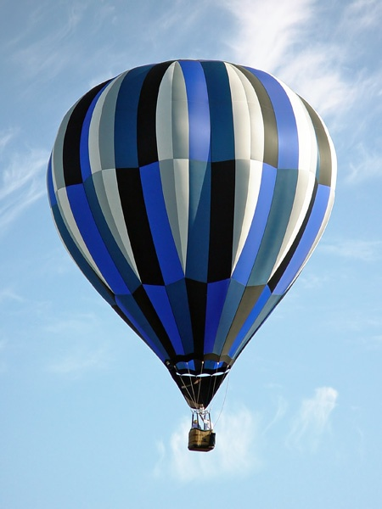
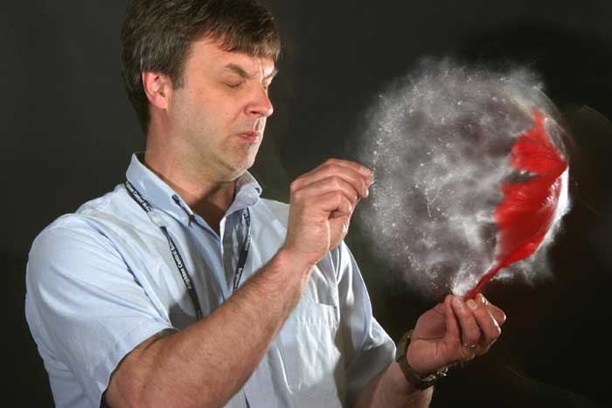
Balloons
Any object in the atmosphere is subject to a buoyant force and Archimedes law applies so if the buoyant force is greater than the weight of an object it will rise. So since the material of a balloon has a density greater than air then the balloon must be filled with a gas having a density less than air. In practice balloons either use Helium or hot air.
As the balloon rises the buoyant force decreases and the balloon will float at constant altitude when the buoyant force is equal to the weight.
F_{B}
mg

Slide 32

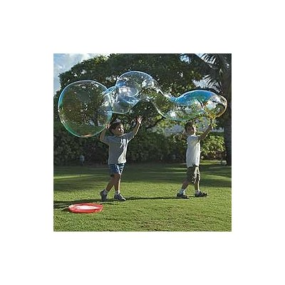
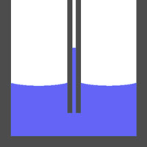
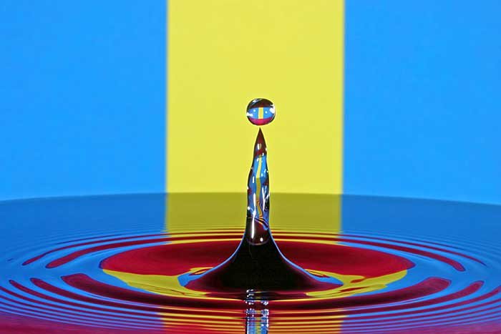
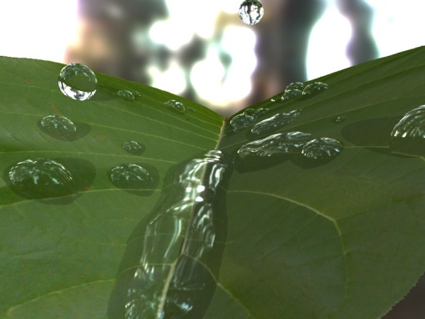
Surface tension
The molecules and atoms in a liquid are continually in motion so that a molecule at the surface can escape and this is evaporation. However a molecule at the surface feels an attractive force pulling it back into the liquid and this is surface tension. This is the reason that one can form bubbles and water drops

