Slide 1
Exam#1 (chapter 1-8)
time: Wednesday 03/24 8:30 am- 9:20 am
Location: physics building room 112
If you have special needs, e.g. exam time extension, and has not contact me before, please bring me the letter from the Office of the Dean of Students before 03/17.
AOB
  multiple choice problems.
  Prepare your own scratch paper, pencils, erasers, etc.
  Use only pencil for the answer sheet
  Bring your own calculators
  No cell phones, no text messaging, no computers
  No crib sheet of any kind is allowed. Equation sheet will be provided.

Slide 2
Mass Density and Number Density
If one takes two objects of exactly the same volume made of different materials they have different weights. So we define a useful quantity
Density ρ = mass/unit volume, kg/m³ or grams/cc so the mass of an object is ρV and the weight ρVg
Water: 1 g/cm³ or 1 ton/m³
Copper: 8.94 g/cm³ or 8.94 ton/m³
Mercury: 13.5 g/cm³ or 13.5 ton/m³
Number Density = number of particles/unit volum.

Slide 3
Pressure
We define pressure as P = F/A
that is the force divided by the area over which the force acts.
  Units: 1 N/m² = 1 Pa (pascal)
  Why needle is sharpened at the tip?

Slide 4
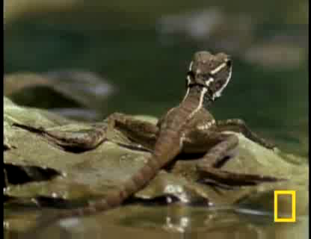
Notes:
Large flipper

Slide 5
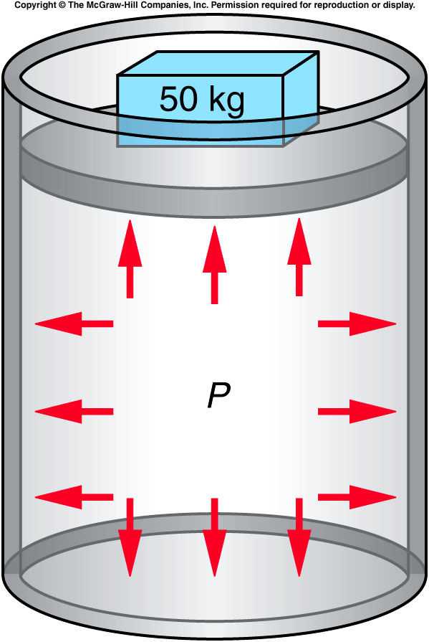
Pascal’s Principle
What happens inside a fluid when pressure is exerted on it?
Does pressure have a direction?
Does it transmit a force to the walls or bottom of a container?
  Any change in the pressure of a fluid is transmitted uniformly in all directions throughout the fluid.

Slide 6
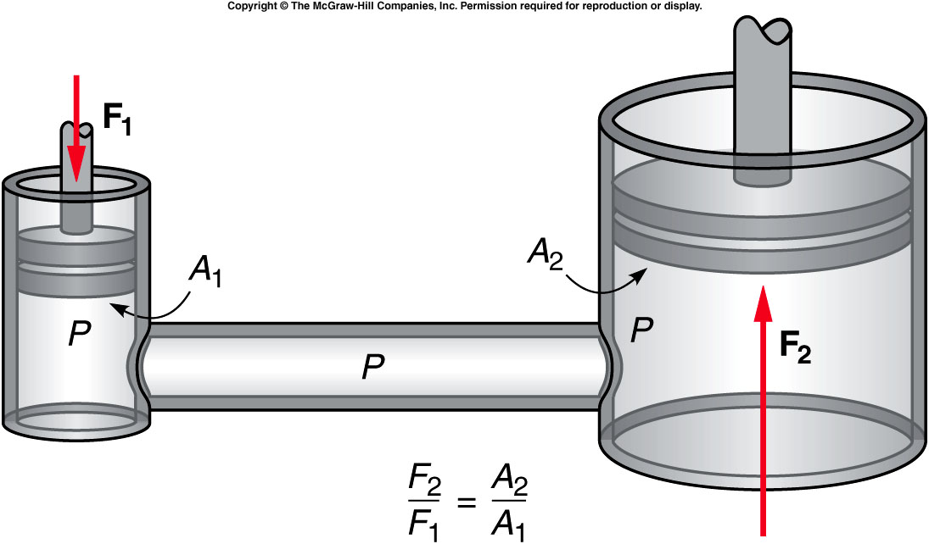

How does a hydraulic jack work?
$F_{2}/A_{2}$= $F_{1}/A_{1}$
A force applied to a piston with a small area can produce a large increase in pressure in the fluid because of the small area of the piston.
This increase in pressure is transmitted through the fluid to the piston with the larger area.
The force exerted on the larger piston is proportional to the area of the piston: F = PA.

Slide 7
A force of 10 N is applied to a circular piston with an area of 2 cm² in a hydraulic jack. The output piston for the jack has an area of 100 cm². What is the pressure in the fluid?
F₁ = 10 N
A₁ = 2 cm² = 0.0002 m²
P = F₁ / A₁ = 10 N / 0.0002 m² = 50,000 N/m²
= 50 kPa
0.002 Pa
5 Pa
10 Pa
50 kPa

Slide 8
Quiz: What is the force exerted on the output piston by the fluid?
P = 50 kPa
A₂ = 100 cm² = 0.01 m²
F₁ = PA₁ = (50,000 N/m²)(0.01 m²) = 500 N
The mechanical advantage is
500 N / 10 N = 50.
50 N
500 N
5,000 N
50,000 N

Slide 9
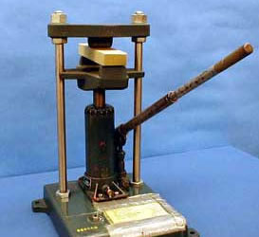
2D-01 Hydraulic Press
Is it possible to crush a 2x4 only with the force exerted by one hand ?
Using the uniformity of pressure within a liquid as a mechanical advantage
Within the Hydraulic fluid the pressure is uniform:
F₁/A₁ = F₂/A₂ → F₁/F₂ = A₁/A₂
Pump piston diameter = 0.5 in
Lift piston diameter = 1.25 in
F₁= 6.25*F₂
This is not enough mechanical advantage to crush the wood. How is it done?
Remember, the lever arm also gives a mechanical advantage. We have: F₁≈ (16)*6.25*F₂ = 100*F₂
THE INPUT FORCE IS GREATLY ENHANCED BY THE HYDRAULIC FLUID AND BY THE LEVERAGE GAINED USING THE LONG HANDLE.
Notes:
To crash a wooden block need a couple of thousand pounds of force.

Slide 10
Atmospheric Pressure and the Behavior of Gases
Living on the surface of the earth, we are at the bottom of a sea of air.
This sea of air is thinner at higher altitudes.
It is also thinner during certain weather conditions.
We describe this property by atmospheric pressure: the pressure of the layer of air that surrounds the earth.
  At sea level, the atmospheric pressure is 100 kPa, or 14.7 pounds per square inch, but it decreases with altitude.
Notes:
Windy weather smaller air pressure.

Slide 11
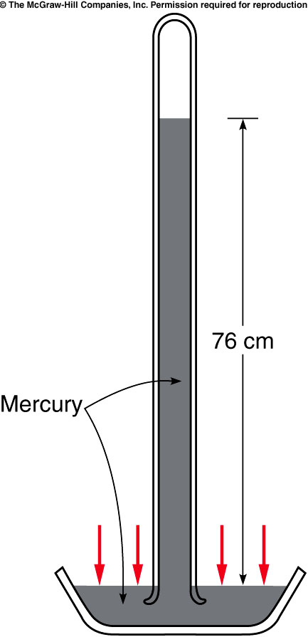
Torricelli invented the barometer, a device for measuring atmospheric pressure.
He filled a tube with mercury and inverted it into an open container of mercury.
Air pressure acting on the mercury in the dish supported a column of mercury, of height proportional to the atmospheric pressure.
  For water: 32 feet = 975.36 cm
  For mercury: 975.36cm/13.6 = 76 cm.
http://www.youtube.com/watch?v=BSo9fSTJcEE
Notes:
Capillarity

Slide 12
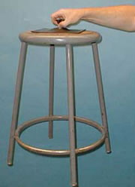
2A-01 Suction Cups
How does a suction cup work ?
How does a suction cup ‘hold on’ to objects?
P_{A}
P_{A}

Slide 13
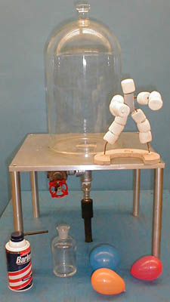
2A-03 Vacuum Demos
Effects of Vacuum on objects made largely of air or air pockets.
Why do the balloons burst in the vacuum ?
Do the balloons burst in vacuum differently then they normally burst ?
Why do the marshmallows get bigger in vacuum ?
What will happen when the marshmallows are returned to normal pressure ?
Can you guess what happens when Shaving Cream is placed in vacuum ?

Slide 14
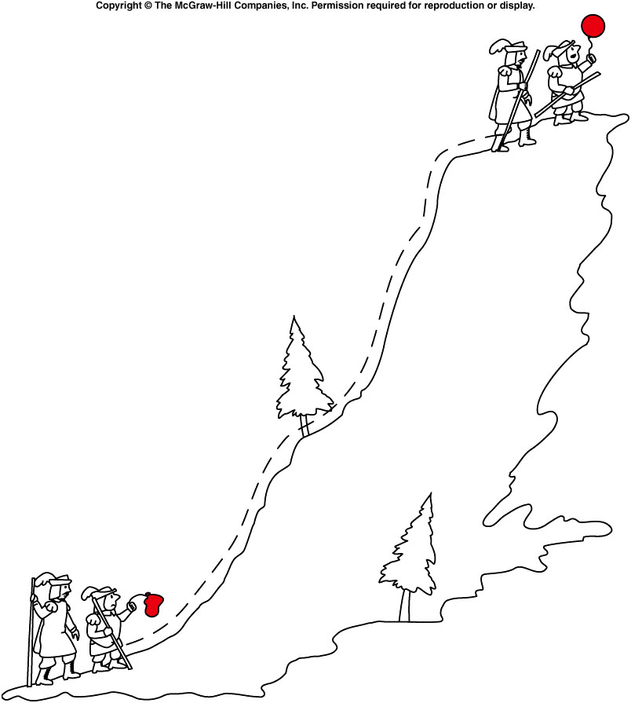
Boyle’s Law
Boyle discovered that the volume of a gas is inversely proportional to the pressure.
Boyle’s Law: PV = constant
  When temperature is contant.
  PV = nkT
  P = (n/V)kT.
    Number Density = n/V
If the pressure increases, the volume decreases.
P₁V₁ = P₂V₂
At higher altitude, the air density become smaller, i.e. larger volume, the air pressure become smaller.
  This is the reason of the balloon inflation.

Slide 15
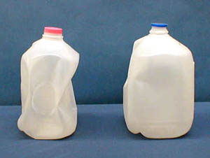
2A-05 Pressure Force Milk Jug
Effect of atmospheric pressure on a partially evacuated milk bottle
What will happen to the container if it is sealed after putting in a small amount of very hot water?
The hot liquid heats the air which expands and some leaves the container. The hot liquid also causes vapor to form in the jug which then cools and condenses.
Liquid takes up a much smaller volume than steam. As the steam cools and condenses a partial vacuum forms and the pressure drops. Atmospheric pressure then crushes it.
Notes:
Ask student to DIY in dorm

Slide 16
Quiz: A fixed quantity of gas is held in a cylinder capped at one end by a movable piston. The pressure of the gas is initially 1 atmosphere (101 kPa) and the volume is initially 0.3 m³. What is the final volume of the gas if the pressure is increased to 3 atmospheres at constant temperature?
P₁ = 1 atm P₂ = 3 atm
V₁ = 0.3 m³ V₂ = ?
V₂ = P₁V₁ / P₂
= (1 atm)(0.3 m³) / 3 atm
= 0.1 m³
0.1 m³
0.3 m³
1 m³
3 m³

Slide 17
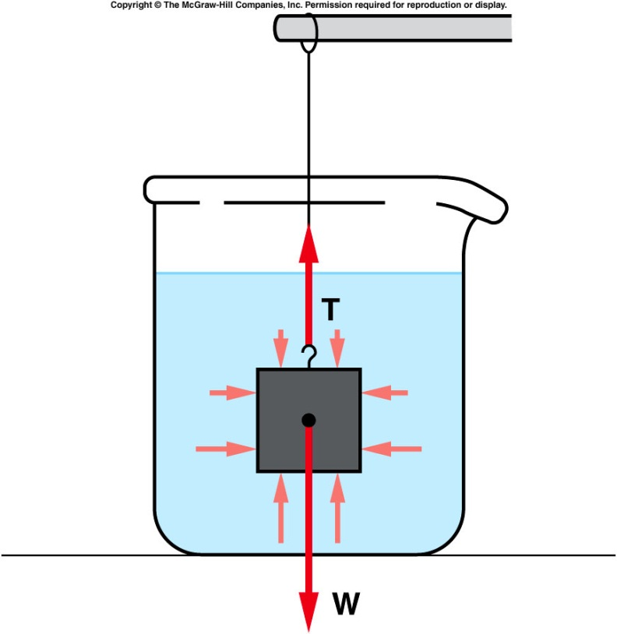
buoyant force
consider a block submerged in water, suspended from a string.
  The pressure of the water pushes on the block from all sides.
  Because the pressure increases with depth, the pressure at the bottom of the block is greater than at the top.
  There is a larger force (F = PA) pushing up at the bottom than there is pushing down at the top.
  The difference between these two forces is the buoyant force.
Pascal’s principle says: density*g*height
is the same everywhere at the same height and in all directions.
Notes:
Think of 3 people standing on top of each other. The person at the bottom feels the pressure of two people. The person at the middle feels the pressure of one person

Slide 18
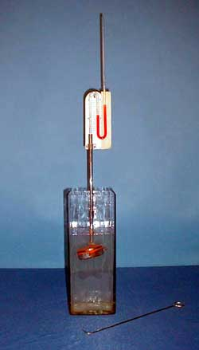
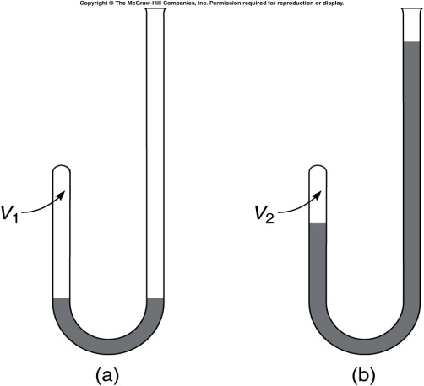
2B-04 Liquid Pressure
Investigating Pressure in different directions within a liquid in equilibrium.
What will happen to the reading on the manometer as the sensor is rotated ?
The increase in pressure ρgh is measured by the difference in height of the liquid in the U tube.
g
h
A
B
A
B
AT ANY GIVEN POINT IN A STATIONARY LIQUID, THE PRESSURE IS THE SAME IN ALL DIRECTIONS.
Notes:
A pillbox shaped sensor has a rubber diaphragm and is attached to a liquid manometer. The sensor is lowered into a deep vessel to a certain depth. The pressure at that depth is indicated on the manometer. The reading on the manometer does not change as the sensor is rotated. The tube holding the sensor is held in place by a clamp that allows the tube to slide downward into the water. DO THIS VERY SLOWLY or you will find yourself drenched with red liquid from the manometer!!!. Once the sensor is at the desired depth, use the wire hook to rotate the sensor.

Slide 19
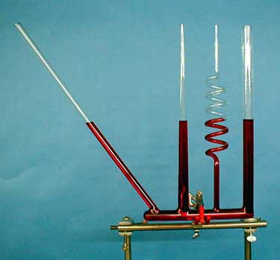
2B-03 Water Seeks Own Level
Liquid pressure depends on the “height” of the liquid column. But how is this height measured ?
Investigating the Dependence of Pressure on Height
The slanted cylinder and twisted cylinder hold a longer “total length” of water. But in each case the vertical height is the same.
P = ρgh
LIQUID PRESSURE DEPENDS ONLY ON VERTICAL HEIGHT (MEASURED STRAIGHT DOWN THAT IS PARALLEL TO g).
Notes:
Same liquid. Same pressure in the bottom

Slide 20
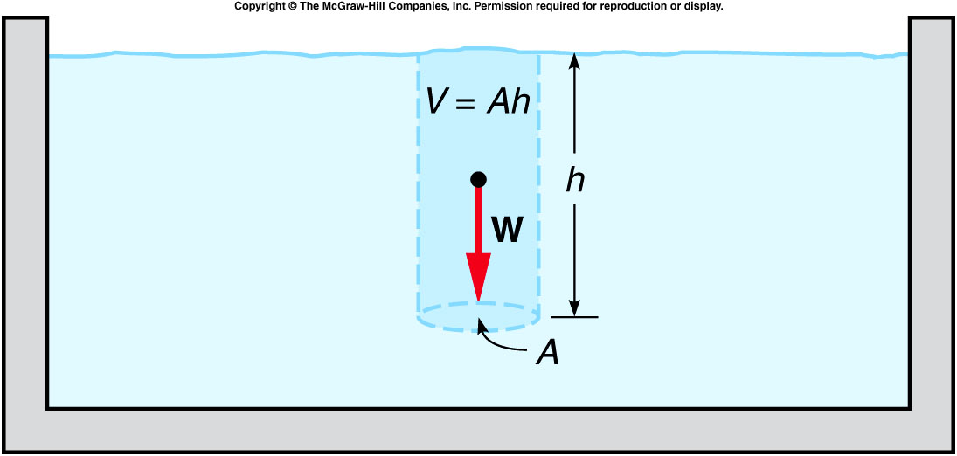
Archimedes’ Principle
Archimedes’ Principle: The buoyant force acting on an object fully or partially submerged in a fluid is equal to the weight of the fluid displaced by the object.
pressure = density*g*height →
buoyant force = difference between forces on top and bottom surface
  = (area*density*h)*g = mg
  = weight of the fluid displaced by the object.

Slide 21
Ch 9 CP 4
Wooden boat: 3m x 1.5m x 1m that carries five people.
Total mass of boat and people equals 1200 kg.
What volume of water must be displaced to float and How much of the boat underwater? (hint: ρ_{H2O} = 1g/cm³)
2.4m³, 0.62m
1.2m³, 0.27m
1.2m³, 0.1m
3.6m³, 0.27m
1m
1.5m
3m
F_{net} = F_{b} – W = 0
F_{b} = 11760 N
c) F_{b} = ρ_{H2O} Vg (see Ch 9 E 12)
F_{b}/ρ_{H2O}g = 11760N/(1000 kg/m3)(9.8 m/s²) = V = 1.2 m³
W
F_{b}
d) V = LWh = (3m)(1.5m)h = 1.2 m³ h = 0.27 m

Slide 22
Quiz: Boat displaces 2.5 m³ of water. Density of water ρ_{H2O} = 1000 kg/m³. What is the mass of water displaced? What is the buoyant force?
A). Mass = 2500 kg, buoyant force = 24500N
B). Mass = 250 kg, buoyant force = 2450N
C). Mass = 25 kg, buoyant force = 245N
D). Mass = 2500 kg, buoyant force = 2450N
E). Mass = 2500 kg, buoyant force = 245N
Mass of fluid displaced
(m_{FD}) = volume x density of fluid.
M_{FD} = V_{FD}ρ_{H2O} = (2.5 m³)(1000 kg/m³) = 2500 kg
F_{b} = W_{FD}
Buoyant force equals weight of fluid displaced.
F_{b} = W_{FD} = m_{FD} g = (2500 kg)(9.8 m/s²) = 24500 N

Slide 23
Q10 If you climbed a mountain carrying a mercury barometer, would the level of the mercury column in the glass tube of the barometer increase or decrease as you climb the mountain?
Increase
Decrease
Same level
The pressure decreases because you have a smaller column of air to support so the height would decrease

Slide 24
Q11 If you filled an airtight balloon at the top of a mountain, would the balloon expand or contract as you descend the mountain?
Contract
Expand
Unchanged.

