Slide 1
Exam#1 (chapter 1-8)
time: Wednesday 03/24 8:30 am- 9:20 am
Location: physics building room 112
If you have special needs, e.g. exam time extension, and has not contact me before, please bring me the letter from the Office of the Dean of Students before 03/17.
AOB
  multiple choice problems.
  Prepare your own scratch paper, pencils, erasers, etc.
  Use only pencil for the answer sheet
  Bring your own calculators
  No cell phones, no text messaging, no computers
  No crib sheet of any kind is allowed. Equation sheet will be provided.

Slide 2
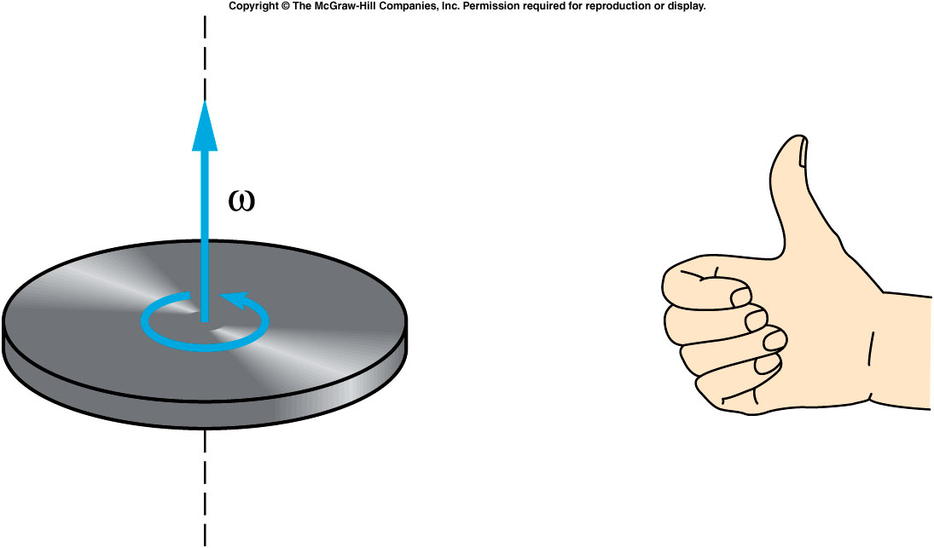
Angular momentum is a vector
The direction of the rotational-velocity vector is given by the right-hand rule.
The direction of the angular-momentum vector is the same as the rotational velocity.

Slide 3
Conservation of Angular Momentum

Slide 4
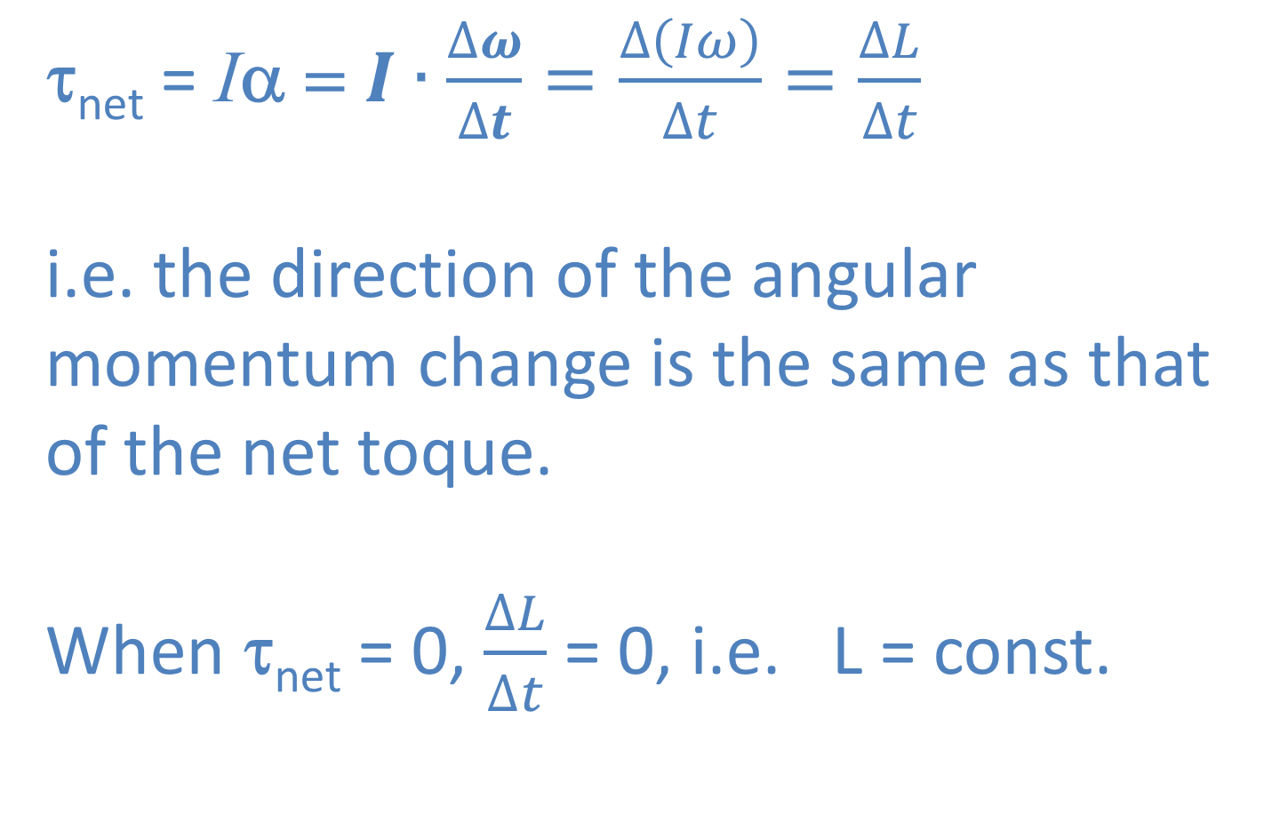
Conservation of Angular Momentum
τ_{net} = Iα = $I∙\frac{∆ω}{∆t}=\frac{∆\left(Iω\right)}{∆t}=\frac{∆L}{∆t}$
i.e. the direction of the angular momentum change is the same as that of the net toque.
When τ_{net} = 0, $\frac{∆L}{∆t}$ = 0, i.e. L = const.

Slide 5
Conservation of Angular Momentum

Slide 6
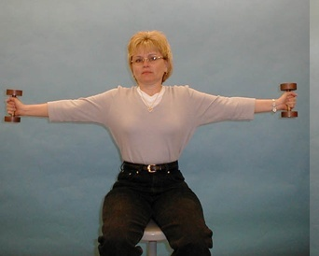
1Q- 23 Conservation of angular momentum
Changing the moment of inertia of a skater
How does conservation of angular momentum manifest itself ?
When pulling in both arms, the person will spin:
Faster
Slower
Same speed
3/9/2021
Physics 214
Fall 2009
6
Notes:
No motion sickness. Pull in the arms and extend the arm back out

Slide 7
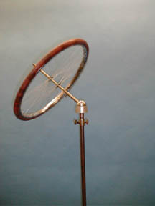
1Q-30 Bicycle Wheel Gyroscope
Gyroscopic action and precession
L
What happens to the wheel, does it fall down?
F
mg
F = mg
After placing the spinning wheel in the socket, the wheel will
Stay as is
Rotate horizontally.
7
Notes:
A bicycle wheel is fitted with a long axle, one end of which has a ball. The ball can be seated in a socket which is free to rotate, placed on a heavy stand. The wheel is set spinning and the ball end set in the socket. By placing the wheel in the socket such that the axle is at an angle or horizontal, the bicycle wheel precesses, the direction being determined by the sense of the rotation of the wheel. This illustrates the relationship between the torque and the change in the angular momentum vector.

Slide 8
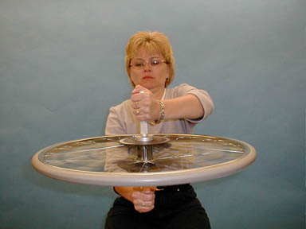
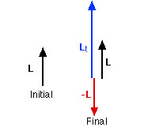
1Q-21 Conservation of angular momentum
Conservation of angular momentum using a spinning wheel
When the wheel is inverted, the stool
Rotate
Stay as is.
3/9/2021
8
Notes:
The demonstrator, holding a bicycle wheel, sits on a stool in the center of the turntable. The wheel is spun and then held with the axis vertical. The angular momentum vector is also in the vertical direction (whether it is up or down depends on how the wheel is spinning). If the wheel is suddenly inverted, the turntable (and demonstrator) acquire an angular momentum in the opposite direction such that the original angular momentum of the system is conserved.

Slide 9
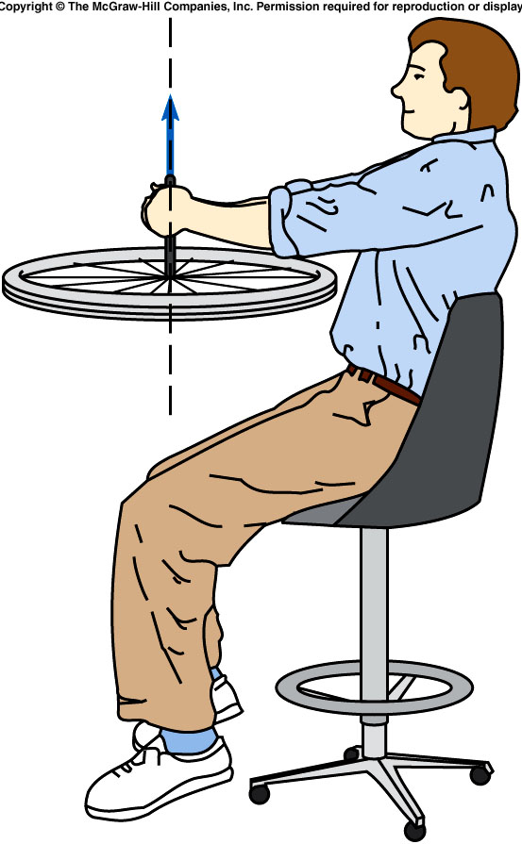
A student sits on a stool holding a bicycle wheel with a rotational velocity of 5 rad./s about a vertical axis. The rotational inertia of the wheel is 2 kg·m² about its center and the rotational inertia of the student and wheel and platform about the rotational axis of the platform is 6 kg·m². What is the initial angular momentum of the system?
10 kg·m²/s upward
25 kg·m²/s downward
25 kg·m²/s upward
50 kg·m²/s downward
L = Iω = (2 kg·m²)(5 rad./s)
= 10 kg·m²/s
upward from plane of wheel

Slide 10
Quiz: A student sits on a stool holding a bicycle wheel with a rotational velocity of 5 rad./s about a vertical axis. The rotational inertia of the wheel is 2 kg·m² about its center and the rotational inertia of the student and wheel and platform about the rotational axis of the platform is 6 kg·m². If the student flips the axis of the wheel, reversing the direction of its angular-momentum vector, what is the rotational velocity of the student and stool about their axis after the wheel is flipped?
1.67 rad/s
3.33 rad/s
60 rad/s
120 rad/s
ω = L / I = (20 kg·m²/s) / (6 kg·m²)
= 3.33 rad/s
in direction of original angular velocity

Slide 11
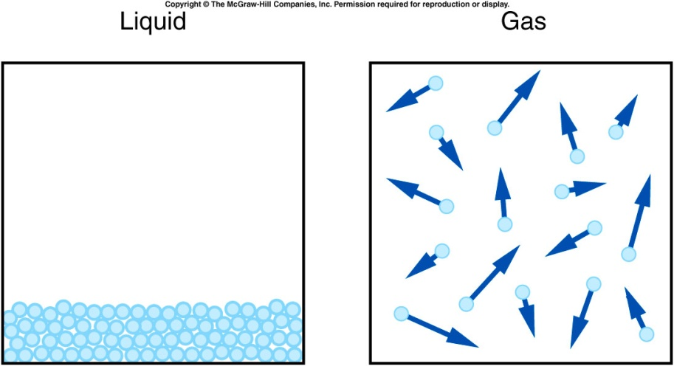
Liquids and Gases
The unit of volume is
the meter cubed , m³, which is a very large volume. Very often we use cm³ = cc. Other everyday units are gallons, quarts, pints
As we know liquids and gases act very differently than solids.
Liquids and gases have mass but their constituent atoms are not tightly bound so that each part of the liquid or gas can move.
The atoms of a liquid are more tightly bound so a liquid can be kept in an open container whereas gas usually requires a closed container.
Liquids, like solids are not very compressible, that is, it is difficult to change the volume.
A volume of gas can have it’s volume changed fairly easily. Both have the property of being able to flow, for example water and gas lines in a house.

Slide 12
Mass Density and Number Density
If one takes two objects of exactly the same volume made of different materials they have different weights. So we define a useful quantity
Density ρ = mass/unit volume, kg/m³ or grams/cc so the mass of an object is ρV and the weight ρVg
Water: 1 g/cm³ or 1 ton/m³
Copper: 8.94 g/cm³ or 8.94 ton/m³
Mercury: 13.5 g/cm³ or 13.5 ton/m³
Number Density = number of particles/unit volum.

Slide 13
Pressure
We define pressure as P = F/A
that is the force divided by the area over which the force acts.
  Units: 1 N/m² = 1 Pa (pascal)
  Why needle is sharpened at the tip?

Slide 14
One person applies a 1N force on a square plate with edge length 1 m and push it against the wall. Another person applies a 1N force on a disk of radius of 1m and push it again the wall. What’s the pressure of the plate and disk on the wall?
A). Plate: 1 Pa, disk: 1 Pa
B). Plate: 1 Pa, disk: 0.32 Pa
C). Plate: 0.32 Pa, disk: 0.32 Pa
D). Plate: 0.25 Pa, disk: 0.25 Pa
E). Plate: 0.32Pa, disk: 1 Pa
area (sqare) = 1m²
area( (disk) = 3.14 m²
Pressure (square) =
1N/1m² = 1pa
Pressure (disk) =
1N/3.14 m² = 0.32 Pa

Slide 15
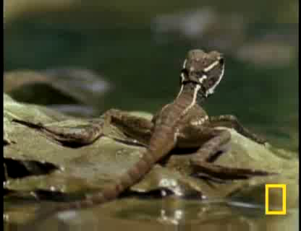
Notes:
Large flipper

Slide 16
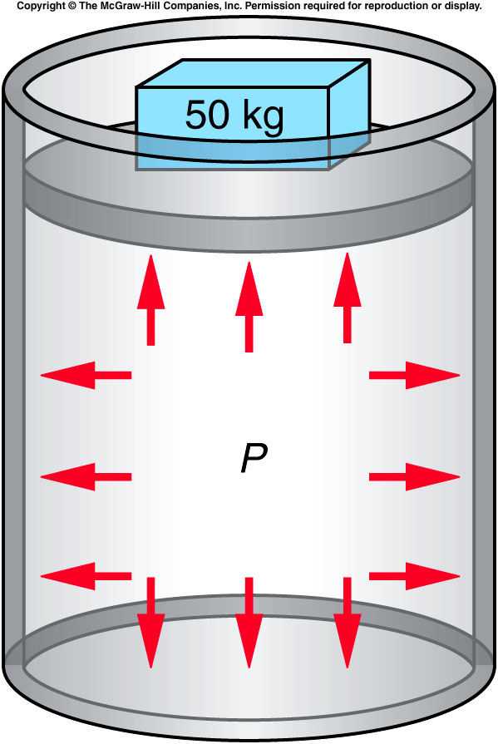
Pascal’s Principle
What happens inside a fluid when pressure is exerted on it?
Does pressure have a direction?
Does it transmit a force to the walls or bottom of a container?
  Any change in the pressure of a fluid is transmitted uniformly in all directions throughout the fluid.

Slide 17
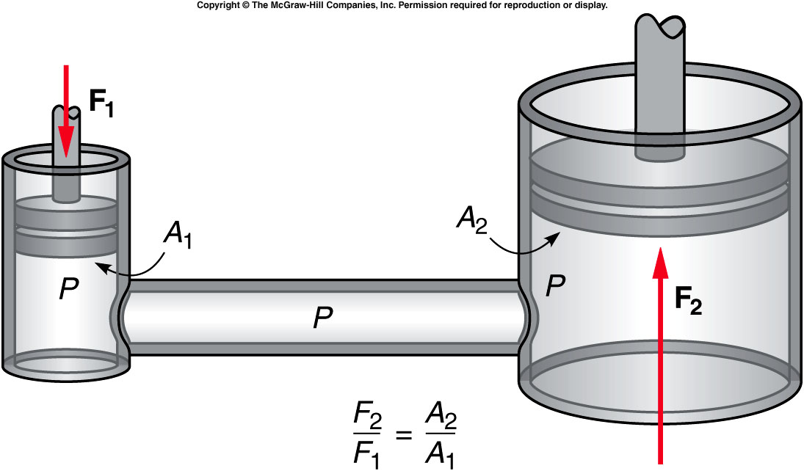
How does a hydraulic jack work?
A force applied to a piston with a small area can produce a large increase in pressure in the fluid because of the small area of the piston.
This increase in pressure is transmitted through the fluid to the piston with the larger area.
The force exerted on the larger piston is proportional to the area of the piston: F = PA.

Slide 18
A force of 10 N is applied to a circular piston with an area of 2 cm² in a hydraulic jack. The output piston for the jack has an area of 100 cm². What is the pressure in the fluid?
F₁ = 10 N
A₁ = 2 cm² = 0.0002 m²
P = F₁ / A₁ = 10 N / 0.0002 m² = 50,000 N/m²
= 50 kPa
0.002 Pa
5 Pa
10 Pa
50 kPa

Slide 19
Quiz: What is the force exerted on the output piston by the fluid?
P = 50 kPa
A₂ = 100 cm² = 0.01 m²
F₁ = PA₁ = (50,000 N/m²)(0.01 m²) = 500 N
The mechanical advantage is
500 N / 10 N = 50.
50 N
500 N
5,000 N
50,000 N

Slide 20
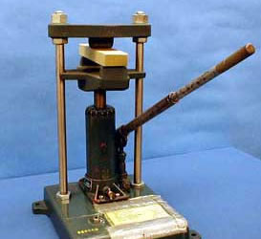
2D-01 Hydraulic Press
Is it possible to crush a 2x4 only with the force exerted by one hand ?
Using the uniformity of pressure within a liquid as a mechanical advantage
Within the Hydraulic fluid the pressure is uniform:
F₁/A₁ = F₂/A₂ → F₁/F₂ = A₁/A₂
Pump piston diameter = 0.5 in
Lift piston diameter = 1.25 in
F₁= 6.25*F₂
This is not enough mechanical advantage to crush the wood. How is it done?
Remember, the lever arm also gives a mechanical advantage. We have: F₁≈ (16)*6.25*F₂ = 100*F₂
THE INPUT FORCE IS GREATLY ENHANCED BY THE HYDRAULIC FLUID AND BY THE LEVERAGE GAINED USING THE LONG HANDLE.
Notes:
To crash a wooden block need a couple of thousand pounds of force.

Slide 21
Atmospheric Pressure and the Behavior of Gases
Living on the surface of the earth, we are at the bottom of a sea of air.
This sea of air is thinner at higher altitudes.
It is also thinner during certain weather conditions.
We describe this property by atmospheric pressure: the pressure of the layer of air that surrounds the earth.
  At sea level, the atmospheric pressure is 100 kPa, or 14.7 pounds per square inch, but it decreases with altitude.
Notes:
Windy weather smaller air pressure.

Slide 22
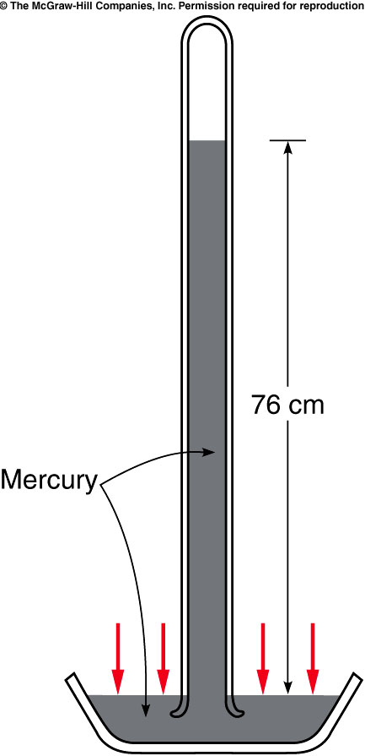
Torricelli invented the barometer, a device for measuring atmospheric pressure.
He filled a tube with mercury and inverted it into an open container of mercury.
Air pressure acting on the mercury in the dish supported a column of mercury, of height proportional to the atmospheric pressure.
  For water: 32 feet = 975.36 cm
  For mercury: 975.36cm/13.6 = 76 cm.
http://www.youtube.com/watch?v=BSo9fSTJcEE
Notes:
Capillarity

Slide 23
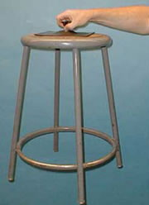
2A-01 Suction Cups
How does a suction cup work ?
How does a suction cup ‘hold on’ to objects?
P_{A}
P_{A}

Slide 24
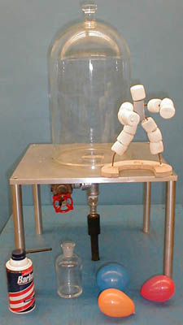
2A-03 Vacuum Demos
Effects of Vacuum on objects made largely of air or air pockets.
Why do the balloons burst in the vacuum ?
Do the balloons burst in vacuum differently then they normally burst ?
Why do the marshmallows get bigger in vacuum ?
What will happen when the marshmallows are returned to normal pressure ?
Can you guess what happens when Shaving Cream is placed in vacuum ?

Slide 25
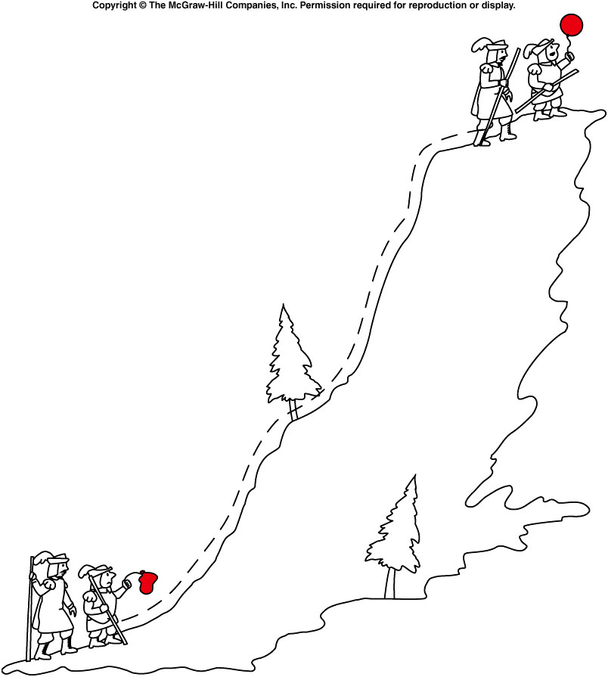
Boyle’s Law
Boyle discovered that the volume of a gas is inversely proportional to the pressure.
Boyle’s Law: PV = constant
  When temperature is contant.
  PV = nkT
  P = (n/V)kT.
    Number Density = n/V
If the pressure increases, the volume decreases.
P₁V₁ = P₂V₂
At higher altitude, the air density become smaller, i.e. larger volume, the air pressure become smaller.
  This is the reason of the balloon inflation.

Slide 26
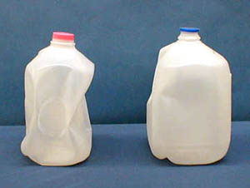
2A-05 Pressure Force Milk Jug
Effect of atmospheric pressure on a partially evacuated milk bottle
What will happen to the container if it is sealed after putting in a small amount of very hot water?
The hot liquid heats the air which expands and some leaves the container. The hot liquid also causes vapor to form in the jug which then cools and condenses.
Liquid takes up a much smaller volume than steam. As the steam cools and condenses a partial vacuum forms and the pressure drops. Atmospheric pressure then crushes it.

