Slide 1
Exam#1 (chapter 1-8)
time: Wednesday 03/24 8:30 am- 9:20 am
Location: physics building room 112
If you have special needs, e.g. exam time extension, and has not contact me before, please bring me the letter from the Office of the Dean of Students before 03/17.
AOB
  multiple choice problems.
  Prepare your own scratch paper, pencils, erasers, etc.
  Use only pencil for the answer sheet
  Bring your own calculators
  No cell phones, no text messaging, no computers
  No crib sheet of any kind is allowed. Equation sheet will be provided.

Slide 2
The center of gravity
  is the point about which the weight of the object itself exerts no torque.
  We can locate the center of gravity by finding the point where it balances on a fulcrum.
  What’s the center of gravity of a disk?
    any point on the edge of the disk.
    Center of the disk
    Any point half way between the center and the edge.

Slide 3
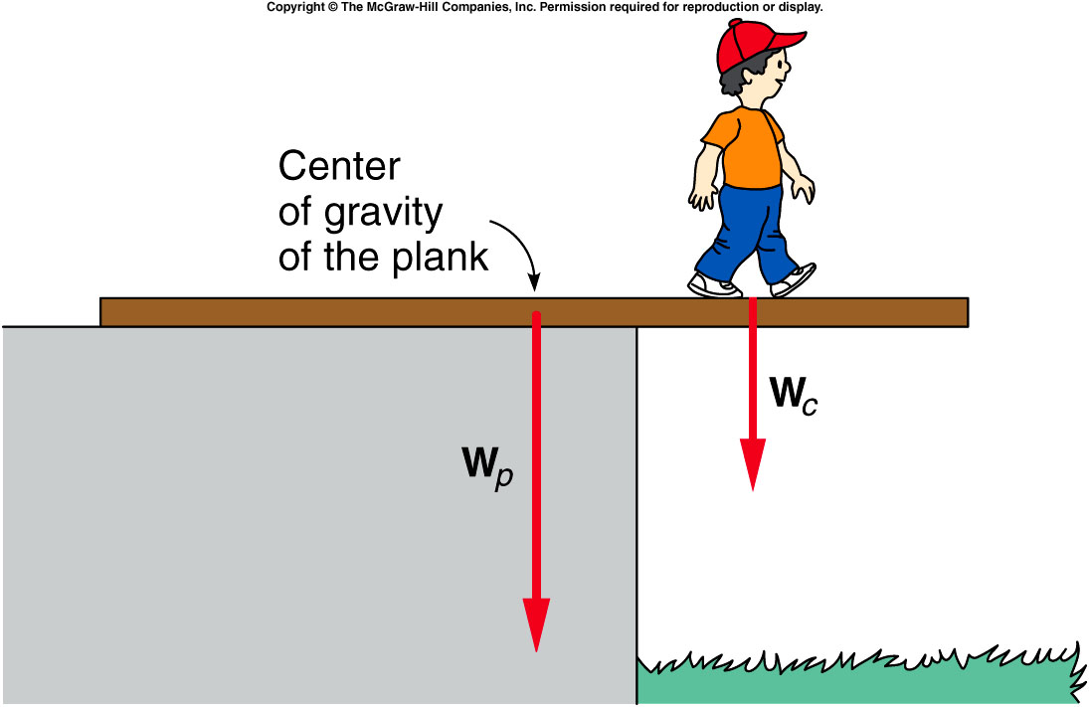
How far can the child walk without tipping the plank?
For a uniform plank, its center of gravity is at its geometric center.
The pivot point will be the edge of the supporting platform.
The plank will not tip as long as the counterclockwise torque from the weight of the plank is larger than the clockwise torque from the weight of the child.
The plank will verge on tipping when the magnitude of the torque of the child equals that of the plank.

Slide 4
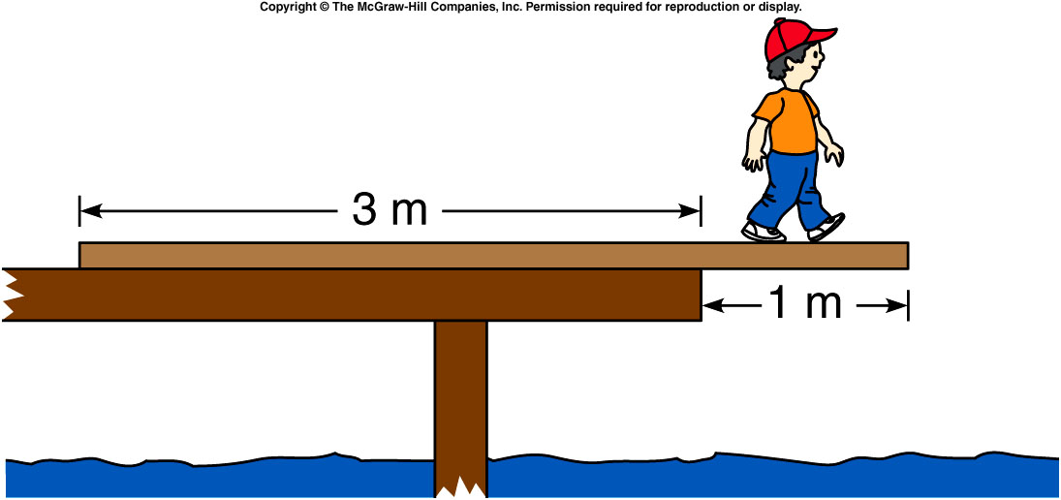
An 80-N plank is placed on a dock as shown. The plank is uniform in density so the center of gravity of the plank is located at the center of the plank. A 150-N boy standing on the plank walks out slowly from the edge of the dock. What is the torque exerted by the weight of the plank about the pivot point at the edge of the dock?
+80 N·m
-80 N·m
+160 N·m
-160 N·m
+240 N·m
-240 N·m
1 m × 80 N = +80 N·m
(counterclockwise)

Slide 5
Quiz: An 80-N plank is placed on a dock as shown. The plank is uniform in density so the center of gravity of the plank is located at the center of the plank. A 150-N boy standing on the plank walks out slowly from the edge of the dock. How far from the edge of the dock can the 150-N boy walk until the plank is just on the verge of tipping?
0.12 m
0.23 m
0.53m
1.20 m
80 N·m / 150 N = 0.53 m

Slide 6
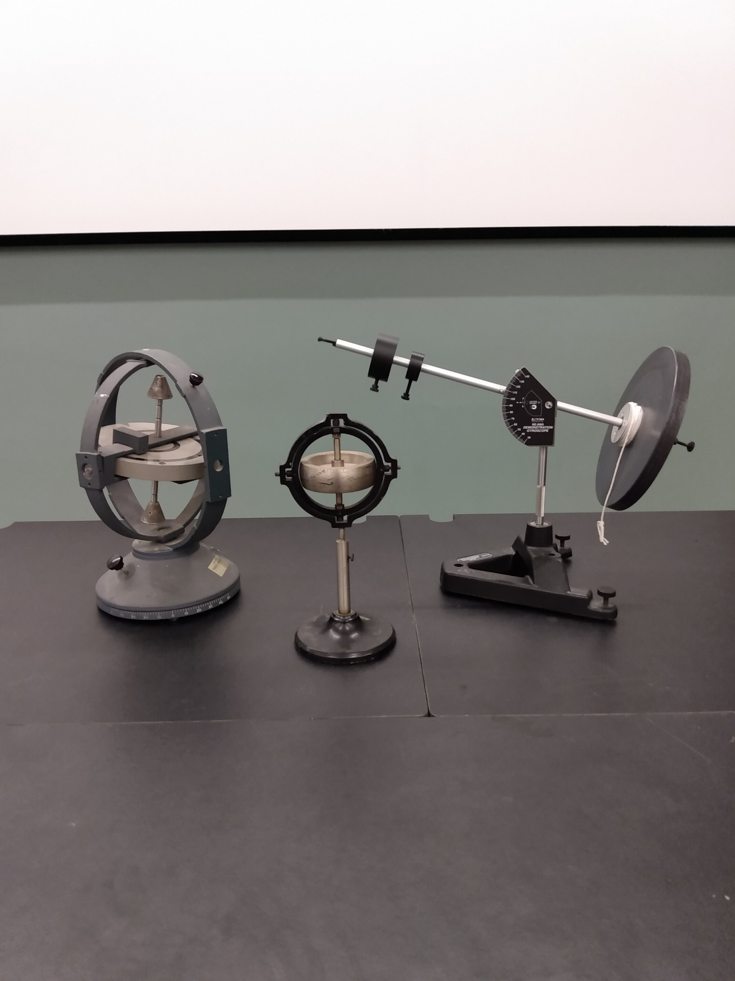
Demos: 1Q-09 Demonstration Gyroscopes
Notes:
Show this demo first and ask students the physics behind it.

Slide 7
Rotational Inertia and Newton’s Second Law
In linear motion, net force and mass determine the acceleration of an object.
For rotational motion, torque determines the rotational acceleration.
The rotational counterpart to mass is rotational inertia or moment of inertia.
  Just as mass represents the resistance to a change in linear motion, rotational inertia is the resistance of an object to change in its rotational motion.
  Rotational inertia is related to the mass of the object.
  It also depends on how the mass is distributed about the axis of rotation.

Slide 8
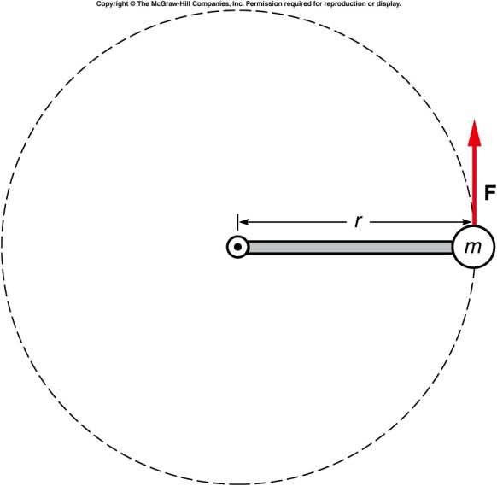
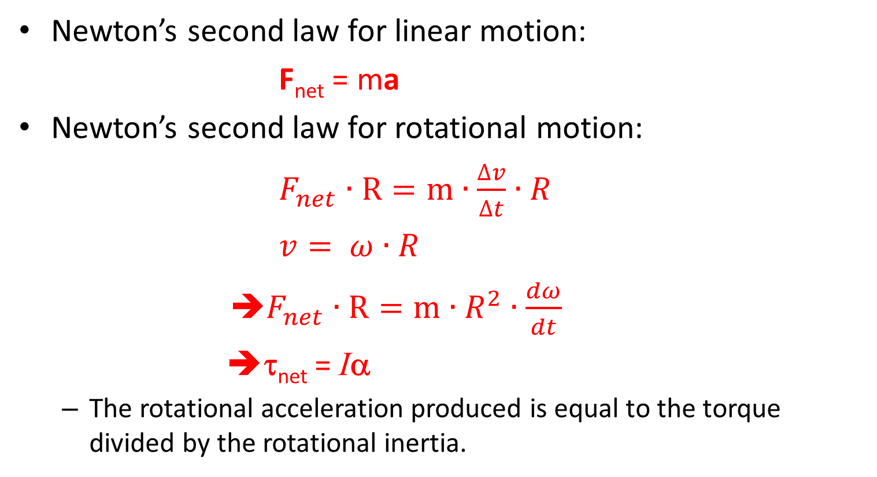
Rotational Inertia and Newton’s Second Law
Newton’s second law for linear motion:
F_{net} = ma
Newton’s second law for rotational motion:
$F_{net}∙R=m∙\frac{∆v}{∆t}∙R$
$v= ω∙R$
➔$F_{net}∙R=m∙R^{2}∙\frac{dω}{dt}$
⎝τ_{net} = Iα
  The rotational acceleration produced is equal to the torque divided by the rotational inertia.
Massless bar

Slide 9
Rotational Inertia and Newton’s Second Law
For an object with its mass concentrated at a point:
  Rotational inertia = mass x square of distance from axis
  I = mr²
The total rotational inertia of an object like a merry-go-round can be found by adding the contributions of all the different parts of the object.

Slide 10
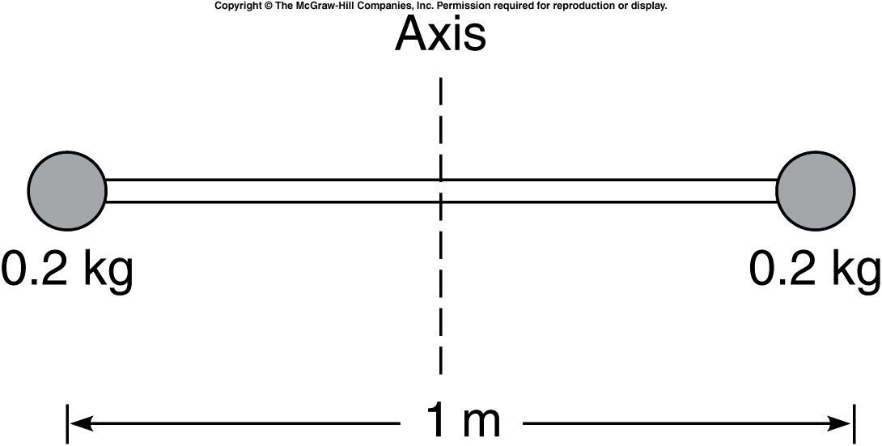
Two 0.2-kg masses are located at either end of a 1-m long, very light and rigid rod as shown. What is the rotational inertia of this system about an axis through the center of the rod?
0.02 kg·m²
0.05 kg·m²
0.10 kg·m²
0.40 kg·m²
I = mr²
= (0.2 kg)(0.5m)² x 2
= 0.10 kg·m²

Slide 11
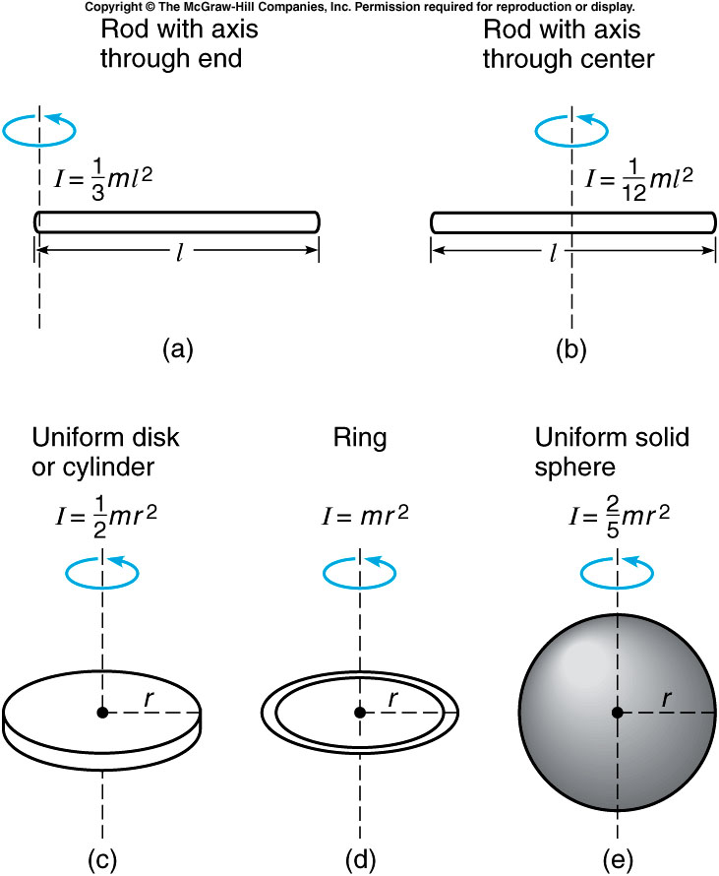
Rotational inertias for more complex shapes:

Slide 12
Angular Momentum
Linear momentum is mass (inertia) times linear velocity: p = mv
Angular momentum is rotational inertia times rotational velocity:
L = Iω
  Angular momentum may also be called rotational momentum.
  A bowling ball spinning slowly might have the same angular momentum as a baseball spinning much more rapidly, because of the larger rotational inertia I of the bowling ball.
Notes:
I stopped here in spring2019

Slide 13
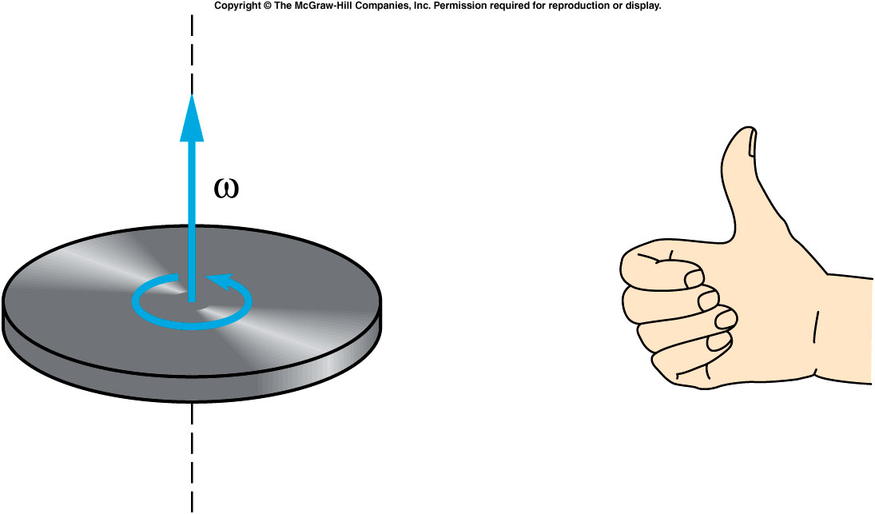
Angular momentum is a vector
The direction of the rotational-velocity vector is given by the right-hand rule.
The direction of the angular-momentum vector is the same as the rotational velocity.

Slide 14
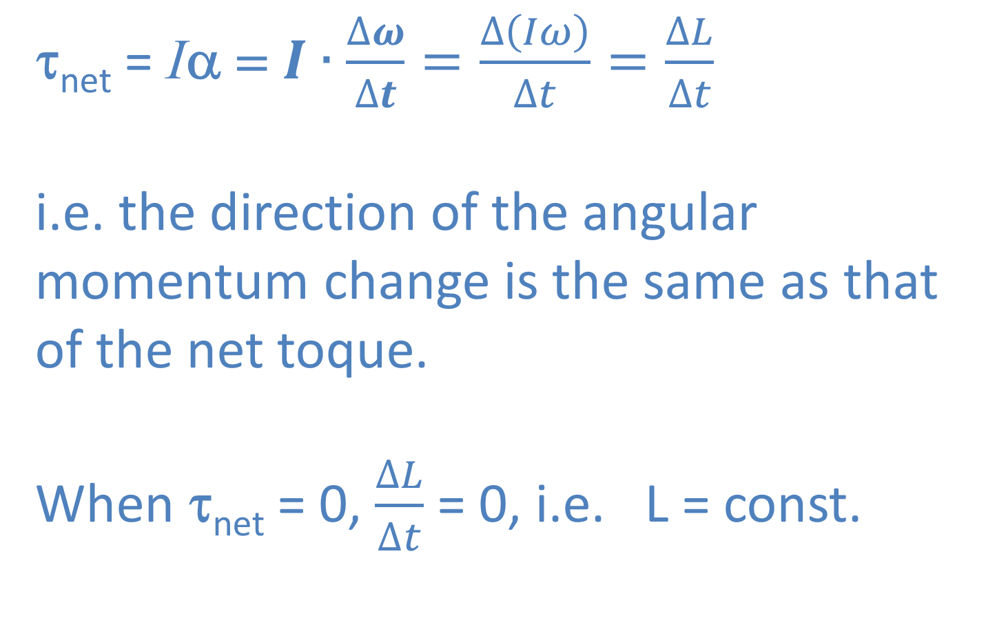
Conservation of Angular Momentum
τ_{net} = Iα = $I∙\frac{∆ω}{∆t}=\frac{∆\left(Iω\right)}{∆t}=\frac{∆L}{∆t}$
i.e. the direction of the angular momentum change is the same as that of the net toque.
When τ_{net} = 0, $\frac{∆L}{∆t}$ = 0, i.e. L = const.

Slide 15
Conservation of Angular Momentum

Slide 16
Demos: 1Q-09 Demonstration Gyroscopes

Slide 17
Quiz: Some new 2-wheel motocycles can stand by itself without support when not moving.
Not possible.
Possible. Angular Momentum conservation is in action.
https://www.youtube.com/watch?v=1KmhTfhaWG8

Slide 18

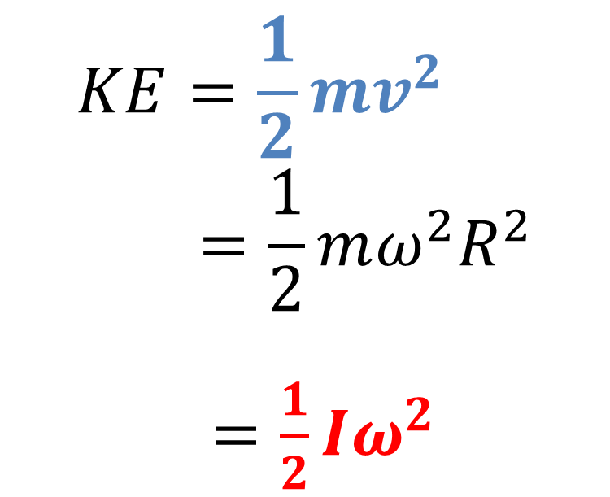
Kinetic Energy
$$KE=\frac{1}{2}mv^{2}=\frac{1}{2}mω^{2}R^{2}$$
$=\frac{1}{2}Iω^{2}$

Slide 19
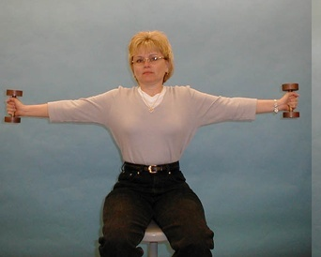
1Q- 23 Conservation of angular momentum
Changing the moment of inertia of a skater
How does conservation of angular momentum manifest itself ?
When pulling in both arms, the person will spin:
Faster
Slower
Same speed
3/7/2021
Physics 214
Fall 2009
19
Notes:
No motion sickness. Pull in the arms and extend the arm back out

Slide 20
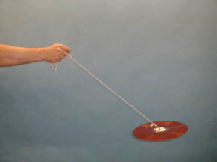
1Q-32 Stability Under Rotation
Example of Gyroscopic Stability: Swinging a spinning Record
Why does the Record not “flop around” once it is set spinning ?
L
L
3/7/2021
Physics 214
Fall 2009
20
Notes:
A disk suspended by a cord through its center hole. If the disk is swung back and forth without spinning, it tends to “flop” around randomly. if the disk is given a spin, the axis will maintain its direction in space as the disk is swung back and forth. Bullet also spin

Slide 21
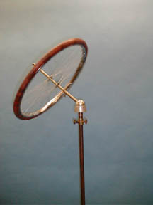
1Q-30 Bicycle Wheel Gyroscope
Gyroscopic action and precession
L
What happens to the wheel, does it fall down?
F
mg
F = mg
21
Notes:
A bicycle wheel is fitted with a long axle, one end of which has a ball. The ball can be seated in a socket which is free to rotate, placed on a heavy stand. The wheel is set spinning and the ball end set in the socket. By placing the wheel in the socket such that the axle is at an angle or horizontal, the bicycle wheel precesses, the direction being determined by the sense of the rotation of the wheel. This illustrates the relationship between the torque and the change in the angular momentum vector.

Slide 22
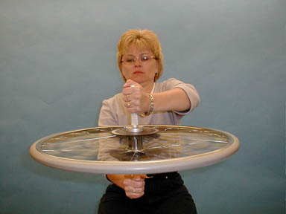
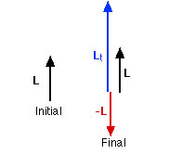
1Q-21 Conservation of angular momentum
Conservation of angular momentum using a spinning wheel
When the wheel is inverted, the stool
Rotate
Stay as is.
3/7/2021
22
Notes:
The demonstrator, holding a bicycle wheel, sits on a stool in the center of the turntable. The wheel is spun and then held with the axis vertical. The angular momentum vector is also in the vertical direction (whether it is up or down depends on how the wheel is spinning). If the wheel is suddenly inverted, the turntable (and demonstrator) acquire an angular momentum in the opposite direction such that the original angular momentum of the system is conserved.

Slide 23
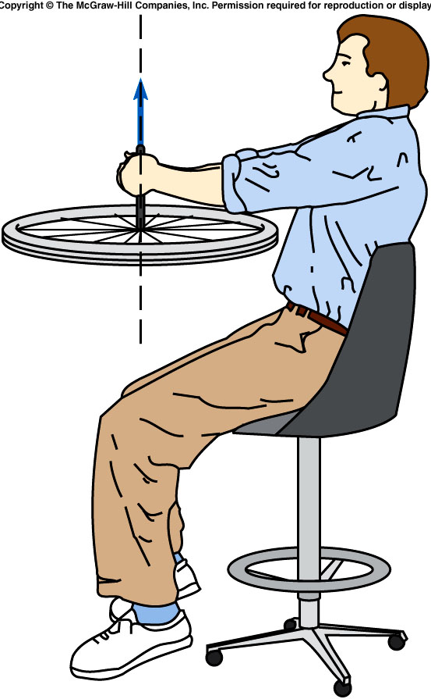
A student sits on a stool holding a bicycle wheel with a rotational velocity of 5 rad./s about a vertical axis. The rotational inertia of the wheel is 2 kg·m² about its center and the rotational inertia of the student and wheel and platform about the rotational axis of the platform is 6 kg·m². What is the initial angular momentum of the system?
10 kg·m²/s upward
25 kg·m²/s downward
25 kg·m²/s upward
50 kg·m²/s downward
L = Iω = (2 kg·m²)(5 rad./s)
= 10 kg·m²/s
upward from plane of wheel

Slide 24
Quiz: A student sits on a stool holding a bicycle wheel with a rotational velocity of 5 rad./s about a vertical axis. The rotational inertia of the wheel is 2 kg·m² about its center and the rotational inertia of the student and wheel and platform about the rotational axis of the platform is 6 kg·m². If the student flips the axis of the wheel, reversing the direction of its angular-momentum vector, what is the rotational velocity of the student and stool about their axis after the wheel is flipped?
1.67 rad/s
3.33 rad/s
60 rad/s
120 rad/s
ω = L / I = (20 kg·m²/s) / (6 kg·m²)
= 3.33 rad/s
in direction of original angular velocity

