Slide 1
Exam#1 (chapter 1-8)
time: Wednesday 03/11 8:30 am- 9:20 am
Location: physics building room 114
If you have special needs, e.g. exam time extension, and has not contact me before, please bring me the letter from the Office of the Dean of Students before 02/27.
AOB
  multiple choice problems.
  Prepare your own scratch paper, pencils, erasers, etc.
  Use only pencil for the answer sheet
  Bring your own calculators
  No cell phones, no text messaging, no computers
  No crib sheet of any kind is allowed. Equation sheet will be provided.

Slide 2
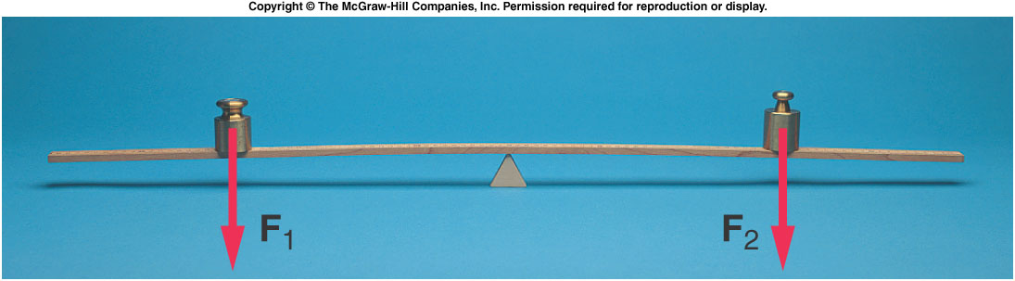
Torque and Balance
What causes the merry-go-round to rotate in the first place?
What determines whether an object will rotate?
If an unbalanced force causes linear motion, what causes rotational motion?

Slide 3
Torque and Balance
When is a balance balanced?
  Consider a thin but rigid beam supported by a fulcrum or pivot point.
  If equal weights are placed at equal distances from the fulcrum, the beam will not tend to rotate: it will be balanced.

Slide 4
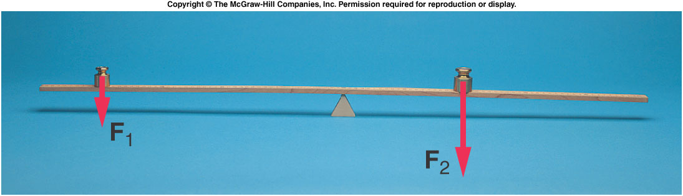
  To balance a weight twice as large as a smaller weight, the smaller weight must be placed twice as far from the fulcrum as the larger weight.
  Both the weight and the distance from the fulcrum are important.
  The product of the force and the distance from the fulcrum is called the torque.

Slide 5
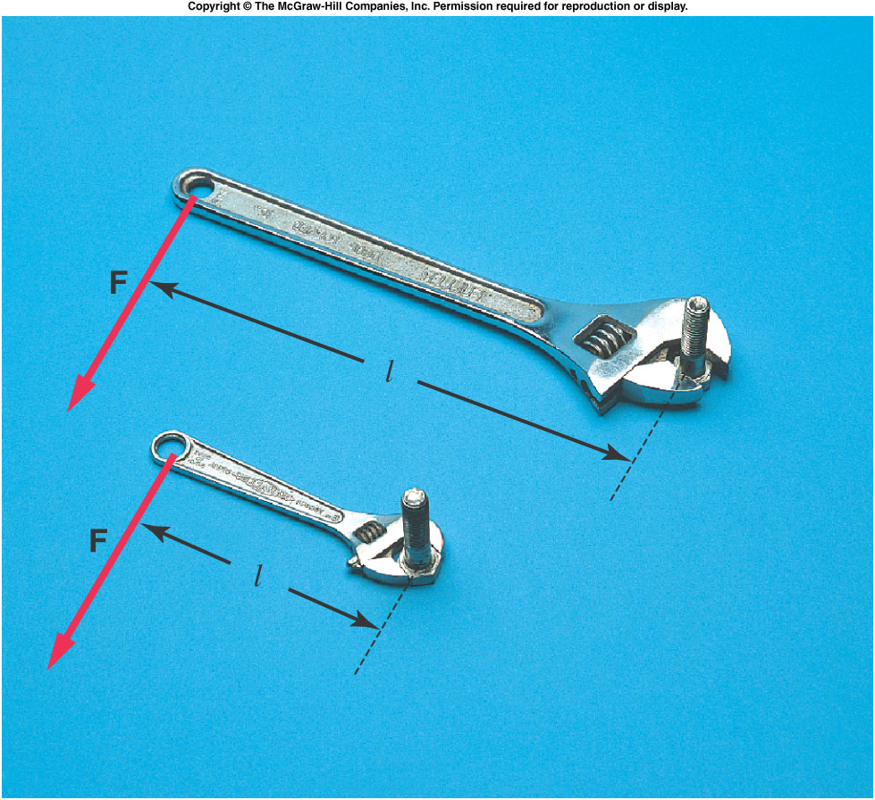
  The distance from the fulcrum to the point of application of the force must be measured in a direction perpendicular to the line of action of the force.
  This distance is
  called the lever arm
  or moment arm.
  For a force F and a
  lever arm l, the
  resulting torque is:
  A longer lever arm
  produces a greater
  torque.

Slide 6
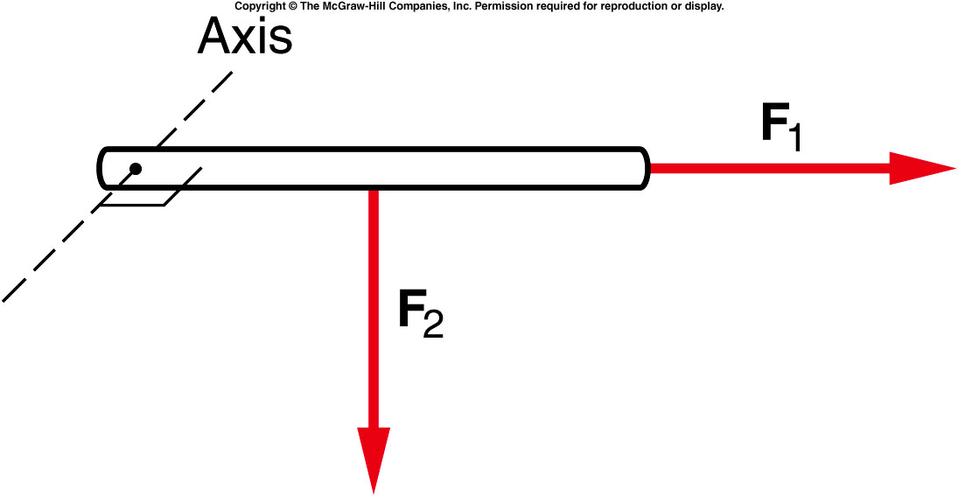
Quiz: Which of the forces pictured as acting upon the rod will produce a torque about an axis perpendicular to the plane of the diagram at the left end of the rod?
F₁
F₂
Both.
Neither.
F₂ will produce a torque about an axis at the left end of the rod. F₁ has no lever arm with respect to the given axis.

Slide 7
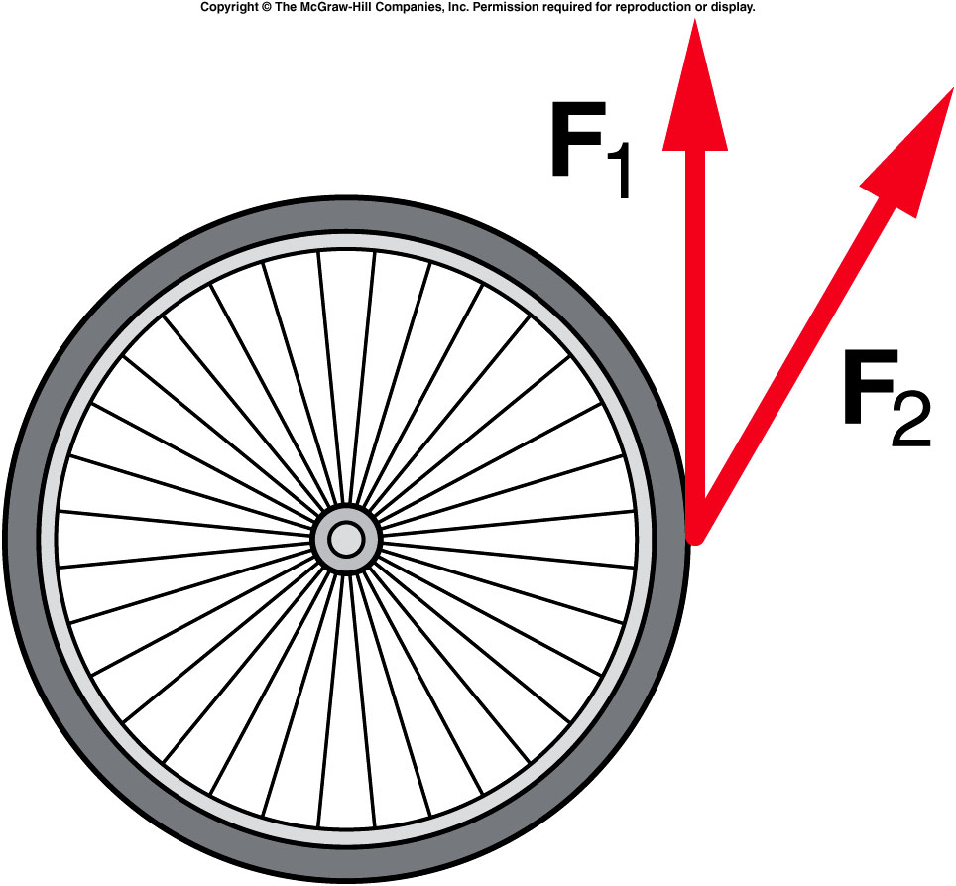
The two forces in the diagram have the same magnitude. Which force will produce the greater torque on the wheel?
F₁
F₂
Both.
Neither.
F₁ provides the larger torque. F₂ has a smaller component perpendicular to the radius.

Slide 8
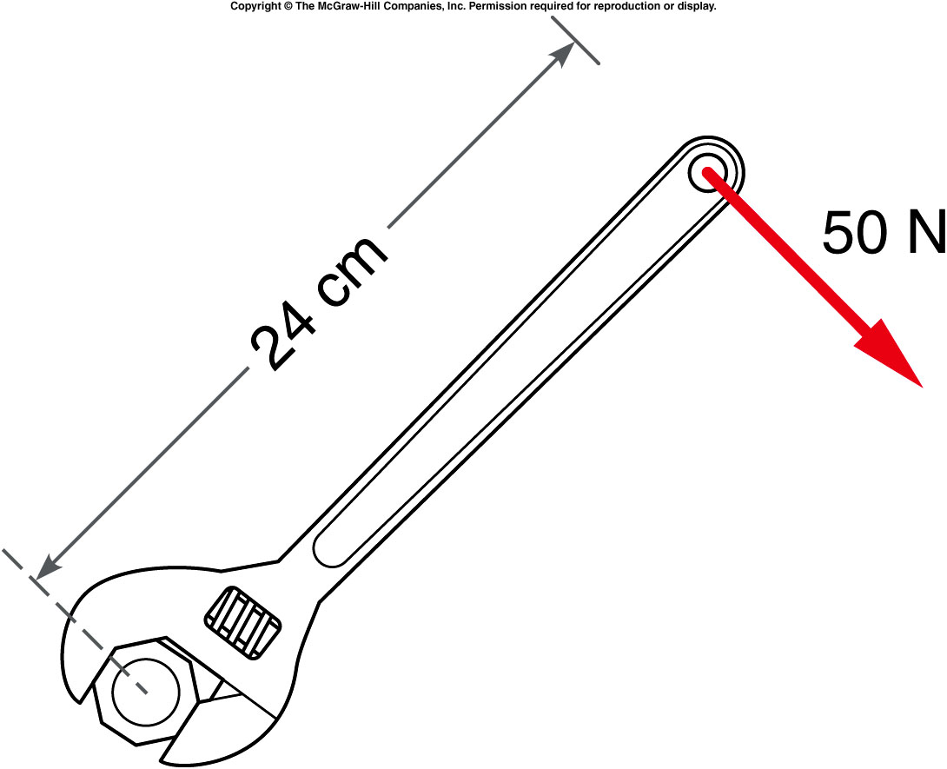
A 50-N force is applied at the end of a wrench handle that is 24 cm long. The force is applied in a direction perpendicular to the handle as shown. What is the torque applied to the nut by the wrench?
6 N·m
12 N·m
26 N·m
120 N·m
0.24 m × 50 N = 12 N·m

Slide 9
What would the torque be if the force were applied half way up the handle instead of at the end?
6 N·m
12 N·m
26 N·m
120 N·m
0.12 m × 50 N = 6 N·m

Slide 10
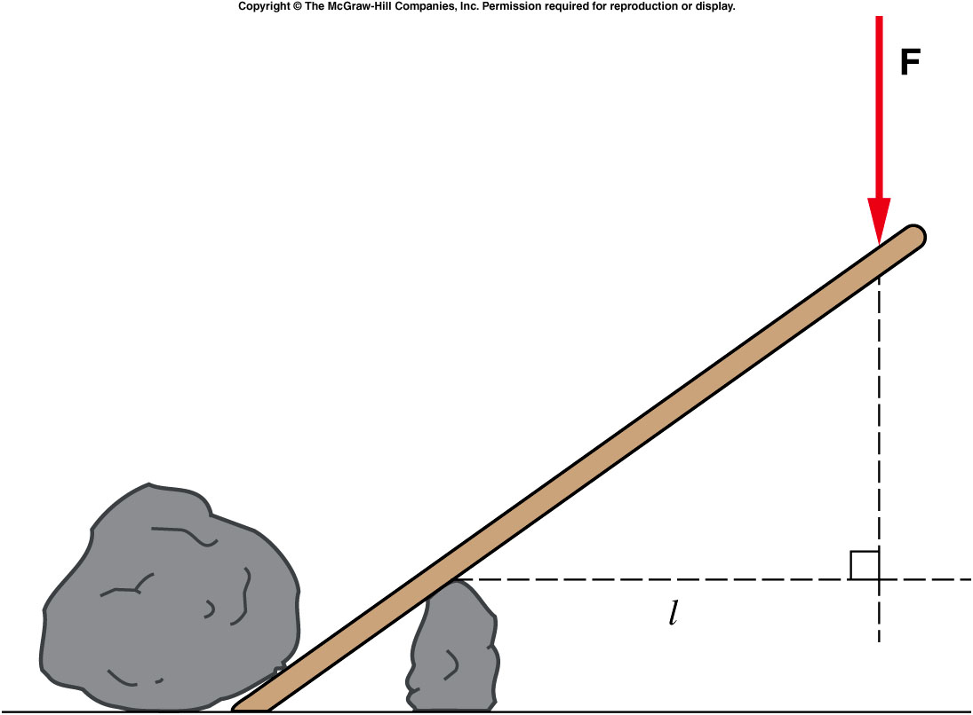
  What’s the lever arm between F and the fulcrum?
  l
  a
  b
a
b

Slide 11
  When the applied force is not perpendicular to the crowbar, for example, the lever arm is found by drawing the perpendicular line from the fulcrum to the line of action of the force.
  We call torques
  that produce
  counterclockwise
  rotation positive,
  and torques that
  produce
  clockwise rotation
  negative.

Slide 12
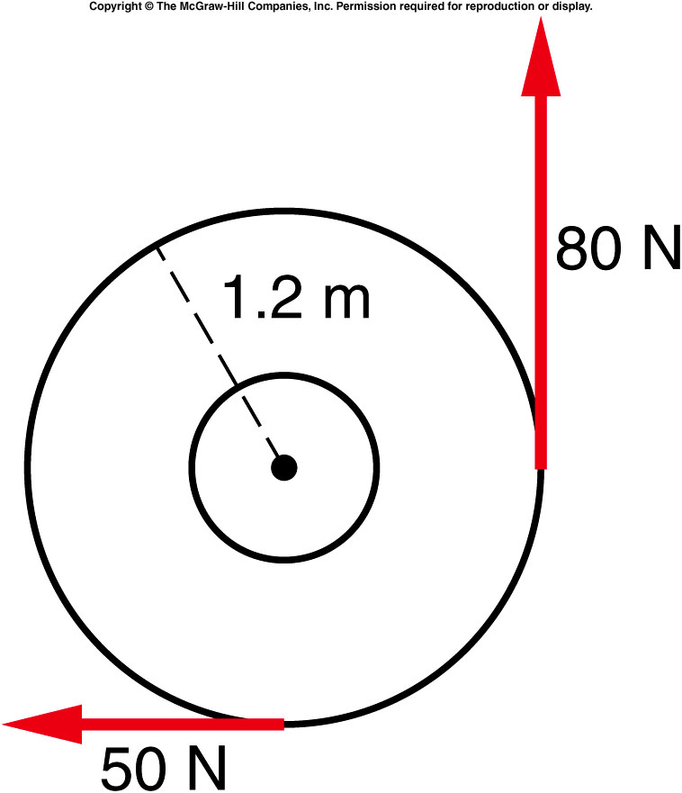
What is the net torque acting on the merry-go-round?
+36 N·m
-36 N·m
+96 N·m
-60 N·m
+126 N·m
96 N·m (counterclockwise)
60 N·m (clockwise)
= +36 N·m (counterclockwise)

Slide 13
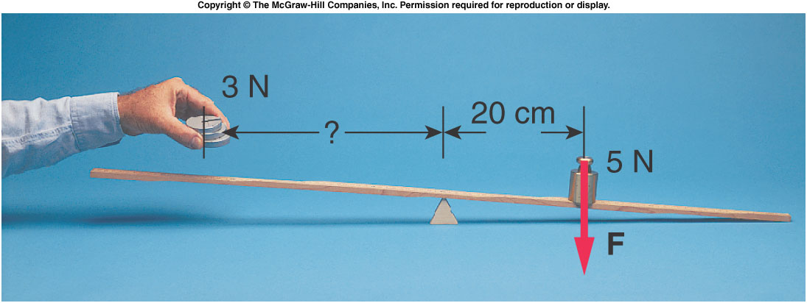
How far do we have to place the 3-N weight from the fulcrum to balance the system?
2 cm
27 cm
33 cm
53 cm
F = 3 N l = τ / F
τ = +1 N·m = (+1 N·m) / (3 N)
= 0.33 m = 33 cm

Slide 14
The center of gravity
  is the point about which the weight of the object itself exerts no torque.
  We can locate the center of gravity by finding the point where it balances on a fulcrum.
  What’s the center of gravity of a disk?
    any point on the edge of the disk.
    Center of the disk
    Any point half way between the center and the edge.

Slide 15
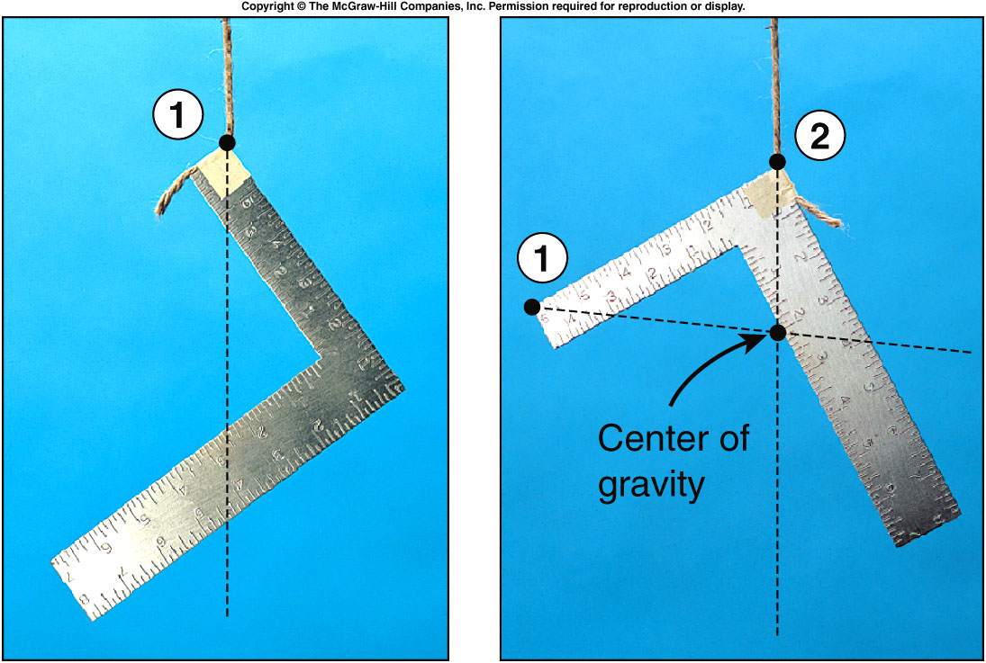
The center of gravity
  For a more complex object, we locate the center of gravity by suspending the
  object from two
  different points,
  drawing a line straight
  down from the point of
  suspension in each
  case, and locating the
  point of intersection of
  the two lines.

Slide 16
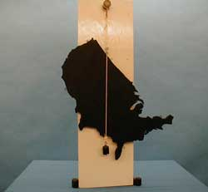
1J-21 Center of Gravity of an Irregular Lamina
How can we find the Center of Gravity of Irregular shapes?
Where is the Center of Gravity of the cut board ?
Why does the mass on the string hang straight down ?
2/25/2020
Physics 214
Fall 2009
16
Notes:
With regard to the cut-out of the “crescent moon,” emphasize that the CG does not have to be at a point where there is mass.

Slide 17
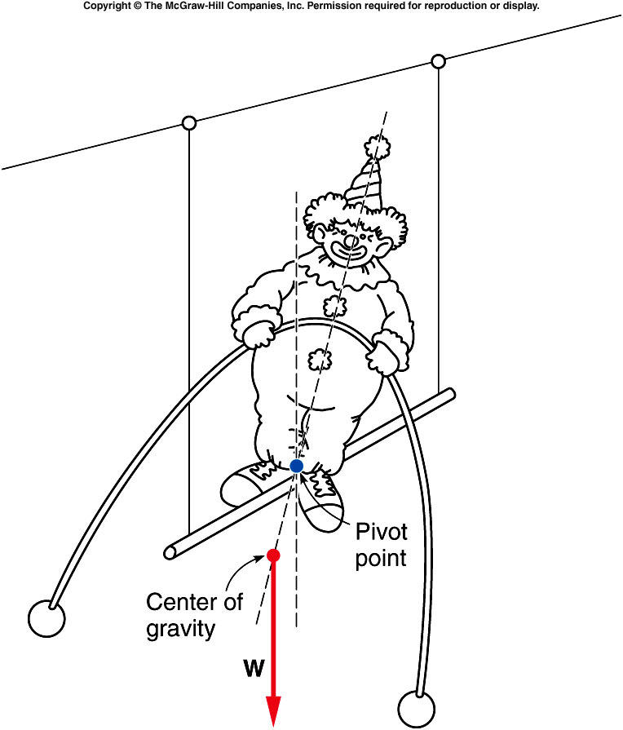
  If the center of gravity lies below the pivot point, the object will automatically regain its balance when disturbed.
  The center of gravity returns to the position directly below the pivot point, where the weight of the object produces no torque.
Notes:
I end up in here for this lecture in SP2019

Slide 18
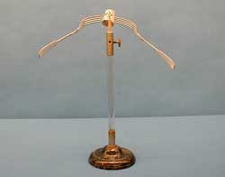
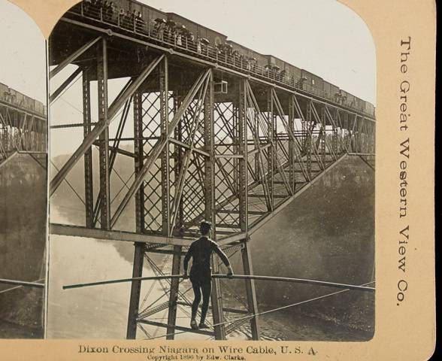
1J-23 Corks & Forks
Can the Center of Gravity lie at a point not on the object?
How difficult is it to balance this system on a sharp point ?
Where is the C of G ?
THE CENTER OF GRAVITY IS NOT ON THE OBJECT. IT ACTUALLY LIES ALONG THE VERTICAL BELOW THE SHARP POINT.
WHEN THE FORK IS MOVED THE CM RISES AND THIS MEANS THE SYSTEM IS IN STABLE EQUILIBRIUM .
2/25/2020
Physics 214
Fall 2009
18
Notes:
Tip of the bird’s beak.
The forks are already embedded in the corks. A small pin in the cork has a tiny depression that allows it to be placed on the sharp point of the stand. The forks may be pushed gently to make the system oscillate. The equilibrium position is stable, showing that the CG of the system is below the contact point and directly beneath it, although no mass is present there.

Slide 19
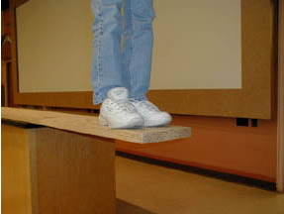
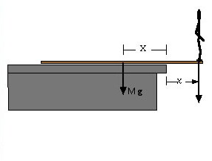
1J-16 Walk the Plank
What happens when a mass is placed at the end of a massive plank?
Sum of Torque about Pivot
X M g – x m g = 0
m = M X / x
Can you safely walk to the end of the plank ?
One can solve for either M or m, if the other quantity is known
EVEN WITH A MASS AT THE END OF THE PLANK, THE SYSTEM CAN STILL BE IN EQUILIBRIUM
2/25/2020
Physics 214
Fall 2009
19

Slide 20
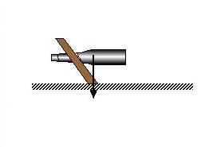
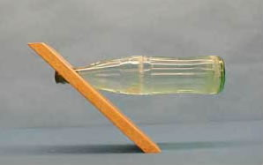
1J-28 Wine Bottle Holder
Balance a Bottle and a Wooden Holder by Eliminating Net Torque
M
How does this system Balance?
Sum of Torque about Pivot
m₁x₁g - m₂x₂g = 0
THE CENTER OF GRAVITY OF THE BOTTLE PLUS THE WOOD MUST LIE DIRECTLY OVER AND WITHIN THE BOUNDARY OF THE SUPPORT (PIVOT). FOR BALANCE THERE CAN BE NO NET TORQUE ON SYSTEM.
2/25/2020
Physics 214
Fall 2009
20

Slide 21
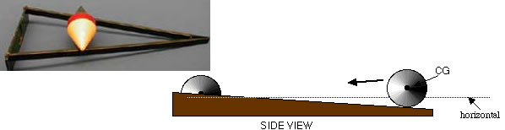
1J - 24 double cone
What happens to the center of mass ?
A). Going down the hill
B). Going uphill
C). Stay at rest
D). Depend on the object shape
The force causing the object to move is gravity and we know that by energy conservation that if the object gains kinetic energy it must lose potential energy. Therefore the center of mass must be falling and the kinetic energy = mgh where h is the distance the CM falls.
Notes:
Viewed form the side, a rolling double cone appears to defy gravity and roll uphill. Upon inspection, it is seen that because the ramp widens, the CG of the double-cone actually drops and is, in fact, rolling downhill.
Before show the result, have another exercise using a rod and ask the same question.

Slide 22
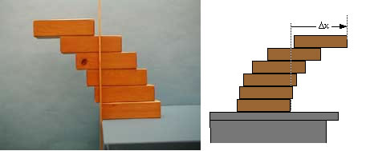
Demos: 1J-29 Overhanging Blocks

Slide 23
Quiz: where is the CG of the beam and the CG of the system (beam + two weights) after it’s balanced?
CG of the beam is Center of the beam, CG of the system is at the pivot point.
Both are at the center of the beam.
Both are the pivot points.

