Slide 1
Ch 7 CP 2
A bullet is fired into block sitting on ice. The bullet travels at
500 m/s with mass 0.005 kg. The wooden block is at rest with a
mass of 1.205 kg. Afterwards the bullet is embedded in the block.
Find the velocity of the block and bullet after the impact (ignore all frictions ).
3.02 m/s
2.07 m/s
500.3 m/s
250.6 m/s
12.02 m/s
p_{final} = p_{initial} = (0.005 kg)(500 m/s)
p_{final} = (M_{bullet} + M_{wood})v = 2.5 kg m/s
v = (2.5 kg m/s)/(1.205 kg) = 2.07 m/s

Slide 2
Ch 7 CP 2
A bullet is fired into block sitting on ice. The bullet travels at
500 m/s with mass 0.005 kg. The wooden block is at rest with a
mass of 1.205 kg. Afterwards the bullet is embedded in the block.
Does the change in momentum of the bullet equal that of wood and how much are the changes?
yes. 2.50 kg m/s
No. Wood changes 2.50 kg m/s. Bullet changes less than that.
Δp for bullet = (0.005 kg)(500 m/s) – (0.005 kg)(2.07 m/s)
= 2.50 kg m/s
Momentum is conserved, so momentum lost by bullet is gained by wood.

Slide 3
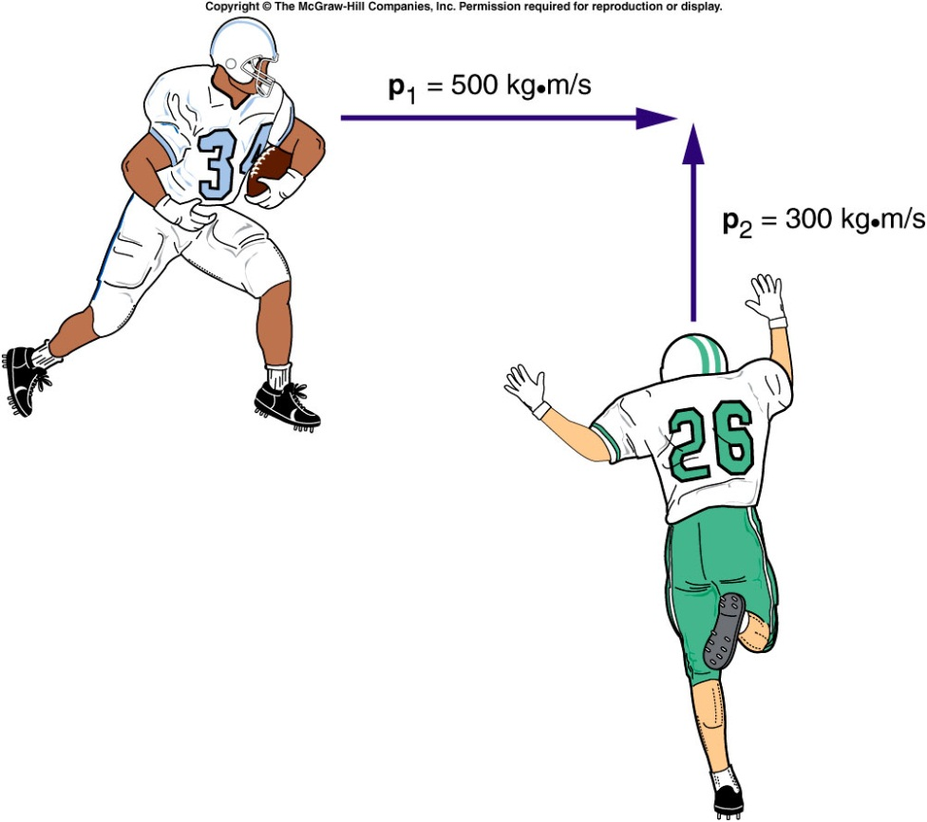
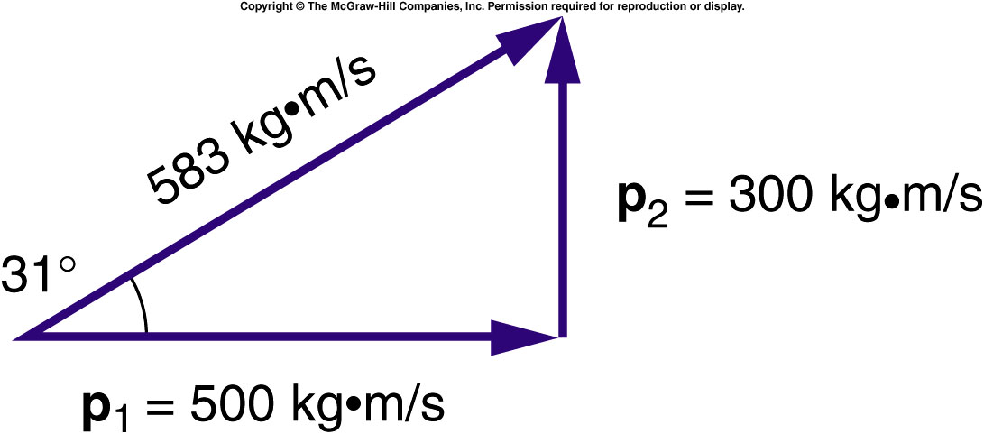
Collisions at an Angle
The total momentum of the two football players prior to the collision is the vector sum of their individual momentums.
  The larger initial momentum has a larger effect on the final direction of motion.

Slide 4
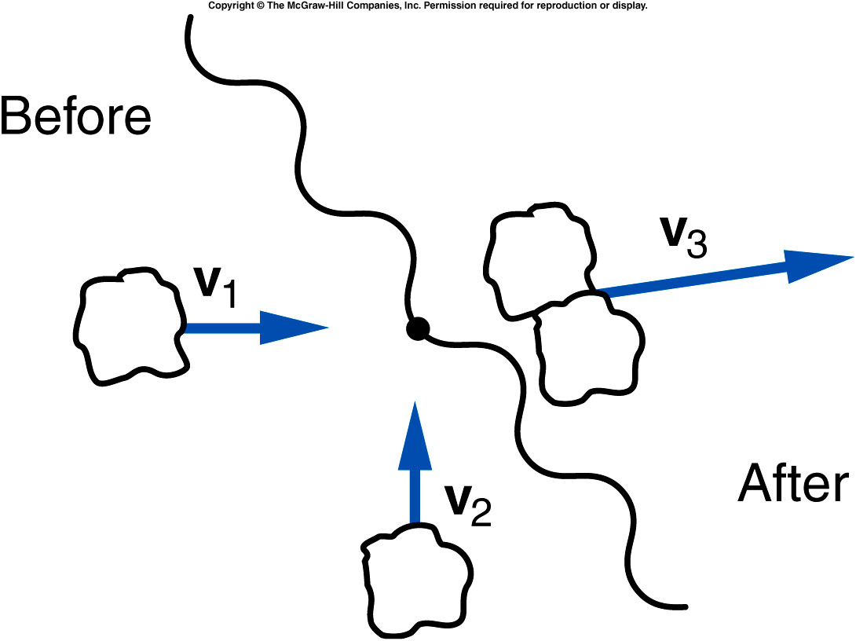
Two lumps of clay of equal mass are traveling at right angles with equal speeds as shown, when they collide and stick together. Is it possible that their final velocity vector is in the direction shown?
yes
no
unable to tell
from this graph
No. The final momentum will be in a direction making a 45º degree angle with respect to each of the initial momentum vectors.

Slide 5
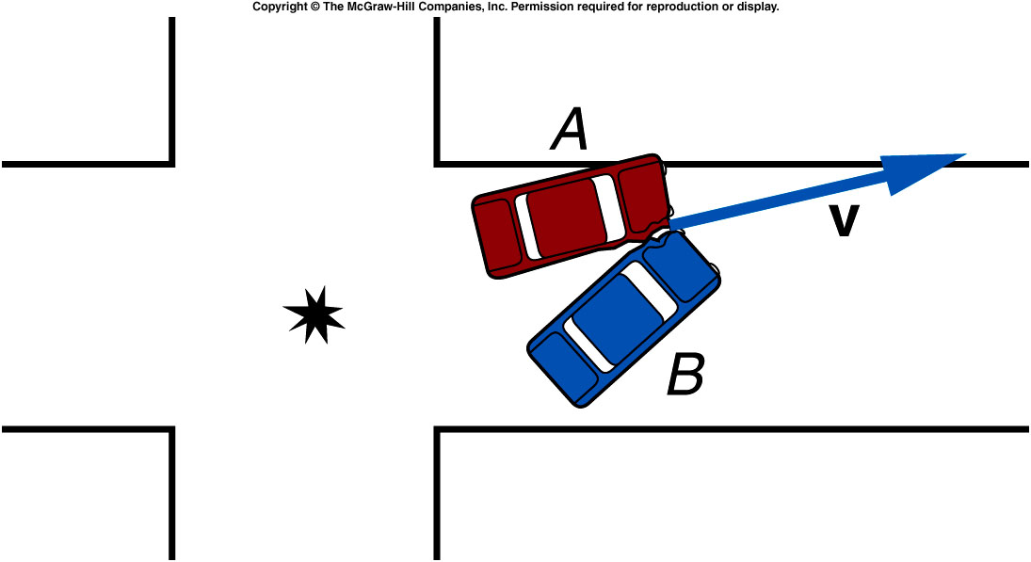
Quiz: Two cars of equal mass Collide at right angles to one another in an intersection. Their direction of motion after the collision is as shown. Which car had the greater velocity before the collision?
Car A
Car B
Their velocities were equal in magnitude.
It is impossible to tell
from this graph.
Since the angle with respect to the original direction of A is smaller than 45º, car A must have had a larger momentum and thus was traveling faster.

Slide 6
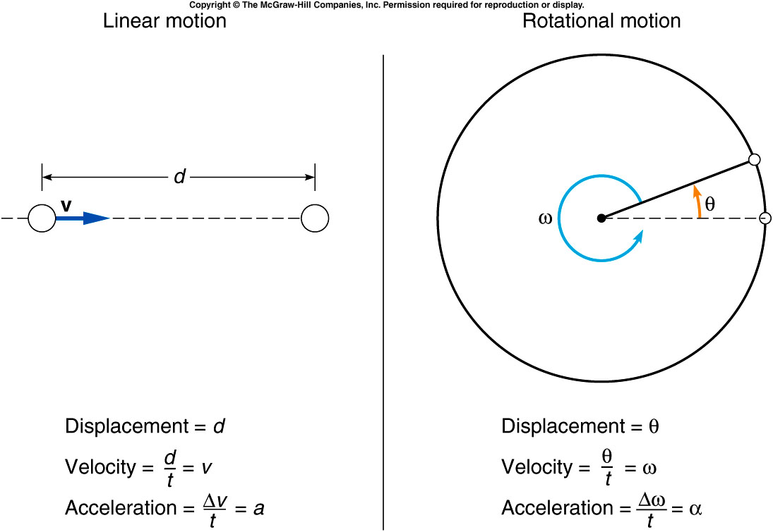
  Rotational displacement is how far the object rotates.
    Units: fractions of a complete revolution; degrees; radians
    1 complete revolution = 360º = 2π radians
    Analogous to linear displacement: the straight-line distance traveled by an object (including direction of travel)

Slide 7
  Rotational velocity is how fast the object is turning.
    Units: revolutions per minute (rpm); degrees per second
    Analogous to linear velocity

Slide 8
  Rotational acceleration is the rate of change of rotational velocity.
    Units: revolutions per second per second (rev/s²); radians per second per second (rad/s²)
    Analogous to linear acceleration

Slide 9
Constant acceleration equations for linear and rotational motion

Slide 10
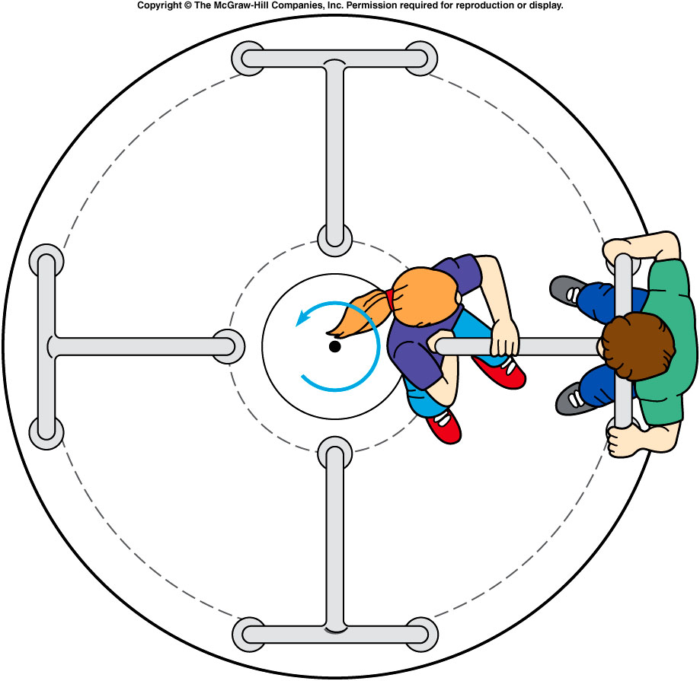

Relationship between linear and rotational velocity
  On a merry-go-round, a rider near the edge travels a greater distance in 1 revolution than one near the center.
  The outside rider is therefore traveling with a greater linear speed.
$s= 2πr$
$\frac{s}{t}=\frac{2πr }{t}$

Slide 11
A merry-go-round is accelerated at a constant rate of 0.005 rev/s², starting from rest.
What is its rotational velocity at the end of 1 min?
0.005 radian/s
0.3 radian/s
0.05 radian/s
1.88 radian/s
α = 0.005 rev/s²
ω₀ = 0
t = 60 s
ω = ω₀ + αt
= 0 + (0.005 rev/s²)(60 s)
= 0.30 rev/s = 0.3*2*3.14 radian/s
= 1.88 radian/s

Slide 12
How many revolutions does the merry-go-round make in 1 minute?
1.5 rev
3.0 rev
9.0 rev
18.0 rev
α = 0.005 rev/s²
ω₀ = 0
t = 60 s, ω = 0.30 rev/s
θ = ω₀t + 1/2 αt²
= 0 + 1/2 (0.005 rev/s²)(60 s)²
= 9 rev

Slide 13
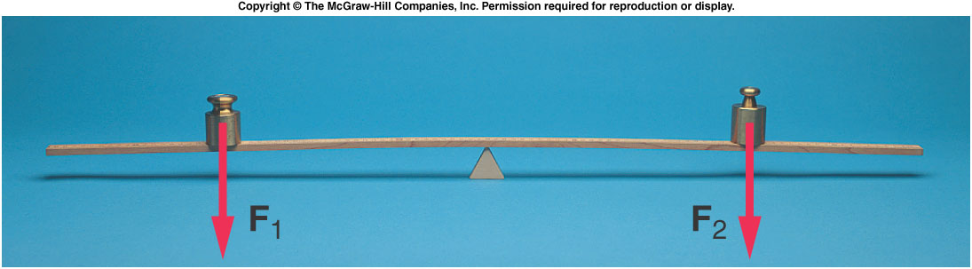
Torque and Balance
What causes the merry-go-round to rotate in the first place?
What determines whether an object will rotate?
If an unbalanced force causes linear motion, what causes rotational motion?

Slide 14
Torque and Balance
When is a balance balanced?
  Consider a thin but rigid beam supported by a fulcrum or pivot point.
  If equal weights are placed at equal distances from the fulcrum, the beam will not tend to rotate: it will be balanced.

Slide 15
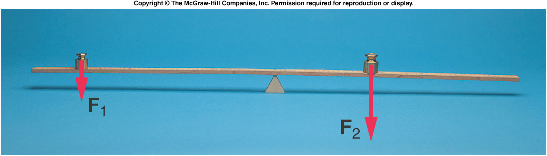
  To balance a weight twice as large as a smaller weight, the smaller weight must be placed twice as far from the fulcrum as the larger weight.
  Both the weight and the distance from the fulcrum are important.
  The product of the force and the distance from the fulcrum is called the torque.

Slide 16
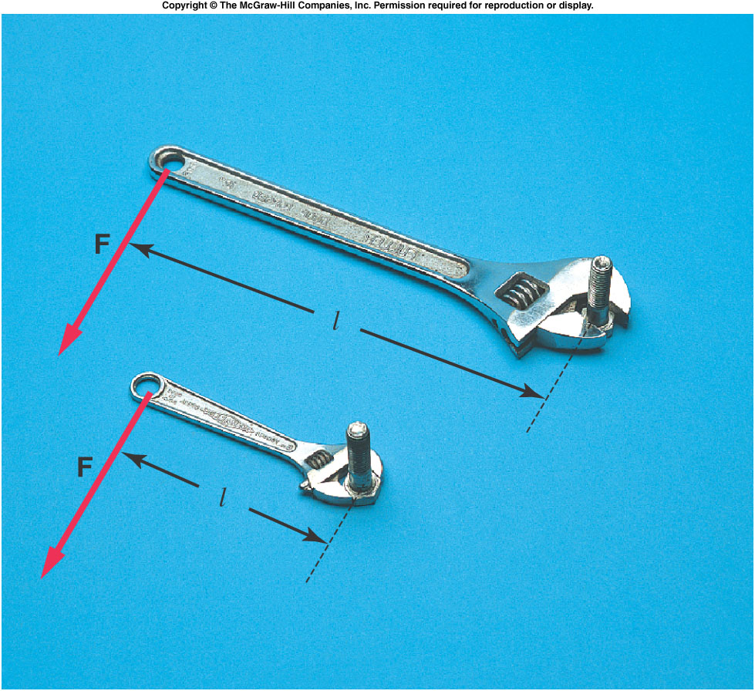
  The distance from the fulcrum to the point of application of the force must be measured in a direction perpendicular to the line of action of the force.
  This distance is
  called the lever arm
  or moment arm.
  For a force F and a
  lever arm l, the
  resulting torque is:
  A longer lever arm
  produces a greater
  torque.

Slide 17
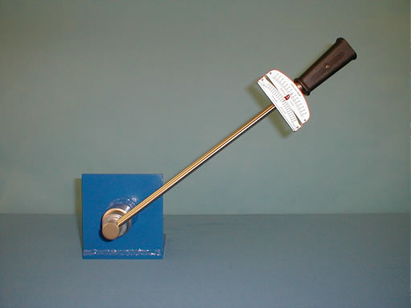
1J-20 Torque Wrench
Notes:
Tighten the nuts first. Then use hand to untighten it and can’t make it. Use a shorter lever arm do so and can not make it. Then use the longest lever arm to untighten it.

Slide 18
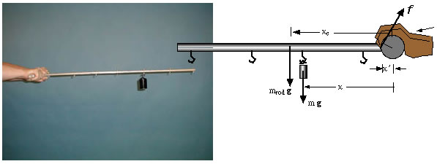
1J-12 Variable Torque

Slide 19
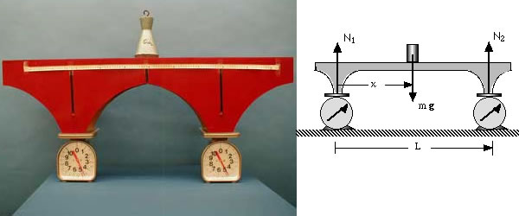
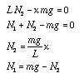
1J-14 Equilibrium of a Bridge

Slide 20
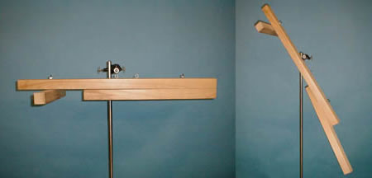
1J-01 Galilean Lever
Notes:
Keep it as a question for students on what is the center of gravity and we will introduce it in next lecture

Slide 21
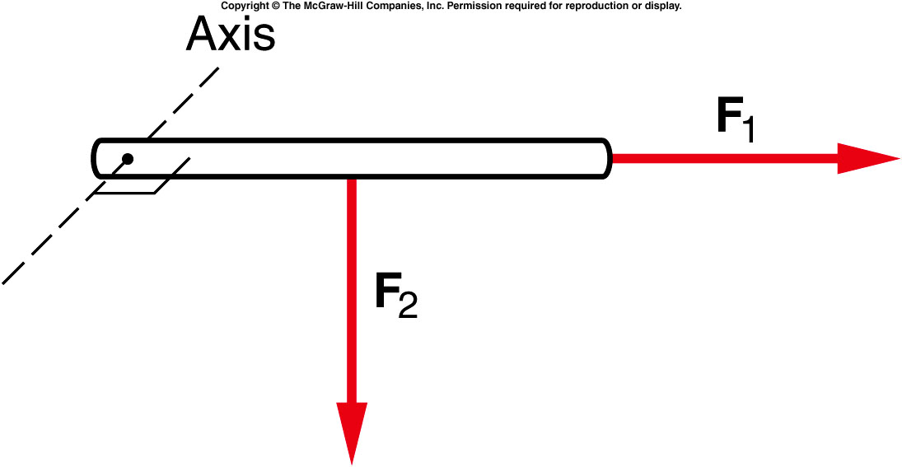
Quiz: Which of the forces pictured as acting upon the rod will produce a torque about an axis perpendicular to the plane of the diagram at the left end of the rod?
F₁
F₂
Both.
Neither.
F₂ will produce a torque about an axis at the left end of the rod. F₁ has no lever arm with respect to the given axis.

Slide 22
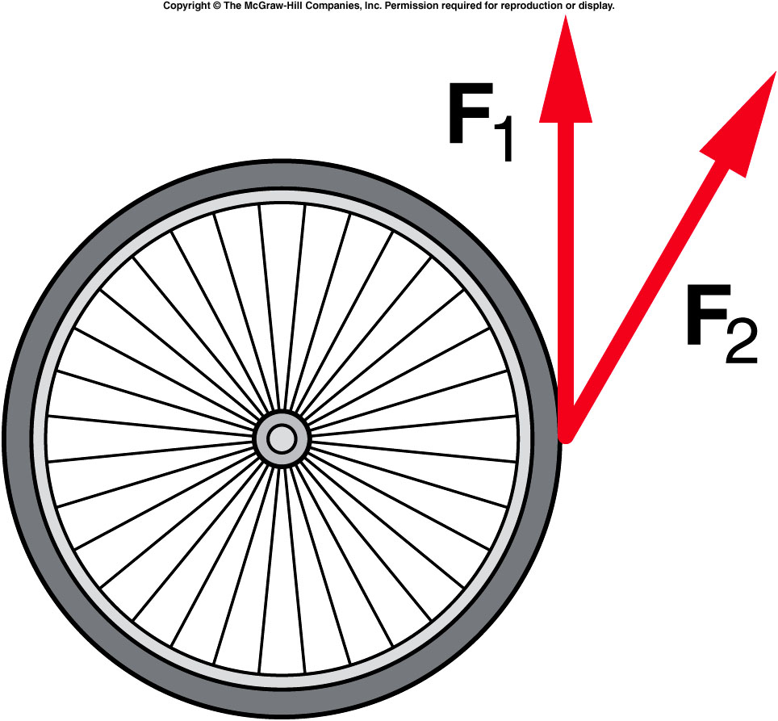
The two forces in the diagram have the same magnitude. Which force will produce the greater torque on the wheel?
F₁
F₂
Both.
Neither.
F₁ provides the larger torque. F₂ has a smaller component perpendicular to the radius.

Slide 23
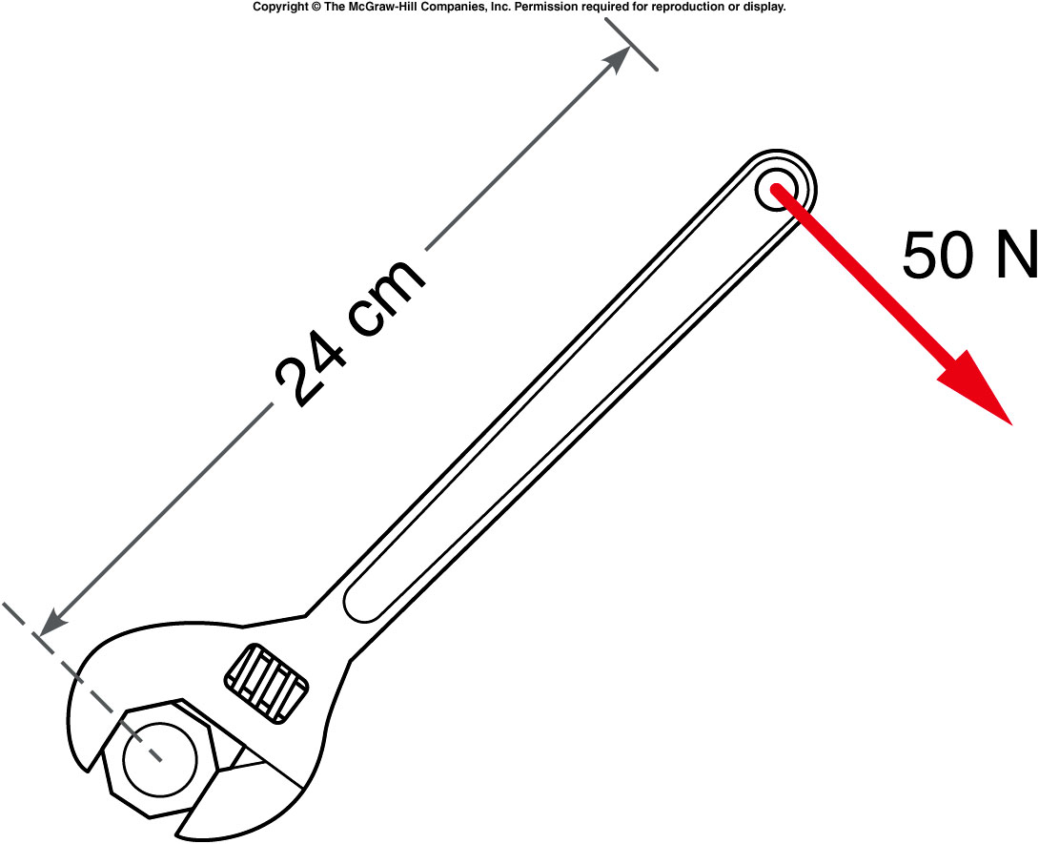
A 50-N force is applied at the end of a wrench handle that is 24 cm long. The force is applied in a direction perpendicular to the handle as shown. What is the torque applied to the nut by the wrench?
6 N·m
12 N·m
26 N·m
120 N·m
0.24 m × 50 N = 12 N·m

Slide 24
What would the torque be if the force were applied half way up the handle instead of at the end?
6 N·m
12 N·m
26 N·m
120 N·m
0.12 m × 50 N = 6 N·m

Slide 25
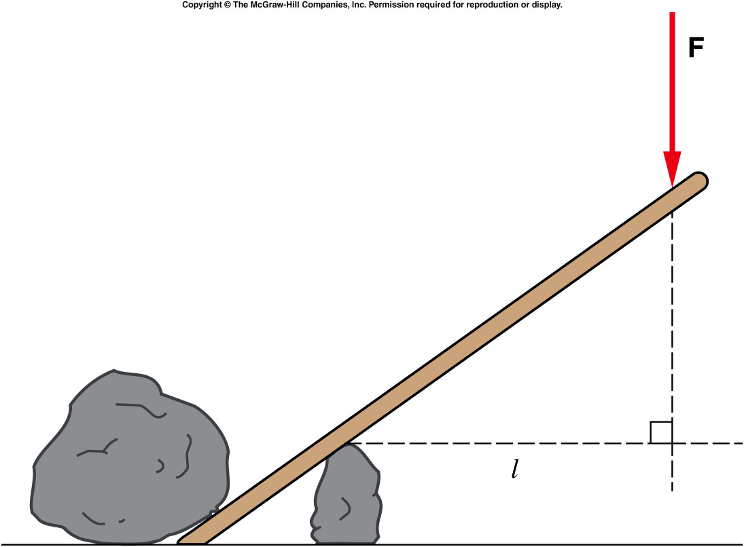
  What’s the lever arm between F and the fulcrum?
  l
  a
  b
a
b

Slide 26
  When the applied force is not perpendicular to the crowbar, for example, the lever arm is found by drawing the perpendicular line from the fulcrum to the line of action of the force.
  We call torques
  that produce
  counterclockwise
  rotation positive,
  and torques that
  produce
  clockwise rotation
  negative.

Slide 27
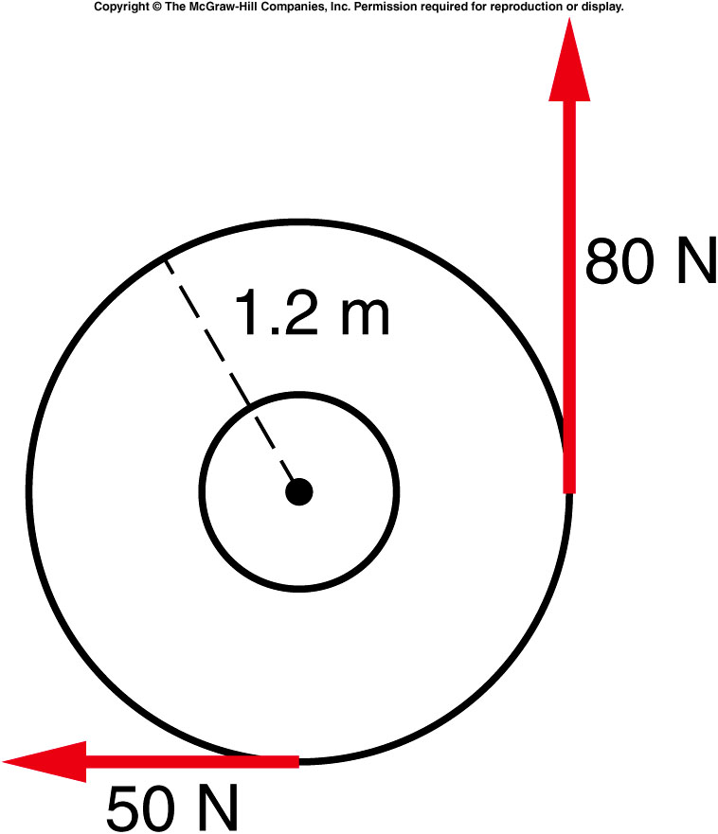
Two forces are applied to a merry-go-round with a radius of 1.2 m as shown. What is the torque about the axle of the merry-go-round due to the 80-N force?
+9.6 N·m
-36 N·m
+96 N·m
-36 N·m
1.2 m × 80 N = +96 N·m
(counterclockwise)

Slide 28
What is the torque about the axle of the merry-go-round due to the 50-N force?
+60 N·m
-60 N·m
+120 N·m
-120 N·m
-(1.2 m × 50 N) = -60 N·m
(clockwise)

Slide 29
What is the net torque acting on the merry-go-round?
+36 N·m
-36 N·m
+96 N·m
-60 N·m
+126 N·m
96 N·m (counterclockwise)
60 N·m (clockwise)
= +36 N·m (counterclockwise)

Slide 30
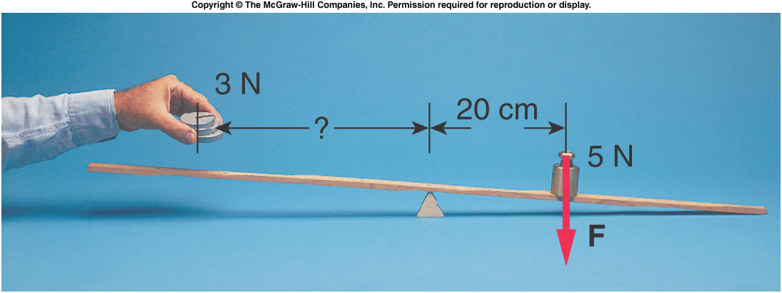
We want to balance a 3-N weight against a 5-N weight on a beam. The 5-N weight is placed 20 cm to the right of a fulcrum. What is the torque produced by the 5-N weight?
+1 N·m
-1 N·m
+4 N·m
+4 N·m
F = 5 N τ = - Fl
l = 20 cm = 0.2 m = - (5 N)(0.2 m)
= -1 N·m

Slide 31
Quiz: How far do we have to place the 3-N weight from the fulcrum to balance the system?
2 cm
27 cm
33 cm
53 cm
F = 3 N l = τ / F
τ = +1 N·m = (+1 N·m) / (3 N)
= 0.33 m = 33 cm

