Slide 1
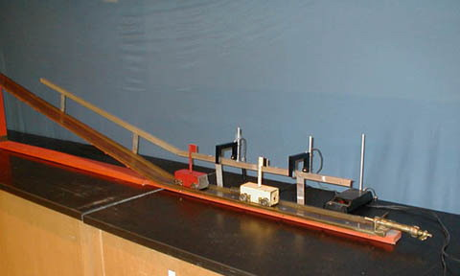
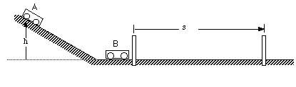
1N-10 Elastic & Inelastic Collisions
Elastic and Inelastic collisions of Two identical Carts on a Frictionless Track
Conservation of momentum
mv_{A} + mv_{B} = mv_{A}’ + mv_{B}’
Conservation of Energy (Elastic)
½ mv_{A}² + ½ mv_{B}² = ½ mv_{A}’² + ½ mv_{B}’²
If v_{B} = 0 then v_{A}’ = 0 and v_{B}’ = v_{A}
Completely inelastic (two carts stick)
if v_{B} = 0 then v_{AB} = ½ v_{A}
WE CAN MEASURE THE SPEED BY TIMING THE CARTS ACROSS A FIXED DISTANCE. For THE INELASTIC CASE HALF THE VELOCITY IMPLIES IT SHOULD TAKE TWICE THE TIME.

Slide 2
Q5 Are impulse and momentum the same thing? Explain.
No impulse changes momentum
Q6 If a ball bounces off a wall so that its velocity coming back has the same magnitude that it had prior to bouncing:
A. Is there a change in the momentum of the ball? Explain.
B. Is there an impulse acting on the ball during its collision with the wall? Explain.
A. Yes momentum is a vector
B. Yes a force acts for a short time

Slide 3
Q9 What is the advantage of an air bag in reducing injuries during collisions? Explain using impulse and momentum ideas.
It increases the time over which the force acts.
It also spreads the force over a larger area
Q11 If you catch a baseball or softball with your bare hand, will the force exerted on your hand by the ball be reduced if you pull your arm back during the catch? Explain.
Yes. The impulse is the same but the impact time is longer.
From a work point of view the kinetic energy = Fd so increasing d
reduces F

Slide 4
Q17 A compact car and a large truck have a head-on collision. During the collision, which vehicle, if either, experiences:
A. The greater force of impact? Explain.
B. The greater impulse? Explain.
C. The greater change in momentum? Explain.
D. The greater acceleration? Explain.
A. The forces are equal and opposite
B. The impulse for each is the same
C. The momentum changes are equal and opposite
D. F = ma so a is larger for the compact car
Q22 Is it possible for a rocket to function in empty space (in a vacuum) where there is nothing to push against except itself?
Yes. It ejects material at high velocity and momentum conservation
means the rocket recoils

Slide 5
Q23 Suppose that you are standing on a surface that is so slick that you can get no traction at all in order to begin moving across this surface. Fortunately, you are carrying a bag of oranges. Explain how you can get yourself moving.
Throw the oranges opposite to the direction you wish to move
Q24 A railroad car collides and couples with a second railroad car that is standing still. If external forces acting on the system are ignored, is the velocity of the system after the collision equal to, greater than, or less than that of the first car before the collision?
The velocity after is exactly half

Slide 6
Ch 7 E 10
M₁ and M₂ collide head on
a) Find initial momentum of M₁ and M₂
b) What is the total momentum of the system before collision?
6.0m/s
3.5m/s
west
M₂ = 80kg
M₁ = 100kg
east
a) p₁ = -100 x 3.5 = 350kgm/s p₂ = 80 x 6 = 480kgm/s
b) Total momentum = 480 – 350 = 130kgm/s east

Slide 7
Ch 7 E 10
M₁ and M₂ collide head on. Ignore external forces, if they stick together after collision, which way do the masses travel?
6.0m/s
3.5m/s
west
M₂ = 80kg
M₁ = 100kg
east
p₁ = -100 x 3.5 = 350kgm/s p₂ = 80 x 6 = 480kgm/s
West
East
they will all stop
Total momentum = 480 – 350 = 130kgm/s east
The masses will travel east with p = 130kgm/sec

Slide 8
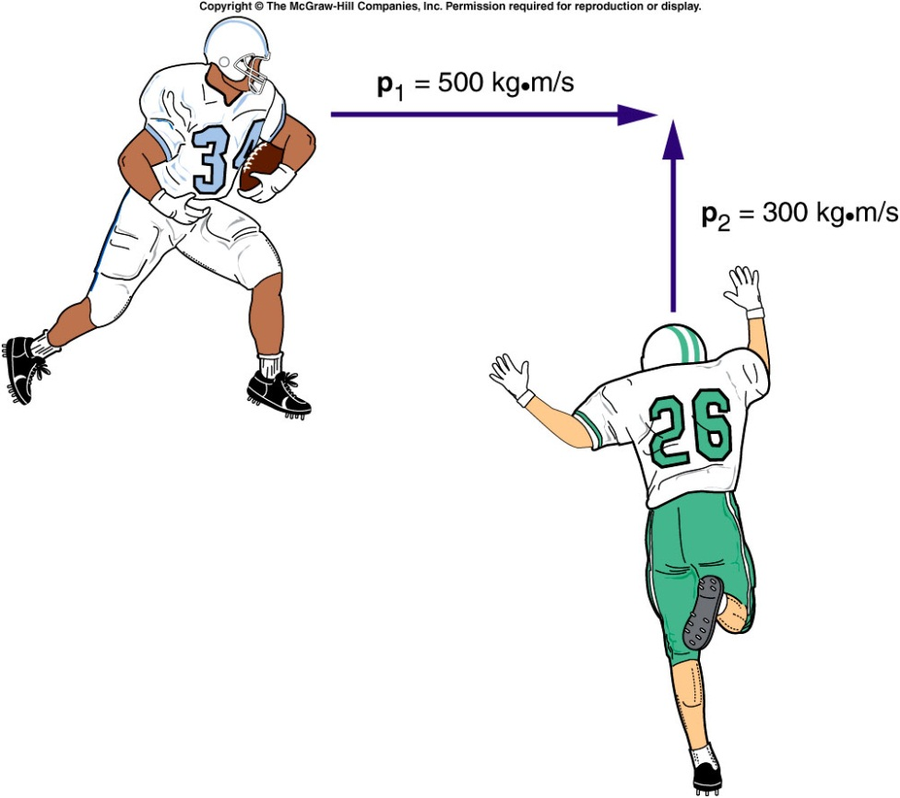
Collisions at an Angle
Two football players traveling at right angles to one another collide and stick together.
  What will be their direction of motion after the collision?
Add the individual momentum vectors to get the total momentum of the system before the collision.
The final momentum of the two players stuck together is equal to the total initial momentum.

Slide 9
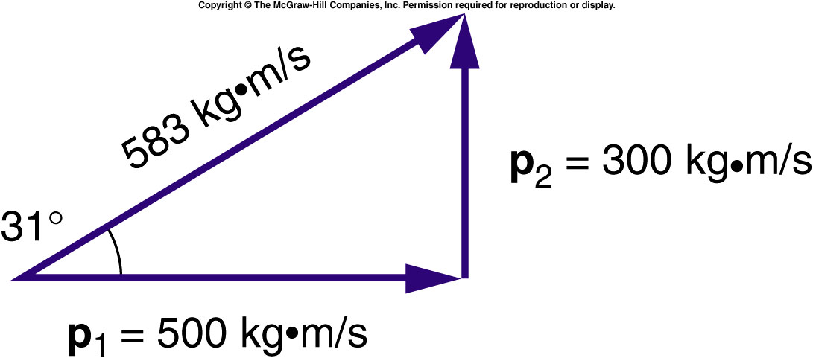
Collisions at an Angle
The total momentum of the two football players prior to the collision is the vector sum of their individual momentums.
  The larger initial momentum has a larger effect on the final direction of motion.

Slide 10
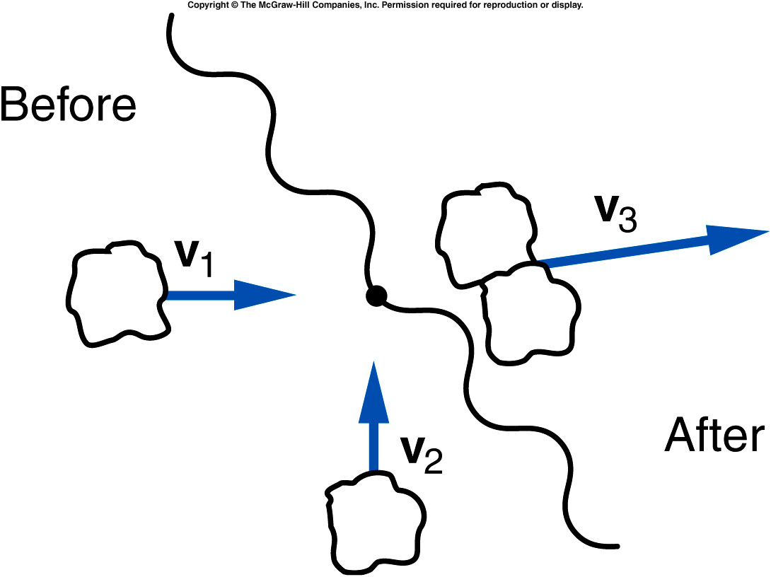
Two lumps of clay of equal mass are traveling at right angles with equal speeds as shown, when they collide and stick together. Is it possible that their final velocity vector is in the direction shown?
yes
no
unable to tell
from this graph
No. The final momentum will be in a direction making a 45º degree angle with respect to each of the initial momentum vectors.

Slide 11
Ch 7 E 18
A truck of mass 4000kg and speed 10m/s collides at right
angles with a car of mass 1500kg and a speed of 20m/s.
What’s the total momentum of system before collision?
70000 kg m/s
10000 kg m/s
50000 kg m/s
40000 kg m/s
30000 kg m/s

Slide 12
Ch 7 E 18
A truck of mass 4000kg and speed 10m/s collides at right
angles with a car of mass 1500kg and a speed of 20m/s.
What’s the total momentum of system before collision?
p
p₁ = 40000
p₁ = 40000
p₂ = 30000
p² = p₁² + p₂²
P = 50000kgm/s
Notes:
Right triangle

Slide 13
Ch 7 CP 2
A bullet is fired into block sitting on ice. The bullet travels at
500 m/s with mass 0.005 kg. The wooden block is at rest with a
mass of 1.205 kg. Afterwards the bullet is embedded in the block.
Find the velocity of the block and bullet after the impact (ignore all frictions ).
3.02 m/s
2.07 m/s
500.3 m/s
250.6 m/s
12.02 m/s
p_{final} = p_{initial} = (0.005 kg)(500 m/s)
p_{final} = (M_{bullet} + M_{wood})v = 2.5 kg m/s
v = (2.5 kg m/s)/(1.205 kg) = 2.07 m/s

Slide 14
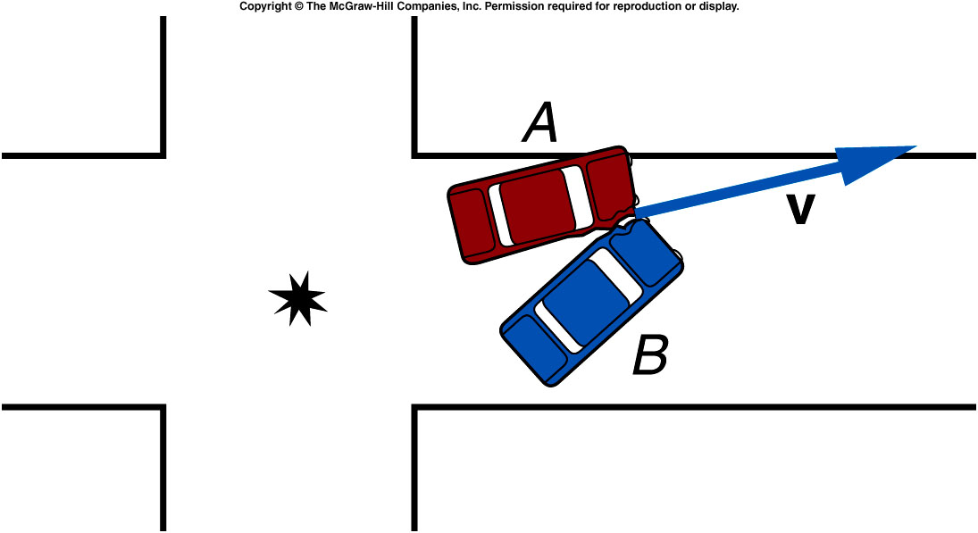
Quiz: Two cars of equal mass Collide at right angles to one another in an intersection. Their direction of motion after the collision is as shown. Which car had the greater velocity before the collision?
Car A
Car B
Their velocities were equal in magnitude.
It is impossible to tell
from this graph.
Since the angle with respect to the original direction of A is smaller than 45º, car A must have had a larger momentum and thus was traveling faster.

Slide 15
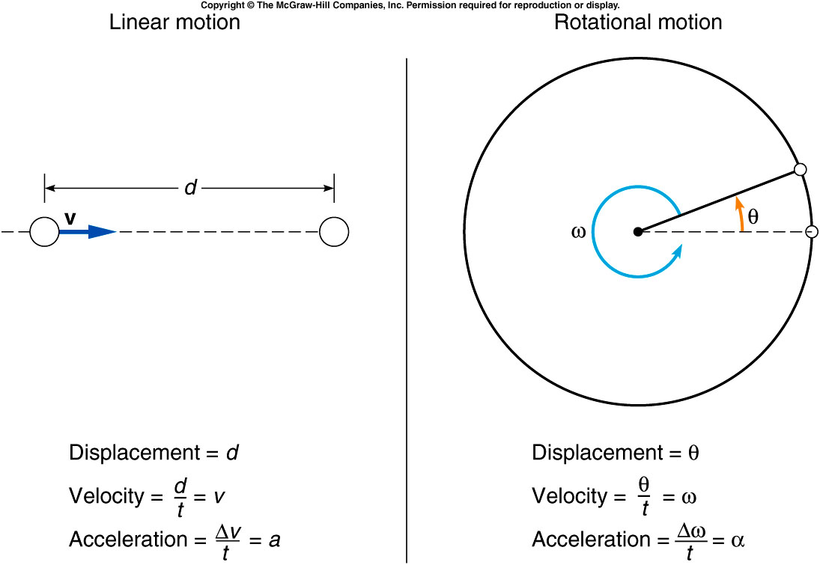
  Rotational displacement is how far the object rotates.
    Units: fractions of a complete revolution; degrees; radians
    1 complete revolution = 360º = 2π radians
    Analogous to linear displacement: the straight-line distance traveled by an object (including direction of travel)

Slide 16
  Rotational velocity is how fast the object is turning.
    Units: revolutions per minute (rpm); degrees per second
    Analogous to linear velocity

Slide 17
  Rotational acceleration is the rate of change of rotational velocity.
    Units: revolutions per second per second (rev/s²); radians per second per second (rad/s²)
    Analogous to linear acceleration

Slide 18
Constant acceleration equations for linear and rotational motion

Slide 19
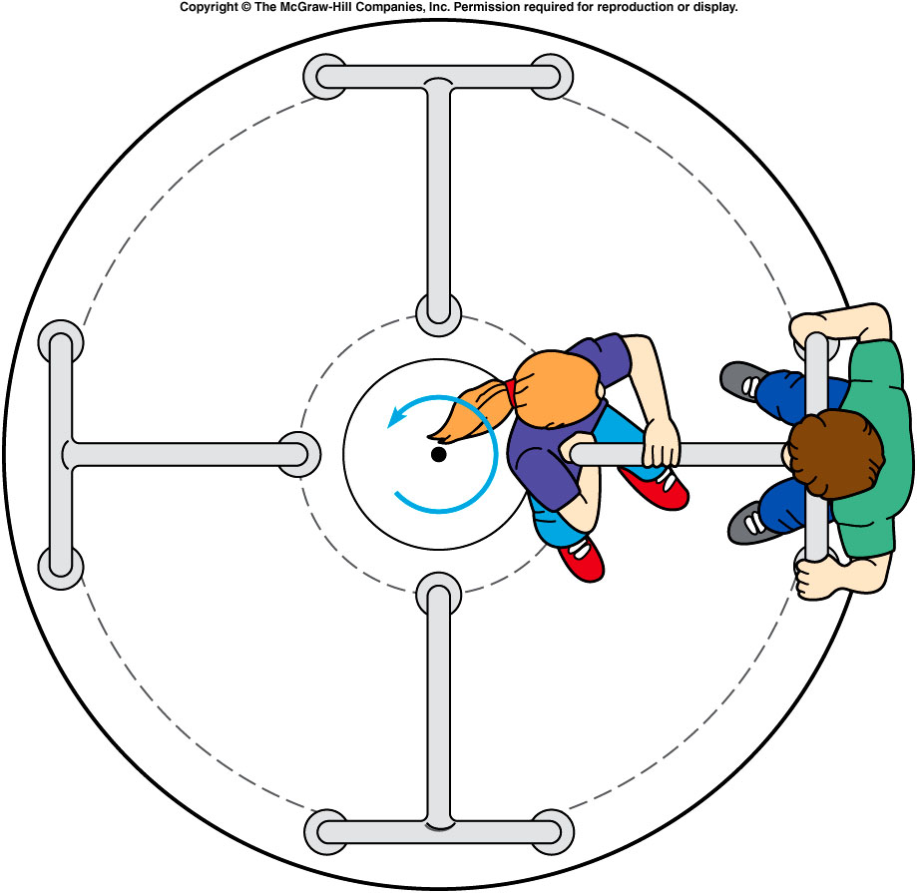

Relationship between linear and rotational velocity
  On a merry-go-round, a rider near the edge travels a greater distance in 1 revolution than one near the center.
  The outside rider is therefore traveling with a greater linear speed.
$s= 2πr$
$\frac{s}{t}=\frac{2πr }{t}$

Slide 20
A merry-go-round is accelerated at a constant rate of 0.005 rev/s², starting from rest.
What is its rotational velocity at the end of 1 min?
0.005 radian/s
0.3 radian/s
0.05 radian/s
1.88 radian/s
α = 0.005 rev/s²
ω₀ = 0
t = 60 s
ω = ω₀ + αt
= 0 + (0.005 rev/s²)(60 s)
= 0.30 rev/s = 0.3*2*3.14 radian/s
= 1.88 radian/s

Slide 21
How many revolutions does the merry-go-round make in 1 minute?
1.5 rev
3.0 rev
9.0 rev
18.0 rev
α = 0.005 rev/s²
ω₀ = 0
t = 60 s, ω = 0.30 rev/s
θ = ω₀t + 1/2 αt²
= 0 + 1/2 (0.005 rev/s²)(60 s)²
= 9 rev

Slide 22
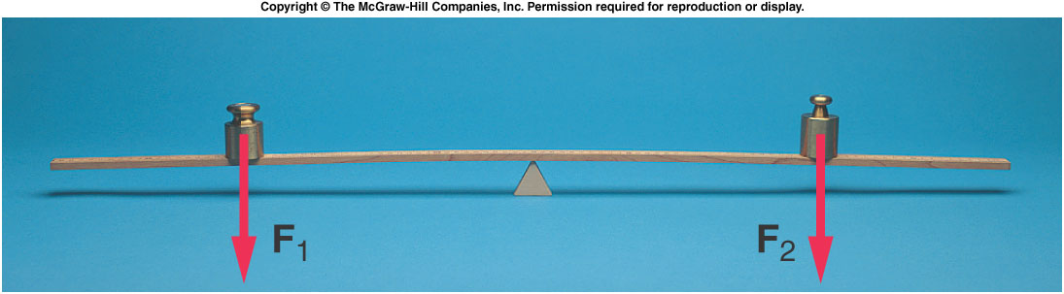
Torque and Balance
What causes the merry-go-round to rotate in the first place?
What determines whether an object will rotate?
If an unbalanced force causes linear motion, what causes rotational motion?

Slide 23
Torque and Balance
When is a balance balanced?
  Consider a thin but rigid beam supported by a fulcrum or pivot point.
  If equal weights are placed at equal distances from the fulcrum, the beam will not tend to rotate: it will be balanced.

Slide 24
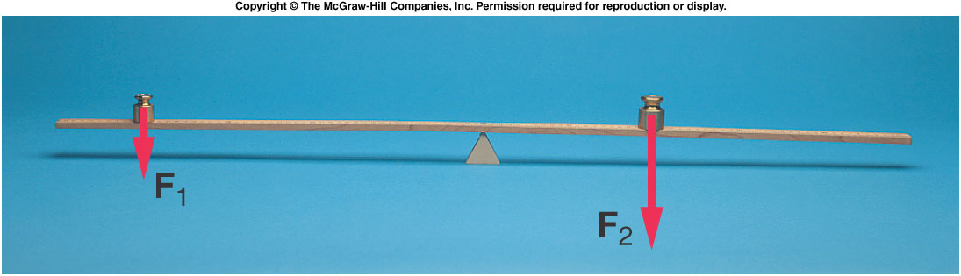
  To balance a weight twice as large as a smaller weight, the smaller weight must be placed twice as far from the fulcrum as the larger weight.
  Both the weight and the distance from the fulcrum are important.
  The product of the force and the distance from the fulcrum is called the torque.

Slide 25
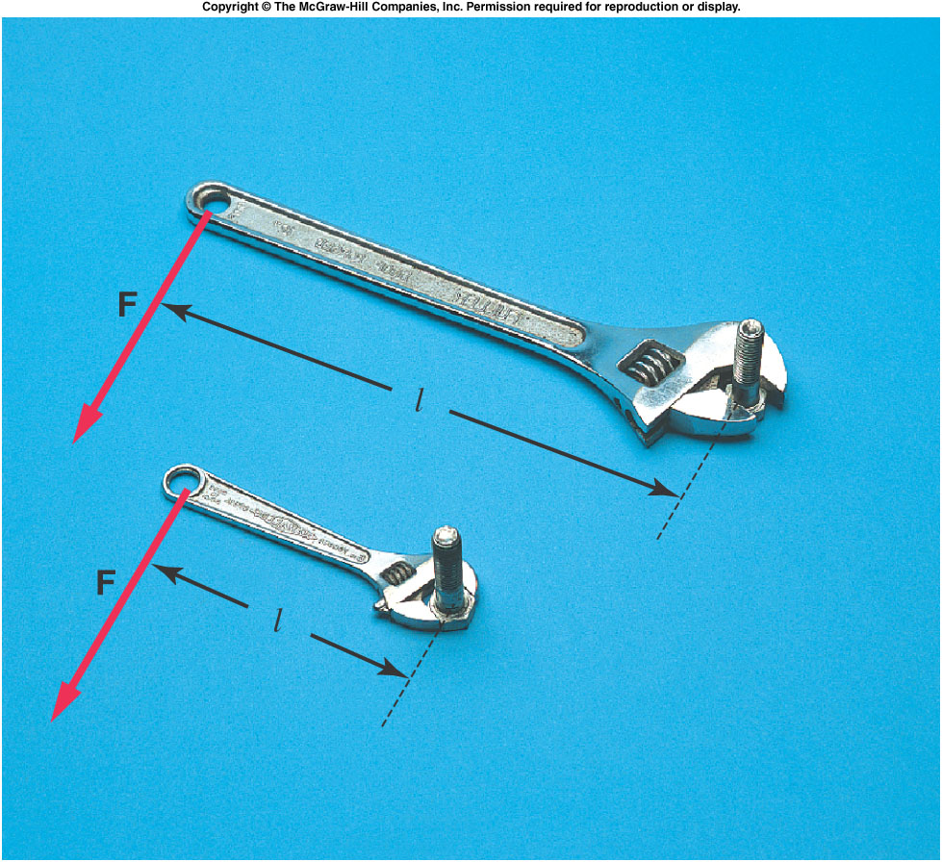
  The distance from the fulcrum to the point of application of the force must be measured in a direction perpendicular to the line of action of the force.
  This distance is
  called the lever arm
  or moment arm.
  For a force F and a
  lever arm l, the
  resulting torque is:
  A longer lever arm
  produces a greater
  torque.

