Slide 1
Impulse-Momentum Principle
The impulse acting on an object produces a change in momentum of the object that is equal in both magnitude and direction to the impulse.
When F = 0, Δp = 0, i.e. total momentum has no change as a function of time, i.e. conserved

Slide 2
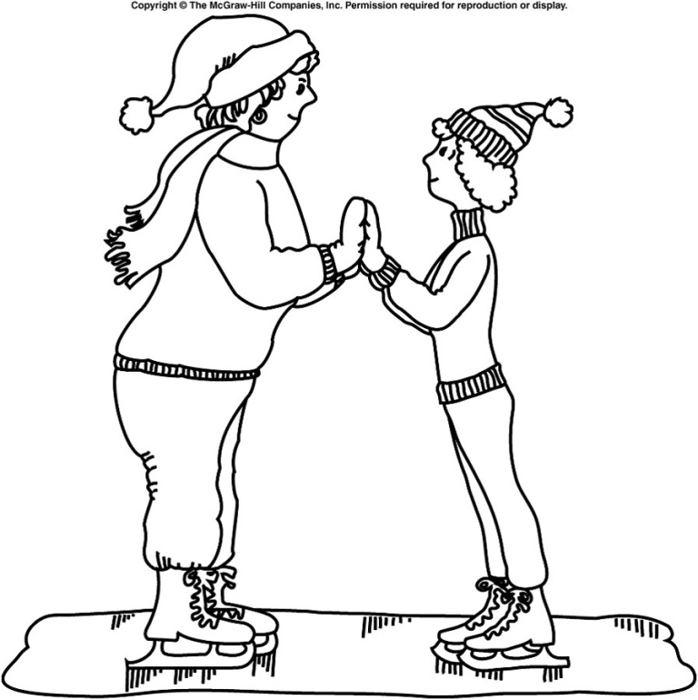
Two skaters of different masses prepare to push off against one another. Which one will gain the larger velocity?
The more massive one
The less massive one
They will each have equal but opposite velocities.
The net external force acting on the system is zero, so conservation of momentum applies.
Before the push-off, the total initial momentum is zero.
The total momentum after the push-off should also be zero.
Both must move with momentum values equal in magnitude but opposite in direction: p₂ = −p₁
When added together, the total final momentum of the system is then zero.
Since momentum is mass times velocity p = mv, the skater with the smaller mass must have the larger velocity: m₁v₁ = m₂v₂

Slide 3
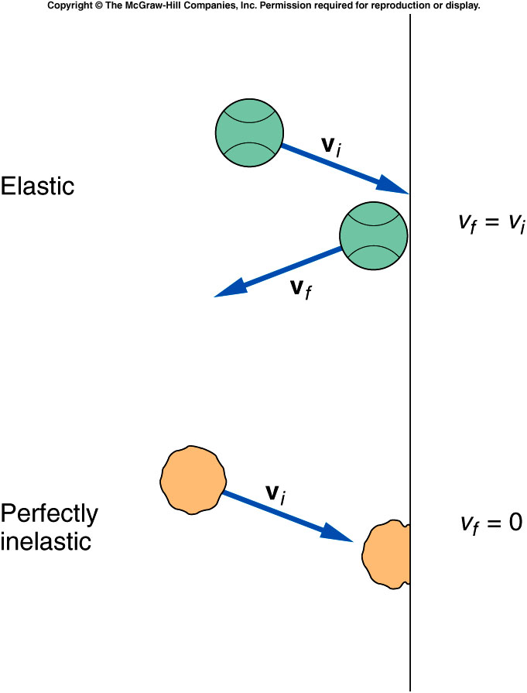
Elastic and Inelastic Collisions
Different kinds of collisions produce different results.
  Sometimes the objects stick together.
  Sometimes the objects bounce apart.
What is the difference between these types of collisions?
Is energy conserved as well as momentum?

Slide 4
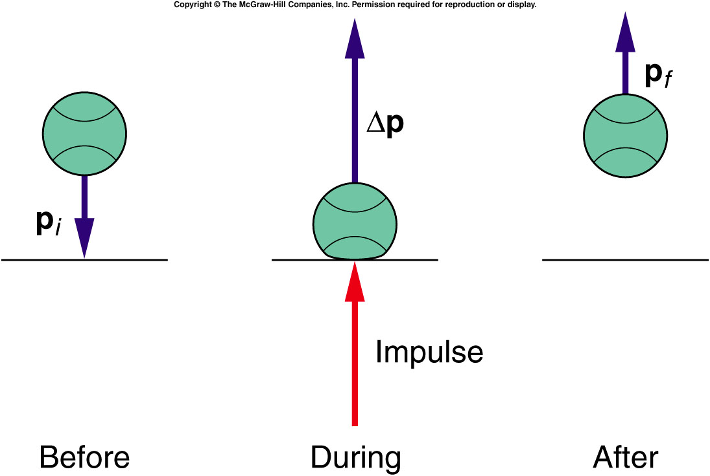
Quiz: When a ball bounces back with the same speed, the momentum changes from mv to -mv, so the impulse and the change in momentum are
2mv, 2mv
mv, mv
No change in momentum. Impulse is 0.
No change in momentum. Impulse is mv

Slide 5
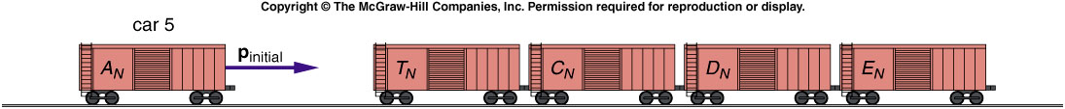
Four railroad cars, all with the same mass of 20,000 kg, sit on a track. A fifth car of identical mass approaches them with a velocity of 15 m/s. This car collides and couples with the other four cars. What is the initial momentum of the system?
m₅ = 20,000 kg
v₅ = 15 m/s
p_{initial} = m₅v₅
= (20,000 kg)(15 m/s)
= 300,000 kg·m/s
200,000 kg·m/s
300,000 kg·m/s
600,000 kg·m/s
1,200,000 kg·m/s

Slide 6
What is the velocity of the five coupled cars after the collision?
1 m/s
3 m/s
5 m/s
10 m/s
m_{total} = 100,000 kg
p_{final} = p_{initial}
v_{final} = p_{final} / m_{total}
= (300,000 kg·m/s)/(100,000 kg)
= 3 m/s

Slide 7
Quiz: Is the kinetic energy after the railroad cars collide equal to the original kinetic energy of car 5?
KE_{initial} = 1/2 m₅ v₅²
= 1/2 (20,000 kg)(15 m/s)²
= 2250 kJ
KE_{final} = 1/2 m_{total} v_{final}²
= 1/2 (100,000 kg)(3 m/s)²
= 450 kJ
KE_{final} ≠ KE_{initial}
yes
no
It depends.

Slide 8
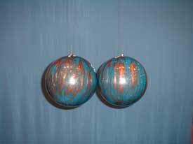
1N-02 Collision of Two Large Balls
What happens when two large balls of equal mass collide elastically while the right one is at rest and the left one moves with velocity v₁?
A). Velocity of right ball is v₁, left one is 0
B). Velocity of left ball is v₁, right one is 0
C). Velocity of left and right are the same but less than v₁
D). Depends on how they collide.

Slide 9
1N-02 Collision of Two Large Balls
What happens when two large balls of equal mass collide one is at rest at the other has velocity v₁?
Conservation of momentum
mv₁ + mv₂ = mv_{1A} + mv_{2A}
→ v₁ = v_{1A} + v_{2A}
Conservation of Energy (Elastic)
½ mv₁² + ½ mv₂² = ½ mv₁² + ½ mv₂²
→ v₁² = v_{1A}² + v_{2A}² v_{1A} = 0 & v_{2A} = v₁
Completely Inelastic collision (stick together)
mv₁ + mv₂ = (m + m)v_{A} (v₂ =0)
→ v₁ = 2v_{A} v_{A} = ½v₁
In practice some energy is always lost. You can hear the noise when they hit and there will be some heat generated at impact
Notes:
Two large bowling balls are suspended by wires. If one is pulled back a few inches and released, it will collide with the other, causing the first ball to stop and the second to move off with the identical speed the first one had just prior to the collision. By placing a piece of clay on one ball, the two will stick upon colliding and the two go off together at half speed.

Slide 10
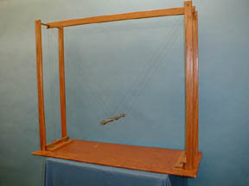
1N-05 Elastic Collision (Magnets)
Two Magnets collide with like poles facing each other
We know that the magnets repel each other, so they will not touch. So is this a collision?
v
Rest
S
S
v
Rest
S
S
What does it mean for objects to ‘touch’ ?
MOMENTUM TRANSFER AND CONSERVATION REQUIRE ONLY THAT THERE BE A MUTUAL INTERACTION.
AT THE MICROSCOPIC LEVEL, ALL CONTACT INVOLVES ELECTROMAGNETIC INTERACTIONS.

Slide 11
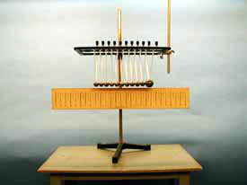
1N-12 Fun Balls
An enlarged version of the Classic Toy - The Array of Steel Balls
First case pull back one ball and release
What happens if we use the big ball?
What happens when more of the balls are pulled back than are left at rest?
The collision is nearly elastic so we can use both momentum conservation and kinetic energy conservation
NO MATTER HOW MANY BALLS ARE PULLED BACK, THE SAME NUMBER RECOIL AT THE SAME SPEED.
Notes:
What happens for large ball ? It can be shown that if the larger ball is initially at rest and the smaller ball made to collide with it, the larger ball will come to rest every other collision.
On the large ball, small ball collision, it can be shown algebraically that the results are independent of what the masses are. It’s just that when the masses are equal, the stop occurs every time, in addition to the every other time.

Slide 12
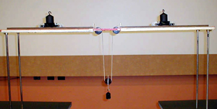
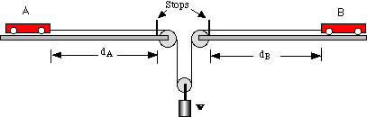
1N-04 Conservation of Linear Momentum
Two carts move under tension of weight on frictionless track
The initial momentum of the carts is zero and they each feel equal and opposite forces. So at any time the net momentum will be zero.
Is momentum conserved in this system ?
0 = m_{A}v_{A} – m_{B}v_{B} → m_{A}v_{A} = m_{B}v_{B}
T
T
v_{A} / v_{B} = m_{B} / m_{A}
d_{A}/d_{B} = (v_{A}t_{A}) / (v_{B}t_{B})
If, t_{A} = t_{B} d_{A}/d_{B} = m_{B} / m_{A}
IF THE MASSES ARE IN INVERSE RATIO TO THE INITIAL DISTANCES, THE CARTS WILL ARRIVE AT THE STOPS SIMULTANEOUSLY.
Notes:
I used 90 cm and 45 cm with 2xmass and it’s not working. Use a smaller distance to reduce the effect of friction.
I can also use the 90/45 cm setup to show the effect of friction. Try it before the demo to make sure it works.

Slide 13
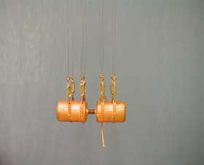
1N-06 Equality of Momentum
Two cylinders are exploded apart by a spring
What happens when the spring is released ?
First case: Both identical
Second case: One much heavier
Use Momentum conservation m₁v₁ = m₂v₂
The height reached is an indication of the initial speed since 1/2mv² = mgh
v = sqrt (2gh)
THE SPRING FORCE THAT DRIVES THEM APART IS INTERNAL TO THE SYSTEM, SO THE NET MOMENTUM REMAINS ZERO.
SINCE THE METAL CYLINDER IS HEAVIER IT FLIES AWAY WITH A SMALLER VELOCITY TO CONSERVE MOMENTUM

Slide 14
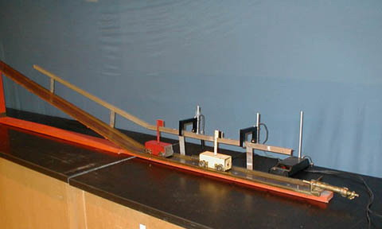
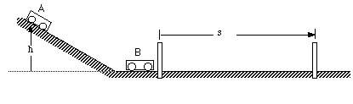
1N-10 Elastic & Inelastic Collisions
Elastic and Inelastic collisions of Two identical Carts on a Frictionless Track
Conservation of momentum
mv_{A} + mv_{B} = mv_{A}’ + mv_{B}’
Conservation of Energy (Elastic)
½ mv_{A}² + ½ mv_{B}² = ½ mv_{A}’² + ½ mv_{B}’²
If v_{B} = 0 then v_{A}’ = 0 and v_{B}’ = v_{A}
Completely inelastic (two carts stick)
if v_{B} = 0 then v_{AB} = ½ v_{A}
WE CAN MEASURE THE SPEED BY TIMING THE CARTS ACROSS A FIXED DISTANCE. For THE INELASTIC CASE HALF THE VELOCITY IMPLIES IT SHOULD TAKE TWICE THE TIME.

Slide 15
Q5 Are impulse and momentum the same thing? Explain.
No impulse changes momentum
Q6 If a ball bounces off a wall so that its velocity coming back has the same magnitude that it had prior to bouncing:
A. Is there a change in the momentum of the ball? Explain.
B. Is there an impulse acting on the ball during its collision with the wall? Explain.
A. Yes momentum is a vector
B. Yes a force acts for a short time

Slide 16
Q9 What is the advantage of an air bag in reducing injuries during collisions? Explain using impulse and momentum ideas.
It increases the time over which the force acts.
It also spreads the force over a larger area
Q11 If you catch a baseball or softball with your bare hand, will the force exerted on your hand by the ball be reduced if you pull your arm back during the catch? Explain.
Yes. The impulse is the same but the impact time is longer.
From a work point of view the kinetic energy = Fd so increasing d
reduces F

Slide 17
Q17 A compact car and a large truck have a head-on collision. During the collision, which vehicle, if either, experiences:
A. The greater force of impact? Explain.
B. The greater impulse? Explain.
C. The greater change in momentum? Explain.
D. The greater acceleration? Explain.
A. The forces are equal and opposite
B. The impulse for each is the same
C. The momentum changes are equal and opposite
D. F = ma so a is larger for the compact car
Q22 Is it possible for a rocket to function in empty space (in a vacuum) where there is nothing to push against except itself?
Yes. It ejects material at high velocity and momentum conservation
means the rocket recoils

Slide 18
Q23 Suppose that you are standing on a surface that is so slick that you can get no traction at all in order to begin moving across this surface. Fortunately, you are carrying a bag of oranges. Explain how you can get yourself moving.
Throw the oranges opposite to the direction you wish to move
Q24 A railroad car collides and couples with a second railroad car that is standing still. If external forces acting on the system are ignored, is the velocity of the system after the collision equal to, greater than, or less than that of the first car before the collision?
The velocity after is exactly half

Slide 19
Ch 7 E 10
M₁ and M₂ collide head on
a) Find initial momentum of M₁ and M₂
b) What is the total momentum of the system before collision?
6.0m/s
3.5m/s
west
M₂ = 80kg
M₁ = 100kg
east
a) p₁ = -100 x 3.5 = 350kgm/s p₂ = 80 x 6 = 480kgm/s
b) Total momentum = 480 – 350 = 130kgm/s east

Slide 20
Ch 7 E 10
M₁ and M₂ collide head on. Ignore external forces, if they stick together after collision, which way do the masses travel?
6.0m/s
3.5m/s
west
M₂ = 80kg
M₁ = 100kg
east
p₁ = -100 x 3.5 = 350kgm/s p₂ = 80 x 6 = 480kgm/s
West
East
they will all stop
Total momentum = 480 – 350 = 130kgm/s east
The masses will travel east with p = 130kgm/sec

Slide 21
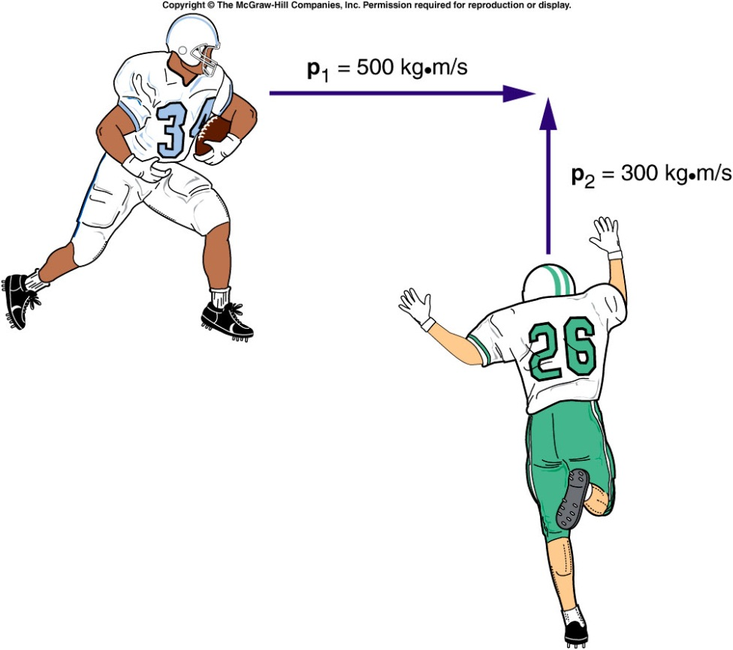
Collisions at an Angle
Two football players traveling at right angles to one another collide and stick together.
  What will be their direction of motion after the collision?
Add the individual momentum vectors to get the total momentum of the system before the collision.
The final momentum of the two players stuck together is equal to the total initial momentum.

Slide 22
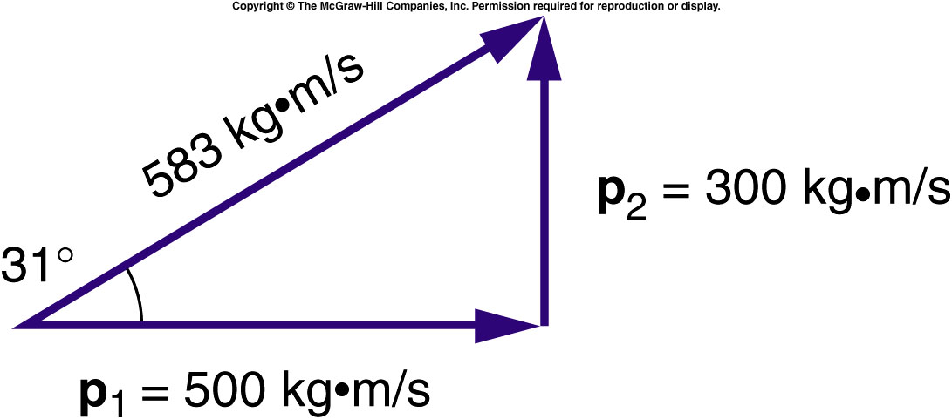
Collisions at an Angle
The total momentum of the two football players prior to the collision is the vector sum of their individual momentums.
  The larger initial momentum has a larger effect on the final direction of motion.

Slide 23
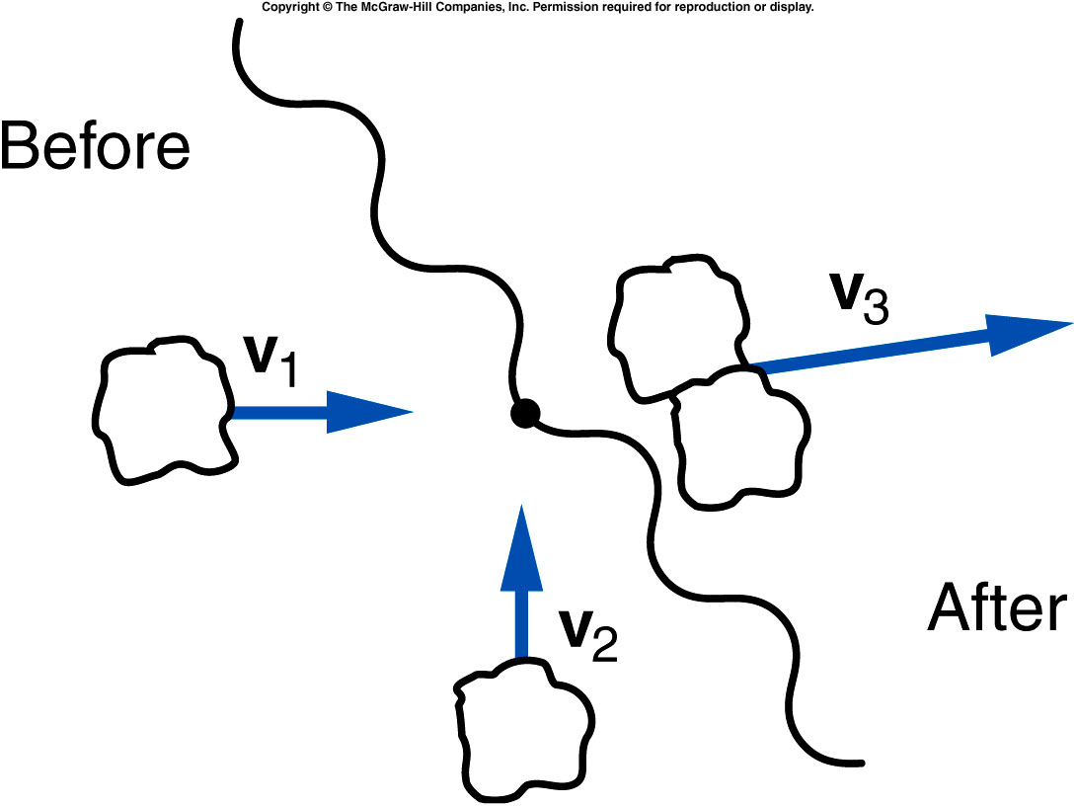
Two lumps of clay of equal mass are traveling at right angles with equal speeds as shown, when they collide and stick together. Is it possible that their final velocity vector is in the direction shown?
yes
no
unable to tell
from this graph
No. The final momentum will be in a direction making a 45º degree angle with respect to each of the initial momentum vectors.

Slide 24
Ch 7 E 18
A truck of mass 4000kg and speed 10m/s collides at right
angles with a car of mass 1500kg and a speed of 20m/s.
What’s the total momentum of system before collision?
70000 kg m/s
10000 kg m/s
50000 kg m/s
40000 kg m/s
30000 kg m/s

Slide 25
Ch 7 E 18
A truck of mass 4000kg and speed 10m/s collides at right
angles with a car of mass 1500kg and a speed of 20m/s.
What’s the total momentum of system before collision?
p
p₁ = 40000
p₁ = 40000
p₂ = 30000
p² = p₁² + p₂²
P = 50000kgm/s
Notes:
Right triangle

Slide 26
Ch 7 CP 2
A bullet is fired into block sitting on ice. The bullet travels at
500 m/s with mass 0.005 kg. The wooden block is at rest with a
mass of 1.205 kg. Afterwards the bullet is embedded in the block.
Find the velocity of the block and bullet after the impact (ignore all frictions ).
3.02 m/s
2.07 m/s
500.3 m/s
250.6 m/s
12.02 m/s
p_{final} = p_{initial} = (0.005 kg)(500 m/s)
p_{final} = (M_{bullet} + M_{wood})v = 2.5 kg m/s
v = (2.5 kg m/s)/(1.205 kg) = 2.07 m/s

