Slide 1
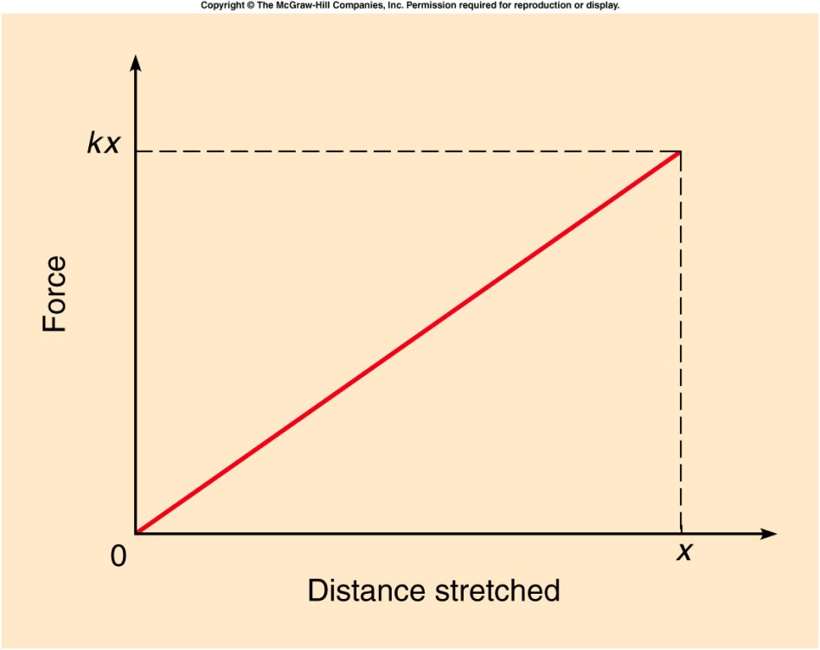
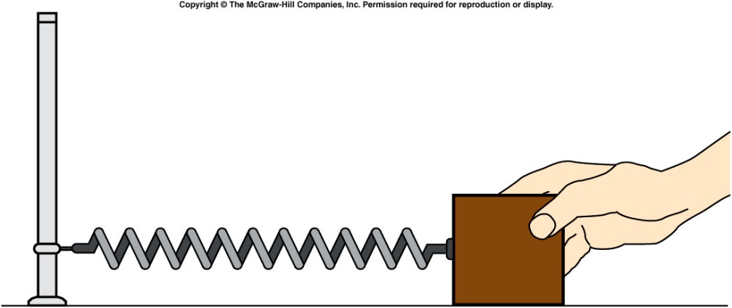
Conversion Between Potential and Kinetic energy
An elastic force is a force that results from stretching or compressing an object, e.g. a spring.
When stretching a spring, the force from the spring is
    F = -kx , where x is the distance stretched
    The spring constant, k, is a number describing the stiffness of the spring.
Notes:
A ball moves from rest down a low-friction ramp with a relatively small slope. It then encounters a steeper ramp, but the ball comes to rest at the same elevation that it started from, showing the conservation of mechanical energy.
Directions: Place the ball at the top of the long ramp and release it. It will just about make it to the top of the other end of the ramp. Then show that it doesn’t matter which end you start from.

Slide 2
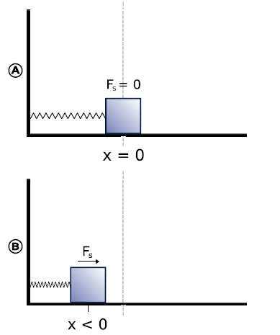
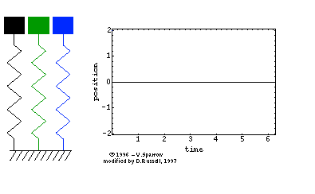
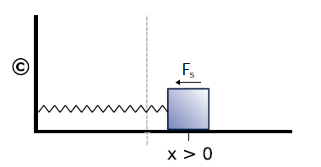

Slide 3
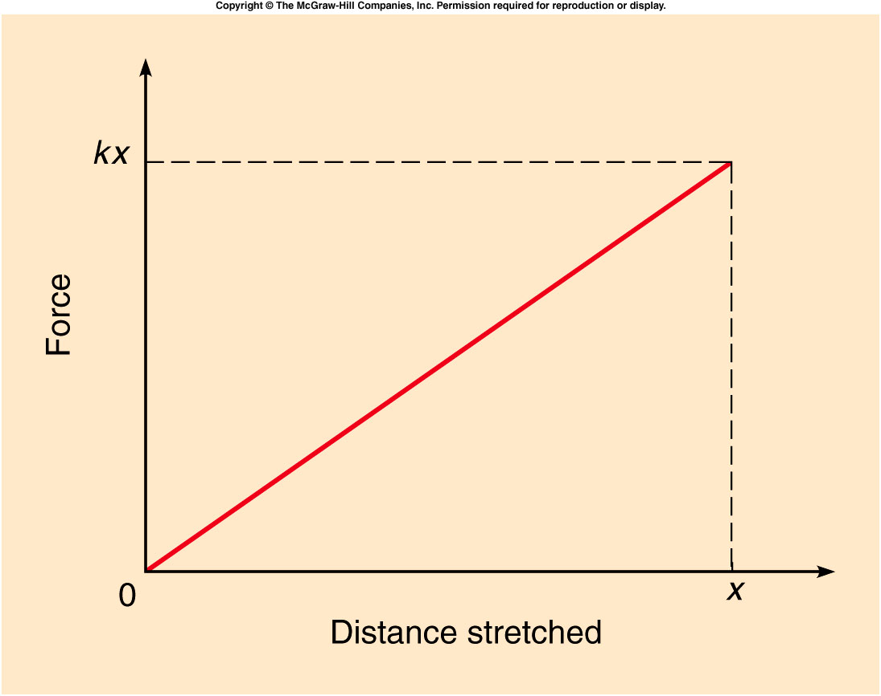
Conversion Between Potential and Kinetic energy
The increase in elastic potential energy is equal to the work done by the average force needed to stretch the spring.

Slide 4
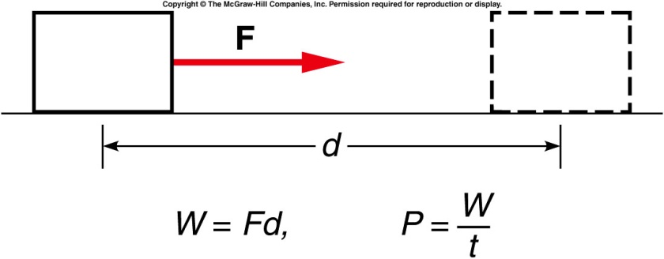
Power
It is not only important how much
work is done but also how quick, i.e.
the rate, at which work is done
So the quantity
Power = P = W/t (unit is a watt)
is very important.
Generally energy supplies, motors, etc are rated by power and one can determine how much work can be done by multiplying by time.
W = Pt (joules).
2/8/2019
4

Slide 5
Examples of Watt and Joules
The unit for electrical usage is the kilowatt –hour. A kilowatt – hour is the energy used by a 1000 watt device for 3600 seconds 1kWHr = 1000*3600 = 3.6 million joules
In order to lift an elevator with a mass of 1000kg to 100 meters requires 1000*9.8*100 joules but we need to do it in 20 seconds.
The power we need is 1000*9.8*100/20 = 49000 Watts so we need to install a motor rated at > 49000 watts

Slide 6
Momentum and Impulse
How can we describe the change in velocities of colliding football players, or balls colliding with bats?
How does a strong force applied for a very short time affect the motion?
Can we apply Newton’s Laws to collisions?
What exactly is momentum? How is it different from force or energy?
What does “Conservation of Momentum” mean?

Slide 7
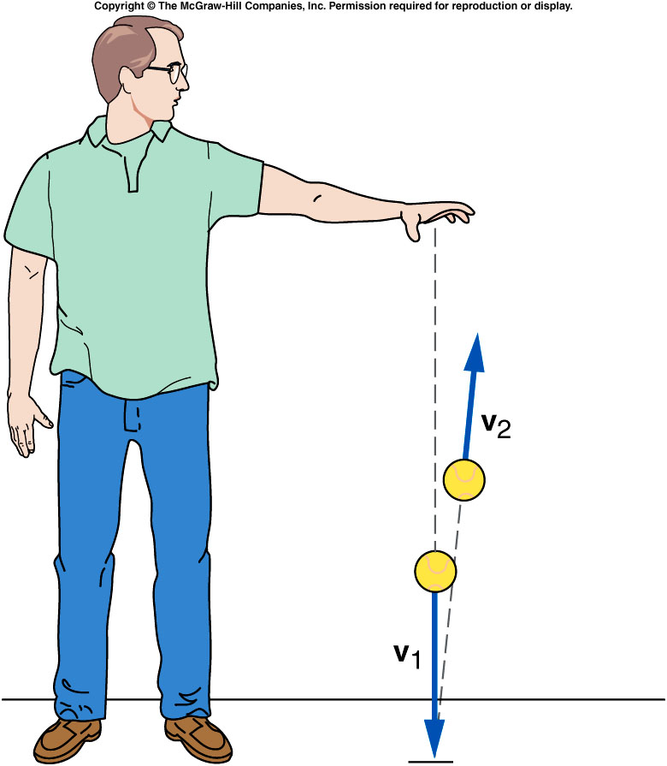
What happens when a ball bounces?
When it reaches the floor, its velocity quickly changes direction.
There must be a strong force exerted on the ball by the floor during the short time they are in contact.
This force provides the upward acceleration necessary to change the direction of the ball’s velocity.

Slide 8
Momentum and Impulse
Multiply both sides of Newton’s second
law by the time interval over which the
force acts:
The left side of the equation is impulse,
the (average) force acting on an object
multiplied by the time interval over which
the force acts.
How a force changes the motion of an object depends on both the size of the force and how long the force acts.
The right side of the equation is the change in the momentum of the object.
The momentum of the object is the mass of the object times its velocity.

Slide 9
Impulse-Momentum Principle
The impulse acting on an object produces a change in momentum of the object that is equal in both magnitude and direction to the impulse.

Slide 10
Conservation of Momentum
Δp = F Δt
This is the impulse equation
When F = 0, Δp = 0, i.e. total momentum has no change as a function of time, i.e. conserved

Slide 11
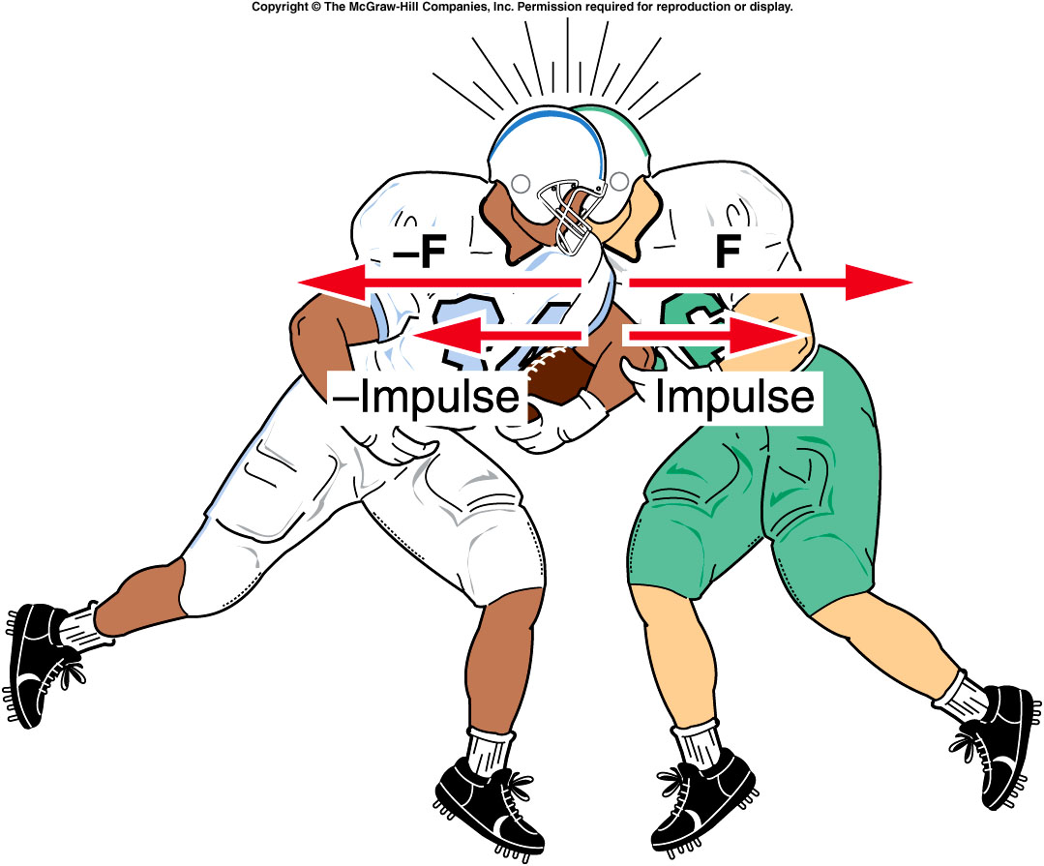
Does the momentum of the fullback conserve?
A). Yes, because the external force is zero.
B). No, because the external force is NOT zero

Slide 12
Does the sum of the momentum of the two players conserve?
A). Yes, because the external force is zero.
B). No, because the external force is NOT zero

Slide 13

Conservation of Momentum
Newton’s third law
  For every action, there is an equal but opposite reaction.
  The defensive back exerts a force on the fullback, and the fullback exerts an equal but opposite force on the defensive back.
  The impulses on both are equal and opposite.
  The changes in momentum for each are equal and opposite.
  The total change of the momentum for the two players is zero.

Slide 14
Conservation of Momentum
  For any system, if the net external force acting on a system of objects is zero, the total momentum of the system is conserved.
  Δp = F Δt
  F = 0, Δp = 0

Slide 15
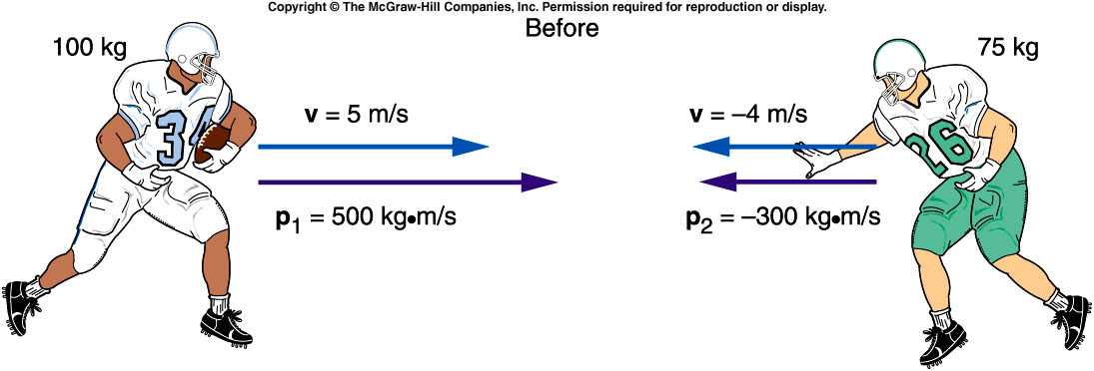
A 100-kg fullback moving straight downfield collides with a 75-kg defensive back. The defensive back hangs on to the fullback, and the two players move together after the collision. What is the initial momentum of each player?
A). Full back: 500 kg·m/s^{2,} defensive back: -300 kg·m/s²
B). Full back: 500 kg·m/s^{2,} defensive back: 300 kg·m/s²
C). Full back: 200 kg·m/s^{2,} defensive back: -300 kg·m/s²
D). Full back: 250 kg·m/s^{2,} defensive back: 300 kg·m/s²
p = mv = (100 kg) (5 m/s) = 500 kg·m/s²
p = mv = (75 kg)(-4 m/s)= -300 kg·m/s²
Fullback:
Defensive back:

Slide 16
What is the total momentum of the system?
A). 150 kg·m/s²
B). 500 kg·m/s²
C). 100 kg·m/s²
D). 200 kg·m/s²
Total momentum:
p_{total} = p_{fullback} + p_{defensive back}
= 500 kg·m/s - 300 kg·m/s
= 200 kg·m/s

Slide 17
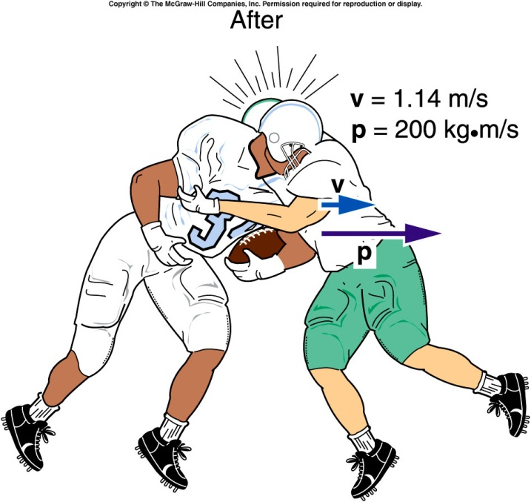
What is the velocity of the two players immediately after the collision?
Total mass: m = 100 kg + 75 kg = 175 kg
4.5m/s
1.14m/s
153 m/s
0 m/s
0.25m/s
Velocity of both: v = p_{total} / m = (200 kg·m/s) / 175 kg = 1.14 m/s

Slide 18
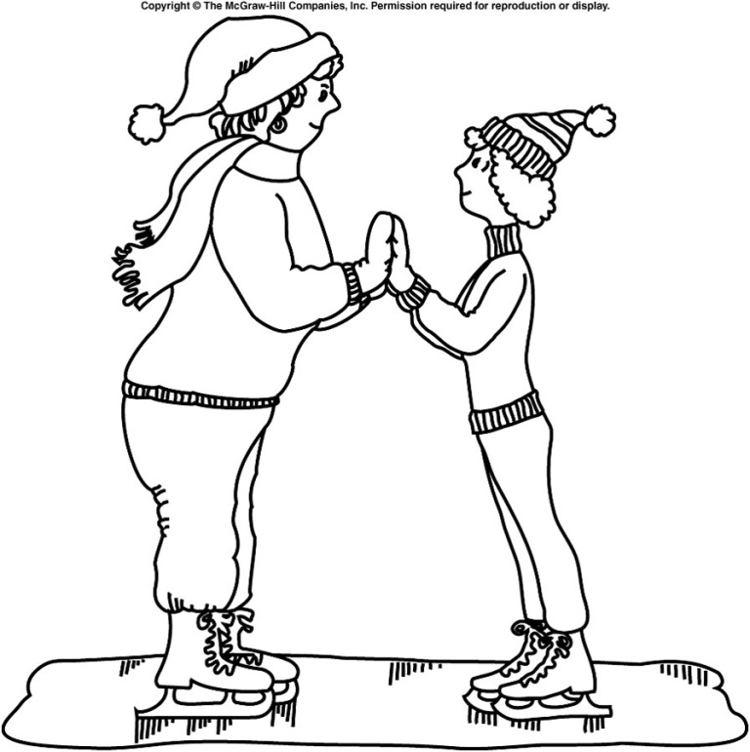
Two skaters of different masses prepare to push off against one another. Which one will gain the larger velocity?
The more massive one
The less massive one
They will each have equal but opposite velocities.
The net external force acting on the system is zero, so conservation of momentum applies.
Before the push-off, the total initial momentum is zero.
The total momentum after the push-off should also be zero.
Both must move with momentum values equal in magnitude but opposite in direction: p₂ = −p₁
When added together, the total final momentum of the system is then zero.
Since momentum is mass times velocity p = mv, the skater with the smaller mass must have the larger velocity: m₁v₁ = m₂v₂

Slide 19
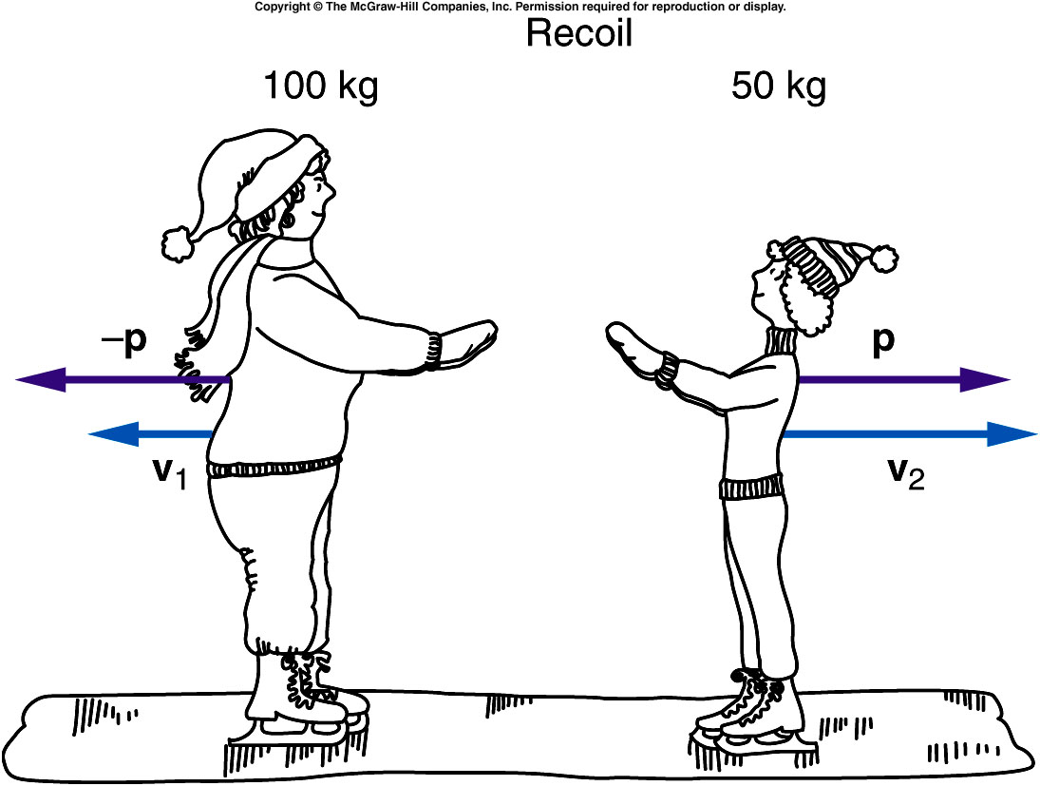
Recoil is what happens when a brief force between two objects causes the objects to move in opposite directions.
The lighter object attains the larger velocity to equalize the magnitudes of the momentums of the two objects.
The total momentum of the system is conserved and does not change.

Slide 20
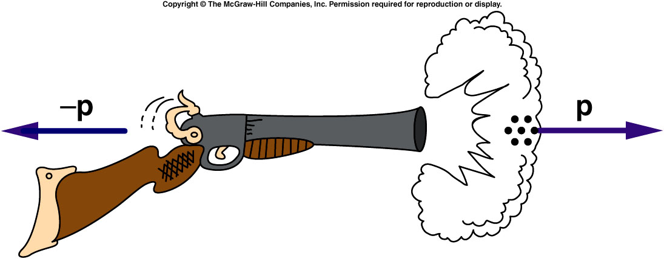
Recoil
The explosion of the powder causes the shot to move very rapidly forward.
If the gun is free to move, it will recoil backward with a momentum equal in magnitude to the momentum of the shot.

Slide 21
Even though the mass of the shot is small, its momentum is large due to its large velocity.
The shotgun recoils with a momentum equal in magnitude to the momentum of the shot.
The recoil velocity of the shotgun will be smaller than the shot’s velocity because the shotgun has more mass, but it can still be sizeable.

Slide 22
How can you avoid a bruised shoulder?
If the shotgun is held firmly against your shoulder, it doesn’t hurt as much.
      WHY?
Notes:
If you think of the system as including yourself and the earth, then momentum is conserved because all the forces involved are internal to this system.
The large mass of the earth means that the change in momentum of the earth would be imperceptible.

Slide 23
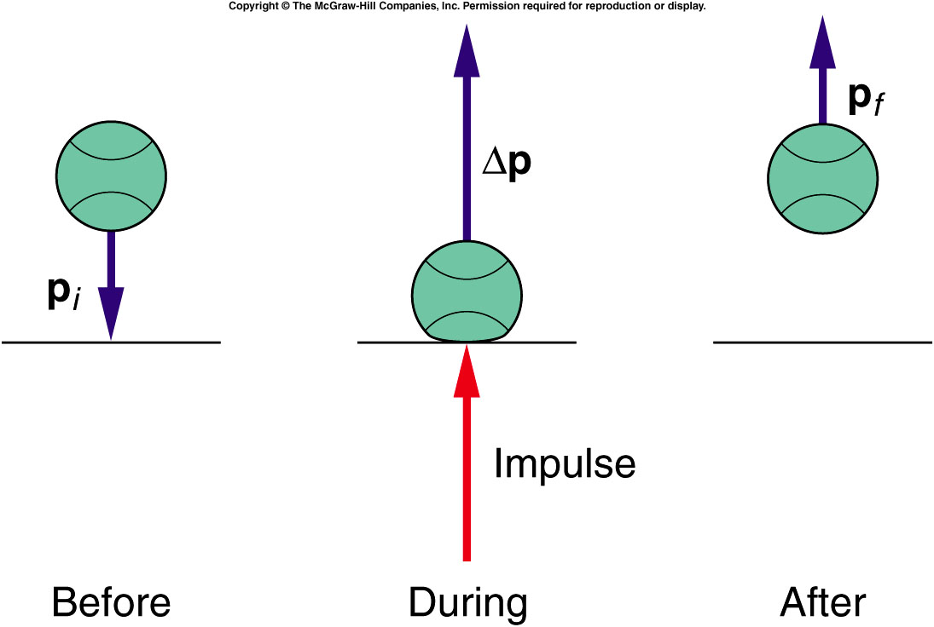
Quiz: When a ball bounces back with the same speed, the momentum changes from mv to -mv, so the impulse and the change in momentum are
2mv, 2mv
mv, mv
No change in momentum. Impulse is 0.
No change in momentum. Impulse is mv

