Slide 1
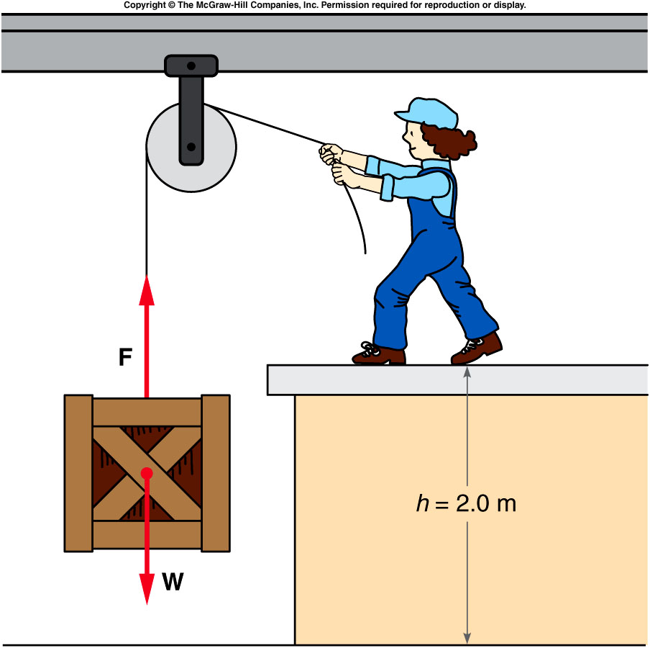
Gravitational Potential Energy and Reference level
Potential energy:
mg x h1
mg x h2
h1
h0
Notes:
A ball moves from rest down a low-friction ramp with a relatively small slope. It then encounters a steeper ramp, but the ball comes to rest at the same elevation that it started from, showing the conservation of mechanical energy.
Directions: Place the ball at the top of the long ramp and release it. It will just about make it to the top of the other end of the ramp. Then show that it doesn’t matter which end you start from.

Slide 2
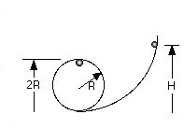
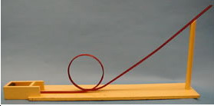
1M-10 Loop-the-Loop
From what height should the ball be dropped to just clear the Loop-the-Loop ?
Ball travels through a Loop-the-Loop
Conservation of Energy:
mgh = mg(2R) + 1/2mv²
At the top of the loop
N + mg = mv²/r
The minimum speed is when N = 0
Therefore h = 5/2 R (Friction means in practice H must be larger)
2/8/2013
2

Slide 3
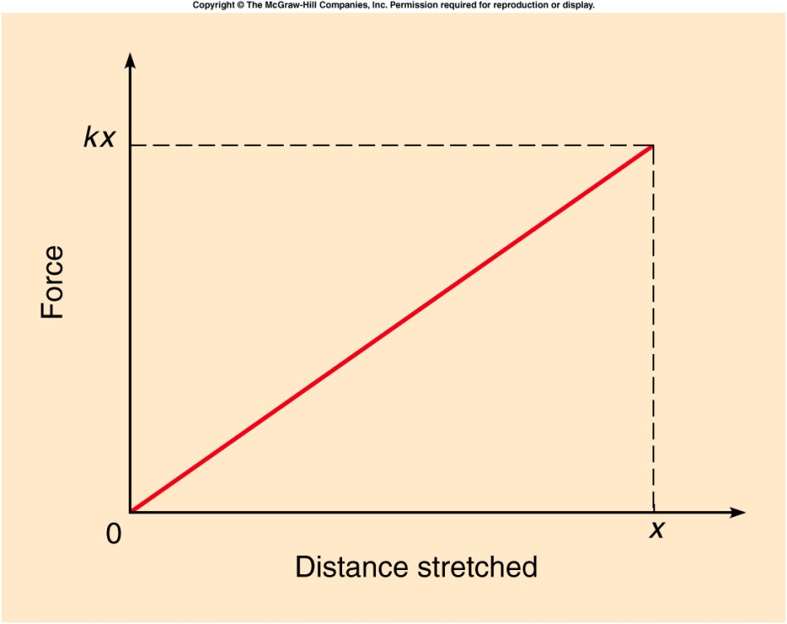
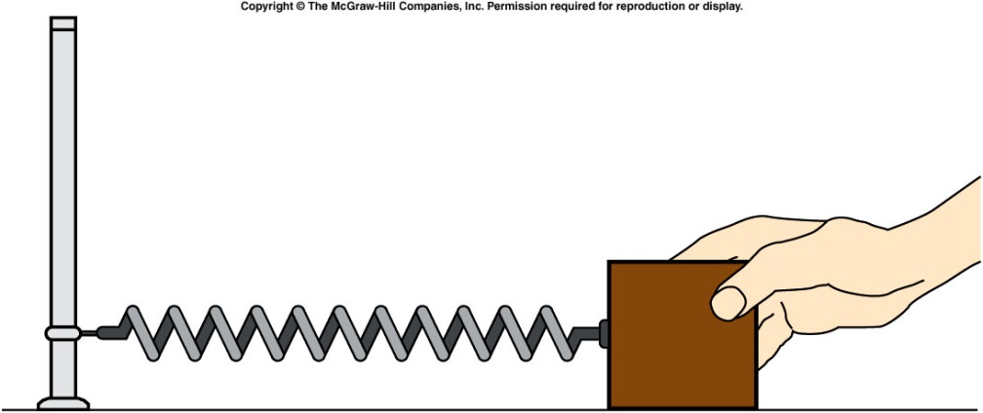
Conversion Between Potential and Kinetic energy
An elastic force is a force that results from stretching or compressing an object, e.g. a spring.
When stretching a spring, the force from the spring is
    F = -kx , where x is the distance stretched
    The spring constant, k, is a number describing the stiffness of the spring.
Notes:
A ball moves from rest down a low-friction ramp with a relatively small slope. It then encounters a steeper ramp, but the ball comes to rest at the same elevation that it started from, showing the conservation of mechanical energy.
Directions: Place the ball at the top of the long ramp and release it. It will just about make it to the top of the other end of the ramp. Then show that it doesn’t matter which end you start from.

Slide 4
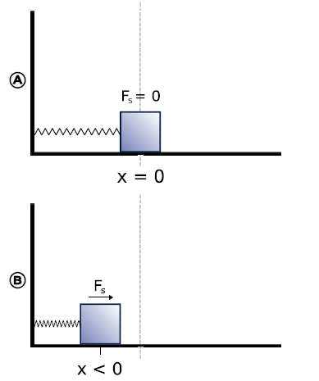
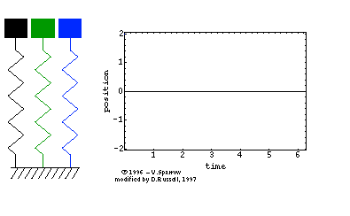
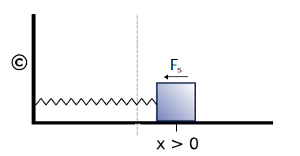

Slide 5
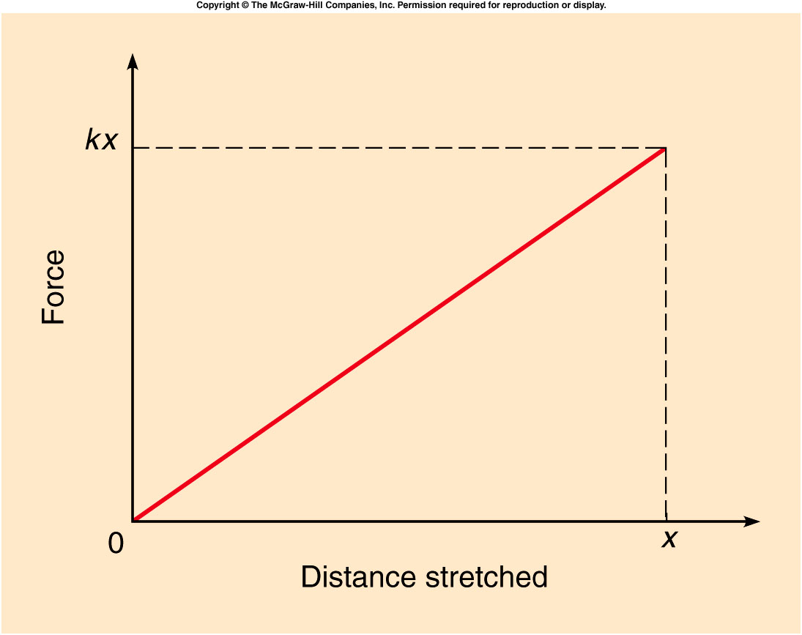
Conversion Between Potential and Kinetic energy
The increase in elastic potential energy is equal to the work done by the average force needed to stretch the spring.

Slide 6
Ch 6 E 10
To stretch a spring a distance of 0.20 m, 40 J of work is done.
What is the increase in potential energy?
And What is the value of the spring constant k?
A). PE = 40J, k = 2000 n/m
B). PE = 40J/0.2m. K = 2000 n/m
C). PE = 40J, k = 200 n/m
D). PR = 40J*0.7m. K = 200n/m
x=0
x=0.20 m
equilibrium
PE = ½ kx²
k = 2PE/x² = 80/(0.2)² ⁻ = 2000n/m
PE = 40J
2/8/2013
6

Slide 7
Ch 6 CP 4
A 0.20 kg mass is oscillating horizontally on a friction-free table on a spring with a constant of k=240 N/m. The spring is originally stretched to 0.12 m from equilibrium and released.
What is its initial potential energy?
A). 1.73 J
B). 17.3 J
C) 2.75 J
D). 275 J
E). 12 J
x=0
x=0.12 m
M
PE = 1/2kx² = ½(240)(0.12)² = 1.73J

Slide 8
Ch 6 CP 4
A 0.20 kg mass is oscillating horizontally on a friction-free table on a spring with a constant of k=240 N/m. The spring is originally stretched to 0.12 m from equilibrium and released.
What is the maximum velocity of the mass? Where does it reach this maximum velocity?
A). 1.73 m/s
B). 4.16 m/s
C) 3.46 m/s
D). 0.765 m/s
E). 12 m/s
No friction so energy is conserved
E=PE+KE, maximum KE when PE=0
KE_{max} = 1/2mv² v = 4.16 m/s.
This occurs at the equilibrium position
8

Slide 9
Ch 6 CP 4
A 0.20 kg mass is oscillating horizontally on a friction-free table on a spring with a constant of k=240 N/m. The spring is originally stretched to 0.12 m from equilibrium and released.
What are values of PE, KE and velocity of mass when the mass is 0.06 m from equilibrium?
x=0
x=0.12 m
A). PE = 0.832J, KE = 0.9J, v = 1.6 m/s
B). PE = 0.482J, KE = 1.28J, v = 3.6 m/s
C). PE = 0.432J, KE = 1.3J, v = 3.6 m/s
D). PE = 4.32J, KE = 1.3J, v = 36 m/s
E). PE = 0.432J, KE = 13J, v = 36 m/s
M
PE = 1/2kx² = ½(240)(0.06)² = 0.432J
Since total energy = 1.73J then
the kinetic energy = 1.73 – 0.432 = 1.3J
KE = 1/2mv² = 1.3 then v = 3.6m/s

Slide 10
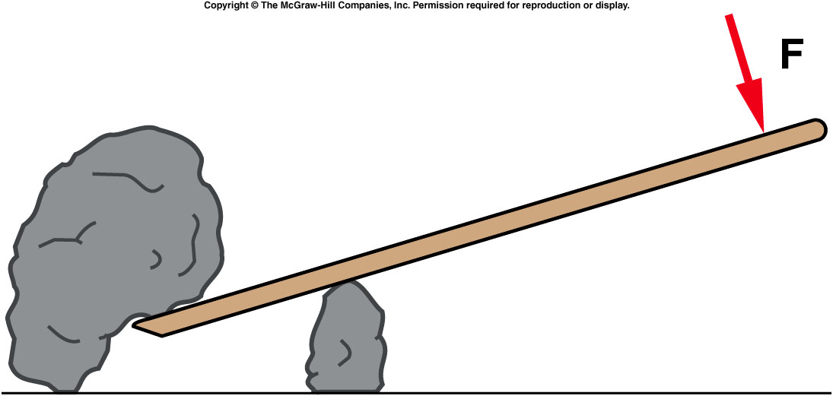
Quiz: A lever is used to lift a rock. Will the work done by the person on the lever be greater than, less than, or equal to the work done by the lever on the rock? (assume no dissipative force, e.g. friction, in action).
Greater than
Less than
Equal to
Unable to tell
from this graph
The work done by the person can never be less than the work done by the lever on the rock. If there are no dissipative forces they will be equal. This is a consequence of the conservation of energy.

Slide 11
Conservative forces
Conservative forces are forces for which the sum of kinetic and potential energy is conserved.
  Gravity and elastic forces are conservative.
  The energy due to the work done by these forces change between kinetic and potential energy, but the sum of the two is constant.
  Friction is not conservative.
  work done by friction force change to heat.

Slide 12
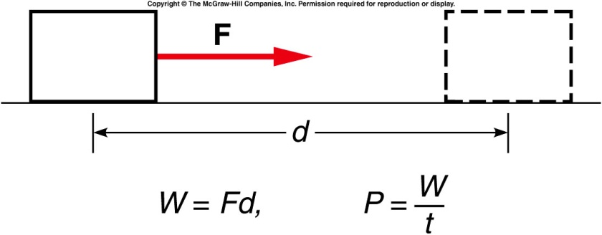
Power
It is not only important how much
work is done but also how quick, i.e.
the rate, at which work is done
So the quantity
Power = P = W/t (unit is a watt)
is very important.
Generally energy supplies, motors, etc are rated by power and one can determine how much work can be done by multiplying by time.
W = Pt (joules).
2/8/2013
12

Slide 13
Examples of Watt and Joules
The unit for electrical usage is the kilowatt –hour. A kilowatt – hour is the energy used by a 1000 watt device for 3600 seconds 1kWHr = 1000*3600 = 3.6 million joules
In order to lift an elevator with a mass of 1000kg to 100 meters requires 1000*9.8*100 joules but we need to do it in 20 seconds.
The power we need is 1000*9.8*100/20 = 49000 Watts so we need to install a motor rated at > 49000 watts

Slide 14
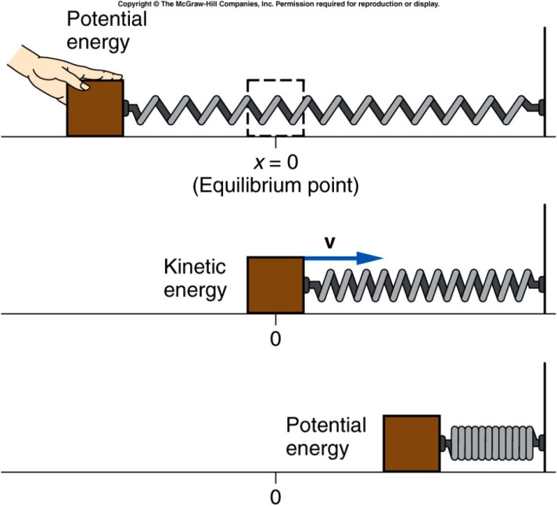
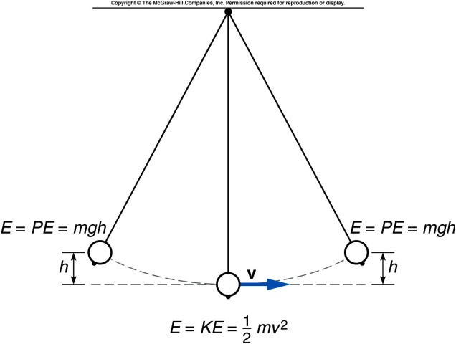
Simple Harmonic Motion
Simple harmonic motion occurs when the energy of a system repeatedly changes from potential energy to kinetic energy and back again.
Energy added by doing work to stretch the spring, or move the object to a higher position, is transformed back and forth between potential energy and kinetic energy.

Slide 15
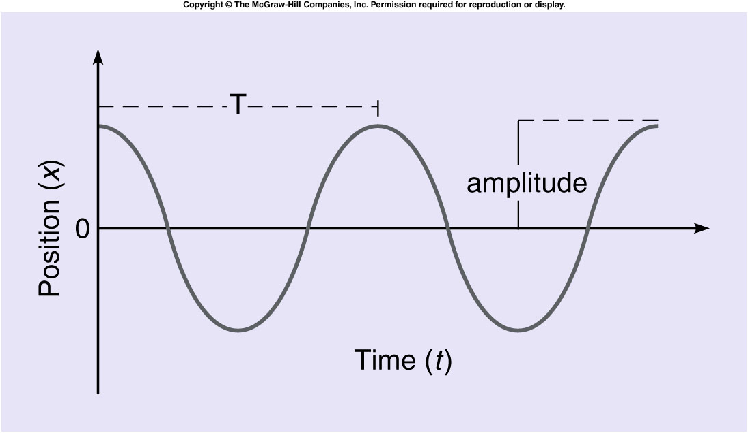
The horizontal position x of the mass on the spring is plotted against time as the mass moves back and forth.
  The period T is the time taken for one complete cycle.
  The frequency f is the number of cycles per unit time.
  The amplitude is the maximum distance from equilibrium.

Slide 16
Ch 6 E 18
The frequency of oscillation of a pendulum is 8 cycles/s.
What is its period?
x
A). 0.5 s
B). 0.25 S
C). 0.125 S
D). 0.05 S
E). 0.02 S
T
t
f = 1/T
T = 1/f = 1/(8 cycles/s)
T = 0.125 seconds
16

Slide 17
Momentum and Impulse
How can we describe the change in velocities of colliding football players, or balls colliding with bats?
How does a strong force applied for a very short time affect the motion?
Can we apply Newton’s Laws to collisions?
What exactly is momentum? How is it different from force or energy?
What does “Conservation of Momentum” mean?

Slide 18
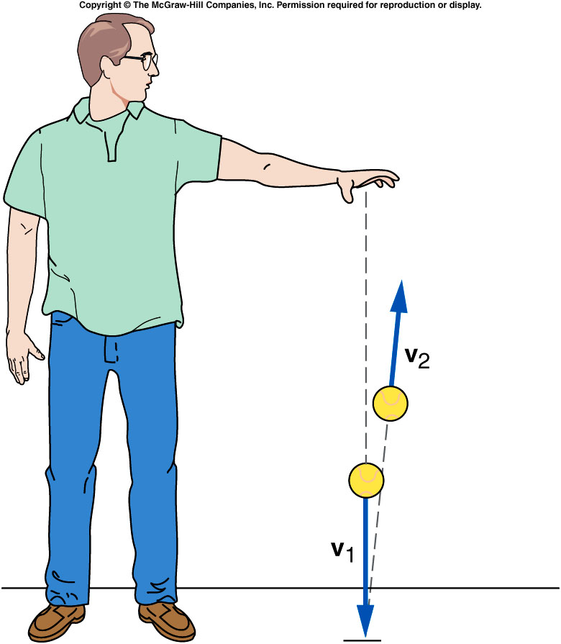
What happens when a ball bounces?
When it reaches the floor, its velocity quickly changes direction.
There must be a strong force exerted on the ball by the floor during the short time they are in contact.
This force provides the upward acceleration necessary to change the direction of the ball’s velocity.

Slide 19
Momentum and Impulse
Multiply both sides of Newton’s second
law by the time interval over which the
force acts:
The left side of the equation is impulse,
the (average) force acting on an object
multiplied by the time interval over which
the force acts.
How a force changes the motion of an object depends on both the size of the force and how long the force acts.
The right side of the equation is the change in the momentum of the object.
The momentum of the object is the mass of the object times its velocity.

Slide 20
Impulse-Momentum Principle
The impulse acting on an object produces a change in momentum of the object that is equal in both magnitude and direction to the impulse.

Slide 21
Conservation of Momentum
Δp = F Δt
This is the impulse equation
When F = 0, Δp = 0, i.e. total momentum has no change as a function of time, i.e. conserved

Slide 22
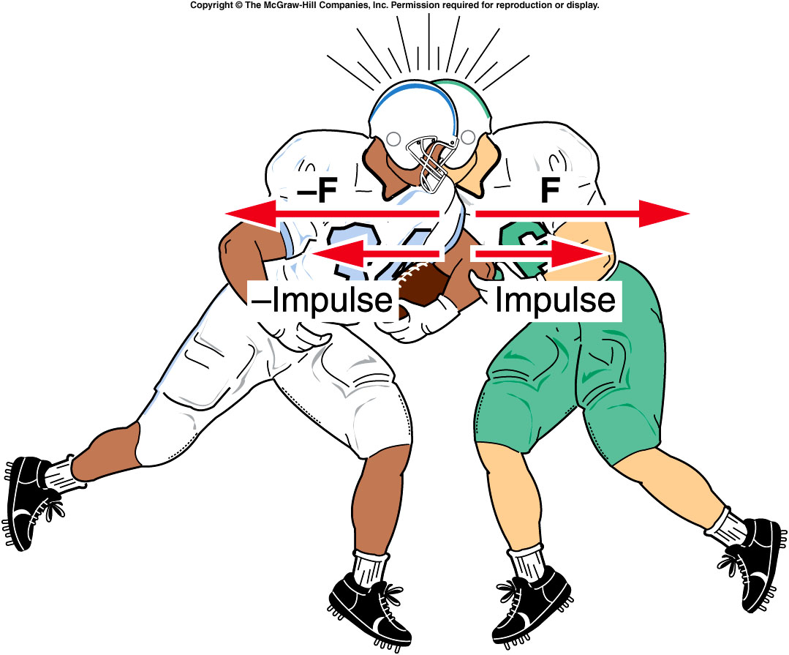
Does the momentum of the fullback conserve?
A). Yes, because the external force is zero.
B). No, because the external force is NOT zero

Slide 23
Does the sum of the momentum of the two players conserve?
A). Yes, because the external force is zero.
B). No, because the external force is NOT zero

Slide 24
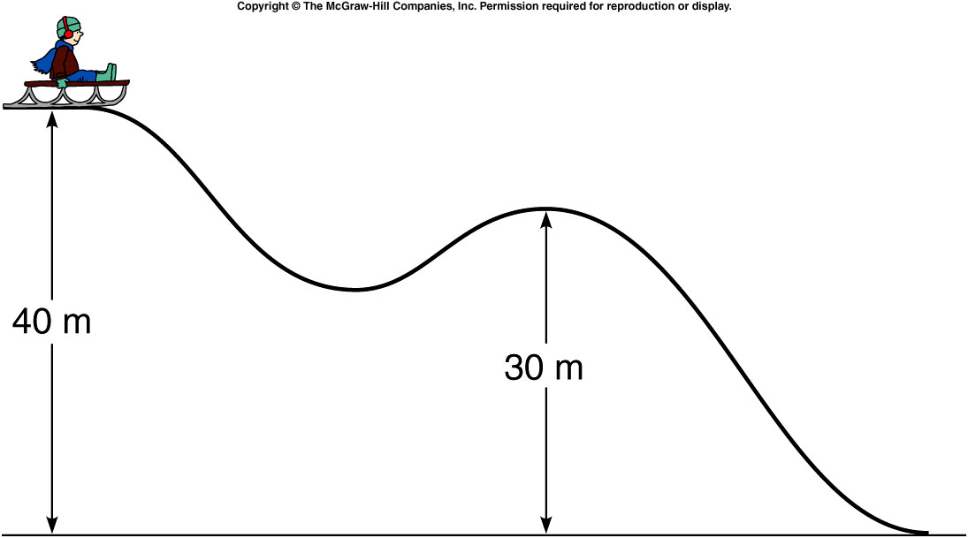
Quiz: A sled and rider with a total mass of 40 kg are perched at the top of the hill shown. Suppose that 2000 J of work is done against friction as the sled travels from the top (at 40 m) to the second hump (at 30 m). Will the sled make it to the top of the second hump if no kinetic energy is given to the sled at the start of its motion?
yes
no
It depends.
Energy conservation:
mgH = mgh + KE + heat
40kg X 9.8N/s² X 40m = 40kg X 9.8N/s² X 30m + KE + 2000J
→ KE = 1920 J > 0, i.e. yes, he can reach the 2nd hump.

