Slide 1
Forms of mechanical energy
Kinetic Energy: energy associated with the motion.
Potential Energy: energy stored in a compressed spring or stretched elastic or in an object that is held at rest above the earths surface.
To change the energy, one need to do some “WORK”.
  The amount of work is equal to the change of total energy.

Slide 2
Definition of Work
We all need to do some work in order to accomplish something each day.
More work is needed to carry 10 pizzas from Pizza Hut to your home than that for 1 pizza. (i.e. larger force is needed with equal distance).
More work is needed to drive yourself from Purdue to LA than that from Purdue to IND. (i.e. same force but longer distance).
Work = Force X distance
Unit: 1 joule = 1N X 1m
If Force points to the opposite direction of motion, work < 0, i.e. negative work.
Otherwise, work > 0, i.e. positive work.

Slide 3
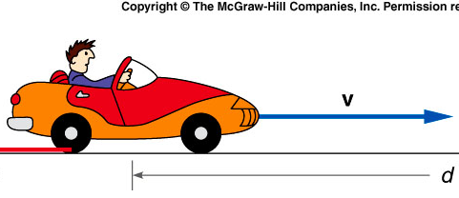
Kinetic Energy
Energy associated with the object’s motion.
v = v₀ + at d = v₀t +1/2at²
F = ma, assume v₀ = 0.
W = Fd = ma(1/2at²) = ma(1/2av²/a²) = ½ X mv² = Kinetic Energy
In this case, the increase of kinetic energy (from zero) is equal to the amount of work done.

Slide 4
Ch 6 CP 2
100 kg crate accelerated by net force = 50 N applied for 4 s.
Use Newton’s 2nd Law to find acceleration?
A). 0.5 m/s²
B). 0.005 m/s²
C). 50 m/s²
D). 12.5 m/s²
E). 25 m/s²
M
F_{net}
F = ma a = F/m = 50N/100kg = 0.5 m/s²
4

Slide 5
Ch 6 CP 2
100 kg crate accelerated by net force = 50 N applied for 4 s.
If it starts from rest, how far does it travel in 4 s?
A). 0.5 m
B). 0.005 m
C). 50 m
D). 12.5 m
E). 4 m
M
F_{net}
b) d = v₀t + ½at² = ½(0.5)(4)² =4m
5

Slide 6
Ch 6 CP 2
100 kg crate accelerated by net force = 50 N applied for 4 s.
What’s the final velocity?
A). 0.5 m/s
B). 2 m/s
C). 50 m/s
D). 12.5 m/s
E). 4 m/s
M
F_{net}
d) v = v₀ + at = 0 + (0.5 m/s²)(4s) = 2m/s
2/11/2020
6

Slide 7
Ch 6 CP 2
100 kg crate accelerated by net force = 50 N applied for 4 s.
How much work is done?
A). 500 J
B). 0.005 J
C). 50 J
D). 200 J
E). 4 J
M
F_{net}
c) W = Fd = (50N)(4m) = 200J

Slide 8
quiz:
100 kg crate accelerated by net force = 50 N applied for 4 s.
What’s the total final kinetic energy?
A). 500 J
B). 0.005 J
C). 50 J
D). 200 J
E). 4 J
M
F_{net}
KE = ½mv² = ½(100kg)(2m/s)² = 200 J
work done equals the kinetic energy.

Slide 9
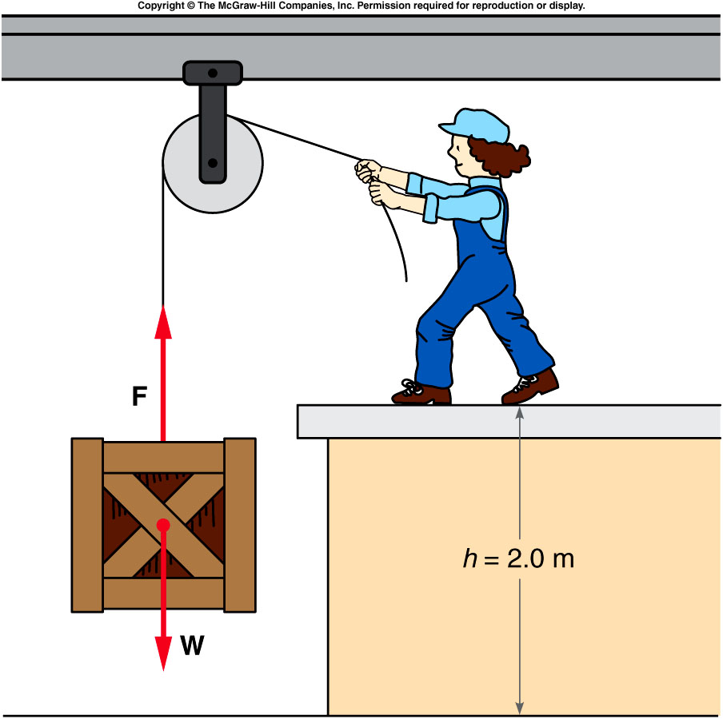
Potential Energy
If work is done but no kinetic energy is gained, we say that the potential energy has increased.
  For example, if a force is applied to lift a crate, the gravitational potential energy of the crate has increased.
  The work done is equal to the force (mg) times the distance lifted (height).
  The gravitational potential energy equals mg X h.
potential energy implies storing energy to use later for other purposes.
  For example, the gravitational potential energy of the crate can be converted to kinetic energy and used for other purposes
    After releasing the string, it reach the ground with higher speed, i.e. large kinetic energy, if it’s positioned higher, i.e. higher potential energy at the beginning.

Slide 10
Ch 6 E 8
5.0 kg box lifted (without acceleration) thru height of 2.0 m
What is increase in potential energy and how much work I
Is needed ?
A). 5000 J, 5000 J
B). 490 J, 490 J
C). 98 J, 98 J
D). 196 J, 196 J
E). 49 J, 49 J
PE = mgh
= (5.0 kg)(9.8 m/s²)(2.0m) = 98J
F = ma = 0 = F_{lift} – mg
F_{lift} = mg = (5.0kg)(9.8m/s²) = 49N
W = Fd = (49N)(2.0m) = 98J

Slide 11
Conversion Between Potential and Kinetic energy
If we raise an object a height h so that it starts and finishes at rest then the average force = mg and the work done = mgh. This energy is stored as potential energy.
if the mass is allowed to fall back to it’s original point then
v² = v₀² + 2gh
½ mv² = ½ mv₀² + mgh,
assume v₀ = 0
→ mgh = 1/2mv² = KE
So the original work in lifting is stored and then returned as kinetic energy
g
F = mg
h

Slide 12
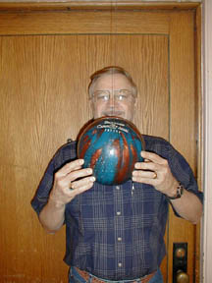
1M-01 Bowling Ball Pendulum
A bowling ball attached to a wire is released like a pendulum
Is it safe to stand here after I release the bowling ball ?
mgh
mgh
h
1/2mv²
mgh = 1/2 mv²
NO POSITIVE WORK IS DONE ON THE BALL
THUS, THERE IS NO GAIN IN TOTAL ENERGY
THE BALL WILL NOT GO HIGHER THAN THE INITIAL POSITION

Slide 13
1M-01 Bowling Ball Pendulum
A bowling ball attached to a wire is released like a pendulum
Does the string tension do any work?
A). Yes.
B). No.
mgh
mgh
h
1/2mv²
mgh = 1/2 mv²

Slide 14
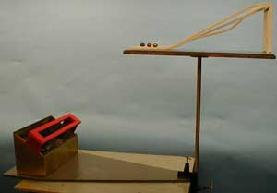
1M-03 Triple Chute
Three Steel Balls travel down different Paths
Each path is clearly different. Which ball will travel the farthest ?
A). The one n the longer track
B). The one on the shorter track
C). All three travel equal distance.
D). Need to know the initial height
2/11/2020
14
Notes:
No slidiIdentical steel balls roll from the same vertical height down three ramps of different shapes. Friction is negligible and the normal force does no work on the ball. So the speed at the bottom of each ramp is the same. Because the speeds are the same, each ball has the same horizontal range and will enter the slot in the box.
Directions: Check the ramp for level before starting. Place a ball on the first ramp directly over the mark. Release the ball and note that it lands in the box after passing through the slot. Do the same for the other two ramps, making certain that the ball is over the mark before releasing it. Each ball should pass through the slot into the box. ng friction

Slide 15
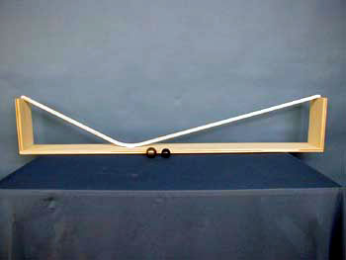

1M-08 Galileo Track
Ball travels down one ramp and up a much steeper ramp
Will the ball travel to a lower or higher height when going up the steeper, shorter ramp ?
A). Higher
B). Same height
C) Lower
D). Need to know the length of the slope
Conservation of Energy:
mgh = 1/2mv² = mgh
AS THE BALL OSCILLATES BACK AND FORTH, THE HEIGHT IS REDUCED BY A LITTLE. WHAT MIGHT ACCOUNT FOR THIS?
FRICTION IS SMALL, BUT NOT ZERO.
So, The Ball should return to the same height
2/11/2020
15

Slide 16
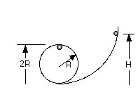
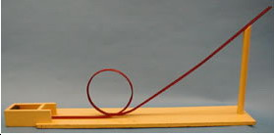
1M-10 Loop-the-Loop
From what height should the ball be dropped to just clear the Loop-the-Loop ?
Ball travels through a Loop-the-Loop
Conservation of Energy:
mgh = mg(2R) + 1/2mv²
At the top of the loop
N + mg = mv²/r
The minimum speed is when N = 0
Therefore h = 5/2 R (Friction means in practice H must be larger)
2/11/2020
16

Slide 17
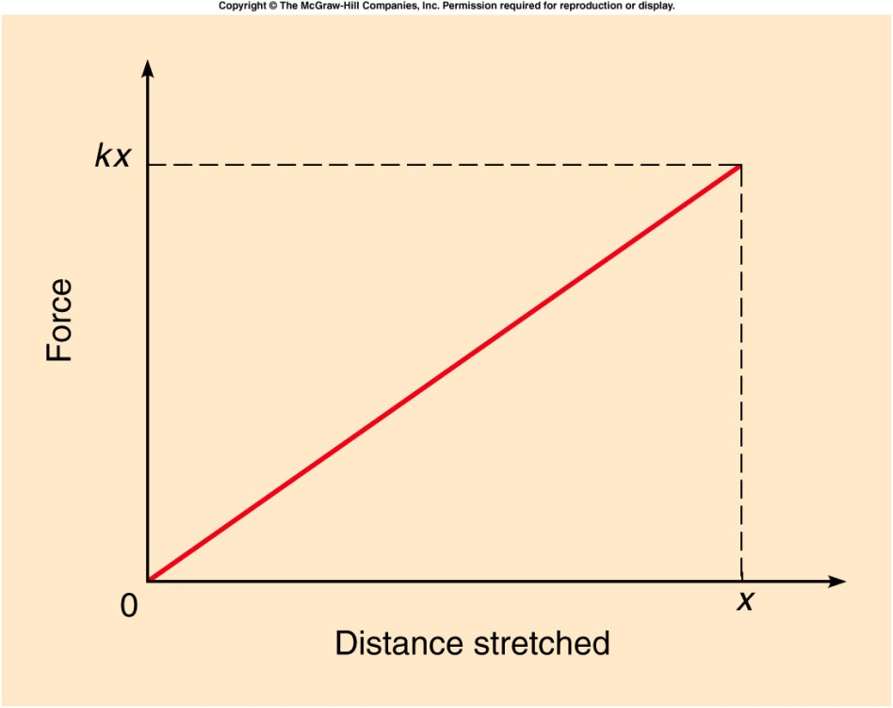
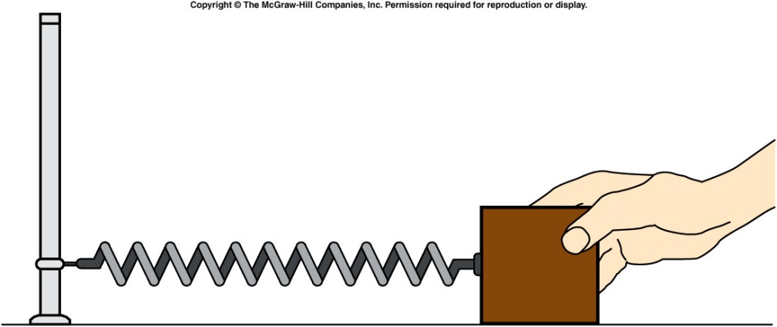
Conversion Between Potential and Kinetic energy
An elastic force is a force that results from stretching or compressing an object, e.g. a spring.
When stretching a spring, the force from the spring is
    F = -kx , where x is the distance stretched
    The spring constant, k, is a number describing the stiffness of the spring.
Notes:
A ball moves from rest down a low-friction ramp with a relatively small slope. It then encounters a steeper ramp, but the ball comes to rest at the same elevation that it started from, showing the conservation of mechanical energy.
Directions: Place the ball at the top of the long ramp and release it. It will just about make it to the top of the other end of the ramp. Then show that it doesn’t matter which end you start from.

Slide 18
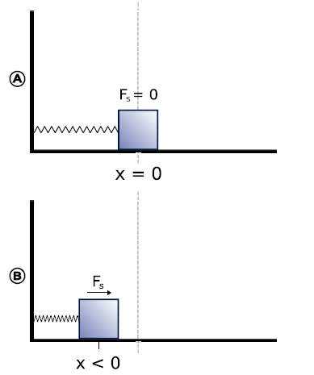
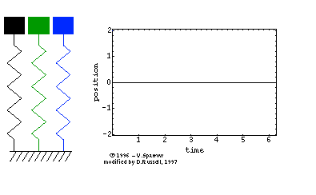
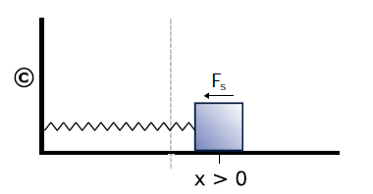

Slide 19
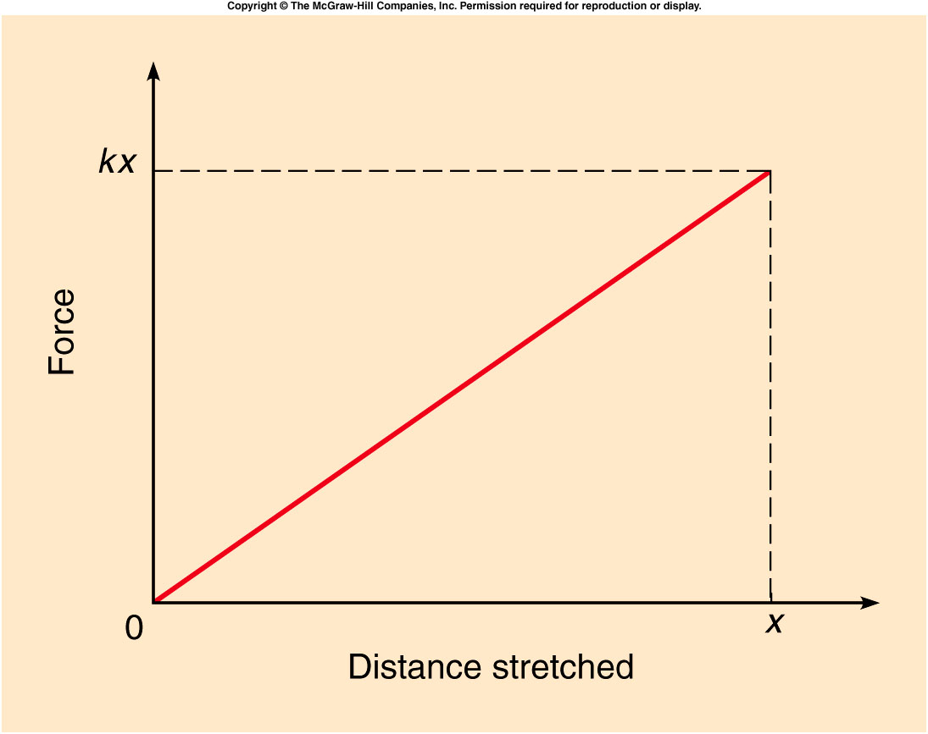
Conversion Between Potential and Kinetic energy
The increase in elastic potential energy is equal to the work done by the average force needed to stretch the spring.

Slide 20
Ch 6 E 10
To stretch a spring a distance of 0.20 m, 40 J of work is done.
What is the increase in potential energy?
And What is the value of the spring constant k?
A). PE = 40J, k = 2000 n/m
B). PE = 40J/0.2m. K = 2000 n/m
C). PE = 40J, k = 200 n/m
D). PR = 40J*0.7m. K = 200n/m
x=0
x=0.20 m
equilibrium
PE = ½ kx²
k = 2PE/x² = 80/(0.2)² ⁻ = 2000n/m
PE = 40J
2/11/2020
20

Slide 21
Ch 6 CP 4
A 0.20 kg mass is oscillating horizontally on a friction-free table on a spring with a constant of k=240 N/m. The spring is originally stretched to 0.12 m from equilibrium and released.
What is its initial potential energy?
A). 1.73 J
B). 17.3 J
C) 2.75 J
D). 275 J
E). 12 J
x=0
x=0.12 m
M
PE = 1/2kx² = ½(240)(0.12)² = 1.73J

Slide 22
Ch 6 CP 4
A 0.20 kg mass is oscillating horizontally on a friction-free table on a spring with a constant of k=240 N/m. The spring is originally stretched to 0.12 m from equilibrium and released.
What is the maximum velocity of the mass? Where does it reach this maximum velocity?
A). 1.73 m/s
B). 4.16 m/s
C) 3.46 m/s
D). 0.765 m/s
E). 12 m/s
No friction so energy is conserved
E=PE+KE, maximum KE when PE=0
KE_{max} = 1/2mv² v = 4.16 m/s.
This occurs at the equilibrium position
22

Slide 23
Ch 6 CP 4
A 0.20 kg mass is oscillating horizontally on a friction-free table on a spring with a constant of k=240 N/m. The spring is originally stretched to 0.12 m from equilibrium and released.
What are values of PE, KE and velocity of mass when the mass is 0.06 m from equilibrium?
x=0
x=0.12 m
A). PE = 0.832J, KE = 0.9J, v = 1.6 m/s
B). PE = 0.482J, KE = 1.28J, v = 3.6 m/s
C). PE = 0.432J, KE = 1.3J, v = 3.6 m/s
D). PE = 4.32J, KE = 1.3J, v = 36 m/s
E). PE = 0.432J, KE = 13J, v = 36 m/s
M
PE = 1/2kx² = ½(240)(0.06)² = 0.432J
Since total energy = 1.73J then
the kinetic energy = 1.73 – 0.432 = 1.3J
KE = 1/2mv² = 1.3 then v = 3.6m/s

Slide 24
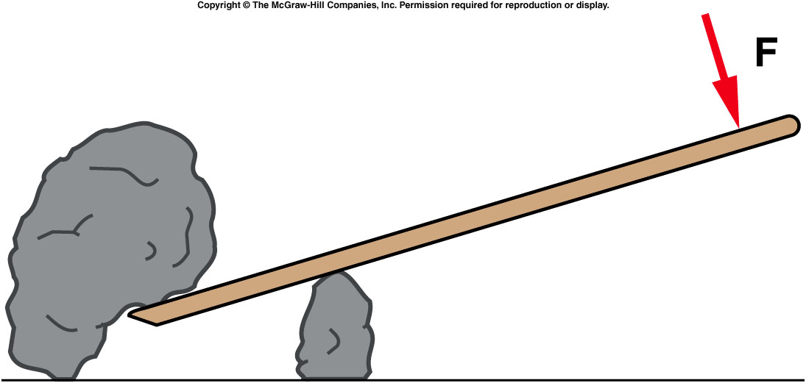
Quiz: A lever is used to lift a rock. Will the work done by the person on the lever be greater than, less than, or equal to the work done by the lever on the rock? (assume no dissipative force, e.g. friction, in action).
Greater than
Less than
Equal to
Unable to tell
from this graph
The work done by the person can never be less than the work done by the lever on the rock. If there are no dissipative forces they will be equal. This is a consequence of the conservation of energy.

