Slide 1
Newton’s Law of Universal Gravitation
Newton was able to explain Kepler’s 1st and 3rd laws by assuming the gravitational force between planets and the sun falls off as the inverse square of the distance.
Newton’s law of universal gravitation says the gravitational force between two objects is proportional to the mass of each object, and inversely proportional to the square of the distance between the two objects.
G is the Universal gravitational constant G, which was measured by Cavendish after more than 100 years
G = 6.67 x 10⁻¹¹ N.m²/kg^{2.}

Slide 2
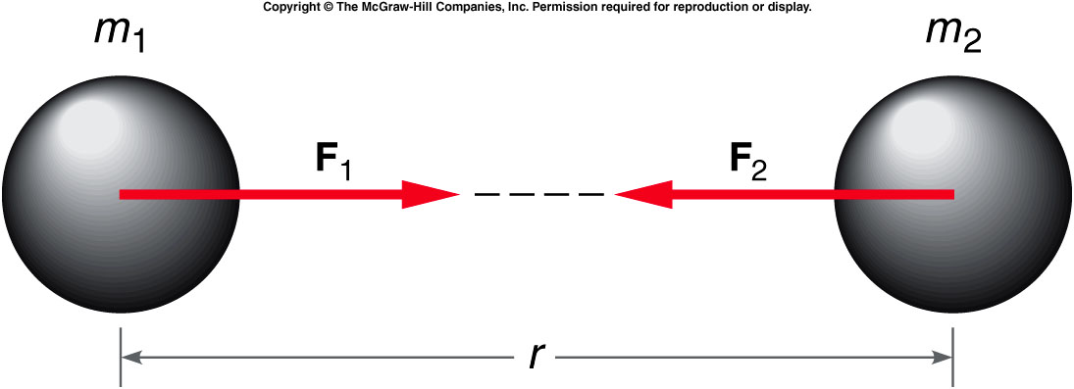
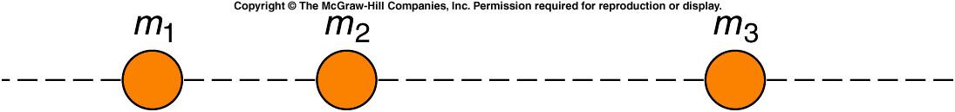
The gravitational force is attractive and acts along the line joining the center of the two masses.
It obeys Newton’s third law of motion.

Slide 3
Ch 5 E 14
The acceleration of gravity at the surface of the moon is about 1/6 that at the surface of the Earth (9.8 m/s²). What is the weight of an astronaut standing on the moon whose weight on earth is 180 lb?
A). 30 lb
B). 180 lb.
C). 15 lb.
D). 200 lb
E). 215 lb.

Slide 4
Ch 5 E 14
The acceleration of gravity at the surface of the moon is about 1/6 that at the surface of the Earth (9.8 m/s²). What is the weight of an astronaut standing on the moon whose weight on earth is 180 lb?
W_{earth} = m g_{earth} = 180 lb
W_{moon} = m g_{moon}
g_{moon} = 1/6 g_{earth}
W_{moon} = m 1/6 g_{earth} = 1/6 m g_{earth} = 1/6 (180 lb)
g_{moon}

Slide 5
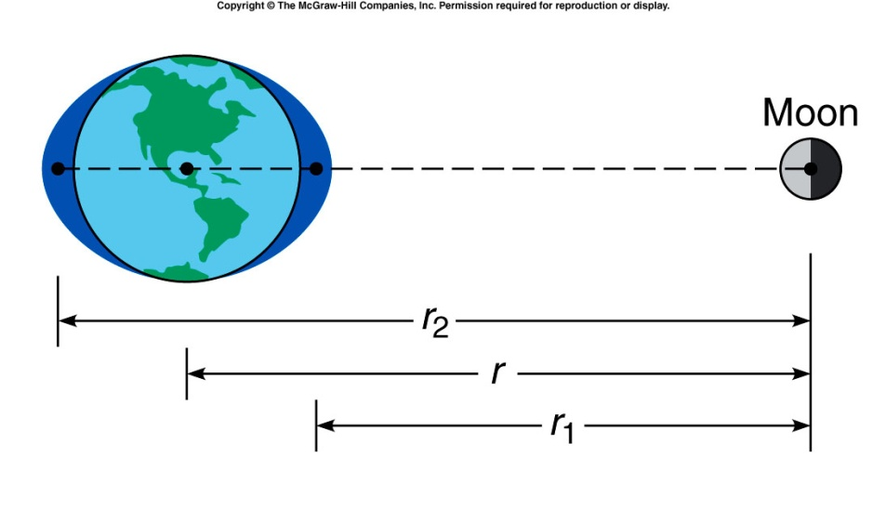
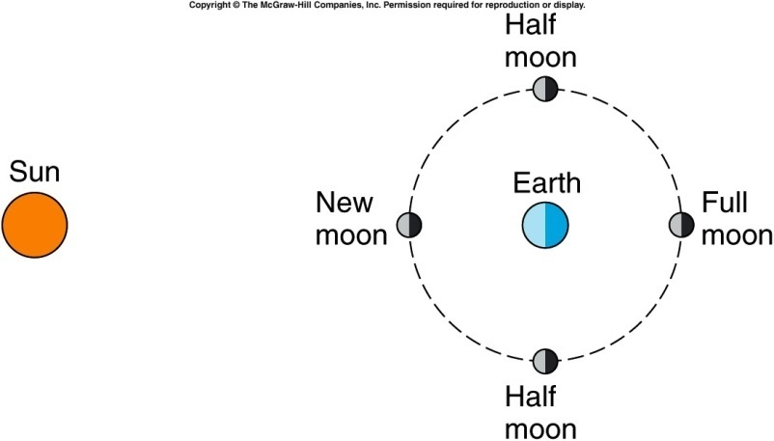
Moon and tides
anim0012.mov
Tides are dominantly due to the gravitational force exerted by the moon. Since the earth and moon are rotating this effect also plays a role. The moon is locked to the earth so that we always see the same face. Because of the friction generated by tides the moon is losing energy and moving away from the earth.
http://www.sfgate.com/getoutside/1996/jun/tides.html

Slide 6
Quiz: Three equal masses are located as shown. What is the direction of the total force acting on m₂?
To the left.
To the right.
The forces cancel such that the total force is zero.
It is impossible to determine from the figure.
There will be a net force acting on m₂ toward m₁. The third mass exerts a force of attraction to the right, but since it is farther away that force is less than the force exerted by m₁ to the left.

Slide 7
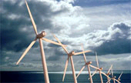
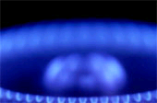
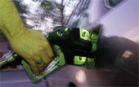

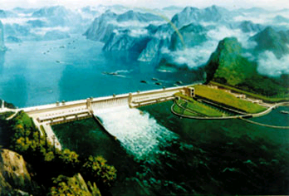
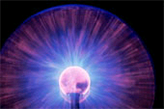
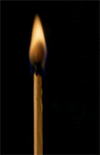
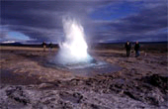


(Some) Sources of Energy

Slide 8
Energy Conservation
If we take a closed system, that is one that nothing can enter or leave, then there is a physical law that energy is conserved.
We will define various forms of energy and if we examine the system as a function of time, energy may change into different forms but the total is constant. Energy does not have direction just a magnitude and units.
Conservation of Energy follows directly from the statement that physical laws do not change as a function of time.
8

Slide 9
Forms of mechanical energy
Kinetic Energy: energy associated with the motion.
Potential Energy: energy stored in a compressed spring or stretched elastic or in an object that is held at rest above the earths surface.
To change the energy, one need to do some “WORK”.
  The amount of work is equal to the change of total energy.

Slide 10
Definition of Work
We all need to do some work in order to accomplish something each day.
More work is needed to carry 10 pizzas from Pizza Hut to your home than that for 1 pizza. (i.e. larger force is needed with equal distance).
More work is needed to drive yourself from Purdue to LA than that from Purdue to IND. (i.e. same force but longer distance).
Work = Force X distance
Unit: 1 joule = 1N X 1m
If Force points to the opposite direction of motion, work < 0, i.e. negative work.
Otherwise, work > 0, i.e. positive work.

Slide 11
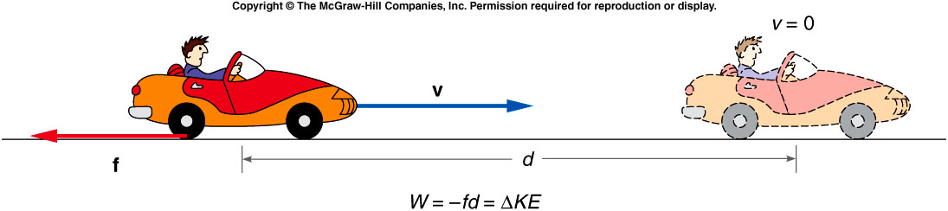
Negative and Positive Work
  A car skidding to a stop. What force is acting to slow the car?
  The force did a negative work
  A car is accelerating. What force is acting to speed up the car?
  The force did a positive work

Slide 12
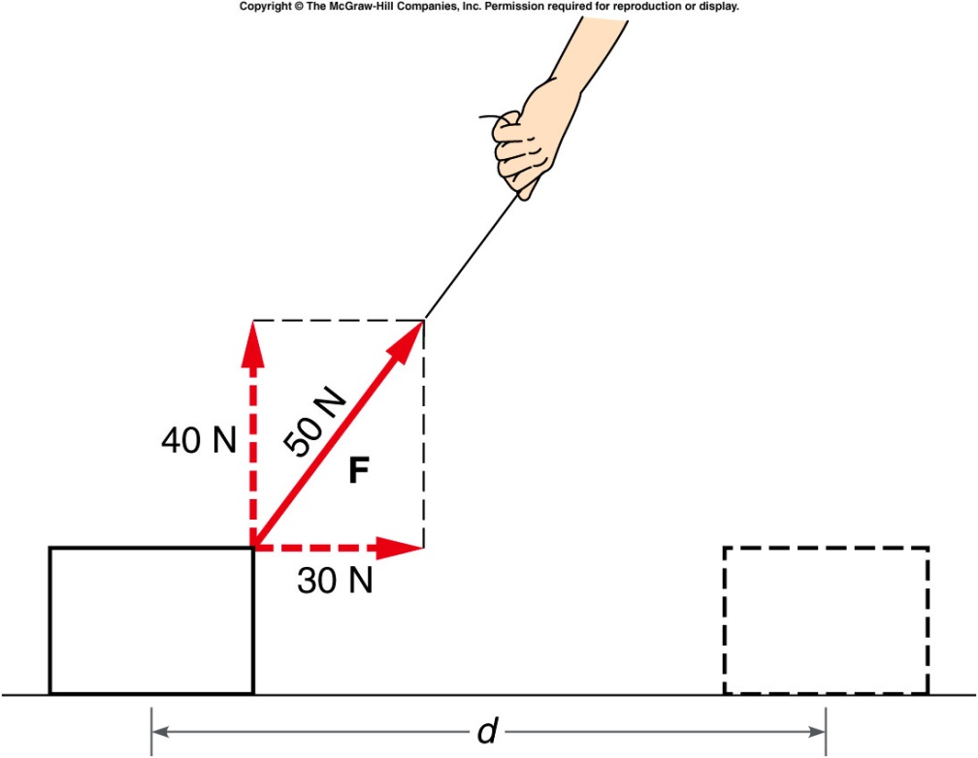
Only forces components parallel to the motion do work.
The amount of work done is:
30N X d instead of 50N X d
The vertical component, i.e. 40N, doesn’t do work because it’s perpendicular to the motion direction .

Slide 13
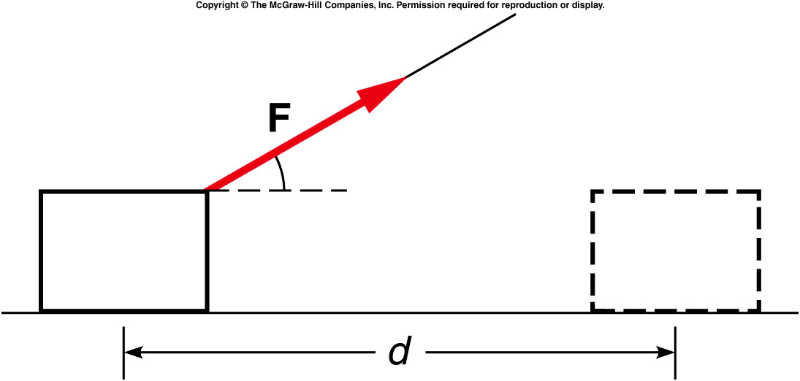
A string is used to pull a wooden block across the floor without accelerating the block. The string makes an angle to the horizontal. If there is a frictional force opposing the motion of the block, does this frictional force do work on the block?
Yes, the frictional force does work.
No, the frictional force does no work.
Only part of the frictional force does work.
You can’t tell from this diagram.
Since the frictional force is antiparallel to the distance moved, it does negative work on the block.

Slide 14
Does the normal force of the floor pushing upward on the block do any work?
Yes, the normal force does work.
No, the normal force does no work.
Only part of the normal force does work.
You can’t tell from this diagram.
Since the normal force is perpendicular to the distance moved, it does no work on the block.

Slide 15
Ch 6 E 2
Woman does 160 J of work to move table 4m horizontally. What is the magnitude of horizontal force applied?
A). 160 N
B). 160 J
C). 40 N
D). 40 J.
E). 80 N
F
d
Force & displacement in SAME direction
W = Fd, 160J = F(4m) F = 40N

Slide 16
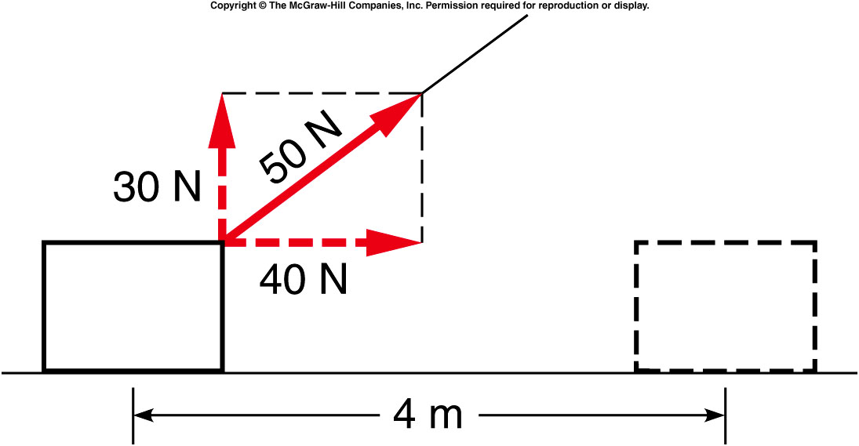
Quiz: A force of 50 N is used to drag a crate 4 m across a floor. The force is directed at an angle upward from the crate as shown. What is the work done by the force?
120 J
160 J
200 J
280 J
0 J
The horizontal component of force is 40 N and is in the direction of motion:
W = F · d
= (40 N) · (4 m)
= 160 J.

Slide 17
Kinetic Energy
Energy associated with the object’s motion.
v = v₀ + at d = v₀t +1/2at²
F = ma, assume v₀ = 0.
W = Fd = ma(1/2at²) = ma(1/2av²/a²) = ½ X mv² = Kinetic Energy
In this case, the increase of kinetic energy (from zero) is equal to the amount of work done.

Slide 18
Net force and Work
If there is more than one
force acting we have to
find the work done by each
force and the work done by
the net force
Net force F – F_{f} work = (F – F_{f})d = 1/2mv²
The work the force F does is Fd and if we write the equation as
Fd = F_{f}d + 1/2mv²
we can see that some work goes into heat and some into kinetic energy and we can account for all the work and energy
F
F_{f}
d

Slide 19
Ch 6 CP 2
100 kg crate accelerated by net force = 50 N applied for 4 s.
Use Newton’s 2nd Law to find acceleration?
A). 0.5 m/s²
B). 0.005 m/s²
C). 50 m/s²
D). 12.5 m/s²
E). 25 m/s²
M
F_{net}
F = ma a = F/m = 50N/100kg = 0.5 m/s²
19

Slide 20
Ch 6 CP 2
100 kg crate accelerated by net force = 50 N applied for 4 s.
If it starts from rest, how far does it travel in 4 s?
A). 0.5 m
B). 0.005 m
C). 50 m
D). 12.5 m
E). 4 m
M
F_{net}
b) d = v₀t + ½at² = ½(0.5)(4)² =4m
20

Slide 21
Ch 6 CP 2
100 kg crate accelerated by net force = 50 N applied for 4 s.
How much work is done?
A). 500 J
B). 0.005 J
C). 50 J
D). 200 J
E). 4 J
M
F_{net}
c) W = Fd = (50N)(4m) = 200J

Slide 22
Ch 6 CP 2
100 kg crate accelerated by net force = 50 N applied for 4 s.
What’s the final velocity?
A). 0.5 m/s
B). 2 m/s
C). 50 m/s
D). 12.5 m/s
E). 4 m/s
M
F_{net}
d) v = v₀ + at = 0 + (0.5 m/s²)(4s) = 2m/s
2/10/2020
22

Slide 23
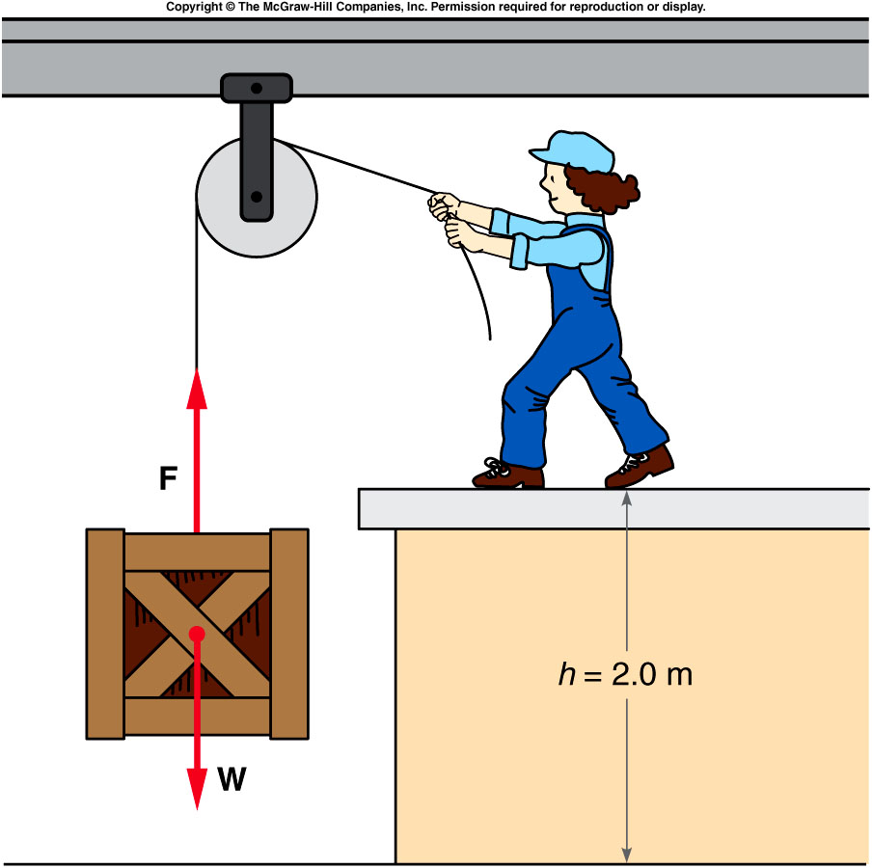
Potential Energy
If work is done but no kinetic energy is gained, we say that the potential energy has increased.
  For example, if a force is applied to lift a crate, the gravitational potential energy of the crate has increased.
  The work done is equal to the force (mg) times the distance lifted (height).
  The gravitational potential energy equals mg X h.
potential energy implies storing energy to use later for other purposes.
  For example, the gravitational potential energy of the crate can be converted to kinetic energy and used for other purposes
    After releasing the string, it reach the ground with higher speed, i.e. large kinetic energy, if it’s positioned higher, i.e. higher potential energy at the beginning.

Slide 24
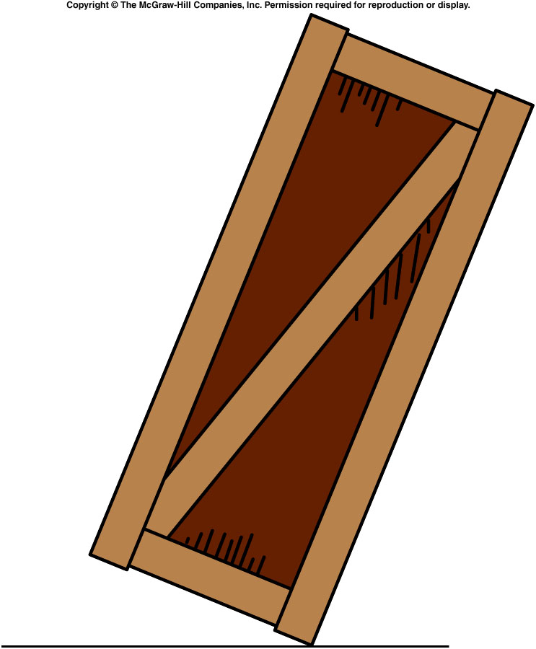
Work is done on a large crate to tilt the crate so that it is balanced on one edge, rather than sitting squarely on the floor as it was at first. Has the potential energy of the crate increased?
Yes
No
Yes. The weight of the crate has been lifted slightly. If it is released it will fall back and convert the potential energy into kinetic energy.

Slide 25
Ch 6 E 8
5.0 kg box lifted (without acceleration) thru height of 2.0 m
What is increase in potential energy and how much work I
Is needed ?
A). 5000 J, 5000 J
B). 490 J, 490 J
C). 98 J, 98 J
D). 196 J, 196 J
E). 49 J, 49 J
PE = mgh
= (5.0 kg)(9.8 m/s²)(2.0m) = 98J
F = ma = 0 = F_{lift} – mg
F_{lift} = mg = (5.0kg)(9.8m/s²) = 49N
W = Fd = (49N)(2.0m) = 98J

Slide 26
Quiz:
100 kg crate accelerated by net force = 50 N applied for 4 s.
What’s the total final kinetic energy?
A). 500 J
B). 0.005 J
C). 50 J
D). 200 J
E). 4 J
M
F_{net}
KE = ½mv² = ½(100kg)(2m/s)² = 200 J
work done equals the kinetic energy.

