Slide 1
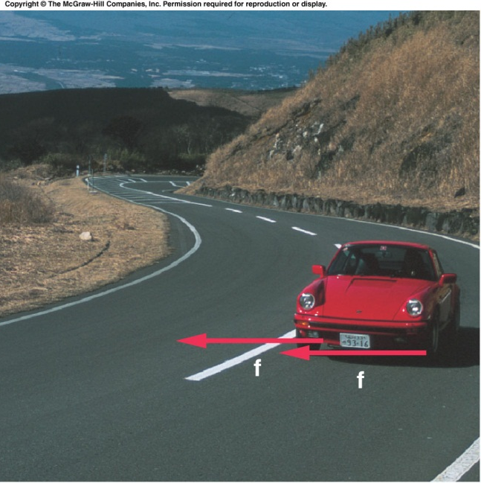
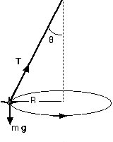
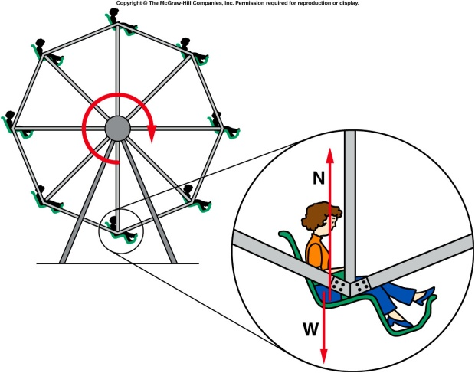
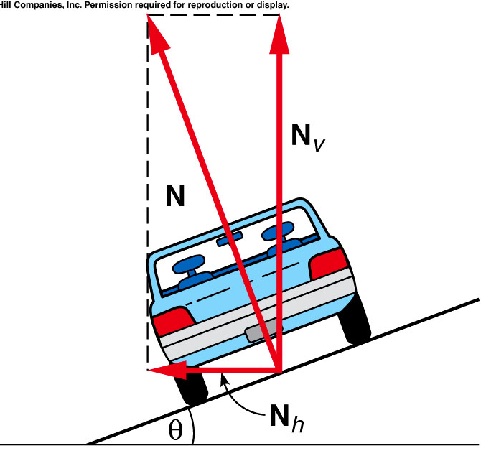

Centripetal Forces
N
v
W = mg

Slide 2
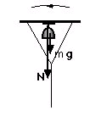
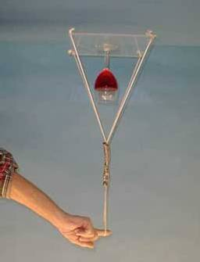
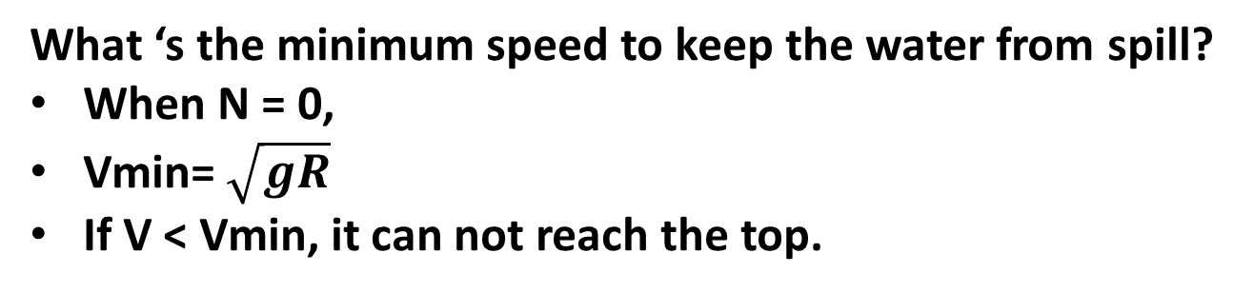
1D-05 Twirling Wine Glass
m
v
Is it possible .to keep the water in the cut upside down?
g
Same as
string
N + mg = mv²/R N > 0
What ‘s the minimum speed to keep the water from spill?
When N = 0,
Vmin= $\sqrt{gR}$
If V < Vmin, it can not reach the top.
Notes:
Place the wine glass carefully on the plastic plate and place your hand through the loop of the rope. Give the plate a couple of gentle swings back and forth and then swing it vigorously in a circle.

Slide 3
Ch 5 CP 2
A Ferris wheel with radius 12 m makes one complete rotation every 8 seconds.
What speed do riders move at?
A). 56.52 m/s
B). 9.42 m/s
C). 18.84 m/s
D). 4.71 m/s
F_{cent}
r = 12m
S = d/t = 2πr/t = 2π(12m)/8s = 9.42 m/s

Slide 4
Ch 5 CP 2
A Ferris wheel with radius 12 m makes one complete rotation every 8 seconds.
What is the magnitude of their centripetal acceleration?
A). 7.40 m/s²
B). 9.40 m/s²
C). 3.70 m/s²
D). 14.80 m/s²
F_{cent}
r = 12m
a_{cent} = v²/r = s²/r = (9.42m/s)²/12m = 7.40 m/s²

Slide 5
Ch 5 CP 2
A Ferris wheel with radius 12 m makes one complete rotation every 8 seconds.
For a 40 kg rider, what is magnitude of centripetal force to keep him moving in a circle? Is his true weight large enough to provide this centripetal force at the top of the cycle?
A). 396 N, weight is large enough.
B). 1028 N, weight is large enough
C). 200 N, weight is large enough
D). 296 N, weight is large enough
E). 296 N, weight is NOT large enough
F_{cent}
r = 12m
F_{cent} = m v²/r = m a_{cent} = (40 kg)(7.40 m/s²) = 296 N
W = mg = (40 kg)(9.8 m/s²) = 392 N
Yes, his weight is larger than the centripetal force required.

Slide 6
Ch 5 CP 2
A Ferris wheel with radius 12 m makes one complete rotation every 8 seconds.
What is the magnitude of the normal force exerted by the seat on the rider at the top?
A). 100 N
B). 96 N
C). 90 N
D). 50 N
E). 48 N
F_{cent}
r = 12m
W – N_{f} = 296 N = 96 newtons

Slide 7
Ch 5 CP 2
A Ferris wheel with radius 12 m makes one complete rotation every 8 seconds.
What would happen if the Ferris wheel is going so fast the weight of the rider is not sufficient to provide the centripetal force at the top? Note: there’s no safe belt.
rider is ejected
Rider remain on seat
F_{cent}
r = 12m
Notes:
Same reason that the truck can not be on track when friction is not large enough.

Slide 8
Ch 5 CP 4
A passenger in a rollover accident turns through a radius of 3.0m in the seat of the vehicle making a complete turn in 1 sec.
what is rotational speed of passenger?
A). 38 m/s
B). 22 m/s
C). 19 m/s
D). 11 m/s
E). 125.3 m/s
s = d/t = 2π(3.0m)/1 = 19m/s
3 m

Slide 9
Quiz
A passenger in a rollover accident turns through a radius of 3.0m in the seat of the vehicle making a complete turn in 1 sec.
What is centripetal acceleration? Compare it to gravity (g = 9.8 m/s²)
A). 118 m/s²
B). 128 m/s²
C). 138 m/s²
D). 108 m/s²
E). 98 m/s²
a = v²/r = s²/r = (19 m/s)²/3m = 118 m/s² ~ 13 g
3 m

Slide 10
Ch 5 CP 4
A passenger in a rollover accident turns through a radius of 3.0m in the seat of the vehicle making a complete turn in 1 sec.
Passenger has mass = 60 kg, what is centripetal force required to produce the acceleration? Compare it to passengers weight.
A). 10000 N
B). 1352 N
C). 7080 N
D). 1159.3 N
E). 205 N
F = ma = (60 kg)(118 m/s²) = 7080 N
F = ma = m (13 X 9.8m/s²) = 13 mg = 13 weight
3 m

Slide 11

How Tough is 13 g?
What’s shown in the video is < 10g.

Slide 12
Planetary Motion
The ancient Greeks believed the sun, moon, stars and planets all revolved around the Earth.
  This is called a geocentric view (Earth-centered) of the universe.
  This view matched their observations of the sky, with the exception of the puzzling motion of the wandering planets.

Slide 13
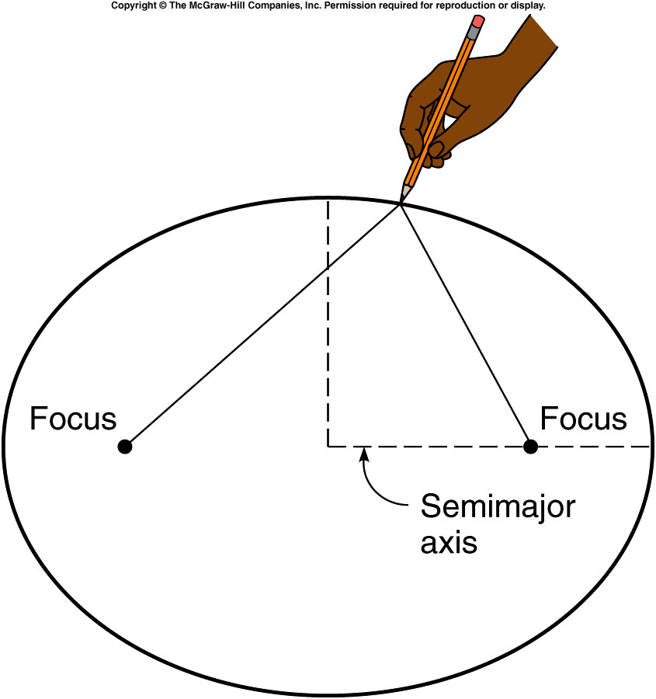
Kepler’s First Law of Planetary Motion
Tycho’s assistant, Kepler, analyzed all that careful data.
Kepler was able to show that the orbits of the planets around the sun are ellipses, with the sun at one focus.
This is Kepler’s first law of planetary motion.

Slide 14
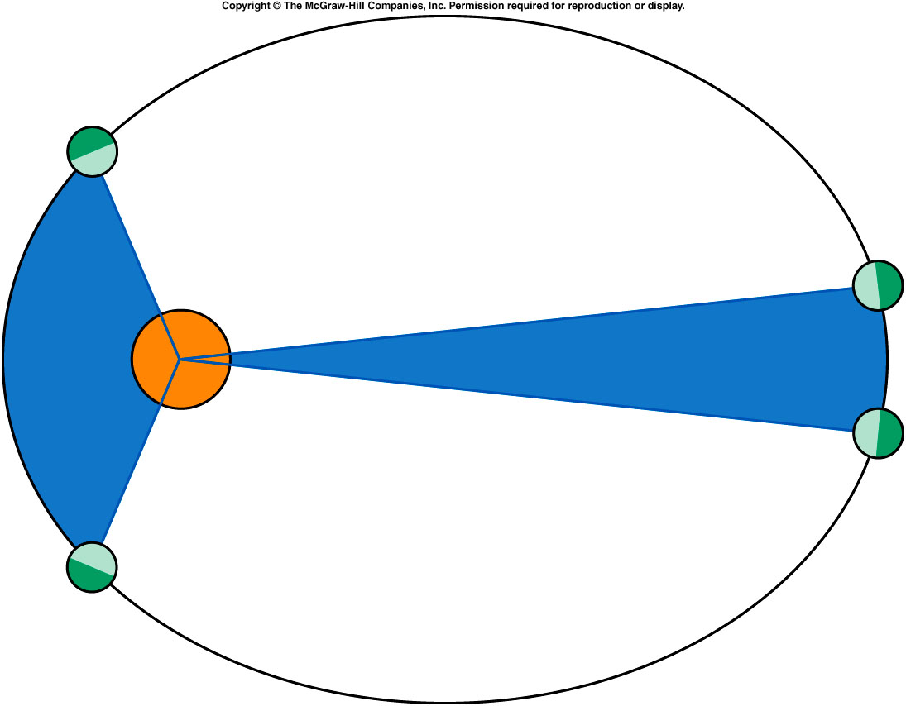
Kepler’s Second Law of Planetary Motion
planets move faster when nearer to the sun, the radius line for each planet sweeps out equal areas in equal times.
The two blue sections each cover the same span of time and have equal area.

Slide 15
Kepler’s Third Law of Planetary Motion
The period (T) of an orbit is the time it takes for one complete cycle around the sun.
The cube of the average radius (r) about the sun is proportional to the square of the period of the orbit.

Slide 16
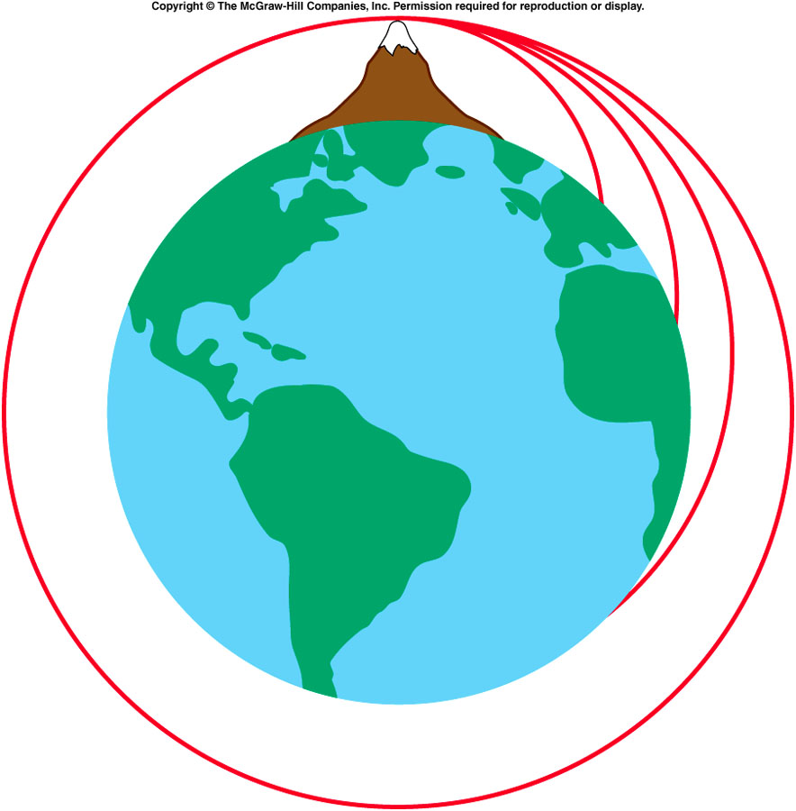
Newton’s Law of Universal Gravitation
http://www.physics.purdue.edu/class/applets/NewtonsCannon/newtmtn.html
Newton recognized the similarity between the motion of a projectile on Earth and the orbit of the moon.
If a projectile is fired with enough velocity, it could fall towards Earth but never reach the surface.

Slide 17
Newton’s Law of Universal Gravitation
Newton was able to explain Kepler’s 1st and 3rd laws by assuming the gravitational force between planets and the sun falls off as the inverse square of the distance.
Newton’s law of universal gravitation says the gravitational force between two objects is proportional to the mass of each object, and inversely proportional to the square of the distance between the two objects.
G is the Universal gravitational constant G, which was measured by Cavendish after more than 100 years
G = 6.67 x 10⁻¹¹ N.m²/kg^{2.}

Slide 18
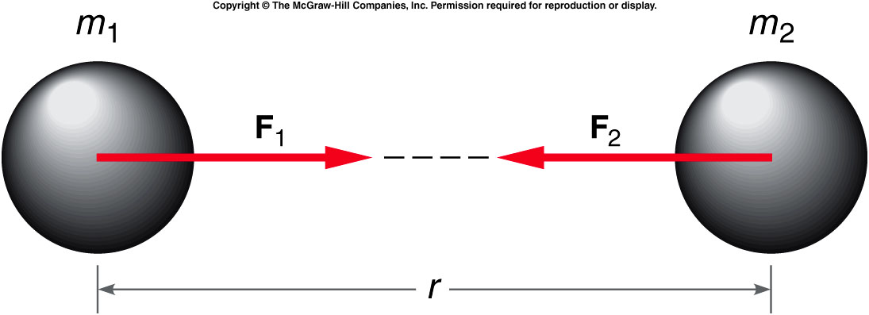
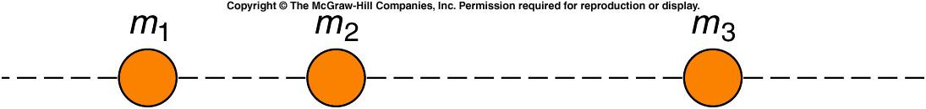
The gravitational force is attractive and acts along the line joining the center of the two masses.
It obeys Newton’s third law of motion.

Slide 19
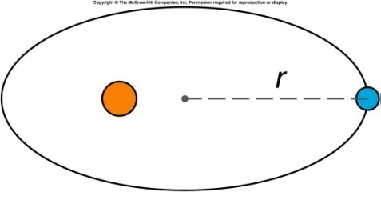
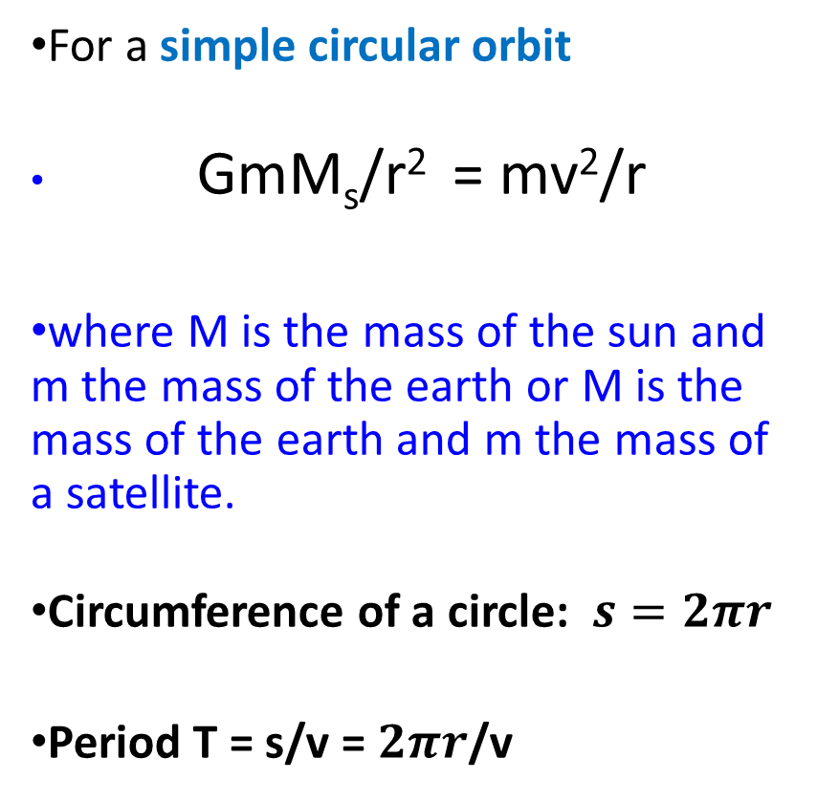
Using Newton’s Gravitational Law to derive Kepler’s 3rd Law
For a simple circular orbit
GmM_{s}/r² = mv²/r
where M is the mass of the sun and m the mass of the earth or M is the mass of the earth and m the mass of a satellite.
Circumference of a circle: $s=2πr$
Period T = s/v = $2πr$/v
T²/r³ = 4π²/GM_{s}

Slide 20
Ch 5 E 14
The acceleration of gravity at the surface of the moon is about 1/6 that at the surface of the Earth (9.8 m/s²). What is the weight of an astronaut standing on the moon whose weight on earth is 180 lb?
A). 30 lb
B). 180 lb.
C). 15 lb.
D). 200 lb
E). 215 lb.

Slide 21
Ch 5 E 14
The acceleration of gravity at the surface of the moon is about 1/6 that at the surface of the Earth (9.8 m/s²). What is the weight of an astronaut standing on the moon whose weight on earth is 180 lb?
W_{earth} = m g_{earth} = 180 lb
W_{moon} = m g_{moon}
g_{moon} = 1/6 g_{earth}
W_{moon} = m 1/6 g_{earth} = 1/6 m g_{earth} = 1/6 (180 lb)
g_{moon}

Slide 22
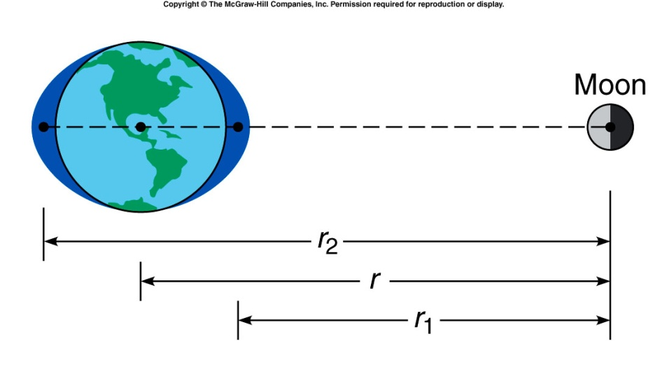
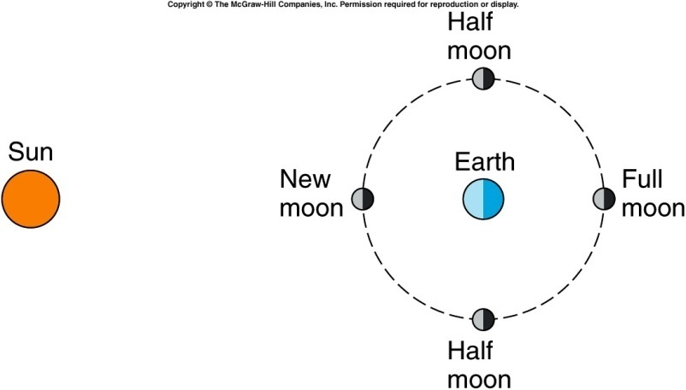
Moon and tides
anim0012.mov
Tides are dominantly due to the gravitational force exerted by the moon. Since the earth and moon are rotating this effect also plays a role. The moon is locked to the earth so that we always see the same face. Because of the friction generated by tides the moon is losing energy and moving away from the earth.
http://www.sfgate.com/getoutside/1996/jun/tides.html

Slide 23
Quiz: Three equal masses are located as shown. What is the direction of the total force acting on m₂?
To the left.
To the right.
The forces cancel such that the total force is zero.
It is impossible to determine from the figure.
There will be a net force acting on m₂ toward m₁. The third mass exerts a force of attraction to the right, but since it is farther away that force is less than the force exerted by m₁ to the left.

