Slide 1
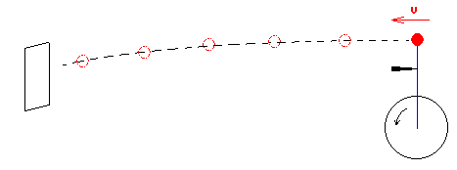
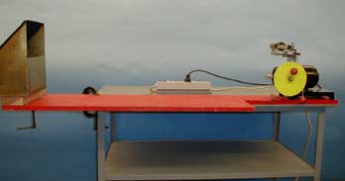
1D-04 Radial Acceleration & Tangential Velocity
Once the string is cut, where is the ball going?
A). Continue with circular path
B). Leave in a straight line
C). Can not determine
D). Leave like a horizontally launched projectile
AT ANY INSTANT, THE VELOCITY VECTOR OF THE BALL IS DIRECTED ALONG THE TANGENT.
AT THE INSTANT WHEN THE BLADE CUTS THE STRING, THE BALL’S VELOCITY IS HORIZONTAL SO IT ACTS LIKE A HORIZONTALLY LAUNCHED PROJECTILE AND LANDS IN THE CATCH BOX.
Notes:
Balls with strings attached are in turn affixed to a disk that is spun rapidly by a motor. The strings stretch out radially, indicating a radial force. At any instant, the velocity vector of the ball is directed along the tangent. This is confirmed by having a razor blade cut the string as it comes to the vertical position. At this instant the ball�s velocity is horizontal so it acts like a horizontally launched projectile and lands in the catch box.

Slide 2


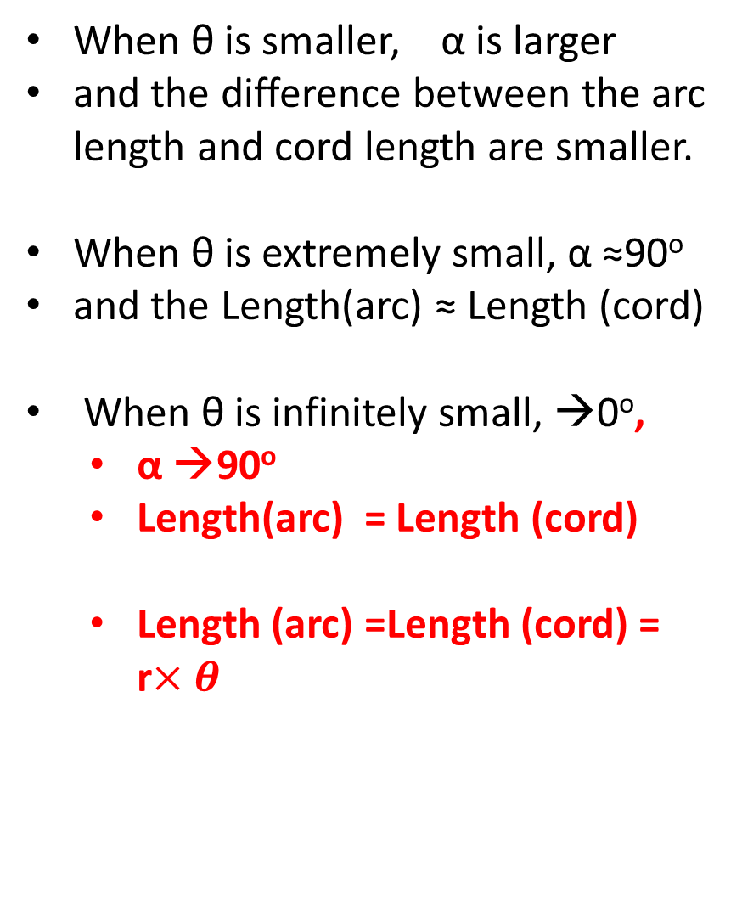


Discussion on Triangle, Arc and Cord
r
When θ is smaller, α is larger
and the difference between the arc length and cord length are smaller.
When θ is extremely small, α ≈90º
and the Length(arc) ≈ Length (cord)
When θ is infinitely small, →0º,
  α →90º
  Length(arc) = Length (cord)
  Length (arc) =Length (cord) = r$×θ$
α
$$θ$$
α
r
α
α
$$θ$$
r
α
$$θ$$
α
r
α
$$θ$$

Slide 3
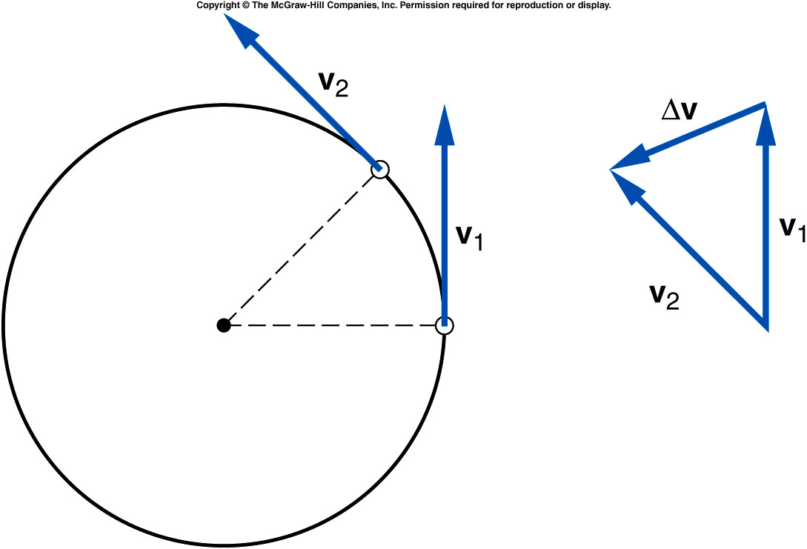

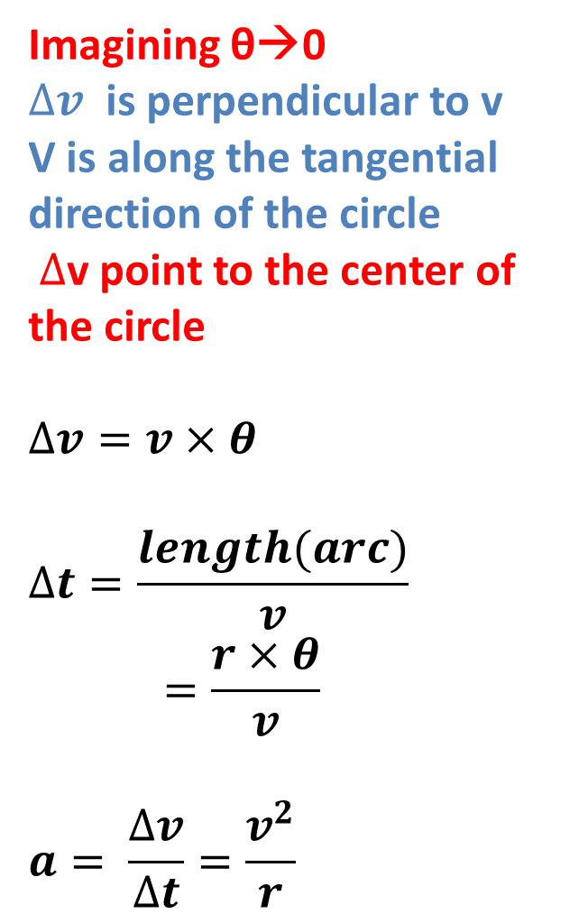

Centripetal Acceleration
Imagining θ→0
$∆v$ is perpendicular to v
V is along the tangential direction of the circle
$∆$v point to the center of the circle
$$∆v=v×θ$$
$$∆t=\frac{length(arc)}{v}=\frac{r×θ}{v}$$
$$a= \frac{∆v}{∆t}=\frac{v^{2}}{r}$$
α
α
$$θ$$
α
$$θ$$
α
r

Slide 4
Centripetal Acceleration
Centripetal acceleration is the rate of change in velocity of an object that is associated with the change in direction of the velocity.
  Centripetal
  acceleration is
  always
  perpendicular to
  the velocity.
  Centripetal
  acceleration always
  points toward the
  center of the curve.

Slide 5
Centripetal Force
The centripetal force refers to any force or combination of forces that produces a centripetal acceleration.

Slide 6
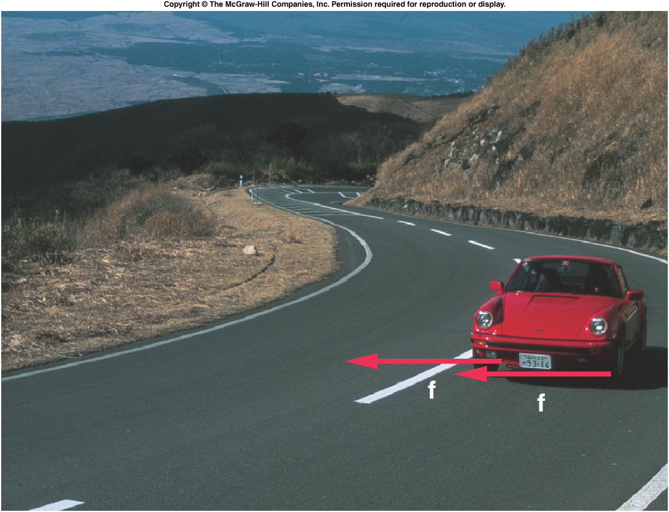
Centripetal Forces
The centripetal force may be due to one or more individual forces, such as a normal force and/or a force due to friction.
The Static force of friction is the frictional force acting when there is no motion along the surfaces.
  No skidding or sliding
The Kinetic force of friction is the frictional force acting when there is motion along the surfaces.

Slide 7
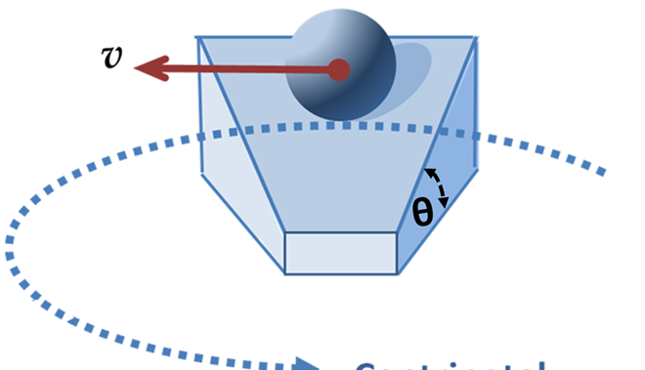
On a banked circular track, assuming no friction on the surface, will the ball be able to make a circular motion with constant speed?
A). Yes.
B). No. friction is absolutely needed.

Slide 8
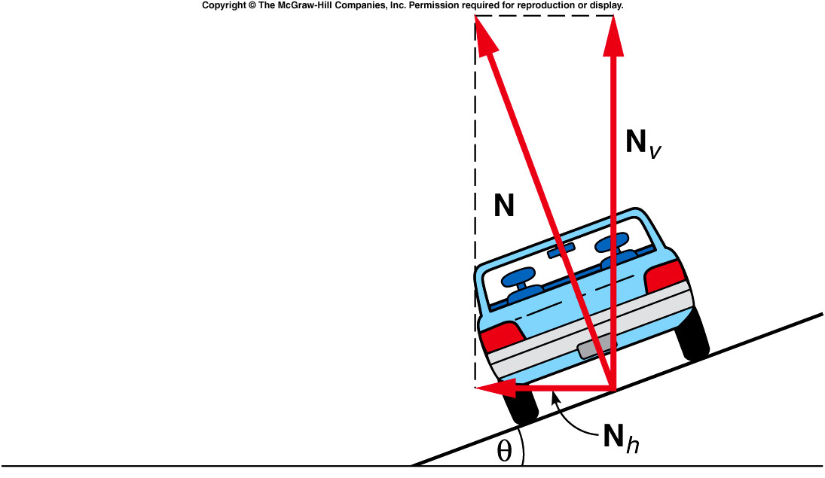
The normal force can be separated into a vertical component and a horizontal component
The horizontal component of the normal force is the centripetal force when there’s no friction in order to keep the object (car) on the circular track.
Notes:
Assuming the car has a jet engine since without friction the wheel can not move the car.

Slide 9
Quiz: A Car moves along a banked circular track (θ=30º) and experience a normal force of 1000 N. How large is the vertical component (N_{v}) and horizontal component (N_{h})?
A). N_{v} = 866 N, N_{h} = 500N.
B). N_{v} = 500 N, N_{h} = 866 N.
C). N_{v} = 500 N, N_{h} = 500 N
D). N_{v} = 866 N, N_{h} = 134 N.
30 º
Notes:
Assuming the car has a jet engine since without friction the wheel can not move the car.

Slide 10
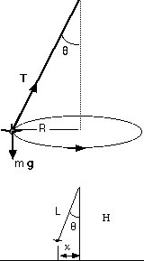
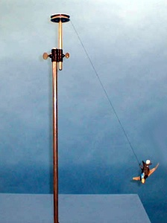
1D-02 Conical Pendulum
Could you find the NET force?
Vertical component of T balance
the mg.
T sin(θ) = mv²/R
T cos(θ) = mg
v = sqrt( gR tan(θ) )
Period of the pendulum
τ= 2πR/v,
where R = L / sin(θ)
τ= 2π sqrt( Lcos(θ)/g )
NET FORCE IS TOWARD THE CENTER OF THE CIRCULAR PATH \

Slide 11
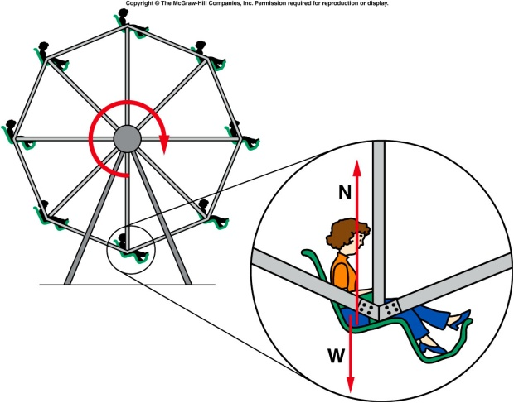

Vertical circles
N
v
g
W = mg
mg – N = mv²/r
+ is always
toward the center of the circle
Ferris wheel
If v = 0 then N = mg
As v increases N becomes smaller
When v²/r = g the car becomes weightless.
At the bottom
N - mg = mv²/r
At the top
Mg – N = mv²/r
http://www.youtube.com/watch?v=SN77b9DqEbc&feature=player_detailpage

Slide 12
Ch 5 CP 2
A Ferris wheel with radius 12 m makes one complete rotation every 8 seconds.
What speed do riders move at?
A). 56.52 m/s
B). 9.42 m/s
C). 18.84 m/s
D). 4.71 m/s
F_{cent}
r = 12m
S = d/t = 2πr/t = 2π(12m)/8s = 9.42 m/s

