Slide 1
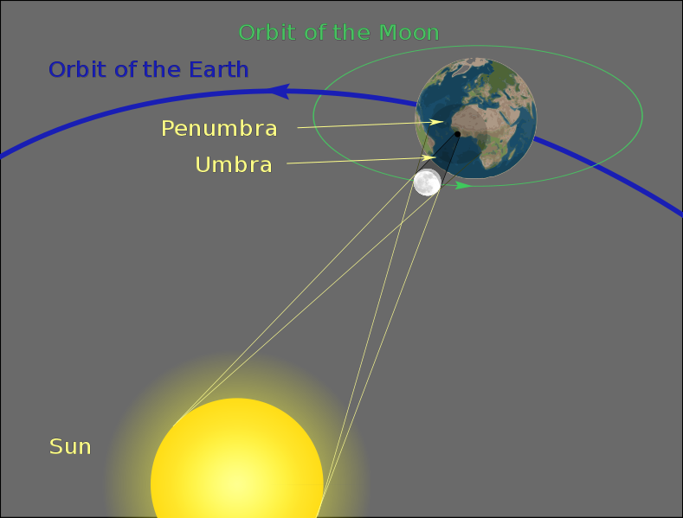
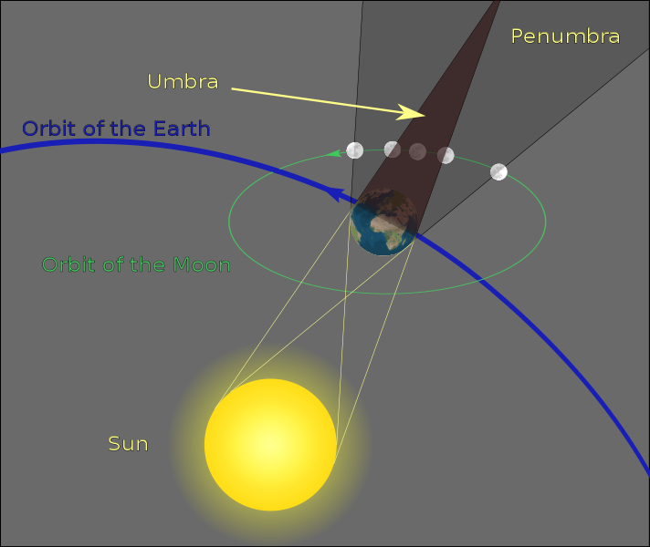
Solar and Lunar eclipse

Slide 2
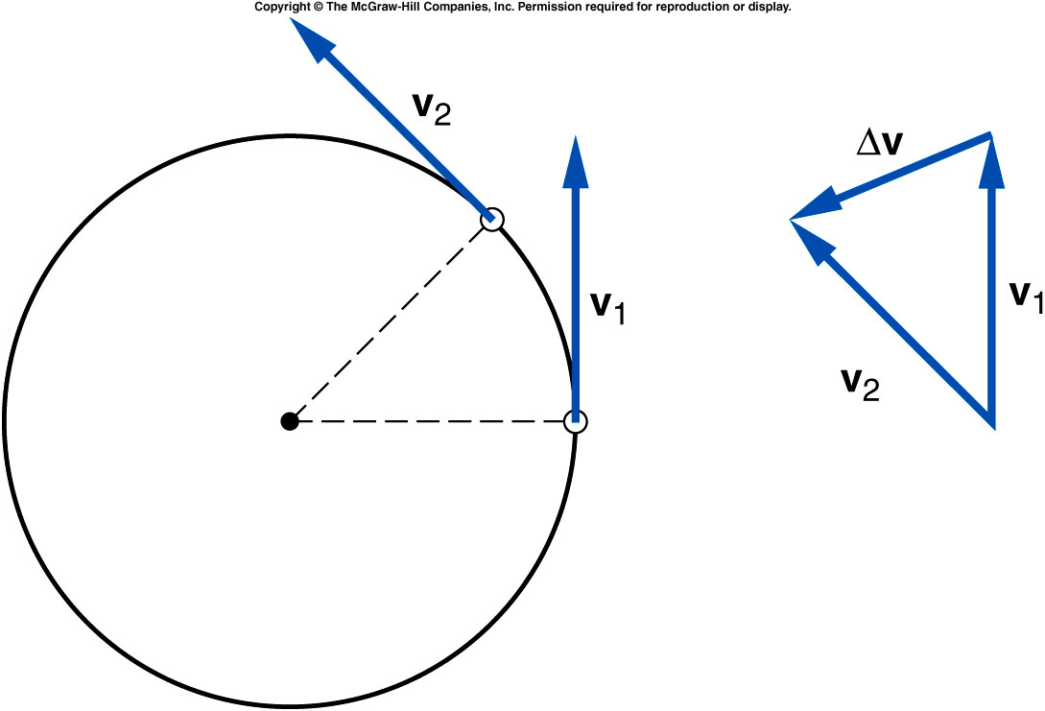
Centripetal Acceleration
Centripetal acceleration is the rate of change in velocity of an object that is associated with the change in direction of the velocity.
  Centripetal
  acceleration is
  always
  perpendicular to
  the velocity.
  Centripetal
  acceleration always
  points toward the
  center of the curve.

Slide 3
Centripetal Forces
The centripetal force may be due to one or more individual forces, such as a normal force and/or a force due to friction.
.

Slide 4
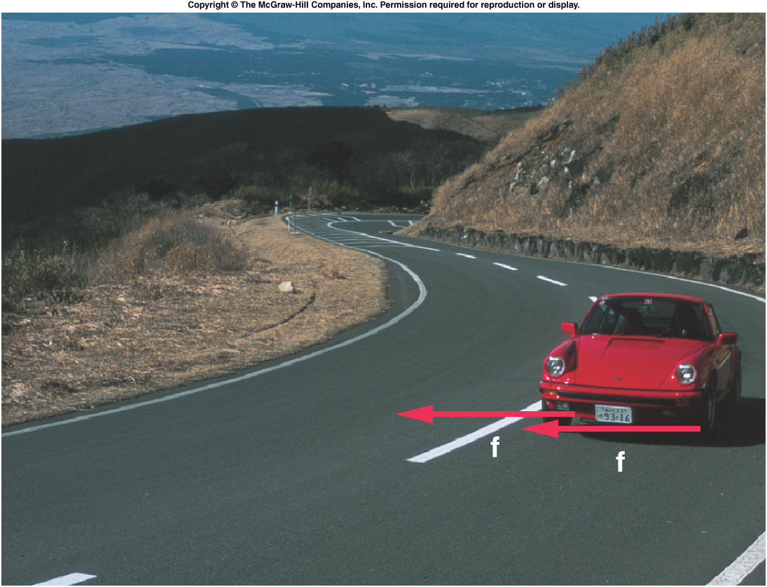
The friction between the tires and road produces the centripetal acceleration on a level curve.

Slide 5
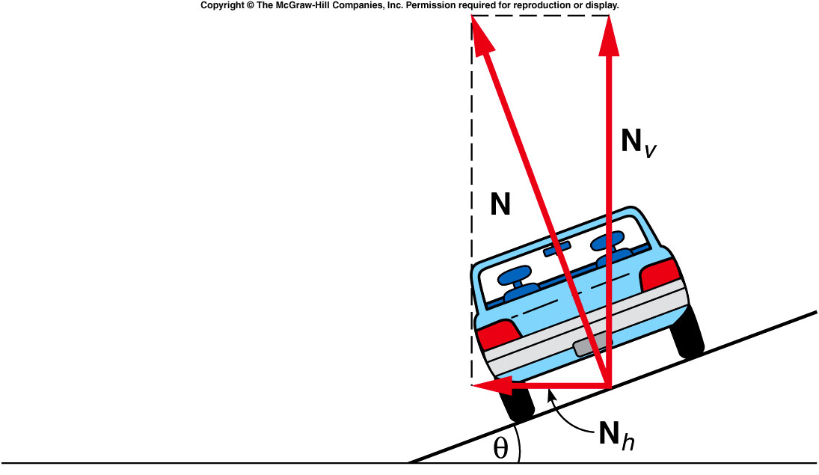
The normal force can be separated into a vertical component and a ho
The horizontal component of the normal force is the centripetal force when there’s no friction in order to keep the object (car) on the circular track.
Notes:
Assuming the car has a jet engine since without friction the wheel can not move the car.

Slide 6
Quiz: A Car moves along a banked circular track (θ=30º) and experience a normal force of 1000 kg. How large is the vertical component (Fv) and horizontal component (Fh)?
A). Fv = 866kg, Fh = 500kg.
B). Fv = 500 kg, Fh = 866 kg.
C). Fv = 500 kg, Fh = 500 kg
D). Fv = 866kg, Fh = 134 kg.
Fh = N cos(30º)
Fv = N sin(30º)
Notes:
Assuming the car has a jet engine since without friction the wheel can not move the car.

Slide 7
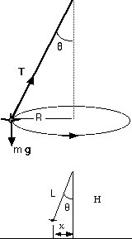
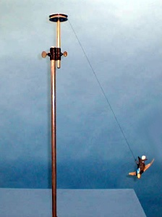
1D-02 Conical Pendulum
Could you find the NET force?
T sin(θ) = mv²/R
T cos(θ) = mg
v = sqrt( gR tan(θ) )
Period of the pendulum
τ= 2πR/v,
where R = L / sin(θ)
τ= 2π sqrt( Lcos(θ)/g )
NET FORCE IS TOWARD THE CENTER OF THE CIRCULAR PATH
Why R become smaller as time goes by?
T sin(θ) has to be smaller while T=mg/cos(θ) increase with larger θ

Slide 8
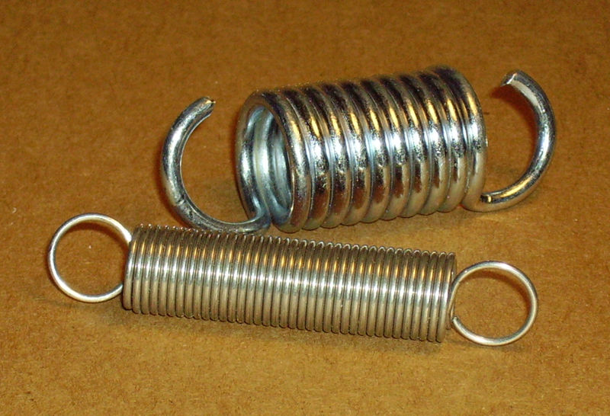

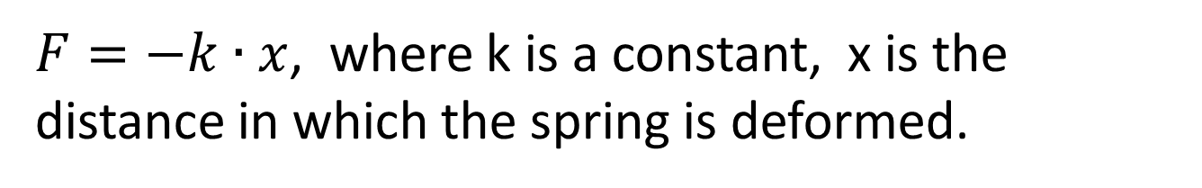
Springs Tension
$F=−k∙x$, where k is a constant, x is the distance in which the spring is deformed.

Slide 9
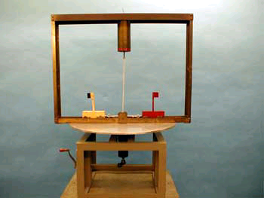
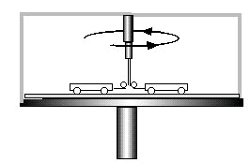
1D-09 Centripetal Force
Will the two carts move away from each others ?
A). yes.
B). No. they will move closer to each other
C). No. their distance will not change. .
Notes:
Mention the spring in the vertical direction.

Slide 10
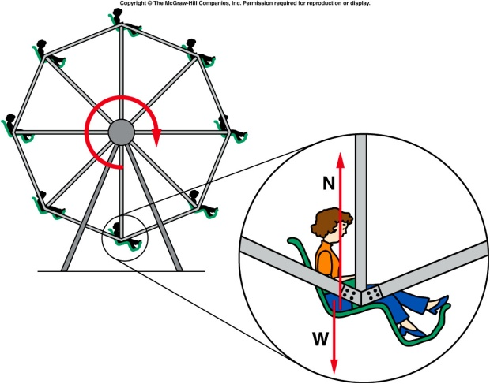

Vertical circles
N
v
g
W = mg
mg – N = mv²/r
+ is always
toward the center of the circle
Ferris wheel
If v = 0 then N = mg
As v increases N becomes smaller
When v²/r = g the car becomes weightless.
At the bottom
N - mg = mv²/r
At the top
Mg – N = mv²/r

Slide 11
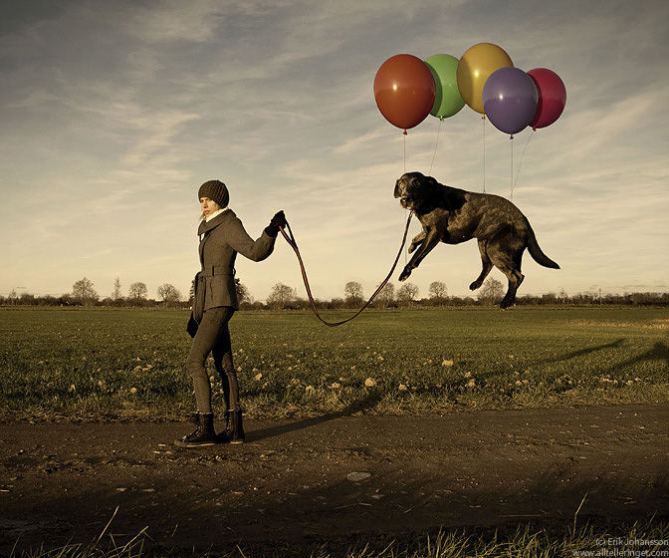
A floating dog
http://www.digitaljournal.com/image/71076
https://www.youtube.com/watch?v=6NvBGb5lf78

Slide 12
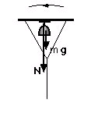
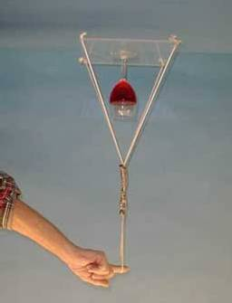
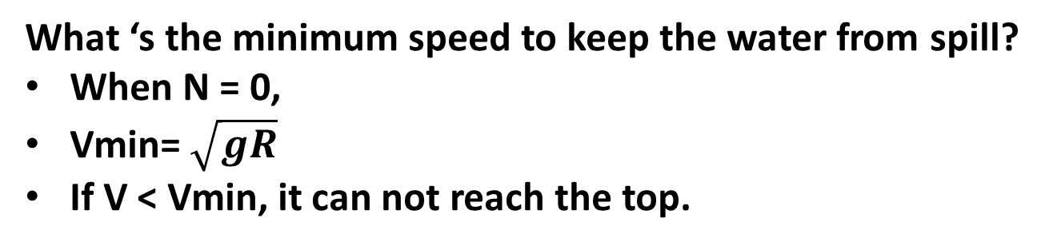
1D-05 Twirling Wine Glass
m
v
Is it possible .to keep the water in the cut upside down?
g
Same as
string
N + mg = mv²/R N > 0
What ‘s the minimum speed to keep the water from spill?
When N = 0,
Vmin= $\sqrt{gR}$
If V < Vmin, it can not reach the top.

Slide 13
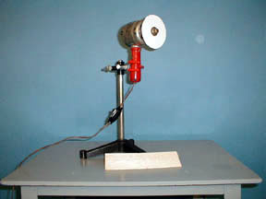
1D-07 Paper Saw
THE RADIAL FORCES HOLDING THE PAPER TOGETHER MAKE THE PAPER RIGID.
Is paper more rigid than wood ?
Notes:
Take a piece of paper and bend it. Then hold the paper and stretch it and show it’s harder to bend it.

Slide 14
Ch 5 CP 2
A Ferris wheel with radius 12 m makes one complete rotation every 8 seconds.
What speed do riders move at?
A). 56.52 m/s
B). 9.42 m/s
C). 18.84 m/s
D). 4.71 m/s
F_{cent}
r = 12m
S = d/t = 2πr/t = 2π(12m)/8s = 9.42 m/s

Slide 15
Ch 5 CP 2
A Ferris wheel with radius 12 m makes one complete rotation every 8 seconds.
What is the magnitude of their centripetal acceleration?
A). 7.40 m/s²
B). 9.40 m/s²
C). 3.70 m/s²
D). 14.80 m/s²
F_{cent}
r = 12m
a_{cent} = v²/r = s²/r = (9.42m/s)²/12m = 7.40 m/s²

Slide 16
Ch 5 CP 2
A Ferris wheel with radius 12 m makes one complete rotation every 8 seconds.
For a 40 kg rider, what is magnitude of centripetal force to keep him moving in a circle? Is his weight large enough to provide this centripetal force at the top of the cycle?
A). 396 N, weight is large enough.
B). 1028 N, weight is large enough
C). 200 N, weight is large enough
D). 296 N, weight is large enough
E). 296 N, weight is NOT large enough
F_{cent}
r = 12m
F_{cent} = m v²/r = m a_{cent} = (40 kg)(7.40 m/s²) = 296 N
W = mg = (40 kg)(9.8 m/s²) = 392 N
Yes, his weight is larger than the centripetal force required.

Slide 17
Ch 5 CP 2
A Ferris wheel with radius 12 m makes one complete rotation every 8 seconds.
What is the magnitude of the normal force exerted by the seat on the rider at the top?
A). 100 N
B). 96 N
C). 90 N
D). 50 N
E). 48 N
F_{cent}
r = 12m
W – N_{f} = 296 N = 96 newtons

Slide 18
Ch 5 CP 2
A Ferris wheel with radius 12 m makes one complete rotation every 8 seconds.
What would happen if the Ferris wheel is going so fast the weight of the rider is not sufficient to provide the centripetal force at the top? Note: there’s no safe belt.
rider is ejected
Rider remain on seat
F_{cent}
r = 12m
Notes:
Same reason that the truck can not be on track when friction is not large enough.

Slide 19
Ch 5 CP 4
A passenger in a rollover accident turns through a radius of 3.0m in the seat of the vehicle making a complete turn in 1 sec.
what is speed of passenger?
A). 38 m/s
B). 22 m/s
C). 19 m/s
D). 11 m/s
E). 125.3 m/s
s = d/t = 2π(3.0m)/1 = 19m/s
3 m

Slide 20
Quiz
A passenger in a rollover accident turns through a radius of 3.0m in the seat of the vehicle making a complete turn in 1 sec.
What is centripetal acceleration? Compare it to gravity (g = 9.8 m/s²)
A). 118 m/s²
B). 128 m/s²
C). 138 m/s²
D). 108 m/s²
E). 98 m/s²
a = v²/r = s²/r = (19 m/s)²/3m = 118 m/s² = 12xg
3 m

Slide 21
Ch 5 CP 4
A passenger in a rollover accident turns through a radius of 3.0m in the seat of the vehicle making a complete turn in 1 sec.
Passenger has mass = 60 kg, what is centripetal force required to produce the acceleration? Compare it to passengers weight.
A). 10000 N
B). 1352 N
C). 7080 N
D). 1159.3 N
E). 205 N
F = ma = (60 kg)(118 m/s²) = 7080 N
F = ma = m (12 X 9.8m/s²) = 12 mg = 12 weight
3 m

Slide 22

How Tough is 12 g?
What’s shown in the video is < 10g.

Slide 23
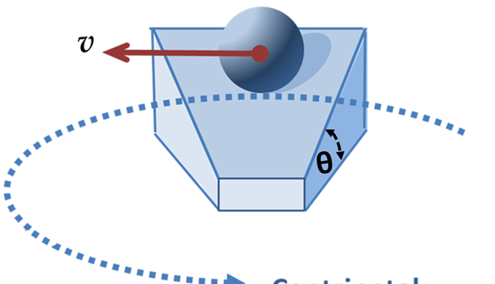
Quiz: On a banked circular track, assuming no friction on the surface, will the ball be able to make a circular motion with constant speed?
A). Yes.
B). No. friction is absolutely needed.

