Slide 1
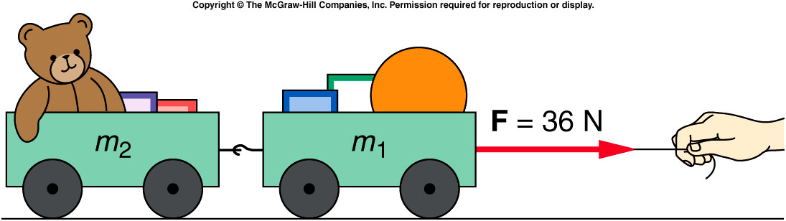
What happens when objects are connected?
Two connected carts with equal mass being accelerated by a force F applied by a string:
Both carts must have the same acceleration a which is equal to the net horizontal force divided by the total mass
Each cart will have a net force equal to its mass times the acceleration
What’s the force acting on the 2nd cart?
A). 32 N
B). 16 N
C). 0 N
32

Slide 2
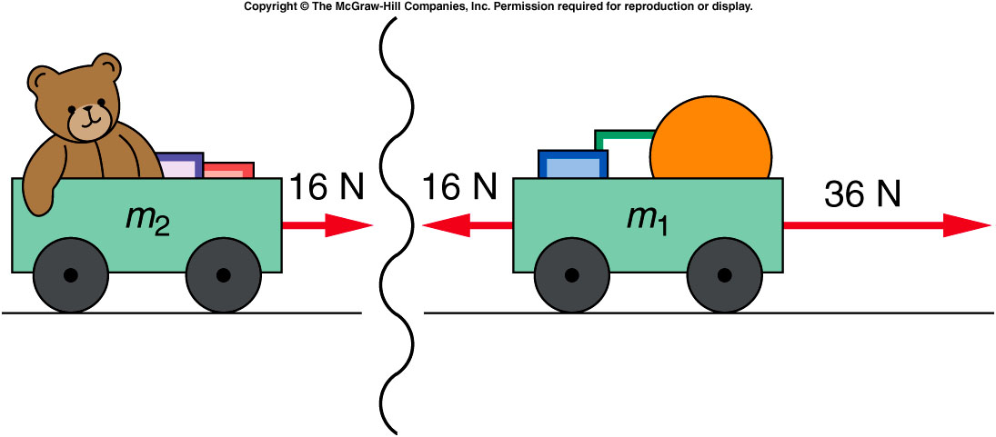
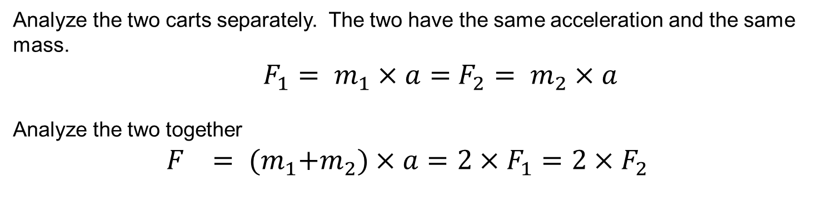
What happens when objects are connected?
Analyze the two carts separately. The two have the same acceleration and the same mass.
$F_{1}= m_{1}×a=$ $F_{2}= m_{2}×a$
Analyze the two together
$$F_{}= {(m}_{1}+m_{2})×a=2×F_{1}=2×F_{2}$$
32

Slide 3
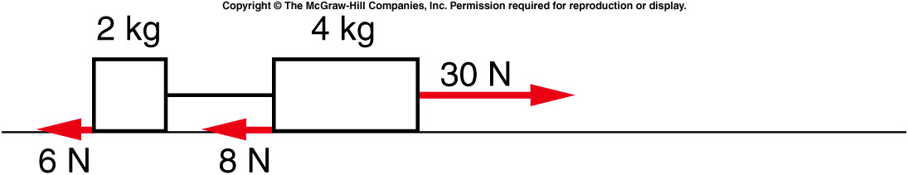
Two blocks tied together by a string are being pulled across the table by a horizontal force. The blocks have frictional forces exerted on them by the table as shown. What is the net force acting on the entire two-block system?
16 N
36 N
38 N
44 N
46 N
The net horizontal force is:
30 N - 6 N - 8 N = 16 N directed to the right.

Slide 4
What is the acceleration of this system?
The total mass is:
2 kg + 4 kg = 6 kg
The acceleration of the system is:
Total force ÷ total mass =
16 N ÷ 6 kg = 2.67 m/s² directed to the right.
2.00 m/s²
2.67 m/s²
5.00 m/s²
7.50 m/s²

Slide 5
Quiz: What force is exerted on the 2-kg block by the connecting string?
16.5 N
11.3 N
38.1 N
44.4 N
46.2 N
The net horizontal force on the 2-kg block is:
F_{net} = ma = 2 kg x 2.67 m/s² = 5.3 N
So the force due to the string is:
F_{string} = F_{net} + 6 N = 11.3 N
directed to the right.

Slide 6
Earth and Sun
An alien took a look at our solar system from a galaxy far far away, he observed that
the earth rotate around the run
the Sun rotate around the earth
https://www.npr.org/sections/thetwo-way/2014/02/14/277058739/1-in-4-americans-think-the-sun-goes-around-the-earth-survey-says

Slide 7
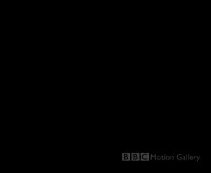
Video Clips of our Solar System

Slide 8
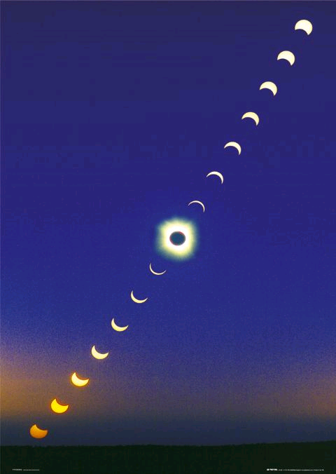
Video Clips of our Solar System
After seeing the clips, we should understand or raise the following questions:
Why we have Day and Night ?
Why all planet circulate around the Sun
Why those closer to the Sun moves faster?
Why we have solar eclipse
Why we have lunar eclipse?

Slide 9
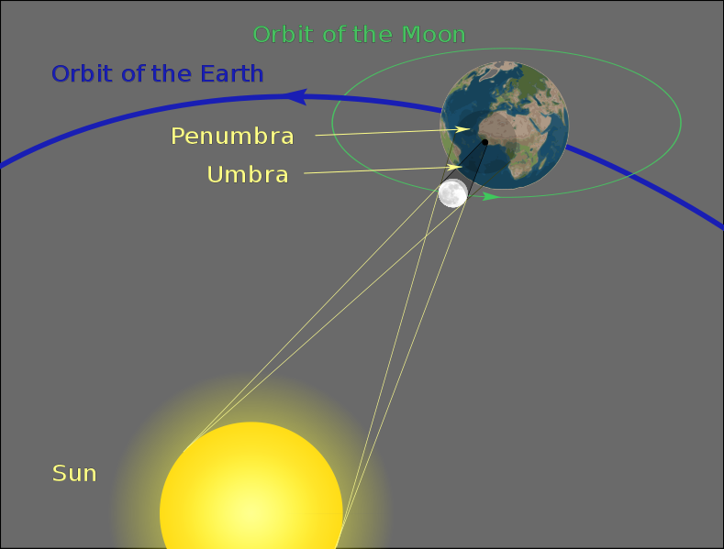
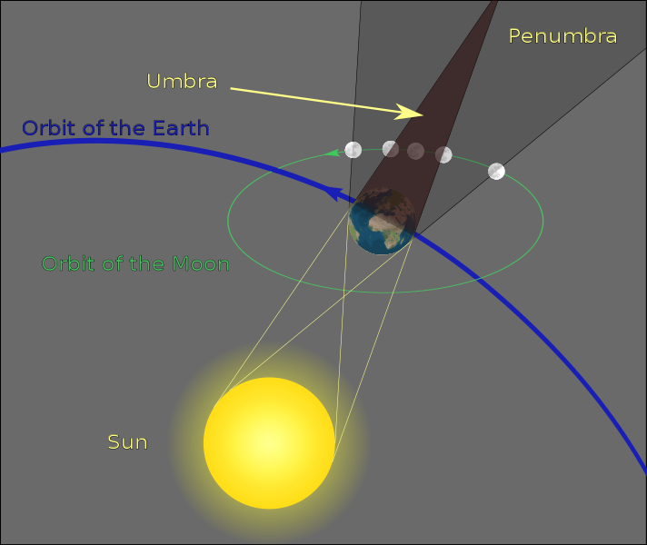
Solar and Lunar eclipse

Slide 10
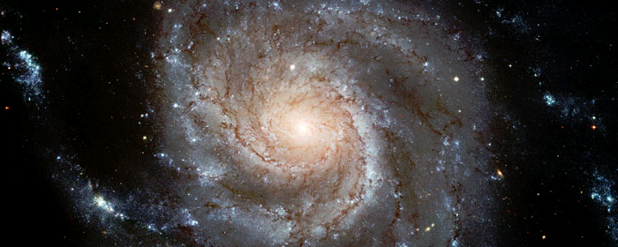
Galaxies are Rotating too
Largest ever Hubble galaxy portrait - stunning HD image of Pinwheel Galaxy
what’s in the center of a galaxy?

Slide 11
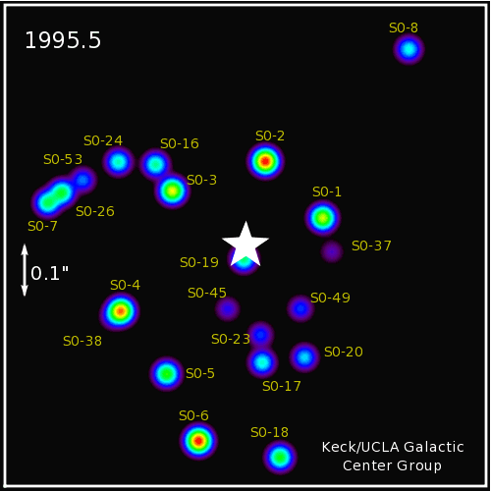
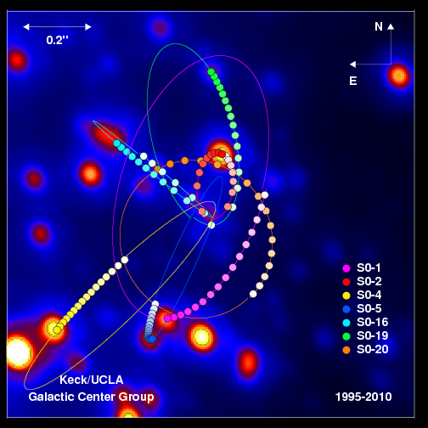

“Images taken from the years 1995 through 2008 are used to track specific stars orbiting the proposed black hole at the center of the Galaxy”
http://www.astro.ucla.edu/~ghezgroup/gc/pictures/orbitsMovie.shtml
“These orbits provide the best evidence yet for a supermassive black hole, which has a mass of 4 million times the mass of the Sun”

Slide 12
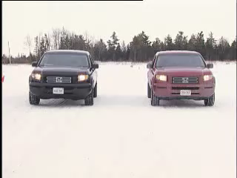
Does the circular motion of the planet around the Sun has anything in common with truck slide when making a turn in snow?

Slide 13
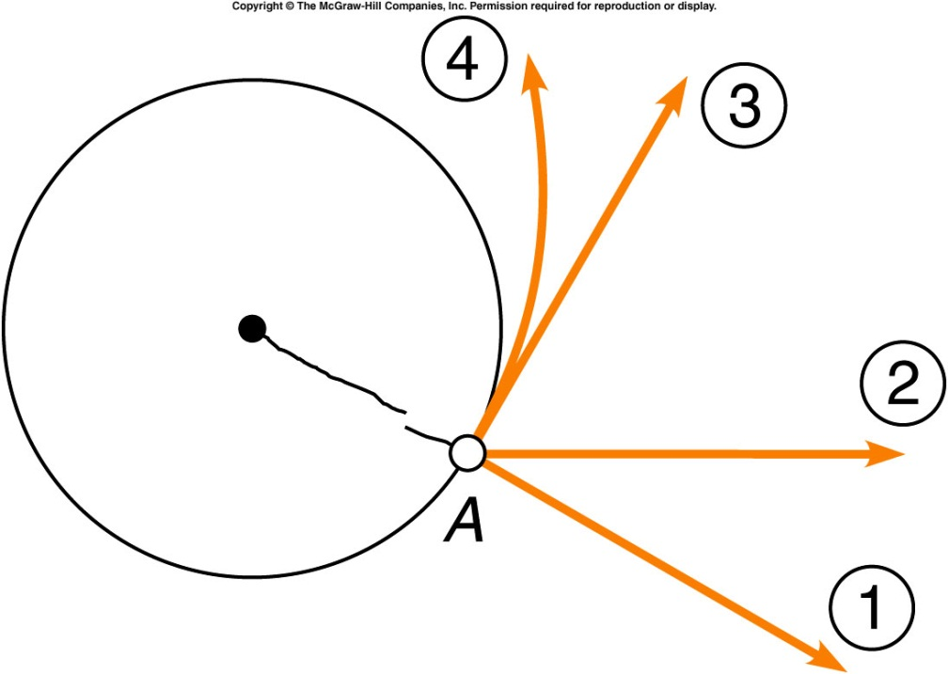
A ball is whirled on the end of a string with constant speed when the string breaks. Which path will the ball take (assuming no gravity)?
Path 1
Path 2
Path 3
Path 4

Slide 14
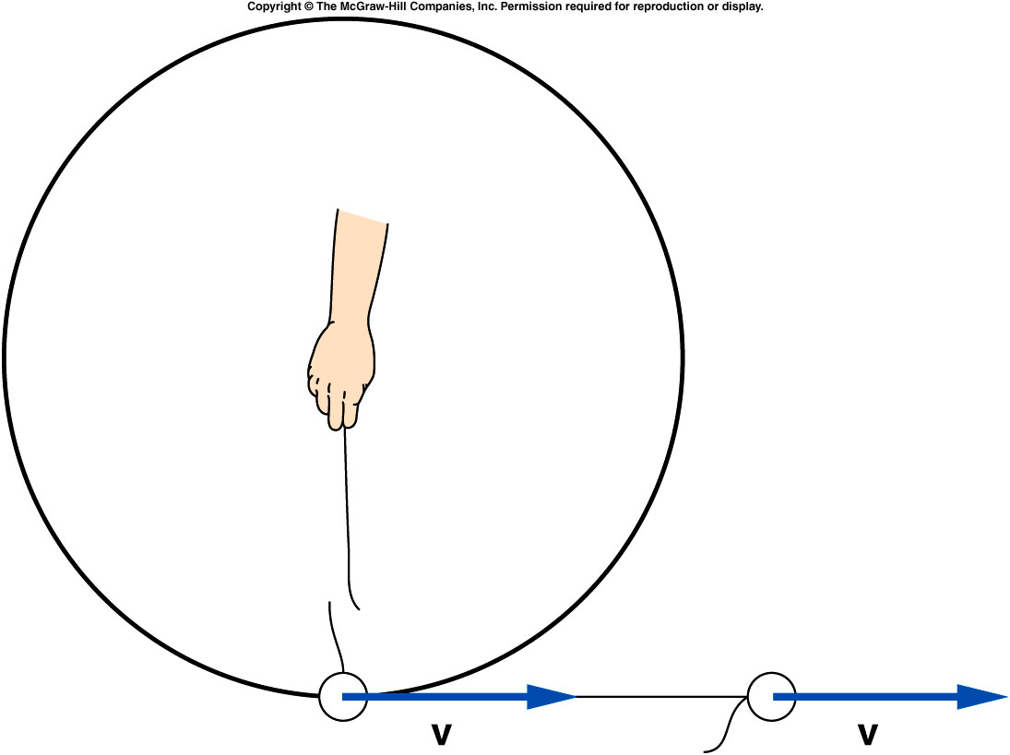
If the string breaks, the ball flies off in a straight-line path in the direction it was traveling at the instant the string broke.
If the string is no longer applying a force to the ball, Newton’s First Law tells us that the ball will continue to move in a straight line.
Circular motion is called centripetal motion, with the string providing a centripetal force.

Slide 15
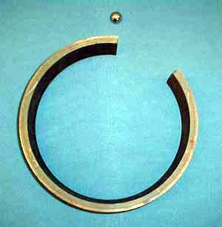
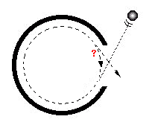
1D-08 Ball in Ring
Is the ball leaving in a straight line or continuing this circular path?
THE FORCE WHICH KEEPS THE BALL MOVING CIRCULAR IS PROVIDED BY THE RING. ONCE THE FORCE IS REMOVED, THE BALL CONTINUES IN A STRAIGHT LINE, ACCORDING TO NEWTON’S FIRST LAW.
A). Continue with circular path
B). Leave in a straight line
C). Can not determine
D). Will stop moving
Notes:
A circular ring containing a gap is placed on the overhead projector. A steel ball is made to roll around the inside circumference of the ring. When the ball leaves the ring through the gap, it continues in a straight line, illustrating that a force is needed to keep the ball moving in a circle.

Slide 16
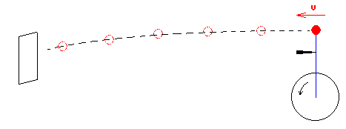
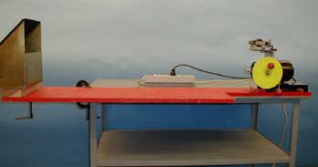
1D-04 Radial Acceleration & Tangential Velocity
Once the string is cut, where is the ball going?
A). Continue with circular path
B). Leave in a straight line
C). Can not determine
D). Leave like a horizontally launched projectile
AT ANY INSTANT, THE VELOCITY VECTOR OF THE BALL IS DIRECTED ALONG THE TANGENT.
AT THE INSTANT WHEN THE BLADE CUTS THE STRING, THE BALL’S VELOCITY IS HORIZONTAL SO IT ACTS LIKE A HORIZONTALLY LAUNCHED PROJECTILE AND LANDS IN THE CATCH BOX.
Notes:
Balls with strings attached are in turn affixed to a disk that is spun rapidly by a motor. The strings stretch out radially, indicating a radial force. At any instant, the velocity vector of the ball is directed along the tangent. This is confirmed by having a razor blade cut the string as it comes to the vertical position. At this instant the ball�s velocity is horizontal so it acts like a horizontally launched projectile and lands in the catch box.

Slide 17


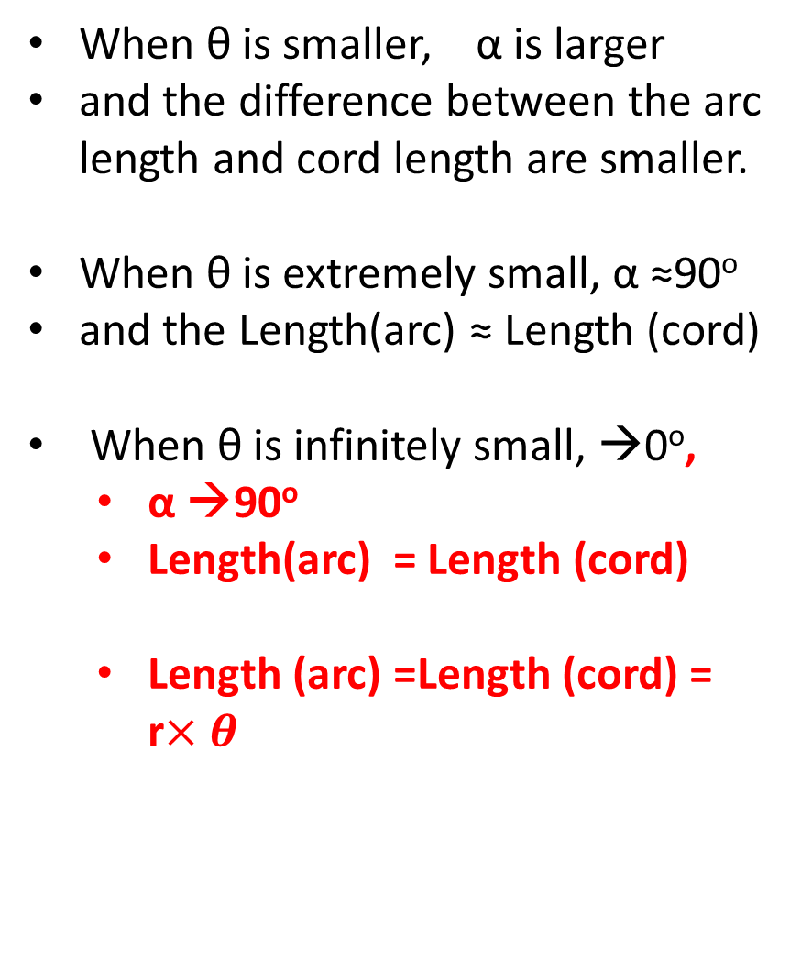


Discussion on Triangle, Arc and Cord
r
When θ is smaller, α is larger
and the difference between the arc length and cord length are smaller.
When θ is extremely small, α ≈90º
and the Length(arc) ≈ Length (cord)
When θ is infinitely small, →0º,
  α →90º
  Length(arc) = Length (cord)
  Length (arc) =Length (cord) = r$×θ$
α
$$θ$$
α
r
α
α
$$θ$$
r
α
$$θ$$
α
r
α
$$θ$$

Slide 18
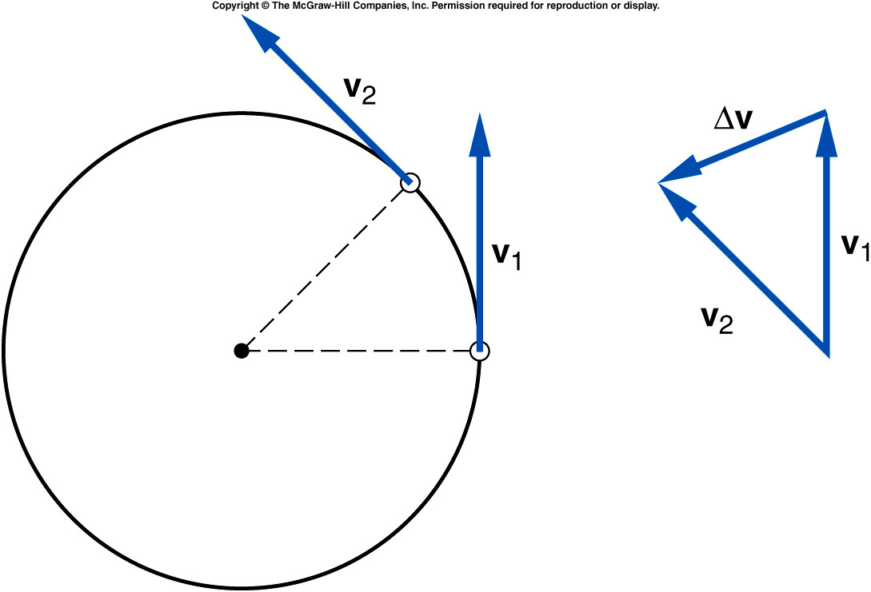

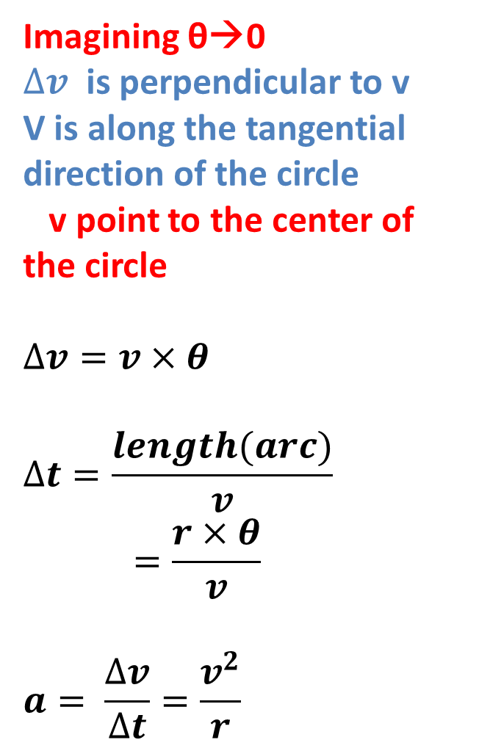

Centripetal Acceleration
Imagining θ→0
$∆v$ is perpendicular to v
V is along the tangential direction of the circle
v point to the center of the circle
$$∆v=v×θ$$
$$∆t=\frac{length(arc)}{v}=\frac{r×θ}{v}$$
$$a= \frac{∆v}{∆t}=\frac{v^{2}}{r}$$
α
α
$$θ$$
α
$$θ$$
α
r

Slide 19
Centripetal Acceleration
Centripetal acceleration is the rate of change in velocity of an object that is associated with the change in direction of the velocity.
  Centripetal
  acceleration is
  always
  perpendicular to
  the velocity.
  Centripetal
  acceleration always
  points toward the
  center of the curve.

Slide 20
Centripetal Force
The centripetal force refers to any force or combination of forces that produces a centripetal acceleration.

Slide 21
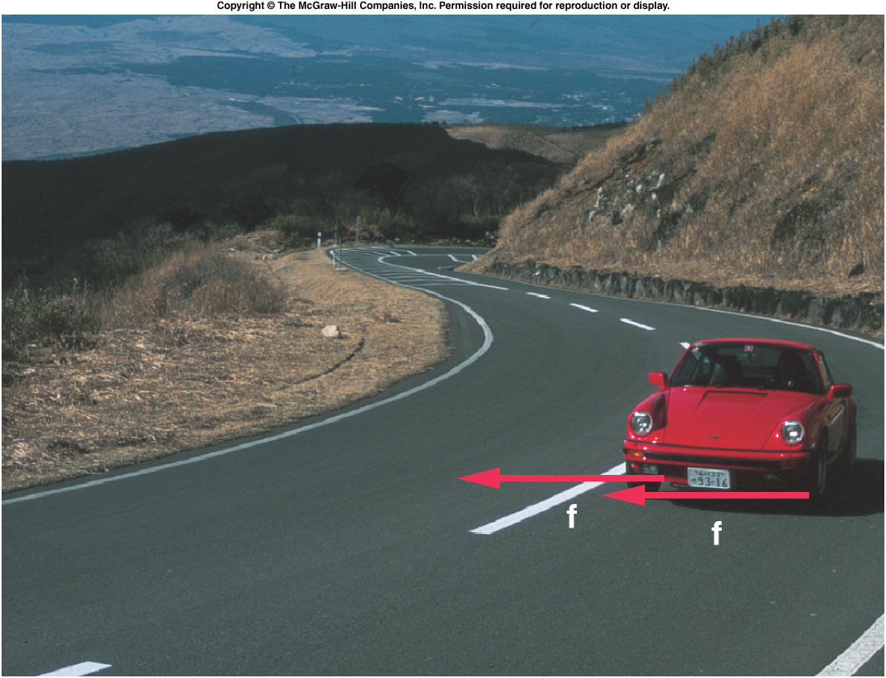
Centripetal Forces
The centripetal force may be due to one or more individual forces, such as a normal force and/or a force due to friction.
The Static force of friction is the frictional force acting when there is no motion along the surfaces.
  No skidding or sliding
The Kinetic force of friction is the frictional force acting when there is motion along the surfaces.

Slide 22
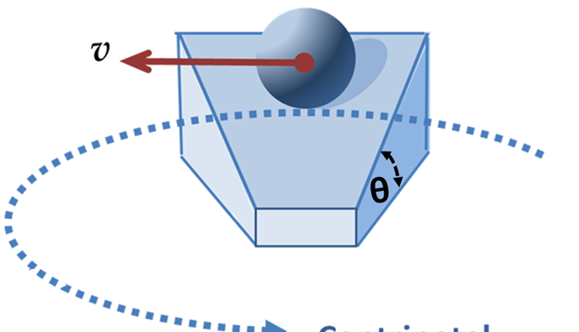
On a banked circular track, assuming no friction on the surface, will the ball be able to make a circular motion with constant speed?
A). Yes.
B). No. friction is absolutely needed.

Slide 23
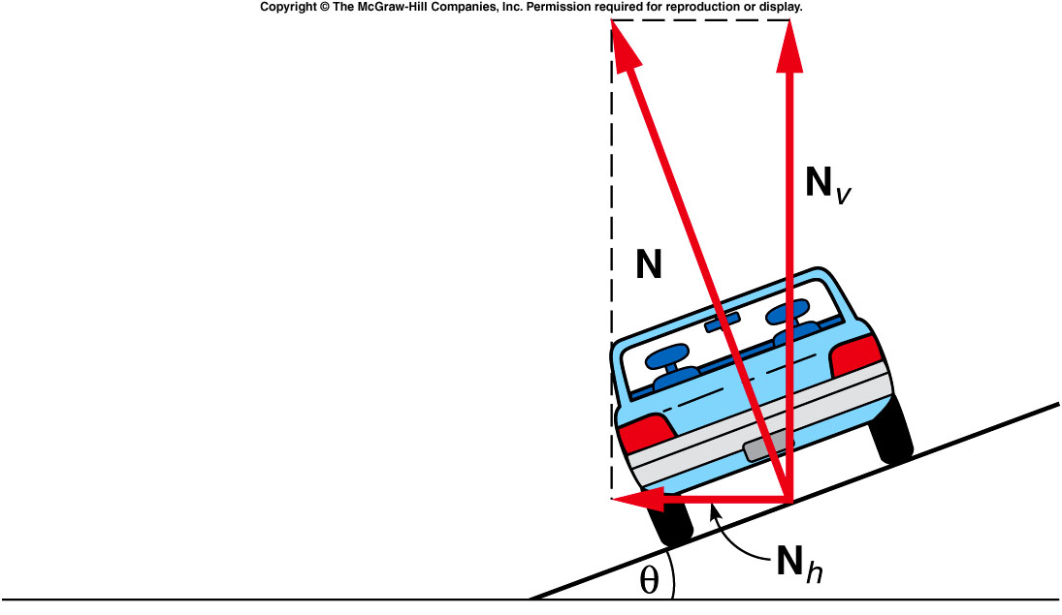
The normal force can be separated into a vertical component and a ho
The horizontal component of the normal force is the centripetal force when there’s no friction in order to keep the object (car) on the circular track.
Notes:
Assuming the car has a jet engine since without friction the wheel can not move the car.

Slide 24
Quiz: A Car moves along a banked circular track (θ=30º) and experience a normal force of 1000 kg. How large is the vertical component (N_{v}) and horizontal component (N_{h})?
A). N_{v} = 866kg, N_{h} = 500kg.
B). N_{v} = 500 kg, N_{h} = 866 kg.
C). N_{v} = 500 kg, N_{h} = 500 kg
D). N_{v} = 866kg, N_{h} = 134 kg.
30 º
Notes:
Assuming the car has a jet engine since without friction the wheel can not move the car.

