Slide 1
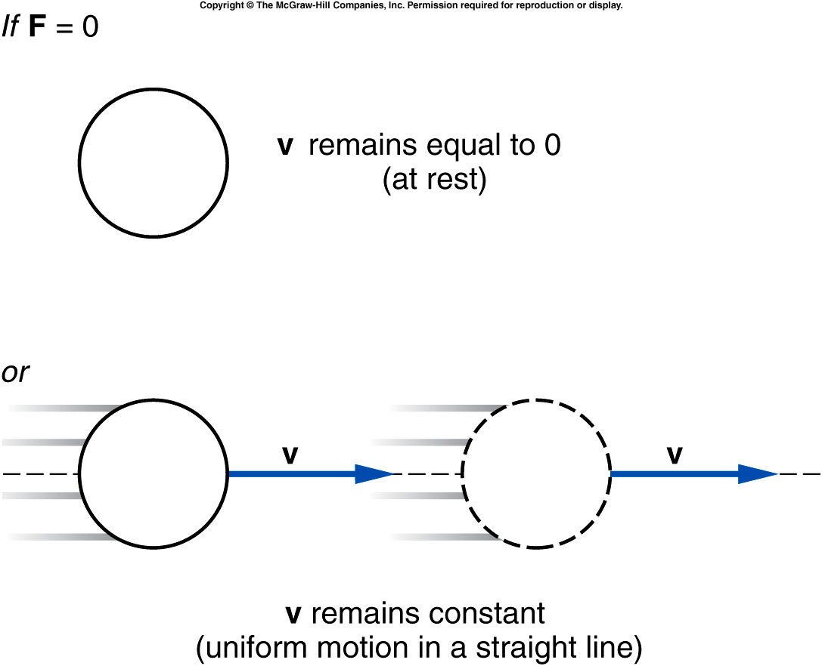
Newton’s First Law of Motion
An object remains at rest,
or in uniform motion in a straight line,
unless it is compelled to change by an externally imposed force.
Notes:
Remind the ice skating. The kid continue move without being pushed anymore.

Slide 2
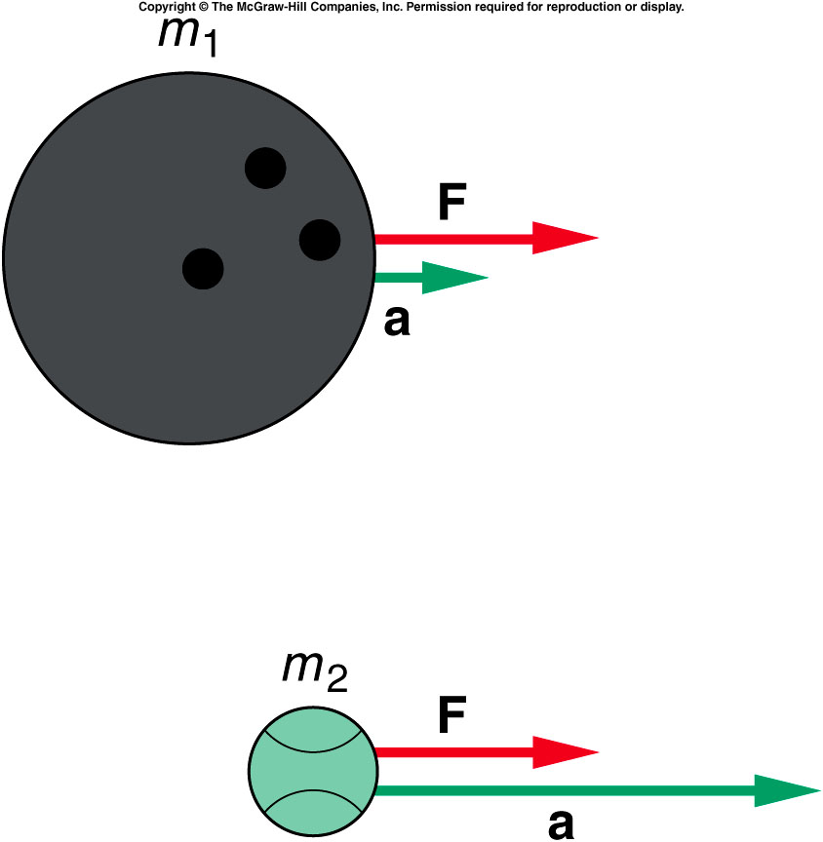
Newton’s Second Law of Motion
The acceleration of an object is directly proportional to the magnitude of the imposed force
and inversely proportional to the mass of the object.
The acceleration is the same direction as that of the imposed force.

Slide 3
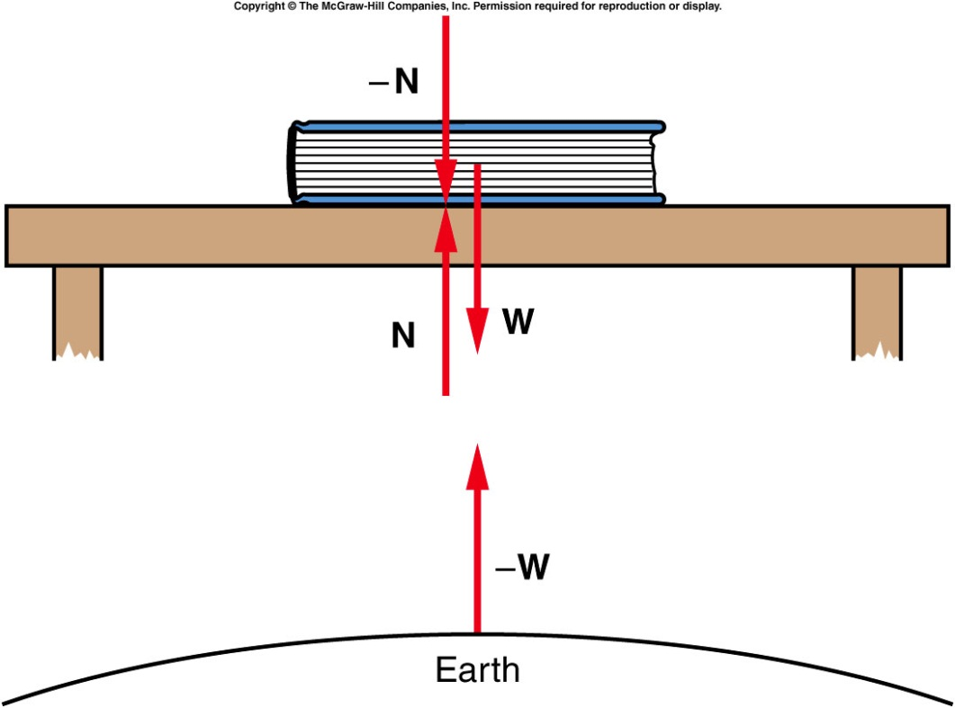
Newton’s Third Law
(“action/reaction”)
For every action (force),
there is an equal but opposite reaction
(force).

Slide 4

Quiz: A vertical force of 6N presses on a book of
0.4kg weight on a table. What is the gravitational force and the normal force ?
g
a). Gravitational Force = mg = 3.92 N
Normal Force = 6 + 0 = 6.0 N
b). Gravitational Force = mg = 0.4 N
Normal Force = 6 + 0.4 = 6.4 N
c). Gravitational Force = mg = 6 N
Normal Force = 6 + 0.4 = 6.4 N
d). Gravitational Force = mg = 3.92 N
Normal Force = 6 + 3.92 = 9.92 N
N
6 N
0.4 kg
1/30/2020
4

Slide 5
Ch 4 CP6
A 60kg person accelerating UP at 1.4m/s²
What is the true weight (W)?
What is the net force (F)?
What is N?
What is the apparent weight (AW)?
N
1.4 m/s²
Mg
a). W = 588 N, F = 84 N, N = 672 N, AW = 504 N
b). W = 588 N, F = 84 N, N = 672 N, AW = 672 N
c). W = 588 N, F = 84 N, N = 504 N, AW = 504 N
d). W = 60 N, F = 84 N, N = 14 N, AW = 14 N
e). W = 60 N, F = 84 N, N = 144 N, AW = 144 N

Slide 6
Ch 4 CP6
A 60kg person accelerating UP at 1.4m/s²
What is the true weight?
What is the net force?
What is N?
What is the apparent weight?
N
1.4 m/s²
Mg
a) True weight = mg
= 60 x 9.8 = 588 N
b) Net Force = Ma = 84 N
c) N = 588 +84 = 672N
d) 672N
1/30/2020
6

Slide 7
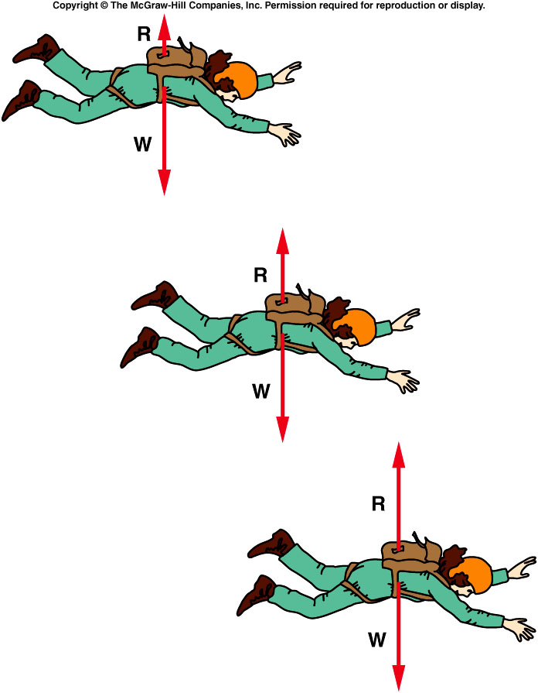
Does a sky diver continue to accelerate? (hint: air resistance increase with velocity)
a). Yes, V increase till he reach the ground
b). No. V decrease till he reach the ground
c). No. after a certain time V will remain constant till he reach the ground.

Slide 8
Does a sky diver continue to accelerate? (hint: air resistance increase with velocity)
a). Yes, V increase till he reach the ground
b). No. V decrease till he reach the ground
c). No. after a certain time V will remain constant till he reach the ground.
Air resistance R is a force directed upward, that opposes the gravitational force W
R increases as the sky diver’s velocity increases
When R has increased to the magnitude of W, the net force is zero so the acceleration is zero
The velocity is then at its maximum value, the terminal velocity

Slide 9
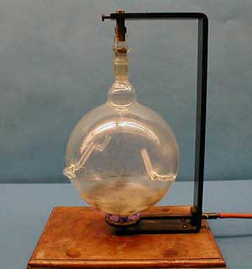
1H-04 Hero's Engine
A glass bulb emits steam from small nozzles
What happens when the Glass Bulb begins to emit steam ?
A). Nothing will happen
B). It will rotate counterclockwise viewing from above
c) It will rotate clockwise viewing from above
1/30/2020
9
Notes:
Show this first because it take time to have the steam out. Show the explanation in a latter slide

Slide 10
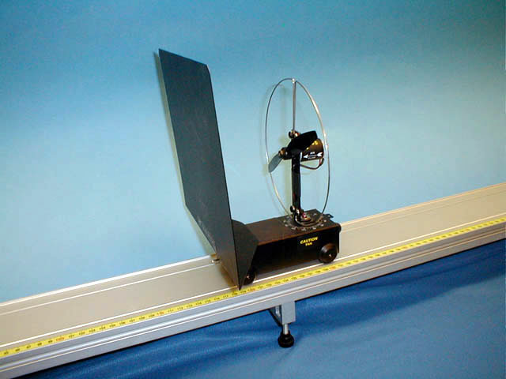
1H-02 Fan Cart (Action-Reaction)
Can a fan attached to a cart propel the cart?
Without the sail, the cart moves. With the sail, will the cart move?
yes.
No.
1/30/2020
10
Notes:
Someone is stranded in a boat but has a battery-operated fan. The stranded party decides to direct the fan toward the sail and propel the boat home. Will this work? What if the sail is canted at an angle so that the air strikes the sail at an angle rather than dead on?

Slide 11
1H-02 Fan Cart (Action-Reaction)
Can a fan attached to a cart propel the cart?
Reaction
Action
INTERNAL FORCES IN A SYSTEM CANCEL EACH OTHER WHEN THE SYSTEM AS A WHOLE IS CONSIDERED. SO IF THE SAIL IS PERPENDICULAR THE FAN DOES NOT MOVE.
1/30/2020
11
Notes:
Someone is stranded in a boat but has a battery-operated fan. The stranded party decides to direct the fan toward the sail and propel the boat home. Will this work? What if the sail is canted at an angle so that the air strikes the sail at an angle rather than dead on?

Slide 12
1H-02 Fan Cart (Action-Reaction)
Can a fan attached to a cart propel the cart?
If the direction of the fan is reversed, will the carts move?
yes.
No.
1/30/2020
12
Notes:
Someone is stranded in a boat but has a battery-operated fan. The stranded party decides to direct the fan toward the sail and propel the boat home. Will this work? What if the sail is canted at an angle so that the air strikes the sail at an angle rather than dead on?

Slide 13
Imagine that you are sitting in a cart with a pile of bricks.
How could you use the bricks to get yourself and the cart to move ?
A). throw one brick after another out of the cart .
B). No way, the cart simply can not move.
Because the repulse

Slide 14
Which one is a more realistic description of what actually happens.
a). Upper
b). Lower
Notes:
This is the similar to the recoil of a gun firing a bullet.

Slide 15
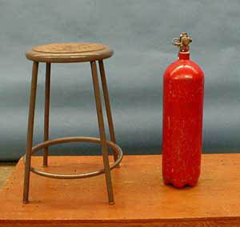
1H-03 CO₂ Rocket
Now, if the bricks were the size of molecules. . .
What happens when the fire extinguisher rapidly “throws” out CO ₂ molecules ?
Will the cart move?
A). Yes.
B) no.
Because the repulse

Slide 16

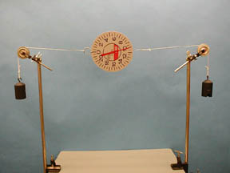
1J-04 Scale Paradox 1
What is the reading on the scale ?
A Scale Measures the Force acting on it
NOW, What is the reading on the scale ?
WALL
mg
mg
mg
A). Same reading
B). Reading double since there are two weights instead of one.
C). Reading will be zero since the two weights are equal.

Slide 17
1J-04 Scale Paradox 1
What is the reading on the scale ?
A Scale Measures the Force acting on it
NOW, What is the reading on the scale ?
WALL
mg
mg
mg
T
T
T
T
mg
T = mg
T = mg
mg
mg
mg
THE TENSION IN THE CORD IS THE SAME FOR BOTH CASES. THE SCALE MEASURES THE TENSION IN THE CORD. FOR EXAMPLE THE TENSION IN A ROPE IS THE SAME IF TWO PEOPLE PULL ON EACH END WITH FORCE F OR IF ONE PERSON PULLS WITH FORCE F TO A ROPE TIED TO A WALL.
1/30/2020
mg
17

Slide 18
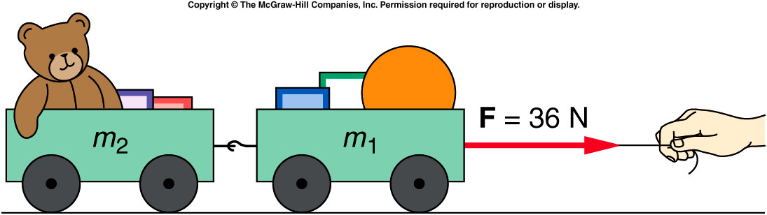
What happens when objects are connected?
Two connected carts with equal mass being accelerated by a force F applied by a string:
Both carts must have the same acceleration a which is equal to the net horizontal force divided by the total mass
Each cart will have a net force equal to its mass times the acceleration
What’s the force acting on the 2nd cart?
A). 32 N
B). 16 N
C). 0 N
32

Slide 19
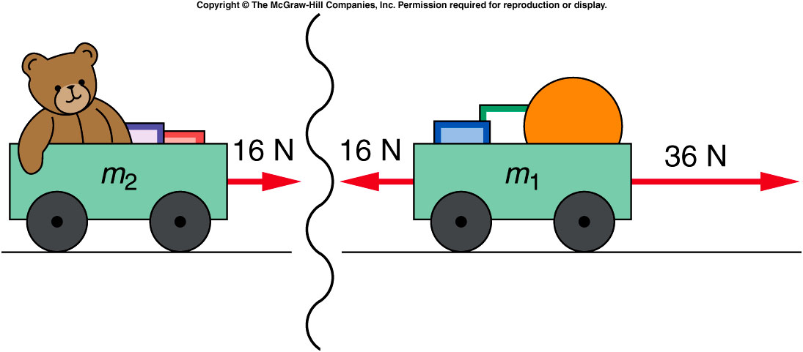
What happens when objects are connected?
The interaction between the two carts illustrates Newton’s third law:
m₁ exerts a pull of 16 N to the right on m₂
m₂ exerts an equal and opposite pull of 16 N to the left on m₁
32

Slide 20
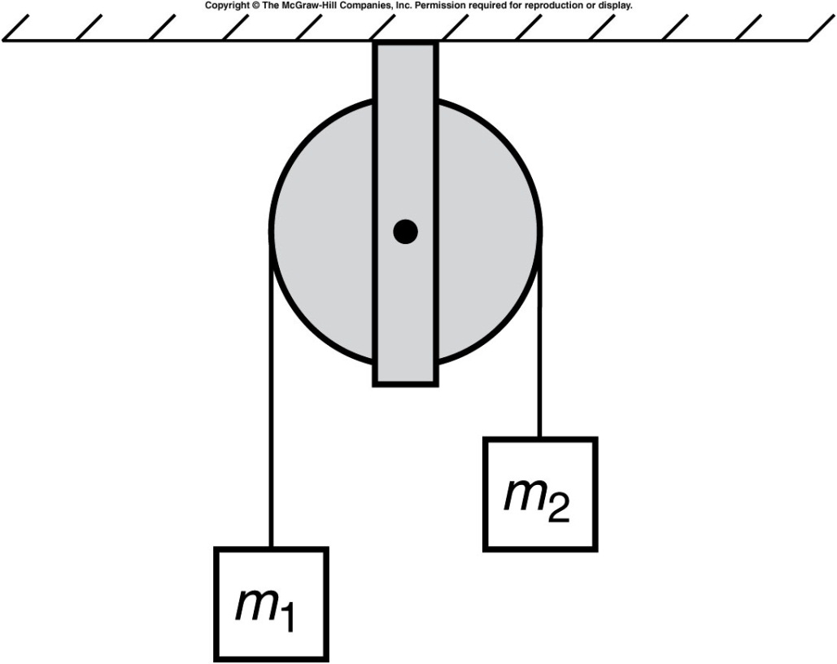
Two masses connected by a string are placed on a fixed frictionless pulley. If m₂ is larger than m₁, will the two masses accelerate?
Yes.
No.
You can’t tell
from this diagram.

Slide 21
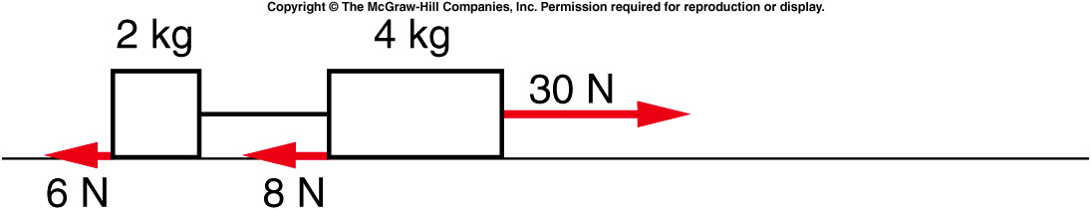
Two blocks tied together by a string are being pulled across the table by a horizontal force. The blocks have frictional forces exerted on them by the table as shown. What is the net force acting on the entire two-block system?
16 N
36 N
38 N
44 N
46 N
The net horizontal force is:
30 N - 6 N - 8 N = 16 N directed to the right.

Slide 22
What is the acceleration of this system?
The total mass is:
2 kg + 4 kg = 6 kg
The acceleration of the system is:
Total force ÷ total mass =
16 N ÷ 6 kg = 2.67 m/s² directed to the right.
2.00 m/s²
2.67 m/s²
5.00 m/s²
7.50 m/s²

Slide 23
What force is exerted on the 2-kg block by the connecting string?
16.5 N
11.3 N
38.1 N
44.4 N
46.2 N
The net horizontal force on the 2-kg block is:
F_{net} = ma = 2 kg x 2.67 m/s² = 5.3 N
So the force due to the string is:
F_{string} = F_{net} + 6 N = 11.3 N
directed to the right.

Slide 24
Quiz: What is the acceleration of the 4-kg block?
2.00 m/s²
2.67 m/s²
5.00 m/s²
7.50 m/s²
The net horizontal force on the 4-kg block is:
F_{net} = 30 N - 8 N - 11.3 N = 10.7 N
So the acceleration of the 4-kg block is:
a = F ÷ m = 10.7 N ÷ 4 kg = 2.67 m/s²
directed to the right.

