Slide 1
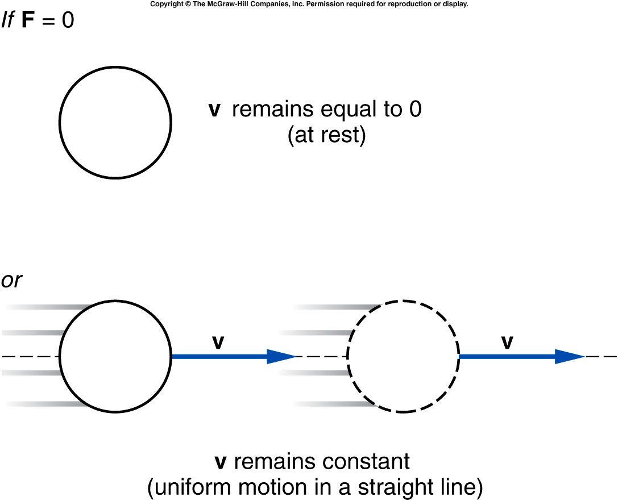
Newton’s First Law of Motion
An object remains at rest,
or in uniform motion in a straight line,
unless it is compelled to change by an externally imposed force.
Notes:
Remind the ice skating. The kid continue move without being pushed anymore.

Slide 2
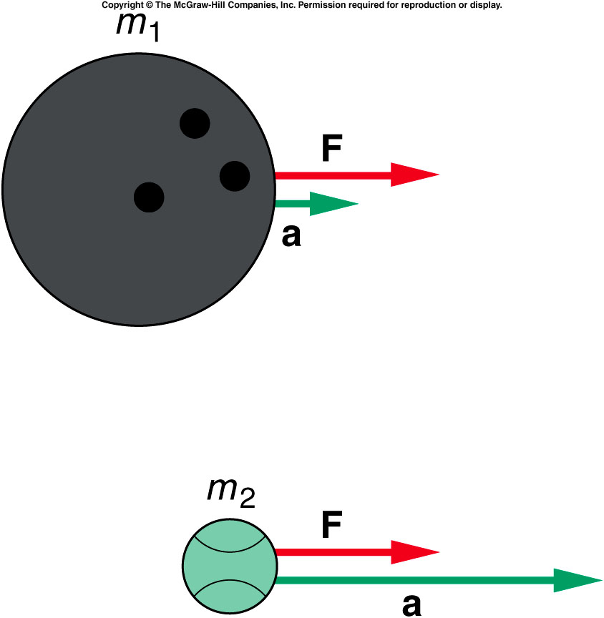
Newton’s Second Law of Motion
The acceleration of an object is directly proportional to the magnitude of the imposed force
and inversely proportional to the mass of the object.
The acceleration is the same direction as that of the imposed force.

Slide 3
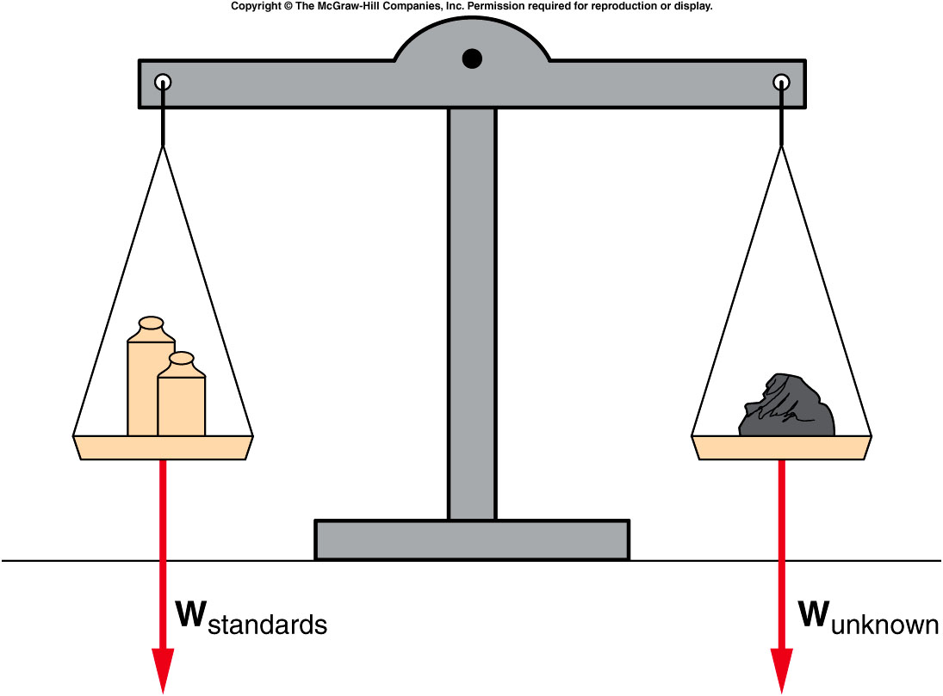
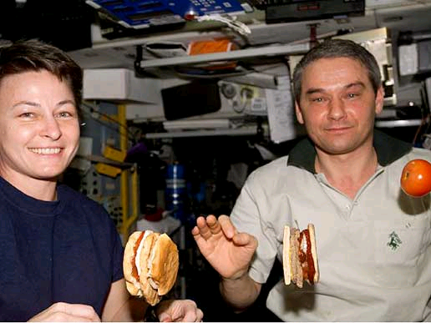
Mass, Weight, and Inertia
An object’s weight is the gravitational force acting on the object.
Weight is a force, measured in units of newtons (N).
In the absence of gravity, an object has no weight but still has the same mass.

Slide 4
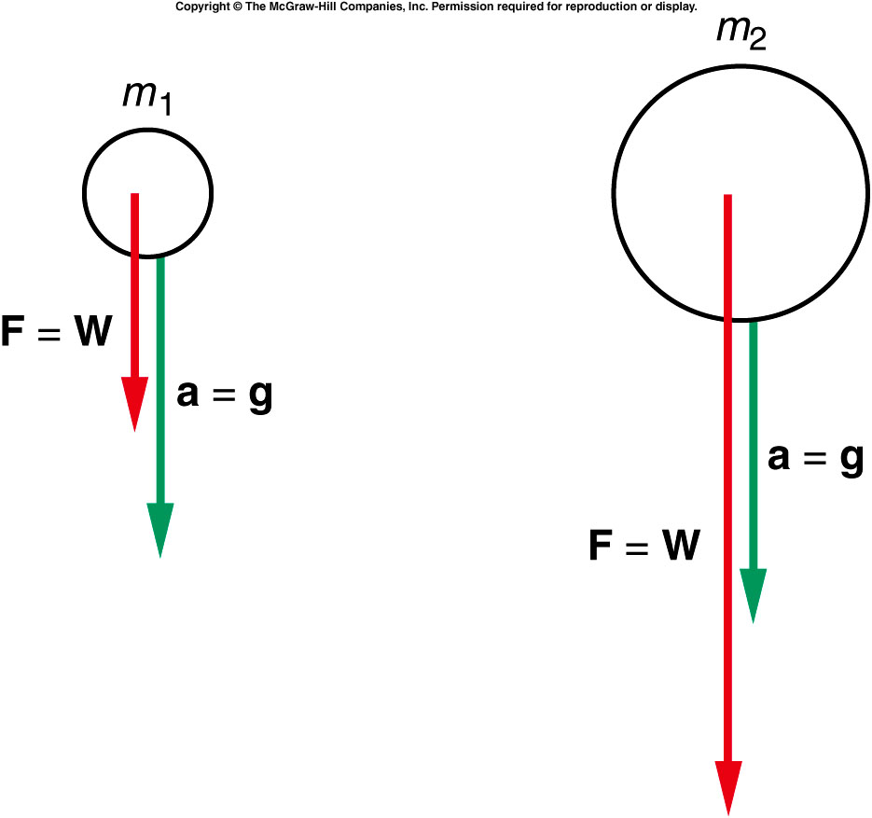
Mass, Weight, and Inertia
Objects of different mass experience the same gravitational acceleration on Earth: g = 9.8 m/s²
By Newton’s 2nd Law, F = ma, the weight is W = mg.
Different gravitational forces (weights) act on falling objects of different masses, but the objects have the same acceleration.
  This is the reason that object with different weight fall at the same speed (without air friction).

Slide 5
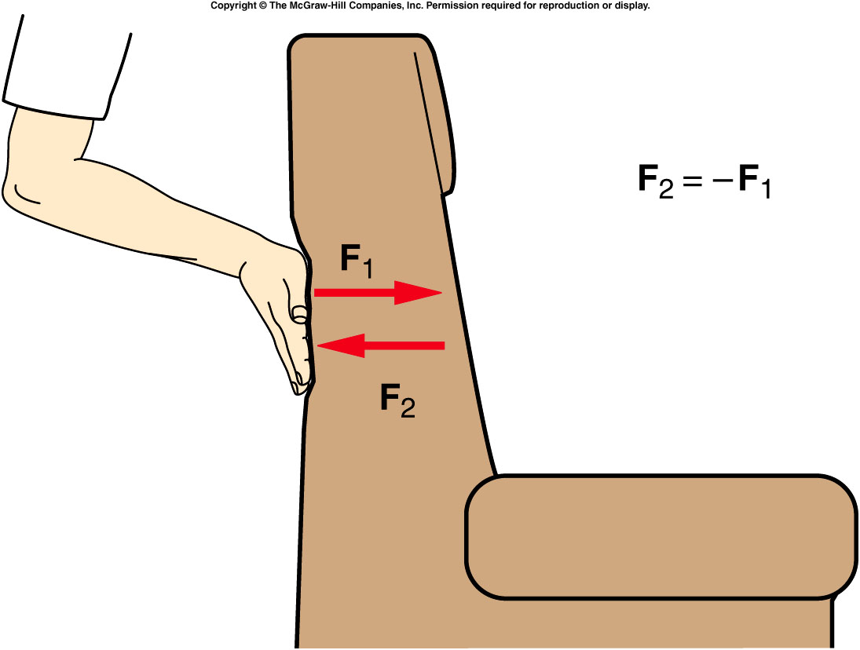
Newton’s Third Law
(“action/reaction”)
For every action (force),
there is an equal but opposite reaction
(force).

Slide 6
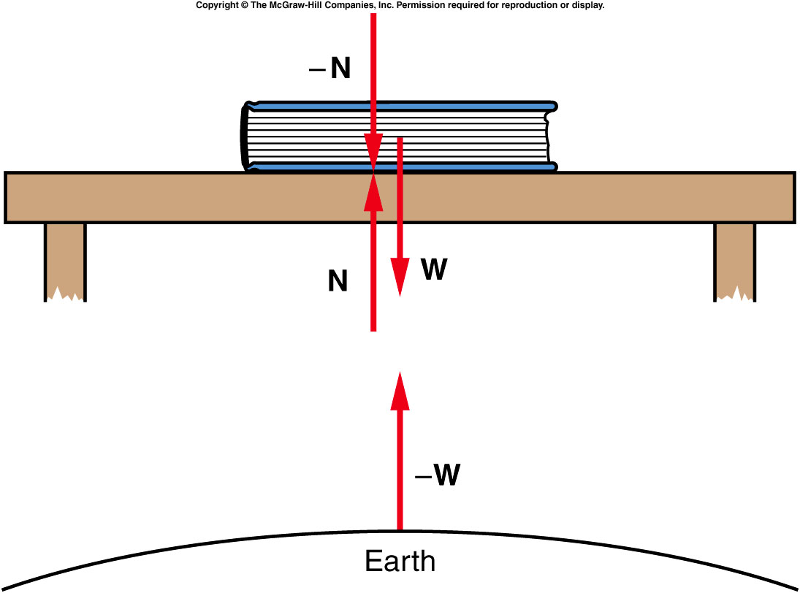
It is important to identify the forces acting on an object. It is also important to identify the action-reaction pairs.
The forces acting on the book are W (gravitational force from Earth) and N (normal force from table).
Normal force refers to the perpendicular force a surface exerts on an object.
The reaction force to the Earth’s attractive force W on the book, is an equal attractive force -W the book exerts on the Earth.
The reaction force to the table’s normal force N exerted upward on the book, is an equal force -N the book exerts downward on the table.

Slide 7
Which one is a more realistic description of what actually happens.
a). Upper
b). Lower
Now see the gun recoil in real life.

Slide 8
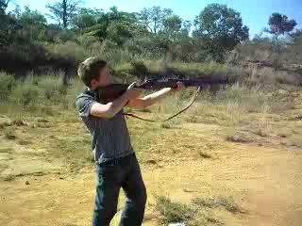
Gun Recoil

Slide 9
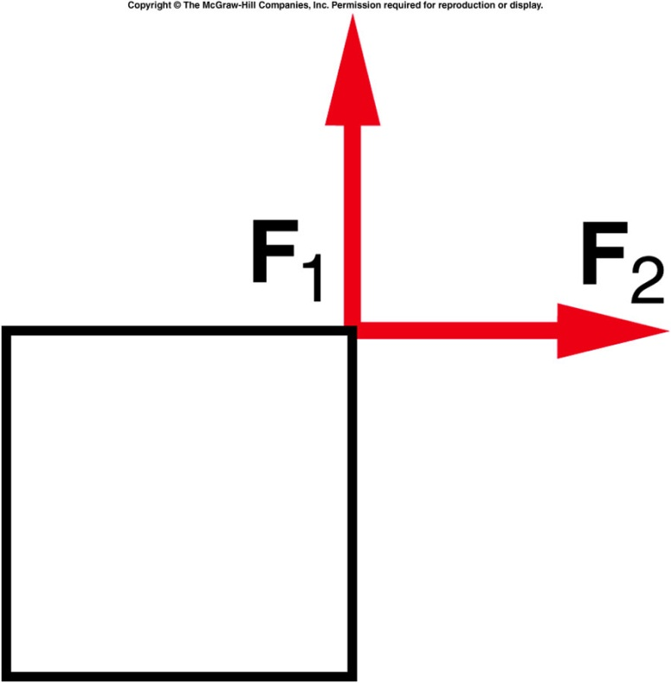
Two equal forces act on an object in the directions shown. If these are the only forces involved, will the object be accelerated?
Yes.
No.
It is impossible to determine
from this figure.

Slide 10
Two equal forces act on an object in the directions shown. If these are the only forces involved, will the object be accelerated?
Yes.
No.
It is impossible to determine
from this figure.
The vector sum of the two forces results in a force directed toward the upper right corner. The object will be accelerated toward the upper right corner.

Slide 11
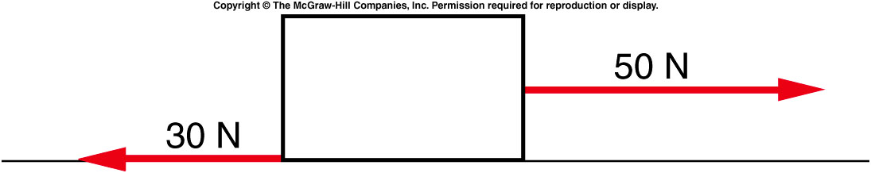
Two forces act in opposite directions on a box. What is the mass of the box if its acceleration is 4.0 m/s²?
5 kg
7.5 kg
12.5 kg
80 kg
120 kg

Slide 12
Two forces act in opposite directions on a box. What is the mass of the box if its acceleration is 4.0 m/s²?
5 kg
7.5 kg
12.5 kg
80 kg
120 kg
The net force is 50 N - 30 N = 20 N, directed to the right. From F=ma, the mass is given by:
m = F/a
= (20 N) / (4 m/s²)
= 5 kg.

Slide 13
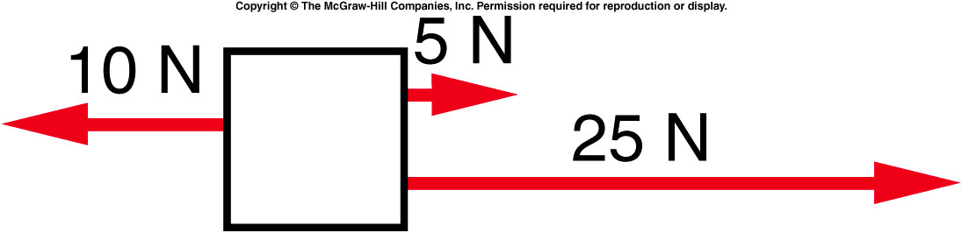
A 4-kg block is acted on by three horizontal forces. What is the net horizontal force acting on the block?
10 N
20 N
25 N
30 N
40 N

Slide 14
A 4-kg block is acted on by three horizontal forces. What is the net horizontal force acting on the block?
10 N
20 N
25 N
30 N
40 N
The net horizontal force is:
5 N + 25 N - 10 N = 20 N directed to the right.

Slide 15
Quiz: A 4-kg block is acted on by three horizontal forces. What is the horizontal acceleration of the block?
6.25 m/s²
1.25 m/s²
5.0 m/s²
2.5 m/s²
7.25 m/s²

Slide 16
Quiz: A 4-kg block is acted on by three horizontal forces. What is the horizontal acceleration of the block?
6.25 m/s²
1.25 m/s²
5.0 m/s²
2.5 m/s²
7.25 m/s²
From F=ma, the acceleration is given by:
a = F/m
= (20 N) / (4 kg)
= 5 m/s²
directed to the right.

Slide 17
Ch 4 E14
A 4kg rock is dropped and experiences
air resistance of 15N
a) What is the acceleration?
4 kg
15 N
Mg
a). 19.6m/s²
b). 9.8m/s²
c). 4.9m/s²
d). 6.05m/s²
e). 12.1m/s²
2/2/2021
17

Slide 18
Ch 4 E14
A 4kg rock is dropped and experiences
air resistance of 15N
a) What is the acceleration?
4 kg
15 N
Mg
a). 19.6m/s²
b). 9.8m/s²
c). 4.9m/s²
d). 6.05m/s²
e). 12.1m/s²
F = 4 x 9.8 – 15
F = ma = 24.2 N
a = 24.2/4 = 6.05m/s²
2/2/2021

Slide 19
Mass, Weight, and Inertia
An object’s (true)weight is the gravitational force acting on the object.
Weight is a force, measured in units of newtons (N).
In the absence of gravity, an object has no weight but still has the same mass.

Slide 20
Forces in an elevator
W = mg = true weight with no acceleration
N = apparent weight
N – mg is the net force taking
N – mg = ma is the equation of motion
If N > mg a is positive and the apparent
weight is > than the true weight
If N < mg a is negative and the apparent
weight is less than the true weight
+
N
g
mg
2/2/2021

Slide 21
Ch 4 E18
A 60kg person is in an elevator
With an upward acceleration of
1.2m/s²
a) What is the net force F?
b) What is the gravitational force W?
c) What is the normal force N?
m = 60 KG
a = 1.2 m/s²
mg
a). F = 36 N, W = 588 N, N = 624 N
b). F = 72 N, W = 588 N, N = 660 N
c). F = 72 N, W = 60 N, N = 132 N
d). F = 36 N, W = 60 N, N = 96 N
e). F = 72 N, W = 588 N, N = 516 N
2/2/2021

Slide 22
Ch 4 E18
A 60kg person is in an elevator
With an upward acceleration of
1.2m/s²
a) What is the net force F?
b) What is the gravitational force W?
c) What is the normal force N?
m = 60 KG
a = 1.2 m/s²
mg
a). F = 36 N, W = 588 N, N = 624 N
b). F = 72 N, W = 588 N, N = 660 N
c). F = 72 N, W = 60 N, N = 132 N
d). F = 36 N, W = 60 N, N = 96 N
e). F = 72 N, W = 588 N, N = 516 N
F = Ma = 60 x 1.2
= 72 N
W=mg = 60 x 9.8 = 588 N
N = 588 + 72 = 660 N
2/2/2021

Slide 23
Ch 4 CP4
A 60kg crate is lowered from a height of 1.4m
and the tension is 500N
Will the crate accelerate?
What is the acceleration?
How long to reach the floor?
How fast does the crate hit the floor?
500 N
g
a) Net Force
= 60 x 9.8 – 500
60 kg
= 588 – 500
= 88 N
b) Will accelerate down
a = ⁸⁸/₆₀ = 1.47 m/s²
c) d = 1/2 at² t = 1.38s
d) v = v₀ + at v = 2.03 m/s
2/2/2021
23

Slide 24
Ch 4 CP6
A 60kg person accelerating DOWN at 1.4m/s²
What is the true weight (W)?
What is the net force (F)?
What is N?
What is the apparent weight (AW)?
N
1.4 m/s²
Mg
a). W = 588 N, F = 84 N, N = 672 N, AW = 504 N
b). W = 588 N, F = 84 N, N = 672 N, AW = 672 N
c). W = 588 N, F = 84 N, N = 504 N, AW = 504 N
d). W = 60 N, F = 84 N, N = 14 N, AW = 14 N
e). W = 60 N, F = 84 N, N = 144 N, AW = 144 N

Slide 25
Ch 4 CP6
A 60kg person accelerating DOWN at 1.4m/s²
What is the true weight?
What is the net force?
What is N?
What is the apparent weight?
N
1.4 m/s²
Mg
a) True weight = mg
= 60 x 9.8 = 588 N
b) Net Force = Ma = 84 N
c) N = 588 – 84 = 504 N
d) 504 N
2/2/2021

Slide 26
Ch 4 CP6
A 60kg person accelerating UP at 1.4m/s²
What is the true weight (W)?
What is the net force (F)?
What is N?
What is the apparent weight (AW)?
N
1.4 m/s²
Mg
a). W = 588 N, F = 84 N, N = 672 N, AW = 504 N
b). W = 588 N, F = 84 N, N = 672 N, AW = 672 N
c). W = 588 N, F = 84 N, N = 504 N, AW = 504 N
d). W = 60 N, F = 84 N, N = 14 N, AW = 14 N
e). W = 60 N, F = 84 N, N = 144 N, AW = 144 N

Slide 27
Ch 4 CP6
A 60kg person accelerating UP at 1.4m/s²
What is the true weight?
What is the net force?
What is N?
What is the apparent weight?
N
1.4 m/s²
Mg
a) True weight = mg
= 60 x 9.8 = 588 N
b) Net Force = Ma = 84 N
c) N = 588 +84 = 672N
d) 672N
2/2/2021

Slide 28

Quiz: A vertical force of 6N presses on a book of
0.4kg weight on a table. What is the gravitational force and the normal force ?
g
a). Gravitational Force = mg = 3.92 N
Normal Force = 6 + 0 = 6.0 N
b). Gravitational Force = mg = 0.4 N
Normal Force = 6 + 0.4 = 6.4 N
c). Gravitational Force = mg = 6 N
Normal Force = 6 + 0.4 = 6.4 N
d). Gravitational Force = mg = 3.92 N
Normal Force = 6 + 3.92 = 9.92 N
N
6 N
0.4 kg
2/2/2021

