Slide 1
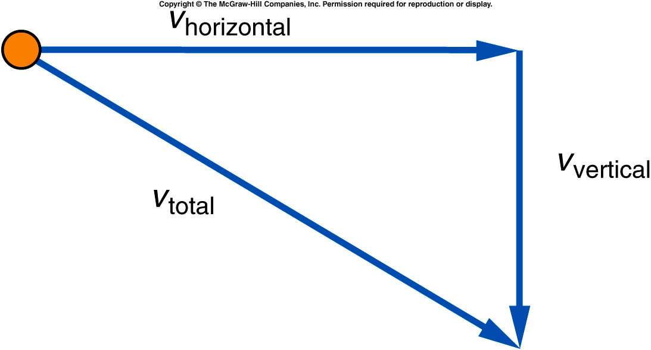
What does the trajectory look like?
The total velocity at any point is found by adding the vertical component of the velocity, at that point, to the horizontal component of the velocity at that point.
The horizontal velocity
remains constant, because
there is no acceleration in
that direction.
The downward (vertical) velocity
gets larger and larger, due to
the acceleration due to gravity.

Slide 2
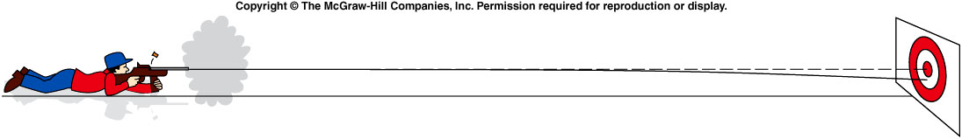
Hitting a Target
If the rifle is fired directly at the target in a horizontal direction, will the bullet hit the center of the target?
Yes.
No.
Notes:
When target is at rest. The bullet will not hit the target. But if the target is moving, e.g. falling, it will works. Then show next slide of java cartoon.

Slide 3
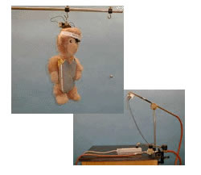
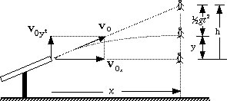
Where to aim in order to Hit the Falling object (ignore air friction)?
y
x
Ignoring friction y = v_{0y}t – 1/2gt² t = x/v_{0x} , v_{0y}/v_{0x} = h/x y = h – 1/2gt²
In the same time the monkey falls 1/2gt², i.e. for the monkey: y = h – 1/2gt²
So the bullet always hits the monkey no matter what the value of v₀

Slide 4
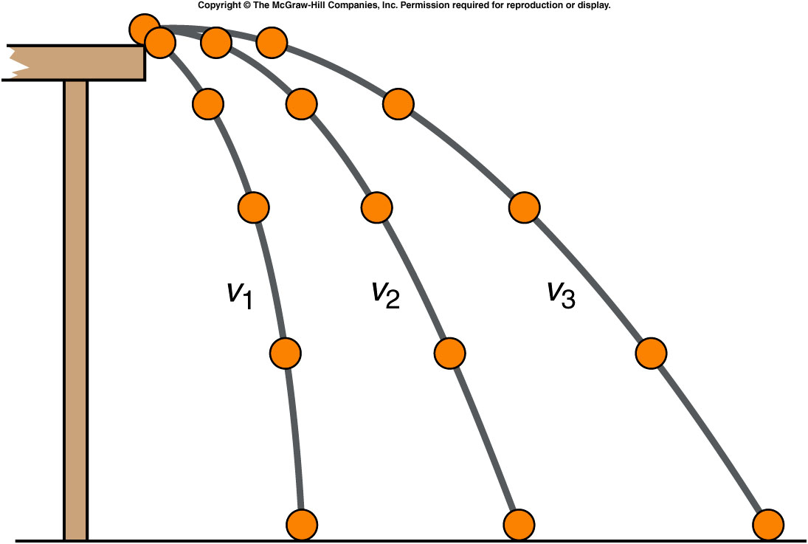
What does the trajectory look like?
Trajectories for different initial velocities of a ball rolling off a table:
  The largest initial velocity is v₃.
  The smallest initial velocity is v₁.
The ball travels
greater horizontal
distances when
projected with a
larger initial
horizontal velocity.
If they left the tabletop
at the same time, which
ball hit the floor first?
Notes:
Ask the student to think about the answer then give the quiz at the end of the class.

Slide 5
Quiz: Which of these three balls would hit the floor first if all three left the tabletop at the same time?
The ball with initial velocity v₁.
The ball with initial velocity v₂.
The ball with initial velocity v₃.
They would all hit at the same time.
Since all three balls undergo the same downward acceleration, and they all start with a vertical velocity of zero, they would all
fall the same distance in the same time!

Slide 6
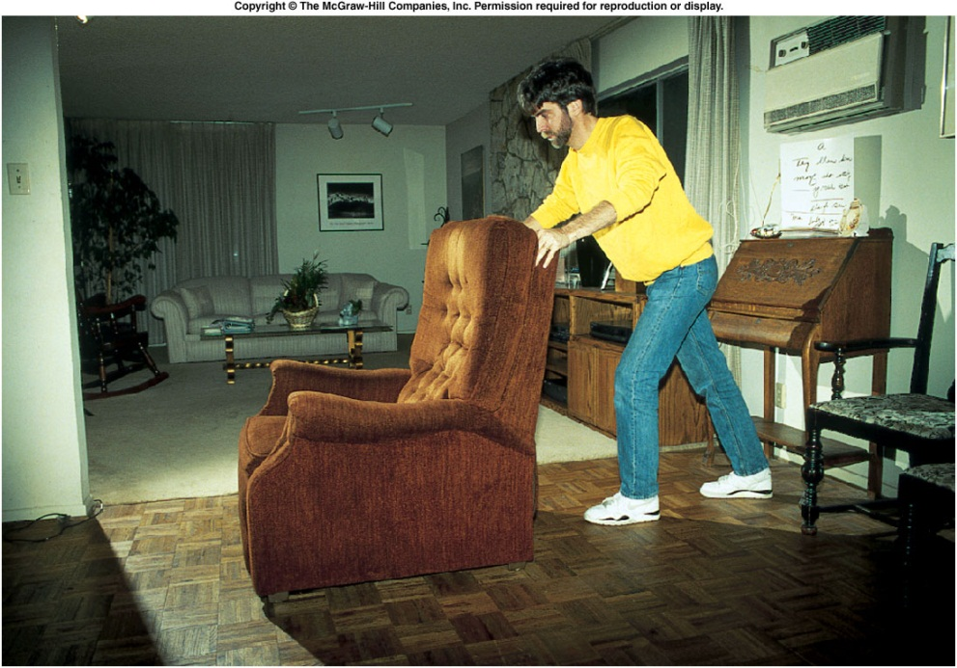
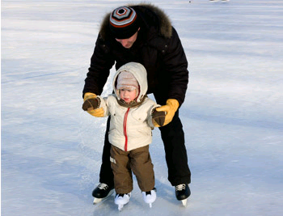
Some Facts about the Motion?
To move a heavy chair, you need to push and apply Force.
After you stop pushing, the chair stops.
After a gentle push, the kid start to move
He will continue moving without being pushed any further.

Slide 7
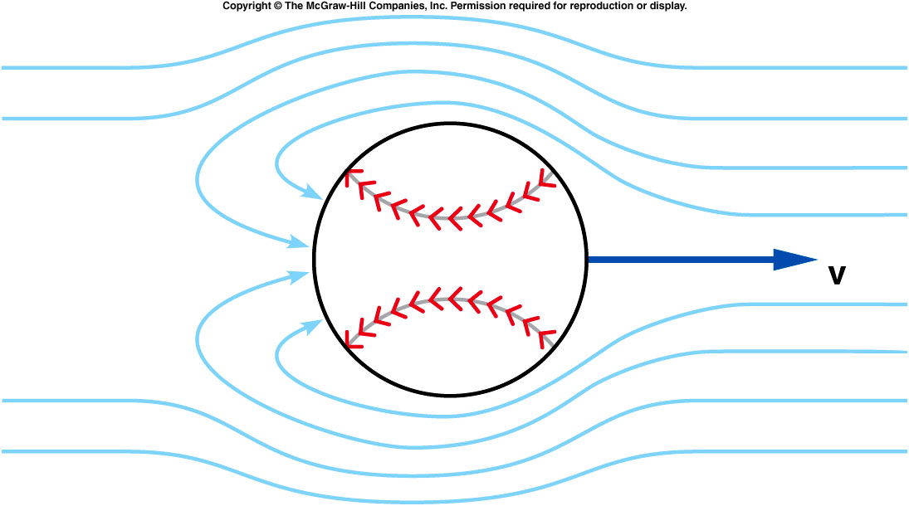
A bit of history: Aristotle’s View on the Cause of Motion
A force is needed to keep an object moving.
Air rushing around a thrown object continues to push the object forward.

Slide 8
A bit of history: Galileo’s Contribution
Galileo challenged Aristotle’s ideas that had been widely accepted for many centuries.
He argued that the natural tendency of a moving object is to continue moving.
  No force is needed to keep an object moving
  This goes against what we seem to experience.

Slide 9
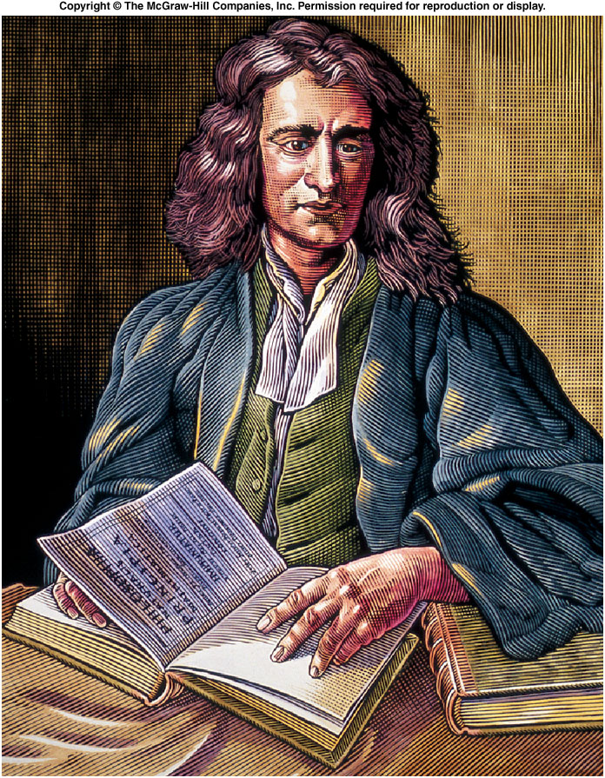
A bit of history: Newton’s Contribution
Newton built on Galileo’s work, expanding it.
He developed a comprehensive theory of motion that replaced Aristotle’s ideas.
Newton’s theory is still widely used to explain ordinary motions.

Slide 10
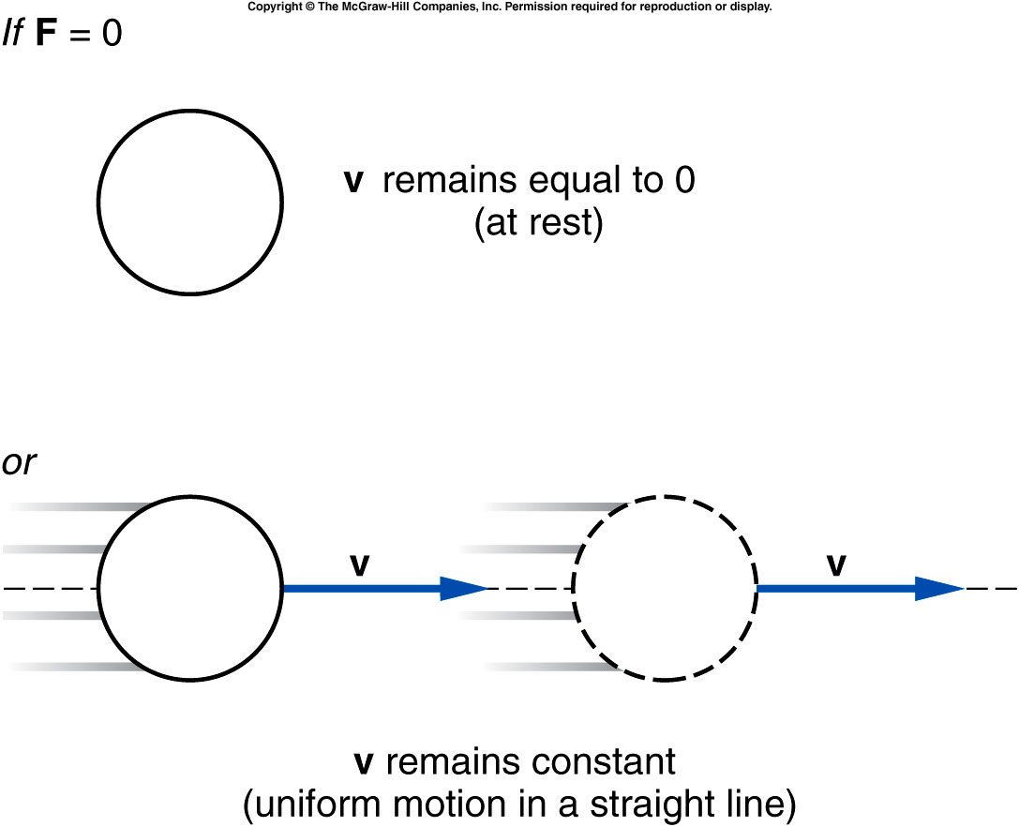
Newton’s First Law of Motion
An object remains at rest,
or in uniform motion in a straight line,
unless it is compelled to change by an externally imposed force.
Notes:
Remind the ice skating. The kid continue move without being pushed anymore.

Slide 11
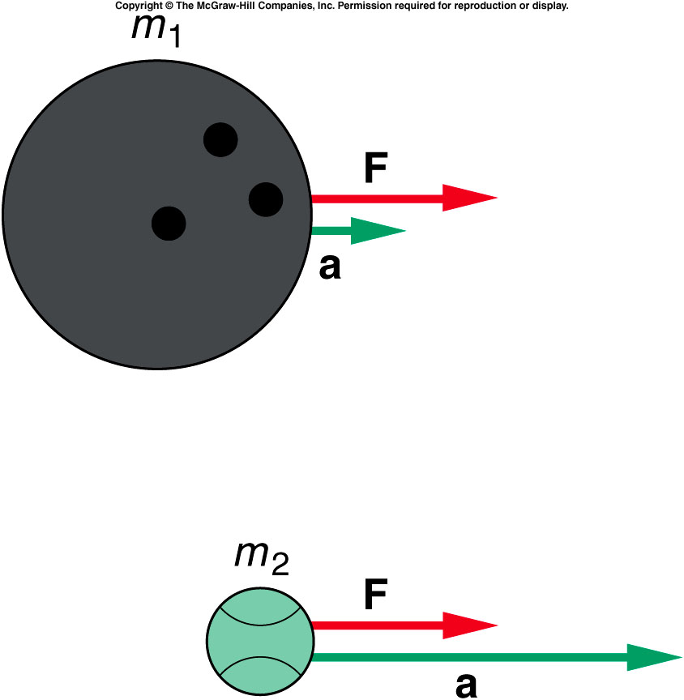
Newton’s Second Law of Motion
The acceleration of an object is directly proportional to the magnitude of the imposed force
and inversely proportional to the mass of the object.
The acceleration is the same direction as that of the imposed force.

Slide 12
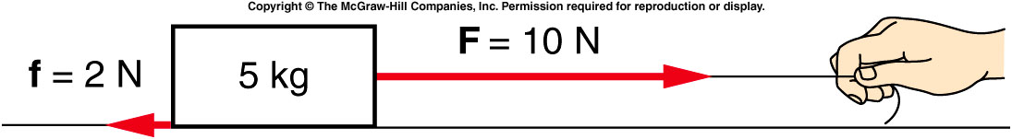
It is the total force or net force that determines an object’s acceleration.
If there is more than one vector acting on an object, the forces are added together as vectors, taking into account their directions.

Slide 13
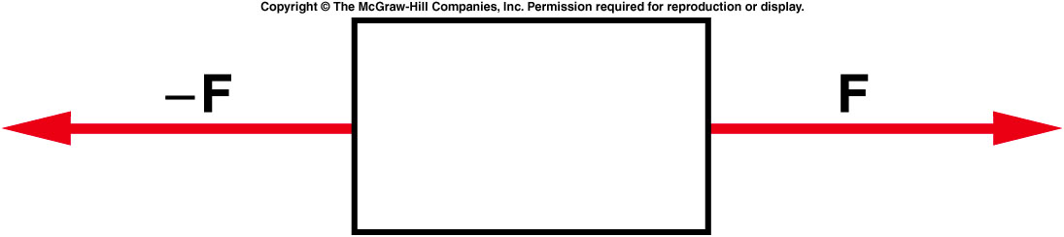
Two equal-magnitude horizontal forces act on a box. Is the object accelerated horizontally?
Yes.
No.
You can’t tell from
this diagram.

Slide 14
Two equal-magnitude horizontal forces act on a box. Is the object accelerated horizontally?
Since the two forces are equal in size, and are in opposite directions, they cancel each other out and there is no acceleration.
Yes.
No.
You can’t tell from
this diagram.

Slide 15
Is it possible that the box is moving, since the forces are equal in size but opposite in direction?
Yes, it is possible for
the object to be moving.
No, it is impossible for
the object to be moving.

Slide 16
Is it possible that the box is moving, since the forces are equal in size but opposite in direction?
Yes, it is possible for
the object to be moving.
No, it is impossible for
the object to be moving.
Even though there is no acceleration, it is possible the object is moving at constant speed.

Slide 17
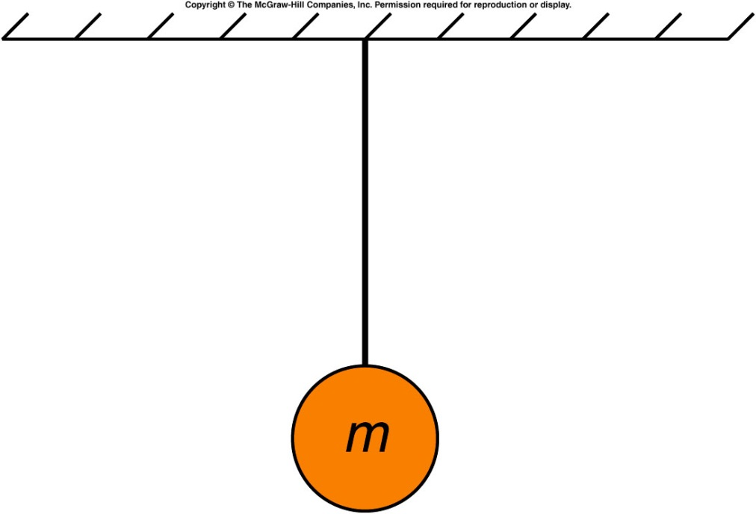
A ball hangs from a string attached to the ceiling. What is the acceleration of the ball?
zero.
Unknown
Not-zero since it is hanging from the ceiling.

Slide 18
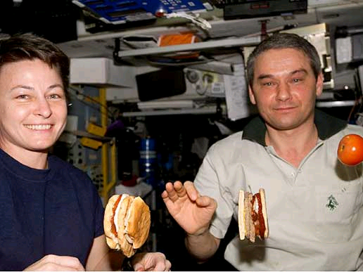
Mass and Weight
What exactly is mass?
Is there a difference between mass and weight?
If something is weightless in space, does it still have mass?

Slide 19
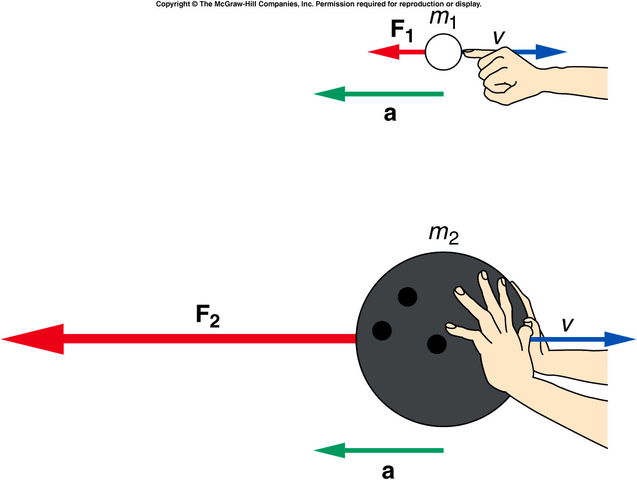
Mass, Weight, and Inertia
A much larger force is required to produce the same acceleration for the larger mass.
  F = ma
Inertia is an object’s resistance to a change in its motion.
Mass is a measure of an object’s inertia.
The units of mass are kilograms (kg).
Since F = ma and a = Δv/t then Ft = mΔv
So if a force acts for a time t the change in velocity will be smaller for larger masses so it is mass that determines inertia.

Slide 20
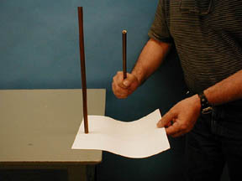
1F-04 Brass Rod (Inertia)
How to remove the paper without toppling the rod ?
Ft = mΔv , i.e. Δv = force x time / mass
One needs to remove the paper quickly so that the frictional force only lasts for a short time and the inertia of the rod prevents it from toppling over.

Slide 21
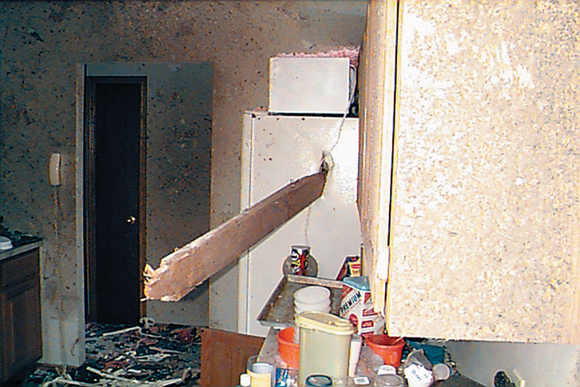
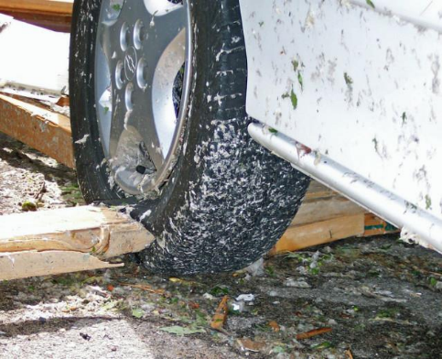
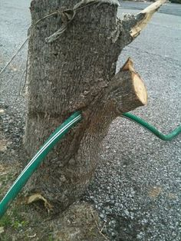
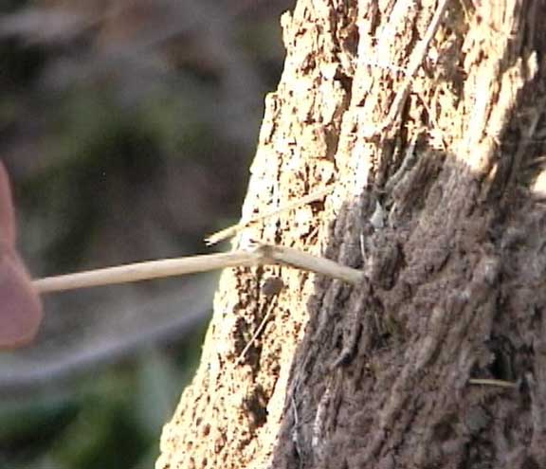
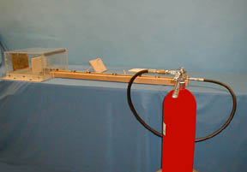
1F-09 Pencil shoot
F = ma
a = Δv/t
1/31/2021
21
Notes:
A slender dowel rod is placed in the end of a long brass tube whose internal diameter is slightly greater than that of the dowel rod.The hose from a fire extinguisher is attached to the end of the tube. Depressing the handle of the fire extinguisher accelerates the pencil down the tube and impales it in a 1/2-inch sheet of plywood, passing at least half-way through the wood.
Directions: Place the dowel rod in the tube and connect the hose from the fire extinguisher. MAKE SURE THAT THE CONNECTION IS FIRMLY MADE. Strike the handle of the fire extinguisher quickly with the side of your hand to “pulse” it.
Suggestions for Presentation: Hold a piece of the plywood in one hand and the small dowel rod in the other. Ask how one might get the rod through the wood. You might even try hammering it through, showing that large forces may be required to get the dowel rod through the wood.

Slide 22
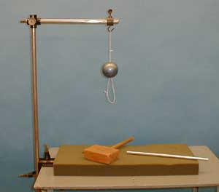
1F-06 Inertial Ball
Case 1: Place the aluminum rod in the
lower loop and pull SLOWLY downward.
Which string breaks first ?
Case 2: Use the wooden mallet to
strike a sharp blow to the aluminum rod.
IF IT IS DONE SLOWLY THE UPPER STRING BREAKS FIRST BECAUSE THE TENSION IN THAT STRING WILL BE THE WEIGHT OF THE BALL PLUS THE TENSION IN THE LOWER STRING.
IF THE LOWER STRING IS STRETCHED SUFFICIENTLY RAPIDLY, IT WILL REACH ITS BREAKING POINT BEFORE THE BALL HAS A CHANCE TO MOVE APPRECIABLY.

Slide 23
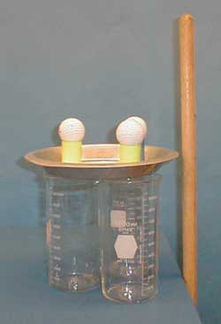
1F-03 Egg drop
Is it possible to get the eggs in the beakers without touching them ?
IF THE PAN IS HIT SHARPLY A FORCE WILL ACT ON THE EGGS FOR A VERY SHORT TIME AND THEY WILL NOT MOVE HORIZONTALLY. THE PAN HAS TO BE HIT HARD ENOUGH SO THAT HAS MOVED OUT OF THE WAY BEFORE THE EGGS DROP ANY APPRECIABLE DISTANCE
1/31/2021
23

Slide 24
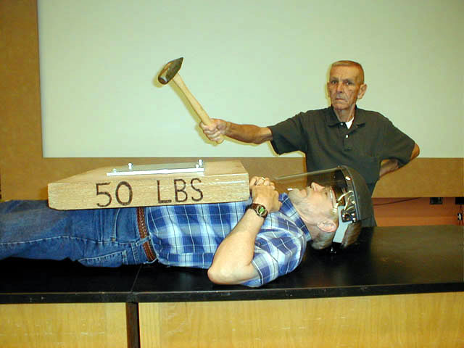
Notes:
The instructor places a 50 pound block on his/her chest (or have a student do this) and has the student strike the block with a sledge hammer. The person holding the block is not harmed. Although the force of the sledge hammer blow is quite large, the impact time is very, very small. The large mass of the block prevents it from gaining any significant movement before the impact is over.

Slide 25
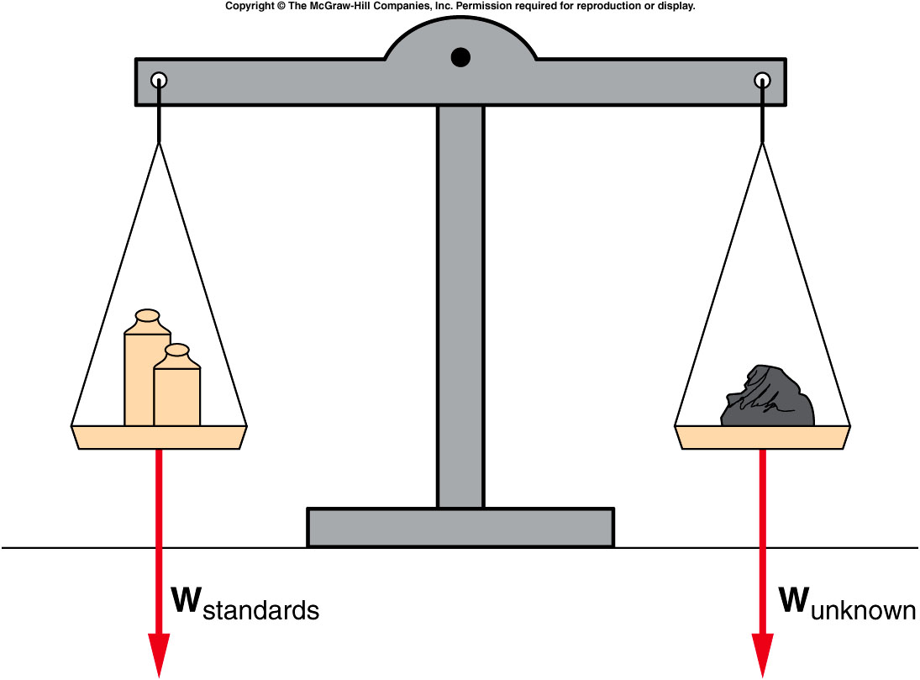
Mass, Weight, and Inertia
An object’s weight is the gravitational force acting on the object.
Weight is a force, measured in units of newtons (N).
In the absence of gravity, an object has no weight but still has the same mass.

Slide 26
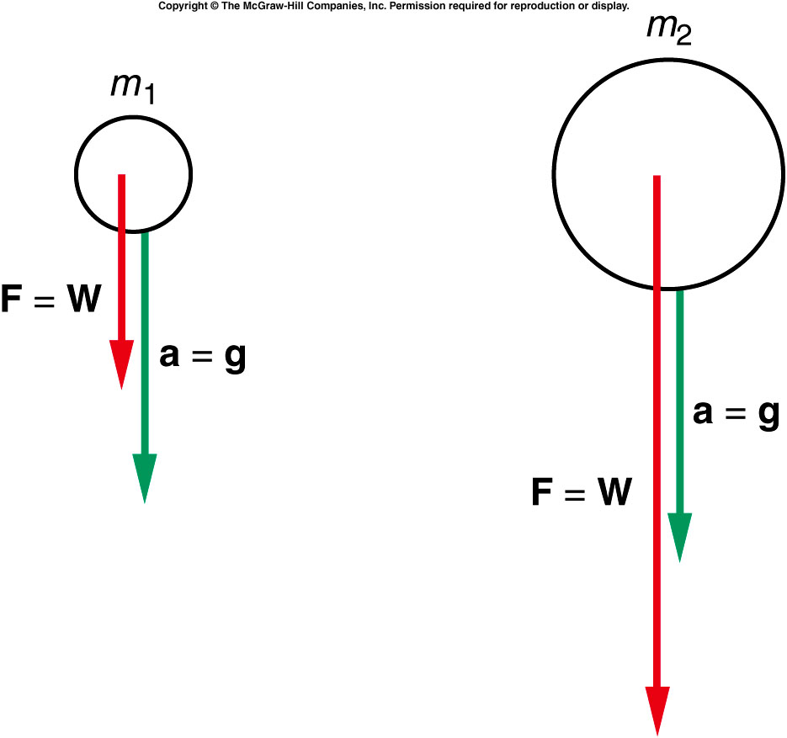
Mass, Weight, and Inertia
Objects of different mass experience the same gravitational acceleration on Earth: g = 9.8 m/s²
By Newton’s 2nd Law, F = ma, the weight is W = mg.
Different gravitational forces (weights) act on falling objects of different masses, but the objects have the same acceleration.
  This is the reason that object with different weight fall at the same speed (without air friction).

Slide 27
Quiz: A ball hangs from a string attached to the ceiling. What is the net force acting on the ball?
The net force is downward.
The net force is upward.
The net force is zero.
Since the ball is hanging from the ceiling at rest, it is not accelerating so the net force is zero. There are two forces acting on the ball: tension from the string and force due to gravitation. They cancel each other.

Slide 28
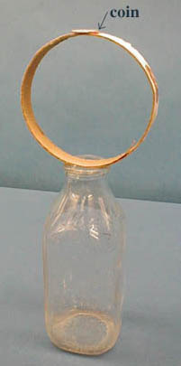
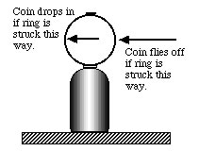
1F-05 Coin, Hoop & Milk Bottle (Inertia)
How can you get the coin into the bottle without touching it ?
This is actually a trick which depends on hitting the ring so that the top deflects down and the coin is free to drop
Notes:
Don’t know WHY??!!

