Slide 1
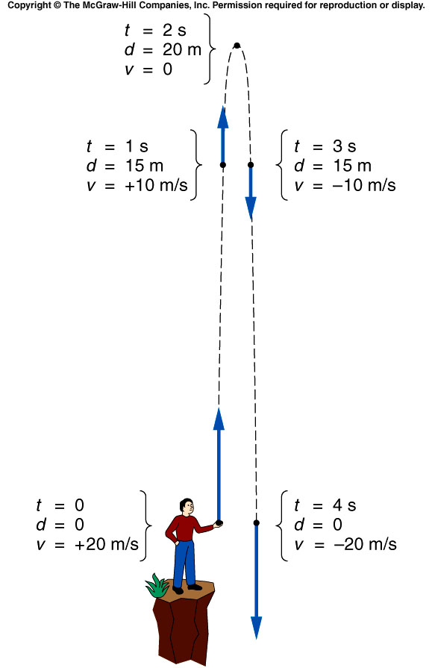
Description of the motion after throwing the object upward
Let the initial velocity be 20 m/s upward.
  It immediately starts experiencing a downward acceleration due to gravity, of approximately ~10 m/s.
  Every second, the velocity decreases by ~10 m/s.
After 2 s, the ball has reached its highest point.
  Its velocity changes direction, from upward to downward, passing through a value of 0 m/s.
Now, the downward acceleration increases the downward velocity.

Slide 2
Find the total time from max. height to your hand.
When d = 0,
→t = 0, i.e. the starting point
OR
→t = 4s, i.e. total time after it fall to the hand .
It take 2s from your hand to the max. height
From max. height to the your hand, it takes 4s-2s = 2s.
Find the maximum height
Define the positive direction of the motion.
V0 = 20 m/s and is positive
a = -9.8 m/s and is negative
When v = 0, → t = (20m/s)/(9.8m/s²) ~2s
Therefore,

Slide 3
Quiz: What is the ball’s acceleration at the top of its path (positive direction is upward)?
zero.
+9.8 m/s
-9.8 m/s
+9.8 m/s²
-9.8 m/s²
Gravity does not “turn off” at the top!
The ball’s velocity is still changing, as it changes from going up to going down. For a moment the velocity is zero, but the gravitational acceleration is a constant throughout the path.

Slide 4
Projectile Motion
The path that a moving object follows is called its trajectory.
  An object thrown horizontally is accelerated downward under the influence of gravity.
  Gravitational acceleration is only vertical, not horizontal.
  The object’s horizontal velocity is unchanged, if we can neglect air resistance.
Projectile motion involves the trajectories and velocities of objects that have been launched, shot, or thrown.

Slide 5
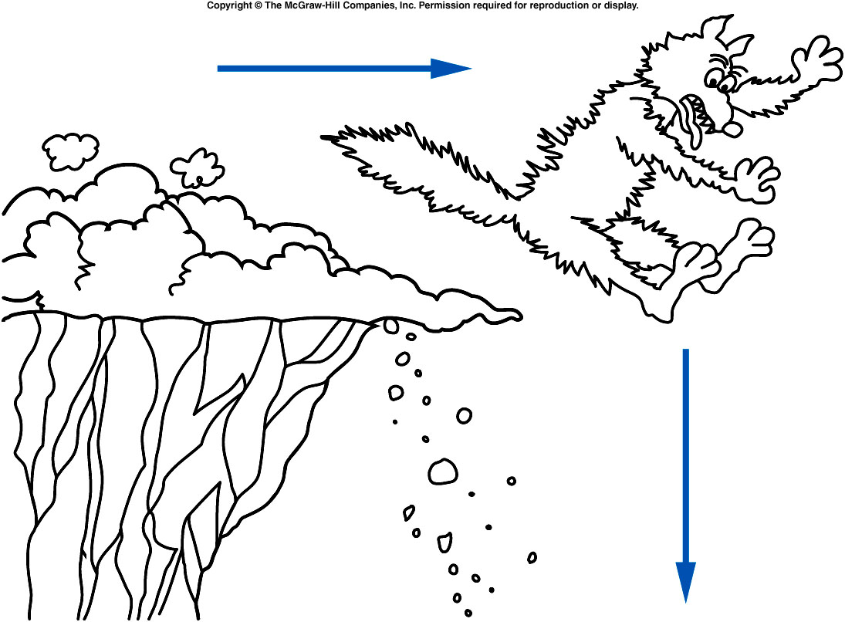
Does this represent a realistic trajectory?
Yes.
No.
Maybe.
Will The coyote go straight horizontally, pause, and then fall straight down?
Notes:
(Speed: when the bus “jumps”;
Spider-man 2: when he suddenly loses
his web power.)

Slide 6
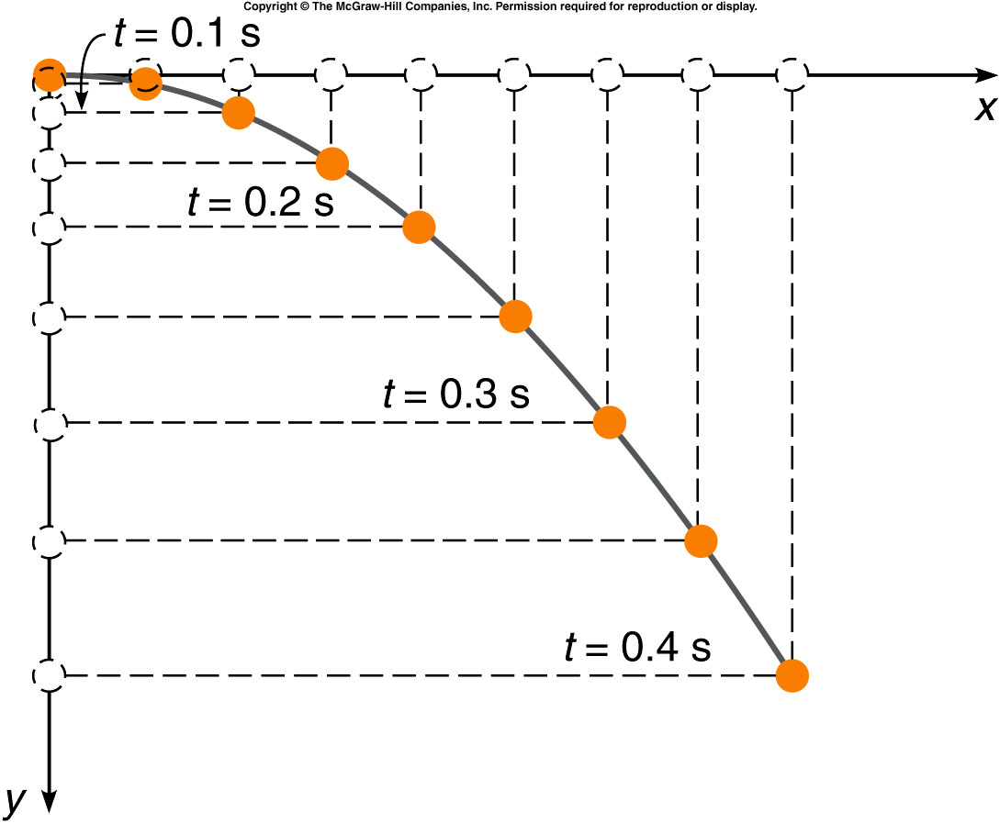
What does the trajectory look like?
The acceleration of the horizontal motion is zero (in the absence of air resistance).
  The object moves with
  constant horizontal velocity.
  It travels equal horizontal
  distances in equal time
  intervals.
The acceleration in the
vertical direction is constant.
  Its vertical velocity increases
  downward just like the falling
  ball.
  In each successive time
  interval, it falls a greater
  distance than in the previous
  time interval.

Slide 7
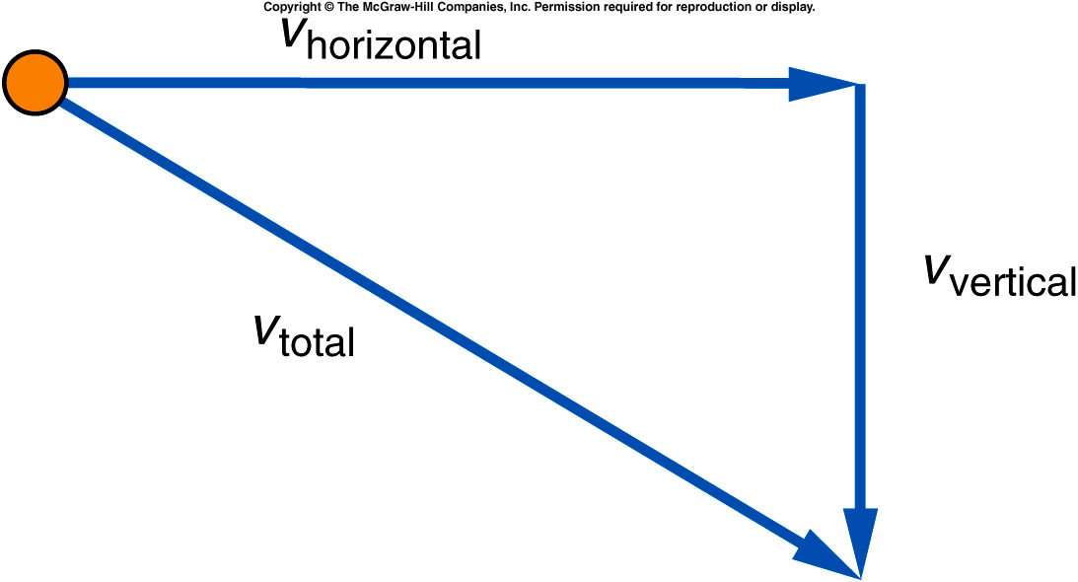
What does the trajectory look like?
The total velocity at any point is found by adding the vertical component of the velocity, at that point, to the horizontal component of the velocity at that point.
The horizontal velocity
remains constant, because
there is no acceleration in
that direction.
The downward (vertical) velocity
gets larger and larger, due to
the acceleration due to gravity.

Slide 8
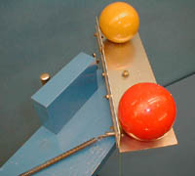
1D-20
Independence of Vertical & Horizontal Motions (Drop-Kick)
One ball drops from rest. The other ball is simultaneously projected horizontally
Which ball will hit the ground first ?
A). Orange
B). Red
C). They hit simultaneously.
Listen to the SOUND when they hit the ground and when they bounce.
THE VERTICAL & HORIZONTAL MOTIONS ARE INDEPENDENT.
THE HORIZONTAL VELOCITY DOES NOT AFFECT THE VERTICAL MOTION.
THE VERTICAL FALL TIME IS THE SAME AS LONG AS THE BALLS DROP SIMULTANEOUSLY FROM THE SAME HEIGHT.
Notes:
Two large bocce balls are placed on a horizontal wooden platform. When the spring on the projecting device is released, one ball is projected horizontally while the other is dropped to the floor. By listening to the "clicks" as the balls hit the floor, it is evident that they reach the floor simultaneously.

Slide 9
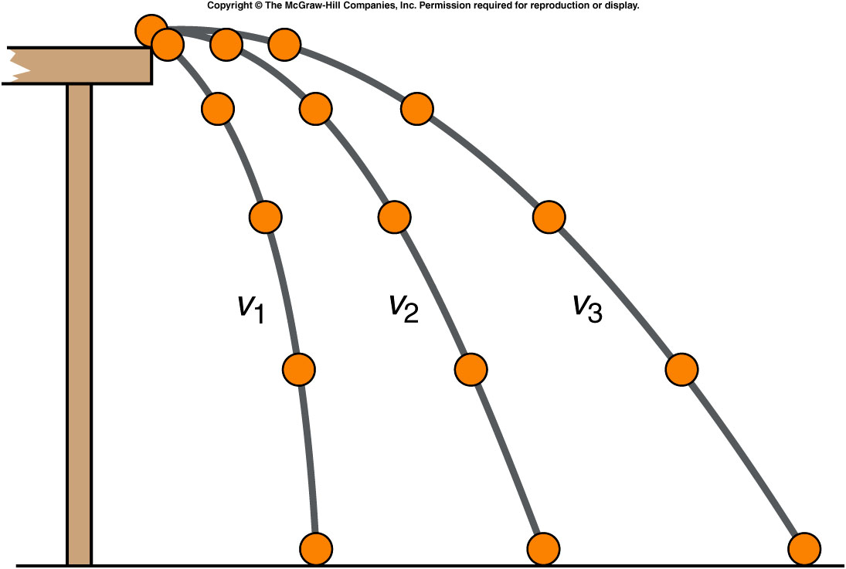
What does the trajectory look like?
Trajectories for different initial velocities of a ball rolling off a table:
  The largest initial velocity is v₃.
  The smallest initial velocity is v₁.
The ball travels
greater horizontal
distances when
projected with a
larger initial
horizontal velocity.
If they left the tabletop
at the same time, which
ball hit the floor first?
Notes:
Ask the student to think about the answer then give the quiz at the end of the class.

Slide 10
Summary of Projectile Motion
Treating the vertical motion independently of the horizontal motion, and then combining them to find the trajectory, is the secret.
  The downward gravitational acceleration behaves the same as for any falling object.
  There is no acceleration in the horizontal direction if air resistance can be ignored.
  The projectile moves with constant horizontal velocity while it is accelerating downward.

Slide 11
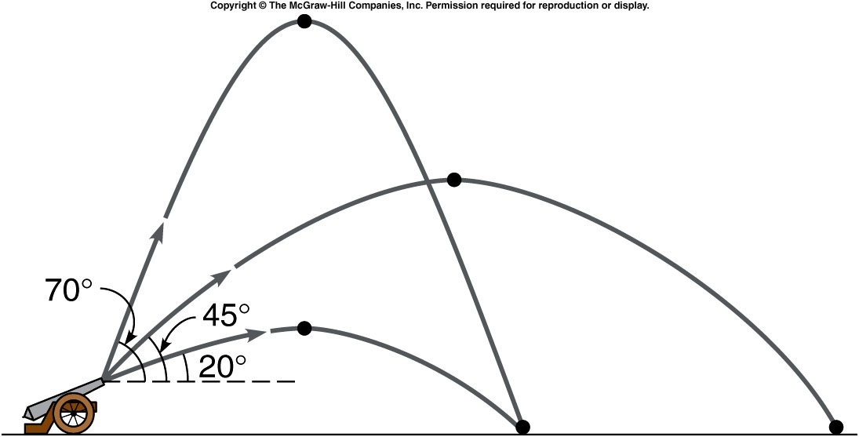
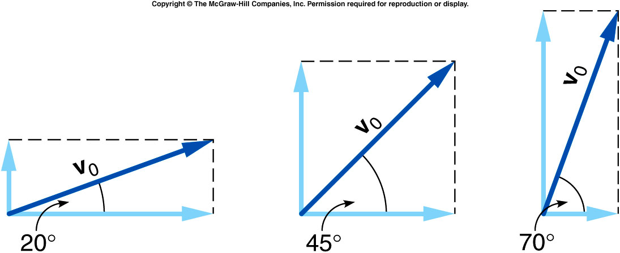

Slide 12
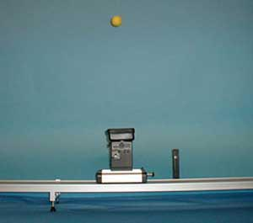
1D-21
Independence of Vertical and Horizontal Motions
A ball is projected vertically from a cart traveling horizontally
Neglect all frictions:
A). The ball will fall back into the cart
B). The ball will not fall back into the cart.
C). The results depends on how tall the ball is projected.
The trajectory in the cart frame
Notes:
A ball is pressed down against a spring in a vertical tube on a cart, the ball being held in this position by an electromagnet. The cart is then given a horizontal velocity and it passes by an electric eye circuit that releases the electromagnet and fires the ball vertically upward RELATIVE TO THE CART. The cart is low-friction so it travels at constant velocity over the length of the track. The ball drops back into the cup, illustrating that the horizontal motion of the ball is unaffected by its vertical motion.

Slide 13
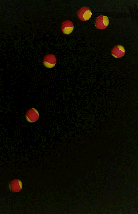
1D-21
Independence of Vertical and Horizontal Motions
A ball is projected vertically from a cart traveling horizontally
The trajectory in the cart frame
The trajectory in the room frame
THE HORIZONTAL MOTION OF THE BALL IS UNAFFECTED BY ITS VERTICAL MOTION.

Slide 14
Ch 3 CP4
V_{0v} = 200m/s v_{0H} = 346m/s
a) How long in the air?
b) How far?
g
200m/s
346m/s
v = v₀ + at time to top = ²⁰⁰/_{9.8} = 20.4s
time to range = ⁴⁰⁰/_{9.8} = 40.8s
b) d = 346 x 40.8 = 14120m

Slide 15
Ch 3 E16
V_{0v} = 30 m/s V_{0H} = 30 m/s
g = - 9.8m/s²
What is time to top?
A). 1.29 s
B). 3.06 s
C). 2.23 s
D). 32.4 s
E). 10.0 s
g
30 m/s
+
30 m/s

Slide 16
Ch 3 E16
V_{0v} = 30 m/s V_{0H} = 30 m/s
g = - 9.8m/s²
What is time to top?
g
30 m/s
+
30 m/s
v = v₀ + at t = ³⁰/_{9.8} = 3.06s

Slide 17
Ch 3 E16
V_{0v} = 30 m/s V_{0H} = 30 m/s
g = - 9.8m/s²
What is time to hit the ground?
A). 1.29 s
B). 3.06 s
C). 6.12 s
D). 32.4 s
E). 10.0 s
g
30 m/s
+
30 m/s

Slide 18
Ch 3 E16
V_{0v} = 30 m/s V_{0H} = 30 m/s
g = - 9.8m/s²
What is time to hit the ground?
g
30 m/s
+
30 m/s
The time to reach the top and the time to fall back to the ground are identical.
t_{R} = 6.12s

Slide 19
Ch 3 E16
V_{0v} = 30 m/s V_{0H} = 30 m/s
g = - 9.8m/s²
What is the range?
A). 201.4 m
B). 183.6 m
C). 15.0 m
D). 30.0 m
E). 60.0 m
g
30 m/s
+
30 m/s

Slide 20
Ch 3 E16
V_{0v} = 30 m/s V_{0H} = 30 m/s
g = - 9.8m/s²
What is the range?
g
30 m/s
+
30 m/s
d = 30 x t_{R} = 183.6m

Slide 21
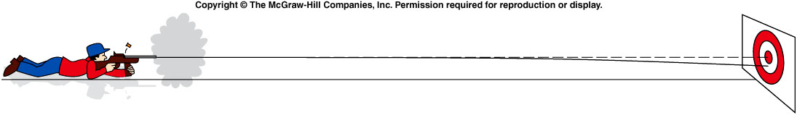
Hitting a Target
If the rifle is fired directly at the target in a horizontal direction, will the bullet hit the center of the target?
Yes.
No.
Notes:
When target is at rest. The bullet will not hit the target. But if the target is moving, e.g. falling, it will works. Then show next slide of java cartoon.

Slide 22
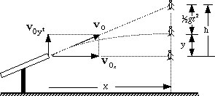
Where to aim in order to Hit the Falling object (ignore air friction)?
y
x
Ignoring friction y = v_{0y}t – 1/2gt² t = x/v_{0x} , v_{0y}/v_{0x} = h/x y = h – 1/2gt²
In the same time the monkey falls 1/2gt², i.e. for the monkey: y = h – 1/2gt²
So the bullet always hits the monkey no matter what the value of v₀

Slide 23
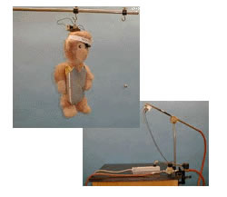
1D-23 Shoot the Monkey
The monkey falls out of the tree at the instant the gun is fired
WHERE SHOULD
ONE AIM, ABOVE,
BELOW OR AT?
Ignoring friction y = v_{0y}t – 1/2gt² t = x/v_{0x} , v_{0y}/v_{0x} = h/d
at x = d y = h – 1/2gt² In the same time the monkey falls 1/2gt²
So the bullet always hits the monkey no matter what the value of v₀
THE VERTICAL MOTION IS INDEPENDENT OF THE HORIZONTAL MOTION
THE EFFECT OF FRICTION IS MINIMIZED BY USING A LARGE TARGET
Notes:
A toy monkey having a metal plate attached to his head, is suspended from an electromagnet attached to the ceiling. A projectile is fired from a tube and the monkey is released just as the projectile leaves the end of the tube. If the tube is aimed directly at the monkey initially, the two will collide in mid-air.
Push the steel ball down into the tube with the push rod. Using the point of a pen, pull the small switch lever up into the slot at the end of the tube, activating the electromagnet circuit. Place the monkey’s collar ring on the hook at the end of the wooden pole and SLOWLY move the head plate against the electromagnet. This may take a few tries. If you have difficulty, ask for assistance from the lec-demo staff. Using the laser pen attached to the tube, aim the tube directly at the target on the monkey’s breast plate. Depress the switch on the air-supply line to fire the projectile.

Slide 24
Quiz: Which of these three balls would hit the floor first if all three left the tabletop at the same time?
The ball with initial velocity v₁.
The ball with initial velocity v₂.
The ball with initial velocity v₃.
They would all hit at the same time.

