Slide 1
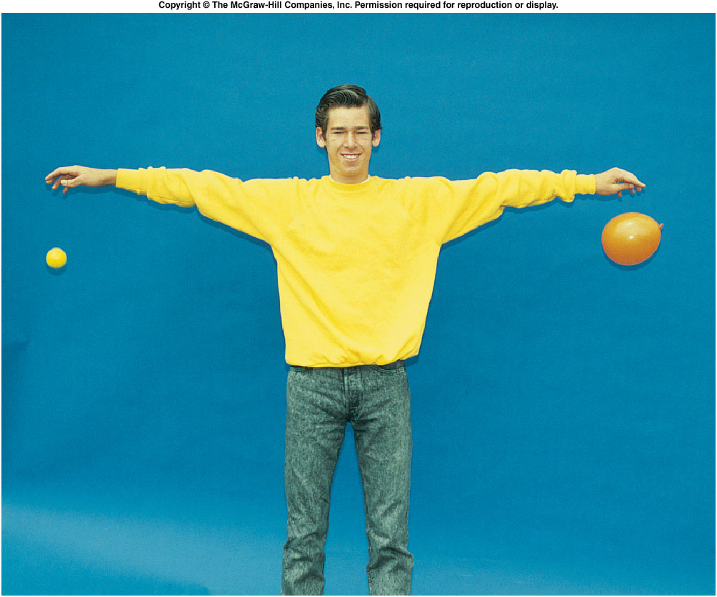
How does a fall object behave?
Before releasing the balls, decide what you think will happen.
the heavier object will fall faster than the lighter one
the lighter object will fall faster than the heavier one
both objects will fall at about the same rate
Aristotle’s said (A) is correct.
Notes:
Drop the feather and coin in the classroom and show Aristotle is “right”.

Slide 2
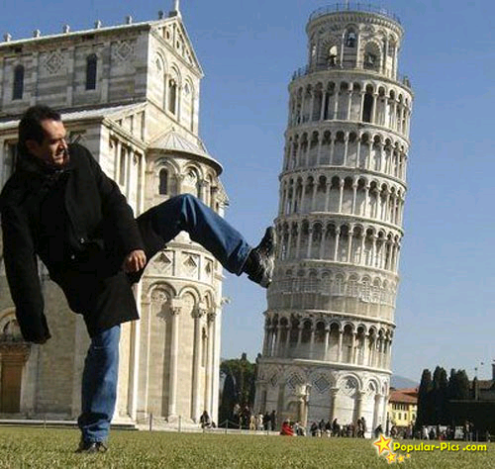
Looks like Aristotle is right, for over 1000 years, until Galileo did an experiment at the Leaning Tower of Pisa.
Notes:
Drop two canon ball with different mass. They fall to the group at the same time.
Maybe the mass of the two canon ball are not that different?
Then go the the demo in next slides.

Slide 3
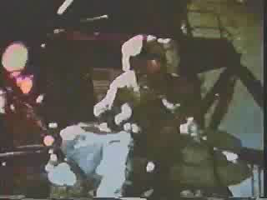
Apollo 15 Hammer/Feather gravity demonstration

Slide 4
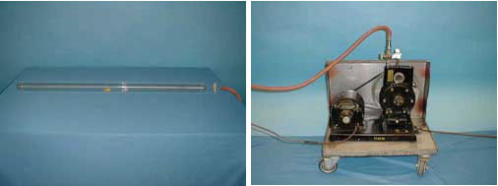
1K-11: Drop a Coin and a Feather
before removing air
Drop a Coin and a Feather
After removing air
Notes:
Also show the Apollo 15 experiment.

Slide 5
Acceleration Due to Gravity
Earth exerts a gravitational force on objects that is attractive (towards Earth’s surface).
Near Earth’s surface, this force produces a constant acceleration downward.
  Galileo was the first to accurately measure this acceleration due to gravity.
v = v₀ + at
d = v₀t + ½*at²
  This acceleration appear at any time and any location on earth.
  is the same for all objects
    Otherwise, the feather and hammer will fall to the ground at different time.
Usually people use g to represent the gravitation acceleration
v = v₀ + gt
d = v₀t + ½*gt²

Slide 6
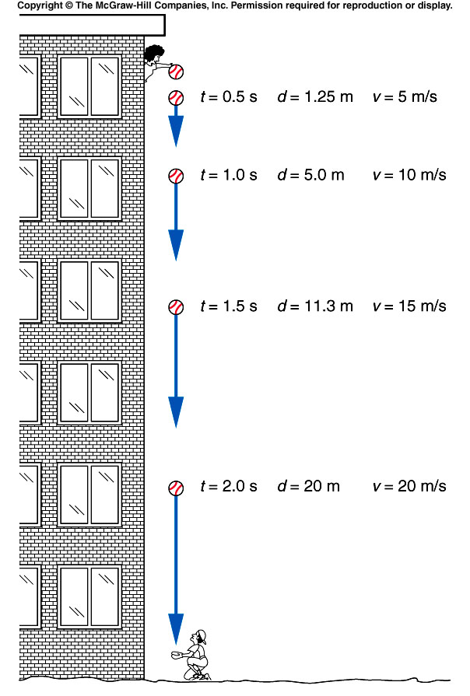
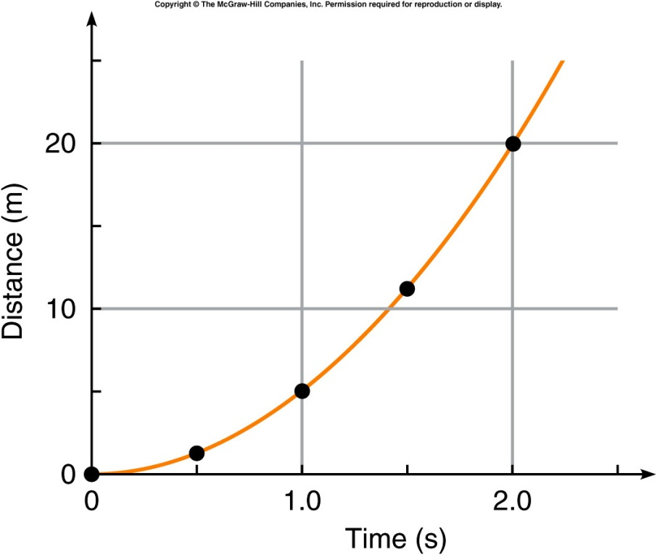
Tracking a Falling Object
The distance increases in proportion to the square of the time:

Slide 7
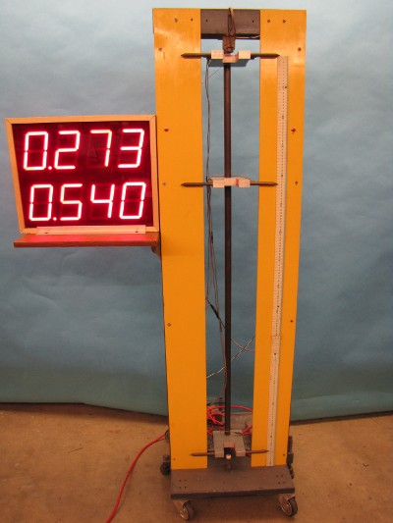
1G-05: Measurement of g
Measuring g by dropping an object
v = v₀ + gt
d = v₀t + ½gt²
d = 1/2gt² t = sqrt ( 2d/g )
g = 2d/t²
The actual value is: g = 9.8 m/s²
Notes:
A steel ball can be held or released by an electromagnet. Photo electric sensors are connected to timers. The top display shows the time between sensor 1 (the release point) and sensor 2 (the middle sensor). The bottom display shows the time between sensor 1 and 3 (at the bottom). A timer reset is on the back of the timers. The ball release is a red button on the front of the apparatus.

Slide 8
Ch 3 E4
Heart beat = 75 beats/minute
What is the time between pulses in seconds?
How far does an object fall in this time? (assume v0 = 0)
a) t = ⁶⁰/₇₅ = 0.8 s
9.8m/s²
b) d = v₀t + ½ 9.8t² = 3.136 m

Slide 9
Ch 3 E6
Ball is dropped
What is the change in velocity
between 1 and 4 seconds?
v
g
+
After 1 sec v = 9.8 t = 9.8 m/s
After 4 sec v = 9.8 x 4 = 39.2 m/s
Change in velocity is 29.4 m/s

Slide 10
Quiz: A lead ball and an aluminum ball, each 1 in. in diameter, are released simultaneously and allowed to fall to the ground. Due to its greater density, the lead ball has a substantially larger mass than the aluminum ball. Which of these balls, if either, has the greater acceleration due to gravity (neglect air friction)?
The lead ball, because of the higher density.
The lead ball, because of the higher mass.
Impossible to determine.
The aluminum ball because of its lower density
The two have the same acceleration.

Slide 11
Throwing a ball downward
Let the ball be thrown downward instead of being dropped.
  It will have a starting velocity different from zero.
  It will reach the ground more rapidly.
  It will have a larger velocity when it reaches the ground.

Slide 12
Ch 3 CP2
V₀₁ = 0 m/s V₀₂ = 12 m/s
a) What are the velocities after 1.5s?
b) How far has each ball dropped in 1.5s?
1
2
12 m/s
v₁ = at = 9.8 x 1.5 = 14.7m/s
v₂ = 12 + 9.8 x 1.5 = 26.7m/s
d₁ = ½at² = 11.03m
d₂ = v₂t + ½at² = 29.03m

Slide 13
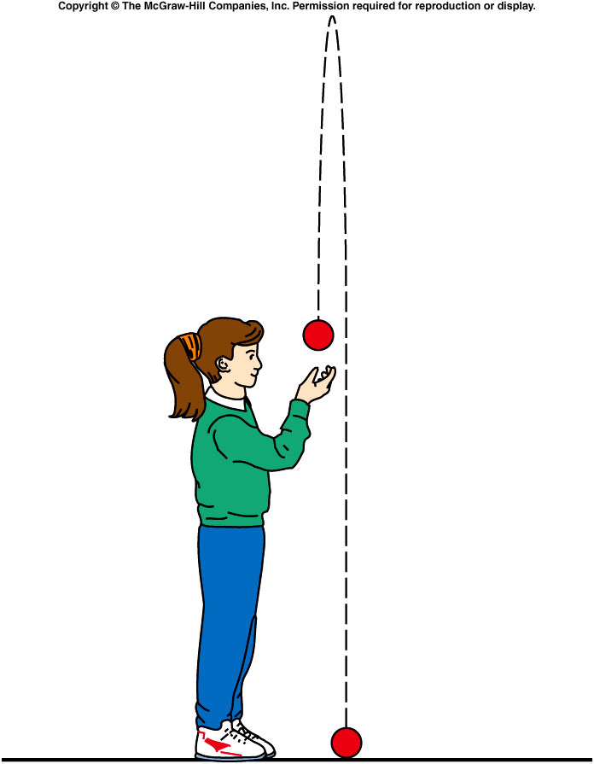
Throwing a Ball Upward
What if the ball is thrown upward?
  Gravitational acceleration is always directed downward, toward the center of the Earth.
  Here, the acceleration is in the opposite direction to the original upward velocity.

Slide 14
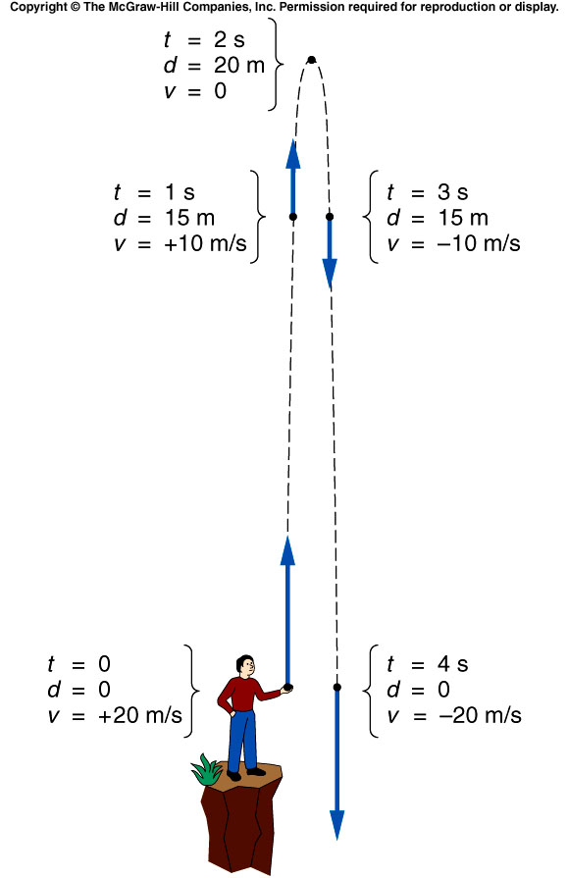
Description of the motion after throwing the object upward
Let the initial velocity be 20 m/s upward.
  It immediately starts experiencing a downward acceleration due to gravity, of approximately 10 m/s².
  Every second, the velocity decreases by 10 m/s.
After ~2 s, the ball has reached its highest point.
  Its velocity changes direction, from upward to downward, passing through a value of 0 m/s.
Now, the downward acceleration increases the downward velocity.

Slide 15
Find the total time from max. height to your hand.
When d = 0,
→t = 0, i.e. the starting point
OR
→t = 4s, i.e. total time after it fall to the hand .
It take 2s from your hand to the max. height
From max. height to the your hand, it takes 4s-2s = 2s.
Find the maximum height
Define the positive direction of the motion.
V0 = 20 m/s and is positive
a = -9.8 m/s and is negative
When v = 0, → t = (20m/s)/(9.8m/s²) ~2s
Therefore,

Slide 16
Ch 3 E8
t = 1.53 s
Ball thrown up at 15 m/s
How high after 1 second?
g
t = 2 s
+
A). 100.3 m
B). 10.1 m
C). 20.6 m
D). 2.3 m
E). 5.0 m.
15 m/s

Slide 17
Ch 3 E8
t = 1.53 s
Ball thrown up at 15 m/s
How high after 1 second?
g
t = 2 s
+
15 m/s
After 1 sec d = v₀t + ½ at² = 15 – 4.9 = 10.1 m

Slide 18
Ch 3 E8
t = 1.53 s
Ball thrown up at 15 m/s
What’s the height to the top
g
t = 2 s
+
A). 11.48 m
B). 5.5m
C). 32.6 m
D). 10.0 m
E). 5.0 m.
15 m/s

Slide 19
Ch 3 E8
t = 1.53 s
Ball thrown up at 15 m/s
What’s the height to the top
g
t = 2 s
+
15 m/s
Time to top v = v₀ + at t = ¹⁵/_{9.8} = 1.53 s
Height at top: d = v₀t + ½ at² = 15x1.53 – 4.9x1.53x1.53 = 11.48 m

Slide 20
Ch 3 E10
V₀ = 18 m/s a = - 2 m/s²
What is v after 4 seconds?
What is time to top?
a=2m/s²
+
18 m/s
A). 20 m/s and 11 s
B). 5.5 m/s and 2 s
C). 32.6 m/s and 1 s
D). 10.0 m/s and 9 s
E). 5.0 m/s and 30 s

Slide 21
Ch 3 E10
V₀ = 18 m/s a = - 2 m/s²
What is v after 4 seconds and What is time to top?
a=2m/s²
+
18 m/s
a) v = v₀ + at
= 18 – 2 x 4 = 10m/s
b) v = 0 t = ¹⁸/₂ = 9s

